Slide 1
Put out Engineering pads

Slide 2
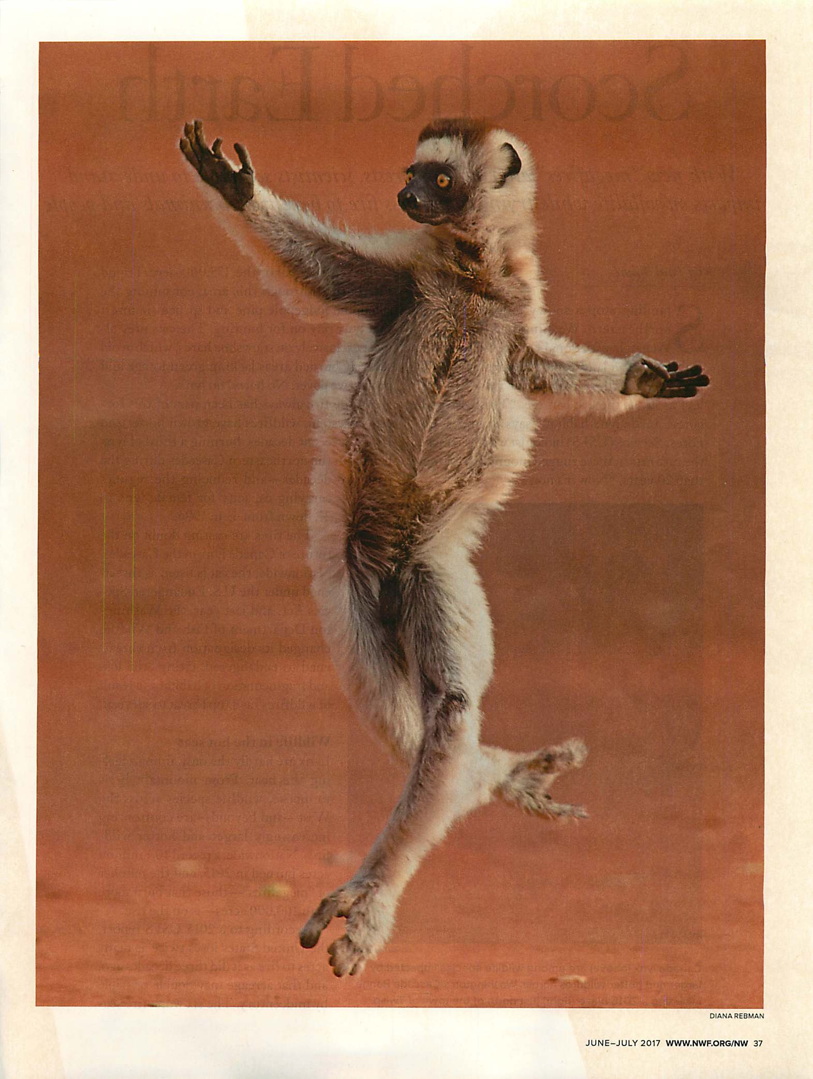
Welcome to Honors Physics
(we gonna dance tonight)

Slide 3
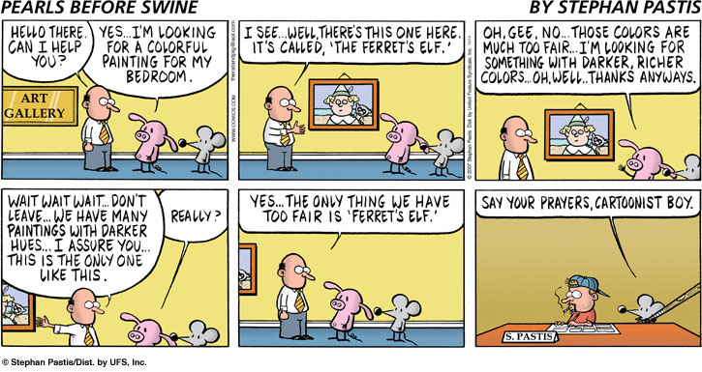
a cartoon a day . . .

Slide 4
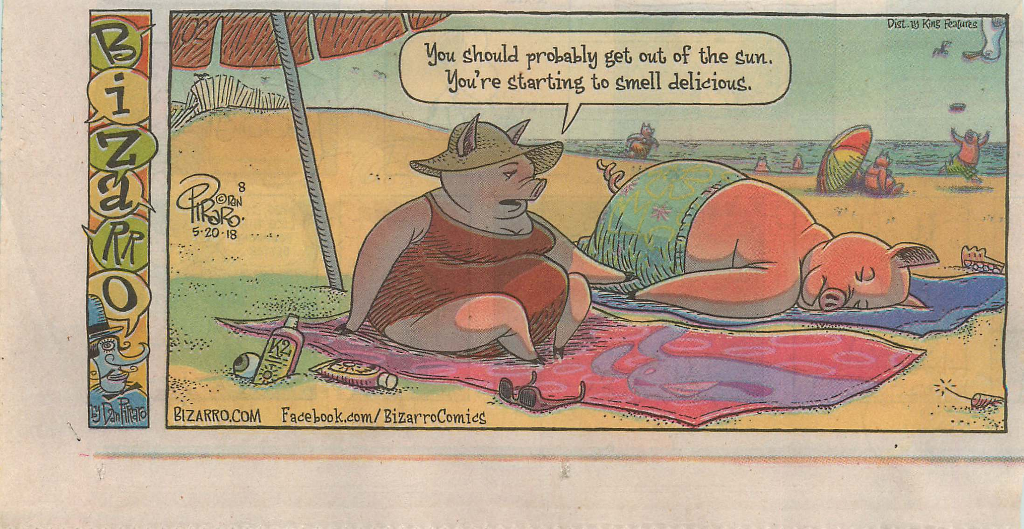
a cartoon a day . . .

Slide 5
Honors Physics
Questions about Preamble
http://faculty.polytechnic.org
Get pdf of OpenStax text (problem-numbering problem)
First test will be on Thursday, Sept 5. It will cover graphs and one-dimensional kinematics. See calendar for further insight as to what you will be expected to do.

Slide 6
Shy to right
Nudged to right
Anxious to right
No, you can’t really multi-task . . . (cell phones verboten)
College rep policy
Period A’s L-day is Day 3; Period E’s is Day 5
Time
Homework
Survey for 5 points . . .
How to succeed

Slide 7
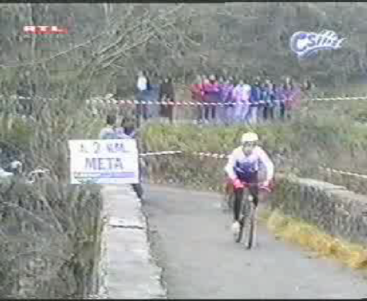
ADVERSARIES?

Slide 8
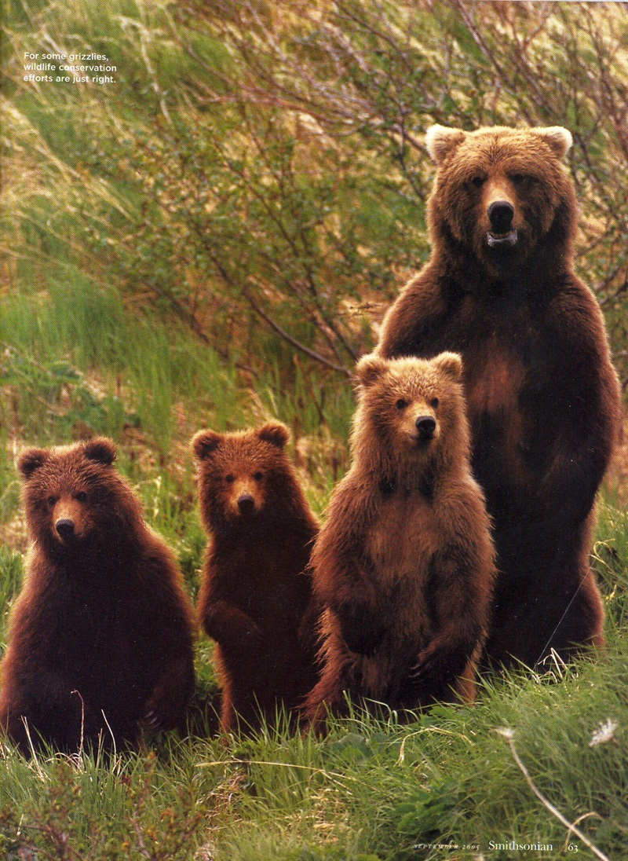
We are a family. We are on the same team. If you don’t succeed, I don’t succeed. My JOB is to help you master the world of physics. If you need help, COME TALK TO ME . . .

Slide 9
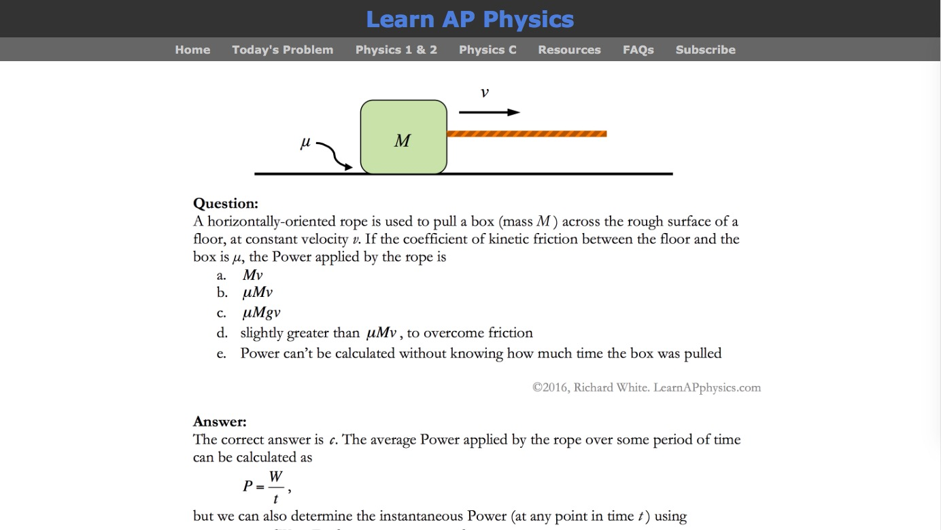
Mr. White’s site . . .

Slide 10
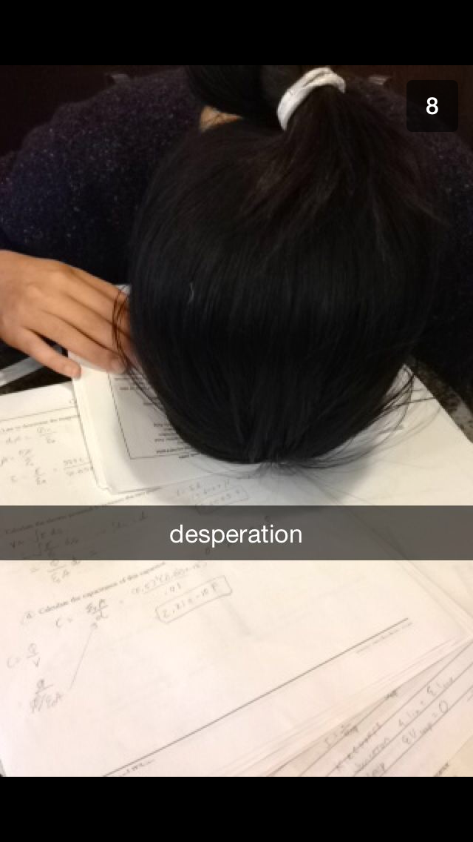
Grades
You’re going to have some really hard material to be learned here.
Grades on tests, even if you study really well, will probably be lower than you might be used to in other classes—that’s normal.
Part of my job is to make sure that your overall grade fairly represents your work, partly based on how well you do on tests but also based on how well you do with labs and homework.

Slide 11
Other Stuff
My office: upstairs, Poly 205 (West end)
My schedule: C, D, F
Available: before school, A, B, E, G, Community Time, after school by appointment; also, I don’t live in my office—if you know you will be looking for me, let me know in advance so I can be sure I’ll be where you can find me . . .
Restroom protocol
Absences
Tardies: “Hard stop, soft start”

Slide 12
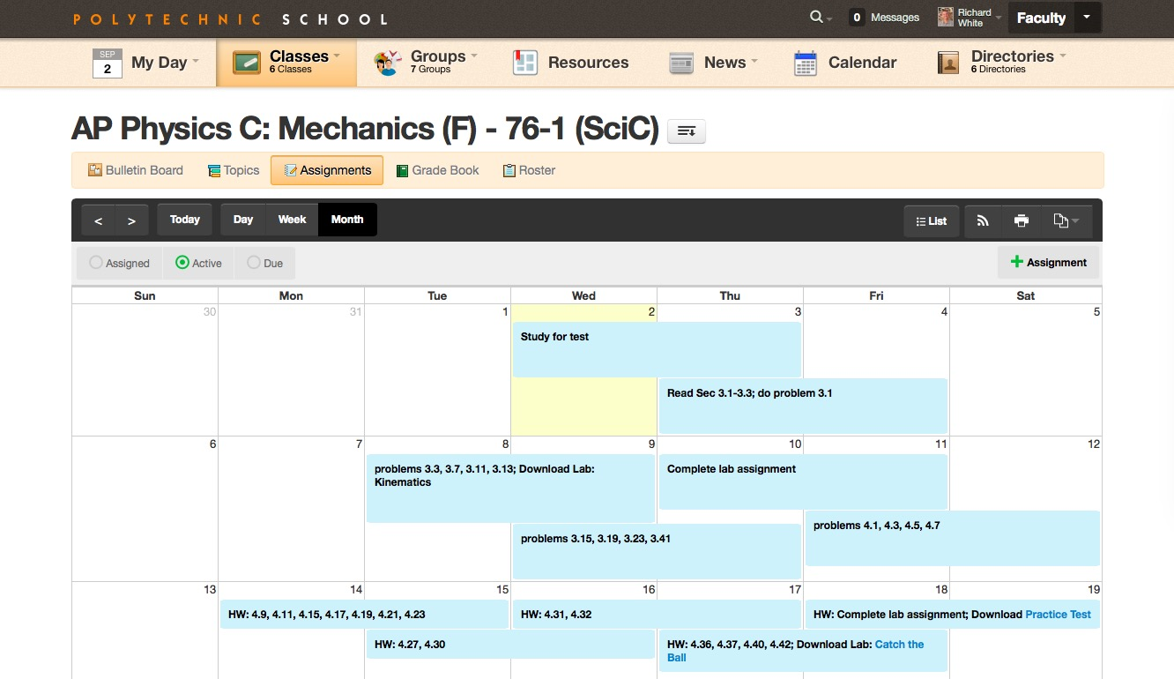
Schedule on websites...

Slide 13
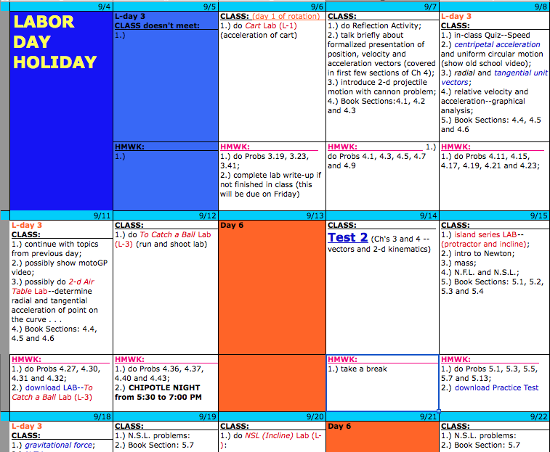
Schedule on websites...

Slide 14
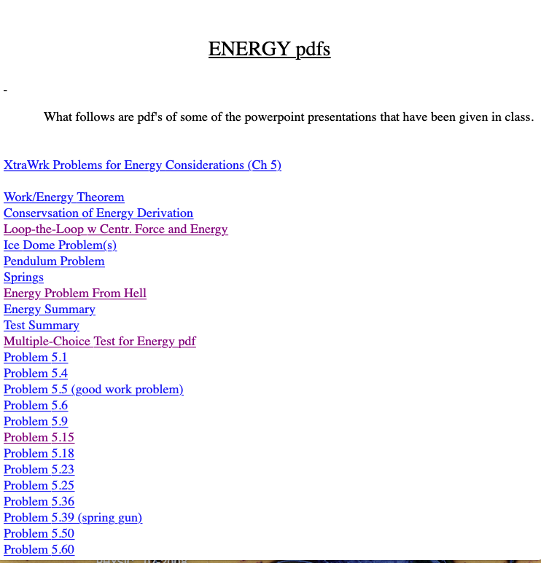
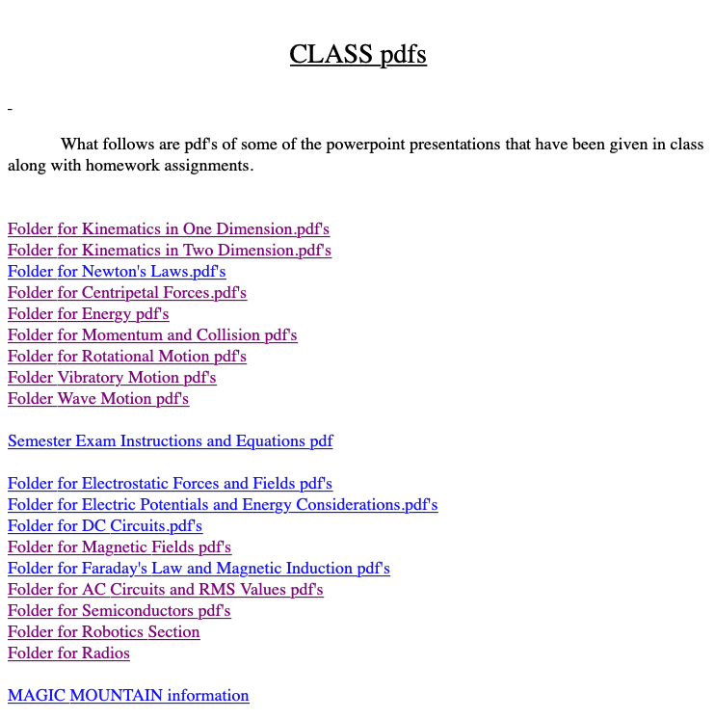
The “class pdfs” file has changed...

Slide 15
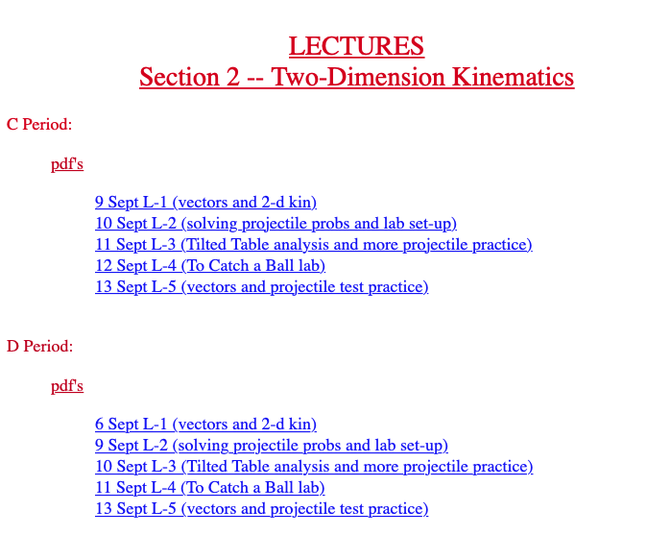
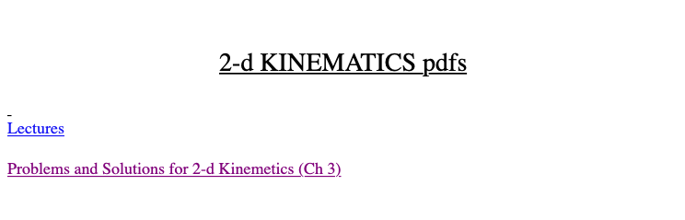

Slide 16
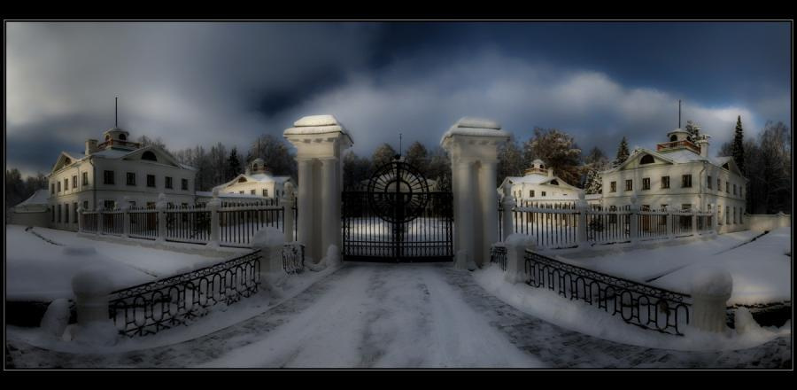
LIGHTEN UP, FOLKS. IT’S NOT AS THOUGH YOU’RE ENTERING A GREAT, SCARY PLACE!

Slide 17
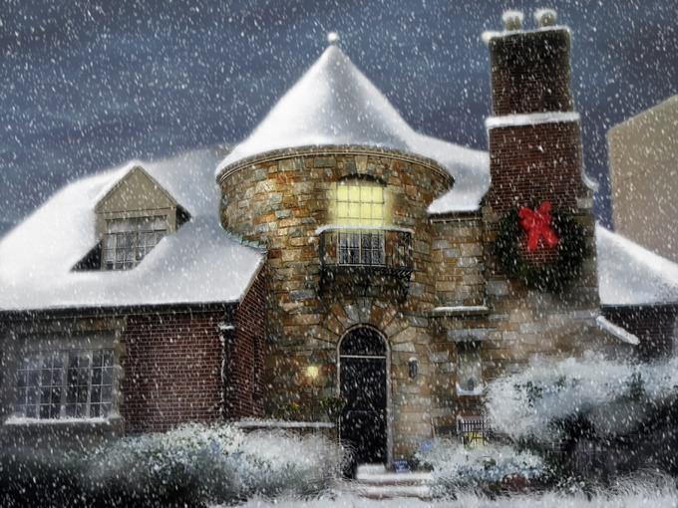
THINK OF IT MORE AS HOME--A COMFY, COZY PLACE.

Slide 18
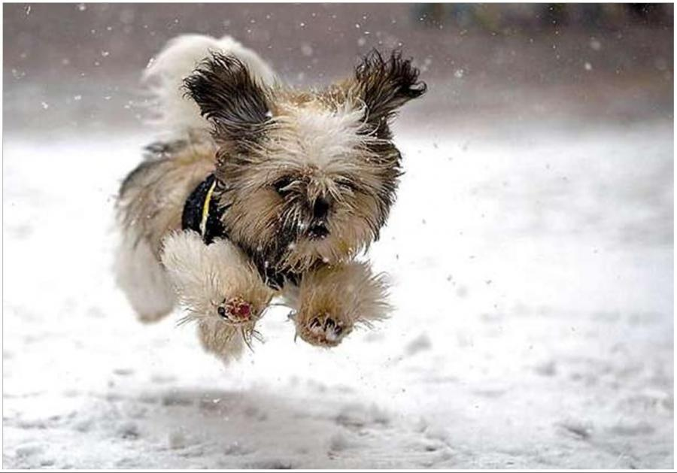
A PLACE WHERE YOU CAN ROMP ENTHUSIASTICALLY.

Slide 19

WHERE YOU CAN TAKE A MOMENT TO STAND IN WONDER.

Slide 20
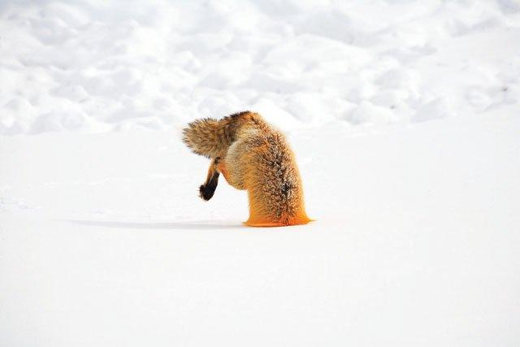
WHERE YOU CAN OCCASIONALLY BURY YOURSELF IN WORK.

Slide 21
AND FEAR NOT AS IT WON’T BE AS PAINFUL AS HAVING A BABY, OR PULLING A WISDOM TOOTH WITHOUT NOVACAINE, OR LOSING TO PREP, AND THERE WILL BE AN END IN SIGHT
. . . SOMETIME AROUND 24,000,000 SECONDS FROM NOW, AT THE END OF THE SCHOOL YEAR.
SO KEEP SMILING LADS AND LASSIES, CAUSE LIFE COULD BE WORSE . . . (AFTER ALL, YOU COULD BE A PHYSICS TEACHER)
:)

Slide 22
guided mind imagery

