Slide 1
How are you doing with graphs of motion?
Which graph(s) to the right best match the following descriptions?
A. An object moves with constant velocity.
B. An object moves backwards, then stops suddenly, then begins to speed up moving forward.
C. An object moves with positive acceleration.
D. An object moves forwards, stops suddenly, then moves backwards to its initial spot.
E. An object decelerates backwards, stops, then moves backwards at a constant velocity.
Graph #5
Graph #2
Graph #1
Graph #7
Graph #4

Slide 2
General announcements
Turn in hmwk
Questions on expectations, calendar, or class Website?
Today: intro to kinematics and graphs
Tomorrow: first lab! We’ll talk about write-ups etc. (this is a short one)
Big Note: If you email me for anything, please include in the message THE CLASS PERIOD you are in. Otherwise, I have to scramble to figure out where you belong, that that just takes additional time.
Reminder: if you receive accommodations on tests, come talk to me so we can make a plan
  Test 1 is Thursday, 9/5

Slide 3
Island Series Introduction

Slide 4
Island series 1: Acceleration walk
How can one student in your group accelerate at a constant rate for 10 meters?
  Parameters:
    You will only get one shot to actually try this! You need to work together to come up with a clear procedure that anyone in the group can follow.
    Talk through potential challenges or pitfalls before settling on a procedure.
    We are talking about a non-zero acceleration here!

Slide 5
Following up…
What would we need to do or know in order to successfully complete the island challenge?
What does acceleration mean…
  Conceptually?
  Mathematically?

Slide 6

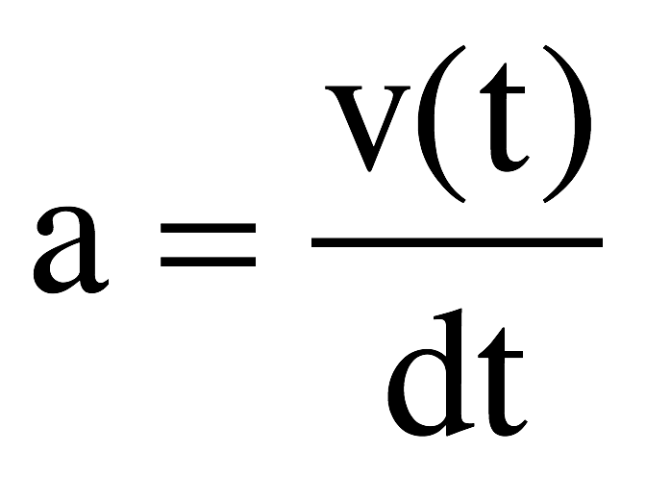

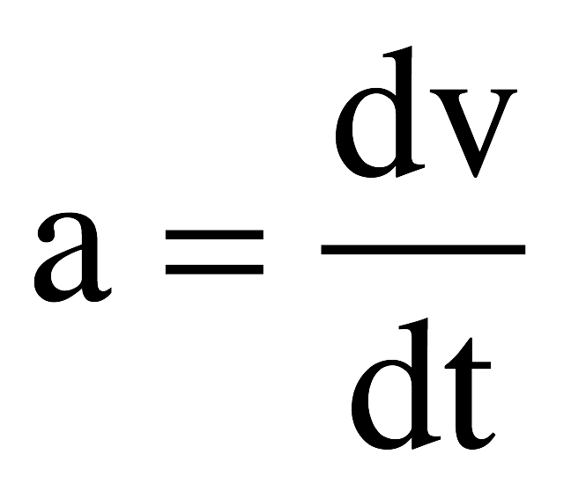

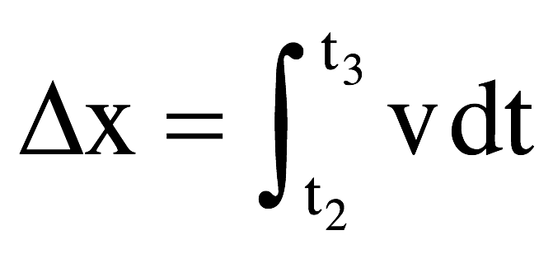
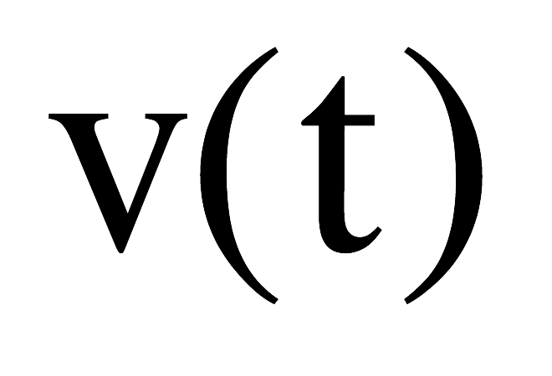

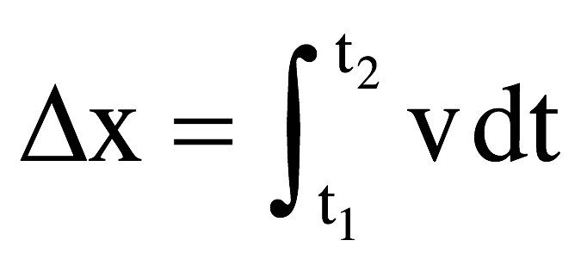
Mathematical relationships
Looking at the graph to the right:
  The slope of the tangent line to a velocity vs. time graph gives the rate of change of velocity…aka acceleration:
  The area under a velocity vs. time graph yields the net displacement of the object:

Slide 7
Mathematical relationships
What about position vs. time?
Sketch a graph of position vs. time for an object that has:
  No velocity
  A constant velocity
  Changing velocity
For a position vs. time graph, a constant slope = constant velocity. The slope of the tangent line at any point gives the instantaneous velocity of the object.

Slide 8
Graphical/mathematical relationships summed up
So, for a velocity vs. time graph, the
  SLOPE of the tangent line = acceleration
  AREA under the graph = displacement
What about for a position vs. time graph?
  The SLOPE represents:
  If the graph is curved, what does that mean?
What about for an acceleration vs. time graph?
  AREA under the graph =
  SLOPE of the tangent line =
velocity
Changing slope means changing velocity – object is accelerating
velocity change
“jerk” (not often used)

Slide 9
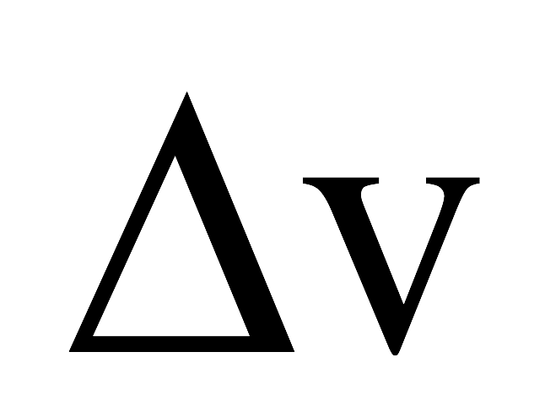
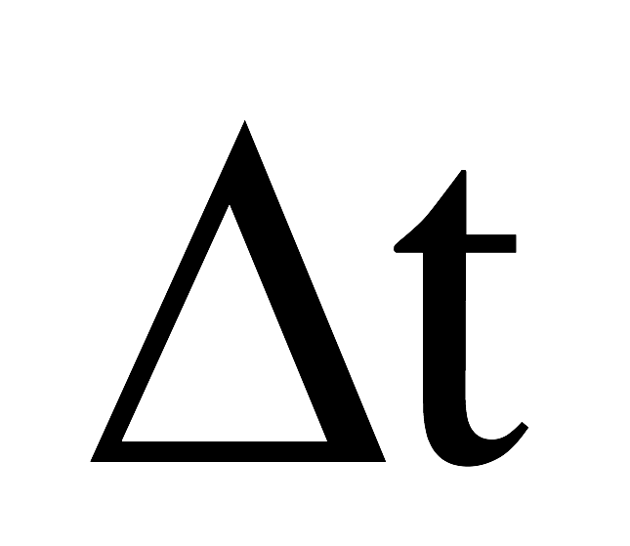
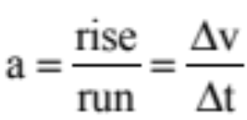
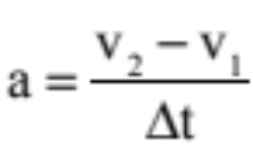

Kinematics derivations: the velocity equation
Acceleration is equal to the slope of a velocity vs. time graph.
If that acceleration is constant, the slope becomes:
This can be rewritten two ways:
v
t
or

Slide 10
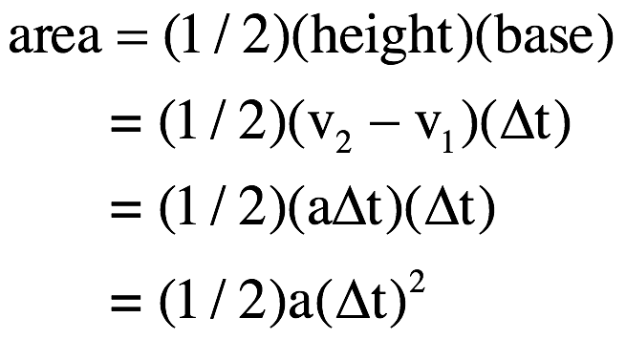
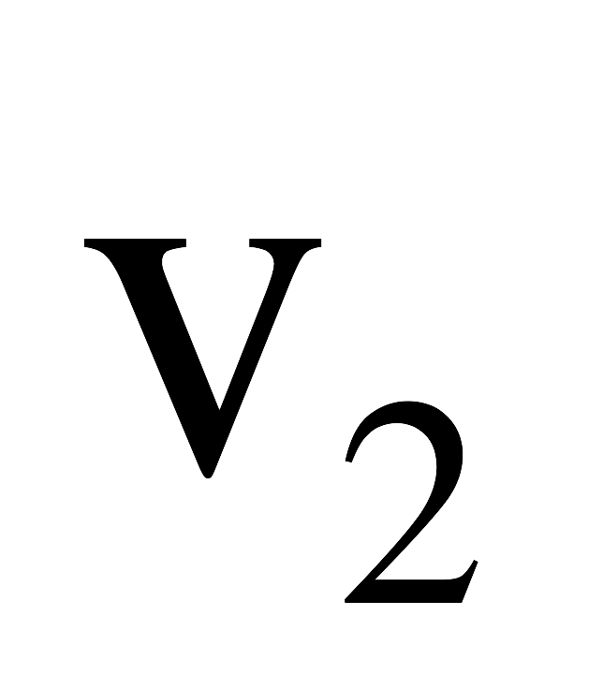
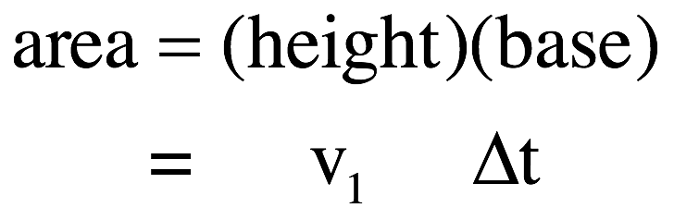
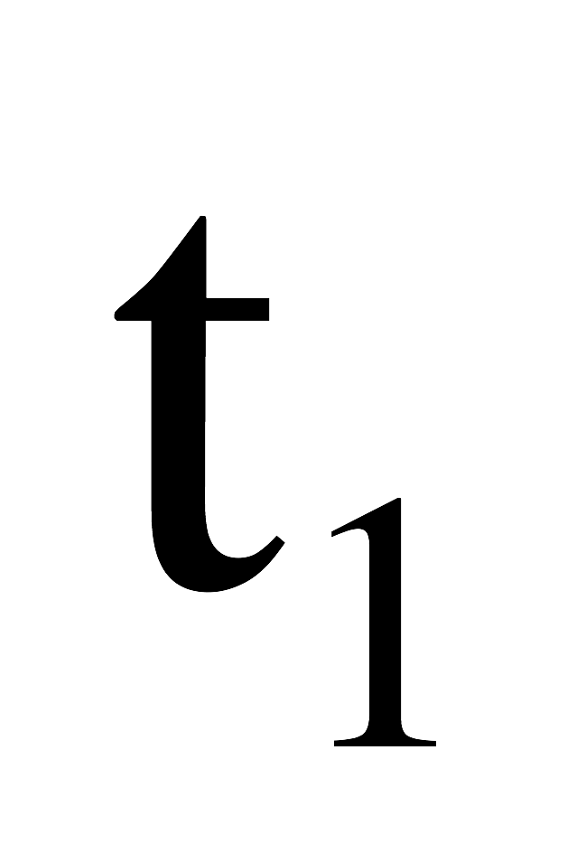
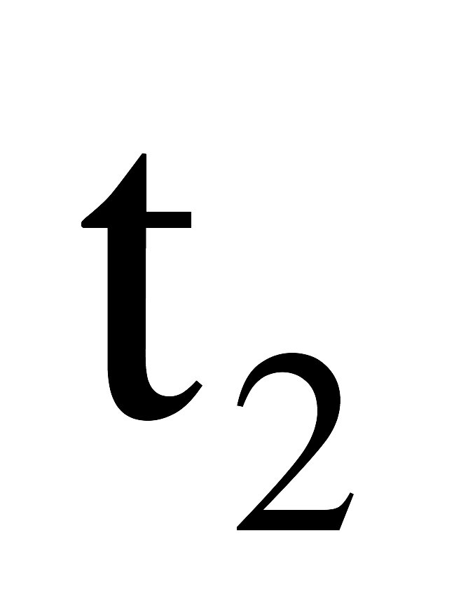
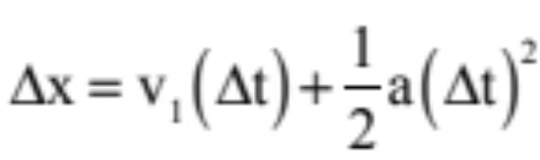
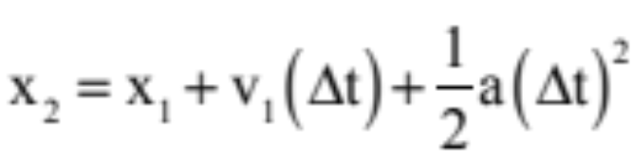
Kinematics derivations: the displacement equation
Displacement is equal to the area underneath a velocity vs. time graph.
If the acceleration is constant, the graph is a straight line. To find the area
This can be rewritten two ways:
or

Slide 11
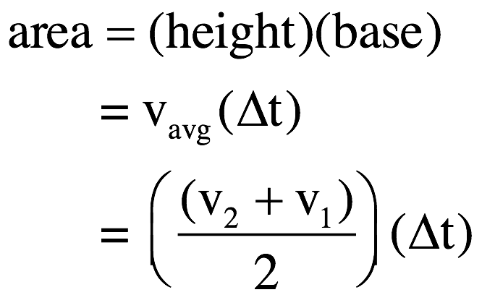
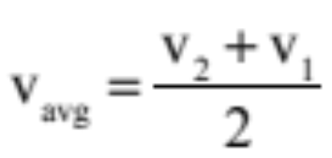
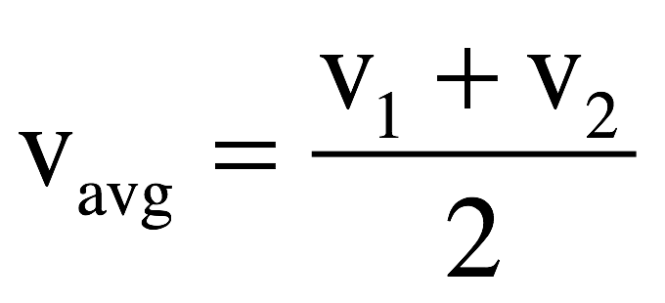
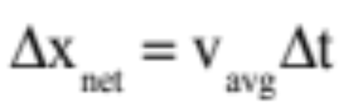
Kinematics derivations: the average-velocity equations
For a constant acceleration situation:
The area under the graph is still the net displacement, and using v_{avg}:

Slide 12

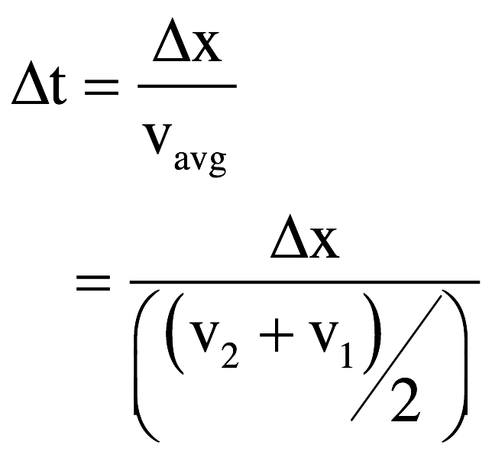
Kinematics derivations: the combination equation
Note: you will never have to derive this for me, but you should know where it comes from!
We know from before that and for any constant acceleration situation
We are going to combine these with the definition of acceleration to derive the third kinematic equation.
From and we can write:

Slide 13
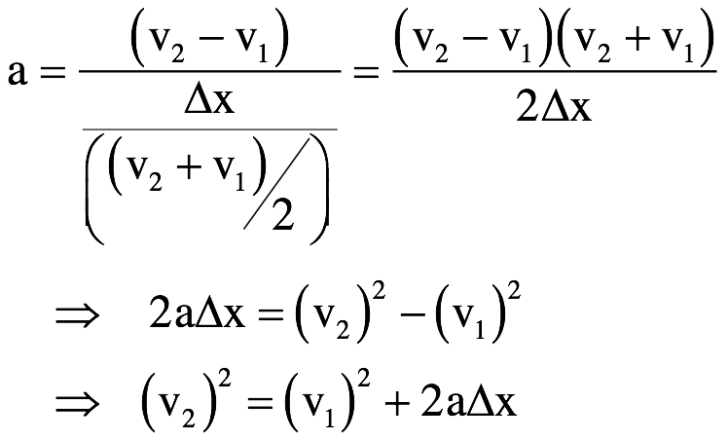
Kinematics derivations: the combination equation
Substituting this into yields:

Slide 14
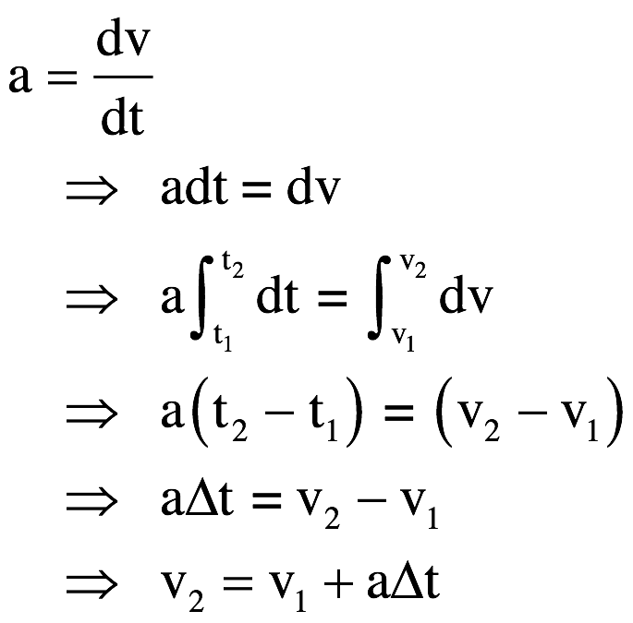
In college classes, the derivations start with the fact that the acceleration is constant and use Calculus to derive the equations. YOU WILL NEVER HAVE TO DUPLICATE THIS--it’s solely for your own edification and amusement.

Slide 15
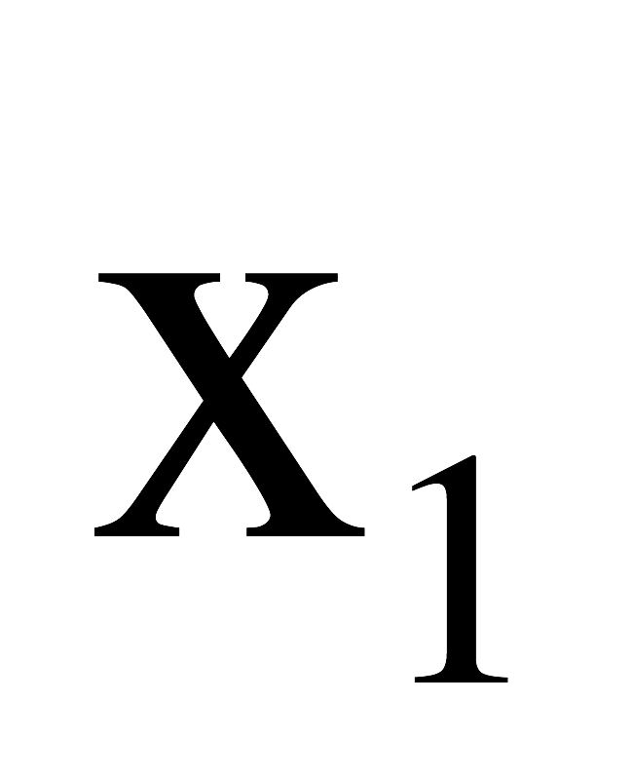
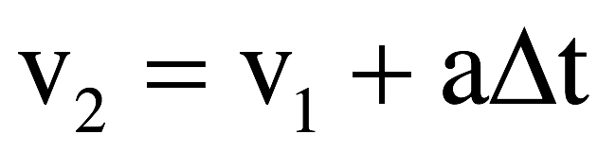

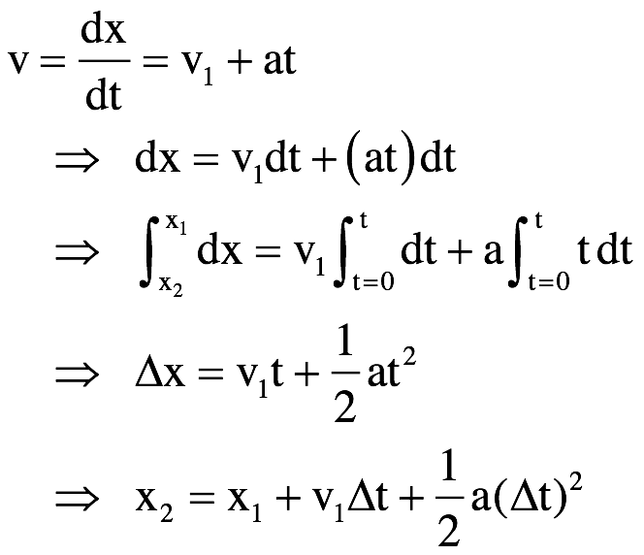
Noting that if the initial time is t = 0 (i.e., the clock starts when the object passes ) and the final time is just “t,” and with we denote the final velocity as just “v,” the previous equations
goes to:
With that, we can write:

Slide 16
Using kinematic equations: step 1
Choose a frame of reference:
  When approaching a problem, the first thing to do is pick a frame of reference (often, but not always, the stationary Earth is a good reference frame)
  Once you’ve chosen a reference frame, stick with it! Don’t change partway through – otherwise, your work will turn into gibberish.
  Indicate your frame of reference with a coordinate system.
    Indicate both the zero position and the positive directions
y
+y
x
+x
Which of these is better?

Slide 17
Why does it matter?
Remember scalars vs. vectors?
  Direction is very important for vectors – always measured relative to your coordinate system
Scalars can be positive or negative, but don’t have direction
  For example, the freeway speed limit is 65 mph, or the temperature of a room is 72 degrees Fahrenheit
Vectors can be positive or negative depending on their direction
  For example, my car’s velocity can be +65 mph or -65 mph depending on which direction I’m driving.

Slide 18





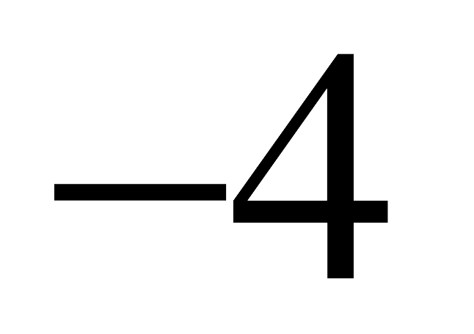
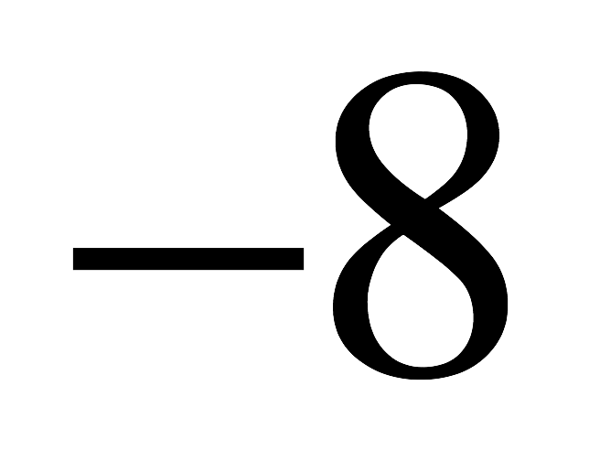
Figure 2.24 on p51
What does this graph represent if it is a:
Position vs. time graph?
Velocity vs. time graph?
Acceleration vs. time graph?

Slide 19
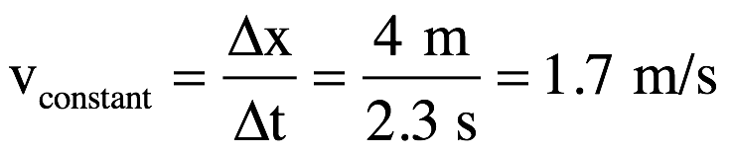
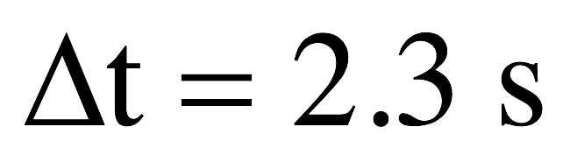
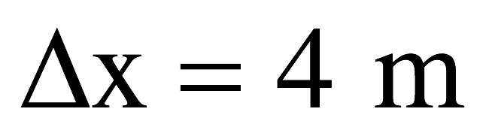
1.) As position versus time graph:
body standing still at x = 8 m
body moving with constant, positive velocity while in positive region
body at origin at t =10 sec
acceleration zero
body moving with constant, positive velocity while in negative region
acceleration non-zero
body standing still at x = -8 m
2.)

Slide 20
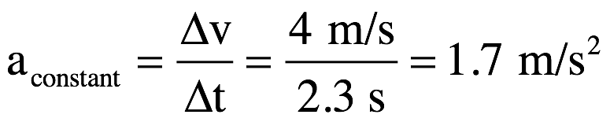
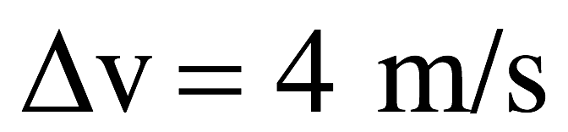
1.) As velocity versus time graph:
body moving with constant velocity v = 8 m/s; you know its traveling in positive direction but you don’t know its coordinate
body accelerating – velocity getting bigger with time
body velocity zero at t = 10 sec point
body changing velocity (accelerating) constantly; magnitude getting smaller with time
body moving with constant velocity v = -8 m/s; you know it’s traveling in negative direction but you don’t know its coordinate
3.)

Slide 21
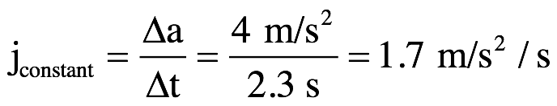
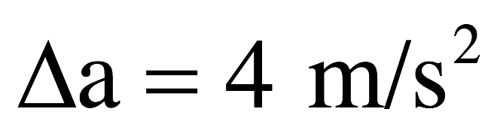
1.) As acceleration versus time graph:
body moving with constant acceleration a = 8 m/s/s but you don’t know if body’s velocity magnitude is increasing or decreasing!
body acceleration zero at t = 10 sec point
body changing acceleration(experiencing jerk) at constant rate
body moving with constant acceleration of v = -8 m/s/s (kinematics work during this period) but you don’t know if velocity magnitude is increasing or decreasing!
4.)

Slide 22
Sign conventions
The sign of a vector quantity indicates its direction.
This requires that you clearly indicate your coordinate axes!
What does it mean to have:
  A positive velocity but negative position?
  Negative displacement and a positive position?
  A positive velocity and positive acceleration?
  Negative velocity but positive acceleration?

