Slide 1
General announcements
Calendar was updated two days ago – check it!
Don’t forget to look at the XtraWrk for helpful videos, problems to consider, etc.
Today: 1D kinematics lab, how to write up a physics lab, and finishing up the kinematic equations

Slide 2
Fun and games with 1-D kinematics Lab
General info:
  Lab handout and lab procedure is on Website (no need to print unless you want to)
  We will talk about write-up format before you leave (and maybe even start it together)
  Do not use the data posted on Website unless you have permission from me - use what you get today
Make sure everyone in your group has their own copies of the graphs BEFORE you leave!

Slide 3
Lab write-up for L-1
Use the template, or recopy similarly to the engineering pads you just received (these are to be used for all labs, please)
For all labs, “blurb” your answers to the analysis questions. Make sure you number to match the lab questions!
Attach all data tables and/or graphs to the back.
  If taking data from a graph, make sure to circle and label the data points used every time
Same format for every lab’s cover sheet – feel free to illustrate!

Slide 4

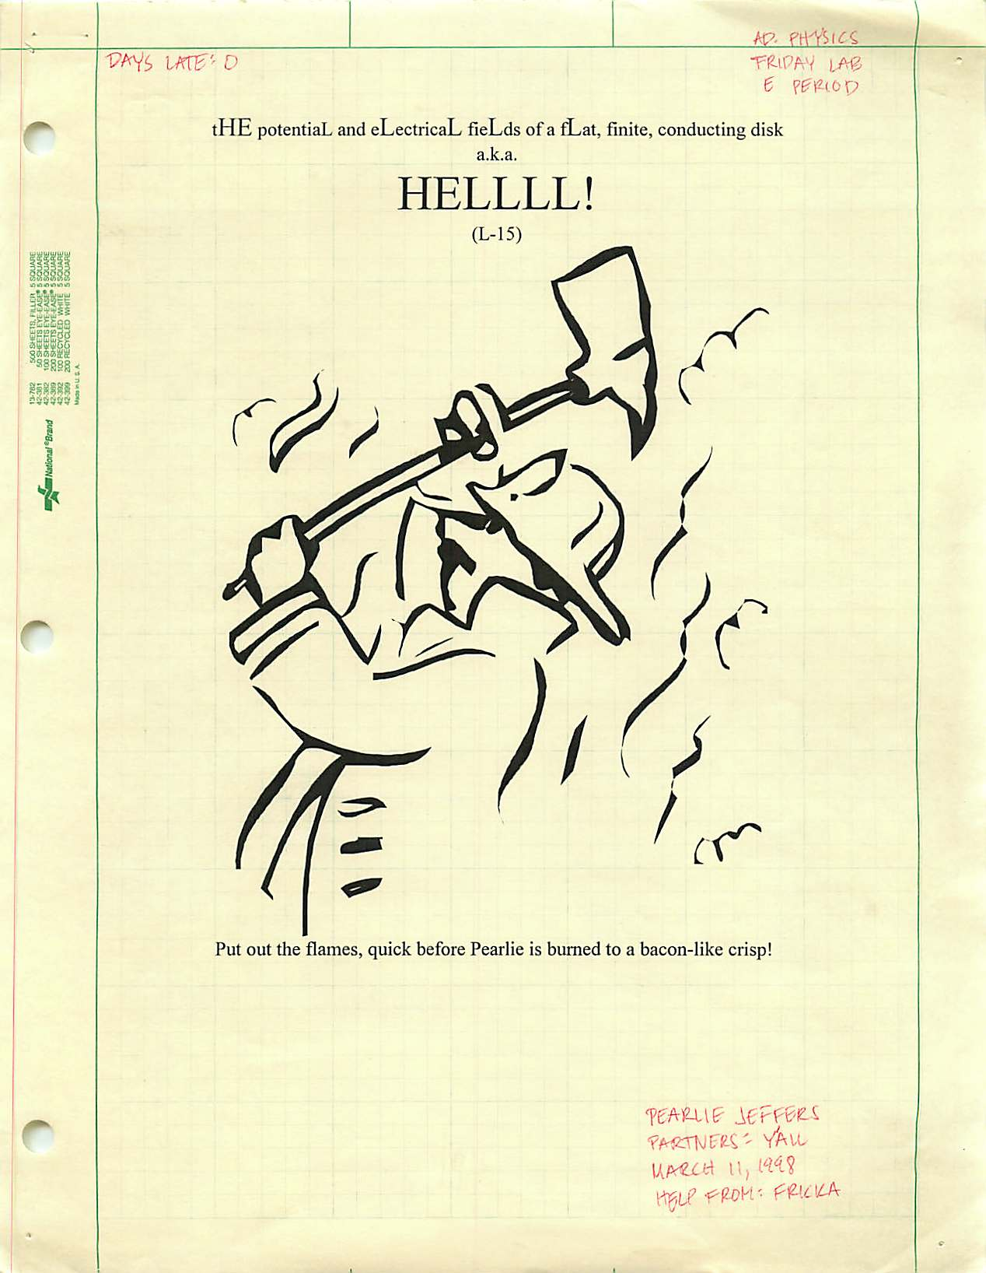

Slide 5
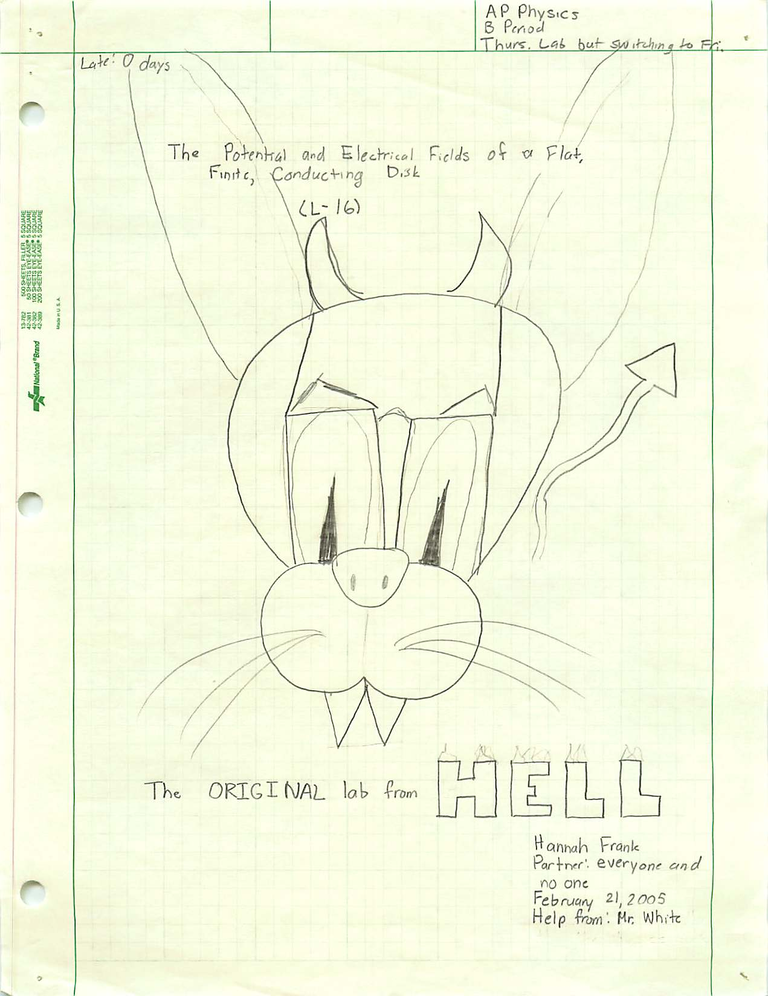
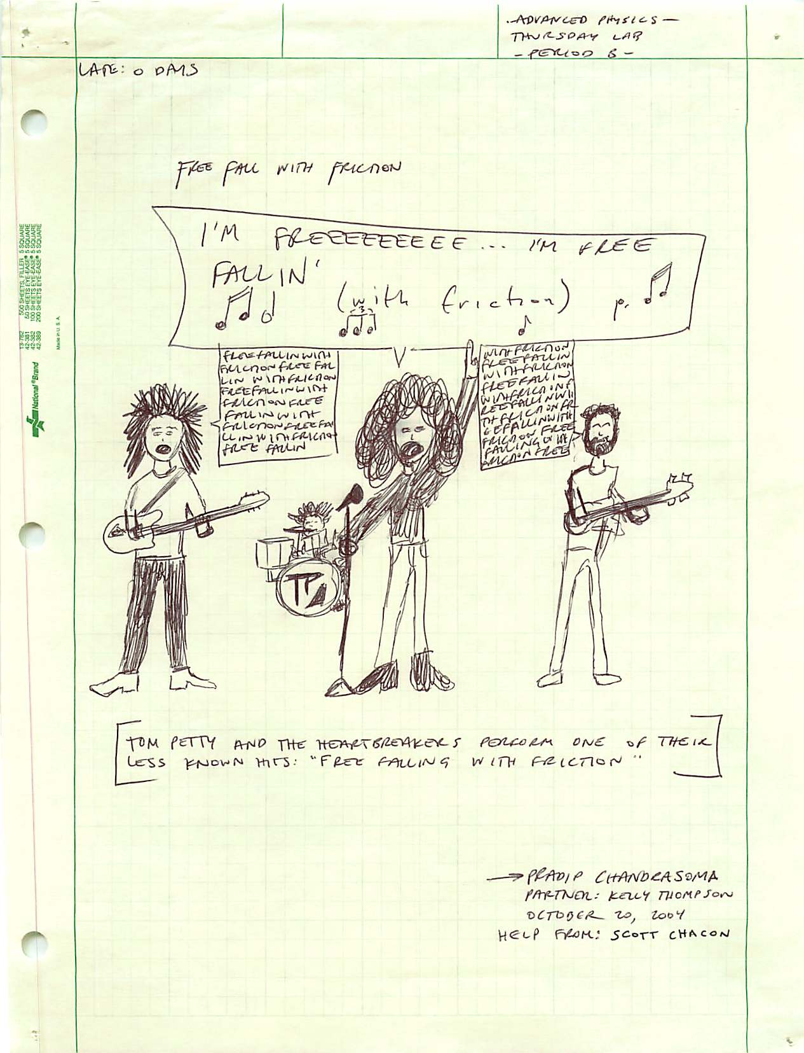

Slide 6
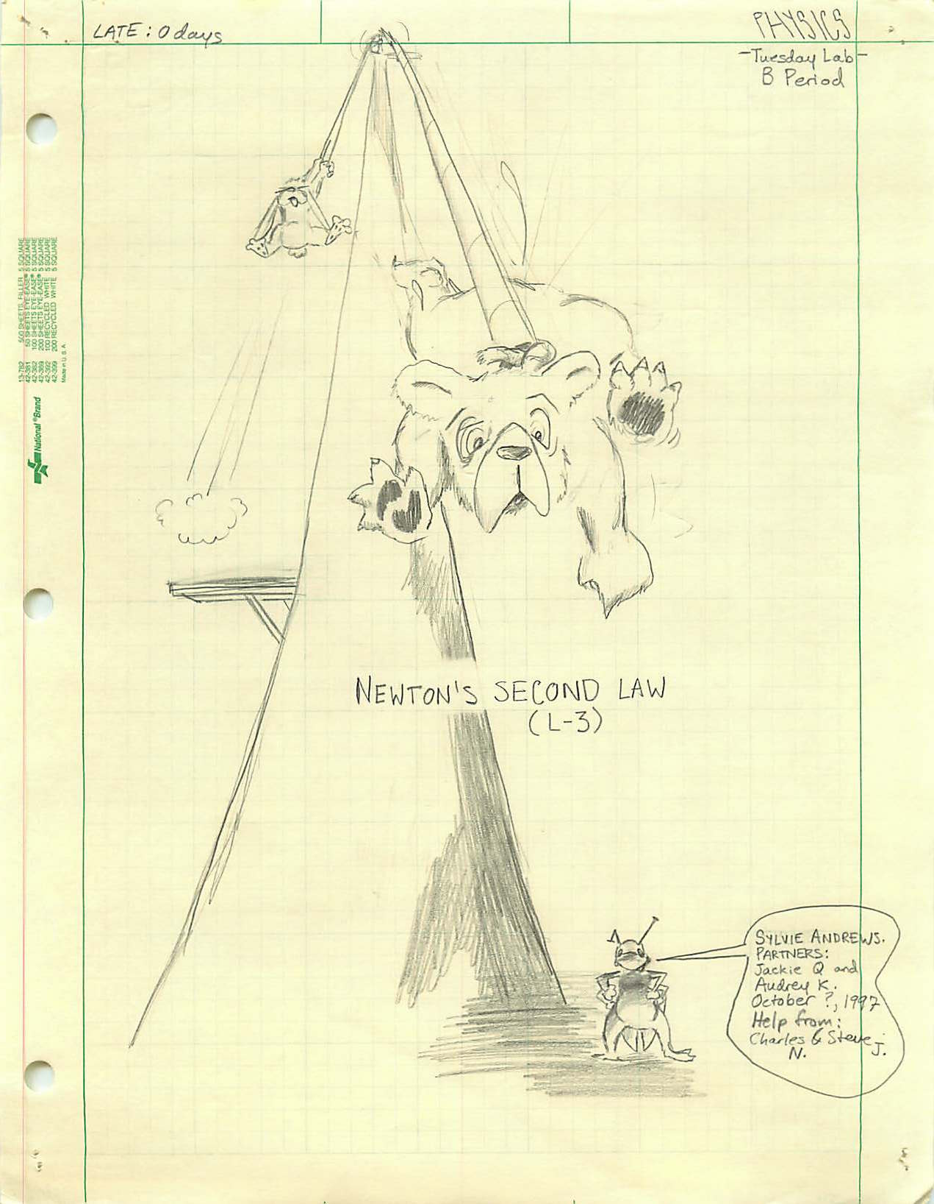


Slide 7
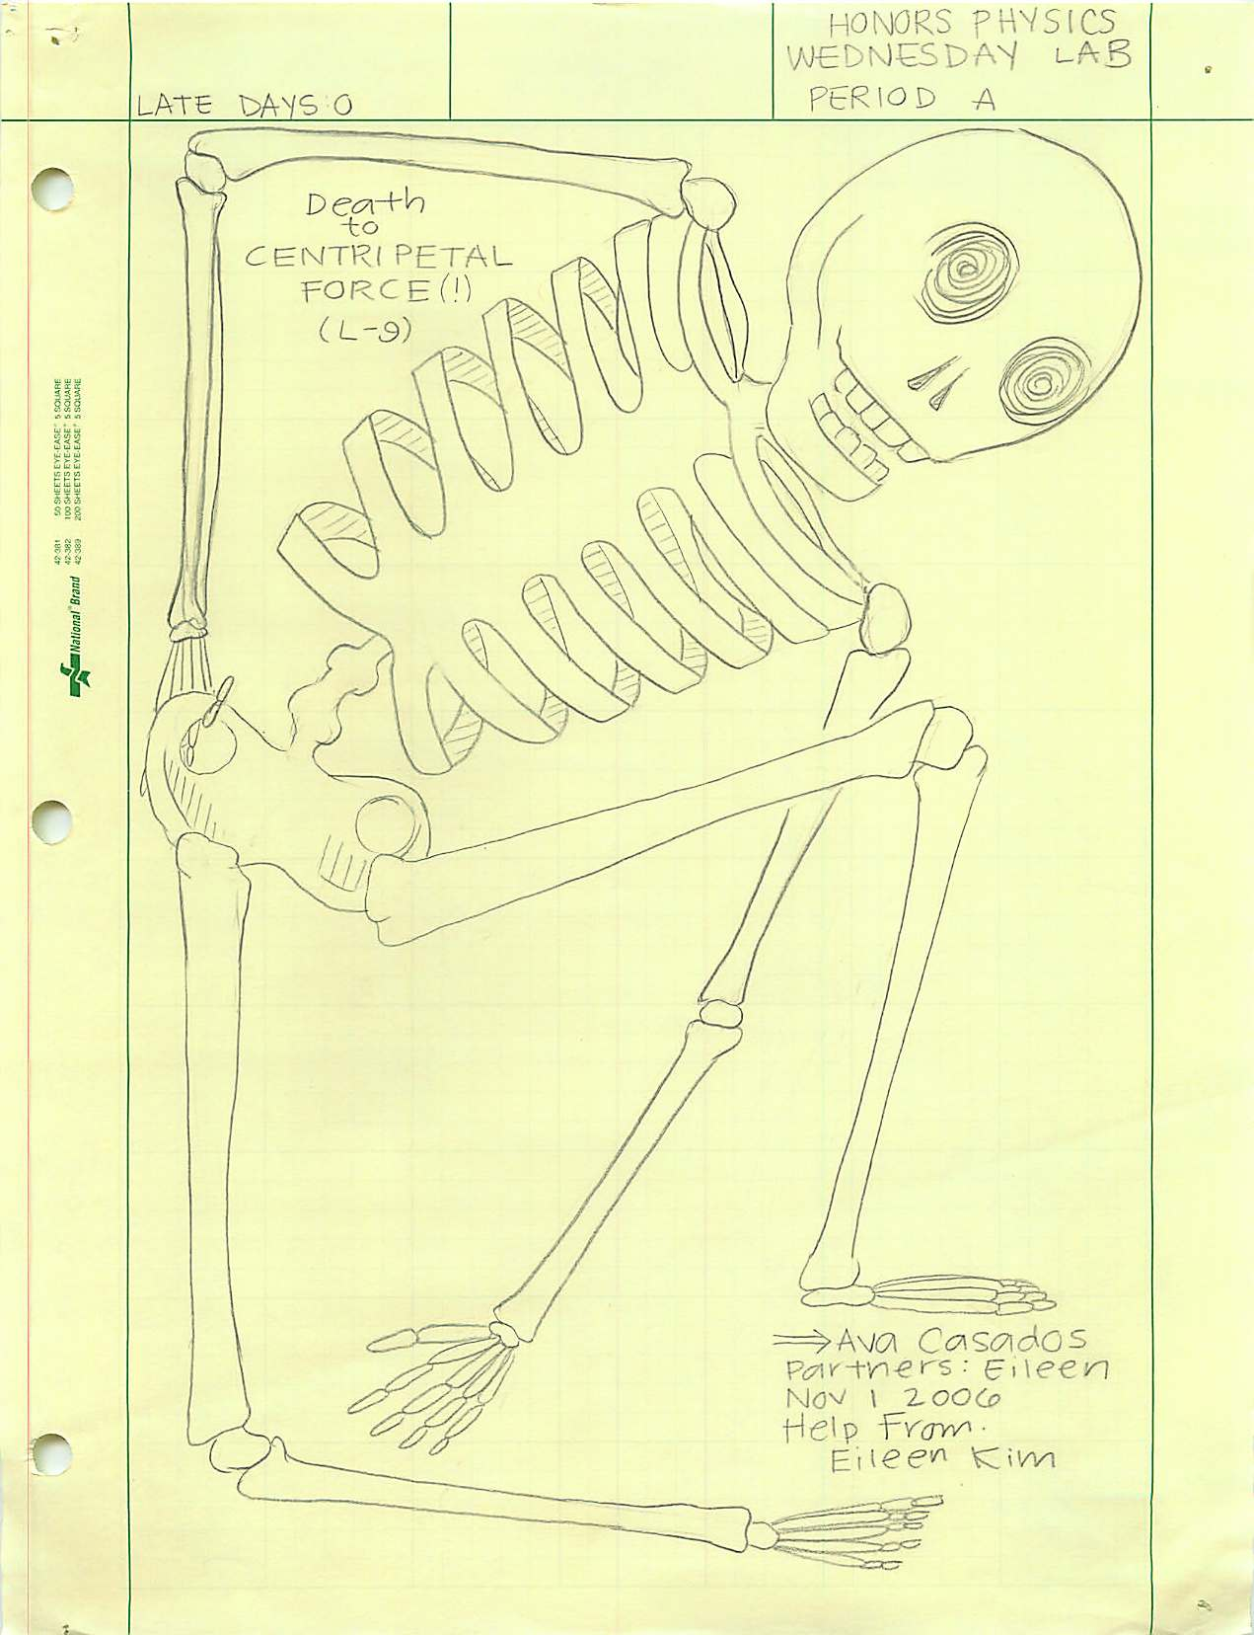
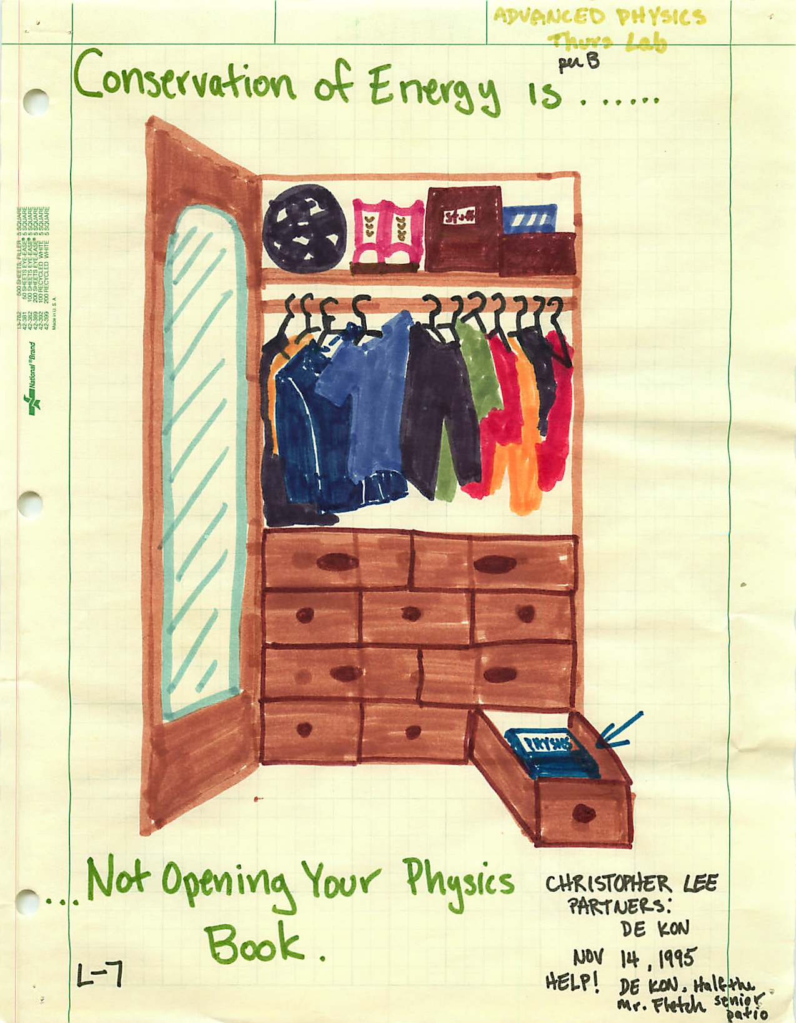

Slide 8
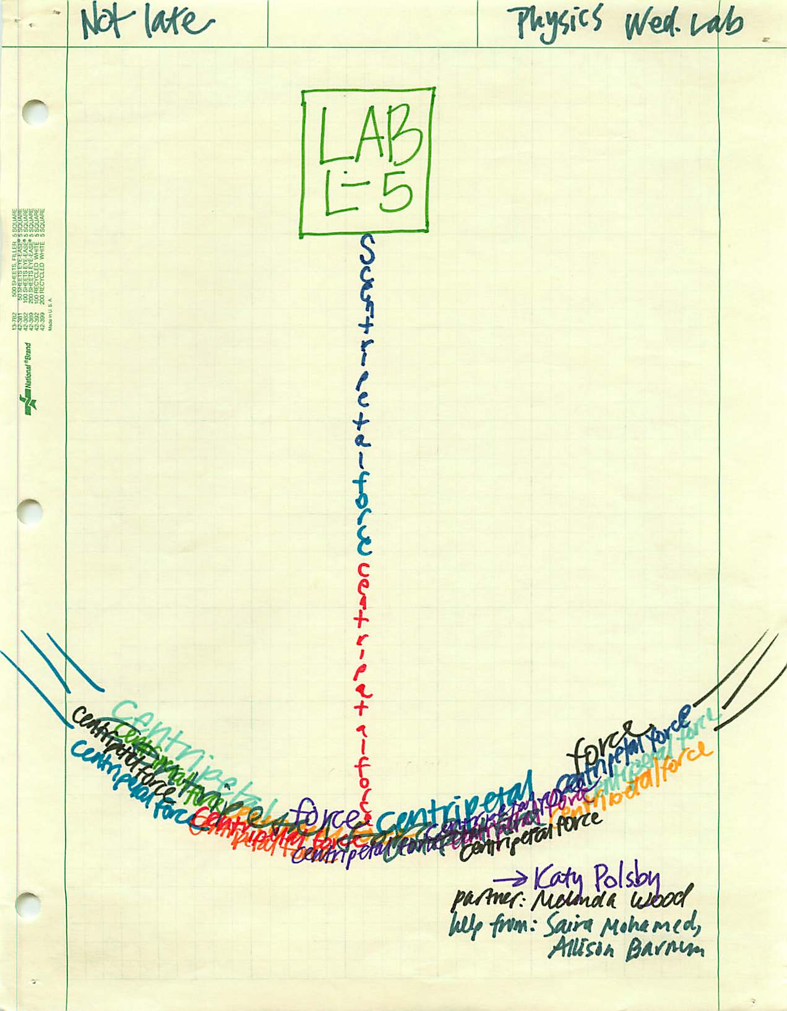
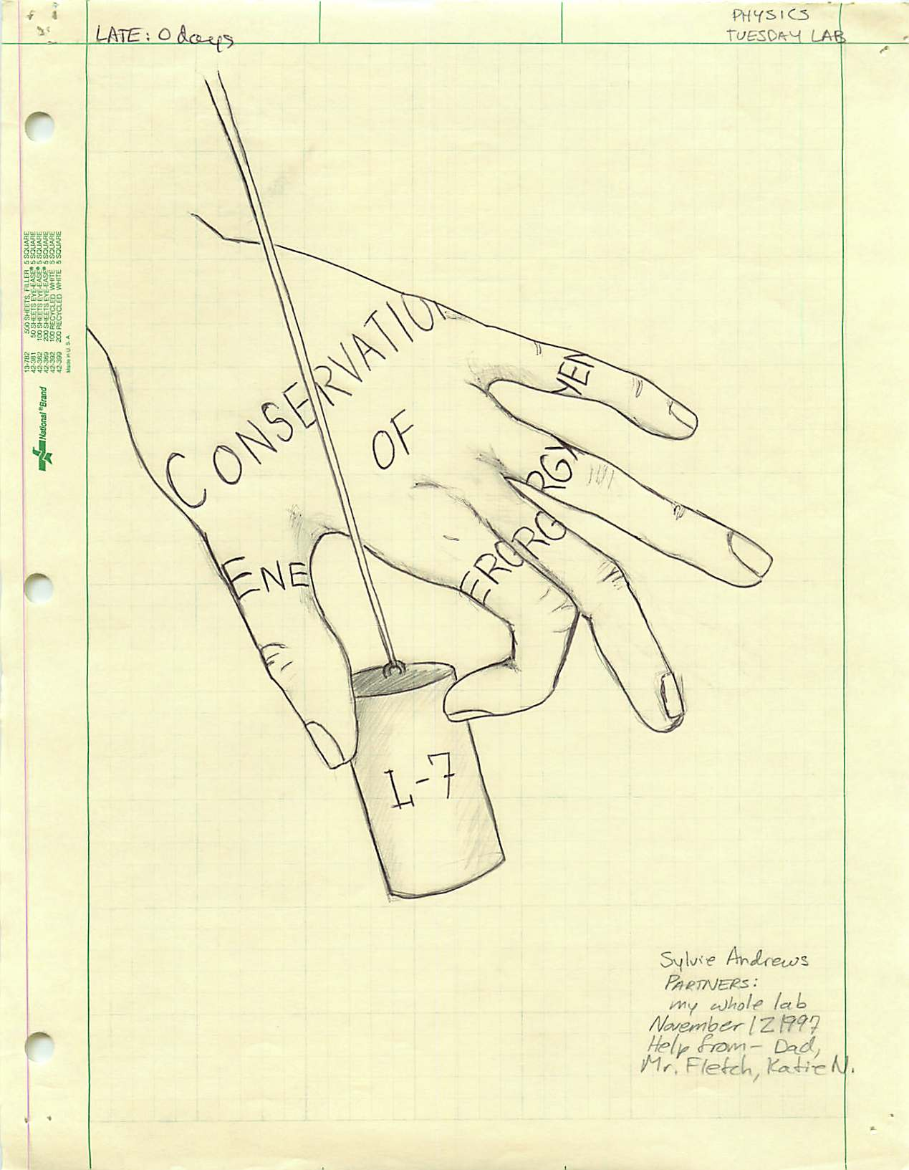

Slide 9
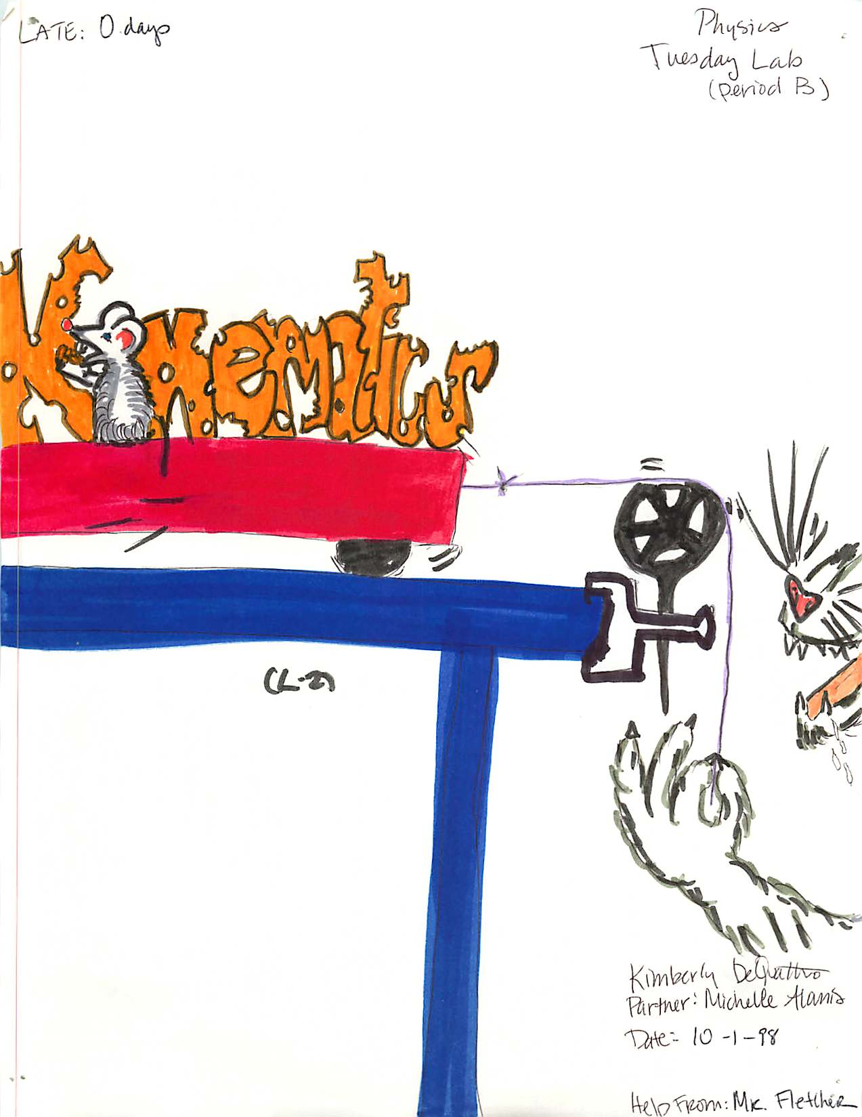


Slide 10
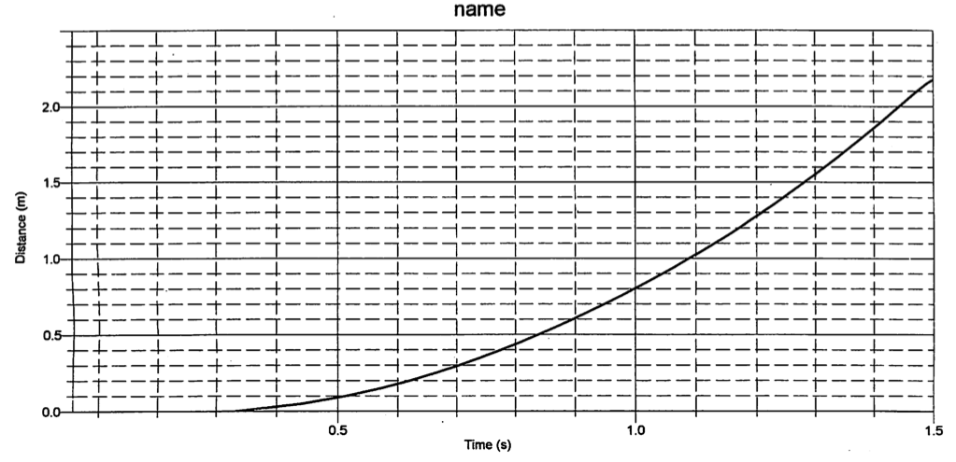
Sample data

Slide 11
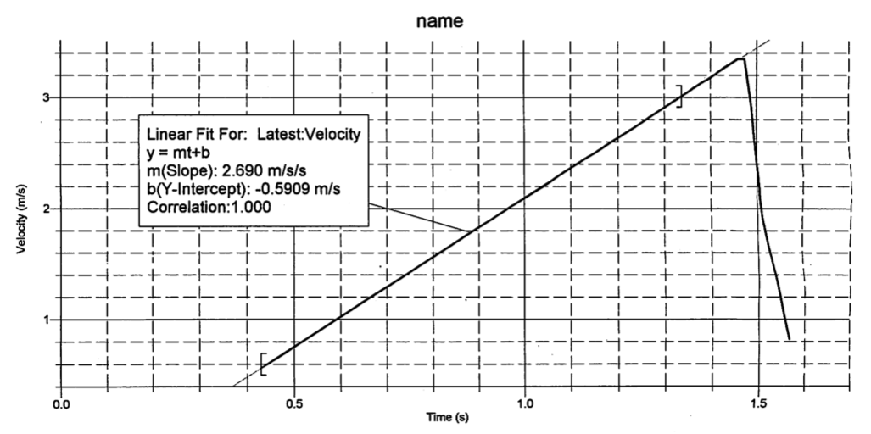
Sample data

Slide 12





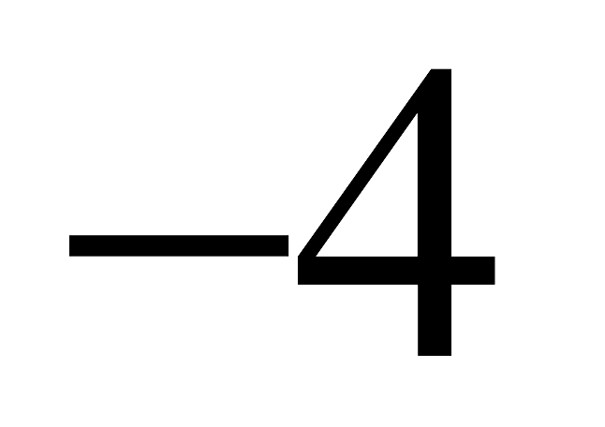
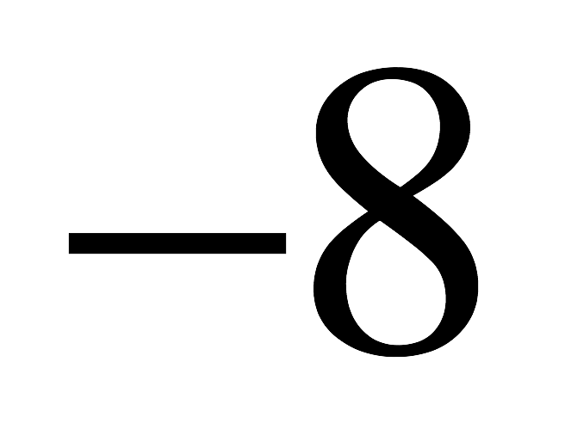
Figure 2.24 from XtraWrk
What does this graph represent if it is a:
Position vs. time graph?
Velocity vs. time graph?
Acceleration vs. time graph?

Slide 13
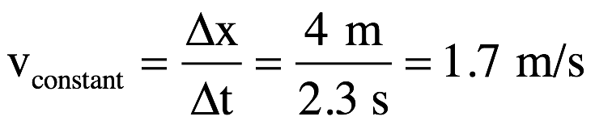
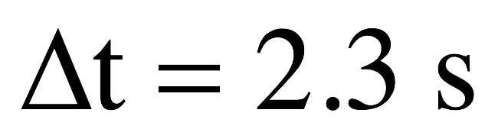
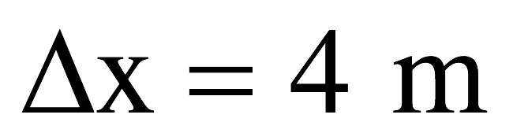
1.) As position versus time graph:
body standing still at x = 8 m
body moving with constant, positive velocity while in positive region
body at origin at t =10 sec
acceleration zero
body moving with constant, positive velocity while in negative region
acceleration non-zero
body standing still at x = -8 m
2.)

Slide 14
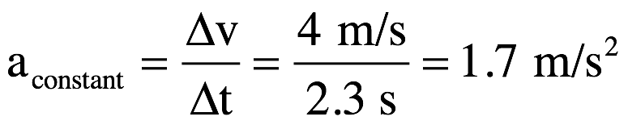
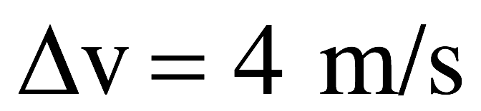
1.) As velocity versus time graph:
body moving with constant velocity v = 8 m/s; you know its traveling in positive direction but you don’t know its coordinate
body accelerating – velocity getting bigger with time
body velocity zero at t = 10 sec point
body changing velocity (accelerating) constantly; magnitude getting smaller with time
body moving with constant velocity v = -8 m/s; you know it’s traveling in negative direction but you don’t know its coordinate
3.)

Slide 15
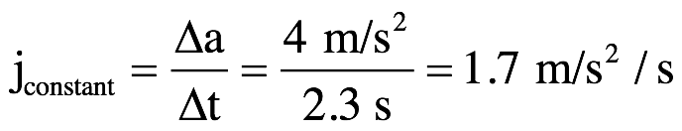
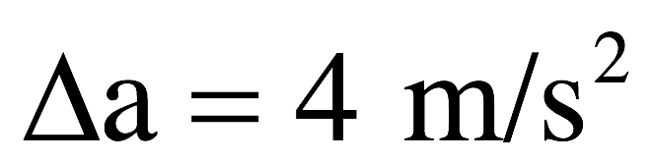
1.) As acceleration versus time graph:
body moving with constant acceleration a = 8 m/s/s but you don’t know if body’s velocity magnitude is increasing or decreasing!
body acceleration zero at t = 10 sec point
body changing acceleration(experiencing jerk) at constant rate
body moving with constant acceleration of v = -8 m/s/s (kinematics work during this period) but you don’t know if velocity magnitude is increasing or decreasing!
4.)

Slide 16
Sign conventions
The sign of a vector quantity indicates its direction.
This requires that you clearly indicate your coordinate axes!
What does it mean to have:
  A positive velocity but negative position?
  Negative displacement and a positive position?
  A positive velocity and positive acceleration?
  Negative velocity but positive acceleration?
  Negative velocity and negative acceleration?

