Slide 1
General announcements
Your lab write-up is due soon . . .
Need help on the lab or the homework/XtraWrk?
  Extra help, A, D, E, F
Clarifications/reminders!
  “blurb” means brief descriptions of what you’re doing in each part. WE have blurbed questions 1, 2, and 3 for you on the template – YOU have to blurb parts a-e for questions 4 and 5.
  The “write-up” is your cover sheet + answers to any analysis/calculation questions + graphs of data. Basically the template + your two graphs stapled to the back.
  Remember to mark clearly on your graphs the two points you used for your calculations!
About that homework . . . (look at example of “good” work)
1.)

Slide 2
Announcements (con’t.)
First test is Wednesday, 9/6 – will cover graphs of motion and 1D kinematics
  We’ve covered graphs: how to use slope, x/y values, shape of graph to determine changing position, rate of velocity, acceleration, etc. (e.g. Figure 2.24 - today)
  See class Website – class pdfs→1D Kinematics for resources (e.g. multiple choice questions, more practice problems) plus your textbook and the XtraWrk
  Expect: 4-5 multiple choice, a page of graph analysis and 2-4 kinematic problems that will require ALL 3 equations (know them!)
  Come talk to me today or tomorrow if you receive extra time
2.)

Slide 3






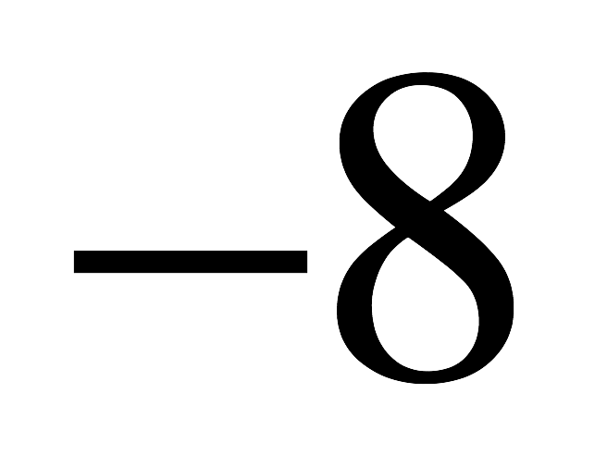
Figure 2.24 on p51
What does this graph represent if it is a:
Position vs. time graph?
Velocity vs. time graph?
Acceleration vs. time graph?
3.)

Slide 4
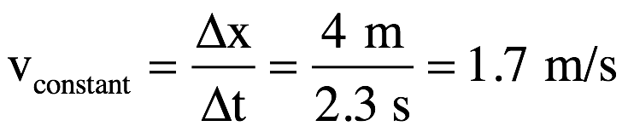
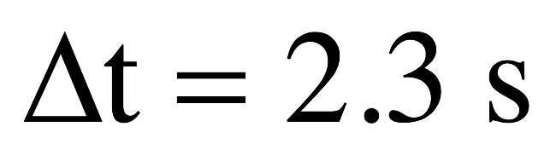

1.) As position versus time graph:
body standing still at x = 8 m
body moving with constant, positive velocity while in positive region
body at origin at t =10 sec
acceleration zero
body moving with constant, positive velocity while in negative region
acceleration non-zero
body standing still at x = -8 m
2.)
4.)

Slide 5
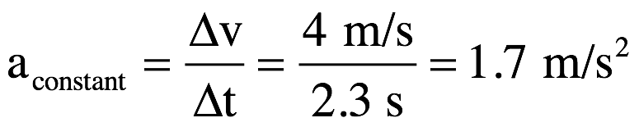
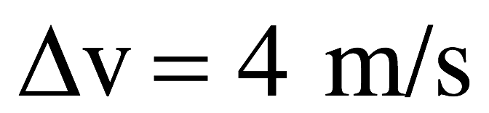
1.) As velocity versus time graph:
body moving with constant velocity v = 8 m/s; you know its traveling in positive direction but you don’t know its coordinate
body accelerating – velocity getting bigger with time
body velocity zero at t = 10 sec point
body changing velocity (accelerating) constantly; magnitude getting smaller with time
body moving with constant velocity v = -8 m/s; you know it’s traveling in negative direction but you don’t know its coordinate
3.)
5.)

Slide 6
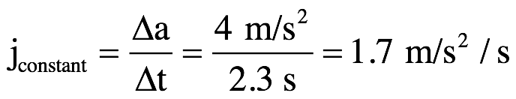
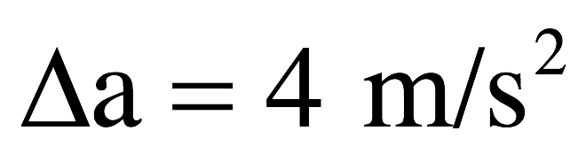
1.) As acceleration versus time graph:
body moving with constant acceleration a = 8 m/s/s but you don’t know if body’s velocity magnitude is increasing or decreasing!
body acceleration zero at t = 10 sec point
body changing acceleration(experiencing jerk) at constant rate
body moving with constant acceleration of v = -8 m/s/s (kinematics work during this period) but you don’t know if velocity magnitude is increasing or decreasing!
4.)
6.)

Slide 7
Sign conventions
The sign of a vector quantity indicates its direction.
This requires that you clearly indicate your coordinate axes!
What does it mean to have:
  A positive velocity but negative position?
  Negative displacement and a positive position?
  A positive velocity and positive acceleration?
  Negative velocity but positive acceleration?
Moving in + direction, on – side of origin
On the + side of origin moving in the - direction
When v and a have same sign, object speeds up
Moving in the + direction and speeding up
When v and a have opposite signs, object slows down
Moving in the – direction and slowing down
7.)

Slide 8
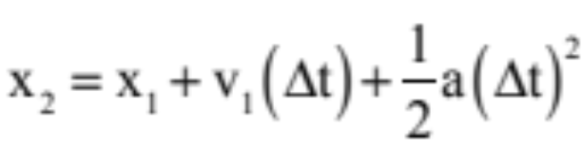
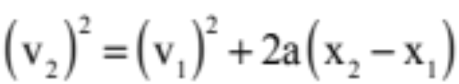

Using kinematic equations
3 main kinematic equations:
What assumption did we make in order to get these equations?
  Constant acceleration
  These equations work for linear motion (1-d) and for 2-d motion (requires a little more set-up but we’ll get there)
Remember to use proper sign conventions!
8.)

Slide 9
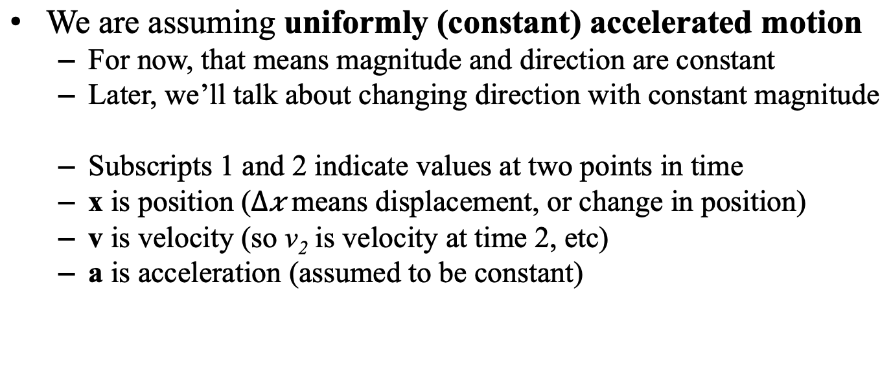
Reminders about kinematic equations
We are assuming uniformly (constant) accelerated motion
  For now, that means magnitude and direction are constant
  Later, we’ll talk about changing direction with constant magnitude
  Subscripts 1 and 2 indicate values at two points in time
  x is position ($∆x$ means displacement, or change in position)
  v is velocity (so v₂ is velocity at time 2, etc)
  a is acceleration (assumed to be constant)
9.)

Slide 10
How to solve problems with kinematic equations--
First--the quick and perilous way
Read the problem. Twice.
Pick the equation(s) you need based on what you know and what you want.
Plug in numbers and check your units and signs.
Show all of your work.
10.)

Slide 11
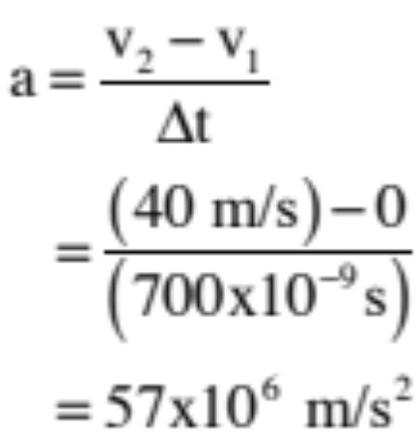
Example #2 – sea anemone
1.) The stinger covering sea anemone tentacles accelerates from zero to 80 mph (approx. 40 m/s) in 700 nanoseconds. What is the acceleration?
11.)

Slide 12
How to solve problems with kinematic equations--
Second--the Safe Way
Read the problem. Twice.
Draw a picture and indicate your frame of reference, including where your axes are and which way is +.
Write down all the known quantities (with their units) and the unknown quantity you are solving for. A chart is really helpful here (like the lab). Circle the unknowns.
Do any necessary unit conversions now.
Pick the equation(s) you need based on what you know and what you want.
Plug in numbers and check your units and signs.
Show all of your work.
12.)

Slide 13




Example #2 – sea anemone
The stinger covering sea anemone tentacles accelerates from zero to 80 mph (approx. 40 m/s) in 700 nanoseconds. What is the acceleration?
In this case, you don’t really need a picture. I wouldn’t hurt to identify the parameters, though, so:
The kinematic equation that does the job for us is:
13.)

Slide 14
Example #3 – funny car
2.) In 2007, it took 4.77 seconds for a funny car to cover a quarter of a mile (approximately 400 meters) with a top end of 317 mph (approximately 160 m/s).
a.) Assume the acceleration is constant and without using the elapsed time, determine the car’s acceleration.
b.) Assume acceleration was constant and determine it using a second approach.
c.) Why the discrepancy?
14.)

Slide 15
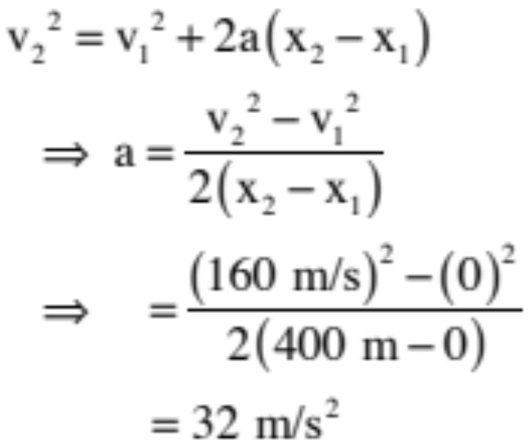
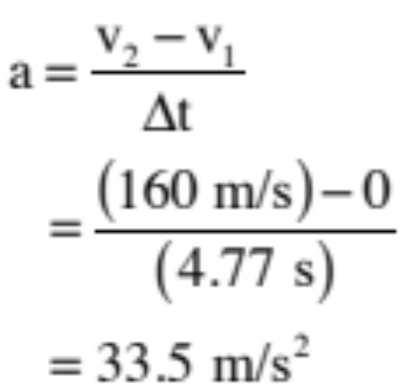
3.) In 2007, it took 4.77 seconds for a funny car to cover a quarter of a mile (approximately 400 meters) with a top end of 317 mph (approximately 160 m/s).
a.) Assume the acceleration is constant and without using the elapsed time, determine the car’s acceleration.
b.) Assume acceleration was constant and determine it using a second approach.
c.) Why the discrepancy?
Acceleration was not constant in real life.
4.)
15.)

Slide 16
How to solve problems with kinematic equations—Two ways—The safe way
Read the problem. Twice.
Draw a picture and indicate your frame of reference, including where your axes are and which way is +.
Write down all the known quantities (with their units) and the unknown quantity you are solving for. A chart is really helpful here (like the lab). Circle the unknowns.
Do any necessary unit conversions now.
Pick the equation(s) you need based on what you know and what you want.
Plug in numbers and check your units and signs.
Show all of your work.
16.)

Slide 17

Example #1 – car
A car starts from rest and accelerates at 4.0 m/s² for 15 s. How far has the car traveled in 15 s and what is its velocity at that time? (Do this “the safe way,” which means you start with a sketch.)
-
+
x(m)
0.00
17.)

Slide 18
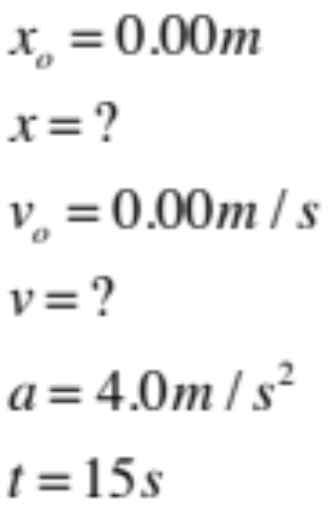
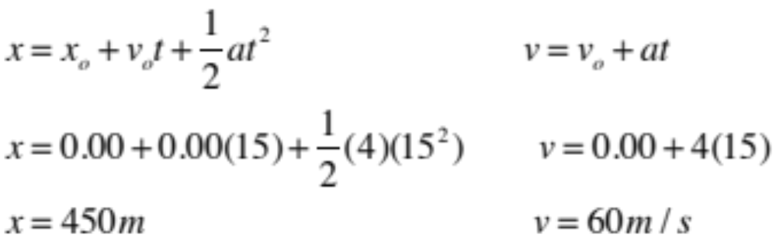
example #1 – The safe way
A car starts from rest and accelerates at 4.0 m/s² for 15 s. How far has the car traveled in 15 s and what is its velocity at that time?
-
+
x(m)
0.00
18.)

Slide 19
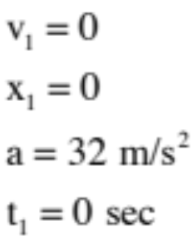
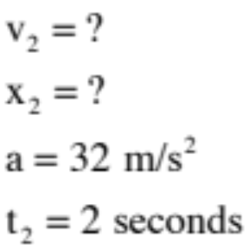
Back to the car…
Assume a hotrod accelerates from rest at a rate of 32 m/s/s.
  A) Where is it, relative to its starting position, after 2 sec?
  B) How fast is it going after 2 seconds?
19.)

Slide 20
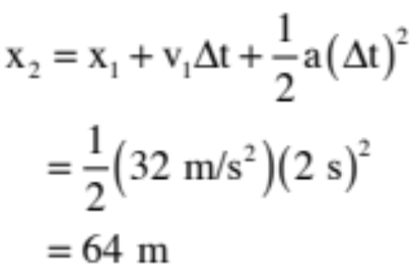


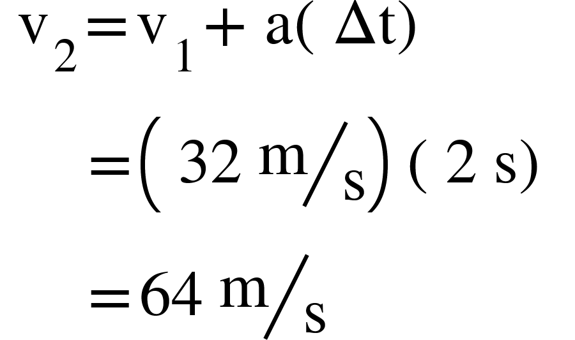
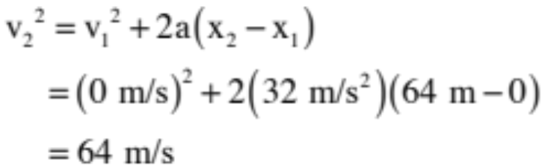
3.) Assume the hotrod accelerates from rest at a rate of 32 m/s/s.
a.) Where is it, relative to the start position, after 2 seconds?
0
0
b.) How fast is it going after 2 seconds?
or
6.)
20.)

Slide 21

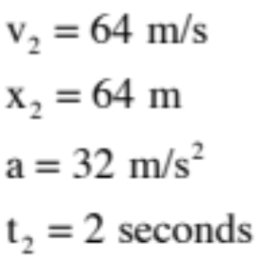
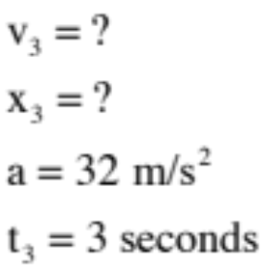
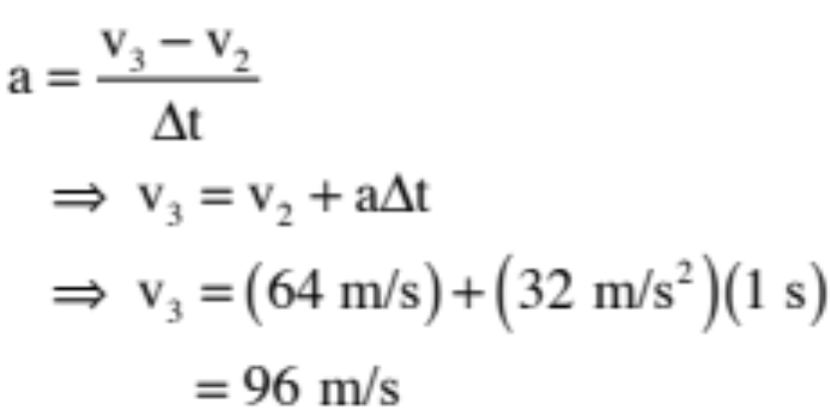
Back to the car…
c.) The hotrod travels another second passed the 2 second point. How fast is it traveling then?
21.)

Slide 22

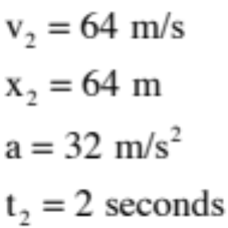
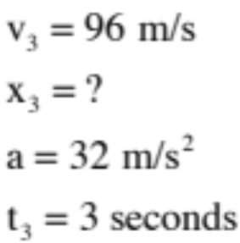
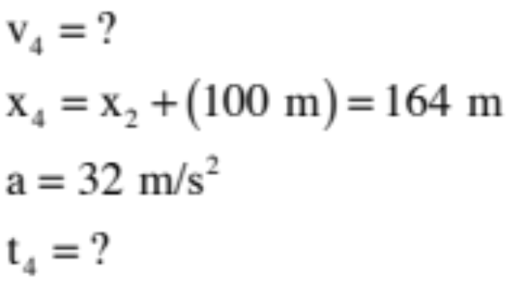
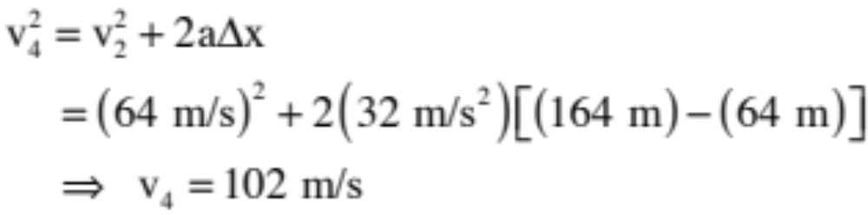
Back to the Car…
d.) The hotrod travels 100 meters passed its position at the 2 second point. How fast is it going?
22.)

Slide 23
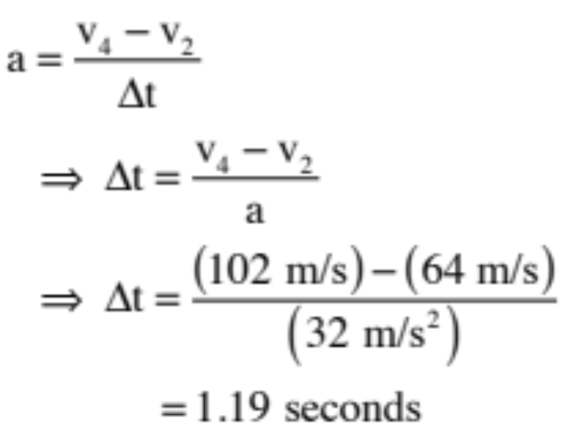
Back to the car…
e.) How long did it take to get to the 100 meter mark passed the t = 2 second point?
102 m/s
23.)

Slide 24
How to tackle complex problems
Sometimes you’ll end up with two objects, multiple equations, and multiple unknowns, or just multi-stage problems that take some thinking. It’s good to know how to set up and solve these types of equations.
This is where drawing a picture, indicating your axes, and keeping consistent signs is critical!
24.)

Slide 25
Two Car problem: the set-Up
The Question: Two cars traveling in opposite directions start out 1600 meters apart. Car A moves with constant velocity 10 m/s. Car B starts from rest and accelerates toward Car A picking up speed at a rate of 4 m/s/s.
  a.) Relative to where Car A started, where do they pass?
  b.) How long did it take for them to pass?
  c.) How fast is Car B moving when they pass?
25.)

Slide 26








Two car problem: the set-up
1. Sketch the set-up and put a coordinate axes on the sketch.
  Indicate the known and unknown values for both cars on the sketch.
  Note that car B’s acceleration is negative so
  Note that each car will take the same amount of time to reach the “pass point”
26.)

Slide 27
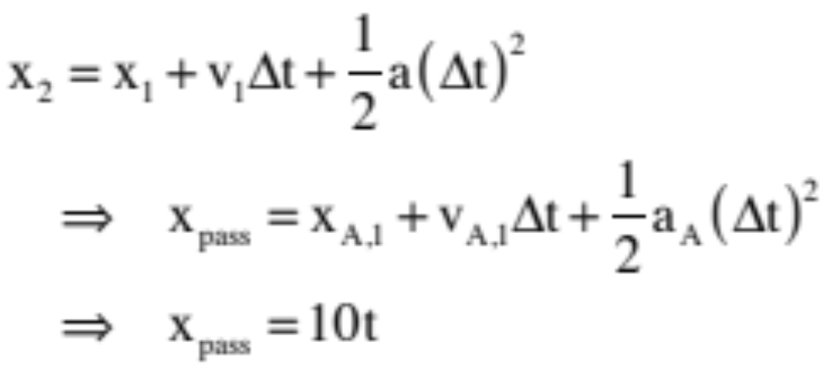
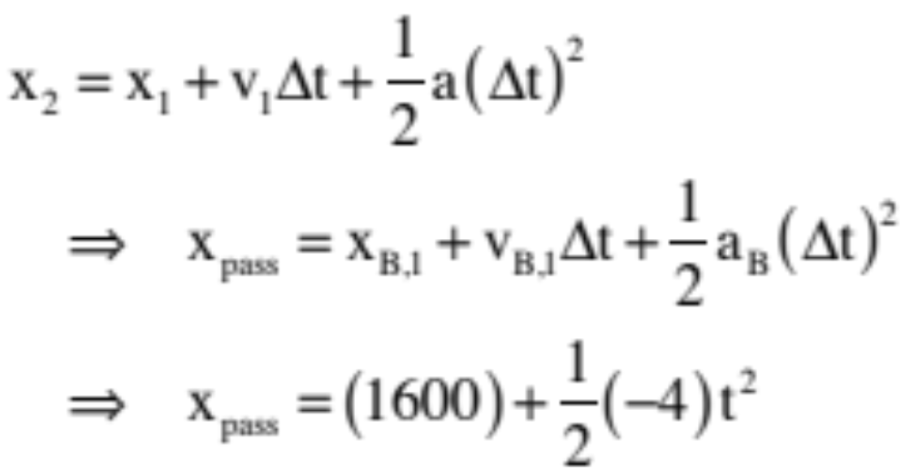
The Two car problem: parts a+b
2. We’re looking for displacement of car A, essentially, so we need an equation for car A:
We also need an equation for car B:
27.)

Slide 28

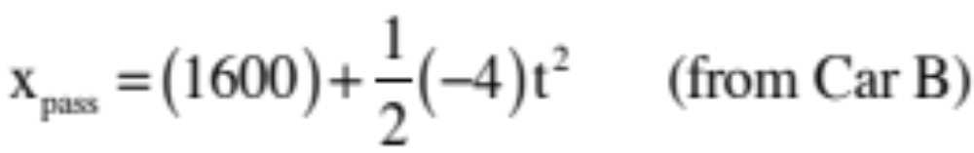
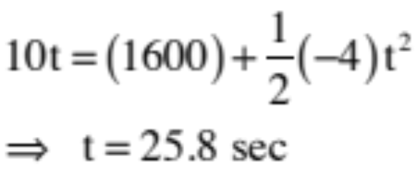
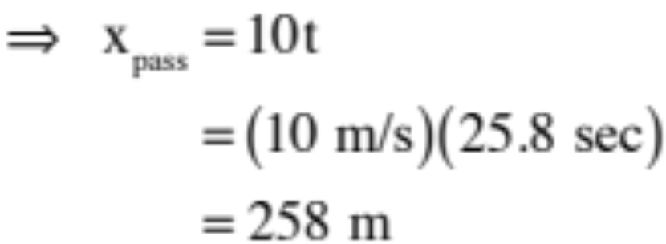
The two-car problem: parts a+b
3. Now we combine the equations to solve simultaneously:
Equating:
Now, find how far A travels in that time:
28.)

Slide 29
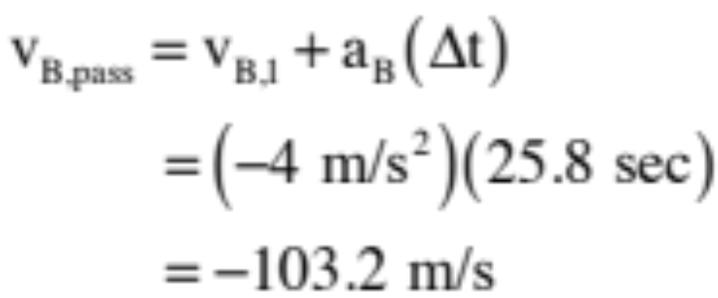
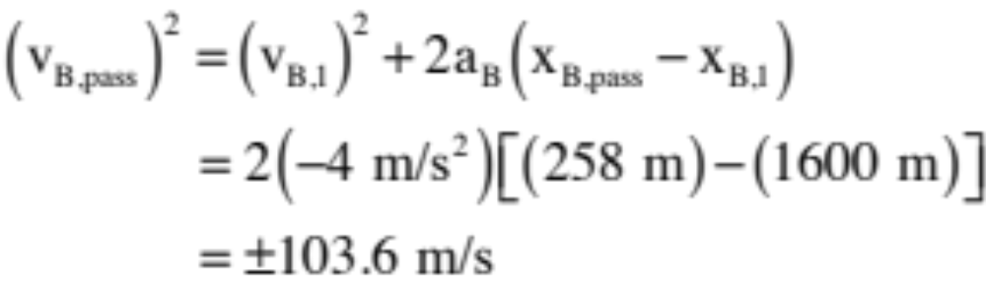
The two-car problem: part C
c) how fast is car B moving when they pass?
We now know the time in which they travel, so for car B:
OR
and you have to put the sign in manually . . .
29.)

Slide 30
Why all these steps?
The “two-car” problem is a great example for why you should be methodical in your solutions and follow all these steps.
  You are less like to make a silly mistake or get lost.
  Your reader is less likely to be confused or be unable to follow your work.
  Both result in more likely correct answers (and points)
Bottom line: even on simple problems, practice all steps of this technique, because when things get nasty, it’s the thing that allows you to make progress even when feeling confused!
30.)

