Slide 1
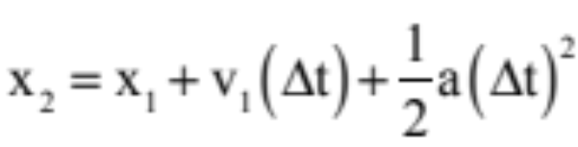
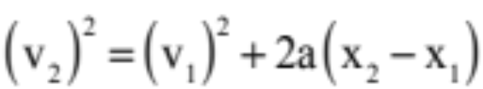

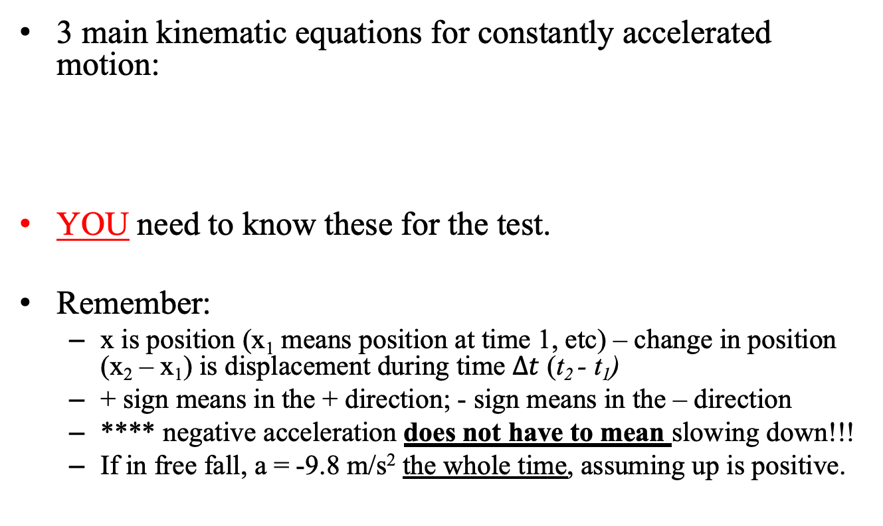
Using kinematic equations
3 main kinematic equations for constantly accelerated motion:
YOU need to know these for the test.
Remember:
  x is position (x₁ means position at time 1, etc) – change in position (x₂ – x₁) is displacement during time $∆t$ (t₂ - t₁)
  + sign means in the + direction; - sign means in the – direction
  **** negative acceleration does not have to mean slowing down!!!
  If in free fall, a = -9.8 m/s² the whole time, assuming up is positive.

Slide 2
How to tackle complex problems
Sometimes you’ll end up with two objects, multiple equations, and multiple unknowns, or just multi-stage problems that take some thinking. It’s good to know how to set up and solve these types of equations.
This is where drawing a picture, indicating your axes, and keeping consistent signs is critical!

Slide 3
Problem 2.53 from XtraWrk
A rocket is launched with 50 m/s of initial velocity straight upwards. It continues to accelerate at 2 m/s² until it reaches a height of 150 m.
  What happens after the propulsion cuts out at 150 m height?
  What is the rocket’s maximum height above the ground?
  How much time does it take to reach that height?
  What is the total time of flight for the rocket?
Solutions in the XtraWrk problems.

Slide 4
2.50) Sandbag and balloon
A sandbag is released from a hot-air balloon that is descending at a constant 1.5 m/s. After 2.0 seconds:
  How fast is the sandbag traveling?
  How far below the hot-air balloon is the mailbag?
  How would parts (a) and (b) change if the balloon had been rising at 1.5 m/s?
Solutions in the XtraWrk problems.

Slide 5
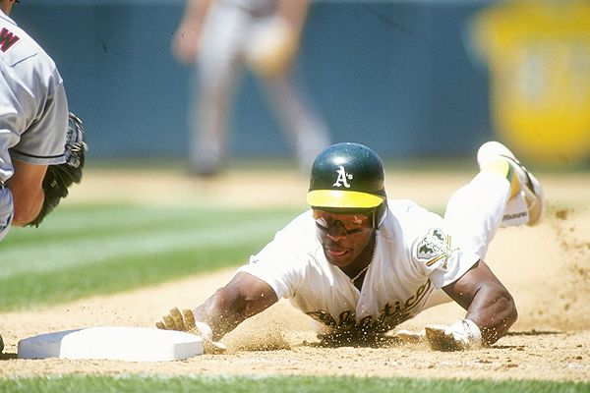
”quiz” yourself
Rickey Henderson, baseball's record holder for stolen bases, approaches third base. He dives head-first, hitting the ground at 6.75 m/s and reaching the base at 5.91 m/s, accelerating at -5.11 m/s/s. Determine the distance Rickey slides across the ground before touching the base.
Solutions in the XtraWrk problems.
AP

Slide 6
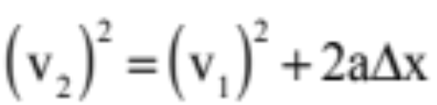
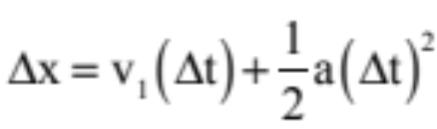
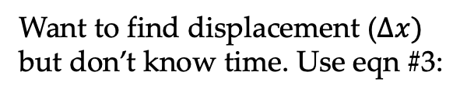



SOLUTION
a = -5.11 m/s/s
X₁ = 0 m
v₁ = 6.75 m/s
X₂ = ??
v₂ = 5.91 m/s
Want to find displacement ($∆x)$ but don’t know time. Use eqn #3:
THEN use that time in the displacement equation:
(5.91)² = (6.75)² + 2(-5.11)($∆x$)
$∆x$ = 1.04 m
= (6.75)(0.164...) + ½ (-5.11)(0.164…)²
=1.04 m
OR you could solve it this way:
Find the time for the slide using velocity equation:
5.91 = 6.75 + (-5.11)t
t = 0.164… sec

Slide 7
Poppers lab (if time)
Your task: determine the launch velocity and the acceleration required for the party popper to fly as it does.
  You may use a meter stick but no other equipment (e.g. no timers).
  Each group needs to turn in a paper that has:
    A sketch of the situation, including coordinate axes and all known values before data were taken
    Any measurements that were taken
    Your analysis (e.g. equations used and work to find the two values above, including blurbs to explain your reasoning)
  Turn in one sheet per two-student team; this is worth 10 lab points

