Slide 1
General announcements

Slide 2
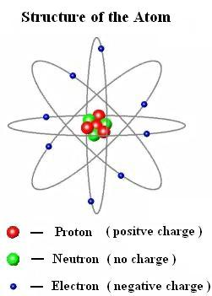
Where does electricity come from?
Compare the three atomic particles in terms of mass, charge, size, and location?
  Electrons are negatively charged, found in outer ”shells” of atom, are TINY compared to protons/neutrons
  Protons are positively charged, found in nucleus, about 2000x more massive than electrons
  Neutrons are the same mass and location as protons, but are electrically neutral. So we don’t care about them (here).
Protons and electrons, while different sizes, have equal magnitudes of charge.
  The charge on an electron or a proton is 1.602 x 10⁻¹⁹ Coulombs
http://www.discoverhover.org/infoinstructors/guide15.htm
2.)

Slide 3
Charge
Because electrons and protons have equal charge, they can cancel out!
  An excess of electrons makes an object electrically negative
  A deficiency of electrons makes an object electrically positive
    Why don’t we say “an excess of protons” even though it’s mathematically true?
Opposite charges attract; like charges repel. You probably knew that already.
When have you experienced charges attracting? In what situations has it happened, and what did you observe?
Protons stay in the nucleus - they don’t move around. Electrons are the things moving between atoms, so we talk about charge in terms of the stuff that’s actually being added or subtracted.
3.)

Slide 4
Atoms and bonding
(aka some chem review)
How do atoms interact to form bonds? What does it have to do with charge, and electricity?
  (hint: what types of materials are usually associated with electricity, and what might their atomic structure have to do with it?)
Atoms share electrons, found in the valence shell (outermost shell). Electrons can move from shell to shell by absorbing or releasing energy.
Metals tend to have at least one electron that is far away from the nucleus (relative to other electrons). That is, a relatively empty valence shell.
Non-metals tend to have no electrons that are far away from the nucleus, relative to other electrons. That is, a mostly full valence shell.
Noble gases have completely filled valence shells.
https://i.ytimg.com/vi/wRNxrxXkCRQ/sddefault.jpg
How might these electrons configurations dictate electric behavior?
4.)

Slide 5
Atoms and bonding
You (hopefully) remember from chemistry that atoms can form covalent bonds (filling valence shells by sharing electrons), ionic bonds (combining ions, which have gained/lost electrons and want to even back out), or metallic bonding (this might be new).
  Metalic bonding is like covalent bonding in the sense that there is sharing, but instead of just sharing valence electrons with neighboring atoms, valence electrons are shared with ALL the atoms in the metal. This means they can move around freely. We call that a conductor.
http://www.bbc.co.uk/schools/gcsebitesize/science/add_ocr_gateway/periodic_table/metalsrev2.shtml
5.)

Slide 6
Conductors vs Insulators
So we know conductors allow electrons (electricity) to flow freely.
Insulators, logically, don’t. Why?
  Insulators generally have tightly-held valence electrons - they don’t move around very easily. Most insulators are covalently bonded (sharing electrons closely).
  This also explains why insulators tend to be more rigid (e.g. plastic, wood) vs. metals which are malleable and ductile (can be made into wire and stretched without breaking when heated, etc).
6.)

Slide 7
Electrostatics
”Electricity” can be broken into two major areas: electric current (circuits and all the related fun stuff we’ll do in a few weeks), and electrostatics (aka static electricity).
Electrostatics is all about how charges interact with each other and with other objects.
Some questions to ponder:
  How do objects acquire a net charge (+ or -)?
  Why don’t they stay that way forever?
  If you touch a charged object, what can happen? Why?
  Do certain situations/environments make that more or less likely? Why?
7.)

Slide 8
The Great Electric-Spark Scavenger Hunt
Bring me electricity!
http://paulsemel.com/wp-content/uploads/2014/08/Young-Frankenstein-40th-Anniversary-main.jpg
8.)

Slide 9
The Great Electric-Spark Scavenger Hunt
This is a mini-lab (like an “island”).
  You need to go out into the world and capture electric charge, bring it back, and use it to shock me (in a minor, temporary fashion - no trying to fry me into a charcoal brick).
  You can use other objects to capture charge, or assist you in doing so, within reason.
  No generators, batteries, large objects, dangerous objects, etc.
  Use your head!
You will have a few minutes to collect your charge (if necessary) and bring it to me!
  If you don’t succeed the first time, you can think about it and try again before the week is up…
Ready…set…go!
9.)

Slide 10
Electrostatics in action!
Classic demo: a metallically-coated pith ball (a small styrofoam-ish ball) hangs from a thread. A charged rod (we’ll talk about how that happens in a bit) is brought nearby. What happens? Why?
http://demoroom.physics.ncsu.edu/html/demos/116.html
10.)

Slide 11
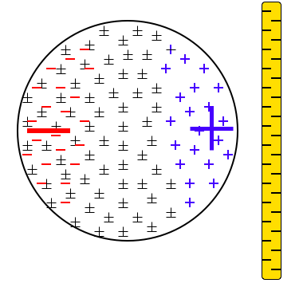
Metallic pith ball explained
Start with the neutral pith ball (note how the charges are uniformly distributed throughout the ball’s volume). A negatively-charged rod is brought close by. What happens?
The electrons in the metallically bonded structure will be repulsed by the electrons on the rod. As they can move, they will migrate away from the rod leaving the right side of the sphere electrically positive and the left side electrically negative. The net effect will be an attraction between the two structures.
11.)

Slide 12
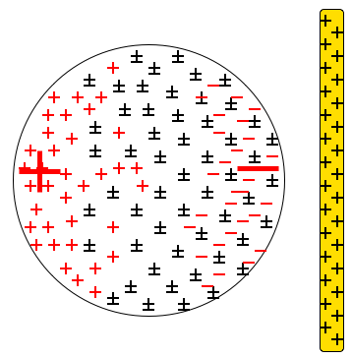
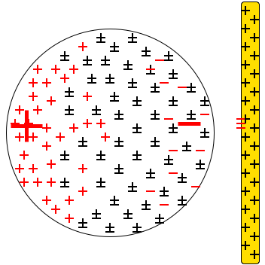
Metallic pith ball explained
The same thing will happen with a positive rod, except the rearrangement of charges in the pith ball will be opposite.
This rearrangement of charge is called (charge) polarization.
What happens if the rod touches the ball?
When the ball touches the rod, electrons will jump to the rod. Because the rod is an insulator, they will stay where they land, leaving the rod still electrically positive. The pith ball, though, having lost electrons, will have more positive charge than negative. The negative will still be closer to the rod, but the increase in positive charge on the ball will govern and the ball will be repulsed.
12.)

Slide 13


Non-metallic pith ball
What if the pith ball has no coating? What will happen?
The electrons in the ball can’t migrate as they did in the conductor because the bonding is covalent, but that doesn’t mean the charged rod won’t affect them!
Zooming into an atom at the edge of the pith ball, and pretending it only has one proton and one electron (for simplicity)…
What we’d find would be the proton fixed in the nucleus with the electron orbiting at somewhere around 5,000,000 miles per second (remember, the atom is only .0000000001 meters across--one angstrom).
C
A
nucleus
What’s important to note is that the electron is at A as much as often as it is at B, and at C as often as at D, etc. This means the AVERAGE position of the electron over time is at the center with the proton. That’s why normal atoms are electrically neutral. Their electrons are, on average, electrically centered on the positive proton.
B
D
13.)

Slide 14

Non-metallic pith ball
So what happens when a negatively charged rod comes in from the right? The electron in the atoms of the ball spend more time on the left side of the atom as they try to get away from the negative charge on the rod.
Electrons spend more time over here thereby shifting the negative charge center to the left
In other words, you get a charge polarization!
Thus, when the rod comes nearby, even though the electrons themselves can’t migrate to the left, each individual atom will have its electrons spend more time on the left side vs. the right (away from the negatively-charged rod), effectively producing a polarization and causing the pith ball to be attracted to the rod!
14.)

Slide 15
Van der Waal force
When the non-metallic pith ball is attracted to the rod, it might touch - but that attraction (probably) won’t be enough to rip electrons and transfer them like before. Thus, the pith ball will ”stick” to the rod -- this attraction is due to a Van der Waal force.
  Same thing happens if you stick a charged balloon to a wall - it will stick for awhile, and eventually float down to the ground as it loses the attractive force.
Speaking of which, back to my earlier question: why do things eventually lose charge and become neutral again?
  Grounding! Electrical grounding happens when electrons can freely flow to/from an object, usually causing it to neutralize.
  Water molecules in the air can also pluck charge off a structure, which is why static electricity is worse on dry days but limited on rainy days!
15.)

Slide 16
How do objects become charged in the first place?
There are three major methods of charging:
  Charging by friction
    This is the one you have definitely experienced many times.
  Charging by conduction
    What it sounds like
  Charging by induction
    A weird one…”no touching” required (sort of…)
16.)

Slide 17
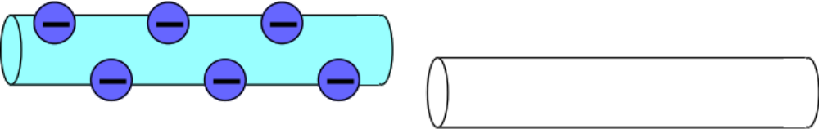
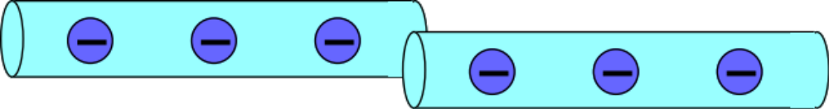
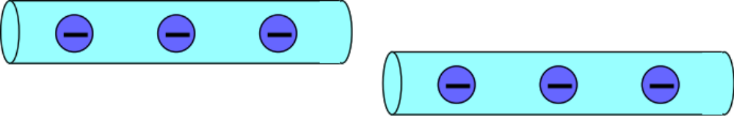
Mr. White’s Charging by Conduction Slide 1
“Charging by conduction” occurs when a charged conductor (metal) touches a neutral conductor: some free electrons pass from one object to the other (it is ALWAYS electrons that move . . . ).
17.)

Slide 18
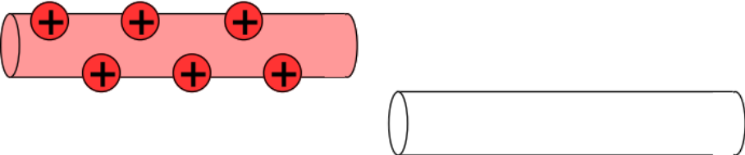
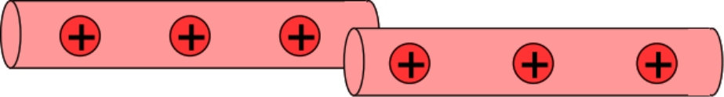
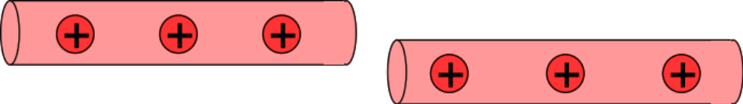
Mr. White’s Charging by Conduction Slide 2
Note 1 from Fletch: The left-hand conductor is positive because electrons have been previously removed.
Note 2 from Fletch: The right-hand rod is electrically neutral.
Note 2 from Fletch: As it is always electrons that move, in this situation, electrons are leaving the right-hand conductor (leaving it electrically positive) and going to the left-hand conductor (making it less electrically positive).
Note 3 from Fletch: If both rods are conductors and they are identical, the charge will distribute evenly (as shown) between the two.
18.)

Slide 19
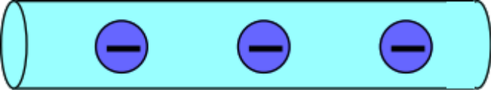
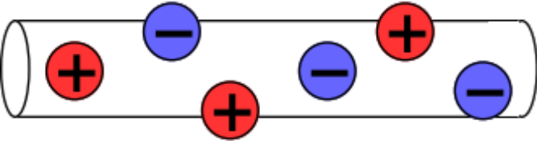
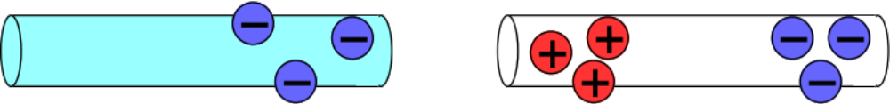
Mr. White’s Charging by Induction Slide 1
“Charging by induction” occurs when a charged object is brought near a neutral conductor.
19.)

Slide 20
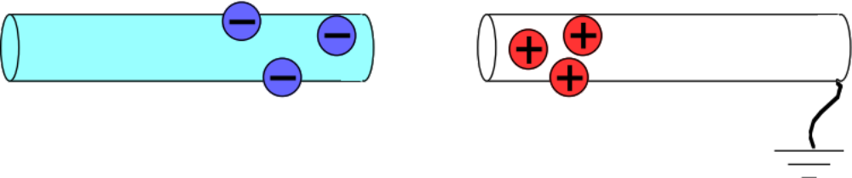
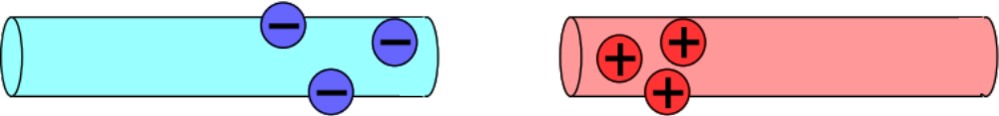
Mr. White’s Grounding Slide
The term grounding refers to connecting a conductor to the literal ground, ie. the earth. The earth readily accepts or gives up electrons—it has plenty to spare—so grounding a conductor allows for the flow of charges. What effect this has depends on the situation.
20.)

Slide 21
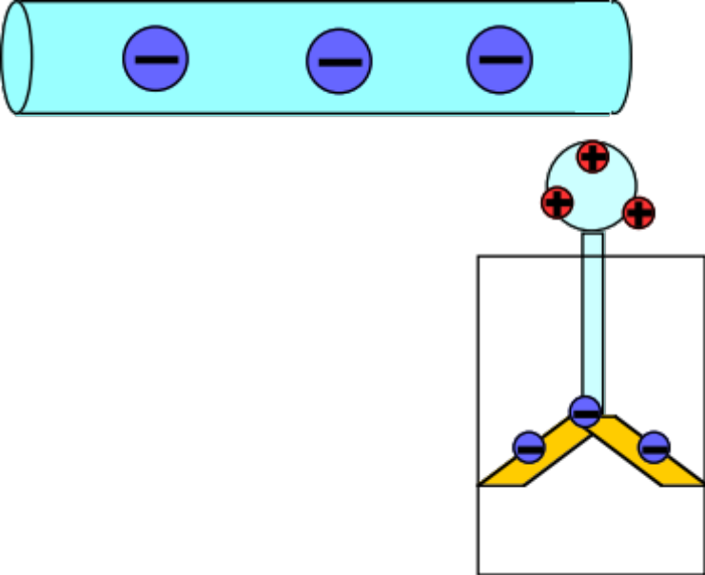
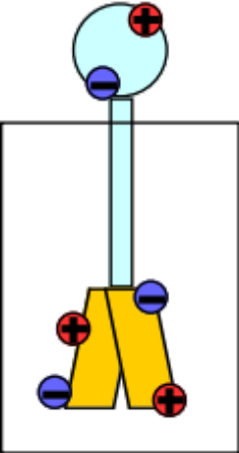
Mr. White’s Electroscope
The electroscope is a simple device designed to detect the presence of electric charges. Movable leaves (of gold?!) connected to a metal ball separate when a charged object is brought near, or touched to the ball. But why?
21.)

