Slide 1
General announcements
1.)

Slide 2
How do objects become charged in the first place?
There are three major methods of charging (this should be review):
  Charging by friction
    This is the one you have definitely experienced many times.
  Charging by conduction
    What it sounds like
  Charging by induction
    A weird one…”no touching” required (sort of…)
2.)

Slide 3
Some basic definitions
We have some familiar, and some new terminology, symbols, and units here:
  Forces are still measured in Newtons, and a net force still causes an acceleration. Nothing new there.
    Newton’s Laws in general still apply…
  Charge is measured in Coulombs, but its symbol (in equations) is q
    You might see this as little q or big Q. There’s a reason for this (we’ll talk about it), but a q of either size represents charge.
We’ll be adding more as we go along, so if ever you see a symbol or unit that you don’t recognize, ask before we get too much farther along!
3.)

Slide 4
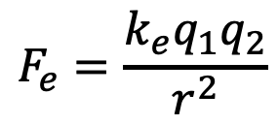
Electric interactions
We’ve seen plenty of times that charged objects interact by attracting or repelling. This means they exert forces on each other!
What might affect the magnitude and/or direction of that force?
Charles-Augustin de Coulomb (1736-1806) used experiments to come up with an equation that defines electric force…so he gets a law named after him. Lucky him. He found:
  Electric force is directed along a line joining two charged particles
  The magnitude is directly proportional to the product of the magnitudes of the two charges (q₁ and q₂) and inversely proportional to the square of the distance between them (r²)
  Or, in equation form:
$$F_{e}=\frac{k_{e}q_{1}q_{2}}{r^{2}}$$
where k_{e} is a constant = 9.0 x 10⁹ Nm²/C²
4.)

Slide 5
Electric force vs. gravitational force
The form of Coulomb’s Law is very similar to Newton’s law of universal gravitation!
  Both deal with forces that are inversely related to the square of the distance between two object (so they’re called “inverse square laws”)
  Both are proportional to the product of some aspect of the objects (charge vs. mass)
  Both have a constant in front that makes everything work out
Which is stronger?
At the atomic level, electric force is way stronger - for a hydrogen atom, the electrostatic attraction between the electrons and proton is 10²³ times stronger than the gravitational pull between them!
At larger scales, it’s rare to have enough charge to exert a strong force, so gravity plays a bigger role at the macroscale.
5.)

Slide 6





Example - 15.10
Calculate the magnitude and direction of the Coulomb force on each of the three charges shown.
6.)

Slide 7

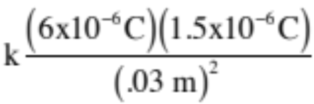


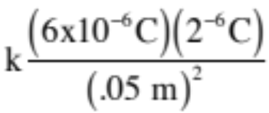
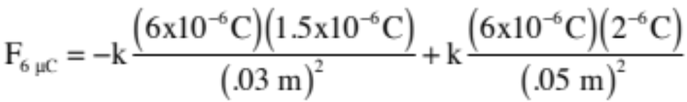
We define the +/- directions, just like before. Here, let’s take left to be negative and right to be positive.
Notice the sign of the force on each charge is due to whether you are seeing attraction or repulsion between the two interacting charges, not because a particular charge is positive or negative. THAT IS, THERE ARE NO NEGATIVE SIGNS IN THE “q” PART OF THE EQUATION!
7.)

Slide 8



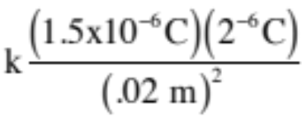
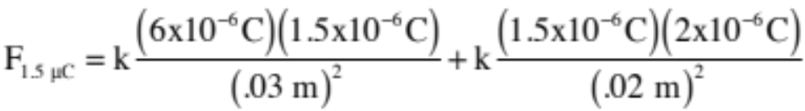

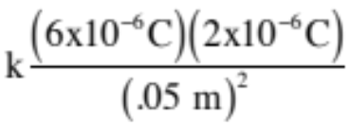

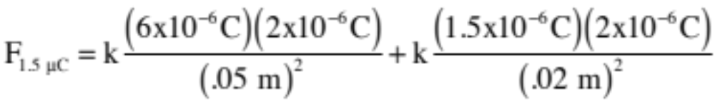
This is the same magnitude but opposite direction as the force by the 1.5 𝝁C on the 6 𝝁C charge - N3L!
8.)

Slide 9





Example - 15.11
What’s the (net) force on the charge at the origin?
9.)

Slide 10
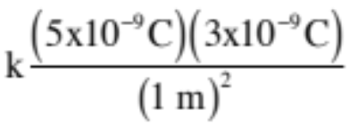
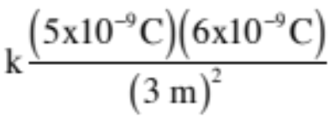
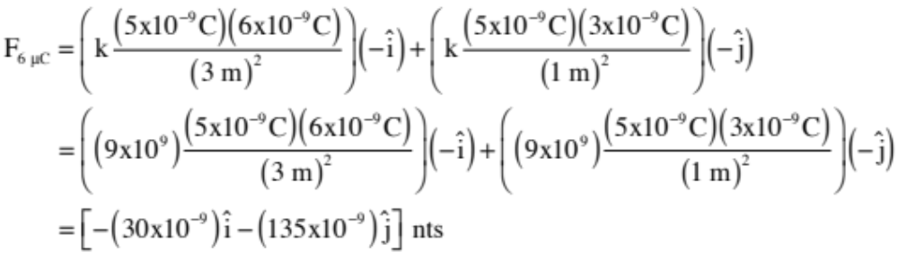
N
10.)

Slide 11
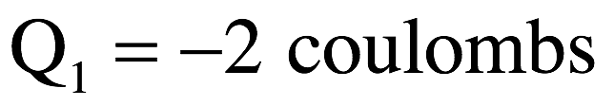
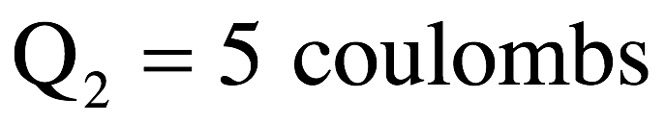
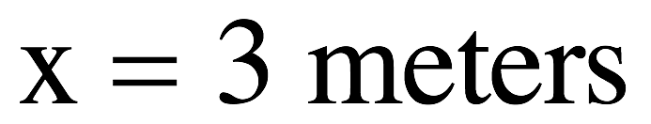
Where to put a charge?
Consider the two point charges shown below. Where in that field will the force on a positive test charge (q) be zero? (And how would that change if the test charge had been negative?)
11.)

Slide 12
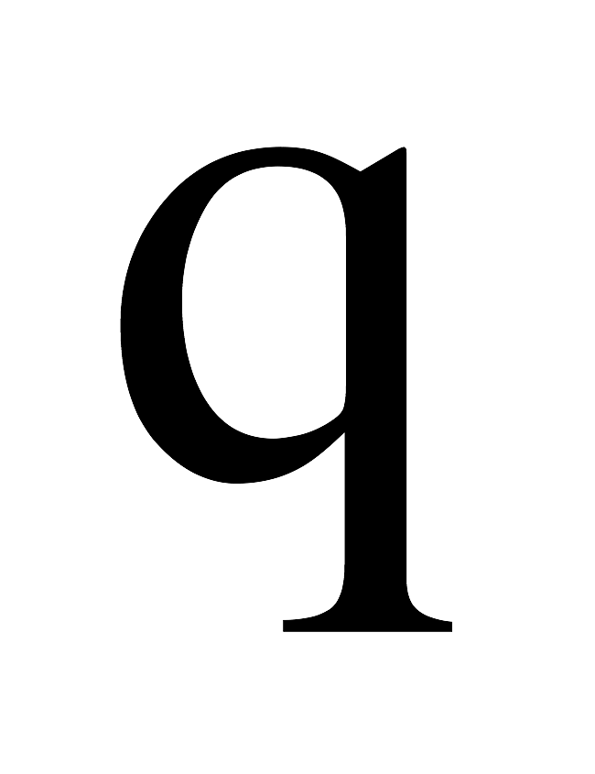
There are three possible “places” you might put the test charge. Along the axis and to the left of the -2 Coulomb charge, along the axis and to the right of the 5 Coulomb charge or on the axis and in-between the two charges.
Hopefully you can see that in between won’t do in any case. The –2 Coulomb charge will attract a positive test charge motivating it to accelerate to the left, and the 5 Coulomb charge will repulse it motivating it to accelerate, again, to the left. There is no place in-between where the net acceleration will not be to the left, so this region won’t do.
At no place will the net force be zero.
12.)

Slide 13
Putting the test charge to the right of the 5 Coulomb charge will get our forces in reasonable directions—that is, the -2 Coulomb charge will try to accelerate the test charge to the left (they will attract) whereas the 5 Coulomb charge will try to accelerate the test charge to the right (they will repulse). The problem here is that because the larger 5 Coulomb charge will always be closer to the test charge than will the -2 Coulomb charge, the 5 Coulomb charge will always dominate and the test charge will always feel a net force to the right.
At no place will the net force be zero.
13.)

Slide 14
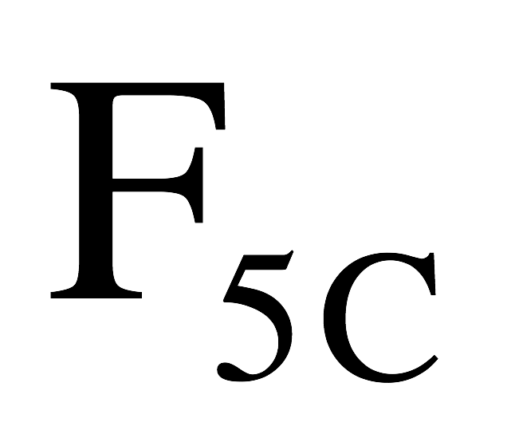
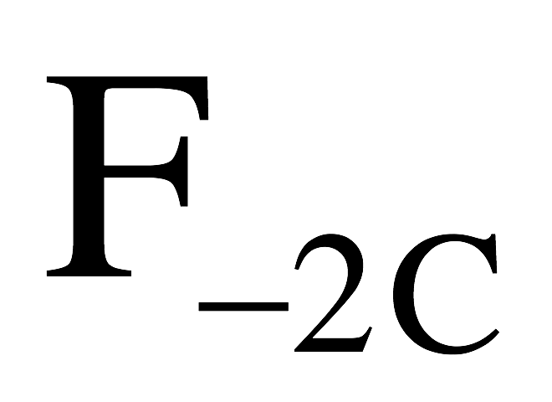
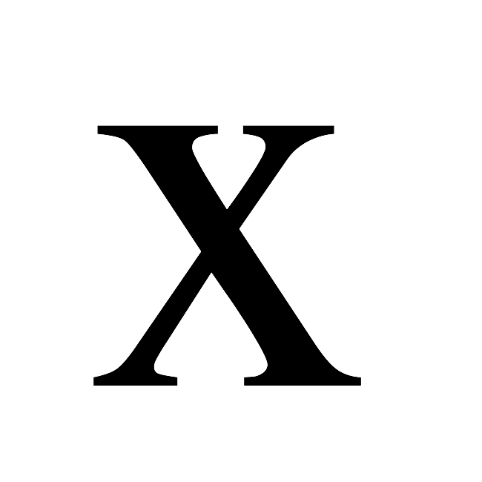
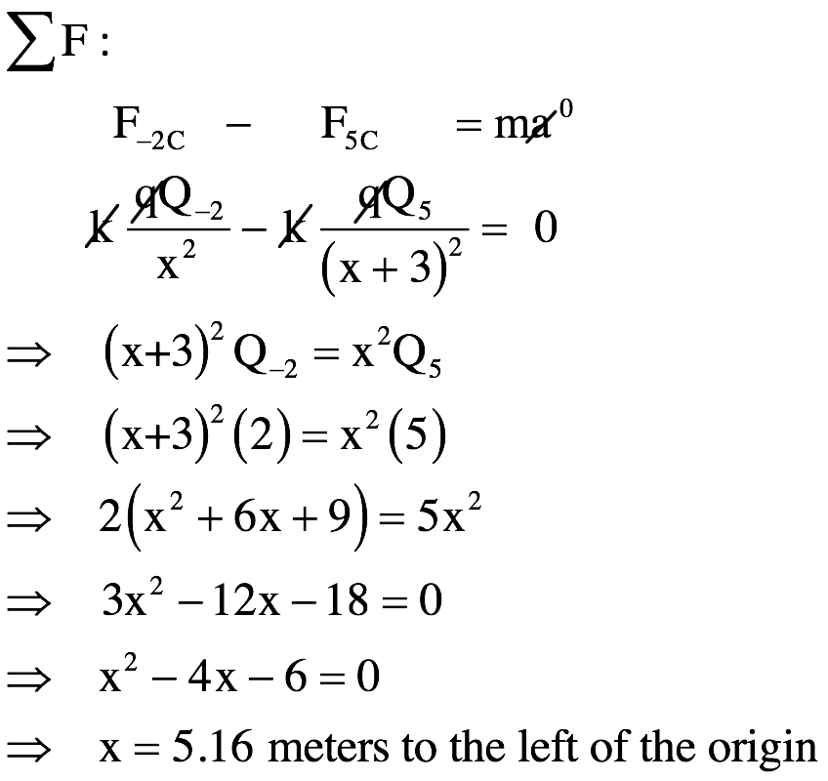
This pretty much leaves us with “along the axis and to the left.” Defining a distance “x” (assumed positive) to identify where the force on the test charge is zero, we can use Coulomb’s law and the geometry we have in the problem to determine what x will do the job.
Using Newton’s Second Law (look to the right), we can write:
14.)

Slide 15
What if the charge was negative instead?
In between still doesn’t work: q would be repelled by the charge at the origin and attracted by the 5C charge, so it would accelerate right.
To the right still doesn’t work, either: it would be closer to the 5C charge and be attracted to the left; the -2C charge would be to far away to counter it.
So the only option is to the left…and the location would be exactly the same. Why? Because the magnitude of F depends on things that haven’t changed: the magnitude of the charges involves and their separations. All that would change would be the directions of the arrows (which one was pushing left vs. right).
15.)

Slide 16
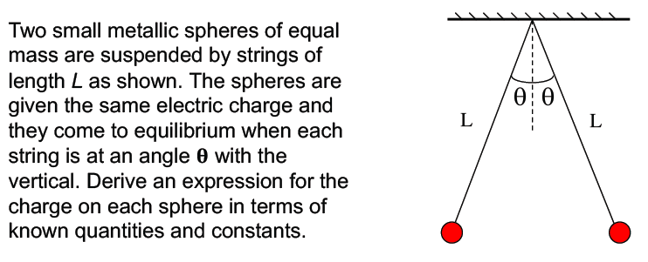
Problem 15.15
See solution on class Website
16.)

