Slide 1
General announcements
1.)

Slide 2

Electric Fields Lines
Recapping: a method to visualize what an electric field looks like is wrapped up in what are called electric field lines. You saw an example of field lines when I introduced the idea of an electrical disturbance around a charge (see figure to the right). The lines are designed to tell you very specific information about the charge configuration:
electric field lines for positive point charge
As electric field lines move away from positive charge and toward negative charge (remember, the direction of an electric field is defined as the direction a positive test charge would accelerate if released at the point of interest), electric field lines always leave positive charges and enter negative charges.
The number of line that leave a charge is proportional to the size of the charge.
The distance between lines gives you a relative feel for the strength of the field at a particular point—the closer the lines, the stronger the force. That means a constant E-fld will have field lines that are parallel and equidistant apart.
The lines gives you a relative feel for the direction of the field at a given point, and skirt areas where an E.fld is zero.
constant E-fld
2.)

Slide 3
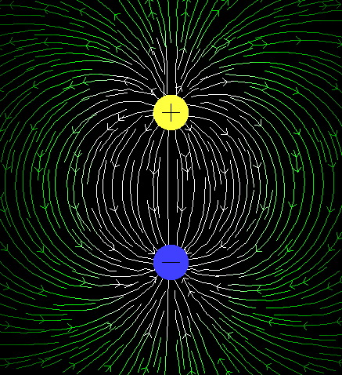
(courtesy of Mr. White)
3)

Slide 4
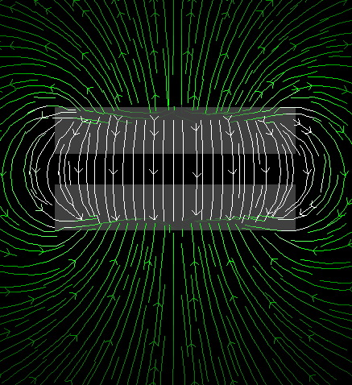
(courtesy of Mr. White)
4.)

Slide 5
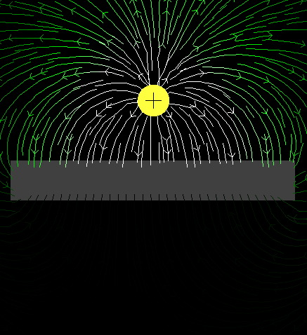
(courtesy of Mr. White)
5.)

Slide 6
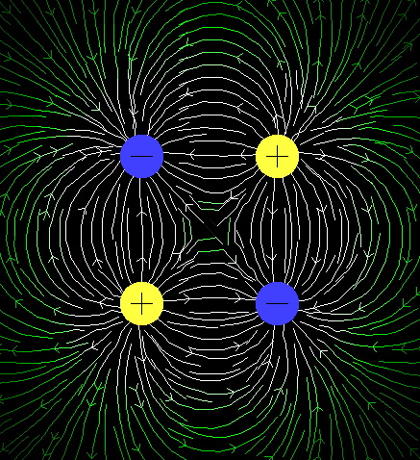
(courtesy of Mr. White)
6.)

Slide 7
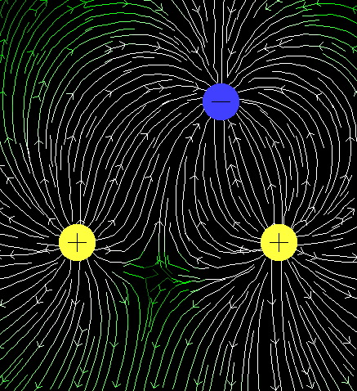
(courtesy of Mr. White)
7.)

Slide 8
Conductors in electrostatic equilibrium
Consider a neutral, metal conductor.
  What is true about some of the electrons in that conductor?
If no net motion of charge occurs in that conductor, it’s in electrostatic equilibrium. (This occurs when a conductor is isolated and insulated from the ground). This means:
  The electric field is zero everywhere inside the conductor.
    If not, what would happen?
  Any excess charge on that conductor is entirely on its surface.
    If not, what would happen?
  The E field just outside a charged conductor is perpendicular to its surface.
    If not, what would happen?
  If irregular, charge accumulates at sharp points (where the radius of curvature is smallest).
    Let’s look at this…
They’re free to move within the material - remember metallic bonding?
The field would cause charge to move - not equilibrium!
They’d repel and move towards the surface anyways!
There would be a surface-parallel component, which would make charges flow…not equilibrium!
8.)

Slide 9
Shielding
When free charge is placed on a conductor, electrical repulsion will motivate electrons to move as far away from other electrons as possible. Consequence:
Force electrons onto a flat conducting surface. At some point, the free electron population already on the surface will provide such a large repulsive force that no additionally placed electrons will make it onto the surface. When that happens, the electrons will be evenly distributed over the surface.
surface charge density
evenly distributed
Bend the surface and you can force MORE electrons on, increas-ing the surface charge density. Why? Because there is now material between the electrons, diminishing their repulsive effect on distance electrons. This phenomenon is called SHIELDING.
surface charge
density increased
Oddly shaped conductors will have different charge densities, depending upon the severity of their curvature.
charge density
really high
The extreme: the lightning rod, a pointed piece of metal insulated from a house. It accumulates HUGES amount of charge at its end point, attracting potential lightning strikes away from the house.
charge density
relatively low
9.)

Slide 10
Irregularly-shaped conductors
Consider the object below. Charges on the flatter (left) end exert repelling forces, which are close to parallel to the surface, so the charges move out until repelling forces from other charges bring them to equilibrium.
Charges on the pointier (right) end exert similar repelling forces, but a much smaller component is parallel to the surface, so the charges don’t move much before being brought to equilibrium.
The result? Charges gather more densely on pointier ends, to keep the electric field oriented perpendicular to the surface.
This is the principle behind lightning rods!
10.)
https://courses.lumenlearning.com/suny-physics/chapter/18-7-conductors-and-electric-fields-in-static-equilibrium/

Slide 11
Flux
What does “flux” mean? Can you give examples?
Electric flux is only one type of flux
  There is also magnetic flux, which we’ll get to later
To understand flux, we need to look at what kind of boundary/surface we’re talking about, and what the thing is that’s passing through it!
Most generally, “flux” means something passing through a boundary, like an “influx” of people at a border, or water flowing (actually where the word comes from) through a cross-section of a pipe.
11.)

Slide 12
Electric Flux
Imagine that there are lots of electric field lines emanating from the board/this screen and pointing out towards you.
Then imagine that you have a piece of paper that you hold up in front of you.
  If you orient the paper parallel to your screen, so that its flat face is facing the screen, what do the electric field lines do?
  If you orient the paper perpendicular to your screen, so that the flat face is at a right angle and only the skinny width of the paper faces the screen, what do the field lines do?
The field lines pass through the paper, in one side and out the other.
Pretty much none of the field lines pass through the paper, because they’re parallel to it.
12.)

Slide 13

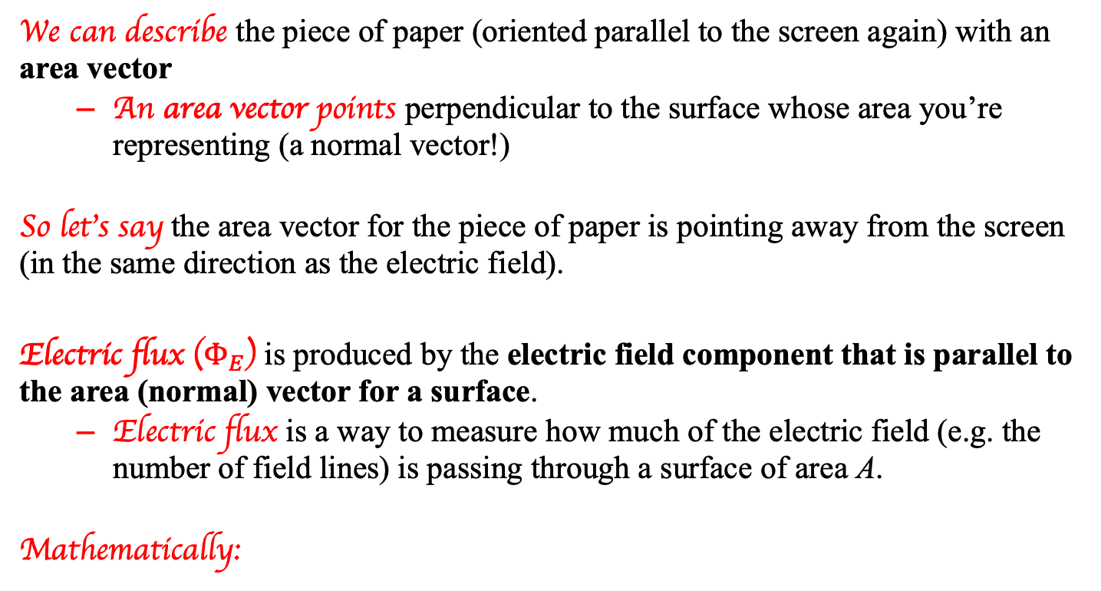

Electric flux
We can describe the piece of paper (oriented parallel to the screen again) with an area vector
  An area vector points perpendicular to the surface whose area you’re representing (a normal vector!)
So let’s say the area vector for the piece of paper is pointing away from the screen (in the same direction as the electric field).
Electric flux ($Φ_{E}$) is produced by the electric field component that is parallel to the area (normal) vector for a surface.
  Electric flux is a way to measure how much of the electric field (e.g. the number of field lines) is passing through a surface of area A.
Mathematically:
$$Φ_{E}=\vec{E}∙\vec{A}=EAcosθ$$
The angle between E and A
Units: $N∙m^{2}/C$
13.)

Slide 14
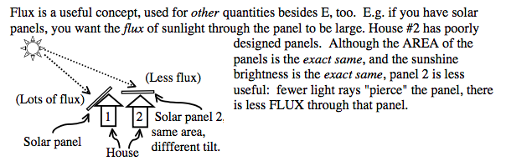
A helpful analogy
Imagine you are outside on the senior patio on a beautiful sunny day. You step out from under the trees into the sunlight. What happens?
  The sun’s rays hit you and warm you up!
What could be done to increase the amount of heat you absorb?
  Expose more surface area to the sun (this is like increasing the area through which the electric field lines pass)
  Increase the intensity of the sun (this is like changing the magnitude of the electric field)
  Turn so the sun’s rays hit you straight on (perpendicular!)
14.)
https://www.colorado.edu/physics/phys1120/phys1120_fa06/notes/notes/Ch24lect.pdf

Slide 15
That “cos𝛉” thing…
15.)
http://slideplayer.com/slide/5014369/

Slide 16
Direction of flux
Imagine a cube as shown below, in a uniform electric field pointing to the right. Each face of the cube has an area, so we can look at the electric flux through each one.
The top, bottom, far, and near faces are all oriented parallel to the electric field - so the electric flux through each of those faces is 0.
The right face has a normal vector that points to the right (outward), which is parallel to the electric field. Thus, the angle between them is 0, and since cos(0) = 1, the flux through the face is EA
The left face has a normal vector that points to the left (outward), which is 180 from the electric field direction. Cos(180) = -1, so the flux through that face is -EA
Bottom line: for a closed surface, flux lines passing into the object are negative, and flux lines passing out of the object are positive.
http://online.missouri.edu/exec/data/courses/2681/public/lesson01/image16.gif
16.)

Slide 17



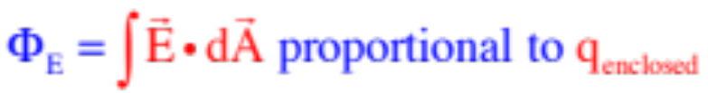
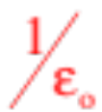
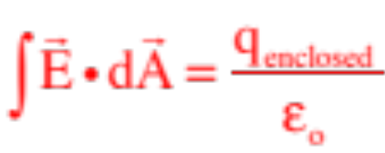
Gaussian surface
So let’s assume a point charge q. is surrounded by an imaginary surface. What can we do with that situation?
Gauss made the simple but powerful observation that there would be an electric flux through the closed surface, called a Gaussian Surface, as long as there was charge enclosed inside the surface.
What’s more, he surmised that the amount of flux would have to be proportional to the amount of charge enclosed inside the Gaussian surface. Noting that the amount of electric field moving through the differential area dA is the component of E along the line of dA (or the dot product of the two vectors), and noting that if we do this process for all the differential areas on the surface and sum (that is, integrate), we can write gauss’ Law as:
The proportionality constant that made the relationship into an equality was the inverse of our old friend, the permittivity of free space (i.e., ), so Gauss’s Law is written as:
17.)

Slide 18
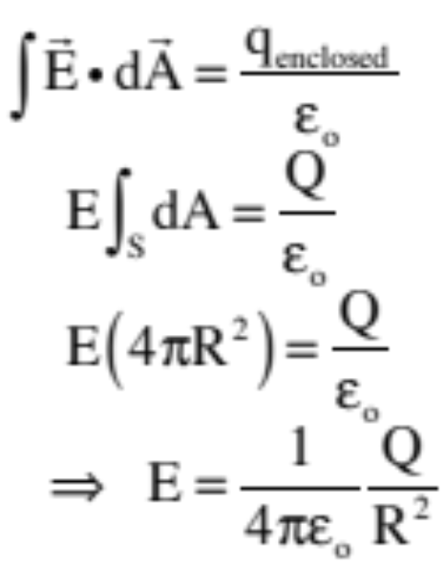
Gaussian surface
The big point for the Honors class is that for an electric field to exist at a point on a close surface, there MUST be charge enclosed inside the surface.
How is this useful? You won’t be tested on this, but let’s say you have a point charge sitting in space. You put a spherical Gaussian surface around the charge with the charge at the center. The magnitude of the electric field will be the same at every point on the surface, so it can be pulled out of the integral. The angle between the dA (always defined as outward from the surface) and E evaluated on the surface will always be zero, so the cosine of the angle between the two vectors in the dot product will be one). With the integral of dA simply being the sum of all the dA’s, or the surface area of the sphere, the math becomes:
You’ve just DERIVED the electric field function for a point charge!!!
18.)

