Slide 1
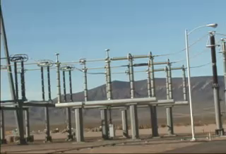
CHAPTER 25:
Electric Potentials and Energy Considerations
courtesy of
Mr. White
1.)

Slide 2



Electric Potential Fields
You should now be comfortable with the idea that a charge configuration will produce an electrical disturbance in its vicinity, and that knowing how much force per unit charge is provided to the region
around the field-producing charge (whether there be a secondary charge is in the region experiencing the force or not) in the form of an electric field is a useful idea to entertain.
It’s time to consider another related field, one associated with energy.
If we release a test charge q (or any charge, for that matter) in the electrical disturbance generated by our field-producing charge, the test charge WILL ACCELERATE.
will
accelerate,
has energy
2.)

Slide 3
Why will the test charge accelerate?
Because there is POTENTIAL ENERGY available to the test charge as it sits in the field.
will
accelerate,
has energy
We could measure the amount of potential energy the test charge has, but that would be quite limiting (the
information would be applicable only to that particular test charge).
The clever thing to do would be to mimic what we did with electric fields. We could measure the test charge’s potential energy while in the field at a particular point, then divide by the size of the test charge to determine how much POTENTIAL ENERGY PER UNIT CHARGE is AVAILABLE at the point (whether the test charge is there to feel the effect or not).
This quantity, with units of joules per coulomb (or volts), is called the ABSOLUTE ELECTRIC POTENTIAL at the point of interest.
3.)

Slide 4

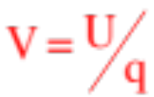
An ELECTRIC POTENTIAL FIELD, measuring the amount of potential energy per unit charge AVAILABLE at all points in the region of a field-producing charge, can be (and is) associated with any charge configuration.
electrical
disturbance
potential
field exists
An ELECTRIC POTENTIAL FIELD exists wherever there is charge (and, for that matter, wherever there is an electric field). For the potential fields to exist, there doesn’t need to be present a secondary charge to feel the effect. And because voltage-flds tell us how much energy is available PER UNIT CHARGE at a point, the electric potential field V is defined as:
Important note: As an absolute electric potential is a function of the charge q that generates the field, a negative charge will produce a NEGATIVE absolute electric potential and a positive charge will produce a POSITIVE absolute electric potential!
4.)

Slide 5
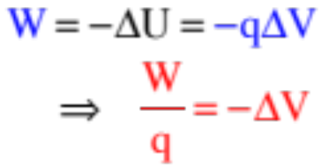

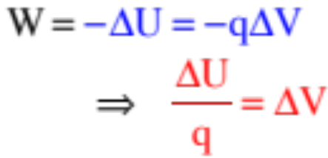
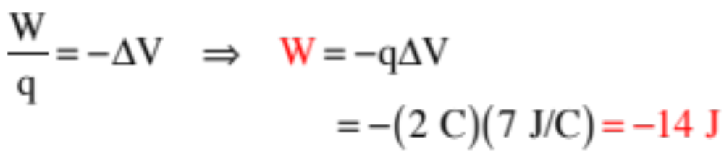
Work and Electric-Potential (Voltage) Fields
Note: An absolute electric potential field is a modified potential energy field.
Everything you can do with energy considerations, you can do with electric potential functions:
Just as the work done on a body moving from one point to another in a conservative force field equals , we can use the definition of absolute electric potential to write:
and
Apparently, if you know the voltage difference between two points, you know how much work per unit charge AND potential energy change per unit charge the field has available between the two points.
Example 5: How much work does a field do on a moving 2 C charge if the potential difference between its beginning and end points is 7 volts?
5.)

Slide 6
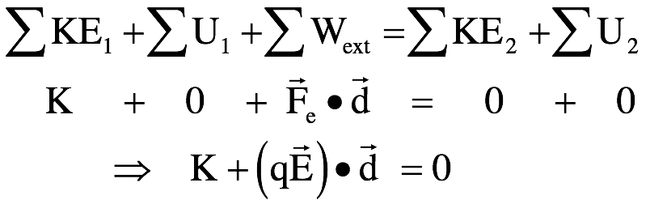
Subtlety About Conservation of Energy Equation
What electric field will be needed to stop an electron with kinetic energy K in distance d. In what direction should the the field be, opposite the direction of the electron’s motion or with the electron’s motion?
This dot product is a little tricky. To determine the angle between the electric field E and d, where d is in the direction of the velocity vector, we need to think a little bit about how an electron behaves in an electric field, and about what THIS electron is doing in this problem.
The electric force on an electron in an electric field will be exactly opposite that of the electric force on a positive charge. (Remember, the direction of an electric field is defined as the direction of force on a positive charge in the field, so the direction of force on an electron will be OPPOSITE the electric field direction.)
direction of force
on positive charge
E
direction of force
on negative charge
6.)

Slide 7
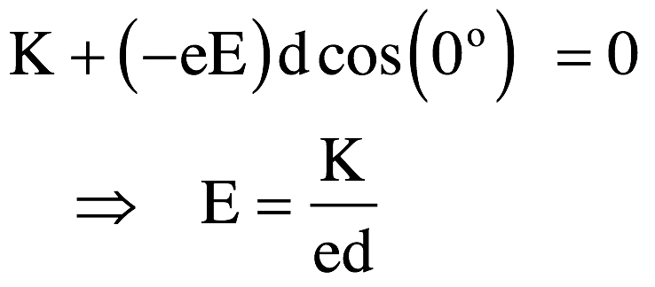
If the electron is moving OPPOSITE the direction of an electric field (i.e., in the direction of the force on it), it will speed up. If the electron is to slow down, it must be moving WITH the electric field.
That means the angle between E and d must be zero and the dot product will, due to its cosine factor, be positive.
But we KNOW the work being done on the electron must be negative as it’s slowing down, so where does the negative sign come from? It comes from the fact that the electron feeling the force is negative. That is, q = -e = -1.6x10^-19 for an electron. That is where the negative sign comes from. Mathematically, this can be written as:
direction of force
on negative charge
in E-field
direction electron
must be moving if
force is to slow it down
7.)

Slide 8





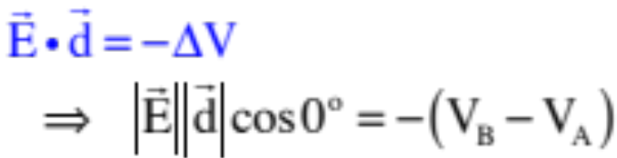


Observations
Example 7: Points A, B and C are identified in a constant electric field as shown in the sketch.
a.) Which point has the GREATER absolute electric potential? (That is, do electric fields run from higher voltage to lower, or vice versa?)
three points in a
constant E-fld
Traversing from A to B, so points along the line of ,
the dot product in our relationship falls out as:
By observation, the left-side of the equation is positive (two magnitudes multiplied together), so the right-side must also be positive. For this to be true, must be larger than .
IMPORTANT OBSERVATION: This means that ELECTRIC FIELDS migrate from HIGHER ELECTRIC POTENTIAL to LOWER.
8.)

Slide 9



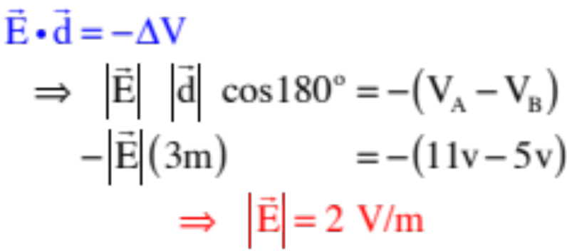

b.) Assume the electric potential at A is and the electric potential at B is . If the distance between the two points is 2 meters, derive an expression for the magnitude of the electric field.
three points in a
constant E-fld
This time, to point out how the angle works, we will traverse from B to A. Noticing that now the angle between and is , we can write:
IMPORTANT SIDE POINT: The unit for ELECTRIC FIELDS is newtons per coulomb, but it is also, apparently, volts per meter.
9.)

Slide 10


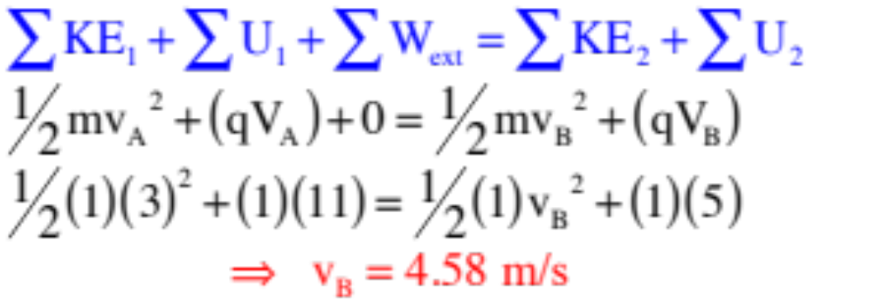

c.) A positive charge Q=1C and mass m=1 kg moves naturally along the E-fld lines.
i.) Is the charge moving from higher electrical potential to lower, or lower electric potential to higher?
This has nothing to do with the charge. Electric fields proceed from higher voltage to lower, so it’s doing the former.
ii.) Is the charge moving from higher potential energy to lower, or lower potential energy to higher?
This has EVERYTHING to do with the charge. POSITIVE CHARGES naturally move from higher to lower voltage along E-fld lines (being by definition the direction a positive charge would naturally accelerate), so it is moving from higher to lower potential energy.
iii.) If Q’s initial velocity was
at A, what is its velocity at B? (Note that the voltages have been put on the sketch.)
10.)

Slide 11


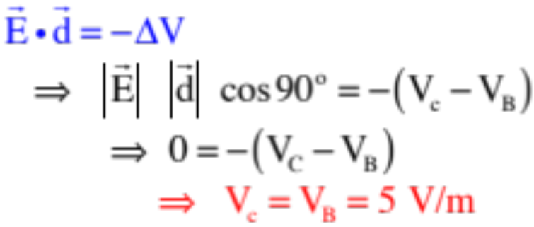

d.) Given the electric potential at B is and the electric field, as calculated in the previous part, is , what is the voltage (i.e., the electric potential) at C, assuming the distance between B and C is .5 meters?
This is slightly tricky. Define on your sketch as shown. Notice that the angle between and is . With that, we write:
IMPORTANT POINT: An EQUIPOTENTIAL LINE is a line upon which every point has the same electrical potential. Points B and C are on the 5-volt equipotential line.
IMPORTANT POINT: Equipotential lines are ALWAYS perpendicular to electric field lines.
11.)

Slide 12
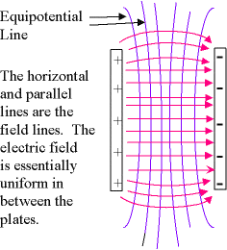
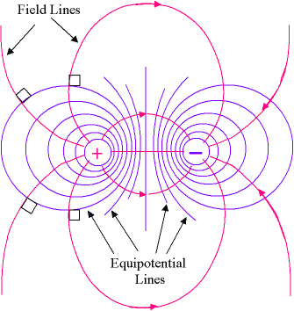
Equipotential Lines
Equipotential lines are a way to represent lines of equal potential - that is, lines along which a charge would move with constant speed (no change in E).
Two examples are shown here. The equipotential lines are in blue. What do you notice about their relationship to E field lines?
Important note: potential is represented by equipotential lines that cross E field lines. There is no such thing as an “electric potential field line” - it’s not a field!
12.)

Slide 13
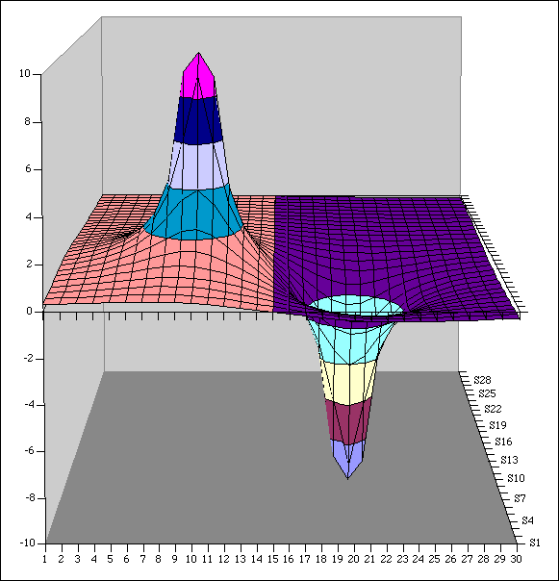
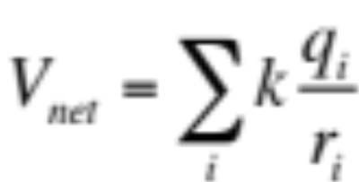
Electric Potential contours (courtesy of Mr. White)
What are the potentials of each of the charges shown here? What do these potential values represent?
13.)

Slide 14
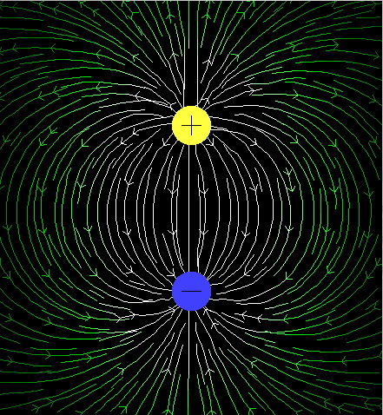
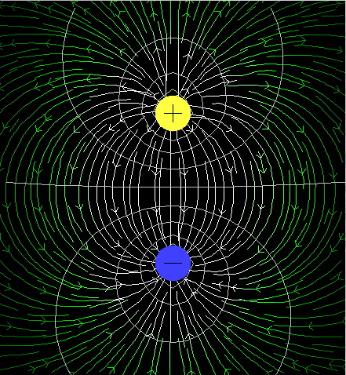
Equipotential Lines
(courtesy of Mr. White)
... are related to Electric Field lines. How?
14.)

Slide 15
Equipotential Lines
(courtesy of Mr. White)
... reveal areas of higher vs. lower electric potential.
15.)

Slide 16
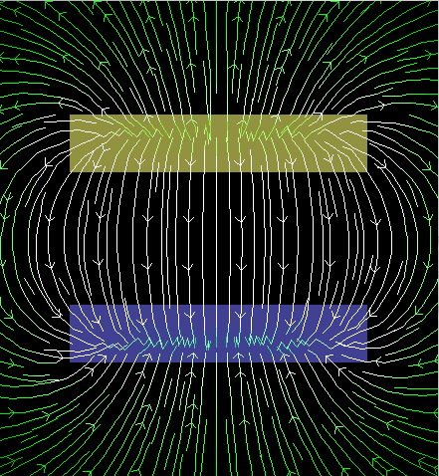
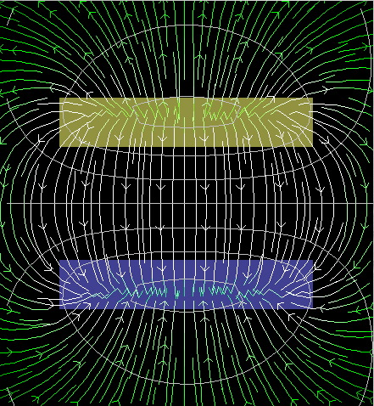
Example 8: (courtesy of Mr. White)
Draw appropriate equipotentials for this electric field.
16.)

Slide 17
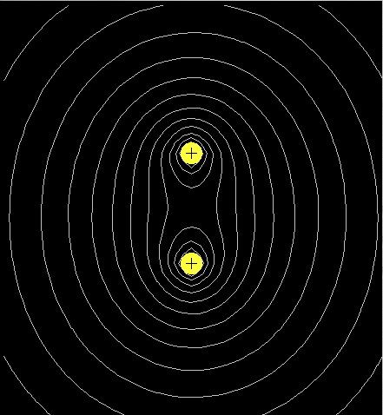
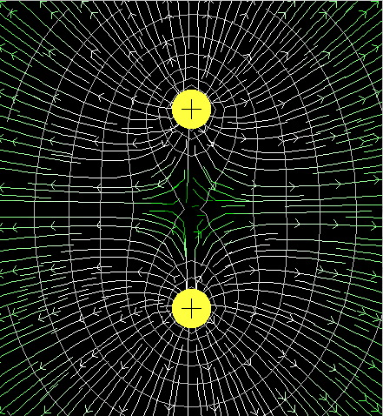
Example 9: (courtesy of Mr. White)
Draw appropriate field lines for these equipotentials.
17.)

Slide 18
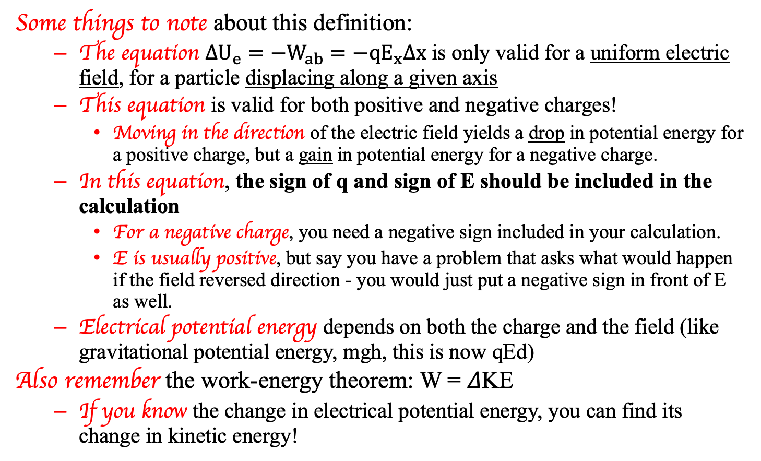
Things to Note About Electrical potential energy
Some things to note about this definition:
  The equation $∆U_{e}=−W_{ab}=−qE_{x}∆x$ is only valid for a uniform electric field, for a particle displacing along a given axis
  This equation is valid for both positive and negative charges!
    Moving in the direction of the electric field yields a drop in potential energy for a positive charge, but a gain in potential energy for a negative charge.
  In this equation, the sign of q and sign of E should be included in the calculation
    For a negative charge, you need a negative sign included in your calculation.
    E is usually positive, but say you have a problem that asks what would happen if the field reversed direction - you would just put a negative sign in front of E as well.
  Electrical potential energy depends on both the charge and the field (like gravitational potential energy, mgh, this is now qEd)
Also remember the work-energy theorem: W = 𝛥KE
  If you know the change in electrical potential energy, you can find its change in kinetic energy!
18.)

Slide 19
Quick check:
How much potential energy does a 2 C charge have at a point where the absolute electrical potential is 3 J/C?
How much potential energy does a -2 C charge have at that same point?
How much potential energy does a -2 C charge have at a point where the absolute electrical potential is -3 V?
V = U/q so U = qV = (2 C)(3 J/C) = 6 J
V = U/q so U = qV = (-2 C)(3 J/C) = -6 J
V = U/q so U = qV = (-2 C)(-3 J/C) = 6 J
19.)

Slide 20
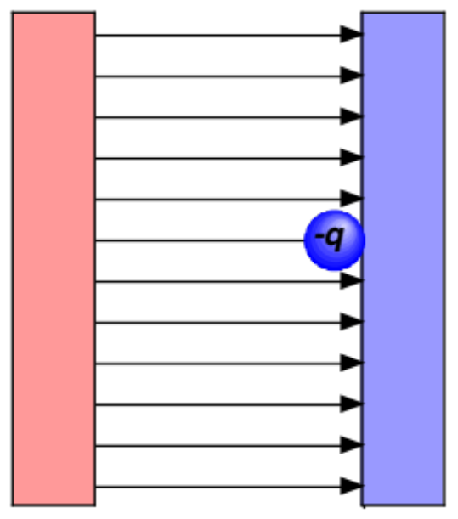

Potential vs potential energy
Electric field lines always point from high potential to low potential --> this is regardless of whether there is a positive, negative, or no charge present at that location at any time
High V Low V
Where high U_{E} is, however, depends on whether the charge feeling the effect is positive or negative charge!
  The high U_{E} position for a positive charge is the high V plate -- it wants to go towards the low voltage (negative) plate
  The high U_{E} position for a negative charge is the low V plate -- it wants to go towards the high V (positive) plate
+
+
+
+
+
+
+
+
+
-
-
-
-
-
-
-
-
-
High U_{E} for a + charge
High U_{E} for a - charge
20.)

Slide 21
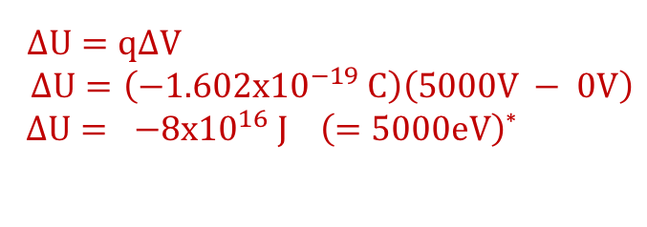
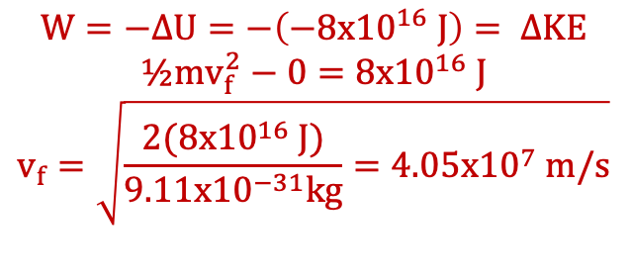
Another quick example
An electron (e⁻) in a TV picture tube is accelerated from rest through a potential difference of 5000 V. The mass of an electron is 9.11 x 10⁻³¹ kg.
  What is the change in U of the electron?
  What is the final speed of the electron?
$∆U=q∆V$
$$∆U=\left(−1.602x{10}^{−19} C\right)\left(5000V − 0V\right)$$
$∆U= −8x{10}^{16} J \left(=5000eV\right)$*
$$W=−∆U=−\left(−8x{10}^{16} J\right)= ∆KE$$
$$½mv_{f}^{2}−0=8x{10}^{16} J$$
$$v_{f}=\sqrt{\frac{2(8x{10}^{16} J)}{9.11x{10}^{−31}kg}=4.05x{10}^{7} m/s}$$
0 V
5000 V
*Fletch’s note: An electron-volt (eV) is defined as the amount of energy an electron picks up when accelerated through a 1 volt electrical potential difference.
21.)

Slide 22
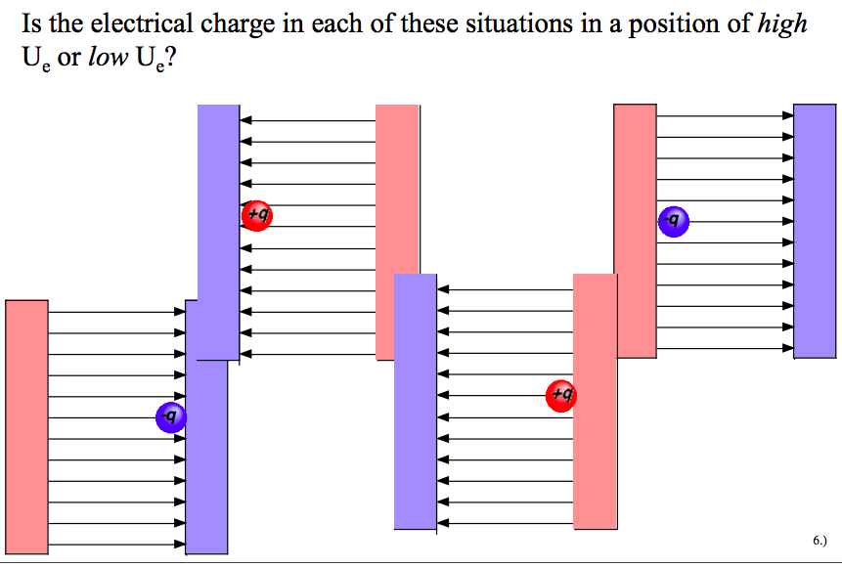
Visual practice (thanks Mr. White!)
low U_{e}
low U_{e}
low U_{e}
low U_{e}
high U_{e}
high U_{e}
high U_{e}
high U_{e}
22.)

Slide 23
Quick practice
If an electron is released from rest in a uniform electric field, the potential energy of the charge-field system
  (a) increases (b) decreases (c) stays the same Explain!
True or false: If a proton and electron both move through the same displacement in an electric field, the change in PE for the proton must be equal in magnitude and opposite in sign to the change in PE for the electron.
When released from rest, the electron will accelerate in the direction opposite the electric field, due to the electric force on it by that field. This means electrical potential energy is converted to kinetic energy, and the potential energy will decrease.
True: 𝛥U = -qEd, and since both have the same magnitude charge, same displacement, and are in the same electric field, the magnitude of the change in PE will be the same, and since the electron is -, the signs will be opposite.
23.)

Slide 24




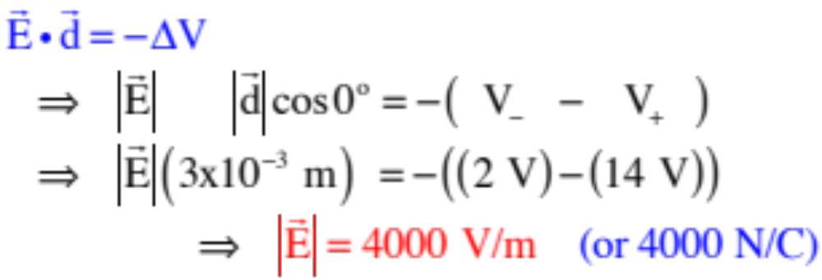
plates viewed
from side
Example 10: A battery has an electric potential of 14 volts at its positive terminal and 2 volts at it’s negative terminal. It is connected to parallel metal plates that are 3 millimeters apart and insulated from one another.
a.) From what you know about the voltages, draw in the electric field lines between the plates.
low voltage
(negative)
terminal
hi voltage
(positive)
terminal
b.) How big is the electric field between the plates?
Traversing from the upper plate to the lower plate (i.e., from the higher voltage to the lower voltage plate ALONG THE E-FLD LINES, we can write:
24.)

Slide 25




plates viewed
from side
c.) Points A, B and C are identified between the plates. A positive charge is placed successively at each point:
i.) At which point will the charge experience the greatest electric field?
(The E-fld is constant between the plates—all points are the same.)
ii.) At which point will the charge experience the greatest electric potential?
low voltage
terminal
hi voltage
terminal
(The voltage closest the positive plate will be highest, which is C.)
iii.) At which point will the charge experience the greatest potential energy?
(A charge’s potential energy at a point is related to voltage as , so for a positive charge, that will be greatest at C . . . or as close to the 14 volt plate as possible.)
d.) Now, a negative charge is placed at each point:
i.) At which point will the charge experience the greatest electric potential?
(Electrical potential has NOTHING TO DO with the charge feeling the effect: it’s still C.)
ii.) At which point will the charge experience the greatest potential energy?
(Using , sign included, the greatest potential energy point for a negative charge is A. This makes sense if you think about it. A -1C charge on the negative plate (pt A)would be -2 joules whereas on the positive plate (pt C) it would be -14 joules. A is bigger (closer to zero)! Also, where, if you let a negative charge go, would it pick up the most kinetic energy? Certainly not if it was next to the positive plate. Definitely next to the negative plate at A!).
25.)

Slide 26


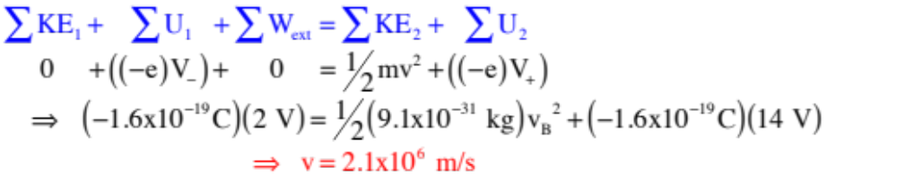
plates viewed
from side
e.) An electron accelerates between the plates. How fast is it moving if it started from rest?
Note that the electron (charge –e) would accelerate from the negative to positive plate, and that the potential energy of a charge sitting at a point whose potential is V is with the charge’s sign included, we can write:
low voltage
terminal
hi voltage
terminal
26.)

Slide 27
Problem 16.7 - preliminary questions
An oppositely-charged set of parallel plates 5.33 mm apart have a potential difference of 600 volts between them. An electron accelerates downward.
Preliminary questions:
i.) Which plate is positive?
ii.) What does the electric field look like between the plates (draw it in)?
iii.) Which plate has the higher electrical potential?
iv.) If you were to assume the higher potential plate had a voltage of 600 volts, what assumption are you making about the lower potential plate?
v.) In general, does negative charge move from higher to lower electrical potential, or vice versa?
vi.) In general, does negative charge move from higher to lower potential energy, or vice versa?
27.)

Slide 28
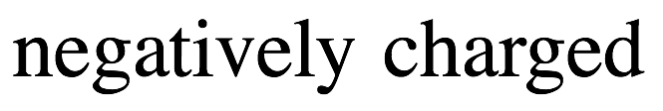

Problem 16.7 - preliminary questions
An oppositely-charged set of parallel plates 5.33 mm apart have a potential difference of 600 volts between them.
Preliminary questions:
i and ii.) Which plate is positive and does the electric field look like between the plates?
See sketch→
iii.) Which plate has the higher electrical potential?
The positive plate always has higher voltage - E fields point from high to low voltage..
iv.) If you were to assume the higher potential plate had a voltage of 600 volts, what assumption are you making about the lower potential plate?
That it has a relative voltage of 0 compared to the higher potential plate.
v and vi.) In general, how does negative charge act?
Negative charges move opposite electric field lines, so they must move from the lower voltage plate to the higher voltage plate -- opposite the way a positive charge would move. For the electron, though, this will be from higher PE to lower PE (all charges naturally flow from higher PE to lower).
28.)

Slide 29

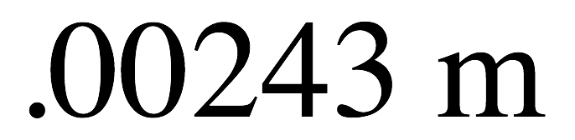


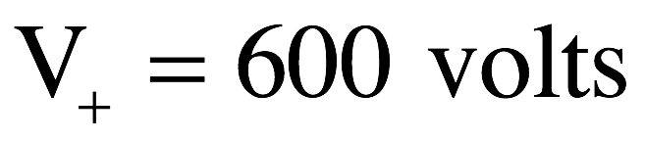

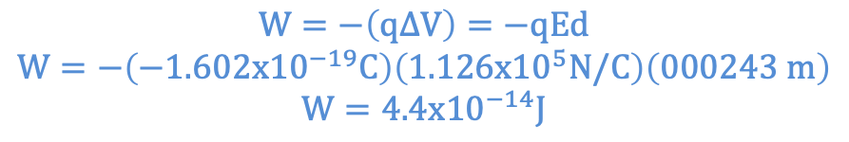
Problem 16.7 modified
An oppositely-charged set of parallel plates 5.33 mm apart have a potential difference of 600 volts between them.
a.) What is the E field magnitude between the plates?
$$∆V=−Ed$$
$$\left(0 V −600 V\right)=−E\left(0.00533m\right)$$
$E=1.126x{10}^{5} V/m$ (or N/C)
b.) What is the force on an electron when sitting between the plates?
$$F=qE=\left(−1.602x{10}^{−19}C\right)\left(1.126x{10}^{5}N/C\right)\left(\hat{j}\right)=1.8x{10}^{4}\left(−\hat{j}\right) N$$
c.) How much work to move the electron to the negative plate from 2.9 mm from the positive plate?
You’ll have to do work to force the electron to the negative plate. If you start where the electron is shown in the sketch and proceed upward, we can write:
$$W=−\left(q∆V\right)=−qEd$$
$$W=−\left(−1.602x{10}^{−19}C\right)\left(1.126x{10}^{5}N/C\right)\left(000243 m\right)$$
$$W=4.4x{10}^{−14}J$$
29.)

Slide 30
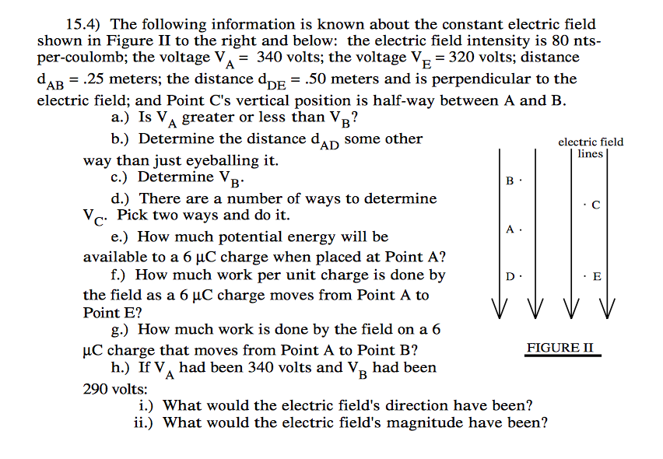
Fletcher’s 15.4 - the kind of thing you might see on your test
30.)

Slide 31
15.4 answers
(a) Less than V_{B}
$$\left(b\right) ∆V=−Ed, d=−\frac{∆V}{E}=−\frac{320V−340V}{80}=0.25 m$$
$$\left(c\right)∆V=−Ed→ \left(340 V−V_{b}\right)=−\left(80\frac{N}{C}\right)\left(0.25 m\right)→ V_{B}=360 V$$
$$\left(d\right) ∆V_{BC}=−Ed, V_{C}−360 V=−\left(\frac{80N}{C}\right)\left(\frac{0.25m}{2}\right)→V_{C}=350 V$$
$$\left(e\right) U_{A}=qV_{A}, U=\left(6x{10}^{−6 }C\right)\left(340 V\right)=2.04x{10}^{−3 }J$$
$$\left(f\right)\frac{W}{q}=−∆V_{AE}=−\left(320V −340 V\right)=20 J/C$$
$$\left(g\right) W=−q∆V_{AB} W=−\left(6x{10}^{−6}C\right)\left(369V−340V\right)=−1.2x{10}^{−4} J$$
(h) (i) Field would reverse direction (lines go from high→low voltage
(ii) $∆V=−Edcosθ, \left(290V−340V\right)=−E\left(0.25m\right)cos0→ E=200 N/C$
31.)

Slide 32

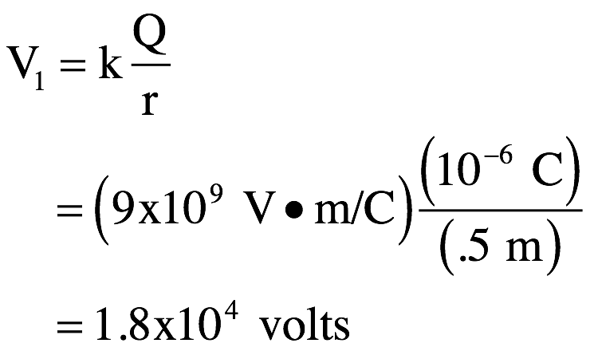
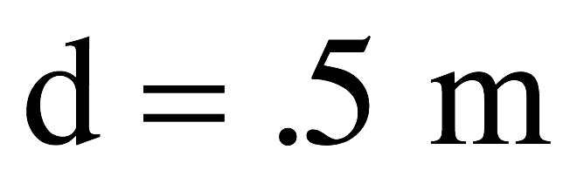
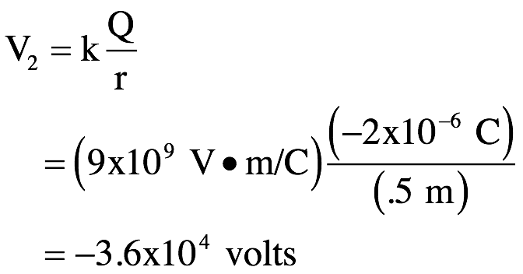
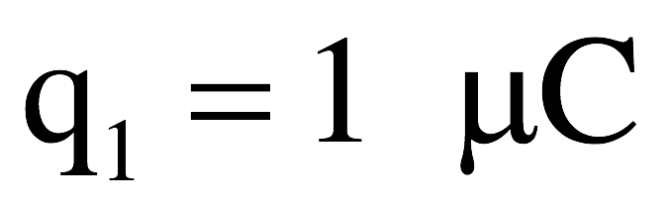
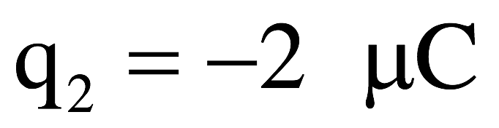
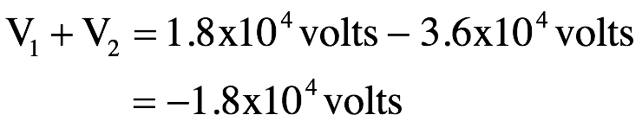
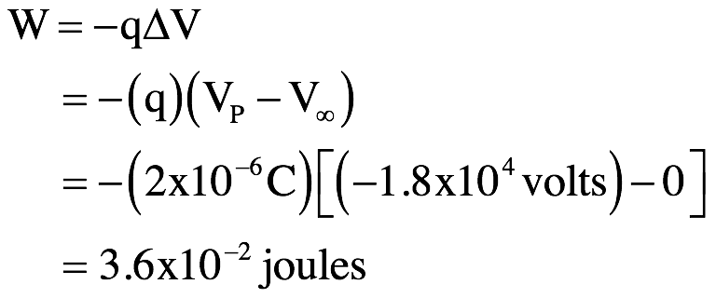
Pt charge potential example - 16.60
a.) What is q₁’s electrical potential at P?
b.) What is q₂’s electrical potential at P?
c.) What is the total electrical potential at P?
d.) What is the work required to move a 2 𝝁C charge from infinity to P?
As the voltage at infinity is zero, we can write:
32.)

