Slide 1
General announcements

Slide 2
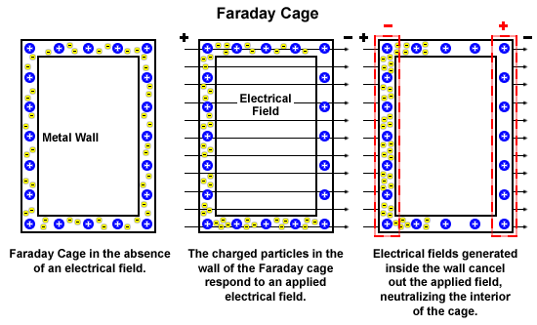
Electrical shielding
c/o C. Vivo
14.

Slide 3
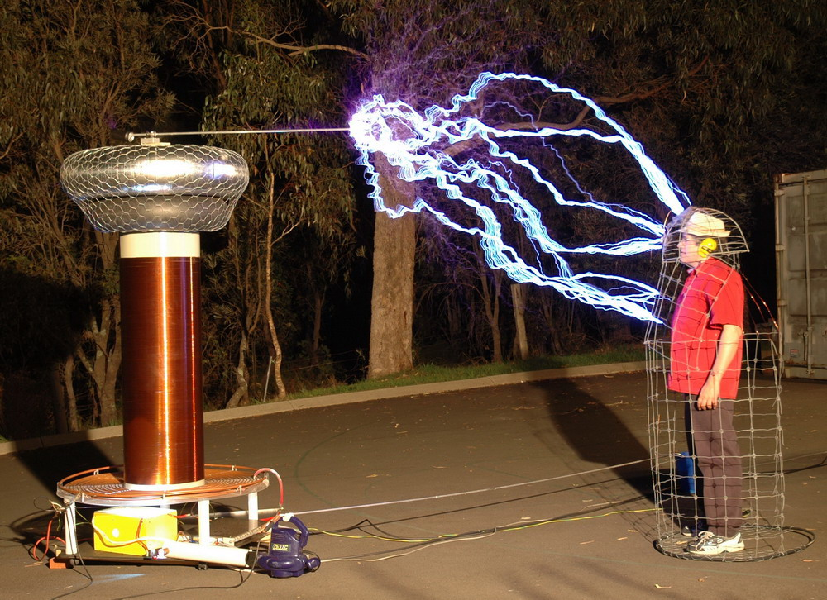
Faraday Cage
c/o C. Vivo
15.

Slide 4
Conductors in electrostatic equilibrium
Consider a neutral, metal conductor.
  What is true about some of the electrons in that conductor?
If no net motion of charge occurs in that conductor, it’s in electrostatic equilibrium. (This occurs when a conductor is isolated and insulated from the ground). This means:
  The electric field is zero everywhere inside the conductor.
    If not, what would happen?
  Any excess charge on that conductor is entirely on its surface.
    If not, what would happen?
  The E field just outside a charged conductor is perpendicular to its surface.
    If not, what would happen?
  If irregular, charge accumulates at sharp points (where the radius of curvature is smallest).
    Let’s look at this…
They’re free to move within the material - remember metallic bonding?
The field would cause charge to move - not equilibrium!
They’d repel and move towards the surface anyways!
There would be a surface-parallel component, which would make charges flow…not equilibrium!
8.)

Slide 5
Shielding
When free charge is placed on a conductor, electrical repulsion will motivate electrons to move as far away from other electrons as possible. Consequence:
Force electrons onto a flat conducting surface. At some point, the free electron population already on the surface will provide such a large repulsive force that no additionally placed electrons will make it onto the surface. When that happens, the electrons will be evenly distributed over the surface.
surface charge density
evenly distributed
Bend the surface and you can force MORE electrons on, increas-ing the surface charge density. Why? Because there is now material between the electrons, diminishing their repulsive effect on distance electrons. This phenomenon is called SHIELDING.
surface charge
density increased
Oddly shaped conductors will have different charge densities, depending upon the severity of their curvature.
charge density
really high
The extreme: the lightning rod, a pointed piece of metal insulated from a house. It accumulates HUGES amount of charge at its end point, attracting potential lightning strikes away from the house.
charge density
relatively low
9.)

Slide 6
Irregularly-shaped conductors
Consider the object below. Charges on the flatter (left) end exert repelling forces, which are close to parallel to the surface, so the charges move out until repelling forces from other charges bring them to equilibrium.
Charges on the pointier (right) end exert similar repelling forces, but a much smaller component is parallel to the surface, so the charges don’t move much before being brought to equilibrium.
The result? Charges gather more densely on pointier ends, to keep the electric field oriented perpendicular to the surface.
This is the principle behind lightning rods!
10.)
https://courses.lumenlearning.com/suny-physics/chapter/18-7-conductors-and-electric-fields-in-static-equilibrium/

Slide 7
St. Elmo’s fire
Why masts, church steeples, and other pointy objects?
Remember that charges want to spread out as much as possible - but can’t get as far away from each other at pointy ends
This creates a stronger electric field at the pointy end
If the field is strong enough, it can ionize the air molecules and create the conditions for the various electrical phenomena we just talked about!
https://courses.lumenlearning.com/physics/chapter/18-7-conductors-and-electric-fields-in-static-equilibrium/
24.

Slide 8
Lightning
What is lightning? How does it form?
1.) Water crystals in a cloud will rub against one another charging by contact.
2.) Lighter particles tend to accumulate positive charge and “float” upward into the top part of the cloud. Heavier particles tend to accumulate negative charge and drop to bottom part of cloud. This charge separation is what creates the situation in which lightning flashes occur.
+
+
+
+
+
+
+
+
+
+
+
+
+
+
+
+
+
+
+
+
+
+
+
light, positively charged ice specks float upward
+
+
+
+
+
+
+
+
heavy, negatively charged ice specks float downward
+
+
+
-
-
-
-
-
-
-
-
-
-
-
-
-
-
-
-
-
-
-
-
-
-
-
-
-
-
-
-
-
-
-
-
-
-
-
-
-
-
-
-
-
-
-
-
-
-
-
-
-
-
3.) A lightning flash will literally bore a hole, in essence creating a vacuum, through what is normally a good insulator, the atmosphere. It is the atmosphere filling in this vacuum that creates the thunder clap.
16.

Slide 9
Revisiting lightning
4.) If the bottom of the cloud is negative, that charge will induce a positive charge on the earth’s surface (on conductors, electrons literally flow away from the surface leaving the surface electrically positive; in insulators, we get the Van der Waal effect making even insulators look electrically positive on their surface).
5.) Lightning can strike from storms several miles away (the path a strike takes is more or less the path of least resistance, and that is not always directly downward). This is where the expression, “From out of the blue,” came from. It is possible to have a strike when the sky overhead is clear.
17.

Slide 10
Some numbers
6.) There are approximately 100 strikes per second worldwide. A single strike can generate temperatures of 25,000-30,000 degrees and can fuse sand into nodules. A single strike can generate 30,000 to 300,000 amps of current and dump 500,000,000 joules of energy.
tree trunk as viewed from above at a particular instant:
7.) One of the problems associated with being close to a lightning strike is that when the strike’s energy is dumped into the ground, it creates what is called an electrical potential gradient. That is, the voltage right next to the tree, for instance, is considerably higher than the voltage just a few feet from the tree. If you happen to be spanning that distance because your feet are spread apart, you will find yourself with a huge voltage difference between your feet. That will produce an enormous electric field through your body and can result in death.
200,000 volts
1,000,000 volts
energy radiates outward with equipotential lines being circles that diminish with time
18.

Slide 11
So…
Based on what you learned last unit, where would you rather be during a lightning storm:
  In your car?
  Under a tree?
  WHY?
http://www.abc.net.au/news/2018-01-09/sydney-hit-by-fierce-lightning-storm-but-hot-weather-to-return/9313516
19.

Slide 12
Remember shielding?
In a lightning strike, the frame of your car acts like a Faraday cage! It’s not the rubber tires that keeps you safe.
Minute Physics - car + lightning strike
Actual footage of a car lightning strike
20.

Slide 13
Ball lightning
What is it?
  Uncommon event (up to 20-25 seconds)
  Looks like a small ball of lightning that often appears in windows, in airplane cockpits, down chimneys
  Not well understood - one working theory is that leftover ions from lightning strikes accumulate on windows or buildings (instead of being grounded), and those ions “pile up” and create an electric field that can get through the glass -- this gives electrons inside the window enough energy to ionize nearby air molecules, creating a glowing ball.
(John Lowke, CSIRO)
Ball Lightning - "Globe of Fire Descending into a Room" in "The Aerial World," by Dr. G. Hartwig, London, 1886. P. 267. Library Call Number QC863.4 H33 1886. Image ID: libr0524, Treasures of the NOAA Library Collection

Slide 14
St. Elmo’s Fire
A similar phenomenon is St Elmo’s Fire, often seen on the masts of ships and mentioned in many works of literature
"Everything is in flames, — the sky with lightning, — the water with luminous particles, and even the very masts are pointed with a blue flame."
— Charles Darwin, 1832
"... sometime I'ld divide,
And burn in many places; on the topmast,
The yards and bowsprit, would I flame distinctly,
Then meet and join.”
— William Shakespeare, The Tempest
"About, about, in reel and rout, The death fires danced at night; The water, like a witch's oils, Burnt green and blue and white.”
—Samuel Taylor Coleridge, The Rime of the Ancient Mariner
http://physicsbuzz.physicscentral.com/2014/10/the-ghostly-glow-of-st-elmos-fire.html
22.

Slide 15
St. Elmo’s fire
A strong electric field can ionize air molecules, creating a plasma
  The strength of the field can rip protons and electrons apart, breaking bonds and releasing energy
  As those electrons travel through the plasma, they interact with air molecules, and excite electrons in those molecules
    What’s air made of? What do you know about how those gases act under high voltage?
  The appearance of St. Elmo’s fire often heralds the end of a thunderstorm, so it’s traditionally considered a good omen by sailors
Discharge tubes showing various gases - our atmosphere is mostly N and O, so air molecules put out a violet/blue light.
http://physicsbuzz.physicscentral.com/2014/10/the-ghostly-glow-of-st-elmos-fire.html
23.

Slide 16
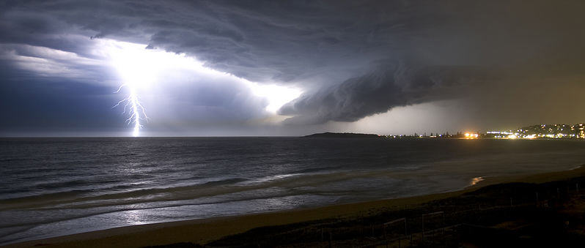
LIGHTNING
Almost all of the photos in this presentation came from the free-picture Web site Pixdaus.

Slide 17
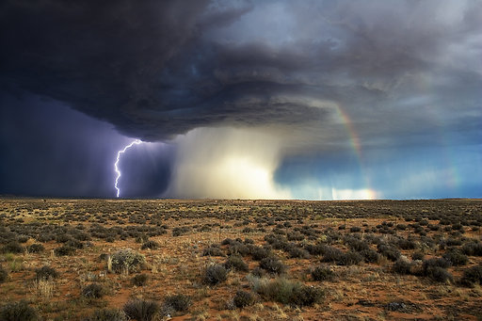

Slide 19
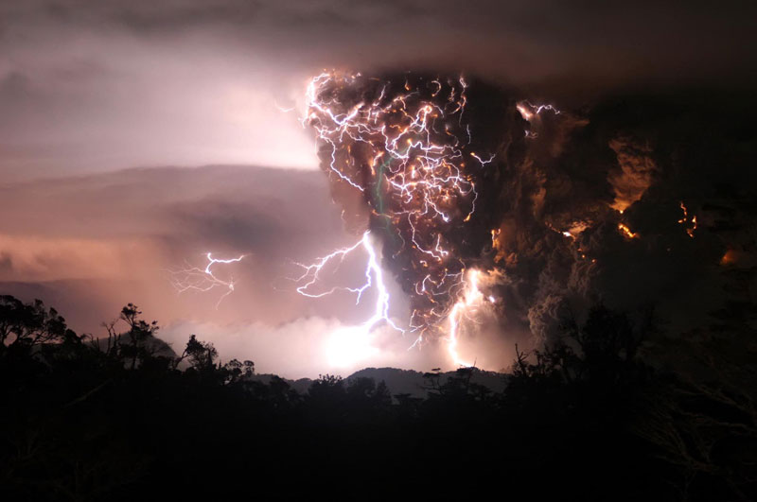

Slide 20
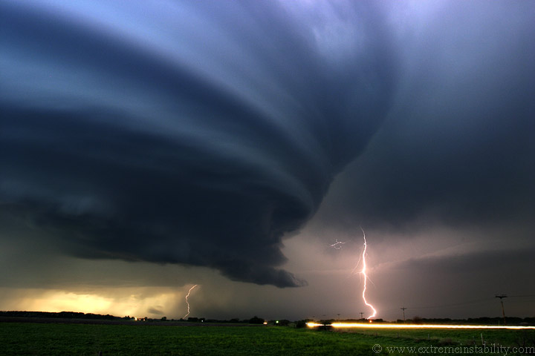

Slide 21
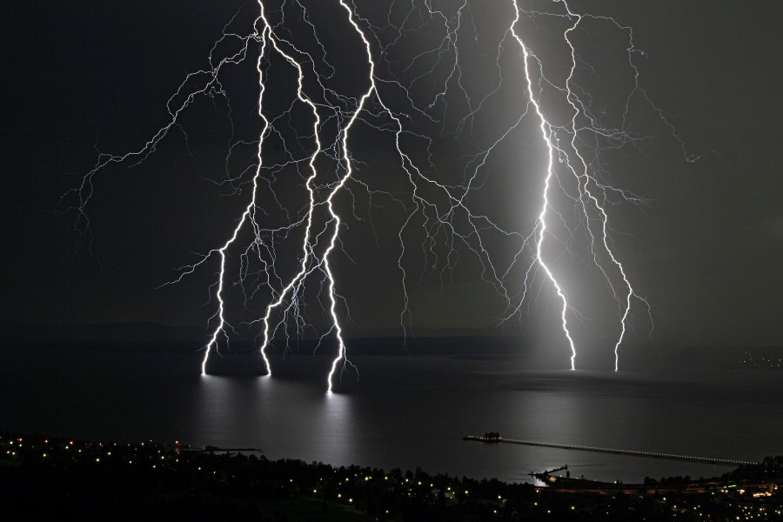

Slide 22
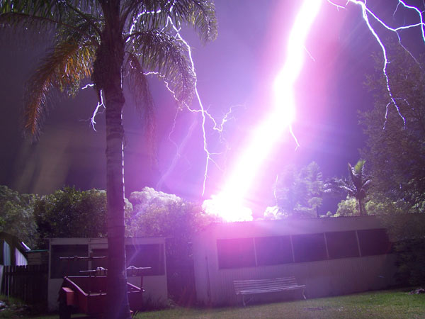

Slide 23
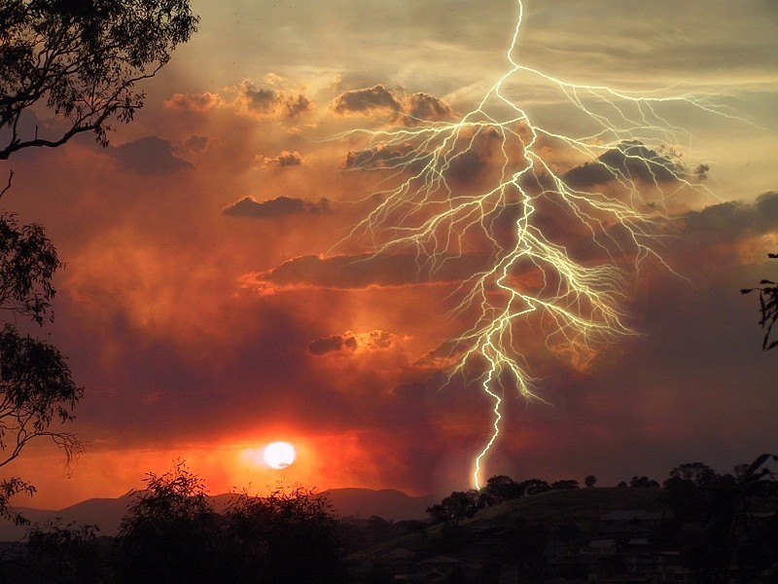

Slide 24
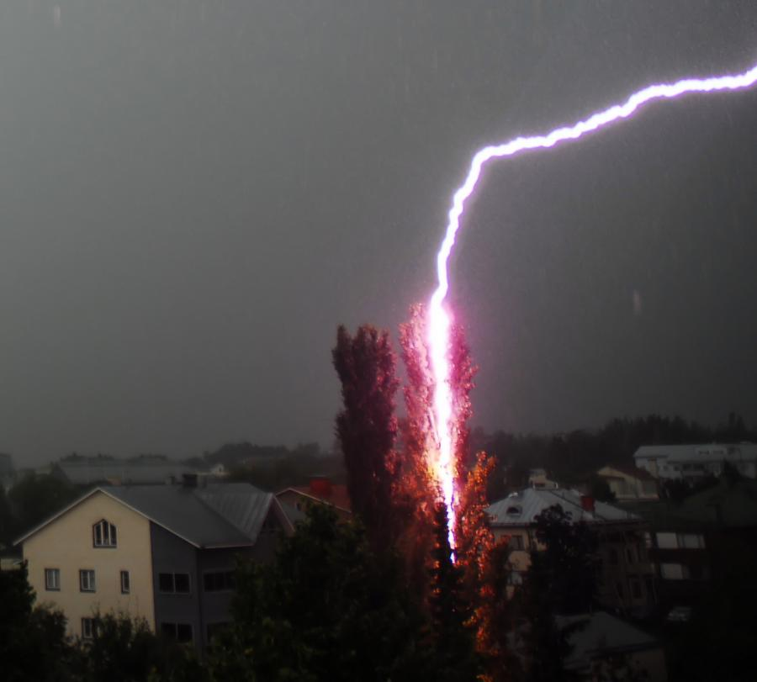

Slide 25
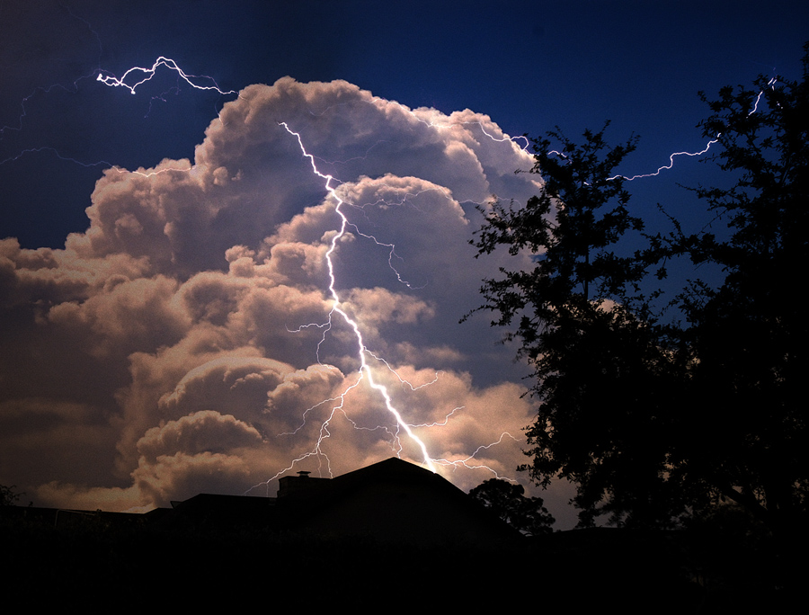

Slide 26
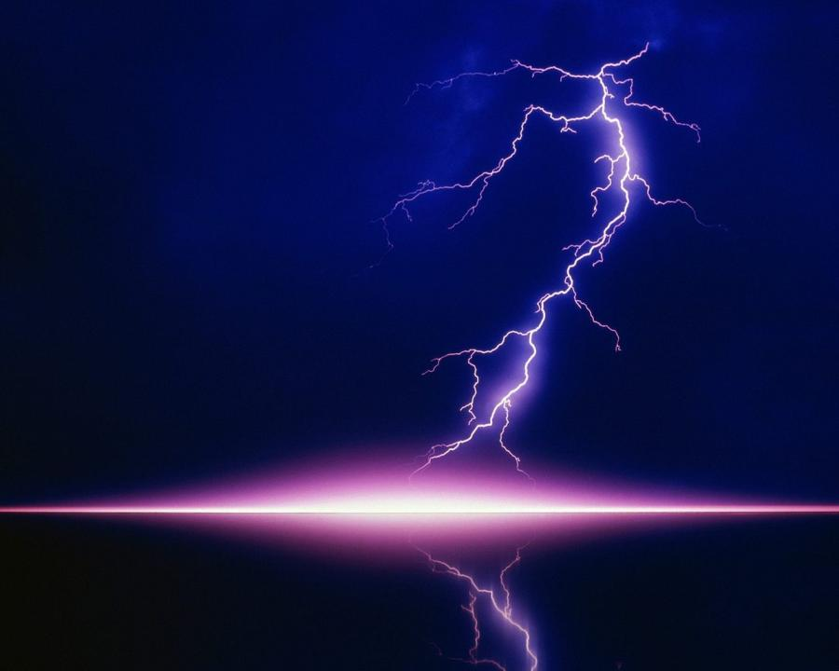

Slide 27
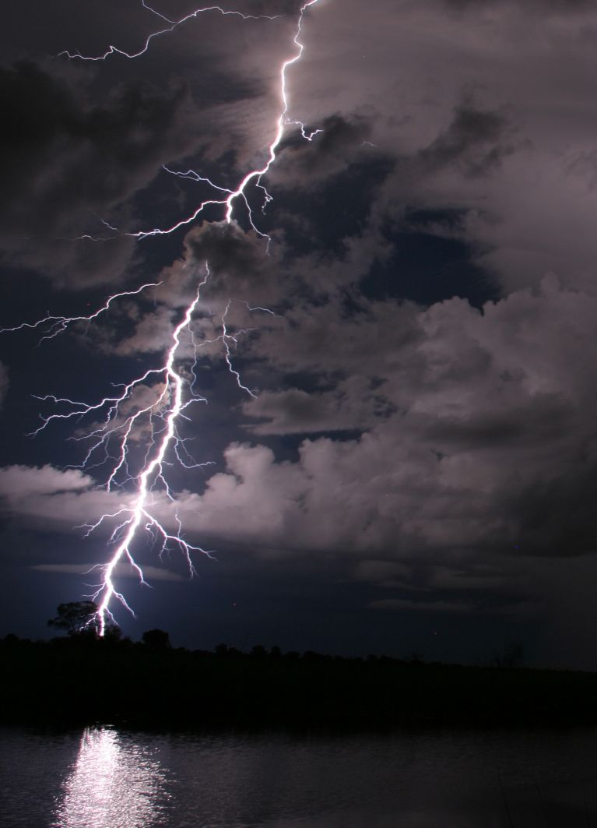

Slide 28
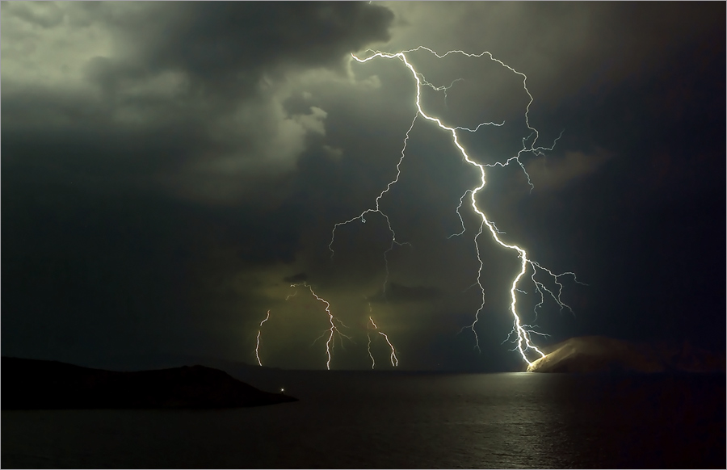

Slide 29
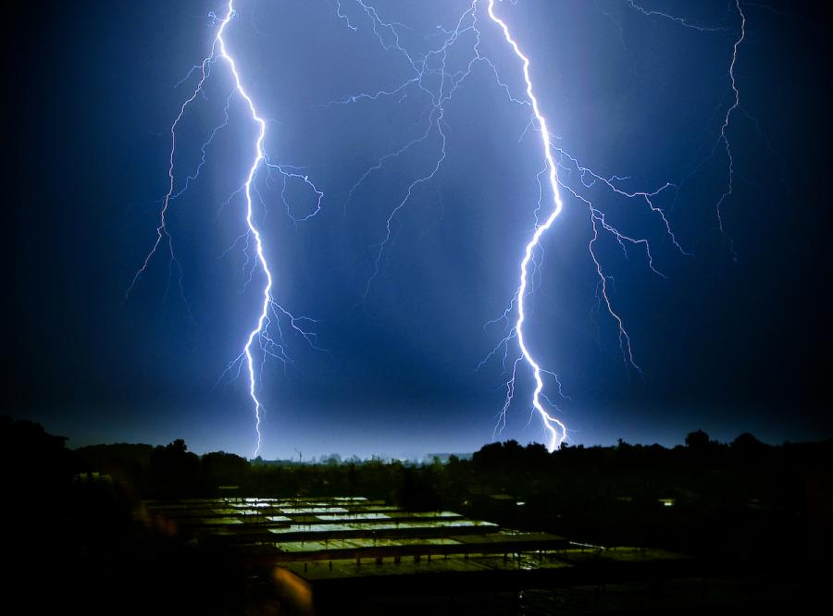

Slide 30
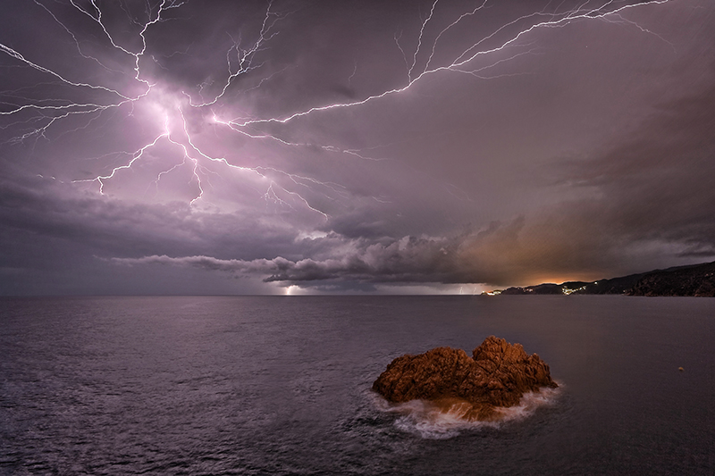

Slide 31
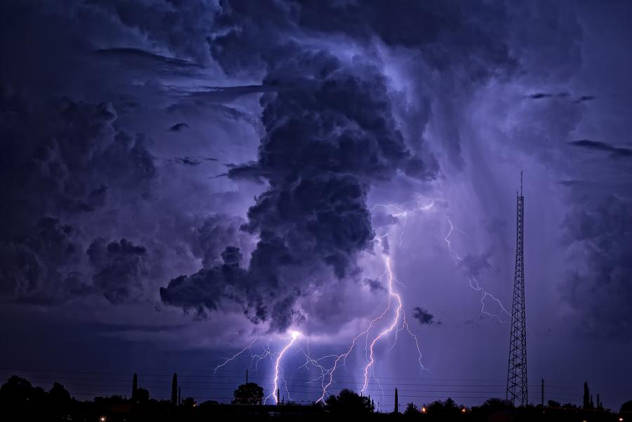

Slide 32
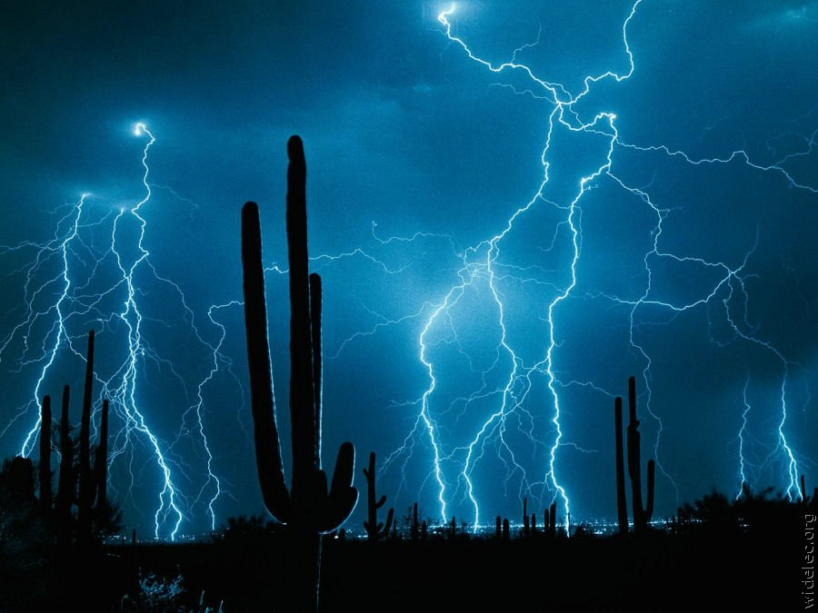

Slide 33
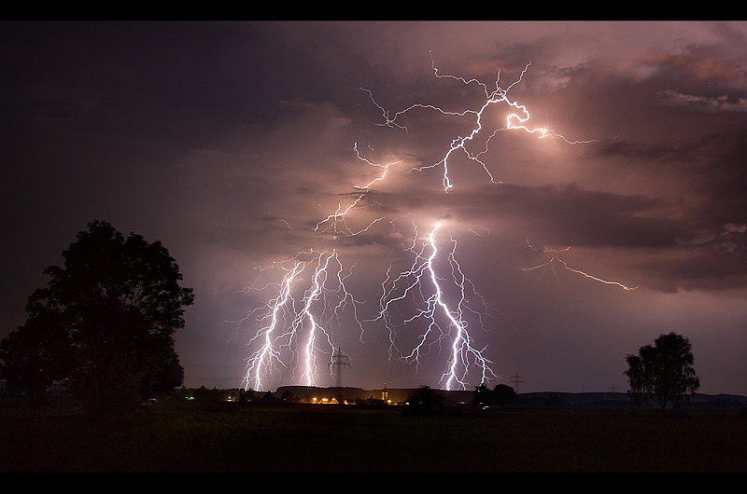

Slide 34
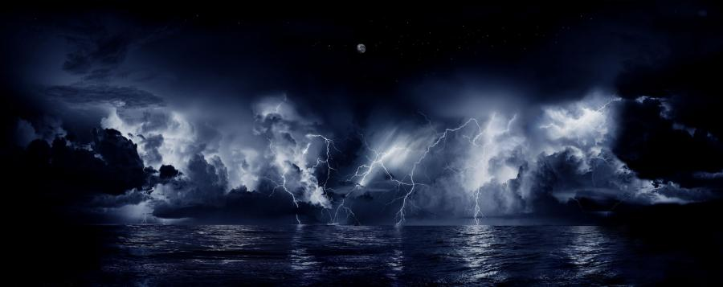

Slide 35
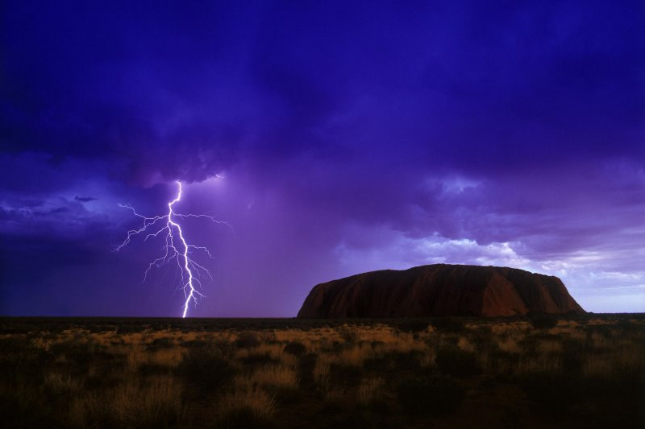

Slide 36
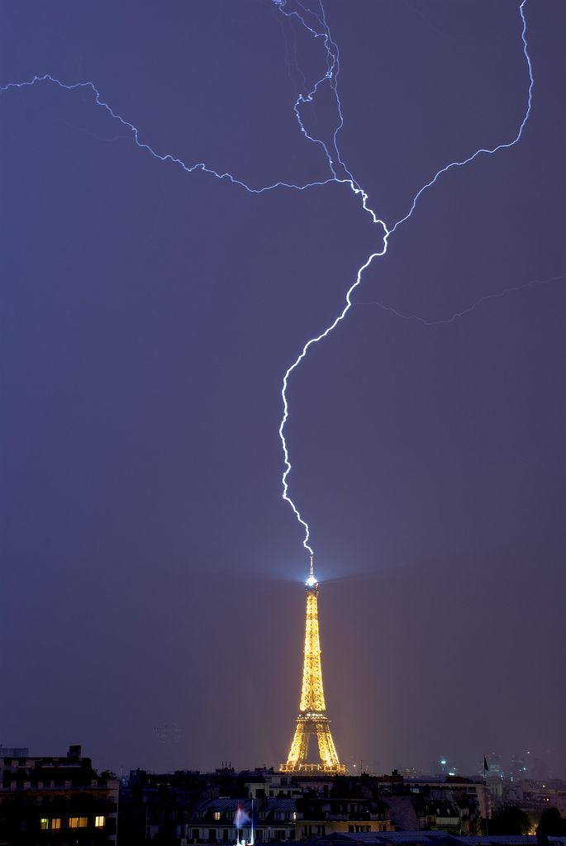

Slide 38
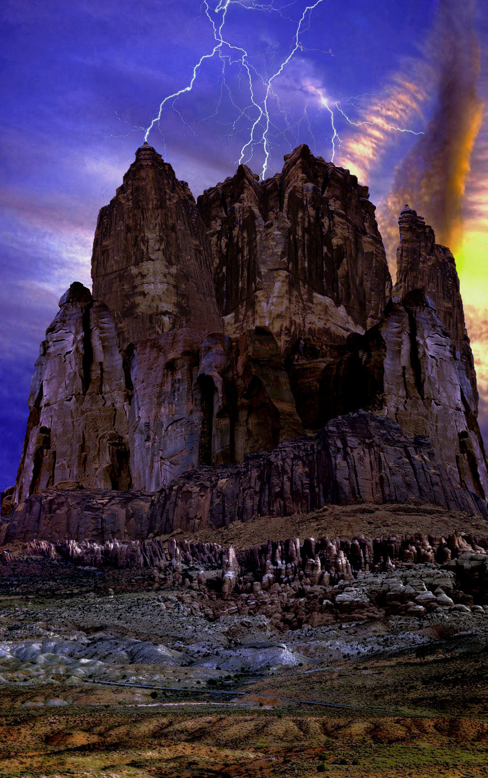

Slide 39
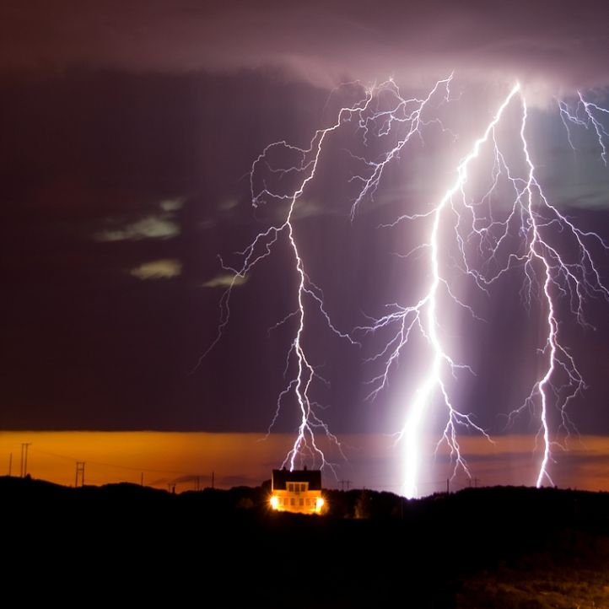

Slide 40
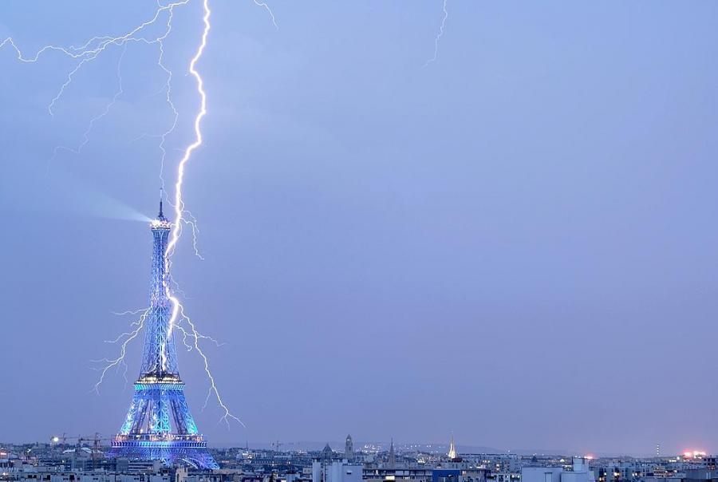

Slide 41
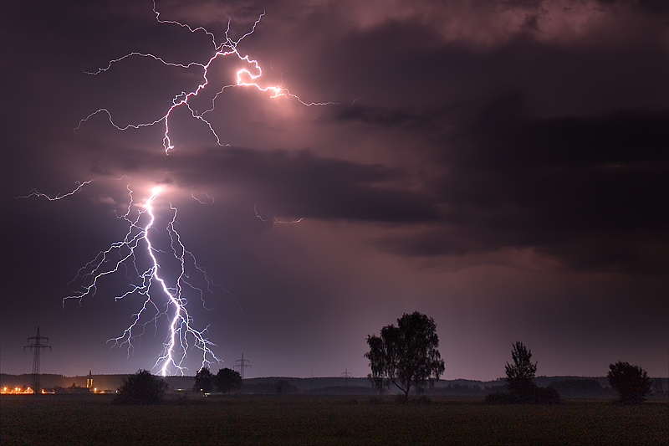

Slide 42
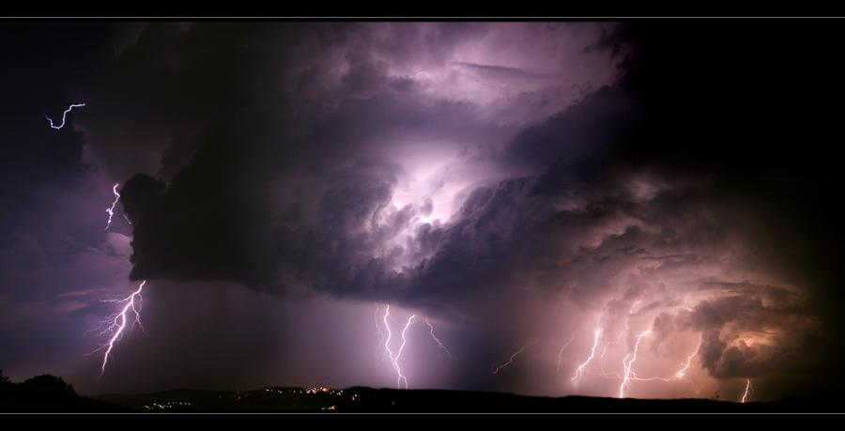

Slide 43
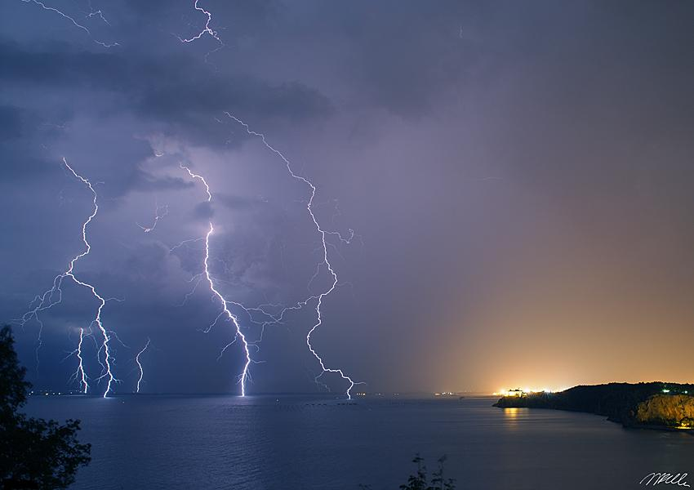

Slide 44
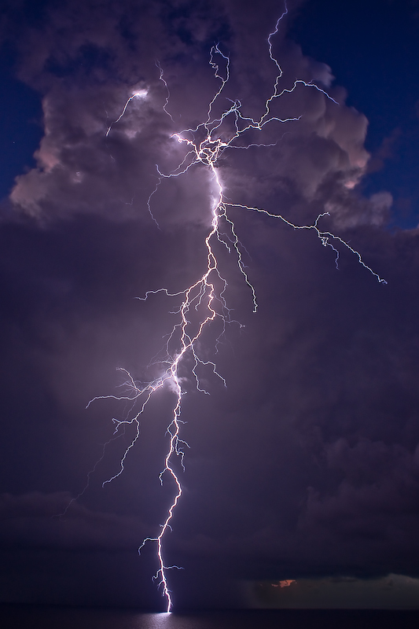

Slide 45
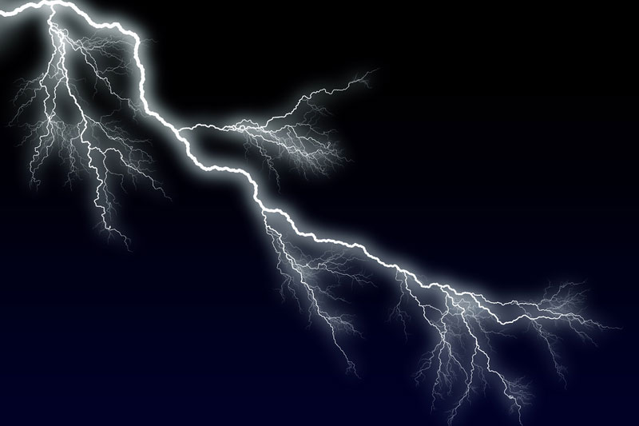

Slide 46
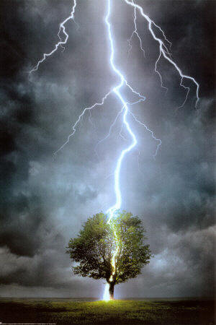

Slide 47
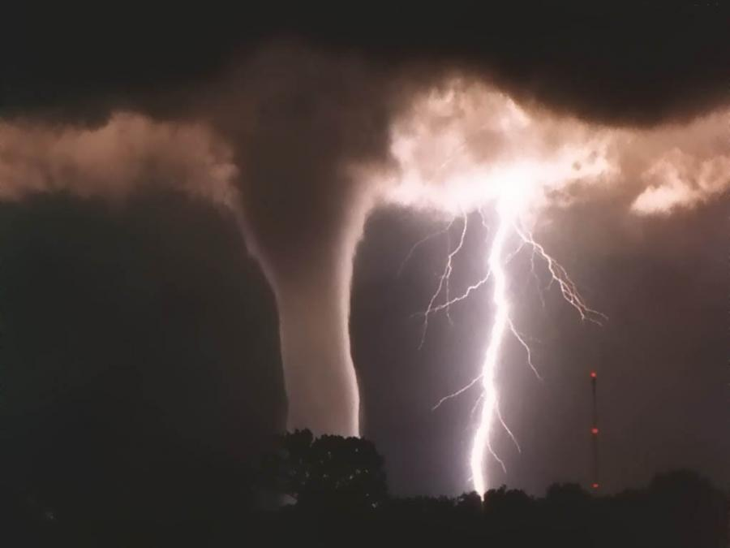

Slide 48
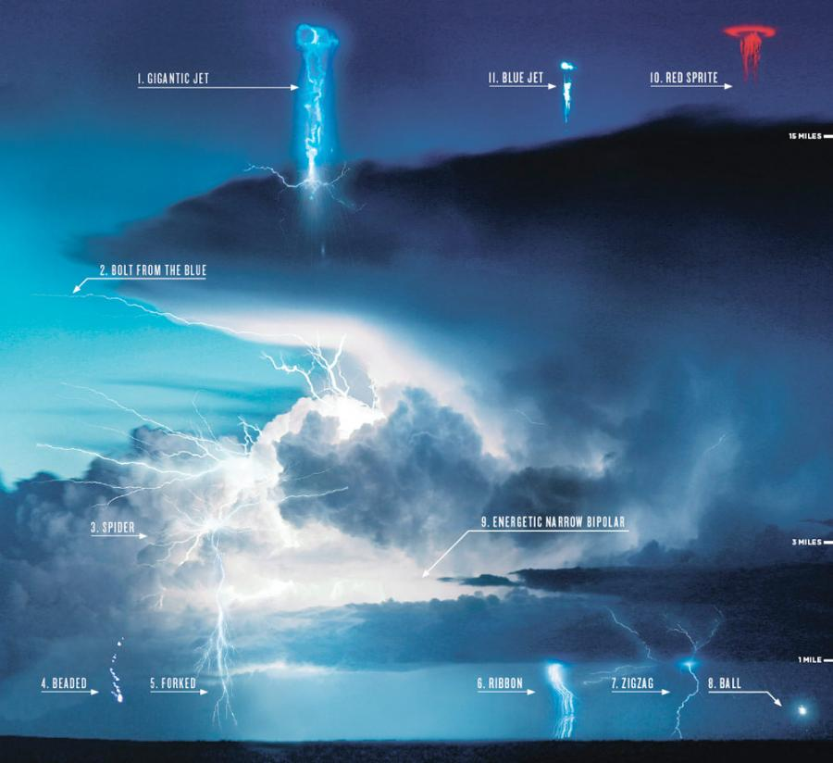

Slide 49
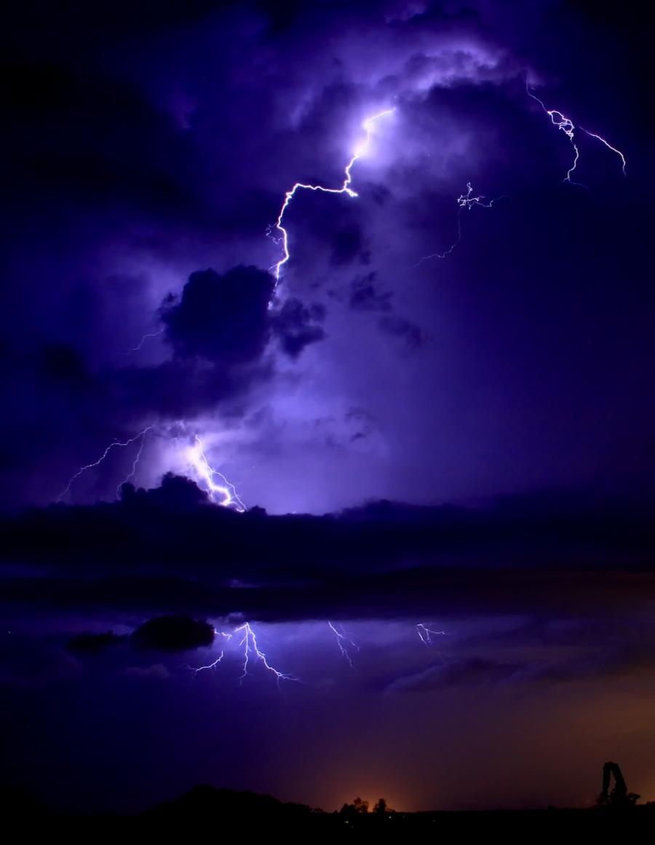

Slide 50
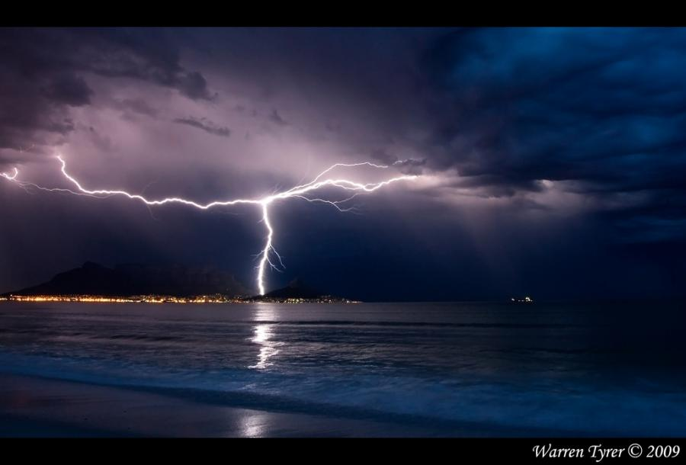

Slide 51
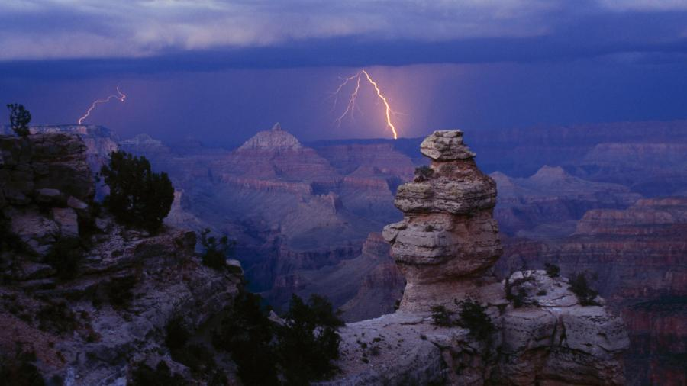

Slide 52
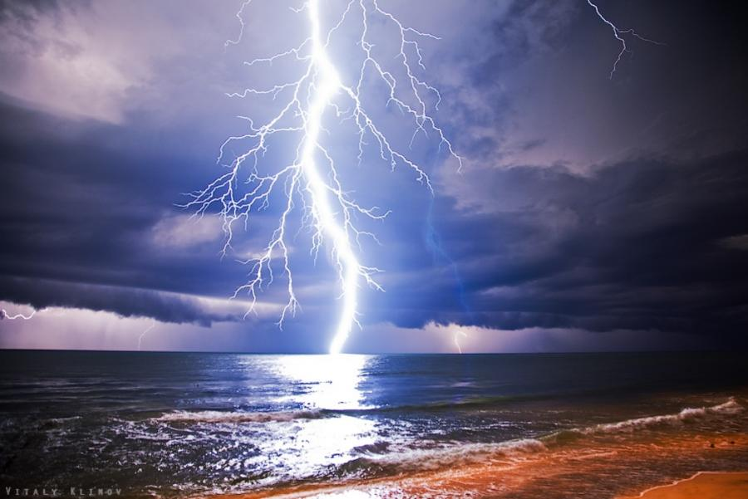

Slide 53


Slide 54
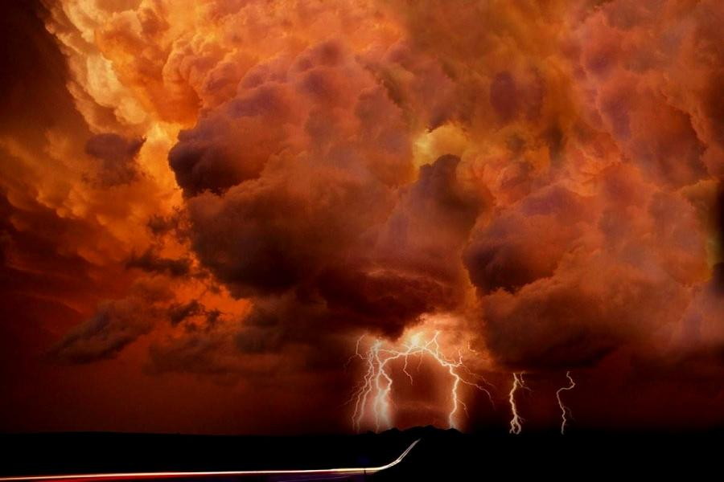

Slide 55
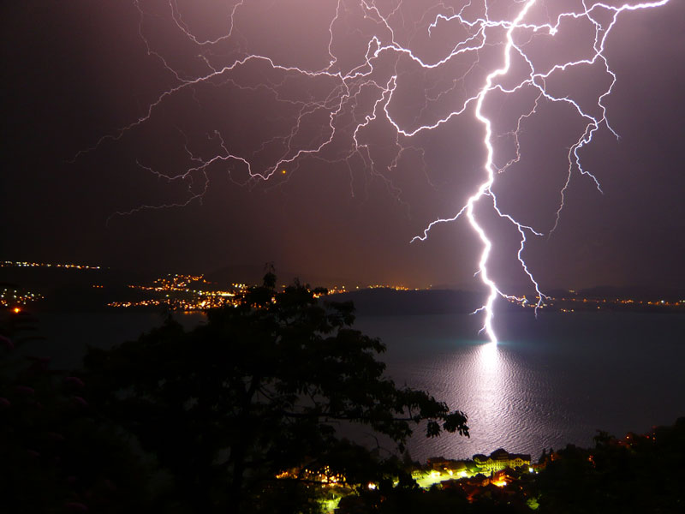

Slide 57
“Making” lightning
A Van de Graaff generator is a commonly known device for creating large voltages with startling (but not dangerous) results
How do you think this works?
https://spectrumscientifics.wordpress.com/2016/08/16/making-electricity-van-de-graaff-generators-and-tesla-coils/
http://hyperphysics.phy-astr.gsu.edu/hbase/electric/vandeg.html
66.

