Slide 1
General announcements

Slide 2

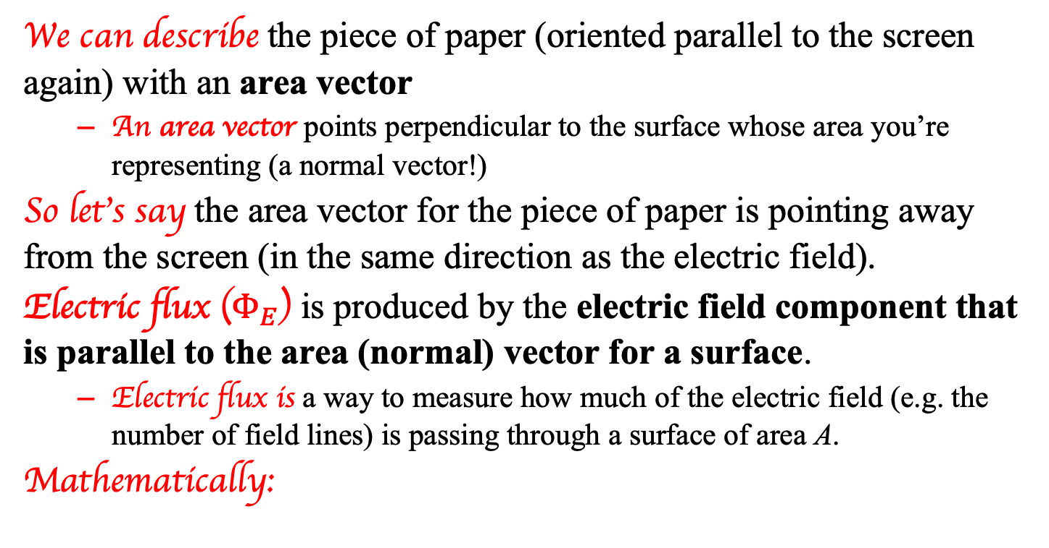

Electric flux
We can describe the piece of paper (oriented parallel to the screen again) with an area vector
  An area vector points perpendicular to the surface whose area you’re representing (a normal vector!)
So let’s say the area vector for the piece of paper is pointing away from the screen (in the same direction as the electric field).
Electric flux ($Φ_{E}$) is produced by the electric field component that is parallel to the area (normal) vector for a surface.
  Electric flux is a way to measure how much of the electric field (e.g. the number of field lines) is passing through a surface of area A.
Mathematically:
$$Φ_{E}=\vec{E}∙\vec{A}=EAcosθ$$
The angle between E and A
Units: $N∙m^{2}/C$
2.

Slide 3




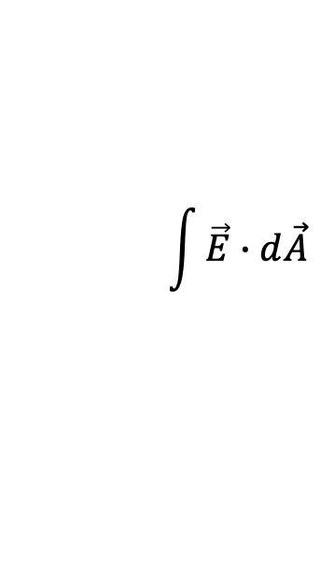
What if the surface isn’t regular?
If you have an irregular surface, then simply dotting E and A won’t work. This requires calculus!
  We won’t be evaluating these integrals, but it’s worth seeing what this would be like in a non-ideal, real-world problem
Imagine a charge, q, inside an irregular surface as shown. At some differential area on the surface, dA, the electric field is as shown.
Summing up all the dA patches, and the E at each point (which is NOT uniform), would give us the net flux:
Gaussian surface
$$\int{\vec{E}∙d\vec{A}}$$
3.

Slide 4
Flux through closed surfaces
Back to the cube: Let’s say there’s a charge Q to the left of the cube as shown. What’s the net electric flux through the cube?
The field lines from Q will enter the cube on the left…but then exit on the right. Every line that enters the cube (which is negative flux) will also exit the cube (which is positive flux).
This means the net flux through the cube will be zero!
Q
4.

Slide 5
Flux through closed surfaces
What if the charge is now inside the cube?
The field lines from Q will now exit the cube through each face…and there will be a net positive electric flux through the cube.
Q
Carl Gauss noticed this too, and realized that as long as there is charge enclosed within the surface, there will be a net electric flux through that surface.
5.

Slide 6
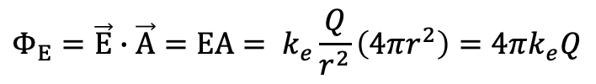
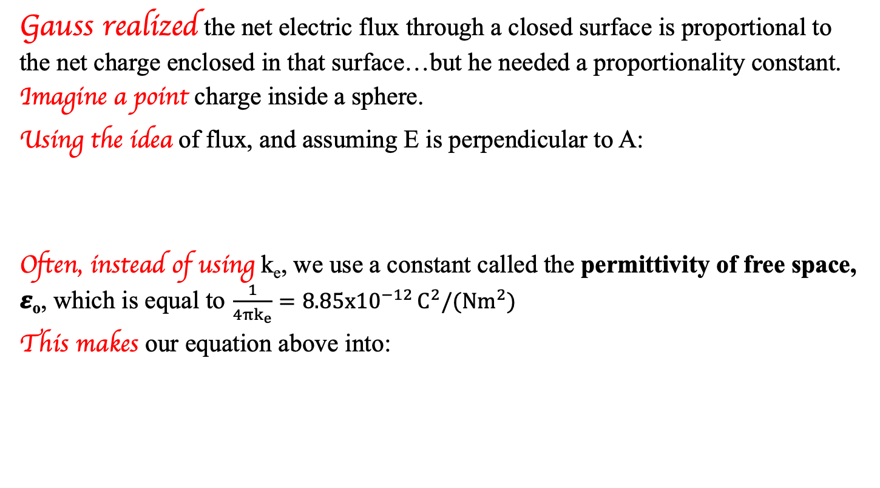
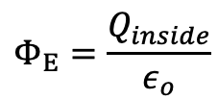
Gauss’s Law
Gauss realized the net electric flux through a closed surface is proportional to the net charge enclosed in that surface…but he needed a proportionality constant.
Imagine a point charge inside a sphere.
Using the idea of flux, and assuming E is perpendicular to A:
Often, instead of using k_{e}, we use a constant called the permittivity of free space, 𝜺_{o}, which is equal to $\frac{1}{4πk_{e}}=8.85x{10}^{−12 }C^{2}/(Nm^{2})$
This makes our equation above into:
$$Φ_{E}=\vec{E}∙\vec{A}=EA= k_{e}\frac{Q}{r^{2}}\left(4πr^{2}\right)=4πk_{e}Q$$
$$Φ_{E}=\frac{Q_{inside}}{ε_{o}}$$
This is Gauss’s Law!
6.

Slide 7
Gauss’s Law
This form of Gauss’s Law is only useful when you have a symmetric surface about the point charge producing the electric field.
This does not have to be a real surface! We are creating a mathematical, imaginary surface to aid in our calculations. These are called “Gaussian surfaces.”
As long as we choose a surface (like a sphere) so that the electric field is constant everywhere on it, we can use this equation to compute the electric field.
In the next few slides, I present an example to show you why and how this is so powerful. Thanks, Mr Fletcher, for this set up!
7.

Slide 8
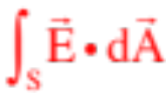



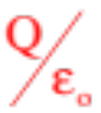
Back to Gauss’s Law
Gauss’s Law is ALWAYS TRUE, no matter how the geometry shakes out, but it is pretty useless unless you can exploit symmetry in a problem.
Example 1: Use Gauss’s Law on the spherical surface of radius R and charge Q as shown.
What the integral is apparently asking us to do is to define an arbitrary, differential surface area dA (remember, dA has a magnitude equal to the area of the enclosed surface and is directed perpendicularly outward from the surface), evaluate both the direction and magnitude of the electric field at that surface, dot the
Gaussian surface
and into one another, then do that for all the differential surfaces over the entire structure and sum them by integrating.
Gauss was right. That flux WOULD equal . But because no two points on the surface are the same distance from the charge Q, and no two dot products are going to be the same (angles different), doing that integral would be a NIGHTMARE. In short, this is an impossible problem to do!!!!!!!
8.

Slide 9
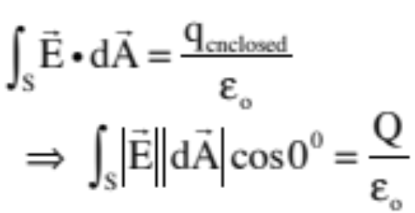
Example 2: This is Example 1 done more reasonable: Derive an expression for the electric field function for a point charge Q.
imaginary Gaussian surface
Important observation: There is no given Gaussian surface to begin with in this problem, just a hanging charge. We need to create an imaginary Gaussian
surface around the charge, one that exploits the symmetry of the charge’s electric field. That is, we need to create a surface such that ever point on the surface is equidistant from the charge.
With the imaginary Gaussian surface centered on the charge, ANY differential area vector dA will be radially outward, which is to say, in the direction of E, and the angle between the electric field vector and the differential area vector will be zero (so the cosine in the dot product will equal 1). With that, we can draw (see sketch), then write:
9.

Slide 10
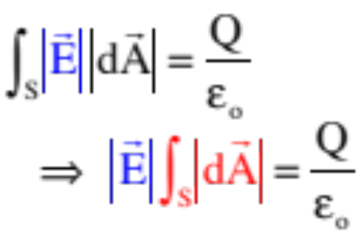

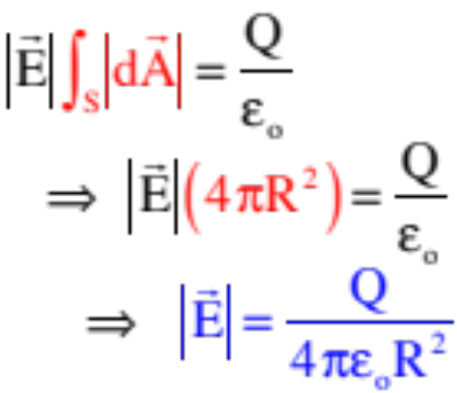
imaginary Gaussian surface
Herein lies the beauty of the method. Because every point on the surface is equidistant from the charge, the evaluation of the E at every differential surface dA WILL BE THE SAME, which is to say, IS A CONSTANT VALUE, and because it is a constant, we can pull it out of the integral. (Note that we couldn’t do that with the original Example 1 because each point was a different distance from Q.) With that, we can write:
That makes life wonderful, as now the only thing inside the integral is the differential surface area dA, and summing that over the surface simply yields the total surface area of the sphere ( ) . . . So we can further write
Look familiar? It should. It’s the same as the electric field function we derived for a point charge using Coulomb’s Law!
10.

Slide 11
So why is this useful?
Gauss’s Law helps us understand what’s going on inside conductors and insulators, and supports what we said about electrostatic equilibrium before. To recap:
  Remember that the field inside a conductor itself is 0!
  Charges on the surface of a conductor can produce electric fields outside the conductor (we’ve seen this).
  Placing a charge inside the conductor can also produce an electric field outside the conductor!
  To wit…
112.

Slide 12
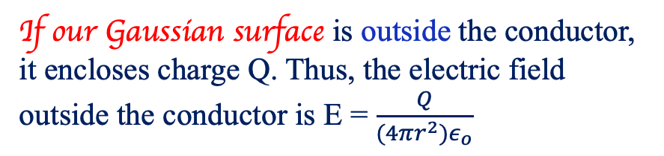
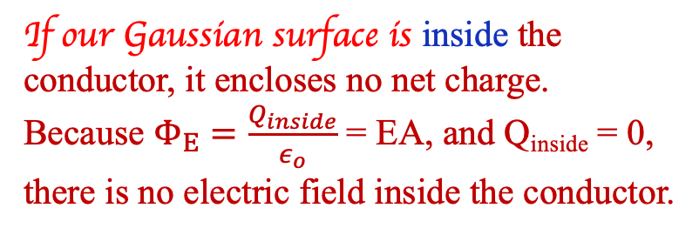
What does the electric field look like here?
The conductor has a net positive charge Q, distributed on its outer surface. From before, we know that the electric field inside the conductor should be zero. Does Gauss’s Law support this?
air
conductor
air
If our Gaussian surface is inside the conductor, it encloses no net charge. Because $Φ_{E}=\frac{Q_{inside}}{ε_{o}}$ = EA, and Q_{inside} = 0, there is no electric field inside the conductor.
If our Gaussian surface is outside the conductor, it encloses charge Q. Thus, the electric field outside the conductor is E = $\frac{Q}{(4πr^{2})ε_{o}}$
12.

Slide 13
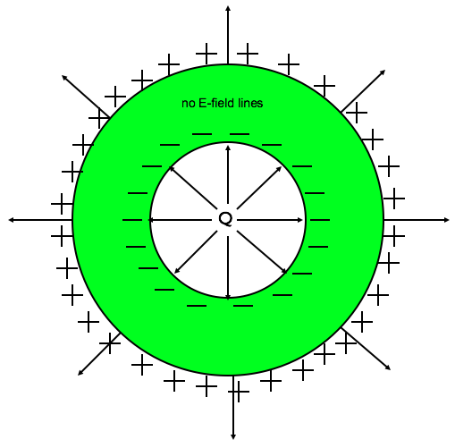
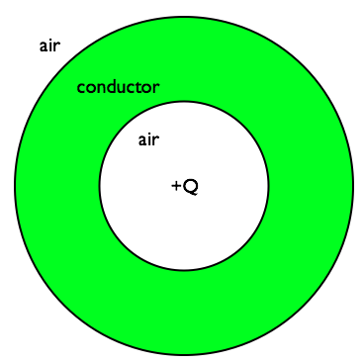
Another example
What do the electric field lines look like for a conducting sphere if there is a charge Q at its center?
This induces a -Q charge on the inside surface of the conductor, and a +Q charge on the outside.
Thus we end up with field lines as shown.
Why are there no field lines in the conductor?
If our Gaussian surface is inside the conductor, it encloses no net charge!
How are there field lines outside the conductor?
A Gaussian surface outside the conductor encloses a net charge of +Q!
13.

Slide 14
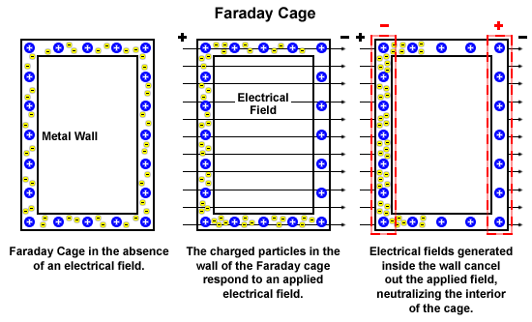
Electrical shielding
c/o C. Vivo
14.

Slide 15
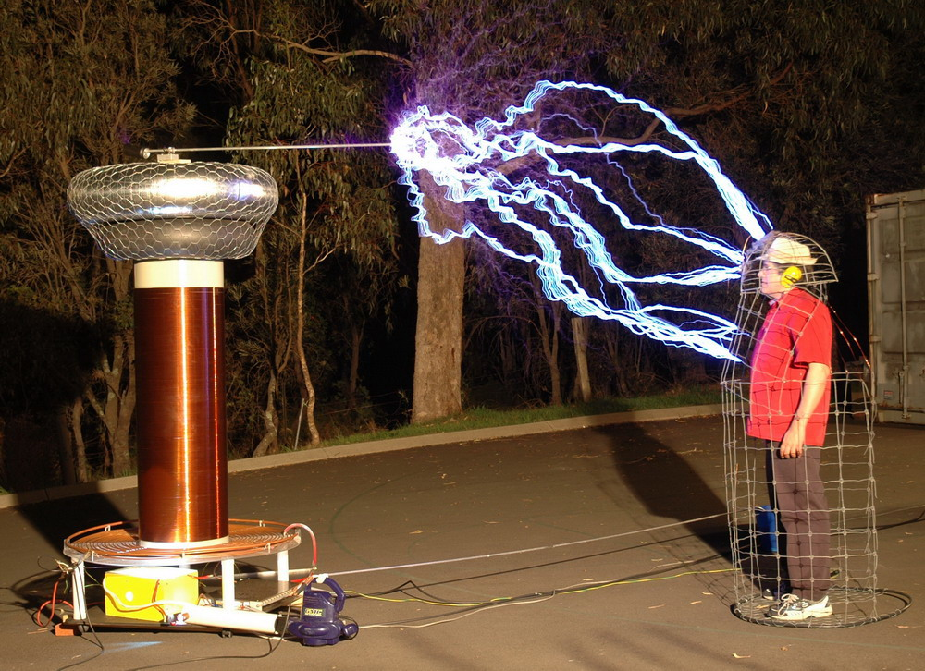
Faraday Cage
c/o C. Vivo
15.

