Slide 1
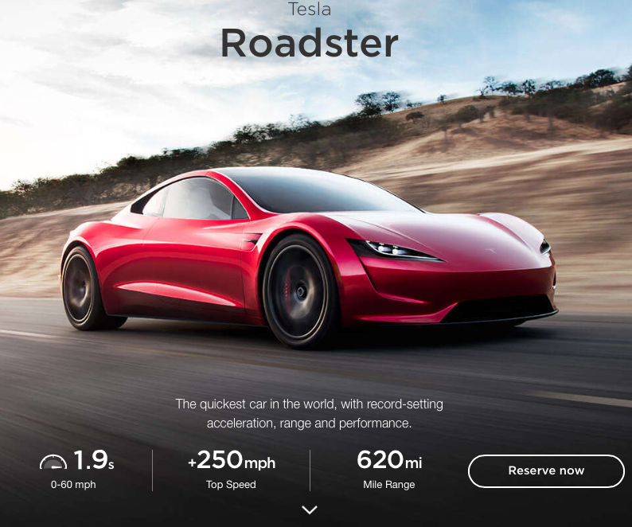
CHAPTER 27:
Current and Resistance
serious
electric car:
1.)

Slide 2








The Analogy
Consider a pipe system through which water flows. What characteristics might that system have?
--It needs a pumping system that produces a pressure difference that will motivate water to flow.
To measure the pressure difference, you need a meter across the pump.
--There is water flow. To measure the amount of flow that passes by per unit time, you need a meter located in the flow.
--There is resistance to flow created by the geometry of the pipe.
--So consider the points a, b and c shown in the upper section. Where is the flow rate the greatest?
Flow rate measures how much water passes by per unit time. It HAS to be the same at every point (otherwise, what happened to the water that didn’t make it?)
2.)

Slide 3



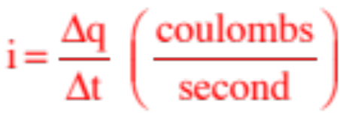
Simple Electrical Circuit
Analogously, the lowly electrical circuit:
--A battery provides power by producing a voltage difference across its terminals. The voltage difference creates an electric field through the wires which motivates charge to move.
--To measure the voltage difference across the battery, you need a voltmeter across the power supply.
--Current is defined as the amount of charge that passes by a point per unit time. Mathematically, this is:
where coulombs/second is given a special name, the ampere (or amp).
--Current is measured with an ammeter placed directly into the circuit.
3.)

Slide 4

--Oddly, when analyzing circuits, current is defined as the motion of POSITIVE CHARGE CARRIERS. That means that “current” (called conventional current to separate it from what is called electron current, which highlights what’s actually happening with electron flow in a circuit), flows from higher to lower voltage. Weird, but that’s the convention.
--A resistor is a circuit element that does two things:
a.) Resistors limit the current in the sense that a large resistance means relatively small current, and a small resistance means relatively big current.
b.) Resistors dissipate energy in the sense that they convert electrical energy into other forms of energy (heat, light, etc.).
Note: Because current is a measure stuff (charge) passing by per unit time, the current entering a resistor must equal the current exiting a resistor. Just sayin ...
4.)

Slide 5





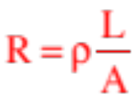

Ohm’s Law
--It has been observed that the voltage across a resistor is proportional to the current through the resistor, or:
--The proportionality constant that makes that relationship into an equality is called the resistance R of the resistor, and the relationship becomes:
--This is called Ohm’s Law.
--As R=V/i, the unit for resistance is the volts/amps, or ohms. The symbol for ohms is (i.e., a capital omega).
--Resistors are temperature dependent. We don’t do anything with this.
--Note that the resistance of a wire of length L, cross sectional area A and resistivity is:
5.)

Slide 6

Lab Cover Artwork
--You are now in a position to come up with some great lab cover artwork. To wit:
mobile ohm
ohm run
ohm plate
ohm on the range
Or go to:
http://home.earthlink.net/~cfletcher
6.)

Slide 7
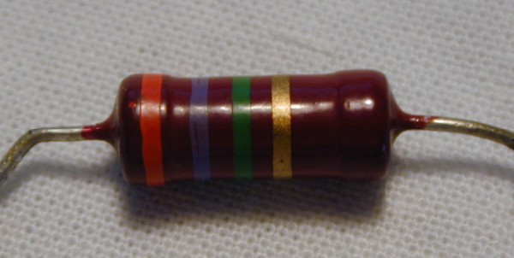
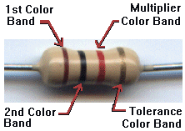
Secret Resistor Code (courtesy of Mr. White)
7.)

Slide 8
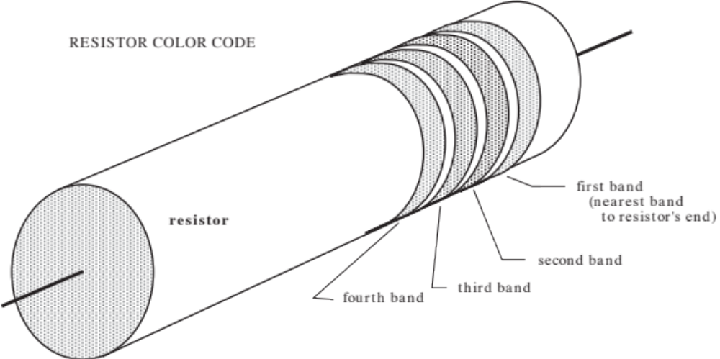


Resistor Color Code
The bands are colored with each color denoting a number.
black 0 green 5
brown 1 blue 6
red 2 violet 7
orange 3 gray 8
yellow 4 white 9
last band gold 5%
last band silver 10%
last band blank 20%
first band
(a)
foruth band
(d)
second band
(b)
third band
(c)
The bands decode as:
Example: If the resistor’s value is , the bands would be colored:
first band: green (for 5);
second band: red (for 2);
third band: blue (for 6);
fourth band: silver (to show
a tolerance of 10%)
8.)

Slide 9
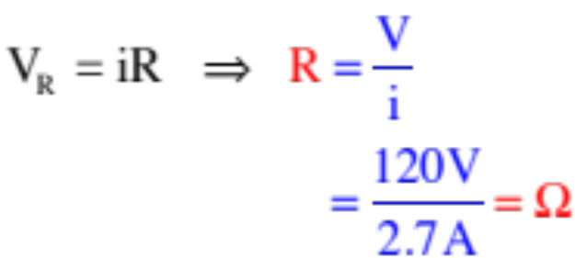
Example 1: (courtesy of Mr. White)
The video projector here uses a 120V_{rms} potential, and “draws” 2.7 Amps of current
a.) What is its resistance?
Note 1: When it comes to power supplies, the electrical potential difference across the power supply’s terminals is often referred to as the power supply’s potential.
Note 2. DC voltage (short for direct current voltage) sets up an electric field that is always in the same direction. AC voltage (alternating current voltage) sets up an electric field that alternates in direction. An AC voltage source will produce some amount of power. The DC source that provides the same amount of power is called AC source’s RMS voltage. It is used in exactly the same way as a DC voltage.
So using Ohm’s Law:
9.)

Slide 10
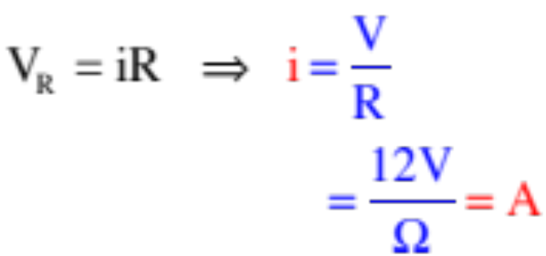
The video projector here uses a 120V_{rms} potential, and “draws” 2.7 Amps of current
b.) What would be the current if the voltage used to run the machine was only 12 volts?
10.)

Slide 11

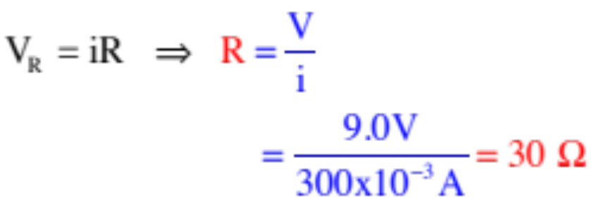


Example 2: (courtesy of Mr. White)
You have an LED with essentially no resistance, that takes 300 mA of current to light. You have a 9 Volt battery that you’d like to use to light the LED.
a.) What will your circuit look like?
b.) How large a resistor should you use to make sure that the LED doesn’t blow out?
c.) What color code should you look for on your resistor?
orange, black, black, blank
11.)

Slide 12
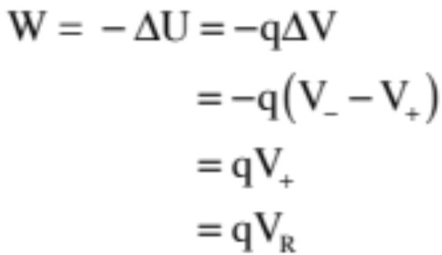




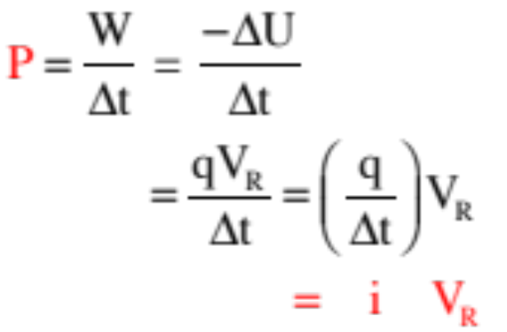

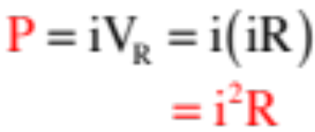
Example 3: Current passes through a resistor? During some period of time, assume q’s worth of charge passes through the resistor. How much work is done on that charge?
Assume the voltage on either side of the resistor is and respectively. With that, we can write:
Example 4: How much power is being dissipated by the resistor in the previous problem?
Power is work per unit time, so:
In short:
This is generally true, but according to Ohm’s Law, we an write:
12.)

Slide 13


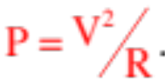
The most general expression for the power rating of an element is:
Power
where i is the current through the element and V is the voltage across the element. Its unit is WATTS.
This is the relationship you would use if you wanted to determine how much power a power supply was providing to a circuit.
When dealing specifically with a resistor, where Ohm’s Law holds sway, the relationship can be written as:
or on very rare occasions,
13.)

Slide 14
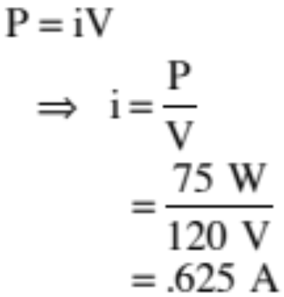
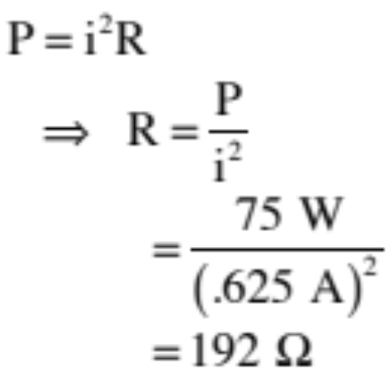
Example 5: A light bulb is rated at 120 volts (RMS), 75 W. Assuming the bulb is powered by a 120 V RMS power supply, determine:
a.) the current in the bulb?
b.) the resistance of the bulb?
14.)

Slide 15
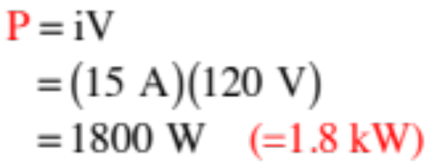
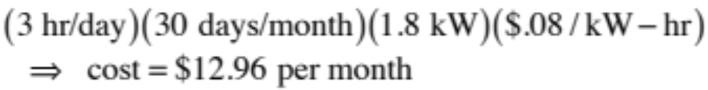
Example 6: An electric heater draws 15 amps on 120 volts (RMS). It operates 3 hours/day for 30 days/month. PG&E charges $.08 per kilowatt-hour.
a.) how much power does the heater draw?
b.) how much does it cost to run the heater for a month?
A kilowatt is a thousand watts, which is a thousand joules per second. A kilowatt-hour is a thousand joules per second times an hour (3600 seconds), which is a unit of energy (that’s what the power company is charging you for when it registers your kW-hr usage for the month, the energy you use). We can leave things in kW-hrs, though, and just use dimensional analysis on this:
15.)

Slide 16
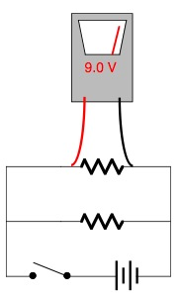
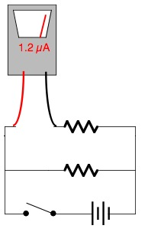
Lab this week (courtesy of Mr. White)
Measuring voltage Measuring current
27.)

Slide 17
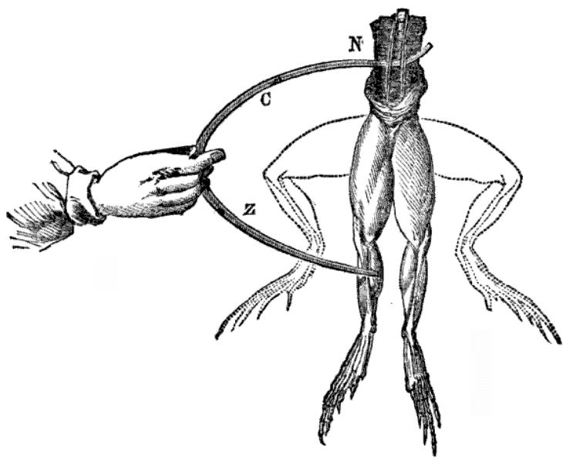
The Electric Battery (courtesy of Mr. White)
1780s - Galvani vs. Volta
28.)
Notes:
1780s -- Luigi Galvani --experiments w/ frogs, and contraction of leg muscles in the presence of static electric charges. One day, while cutting a frog leg with a steel scalpel, the scalpel accidentally touched a slime covered brass hook that was holding the frog’s leg in place, and it started twitching. He suspect that the twitching was due somehow to the metal conducting the “animal electricity,” which he took to be evidence of the animal’s “life force.”
Alessandro Volta, a friend of Galvani’s who lived about 200 km (120 miles) away, respectfully disagreed. Volta thought that the source of electricity wasn’t the animal, but the brass and steel metals themselves.
Volta conducted a series of experiments with various metals, and various types of moist conductors between the metals, in order to determine which combinations of materials would cause the frogs’ legs to twitch the most.
Volta couldn’t convince Galvani that the metals produced the electricity, because the frog legs were the only “electroscope” at the time capable of detecting such small amounts of charge.
Galvani--static charges produce twitching
twitching was evidence of “animal electricity”, or “life force”
Volta--twitching was evidence of electric charges in metals
Volta’s experiments lead him to develop the first Electric Pile, or Battery. Less potential, but ability to deliver current over a long period of time

Slide 18
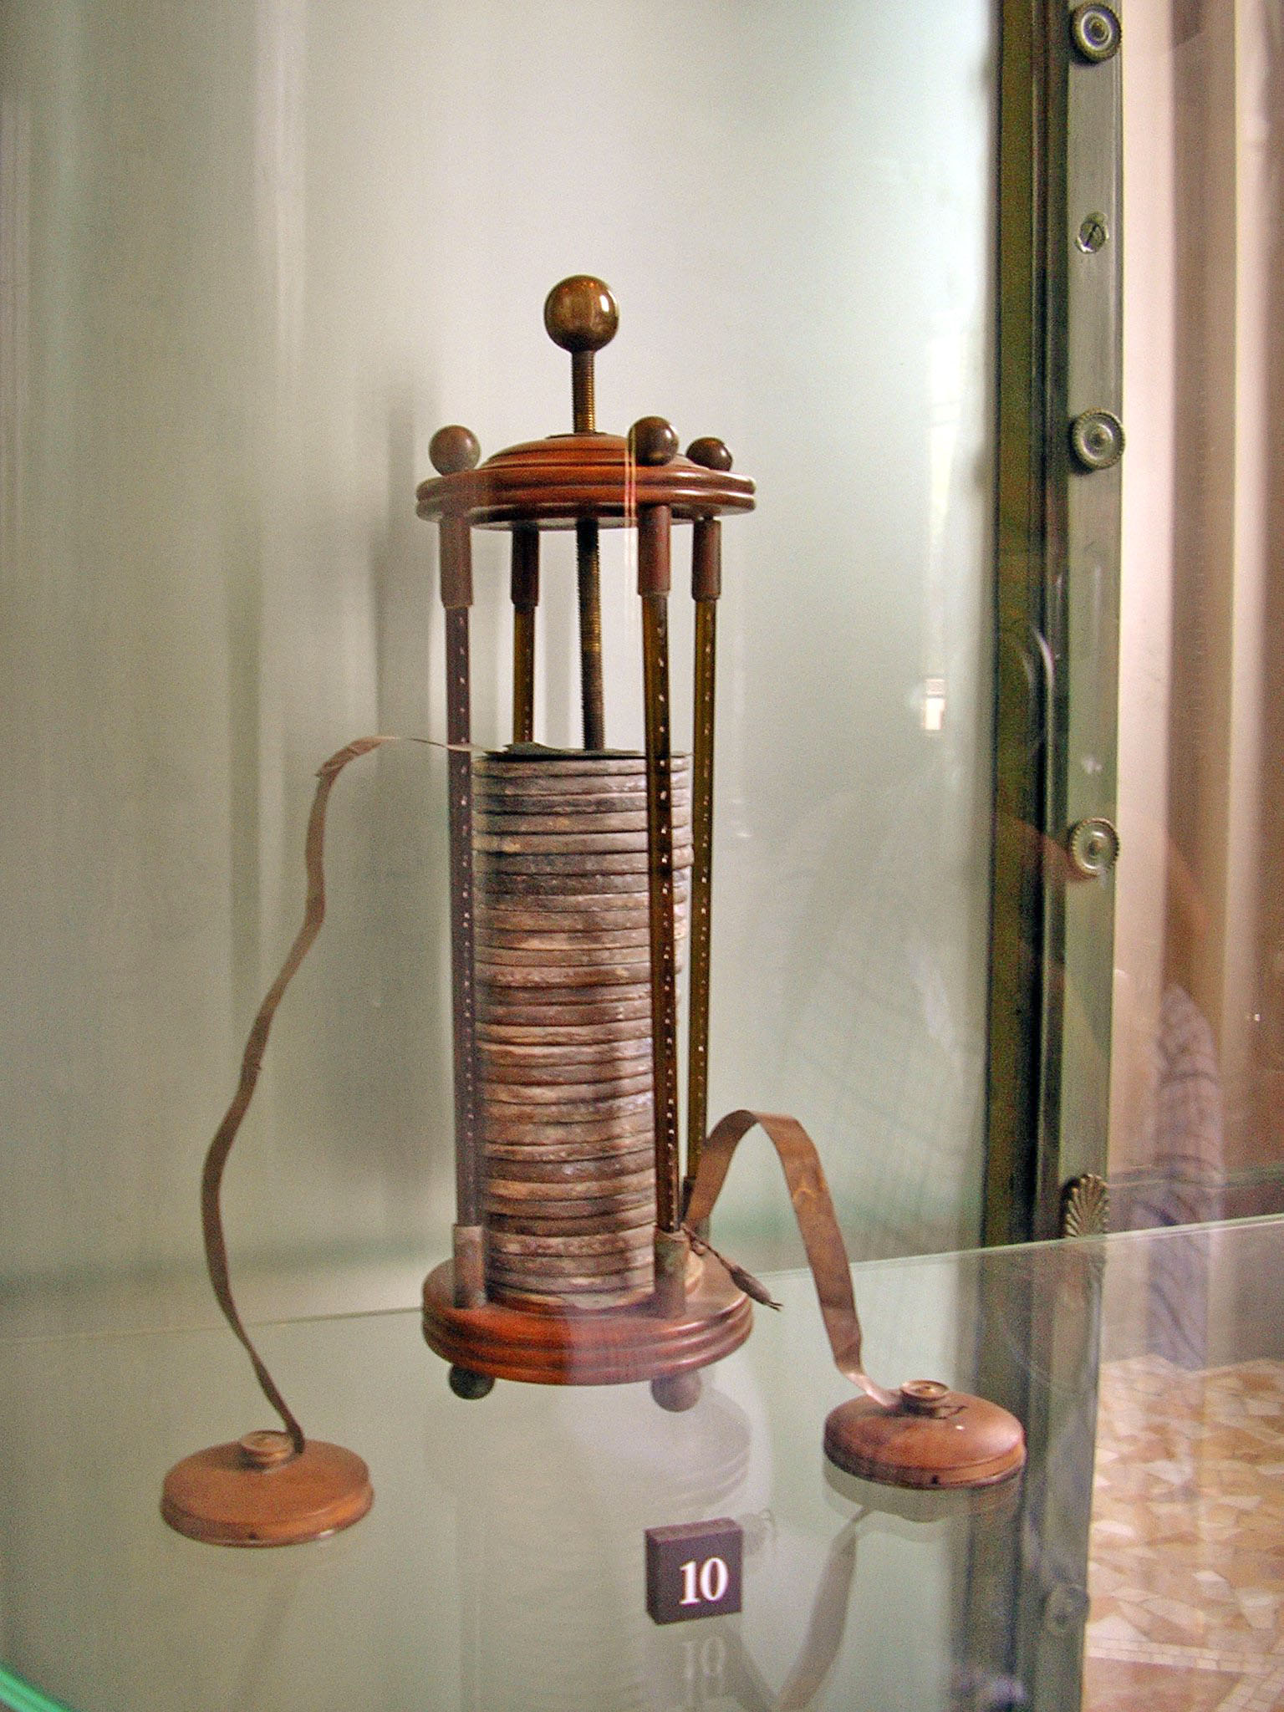
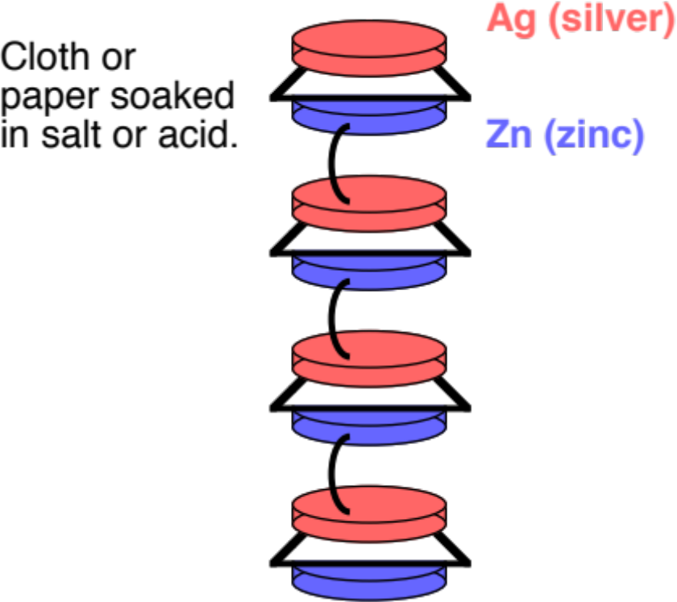
The Electric Battery (courtesy of Mr. White)
1780s - Galvani vs. Volta
29.)
Notes:
1780s -- Luigi Galvani --experiments w/ frogs, and contraction of leg muscles in the presence of static electric charges. One day, while cutting a frog leg with a steel scalpel, the scalpel accidentally touched a slime covered brass hook that was holding the frog’s leg in place, and it started twitching. He suspect that the twitching was due somehow to the metal conducting the “animal electricity,” which he took to be evidence of the animal’s “life force.”
Alessandro Volta, a friend of Galvani’s who lived about 200 km (120 miles) away, respectfully disagreed. Volta thought that the source of electricity wasn’t the animal, but the brass and steel metals themselves.
Volta conducted a series of experiments with various metals, and various types of moist conductors between the metals, in order to determine which combinations of materials would cause the frogs’ legs to twitch the most.
Volta couldn’t convince Galvani that the metals produced the electricity, because the frog legs were the only “electroscope” at the time capable of detecting such small amounts of charge.
Galvani--static charges produce twitching
twitching was evidence of “animal electricity”, or “life force”
Volta--twitching was evidence of electric charges in metals
Volta’s experiments lead him to develop the first Electric Pile, or Battery. Less potential, but ability to deliver current over a long period of time

Slide 19


How It Works (courtesy of Mr. White)
Two electrodes (carbon and zinc) are immersed in a dilute acid (the electrolyte).
C
As the acid dissolves the Zn, ions are drawn into the electrolytic solution leaving
in the zinc.
C⁴⁺
2e–
Zn²⁺
2e–
Zn²⁺
C⁴⁺
Extra are pulled from the carbon rod to neutralize the now positively charged electrolyte, leaving positive charges (electron holes) on the carbon.
2e–
2e–
Zn²⁺
Zn²⁺
e–
e–
e–
Zn
e–
e–
e–
e–
In this way, an electrical potential difference is created between the rod and the bottom plate of the battery.
e–
30.)
Notes:
As acid eats into Zn, Zn²⁺ ions are drawn into electrolyte, leaving e⁻ in the zinc. Extra e⁻ are pulled from the carbon rod to neutralize the now positively charged electrolyte, leaving “positive charges” (electron holes) on the carbon.

