Slide 1

CHAPTER 28A
Elementary DC Electrical Circuits
1.)

Slide 2










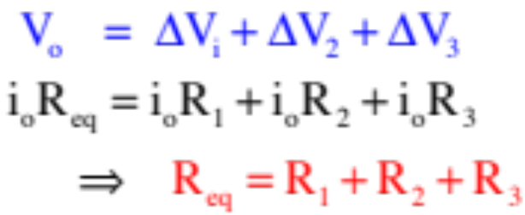
Series Resistor Combinations
Example 2: Derive an expression for the equivalent resistance (the single resistor that can take the place of the resistor combination) for the series combination shown to the right. Assume an ideal power supply with no internal resistance.
The idea behind is to find the single resistor that can take the place of all the resistors in the system. In other words, the single resistor that, when put across will draw .
Using the idea that the sum of the voltage drops across all the resistors will equal the voltage drop across the power supply, and including Ohm’s Law in the mix, we can write:
2.)

Slide 3






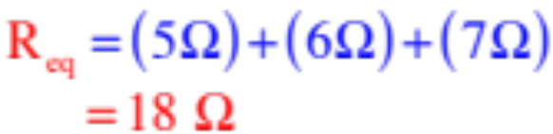
Characteristics of a Series Combinations
--Each element in a series combination is attached to its neighbor in one place only.
--Current is common to each element in a series combination.
--There are no nodes (junctions—places where current can slit up) internal to series combinations.
--The equivalent resistance for a series combination is:
--This means the equivalent resistance is larger than the largest resistor in the combination;
--This means that if you add a resistor to the combination, will increase and the current through the combination (for a given voltage) will decrease.
Example 3: What’s the equivalent resistance of a resistor in series?
3.)

Slide 4



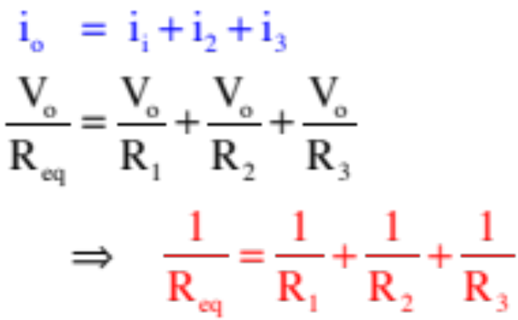
Parallel Resistor Combinations
Example 3: Derive an expression for the equivalent resistance (the single resistor that can take the place of the resistor combination) for the parallel combination shown to the right. Assume an ideal power supply with no internal resistance.
What’s common in a parallel combination is the voltage drop across each element.
Also, in this case, the sum of the currents through the parallel combination must equal the current drawn from the power supply. Using that and Ohm’s Law, we can write:
4.)

Slide 5



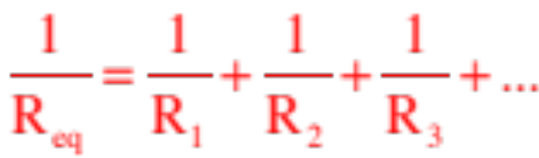
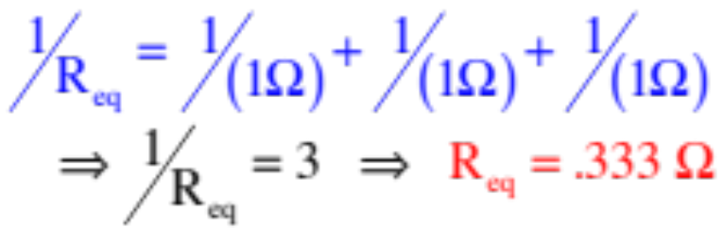
Characteristics of a Parallel Combinations
--Each element in a series combination is attached to its neighbor in two place.
--Voltage is common to each element in a parallel combination.
--There are nodes (junctions—places where current can slit up) internal to parallel combinations.
--The equivalent resistance for a parallel combination is:
--This means the equivalent resistance is SMALLER than the smallest resistor in the combination;
--And, if you add a resistor to the combination, will decrease and the current through the combination (for a given voltage) will increase.
Example 3: What’s the equivalent resistance of three one-ohm resistors in parallel?
5.)

Slide 6






Seat of the Pants Problems
Example 4: An ideal power supply has EMF powering it. Any blue letters that show up designate points on the circuit. Assume the low voltage terminal of the p.s. is at zero volts. Assume the resistor values are the same as the resistor subscripts.
a.) What is the first thing you would do if asked to work with this circuit?
Redraw the circuit without the meters. They aren’t doing anything in the circuit except identifying a branch or resistor for which you want a current.
b.) What is the absolute electrical potential at Point a?
There is essentially no resistance between Point a and the high voltage terminal of the p.s., so their voltages are the same point being .
c.) What will the ammeter read?
Some amount of current is being drawn from the power supply. Being in the same branch as Points a, b and g, it will be the same for all three points. It will also be the current through the ammeter. So how do we get that?
6.)

Slide 7
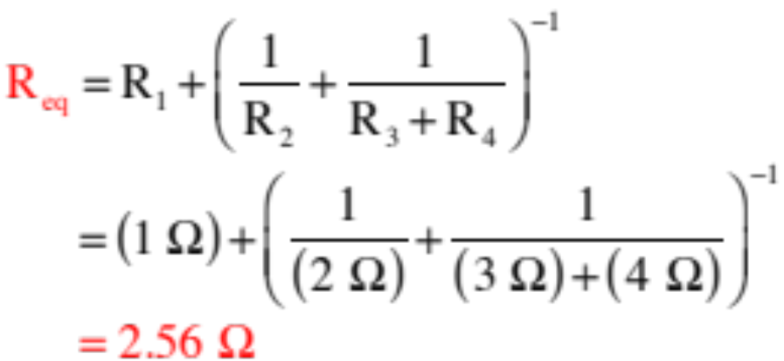
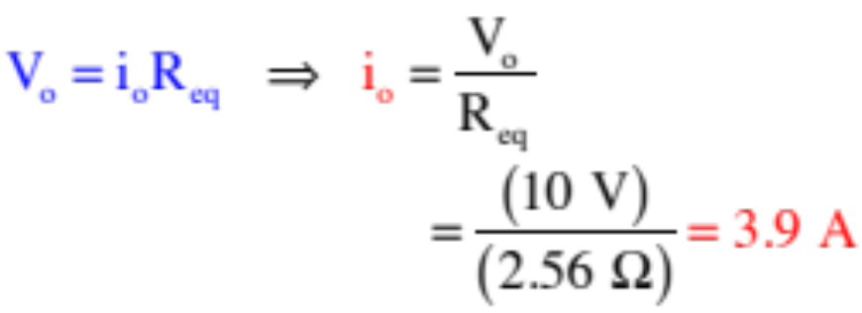
c.) ammeter?
Here is the circuit with the meters removed. The trick here is to find the equivalent resistance for the circuit, then use Ohm’s Law.
This circuit is in series with in parallel with and in series. That is:
Using the circuit:
The ammeter will read 3.9 amps.
7.)

Slide 8
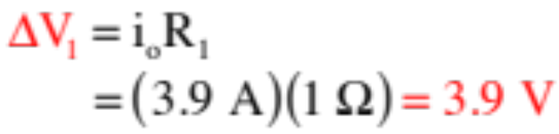
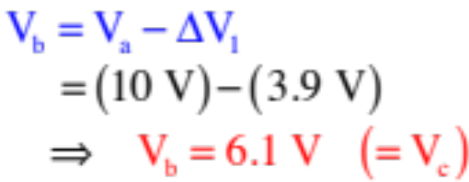

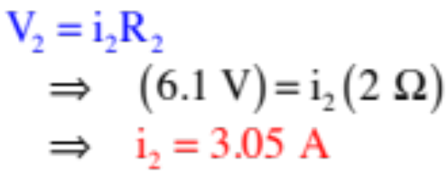
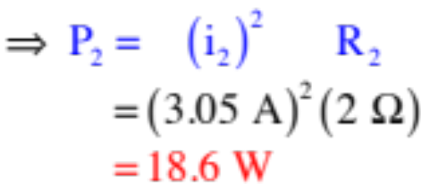
d.) How much power does dissipate?
We know the absolute electrical potential (the voltage) at Point a is 10 volts.
We know current goes from high voltage to low voltage, so the voltage change across must be a voltage DROP equal to:
Logic dictates that the absolute electrical potential at Point b is:
Because the absolute electrical potential at Point d is zero, the voltage across equals and:
The power dissipated by is, then:
8.)

Slide 9




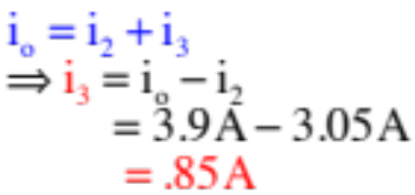
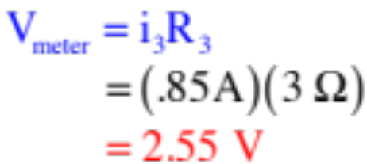
e.) What does the voltmeter read?
You should begin to see a pattern here. Every question, whether it be asking for an ammeter reading or voltmeter reading or power calculation or current through an element or voltage cross an element, they all require you to determine the CURRENT
through the branch in which the element exists. That, in general, is what you will always be doing—trying to derive expressions for current values.
In this case, you could determine the current through the far-right branch (so you could use Ohm’s Law on to get what the voltmeter would read) by using the same approach we used to get the current in the central branch in Part c (you’d just be using Points e and f instead of Points c and d in the process).
Or . . .
Look at node h
So
9.)

Slide 10













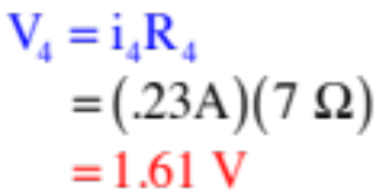
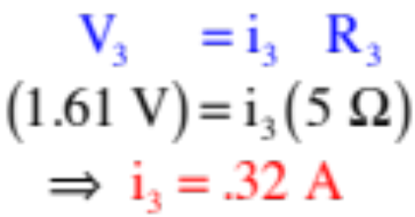
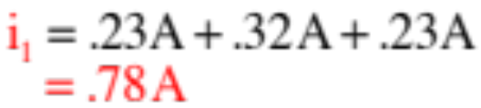
Example 5: A power supply with of internal resistance is used to power a circuit. If the current through is .23 amps, what is the current through ?
Start with what is obvious.
The current through in the bottom branch will equal all the currents in the parallel combination put together, or
We know the current through (given) and (same size resistance with same voltage across it), so all we need is the current through .
The voltage across each of the parallel resistors is the same, and equal to:
The the current through is:
So:
10.)

Slide 11







Example 6: The current from the battery is 3 amps. How much current goes through the upper branch of the parallel combination?
This is another use-your-head question.
If the upper branch has half the resistance of the lower branch, it should draw twice the current.
With 3 amps coming in, that means 2 amps should pass through the upper branch.
Note: AP questions often have easy, non-mathematical, use-your-head solutions like this. That is why I’m showing you screwball problems like this. We will get into a more formal approach for analyzing circuit problems shortly.
11.)

Slide 12









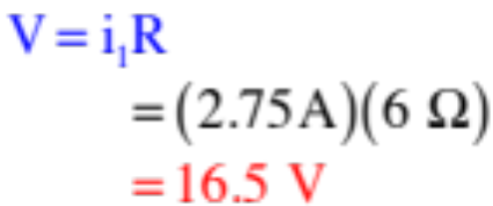



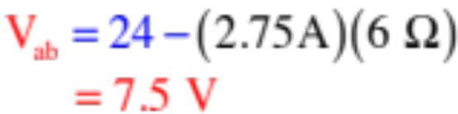
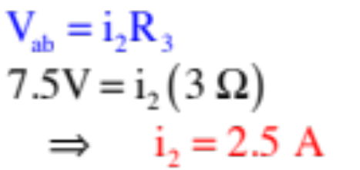
Example 7: Consider the circuit shown.
a.) What does the voltmeter read?
b.) What is the voltage difference between Points a and b?
Assuming the voltage at Points a is zero (not a bad bet as it’s sandwiched between two battery ground terminals), the voltage changes will be due to the increase due to the battery in the right branch and the drop due to the 6 ohm resistor. That is:
c.) What does the ammeter read?
This is just the current through the 3 ohm resistor, or:
12.)

Slide 13

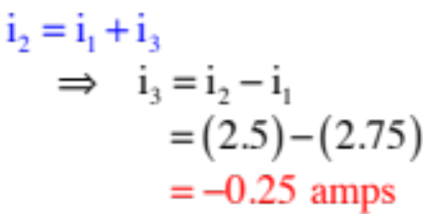

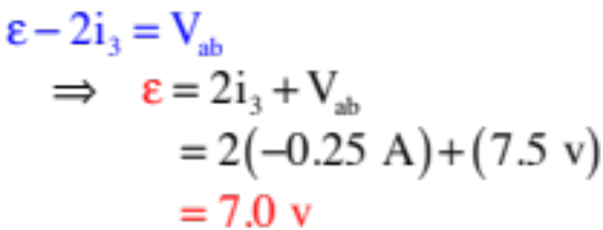
c.) What is the current ?
The currents into node a have to equal the currents out of node a, so we can write:
b.) What is the battery EMF in the left branch?
Using the same technique of tracking voltage changes starting at Point a, remembering that the voltage DROPS if you are traversing in the direction of the current flow and using the negative value for , we can write:
13.)

Slide 14




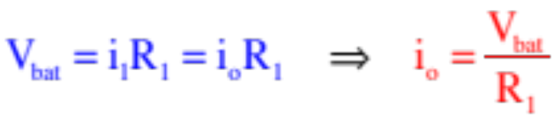



EMF and Terminal Voltage
Example 8: Consider the circuit to the right. If the resistors represent light bulbs:
a.) What does the ammeter read when the switch is open?
(step 1—redraw without the meters)
All the battery’s voltage drop happens across the resistor , and the current through the ammeter is just , so:
b.) In an ideal world, what should happen to the current through when the switch is thrown?
Nothing, and this is tricky. If you think of the current from the battery as fixed, you’ll conclude current will drop as some current will now be needed for . But au, contraire. Current through is governed by the voltage across it and its resistance, neither of which changes when you throw the switch. So what happens?
The battery outputs MORE CURRENT so and , in theory, should remain unaffected.
14.)

Slide 15







c.) Here’s the rub: if you carry this experiment out in the real world, the light bulb associated with will actually dim suggesting that the current through has diminished. So what’s going on?
The problem lies in the internal workings of power supplies. There are actually two parts to a p.s.:
1.) There is the part of the battery that creates the electric field that motivates charge to move through the wires. This part has the units of volts and is called the electromotive force, or EMF (symbol );
2.) Although it is possible to “rectify” a power supply to compensate for this, a power supply in its natural state also has internal resistance .
Including the voltage drop due to , this means a VOLTMETER will read what is called the terminal voltage (i.e., the voltage as measured at the terminals of the p.s.) equal to:
Soooo, if you increase by throwing the switch, does DOWN across the resistors and the bulbs will dim!
15.)

Slide 16






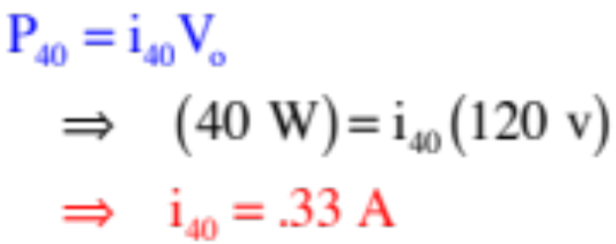
Power and Resistors in Series
Example 9: Consider a 40 watt, a 60 watt and a 100 watt lightbulb hooked up in series across a 120 volt (RMS) power supply (a wall socket). Which of the bulbs will shine the brightest? Justify your prediction.
The brightest will be the 40 watt bulb. How so?
The first thing we need to know is how much current is required to make each bulb glow to its maximum capacity. To do that, consider each bulb by itself across a standard 120 volt (RMS) outlet:
16.)

Slide 17
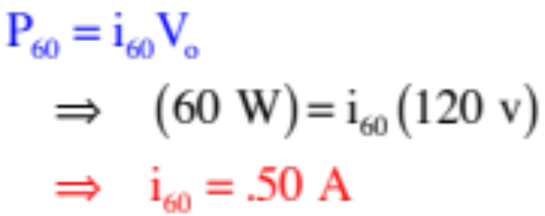
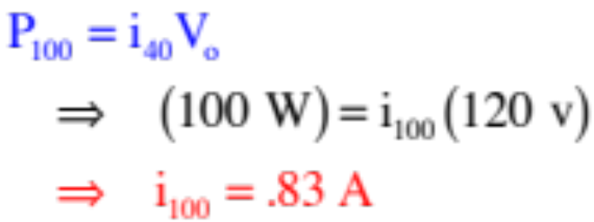

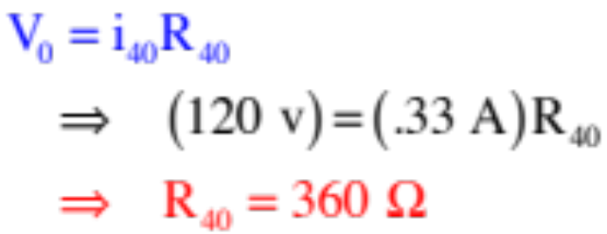
Executing a similar process for the other two bulbs yields:
The next thing we need to know is the resistance of each bulb. Using Ohm’s Law:
17.)

Slide 18
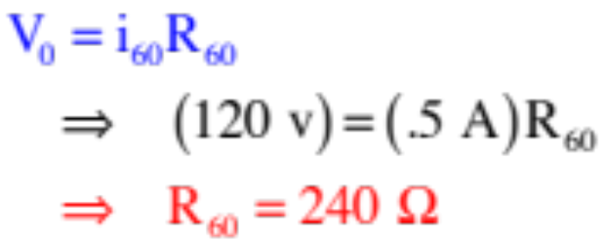
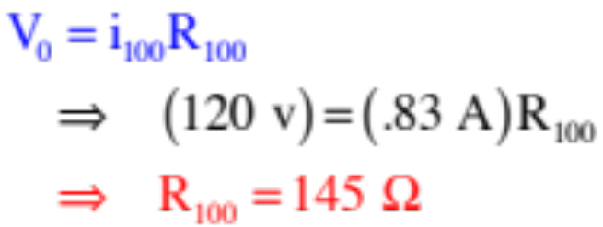

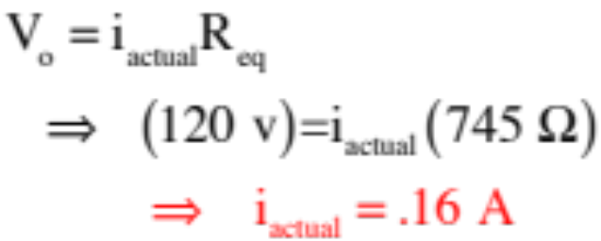
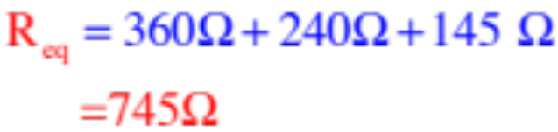
Executing a similar process for the other two bulbs yields:
With that, the equivalent resistance and, hence, actual current in the circuit becomes:
and
which is way too little current to power the 100 W bulb and just barely enough to power the 40 W bulb!
18.)

Slide 19
Sign of a Current
Example 10: Let’s say you were to solve for the current through the middle branch of the parallel combination, and the numerical answer turned out to be -8 amps.
What would the negative sign signify?
It would tell you you had assumed the WRONG DIRECTION for charge flow in the branch, which is to say, the arrow denoting the current in the branch would be in the wrong direction.
Consequence: You could state this fact, but you wouldn’t have to change anything. The real point of order is that if you were to use that current value in subsequent calculations, you would leave it negative.
19.)

Slide 20


Some Definitions
A branch: A section of a circuit in which the current is the same everywhere.
Loop 3
branch
branch
--elements in series are a part of a single branch (look at sketch).
branch
Loop 1
Loop 2
--in the circuit to the right, there are three branches.
A node: A junction where current can split up or be added to.
--elements in parallel have nodes internal to the combination.
--in the circuit above, there are two nodes.
A loop: Any closed path inside a circuit.
--in a circuit, loops can be traverse in a clockwise or counterclockwise direction.
--in the circuit above, there are three loops.
20.)

Slide 21



For your Amusement
For the circuit to the right:
a.) How many branches are there?
six
b.) How many nodes are there?
four
c.) How many loops are there?
seven
And that last little nubbin is supposed to be a tooth, cause this looks like a face to me!
21.)

