Slide 1

CHAPTER 28B (extended):
Kirchoff’s Laws and Capacitors
1.)

Slide 2







The Island Series:
You have been kidnapped by a crazed physics nerd and left on an island with twenty-four hours to solve the following problem. Solve the problem and you get to leave. Don’t solve the problem and you don’t.
The problem: Determine the equivalent resistance for the combination of resistors found in the circuit to the right.
1.)

Slide 3


Some Definitions
A branch: A section of a circuit in which the current is the same everywhere.
Loop 3
branch
branch
--elements in series are a part of a single branch (look at sketch).
branch
Loop 1
Loop 2
--in the circuit to the right, there are three branches.
A node: A junction where current can split up or be added to.
--elements in parallel have nodes internal to the combination.
--in the circuit above, there are two nodes.
A loop: Any closed path inside a circuit.
--in a circuit, loops can be traverse in a clockwise or counterclockwise direction.
--in the circuit above, there are three loops.
2.)

Slide 4
For the Amusement
For the circuit to the right:
a.) How many branches are there?
six
b.) How many nodes are there?
four
c.) How many loops are there?
seven
And that last little nubbin is supposed to be a tooth, cause this looks like a face to me!
3.)

Slide 5
For the Amusement
For the circuit to the right:
a.) How many branches are there?
six
b.) How many nodes are there?
four
c.) How many loops are there?
seven
And that last little nubbin is supposed to be a tooth, cause this looks like a face to me!
3.)

Slide 6














Kirchoff’s Laws—the Formal Approach
With the definitions under your belt, Kirchoff’s Laws are simple (and you’ve been inadvertently using them in the seat-of-the-pants evaluations). They are:
Node A
Kirchoff’s First Law: The sum of the currents into a node equals the sum of the currents out of a node. Mathematically, this is written as:
Loop 1
Loop 2
Example from the circuit’s Node A:
Kirchoff’s Second Law: The sum of the voltage changes around a closed path (a loop) equals ZERO. Mathematically, this is written as:
Examples: starting at Node A:
Loop 1 traversing counterclockwise:
Loop 2 traversing clockwise:
Note: Current moves from hi to lo voltage, so traversing against the current through a resistor produces a that is positive; traversing with current makes it negative.
4.)

Slide 7



Kirchoff’s Laws—Using the Approach
Example 8: Determine the meter reading in the circuit to the right using Kirchoff’s Laws. Assume the power supply is ideal with an EMF of 10 volts, and assume the resistor values are the same as their subscripts (this is essentially Example 4).
Node A
Step 0: Remove the meters.
Step 1: Define one current for each branch.
Step 2. Write out node equations for as
many nodes as you can (see note below). Be sure to identify which node you are working with. For this problem:
Node A:
Important note: If you had written out the node equation for the node at the bottom, you would have gotten . This is the same equation as above. There will always be fewer independent node equations than actual nodes in a circuit. In this case, there were two nodes and only one independent node equation.
5.)

Slide 8


Additional note: You have three branches and three unknown currents, which means you will need three equations to solve. You have one node equation, which means you will need two more equations, presumably from your loops. Kindly note: there are three loops in this circuit, but you can only get TWO INDEPENDENT LOOP EQUATIONS
Node A
Loop 1
Loop 2
from them. Any two of those equations will do, and any two will produce the third, which means that if you try to do this problem using nothing but loop equations, you’ll end up with mush. (Try it if you don’t believe me!)
Step 3. Identify and label the loops you will use. Use an arrow in each to show the direction you intend to traverse that loop.
Note 1: If there is a power supply in the loop, I prefer to start at the low voltage terminal and proceed through the supply. That way, the voltage change through the supply will be positive. With that in mind:
Loop 1:
Loop 2:
Note 2: Put resistance terms first as they’ll usually be assumed known whereas currents will not be.
6.)

Slide 9




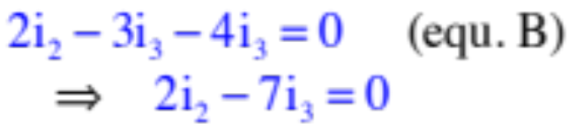
Solving 3 Equations with 3 Unknowns
We have three equations and three unknowns. The ammeter is in the branch whose current is . So how to solve for ? There are three approaches.
Our equations:
Putting in the numbers to make life easier:
Approach 1—Brute force algebra:
I’ll lay this out on the next page, just to convince you it’s not the way to go.
7.)

Slide 10

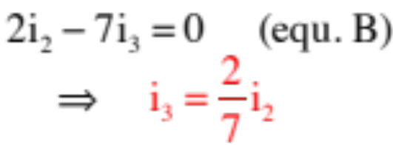
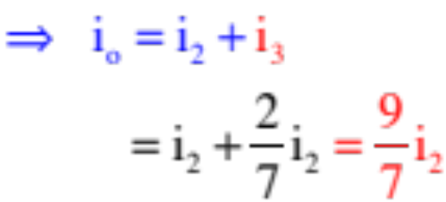
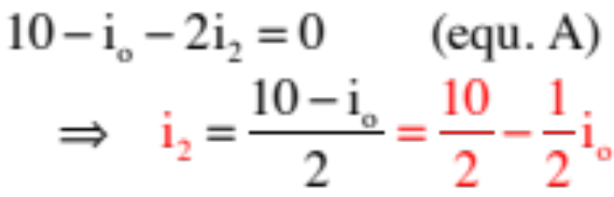
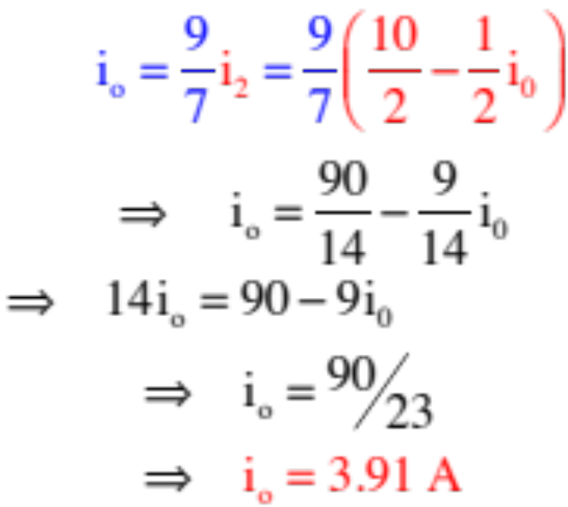
Like I said, NASTY!
as
but
so
8.)

Slide 11




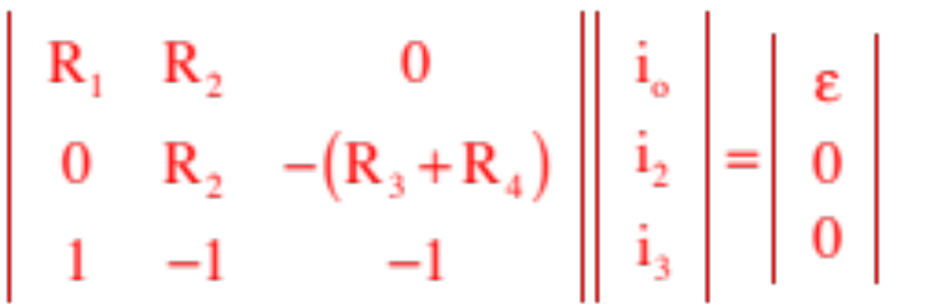
Approaches 2 and 3: Matrices:
--Begin by rewriting each equation so their term is in the first column, its term is in the second column, etc., and its voltage term (if there is one) is on the right side of the equal sign.
Our equations become:
--Put the information into a matrix:
voltage
column
column
column
column
9.)

Slide 12
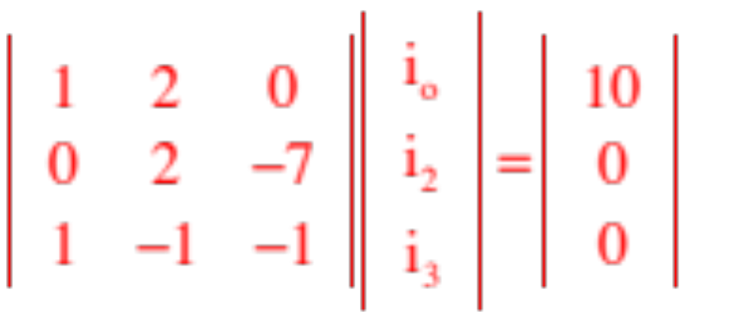
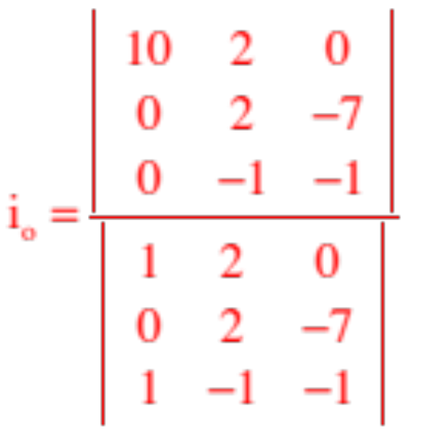
--Using numbers:
becomes
--You have two options at this point, depending upon your abilities with a calculator and whether there are any variables in your relationship. The first approach is a manual evaluation of the matrices and will always work.
Noting that the left-hand 3x3 matrix is called the determinate, solving for, say, , requires the evaluation of two matrices, one divided into the other. Specifically, the determinate divided into the determinate with the column replaced by the voltage column (the far column to the right). That is:
10.)

Slide 13
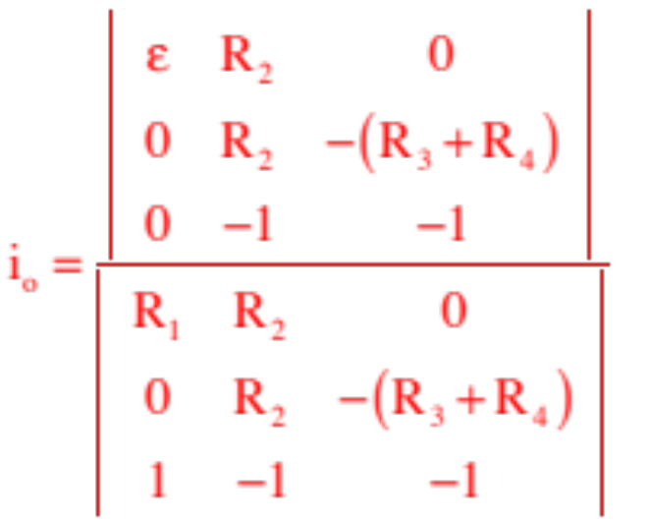
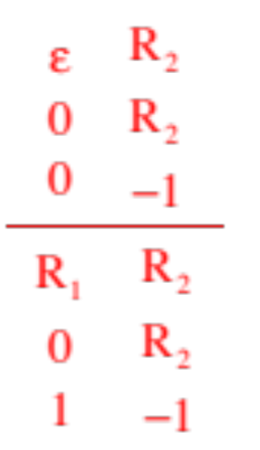
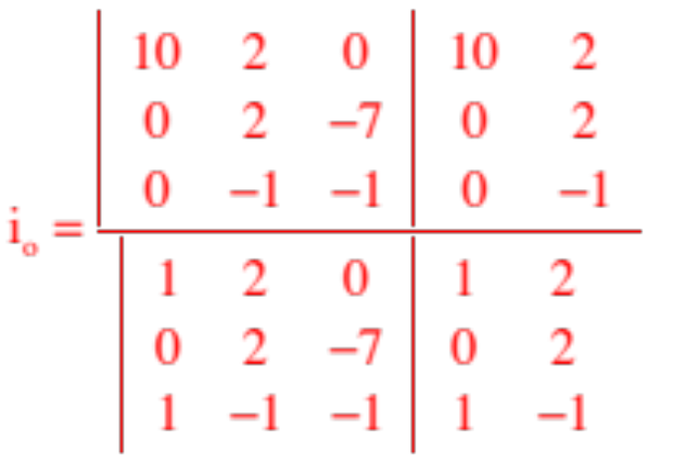
--How to evaluate a matrix? Start by reproducing the first two columns at the end of the matrix.
--With numbers:
11.)

Slide 14
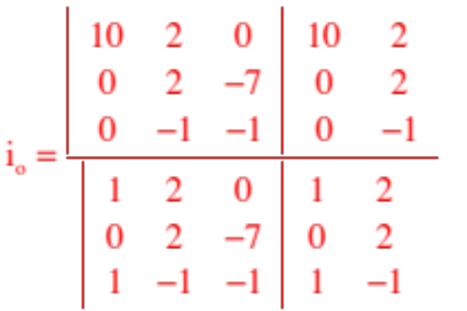
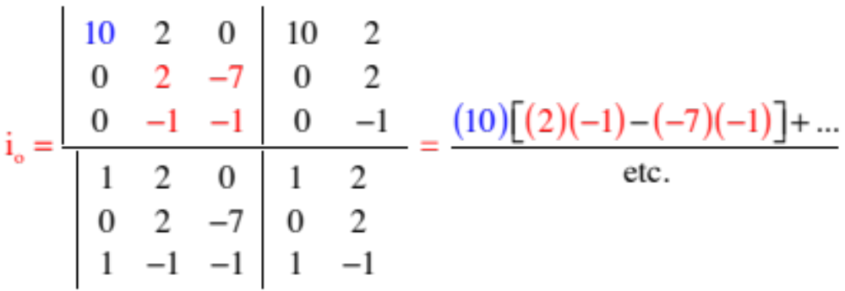
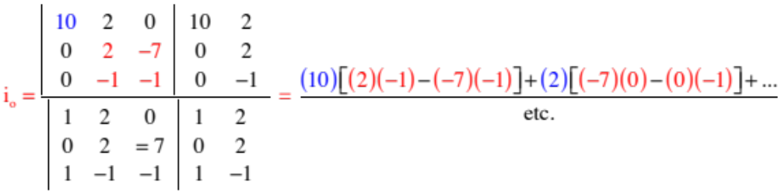
--The first part of the execution is shown below:
--The second part:
12.)

Slide 15
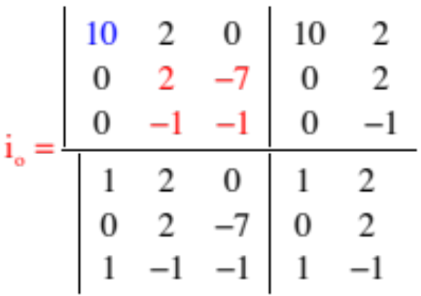
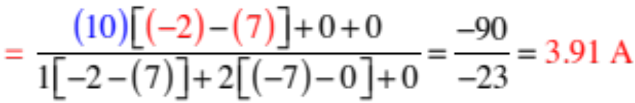
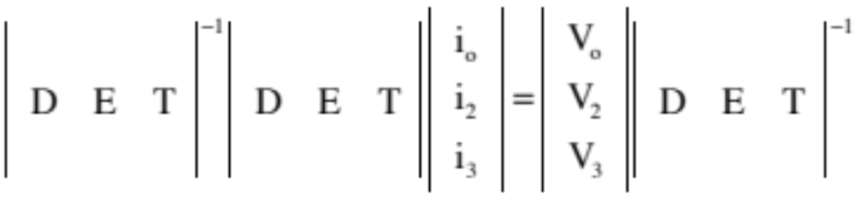

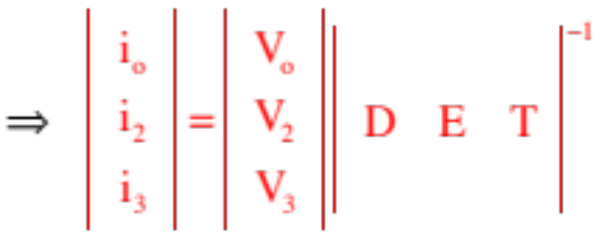
--Once you get the hang of the pattern, you can do these in your head without writing much of anything down:
--The other alternative has to do with matrix manipulation on a calculator. Specifically, if you multiply everything by the inverse determinate, you end up with a 1x3 matrix whose elements are the solution for the three unknowns.
13.)

Slide 16







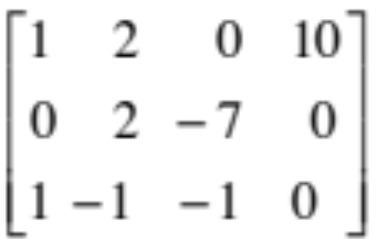
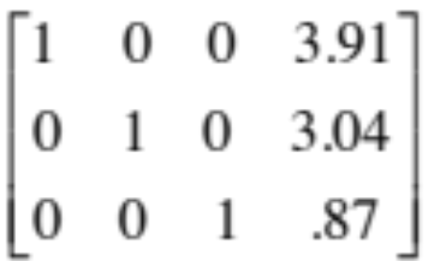



--the alternate alternate is to have your calculator execute an rref (reduce row echalon format) operation. The following is courtesy of Mr. White.
Using your calculator:
Math -> Matrix -> Edit -> A (for name of matrix) . . . note that some calculators just have a “matrix” key you can use (versus starting with “math”)
3 [Enter] 4 [Enter] (this gives you a 3x4 matrix)
Enter coefficients and values into Matrix; exit, then go back to “matrix” and:
In “math,” use “rref” A (reduced row echelon form)
You’ll end up with 1’s and the last row will give you the current values.
14.)

Slide 17

Example 9: Example 8 using a clever shortcut. Again the power supply is ideal with an EMF of 10 volts, and assume the resistor values are the same as their subscripts.
Node A
Step 0: Remove the meters.
Step 1: Define one current for each branch.
And here is the clever move.
Think about it. If current comes into
node A,
how much current must go through ? Must be . So why not just call it that (instead of )? Doing so eliminates one unknown, which makes the solving a lot easier.
and current goes out of node A and through ,
Consequence: You only need to write two loop equations (you’ve already used the node information in defining the currents).
15.)

Slide 18
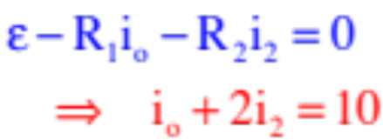
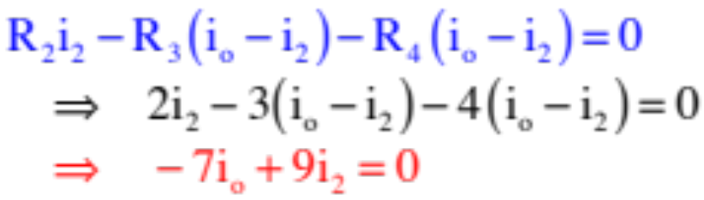
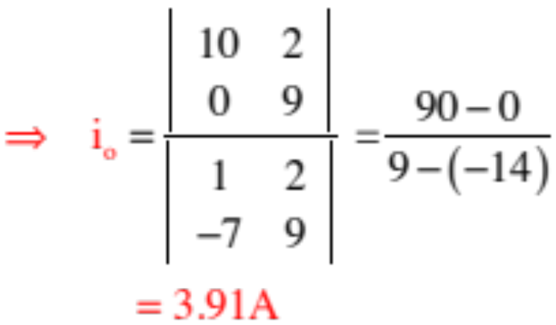
Loop 1:
Node A
Loop 2:
Loop 1
Loop 2
Solving:
16.)

Slide 19
The Island Series:
You have been kidnapped by a crazed physics nerd and left on an island with twenty-four hours to solve the following problem. Solve the problem and you get to leave. Don’t solve the problem and you don’t.
The problem: You are given a small spotlight, the outline of a bat that can go over the lamp’s face, two copper serving platters, some wire and a car battery. You find that if you hook the battery to the lamp, it doesn’t shine very brightly. You need it to shine brightly, but only for a second (you want to project the bat-signal onto a cloud so Batman will come rescue you). What clever thing might you do to light up the lamp for just a moment?
Solution: Set the two plates close without touching and parallel to one another (they have to be rigidly separated). Hook one lead from the battery to one of the plates and the second lead to the other plate. This will allow the plates to charge up, acting like a capacitor. Disconnect the lead. Hook one lamp lead to one of the plates. When you hook the other lead to the other plate, the cap will discharge very quickly through the lamp, providing a burst of energy that should light it up nicely.
17.)

Slide 20
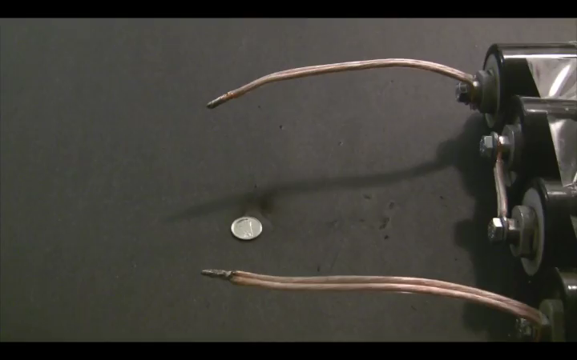
CHAPTER 26:
Capacitors
discharging capacitor:
18.)

Slide 21
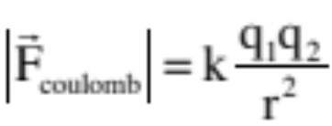
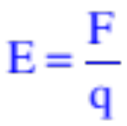
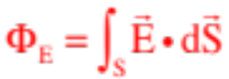
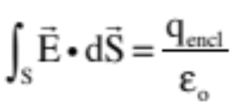
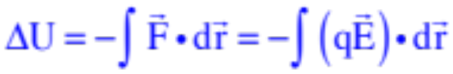
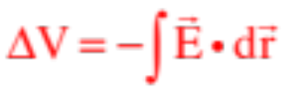
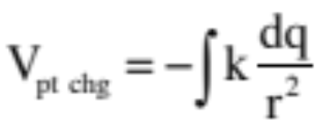
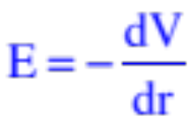
General Review
Electric fields: exist in presence of charge configurations; are modified force-fields
Gauss’s Law: used to generate electric field functions for symmetric charge configurations
Electrical potentials: voltage fields that exist in the presence of charge configurations; are modified potential energy functions; the potential difference between two points equals work-per-unit-charge available to a secondary charge due to presence of field-producing charge
19.)

Slide 22




Capacitors
initially
at zero
voltage
A physical capacitor is quite literally two metal, parallel plates sitting next to one another, completely insulated from one another.
A battery generates an artificially created electrical potential difference between it’s terminals. The + terminal is at higher voltage (the + terminal is the longer, red line in the sketch). The “voltage” of the battery is the electrical potential difference between the terminals.
Connecting a battery across an uncharged capacitor will effect an interesting situation.
Initially, there will be a voltage difference between the battery’s + terminal and the capacitor’s uncharged green plate, motivating charge to move between the two plates. If we assume it is positive charge that is moving (controversial, but we’ll talk about that later), the green plate will begin to charge up positively.
20.)

Slide 23
As the green (left) plate charges up, two things happen:
Electrostatic repulsion will motivate a like-amount of positive charge off the yellow plate, leaving it electrically negative; and
The voltage build-up on the green plate will diminish the voltage difference between it and the battery’s + terminal, and the current will decrease (ultimately to zero once the cap is fully charged).
What we end up with in our charged capacitor is an electrical device that has charge stored on it, that has an electric field between its plates, and that has energy stored in that electric field.
In other words, in an DC (direct current) electrical circuit, capacitors store electrical energy.
21.)

Slide 24




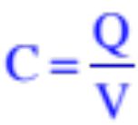






Furthermore, the charge Q on ONE PLATE will always be proportional to the magnitude of the voltage difference across the plates, with the proportionality constant being the cap’s capacitance. Mathematically, then:
Usually written in truncated form as:
this also means that the capacitance is defined as:
This, in turn, means the capacitance of a capacitor is a constant that tells you how much charge per volt the capacitor has the capacity to hold.
Its unit of coulombs per volt is given a special name—the farad.
It’s not uncommon to find capacitors in the range of: millifarad (mf = ), or microfarad (Mf or = ), or nanofarad (nf = ), or picofarad (pf = ).
22.)

Slide 25











Picky but Important Points
1.) A 1 farad capacitor is a HUGE capacitor. It is much more common to run into capacitors in the:
--millifarad (mf) range: this is
--microfarad (Mf or ) range: this is
--nanofarad (nf) range: this is
--picofarad (pf) range: this is
2.) When traversing between capacitor plates along the electric field lines, the voltage goes from high to low. That is why the negative sign is needed in .
But in is the POSITIVE voltage-change across the plates, meaning:
This observation is going to be important shortly!
23.)

Slide 26
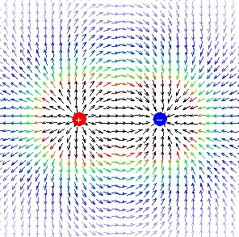
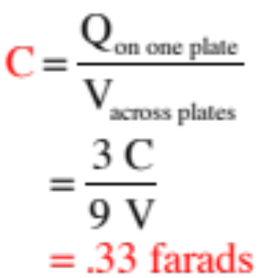
Example 1 (courtesy of Mr. White)
What is the capacitance of this system, where each conductor has a charge of +/- 3 Coulombs, and a 9-Volt potential exists between the two conductors?
24.)

Slide 27
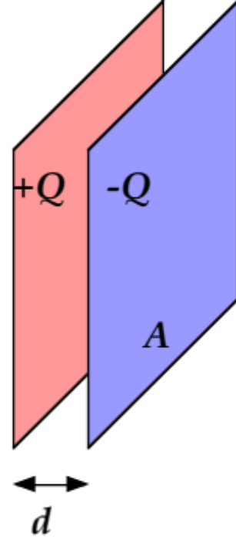
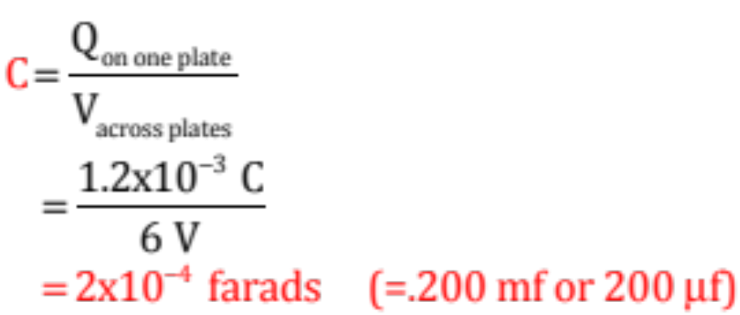
Example 2 (courtesy of Mr. White)
Two conducting plates have a charge of 1.2 mC on each, with a 6.00-V potential difference between the two of them. What is the capacitance of this system?
The only thing tricky about this problem is that everything has to be in MKS—electrical potential in volts and charge in coulombs. Sooo . . .
Note: Clearly you need to become familiar with the prefixes (and symbols) for milli, micro, nano and picofarads.
25.)

Slide 28
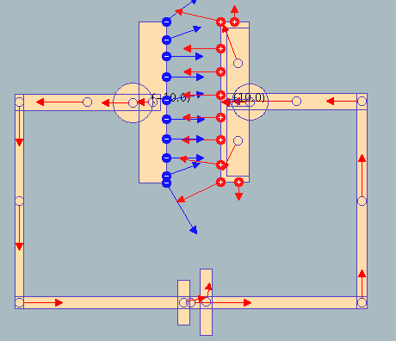
Demo :Parallel Plate Capacitor
Physlet I.26.1
26.)

Slide 29




In a series combination of circuit elements, each element is attached to its neighbor on one side only. What is common to all series combinations is current (i.e., the amount of charge that passes through the element per unit time).
Series Combinations
Think back to how uncharged capacitors work in electrical
circuits. A battery provides a voltage difference across its terminals which generates a voltage difference between its + terminal and the left plate (in the circuit above) of . As such, charge begins to accumulate on that plate electrostatically repulsing like charge off its right plate.
In a series combination, the repulsed charge from the right plate moved to the next capacitor, depositing itself on that cap’s left plate, electrostatically repulsing like charge off its right plate . . . which proceeds back to the battery (hence a complete circuit).
What’s common in the series combo of caps, then, is “the charge” on each cap.
27.)

Slide 30



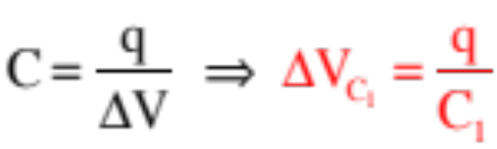

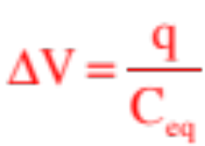
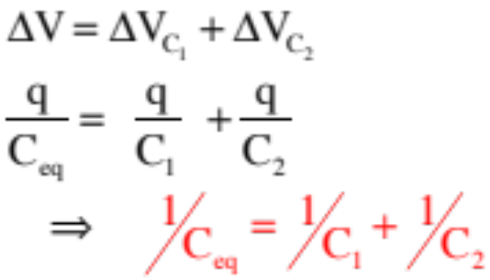
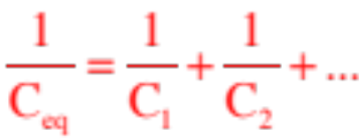
We know the total voltage-change across the battery, and hence across the capacitors, is . Logic additionally dictates that:
Capacitors in Series
We know, though, that:
If we had a single, equivalent capacitance that could take the place of the series combination (i.e., a cap that would draw the same charge q for the same battery voltage ), we could write:
In other words for a series combination of capacitors:
Bottom line:
28.)

Slide 31


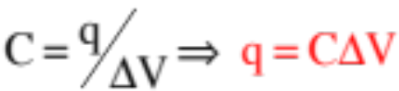
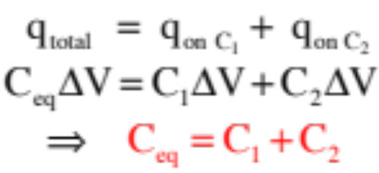

Capacitors in Parallel
Unlike series combinations, each element in a parallel combination attaches to its neighbors in two places.
What is common in a parallel combination is the voltage drop across each element.
So in the parallel combination of capacitors shown, charge will leave the battery and distribute itself between the two initially uncharged capacitors in such a way that the voltage across each cap is the same. If is the total charge drawn from the battery over a period of time:
Using and our equivalent capacitance circuit, we can write:
Bottom line:
29.)

Slide 32


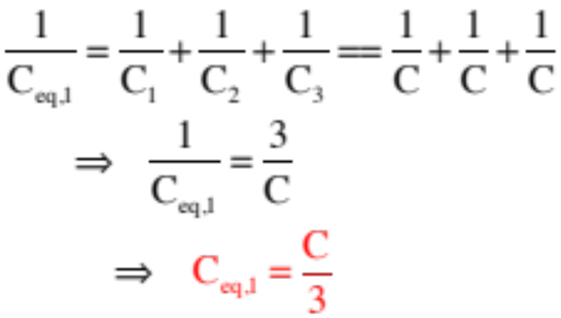
Example 7: Derive an expression for, then determine the equivalent capacitance of the capacitor combination shown to the right. Assume all the capacitors are
--This is essentially a series combination—three caps in series with a parallel combination (remember, what makes a series combo—each element is connected to its neighbor at one place).
--For the three series caps: Technically, we should write:
BIG NOTE: When you have equal-sized caps C in series, the equivalent capacitance equals C divided by the number of caps in the combination (look at our problem for confirmation!).
30.)

Slide 33

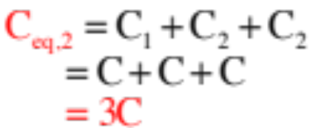

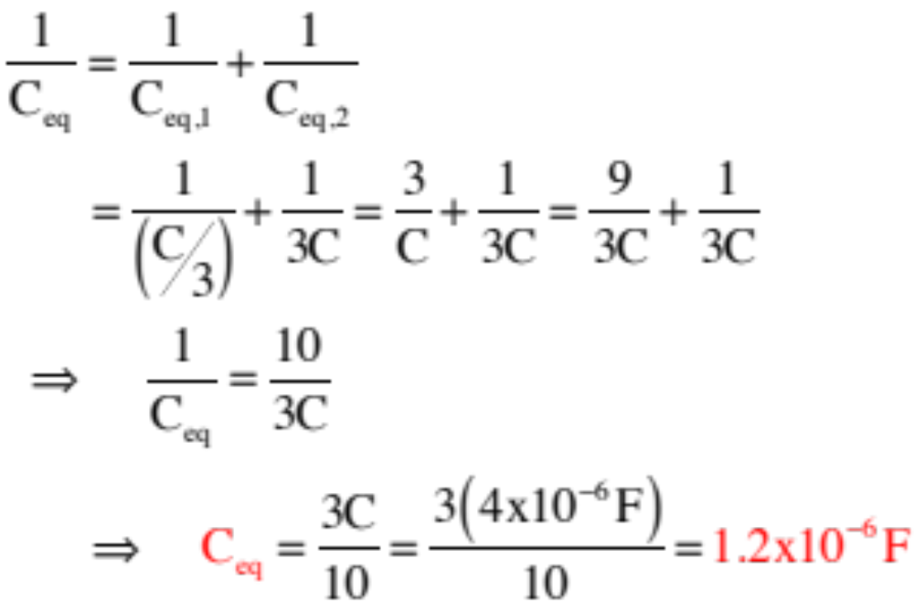
--Redrawing:
--To continue, we need the equivalent capacitance for the parallel combination. As parallels just add, we get:
--Redrawing:
--For the final series combination:
31.)

Slide 34












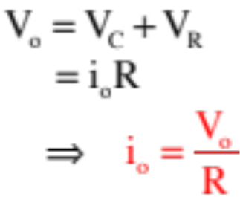

Capacitors—Charging Characteristics
Example 10: Consider a resistor, an uncharged capacitor, a switch and a power supply all hooked in series. Note also that when the switch is thrown, the voltage across “a” and “b” is equal to both the battery voltage and the sum of voltages across the resistor and capacitor. That is:
a.) At t = 0, the switch is closed. What initially happens in the circuit?
As the cap initially has no charge on its plates, it will provide no resistance to charge flow. That means no voltage drop
across the capacitor with all the voltage drop happen across the resistor . . . which means:
32.)

Slide 35



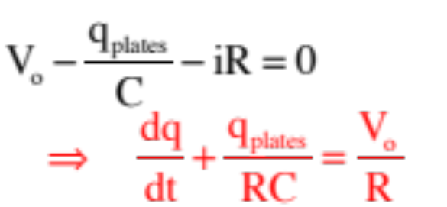
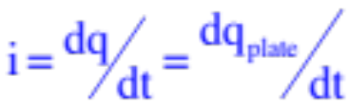
b.) What happens as time proceeds?
As the cap begins to charge, some of the voltage drop happens across the resistor and some across the capacitor leaving us with a Kirchoff expression of:
The problem? There are two different types of q in this expression. One refers to the amount of charge on one capacitor plate. The other refers to charge flowing through the circuit (current is defined as the time rate of charge flow).
Although this won’t always be the case, in this instance the rate at which charge accumulates on the cap plates will equal the rate at which charge passes by per unit time, and we can write:
33.)

Slide 36



This means Kirchoff’s Law can be written as:
Note that as time proceeds toward infinity, the charge on the capacitor plates reaches maximum, all the voltage drop happens across the capacitor, current in the circuit drops to zero and there is no voltage drop across the resistor. In that case:
34.)

Slide 37


Solving:
35.)

Slide 38






Time Constant for a Capacitor
A graph of the charging characteristic of a charging capacitor is shown below.
In theory, capacitor fully charged at t =
no charge on capacitor initially
36.)

Slide 39






It would be nice to get a feel for how fast a capacitor/resistor combination will charge or discharge.
To that end, how much charge would the cap have accumulated after a time equal to RC?
This time is defined as one time constant . It is the amount of time it takes the capacitor to charge to 63% of its maximum. Two time constants will charge it to 87% of its maximum (try the calculation if you don’t believe me).
37.)

Slide 40





c.) What is the current as a function of time?
38.)

Slide 41






A graph of the current characteristics for a charging capacitor/resistor combination:
Note that after one time constant, the current is:
After one time constant, the capacitor’s current will have dropped 63% and will be at 37% of its maximum. After two time constants, it will be at 13% of its maximum.
39.)

Slide 42






Capacitors—Discharging Characteristics
Example 11: At t = 0, the switch is thrown and a charged capacitor begins to discharge.
switch closed at t = 0
a.) How are current through the circuit and charge on the capacitor plates related?
When a capacitor is discharging, the rate of change of charge on the plate is negative (charge is leaving) and:
Using this with Kirchoff’s Law (tracking along the direction of current flow) yields:
40.)

Slide 43

Solving:
switch closed at t = 0
41.)

Slide 44






A graph of the charge on plate characteristics for a discharging capacitor/resistor combination:
Note that after one time constant, the charge is:
After one time constant, the capacitor’s charge will have dropped 67% and will be at 37% of its maximum. After two time constants, it will be at 13% of its maximum.
42.)

Slide 45





Summary of Graphs
Graphs of capacitor charging and discharging characteristics.
charge vs. time
(discharging)
charge vs. time
(charging)
current vs. time
(both charging and discharging)
43.)

Slide 46
reverse electric-field due to van der Waal effect in insulating dielectric
Dielectrics
Consider the charged, parallel-plate capacitor shown to the right (complete with its E-fld).
Placing an insulating material (called a dielectric) between the plates does a number of things.
1.) The dielectric experiences a van der Waal effect due to its presence in the electric field between the plates.
This creates a reverse electric field that diminishes the net electric field across the plates (see sketch on next page).
net electric field, hence net voltage across the plates, decreases with dielectric
2.) With the net electric field diminishing, the net electrical potential across the plates goes DOWN.
As C=q/V, a diminishing of V means the capacitance goes UP.
3.) Conceptually, placing a dielectric between the plates effectively allows the plates to hold more charge per unit volt. This is why the capacitance increases when a dielectric is placed internal to the cap.
44.)

Slide 47



reverse electric-field due to van der Waal effect in insulating dielectric
Net effect: For the charged, parallel-plate capacitor shown to the right.
1.) The capacitance of a capacitor with a dielectric between its plates will equal:
where , sometimes characterized as , is the proportionality constant called the dielectric constant.
Note 1: This means there are three ways to increase a capacitor’s value:
net electric field, hence net voltage across the plates, decreases with dielectric
1.) increase the plate area.
2.) bring the plates closer together.
3.) place an insulating dielectric between the plates.
45.)

