Slide 1
General announcements
Check out lab covers outside the classroom door for amusement, inspiration, etc.
This is a short unit! Next test is next Thursday, 9/14 for the B folks and Friday, 9/15 for the C folks
  It will cover:
  Vectors vs scalars Graphical and mathematical vector manipulation
  2D kinematics (i.e. projectile motion!)
2 labs this unit:
  Tilted Table lab: we collected data yesterday—
  To Catch a Ball lab: “run and shoot” – you predict, and we do in class. No formal write up. This will be done this Friday.

Slide 2

Vectors and scalars
SCALARS have only magnitude
VECTORS have a magnitude AND a direction
(not 78 degrees down or up, just 78 degrees—just a relative measure of the average amount of kinetic energy per molecule of air)
There are two ways to deal with vectors, graphically and in conjunction with a coordinate axis. We’ll start with the graphical approach first.

Slide 3









Graphical addition of vectors
This is also known as the “tip to tail” method
A+B+C+D
A+B-C+D

Slide 4


Vector odds n’ ends
Subtracting a vector just means reversing its direction 180º without changing its magnitude, as we saw on the previous slide.
You can also change the magnitude of a vector by scaling it!
$$then 0.5\vec{C}$$
and $2\vec{C}$

Slide 5











Graphical manipulation
individual
vectors:
Given information about the magnitude (length) and orientation (angle) of each vector, use a ruler and a protractor to draw vectors to scale.

Slide 6

Graphical manipulation
To graphically add vectors, draw each scaled vector tip to tail in order, being careful to keep lengths and orientations accurate.
Draw the resultant vector from the starting point (tail) of the first vector to the ending point (tip) of the last vector. Measure with ruler and protractor.
(using cm. stick and protractor)

Slide 7







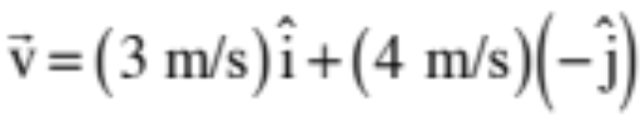
VECTORS
Vectors (defined in polar notation)
(a force whose magnitude is 8 newtons oriented at an angle of 125 degrees relative to the +x-axis)
Vectors (defined in unit vector notation)
A vector with magnitude ONE defined to be in the x-direction is called a UNIT VECTOR in the x-direction. It’s symbol is (pronounced “i-hat”). The unit vector in the y-direction is .
A vector framed in Cartesian coordinates in unit vector notation might look like:
(this is really the addition of a mini-vector of magnitude 3 m/s in the x-direction and a min-vector of magnitude 4 in the minus y-direction)
4.)

Slide 8



Vector conversions
How do we go from polar to unit vector notation?
  Example 1:

Slide 9
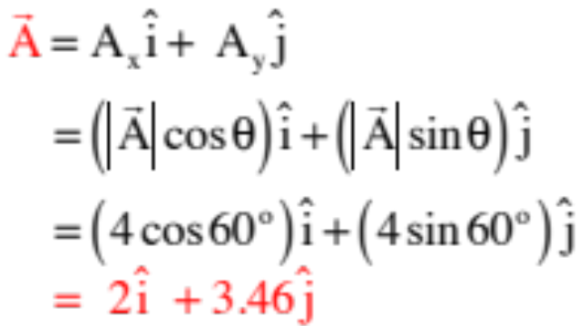
Vector conversions
How do we go from polar to unit vector notation?
  Example 1:

Slide 10

Vector conversions
How do we go from polar to unit vector notation?
  Example 2:
This is a little bit trickier because you are no longer looking at a first-quadrant triangle. There are two ways to do this. The easiest is to create a triangle that IS a right triangle (see sketch), determine its sides, then add whatever signs and unit vectors are needed to characterize the vector. Remember, what you are doing with unit vector notation is creating mini-vectors, one in the x-direction, one in the y-direction, and adding them.

Slide 11



Vector conversions

Slide 12
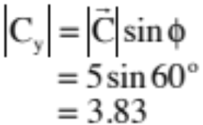
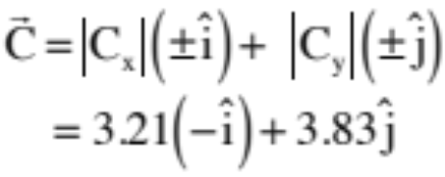
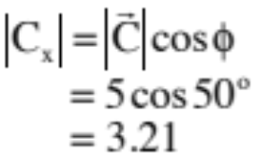
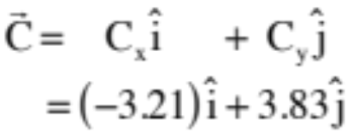
Vector conversions
In looking at the sketch, you can either use the magnitudes, which are always positive, and manually put in the signs for the unit vectors, yielding:
OR write it in terms of components, which carry along the signs with them, yielding:
You get the same result either way.

Slide 13





Vector conversions
How do we go from unit vector to polar notation?
  Example 1:
$\vec{B}=2\hat{i}+3.46\hat{j}$ to polar
In looking at the sketch and noting that you can get the magnitude using the Pythagorean relationship and the angle using the tangent function, we can write:

Slide 14
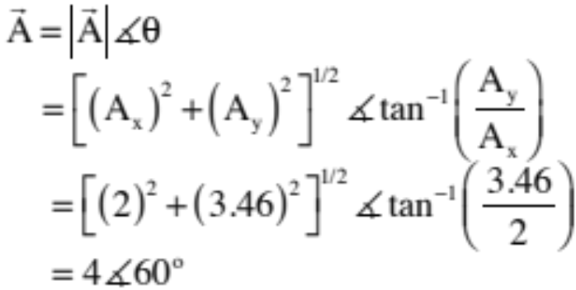


Vector conversions
How do we go from unit vector to polar notation?
  Example 1:
$\vec{A}=2\hat{i}+3.46\hat{j}$ to polar
Note that is ALWAYS positive.

Slide 15





Vector conversions
Example 2:

Slide 16
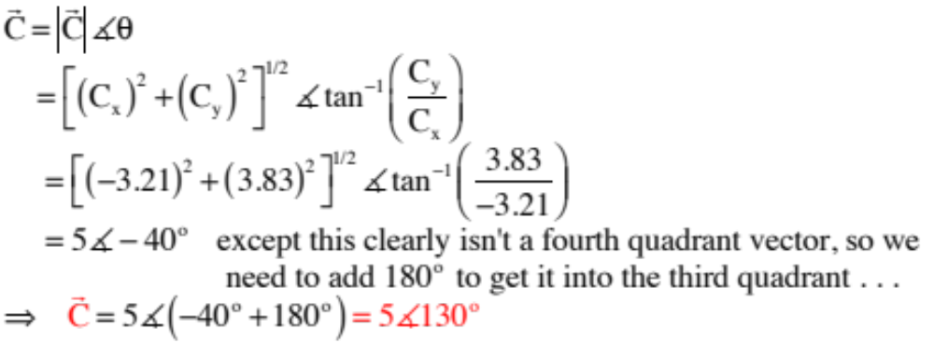
Vector conversions
Example 2:

Slide 17
Force table mini-lab
See the apparatus at the front of the room. As a class, we need to figure out how to balance out the contraption!

Slide 18
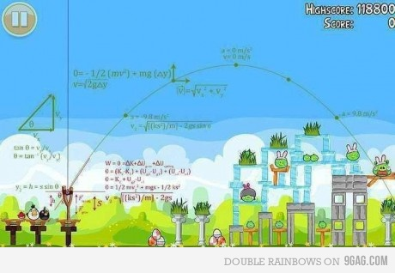
Why bother with vectors?
Image Source: http://www.motivateplay.com

