Slide 1
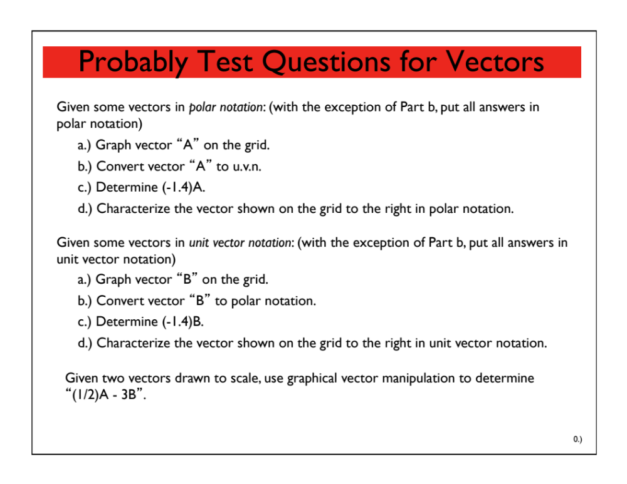
Vectors Test Questions
You’ll find this and other useful “stuff” in the “Problems” folder on the class Website!

Slide 2
Vectors revisited
Describe the displacement vector to the right in:
  a) unit vector notation
  b) polar notation
Determine B = 4A:
Determine C = -0.2A:
3
2
1
A
30º
1 2 3

Slide 3
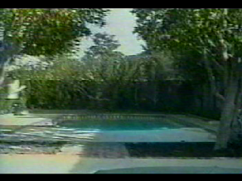
2-d Kinematics
Two-dimensional kinematics is classically modeled as a projectile problem. Example:

Slide 4
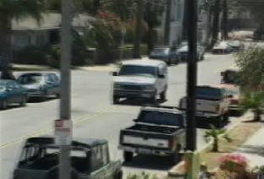
2-d Kinematics
Another example:

Slide 5

2-d Kinematics
And still another example:

Slide 6
Ground rules for projectiles
Neglect air resistance
Consider motion only after release and before it hits
Analyze the vertical and horizontal components separately (Galileo)
No acceleration in the horizontal, so velocity is constant
Acceleration in the vertical is – 9.8 m/s² due to gravity and thus velocity is not constant.
Object projected horizontally will reach the ground at the same time as one dropped vertically
  Wait, what?

Slide 7
Thinking about projectile motion…
Consider the following projectile problem:
v₀ = 100. m/s
𝛉 = 30.0º
y = 2.0 m
h = 200. m

Slide 8





Thinking about projectile motion…
Looking face-on (back at the cannon from the far end), what does the ball appear to do?
It will travel upward to some maximum height, stop, then travel back downward toward the ground. What’s more, its initial velocity will equal to the y-component of the initial velocity of the ball.
$$v_{0y}=v_{0}sinθ$$
$$=\left(100.\frac{m}{s}\right)\sin\left(30.0°\right)$$
= 50.0 m/s
y₀ = 2.0 m
.

Slide 9


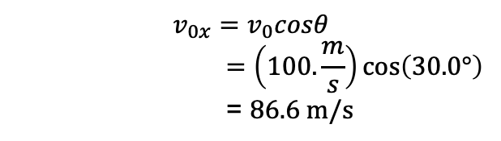
Thinking about projectile motion…
How about viewed from above?
$$v_{0x}=v_{0}cosθ$$
$$=\left(100.\frac{m}{s}\right)\cos\left(30.0°\right)$$
= 86.6 m/s
Note that as there is no acceleration in the x-direction (at least in this problem), the velocity in the x-direction will be the same as the initial velocity in the x-direction!

Slide 10
How to tackle a projectile problem
Step 1: Panic and scream: “I CAN’T DO THIS, AHHHH!” (30 seconds. MAX.)
Step 2: Take a deep breath. Possibly two.
Step 3: Draw a picture of the whole situation and LABEL things – all known variables, and question marks for unknown ones.
Step 4: Convert any units necessary (e.g. km/h → m/s)
Step 5: Write out all horizontal and vertical components SEPARATELY and clearly.
Step 6: Add up horizontal and vertical components, solve for whatever you need.

Slide 11





Cannonball problem set up
So if you were asked to present all the information you could for this problem, you would start with a well labeled sketch and proceed…
.
50.0 m/s
y₀ = 2.0 m
$$v_{o,x}=86.6 m/s$$
y_{final} = -200 m
.

Slide 12
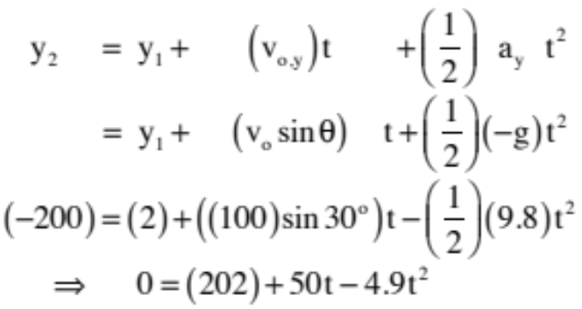
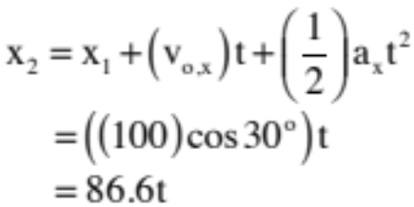
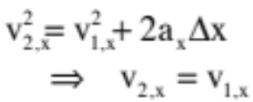
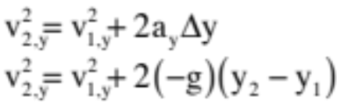
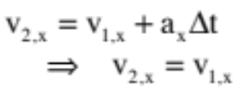
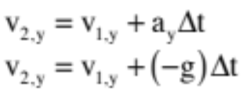
Cannonball problem equations
x-direction:
y-direction:
In other words, the only equation for the x-direction that is going to be of help, assuming the acceleration in the x-direction is zero (i.e., no jet pack), will be the first one.
Note: As the y-component of velocity at the top of the flight is zero, the second of these equations is usually used when trying to determine the maximum height of the flight.
8.)

Slide 13
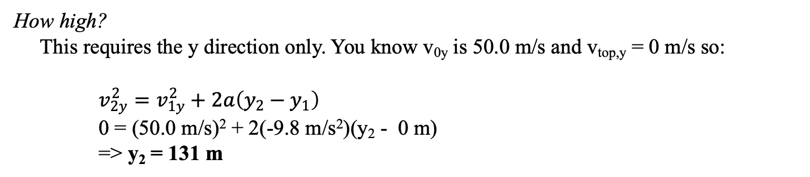
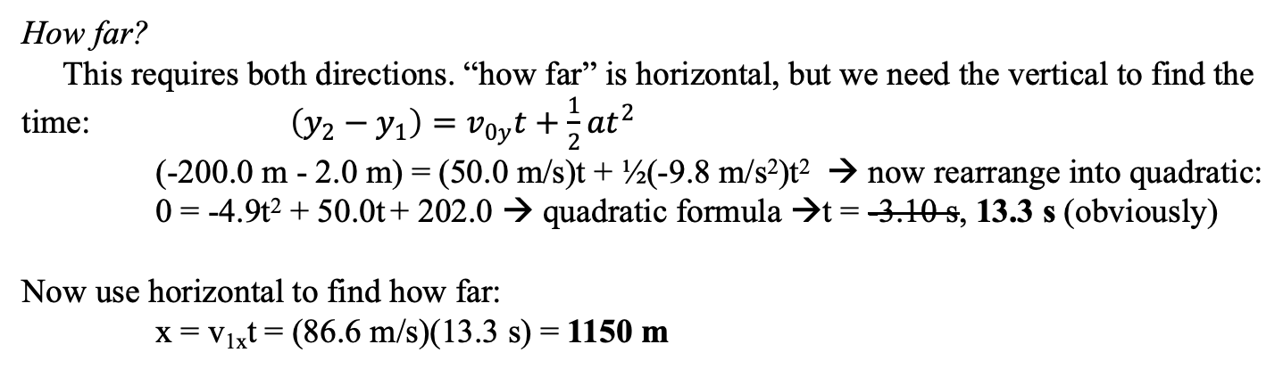
Cannonball problem . . .
How high? How far?
If you were asked to find the two distances above, here’s what you might do:
How high?
This requires the y direction only. You know v_{0y} is 50.0 m/s and v_{top,y} = 0 m/s so:
$v_{2y}^{2}=v_{1y}^{2}+2a\left(y_{2}−y_{1}\right)$
0 = (50.0 m/s)² + 2(-9.8 m/s²)(y₂ - 0 m)
=> y₂ = 131 m
How far?
This requires both directions. “how far” is horizontal, but we need the vertical to find the time: $\left(y_{2}−y_{1}\right)=v_{0y}t+\frac{1}{2}at^{2}$
(-200.0 m - 2.0 m) = (50.0 m/s)t + ½(-9.8 m/s²)t² → now rearrange into quadratic:
0 = -4.9t² + 50.0t + 202.0 → quadratic formula →t = -3.10 s, 13.3 s (obviously)
Now use horizontal to find how far:
x = v_{1x}t = (86.6 m/s)(13.3 s) = 1150 m

Slide 14
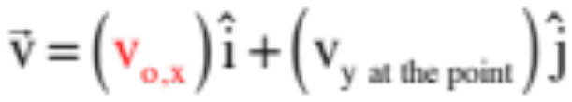
What about final velocity?
For a projectile, when it hits the ground, its final velocity vector has BOTH an x-component and a y-component.
  We know the x-component of velocity never changes (a_{x} = 0)
  We can find the y-component using kinematics
  The final velocity can be expressed in unit vector notation (above) or polar notation (requiring you to find the resultant and angle and state both).
ALWAYS THE SAME!!!!

Slide 15
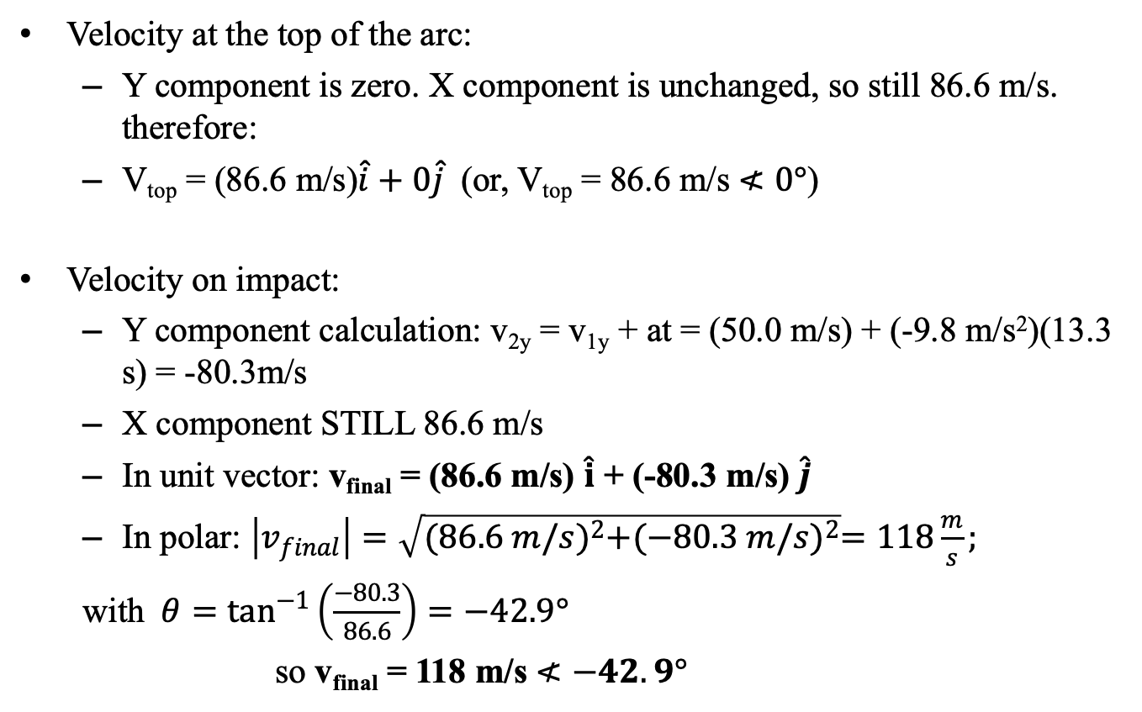
Velocity at a point for a projectile
Velocity at the top of the arc:
  Y component is zero. X component is unchanged, so still 86.6 m/s. therefore:
  V_{top} = (86.6 m/s)$\hat{i}+0\hat{j}$ (or, V_{top} = 86.6 m/s $≮0°$)
Velocity on impact:
  Y component calculation: v_{2y} = v_{1y} + at = (50.0 m/s) + (-9.8 m/s²)(13.3 s) = -80.3m/s
  X component STILL 86.6 m/s
  In unit vector: v_{final} = (86.6 m/s) $\hat{i}$ + (-80.3 m/s) $\hat{j}$
  In polar: $\left|v_{final}\right|=\sqrt{{(86.6 m/s)}^{2}+{(−80.3 m/s)}^{2}}=118\frac{m}{s};$
  with $θ=\tan^{−1}\left(\frac{−80.3}{86.6}\right)=−42.9°$
  so v_{final} = 118 m/s $≮−42.9°$

Slide 16
To Catch a Ball Lab
On Thursday, you will be executing the “To Catch a Ball Lab” procedure. This lab is EASY to do, but NOT SO EASY to prepare for. Basically, do the legwork BEFORE class!
The set up:
  The ball moving at a determinable velocity rolls off a table of known height. Using your knowledge of kinematics and common sense, you and your partner need to calculate BEFOREHAND where a cup needs to be positioned on the floor to catch the ball.
You must present your prelab BEFORE testing. This is the list of equations and summary of measurements you will need to complete the task.
You will get a few minutes to take whatever data you need to calculate your predicted distance.
Then you get ONE shot to test your prediction (yes there is partial credit).
  Your score on this lab will be determined by how close to the cup you come (hit it and you’ve got 20 points; be a cm or two off and you’ve got 19 points, etc.)

Slide 17


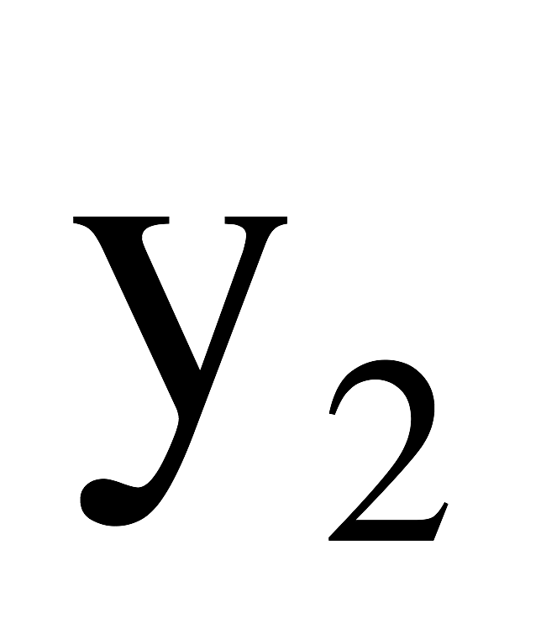
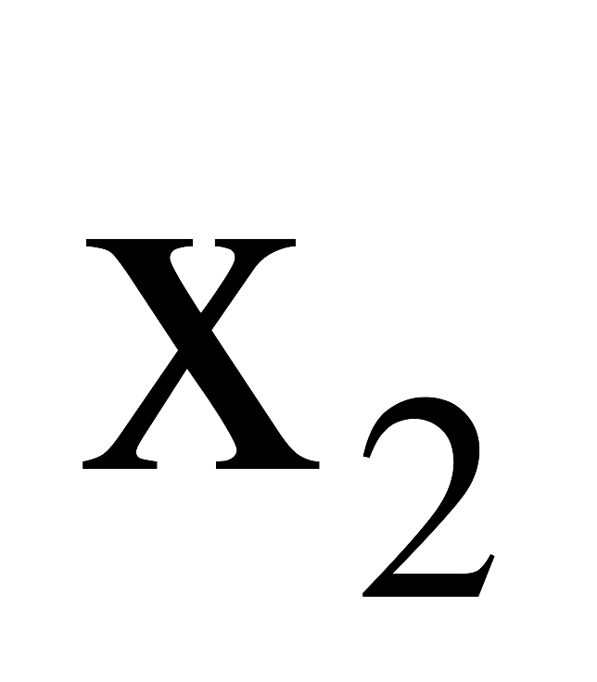
To Catch a Ball lab
table
cup
floor

Slide 18
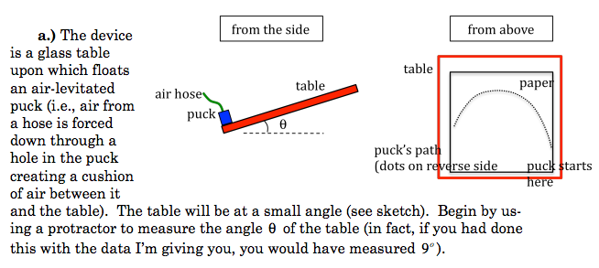
Tilted Table Lab
Later this week we will take the data and look at how to analyze and write this lab up.

Slide 19
Problem 3.23 (modified)
A student throws a baseball off the top of a 50.0 m tall building with an initial speed of 18.0 m/s at an angle of 30.0º below the horizontal.
  a) What are the baseball’s initial coordinates?
  b) Find the x- and y-components of the initial velocity.
  c) Write the velocity equations as a function of time for both the x and y directions.
  d) Write the position equations as a function of time for both the x and y directions
Problem 3.29 - how is this different?
A stone is thrown upward from the top of a building at 15 m/s at an angle of 25º above the horizontal. The stone hits the ground below after 3.0 s. How tall is the cliff? How far from the base of the cliff does the stone land?

Slide 20
Modified 3.23 solution from class

Slide 21
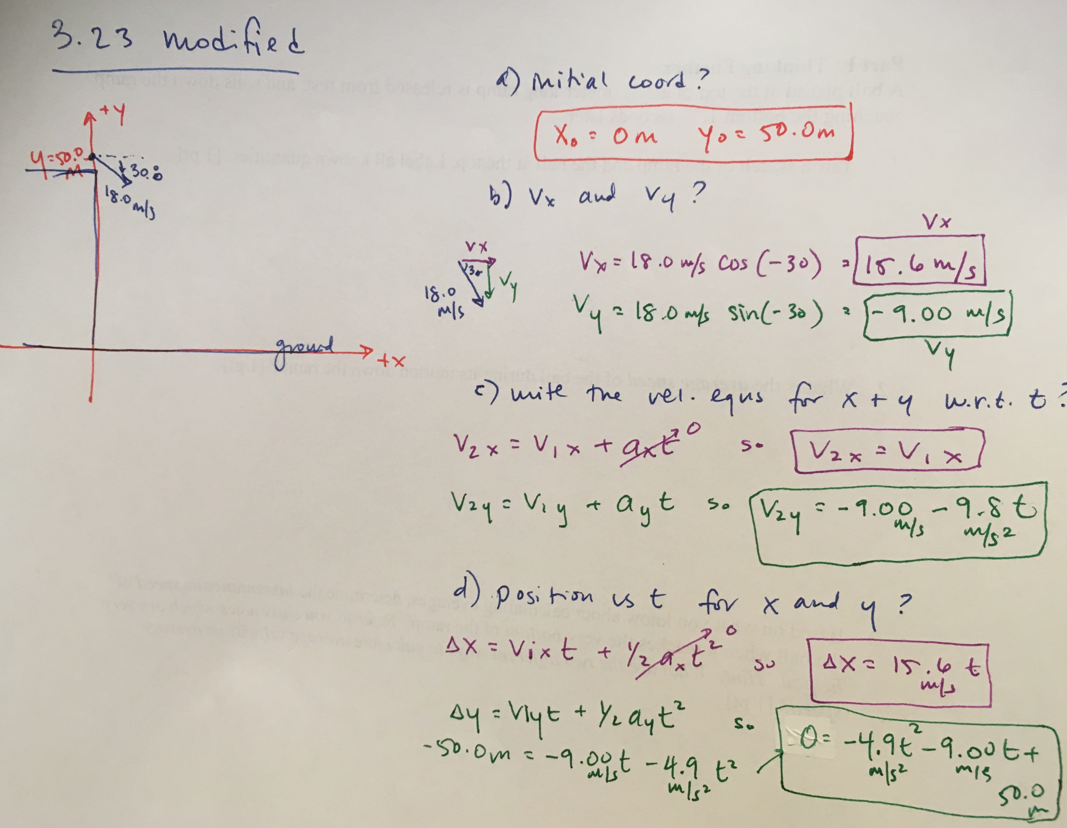
Modified 3.23 solution from class

