Slide 1
General announcements

Slide 2
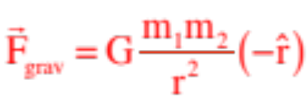
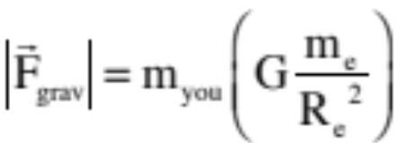


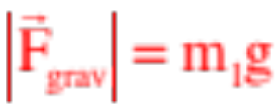
Gravity in general
Newton realized that the attraction between any two object was proportional to the masses involved and inversely proportional to the distance between the objects. With G as proportionality constant:
(Notice that this is written in radial unit vector notation.)
If one of the masses is the earth with the second is an object on or near the earth’s surface, like you, the “r” term becomes the radius of the earth and one of the masses becomes the earth’s mass, and we can re-write the force magnitude as:
But we know “G,” and we know both the radius and mass of the earth, so putting those numbers in and we get:
Called a your “weight,” and defining , (which is POSITIVE), we can define the magnitude of the force of gravity on an object near the earth to be
24.)

Slide 3
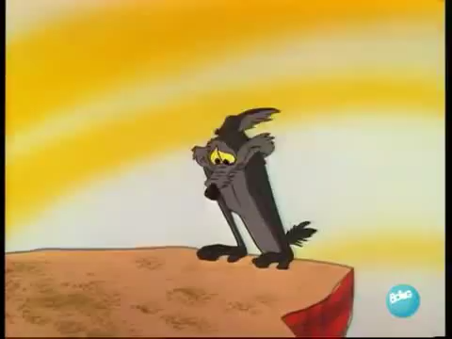


Force Types
There are five types of forces you will need to deal with when negotiating Newton’s Second Law (N.S.L.). They are:
Gravitational force:
https://youtu.be/Gq_bjaI0NTo
--Usually downward;
Wiley coyote--gravity being inappropriate
--Near the earth’s surface, the magnitude denoted as:
where “g” is always positive and, near the surface of the earth, is numerically equal to
25.)

Slide 4

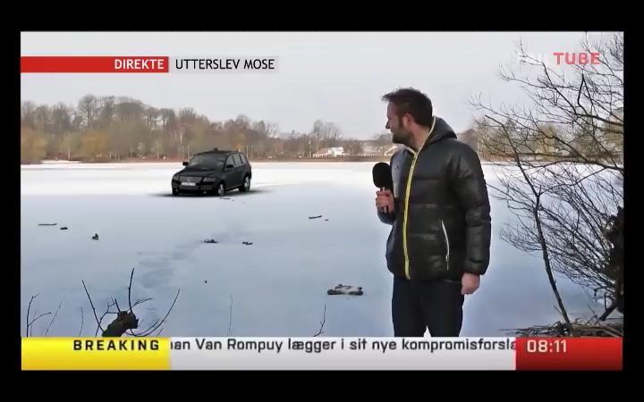
Normal force:
--Force of support;
--can be provided by floors, walls, other objects;
--always directed perpendicularly away from object that provides it;
--Magnitude denoted as:
when normal forces go bad . . .
26a.)

Slide 5
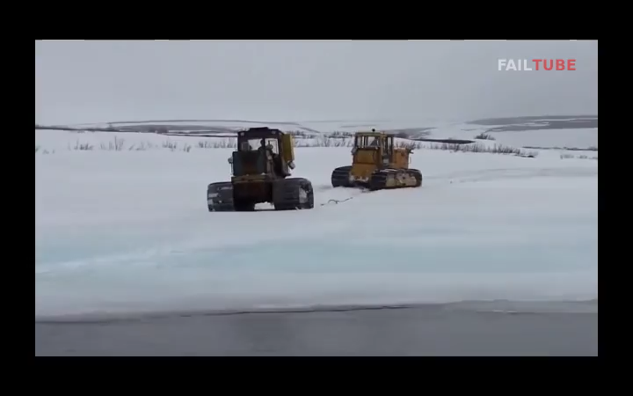
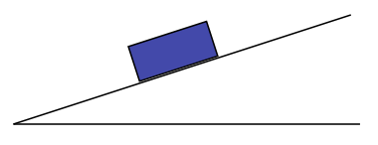
Normal force (con’t.)
https://youtu.be/-1X1o4tQqCw
Note: If an object is on an inclined plane, we often need to break F_{g} into its down-slope and normal components:
+y
F_{gx} = mgsin𝝷
+x
F_{N}
𝛉
F_{gy} = mgcos𝝷
𝛉
F_{g}
26b.)

Slide 6
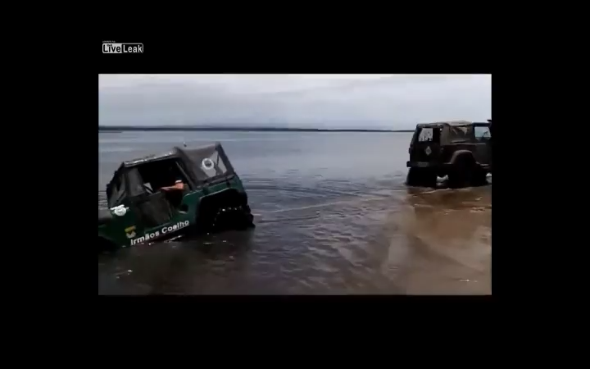


(the guy was OK)
Tension force:
--Provided by rope or cable;
-- Always directed away from the object that provides it;
--Magnitude denoted as:
when tension goes bad . . .
https://youtu.be/xxrM5tv_RNI
(start at 1:35)
23.)

Slide 7
“Push-me-pull-you” Force (Ms. Dunham’s summary)
Any force that doesn’t fit into one of the four previous categories is an applied, or “push-me-pull-you” force
  Why “push-me-pull-you” and not just “push-me”??

Slide 8




--Magnitude denoted as:
Tension force (con’t):
What is the difference in the tensions in the three situations? That is, how will the scale values differ?
28.)

Slide 9
Kinetic and Static frictional force:
There are a number of types of frictional force. Friction always involves two bodies in contact with one another. Although we will deal with rolling friction later, this chapter will only discuss and use what is called kinetic friction, sometimes referred to as sliding friction (think pushing a crate across a floor), and static friction, which occurs when two bodies are in contact but are not slipping, relative to one another (think holding traction as you drive through a curve on a freeway).
The first set of example problems do not require the use of friction, so we will be putting off our discussion of frictional forces until later in the chapter.
29.)

Slide 10
Types of forces (a summary)
1. Gravitational force
  Force due to Earth pulling down on an object (or whatever gravitational center we’re talking about) – points towards center of gravitational object – magnitude always “mg,” where g = +9.8 m/s/s
2. Normal force
  Force perpendicular to and away from a surface of support (doesn’t have to be underneath!)
3. Tension force
  Force due to a string or rope – always AWAY FROM body feeling effect
4. Friction force
  Force parallel to two surfaces due to rubbing against each other
5. Random Applied force (aka push-me-pull-you force)
  Catch-all term when other, non-descript forces are in a problem

Slide 11



Drawing FBD’s
A free body diagram shows all the forces acting on an object. Drawing an accurate FBD is part of showing your work, and should accompany EVERY problem in which you use Newton’s 2nd Law.
General rules:
  Forces are shown by arrows pointing in the proper direction, labeled with the type of force (e.g. F_{g} or “mg,” F_{N} or ”N,” F_{T} or “T,” F_{fs} or , F_{fk} or and for the push-me, push-you force)
  If the object is not rotating, the arrows should originate close to the center of the object and point outward.
  Again, if the object is not rotating, you can slide forces on line with their direction but away from where they actually act. (Example: often normal forces are not shown acting at the interface between a block and the surface providing them but, rather, on the opposite side of the block—you will see what is meant by this shortly).

