Slide 1
General announcements

Slide 2




A Simple Newton’s Second Law Problem
Consider: Three blocks of known mass, all in terms of “m,” are arranged as shown. A F =60 nt force is applied.
What is the acceleration of the system?
The solution to this problem may or may not be obvious. There is a formal approach, though, that will always take you to a conclusion. Called the formal approach, it follows:

Slide 3
The Formal Approach,
According to Fletch
Step 0: Begin by thinking to yourself, “I couldn’t possibly do this problem.” Having acknowledged that, begin the process:
Step 1: Pick one object in the system and draw a free-body diagram (FBD) depicting all the forces acting on the body (options: gravity, tension friction, normal, push-me pull-you);
Step 2 and 3: Identify the line of the acceleration. Once identified, place a coordinate axis along that line and a coordinate axis perpendicular to that line;
Step 4: If there are any off-axis forces acting on the body, break them into components along the defined axes;
Step 5: Sum the forces, keeping track of signs, along one axis, and put that sum equal to “ma,” where “a” is the acceleration along that axis;
Step 6: If you have enough to solve, do so. If not, either sum the forces along the other direction or repeat the process on another body in the system.
31.)

Slide 4
Notes on the formal approach:
--Assume nothing that can be derived using f.b.d.s and N.S.L.
--When in doubt, once you have acknowledged the claim made in Step 0, FOLLOW THE BLINKING PROCEDURE and it will take care of you!!!!!!!!
--It is important that you consciously identify the line of the acceleration in each problem as there will come a time when dealing with bodies traveling around curved paths when that line will NOT be along the line of motion, and misidentifying the line of acceleration in those instances will be disastrous (more about that later).
--You need to understand how to use the formal approach, but there is another way, a shortcut seat of the pant approach, you can use to check yourself. It will be presented to you shortly.

Slide 5






So back at the ranch: Three blocks of known mass, all in terms of “m,” are arranged as shown. A F =60 nt force is applied.
By the numbers:
Step 0: Lordy, lordy, “I couldn’t possibly figure this out.”
Step 1: Pick one body in the system and draw a f.b.d. for it (blurbing well!).
Step 2: Identify the body’s line of acceleration and put a coordinate axis along that line. Put a second axis perpendicular to the first.
33.)

Slide 6
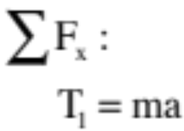
Step 3: If there are any off-axis forces, break them into components along your two coordinate axes. (There aren’t any.)
Step 4: Sum the forces running along one of the axes and put that sum equal to the body’s mass “m” times its acceleration along that line (include blurbs).
Note that with no friction in the system, summing along the y-direction is not needed.
Step 5: Repeat the process if you don’t have enough information to solve the problem.
34.)

Slide 7



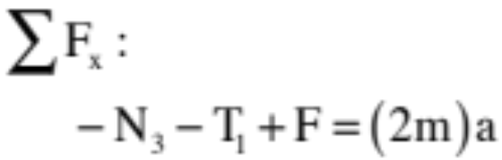




Steps 1, 2, 3 and 4: Pick another body and draw a f.b.d. and axes for it (blurbing well!). With no off-axis forces, sum the forces in the x-direction.
--Note that there is a normal in the horizontal due to 3m being jammed up against 2m, the force F acting only on the 2m and a tension force on 2m.
--Note also that because was the magnitude of the tension force on m, I need to call the magnitude of that same tension acting on 2m the same variable
Still not enough . . .
35.)

Slide 8



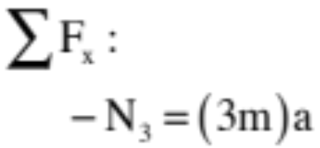

Steps 1, 2, 3 and 4 again:
--Note that there is a normal in the horizontal due to 2m being jammed up against 3m. I’ve already identified the magnitude of that force as on the previous f.b.d., so I have to use that same designation on this f.b.d.!
Now we need to solve equations simultaneously:
36.)

Slide 9



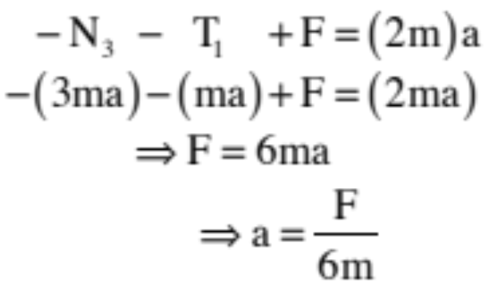
Our equations are:
Substituting Equ’s A and C into B yields:
37.)

Slide 10
The “quick and dirty” approach
If the magnitude of the acceleration of all of the bodies in a system is the same, we can examine the system from a holistic perspective and the total, net force acting on the system in the direction of acceleration will equal the total mass in the system times the system’s acceleration.
If you know how to use this approach, it can take a classic, five minutes, by the book Newton’s Second Law problem and turn it into a 30 second romp.
The technique follows:
Step 1: Identify all the forces that help the system accelerate (an FBD may help).
Step 2: Define the forces that make the system accelerate in one direction as POSITIVE and the forces that make the system accelerate in the opposite direction as NEGATIVE.
Step 3: Sum the forces, signs included, and put them equal to the TOTAL MASS of the system times the acceleration of the system.
Step 4: Solve for the system’s acceleration.

Slide 11
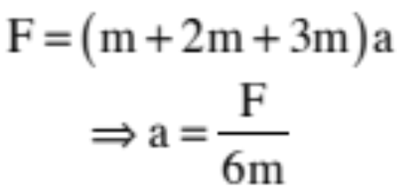
For Our Problem—Quick and Dirty
Step 1: The only force motivating the system to acceleration is F. All other forces acting are “internal” to the system.
Step 2: As there is only one motivating force, we don’t have to worry about assigning positiveness and negativeness to forces.
Step 3: Summing the motivating forces (signs included) and putting them equal to the TOTAL MASS OF THE SYSTEM times the acceleration of the system yields:
Like I said, quick and dirty!
39.)

Slide 12




Another Newton’s Second Law Problem
Consider a hanging mass attached to a string that is threaded over a frictionless, massless pulley. The other end of the string is attached to a block of mass sitting on a frictionless table (in case you care, this is the set-up for Problem 4.36)
a.) Determine the acceleration of the frictionless system; and
b.) Determine the tension in the cable.
Something to note:
Because the pulley is assumed massless, all it does is re-direct the line of the tension. That means the magnitude of the tension on one side of the pulley will be the same as the magnitude of the tension on the other side of the pulley.
So go ahead and do the problem . . .

Slide 13
Another Newton’s Second Law Problem
Consider a hanging mass attached to a string that is threaded over a frictionless, massless pulley. The other end of the string is attached to a block of mass sitting on a frictionless table (in case you care, this is the set-up for Problem 4.36)
a.) Determine the acceleration of the frictionless system; and
b.) Determine the tension in the cable.
Something to note:
Because the pulley is assumed massless, all it does is re-direct the line of the tension. That means the magnitude of the tension on one side of the pulley will be the same as the magnitude of the tension on the other side of the pulley.
So go ahead and do the problem . . .

Slide 14
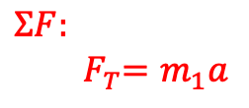
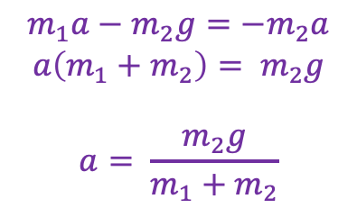
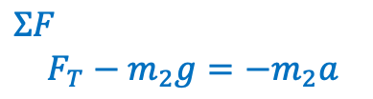
Solution
fbd on block
fbd on hanging mass
F_{N}
F_{T}
m₁
F_{T}
m₂
F_{g} = m₁g
In the horizontal direction:
F_{g} = m₂g
Common parameters: magnitude of the tension force F_{T} and magnitude of the acceleration (they move together). Substituting in yields:
$$ΣF:$$
$${ F}_{T}=m_{1}a$$
In the vertical direction:
$$m_{1}a−m_{2}g={−m}_{2}a$$
$$a\left(m_{1}+m_{2}\right)= m_{2}g$$
$$a= \frac{m_{2}g}{m_{1}+m_{2}}$$
$$ΣF$$
$$F_{T}−m_{2}g={−m}_{2}a$$

Slide 15

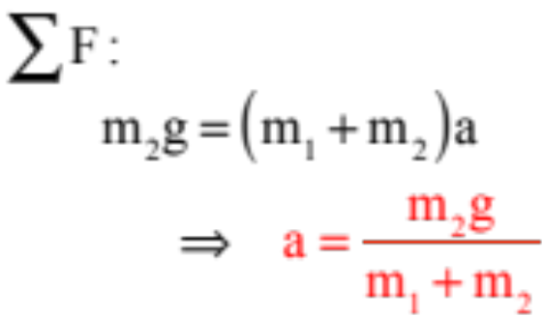
Intro N2L problem
Using quick and dirty approach:
Force driving acceleration to right/down:
Force opposing acceleration to right/down:
none

Slide 16




Now with inclines!
A 5-kg block (m_{b}) sits on an inclined plane that makes a angle with the horizontal. It is attached to a massless rope passing over a massless, frictionless pulley on which hangs a 10-kg mass (m_{h}). Assuming the ramp is frictionless, what is the acceleration of the block when the system is released?
Give it at try in algebra form, but FIRST A NOTE!

Slide 17







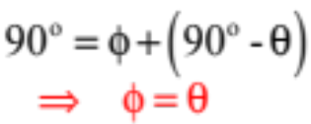
Consider a block of mass m sitting stationary on a slanted table of known angle . For whatever reason, you decide you want to know the component of gravity acting on the block along the line of the table, and the component of gravity perpendicular to the table. How would the incline’s angle fit into that calculation?
A normal (in red) at right-angles to the table looks like,
and our force diagram looks like:
+y
Conclusion: For incline problems, the incline’s angle will always be found between the vertical and the normal to the incline.
+x
+x
A right triangle with in it and one side in the vertical looks like:
+x
so summing angles (see diagram) yields:
with components (as shown):

Slide 18







Incline . . . Solution!
Now give it a try . . .
FBD on mass :
+y
+x
Look at the f.b.d. to see what forces are acting in the x-direction. Keeping track of the signs (up the incline is the positive direction), use N.S.L. in the x-direction. That is, sum those forces (some will be positive, some negative) and put them equal to .
Notice: You have two unknowns, “a” and “T.” You want “a.” You need a second equation so you can eliminate “T.”

Slide 19





FBD on mass :
+v
Notice I’ve made the vertical direction “v” instead of “y”—you can call it anything you want!
+h
Look at the f.b.d. to see what forces are acting in the vertical v-direction. Keeping track of the signs (up is positive), use N.S.L. in the v-direction putting the sum of forces equal to . . .
ALMOST . . .
Because we need to treat “a” as a magnitude so the “a” term for the incline mass and the “a” term for the hanging mass will be the same term. That means we need to unembed acceleration signs where needed to make “a” into a magnitude, which in turn means the “ma” term for the hanging mass is really . In short:

Slide 20




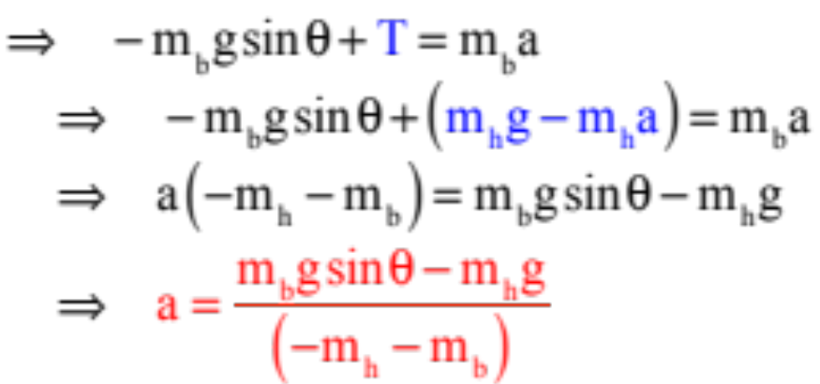
+v
FBD on mass :
+h
So the hanging mass’s f.b.d. suggests:
We have two equations:
and
Solving simultaneously yields:
Note: You’ll rarely be asked to plug numbers into a problem like this, but because numbers were given:
Plugging in m_{b} = 5 kg, m_{h} = 10 kg, and 𝝷 = 25° → a = 5.2 m/s²

Slide 21
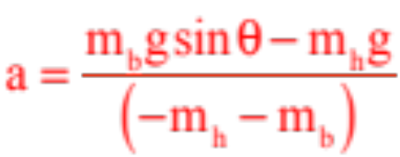


Some Big Observations
--If we put numbers into the expression:
and ended up with a negative number (which would be odd as the acceleration was defined to
be a magnitude), what would the negative sign tell you?
It would NOT suggest that the systems was accelerating in the negative direction (which would be nonsensical). It would simply mean we assumed the wrong direction for the acceleration).
How would that work with our problem?
In our problem, we assumed that the hanging mass was large enough to overpower the incline’s mass so the incline’s mass would accelerate up the incline while the hanging mass accelerated downward in the negative direction. Looking at the expression, the denominator is negative and the numerator will be negative is is bigger than . I the situation is the other way around, the “a” term becomes negative and we know that the incline’s mass was the dominate accelerating factor . . . no big deal!

Slide 22

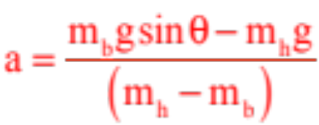
Some Big Observations
--What happens if we don’t unembed the acceleration’s sign appropriately?
The math shows up the problem nicely.
The two equations we started out with when we solved simultaneously were:
and
where clearly the first (for the hanging mass) had its negative sign unembedded. If we hadn’t done that, then our two equations would have been:
and
and our solution would have been:
What’s wrong with this?
If the masses were the same, the expression suggests a zero in the denominator, which isn’t kosher. The denominator can be all negative or all positive, but if it ever shows as one of each, it means you’ve dropped a sign somewhere on the ”ma” side of N.S.L.

Slide 23
Some Big Observations
--When we were setting up N.S.L. for the two masses, we needed to unembed the negative signs for the acceleration terms, given the way we defined the coordinate axes (if the acceleration was in what our axes called “the negative direction,” it was negative. Could we have treated the problem differently?
The answer is yes. If you always take the defined direction of acceleration as the positive direction, then the “ma” term will always be positive and you won’t have to worry about unembedding negative signs. The only down-side is that you will find yourself defining, say, downward as positive (think about this problem with the hanging mass accelerating downward—this would mean that DOWN would have to be defined as positive), and some people just don’t like doing that. If you can get around that, though, this is a good workaround.

Slide 24





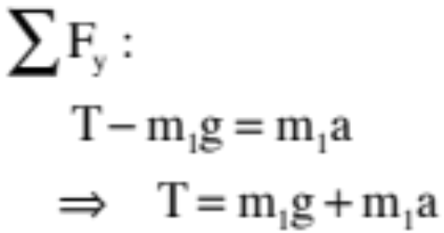


Another Example: Called an Atwood Machine, a massless, frictionless pulley is suspended from the ceiling with a string threaded through it. Two unequal masses are attached to either end of the string and the system is allowed to free fall.
Without identifying the steps, but executing them:
(from the f.b.d.)
Big observation: Because +y is UP and “a” has been defined as + in our equation, we are assuming is accelerating UPWARD. This is important as it tells us acceleration direction.
40.)

Slide 25



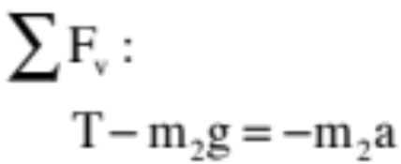


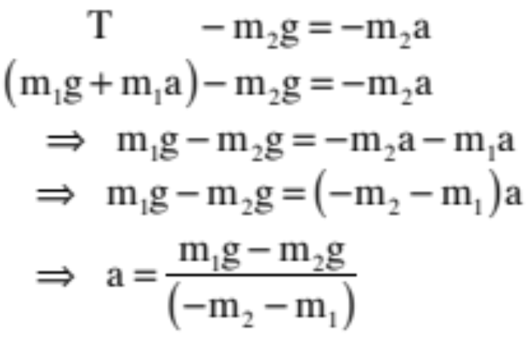
Another observation: Because the +v-direction is UP and “a” for has been deduced to be down, we must unembed the negative sign in the acceleration term so that “a” can be a magnitude.
Combining the previous equation with our new relationship:
Note 1: If you put in numbers and solve to get a negative “a,” it just means you’ve assumed the wrong direction for “a.”
Note 2: If the numerator’s variables have different signs, you’ve messed up one of the “ma” signs when you used N.S.L.
41.)

Slide 26
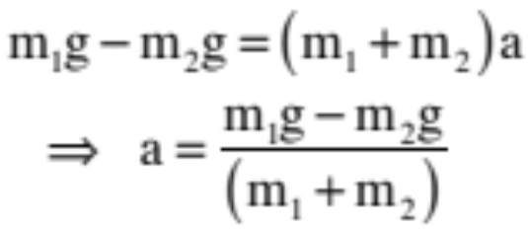
Quick and dirty:
Note: I’ve picked the mass I think will dominate and made its acceleration positive (even though that acceleration in this case will be downward). If, once numbers have been included, the math turns out to yield a negative acceleration, the negative sign simply means I have assumed the wrong direction for the acceleration and the opposite direction is the correct one. Nothing needs to be done beyond a statement to that effect.
42.)

Slide 27



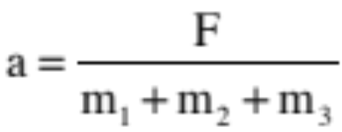












Seat of the pants problem: Quick! Three blocks on a frictionless surface with force F applied as shown.
a.) What’s the acceleration of the system (quick like a bunny!).
b.) Draw a f.b.d. on each block (quick!).
c.) Determine the net force on each block (quick!).
d.) Determine the contact force on the last block.
a.)
b.)
c.)
d.)
65.)

Slide 28
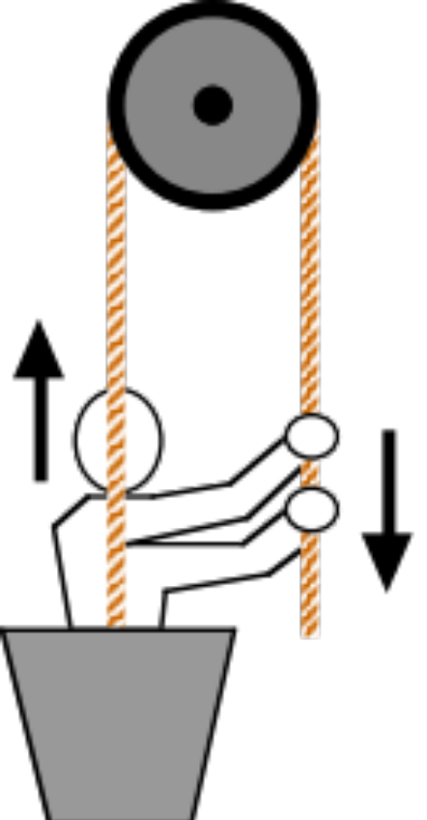


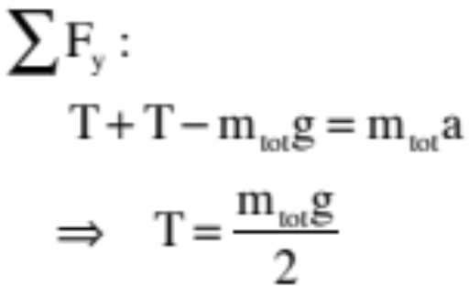

ideal pulley
One last bit of nastiness with a nice picture courtesy of Mr. White. An individual in a bucket pulls herself upward with constant acceleration. How much pulling force must she apply to do this?
Getting the f.b.d. right, which should view the person and bucket as one, is crucial here. Think about what is happening. Gravity is acting on the two, and there are TWO tensions acting away from contact points (i.e., upward).
50.)

Slide 29
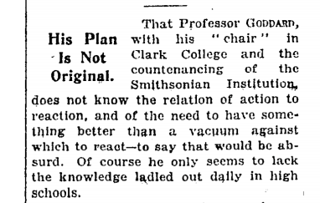
Another great example of Newton’s Laws
In the early 1900s, Robert Goddard proposed using a rocket outside of Earth’s atmosphere to get to the Moon. Rockets had been used in near-surface activities at this point, but nothing into “space.”
This idea was completely ridiculed by many who read his initial paper…including the New York Times, which in 1920 published an op-ed mocking him.
So what did Goddard know that they didn’t? How do rockets fly in space?
See it in action…in slo-mo!

