Slide 1
General announcements
How’s N2L lab write up going?
  fbd’s? Relationship between a₁ and a₂? Deriving expression for a₁?
  Due but don’t leave it …
Today:
  Start a more in-depth discussion on friction

Slide 2
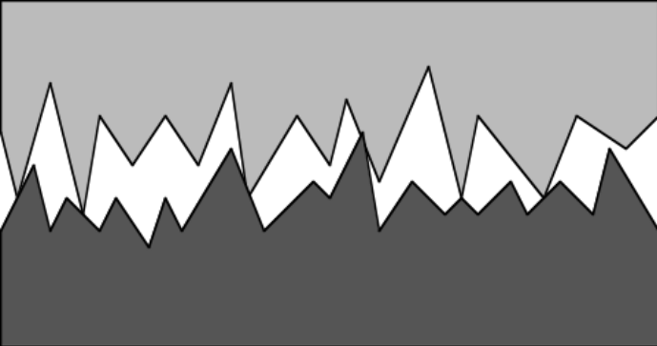
Kinetic and Static frictional force:
Time to talk friction. As I said above, there are two types that we are interested in. Kinetic friction occurs when two bodies are in contact and one is moving relative to the other (think pushing a box across a floor). Static friction occurs when two bodies are in contact but are not slipping, relative to one another (think holding traction as you drive through a curve on a freeway).
There are lots of ways friction can be generated. A dragster, for instance, literally melts its tires, creating a “scotch tape dragged across a surface” effect. That model is NOT going to be ours.
Ours acknowledges the fact that when two objects are in contact with one another, their molecular and atomic structures both jam up against one another and, to some degree, meld into one another. Shearing that meld (or attempting to do so) is what causes friction.
51.)

Slide 3









A little closer look is instructive. As the electrons of the upper object (in blue) nestle into the electron configuration of the lower object (in red),
they apply a repulsive force to one another (see sketch).
The horizontal components add to zero.
The vertical components produce the normal force that supports the upper object.
But try to move the upper body to the right and the horizontal components will no longer cancel.
This net horizontal force is known as the static frictional force between the two bodies. It is the force that has to be overcome before the upper body can actually accelerate to the right. Put a little differently, for the top body to accelerate, an external force to the right that is large enough to effectively shearing the repulsive bonds that exist between electrons has to be applied.
51.)

Slide 4





KINETIC FRICTION
--when objects are in contact and moving relative to one another, the shearing of the partial bonding between the two produces a force that is always parallel to the surfaces and directed opposite the direction of RELATIVE MOTION between the two bodies
the mass’s motion relative to table is to right, so kinetic frictional force to left
A force F motivates the red mass to the right. As the red mass tries to slide out from under the blue mass, the blue mass moves to the left RELATIVE TO THE RED MASS. As such, the shearing of the melding between the two masses will produce a kinetic frictional force on the blue mass to the right . It will ALSO, due to Newton’s Third, produce a kinetic frictional force on the red mass to the left.
--its magnitude is proportional to the amount of melding, which is measured by the normal force, between the two masses, and is denoted by and is equal to:
where is a constant called the coefficient of kinetic friction and N is the magnitude of the normal force acting between the surfaces.
52.)

Slide 5
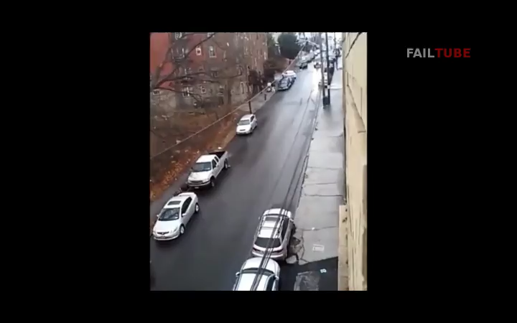
when kinetic friction goes bad . . .
https://youtu.be/DrOO_HcQngg
start 0:48 to 1:03
53.)

Slide 6



STATIC FRICTION
--if the melding between two objects in contact is great enough, the shearing required for the bodies to break loose won’t happen. The stress generated by that opposition produces a force that is parallel to the surfaces and directed opposite the direction of RELATIVE MOTION the bodies WOULD experience if they broke loose. There is a continuum of static frictional forces from zero to the break-loose point.
A force F motivates the red mass to the right. As the red mass tries to slide out from under the blue mass, the blue mass holds on, so to speak, being motivated to the right by the static frictional force between the two bodies. How so? If the masses broke loose as the red mass moved right, the blue mass would move left, relative to the red mass (the red mass would slide out underneath the blue mass). What keeps the blue mass from moving leftward, relative to the red guy, is the static frictional force between them to the RIGHT.
Additionally, due to Newton’s Third, an equal and opposite static frictional force will be applied to the red mass to the left, retarding its motion.
--the magnitude of the MAXIMUM static frictional force is:
where is a constant called the coefficient of kinetic friction and N is the magnitude of the normal force acting between the surfaces.
54.)

Slide 7

when static friction goes bad . . .
55.)

Slide 8

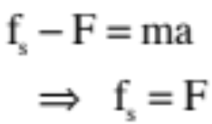


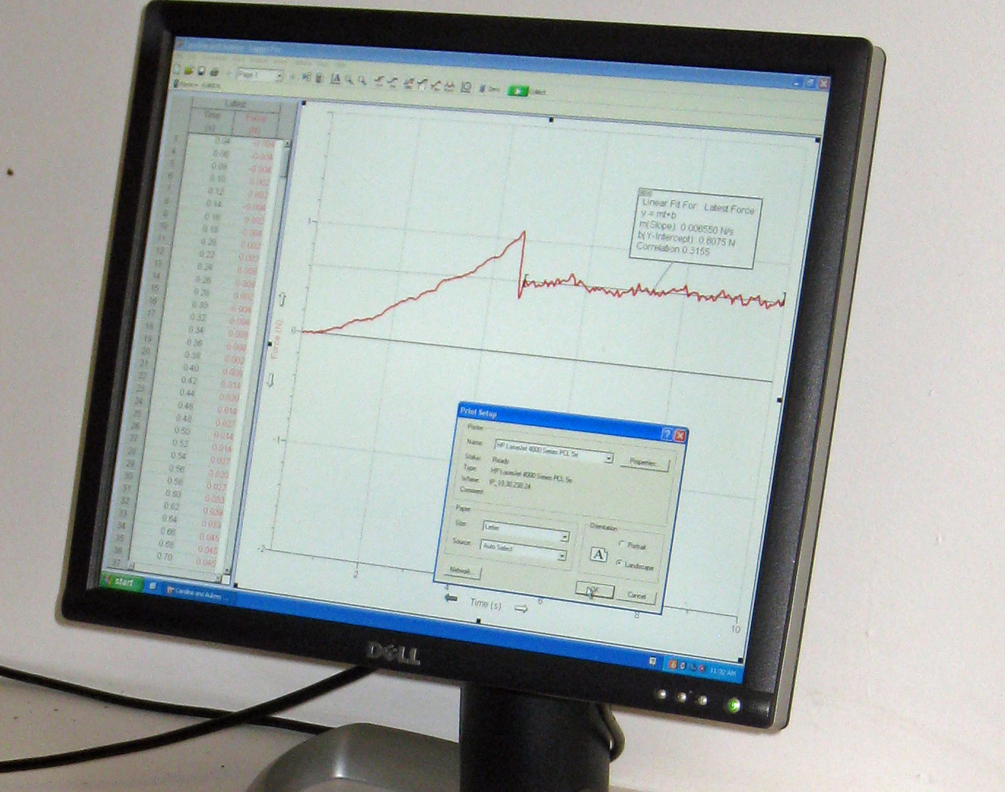


General observation about kinetic and static friction: Very gently apply a force F to a box sitting stationary on a surface. If the box does not accelerate, it means the static friction is holding it in place. In other words, the force you applied is equal and opposite the static frictional force generated between the surfaces.
If you begin to increase F, at some point the static frictional force will cease to hold, you will have reached the maximum static frictional force and the box will break loose and begin to slide. At that point, kinetic friction will take over and the frictional force on the body will be a constant (unless you change the characteristics of the surfaces by heating or melting or whatever, which we will assume you won’t do).
43.)

Slide 10


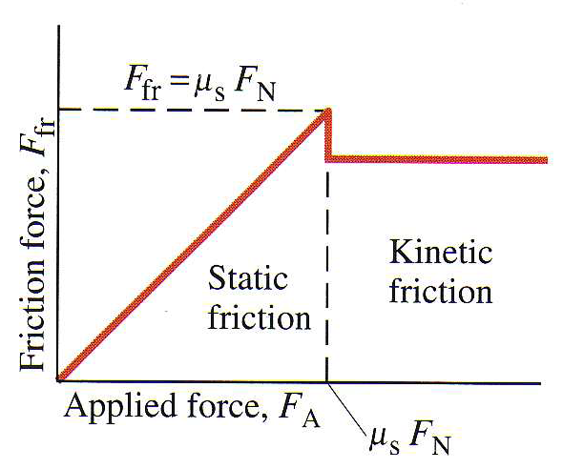



The point is that the two frictional forces are not the same critter. One, for kinetic friction, is constant and always acts while there is sliding between the two surfaces (which makes the denotation for static friction, , unfortunate, as people take the “s” subscript to refer to sliding instead of static). There are an infinite number of static frictional forces with only the MAXIMUM being of much interest, as that is the one that is equal to . In any case, the two are summarized graphically (courtesy of Mr. White), below
And as a side point, pretty clearly is always true for a given surface.
57.)

Slide 11









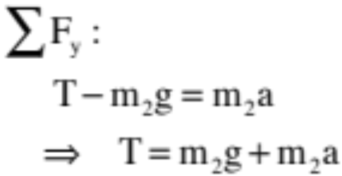


An Example With Friction: A block on a frictional incline of known angle and coefficient of friction is attached to a string that is threaded over a massless, frictionless pulley. The string is attached at its other end to a second mass (see sketch). What is the acceleration of the system?
Without listing the steps, but following them:
Observation: I’m denoting the vertical axis with a “v” and the horizontal axis with a “h.”
Observation: Because the pulley is massless, the tension T is the same on either side. That is, all the pulley does is redirect the line of force due to tension.
Big observation: Because +v is UP and “a” has been defined as + in our equation, we are assuming is accelerating UPWARD. This means must be accelerating down the incline.
58.)

Slide 12












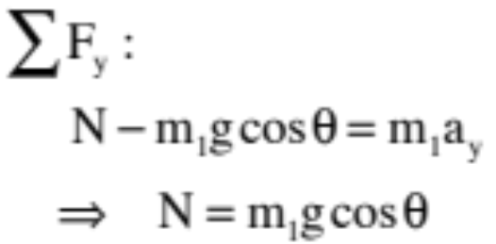
Because is on a slant, it’s f.b.d. must be on a slant. Also, remember that “T” is the same on both sides of the pulley.
Observation: Notice the f.b.d. is tilted in a manner similar to the block on the incline. This is standard procedure.
Observation: Notice how the angle in the “mg” force triangle is related to the incline’s angle.
Observation: Notice I’m assuming acceleration is down the incline because I assumed acceleration was UP, NOT because the is moving down the incline.
(from looking at the f.b.d.)
Observation: Notice I needed to know the direction of
VELOCITY (not its acceleration) to determine the direction of the kinetic frictional force on it, which will be OPPOSITE the (relative) motion.
59.)

Slide 13
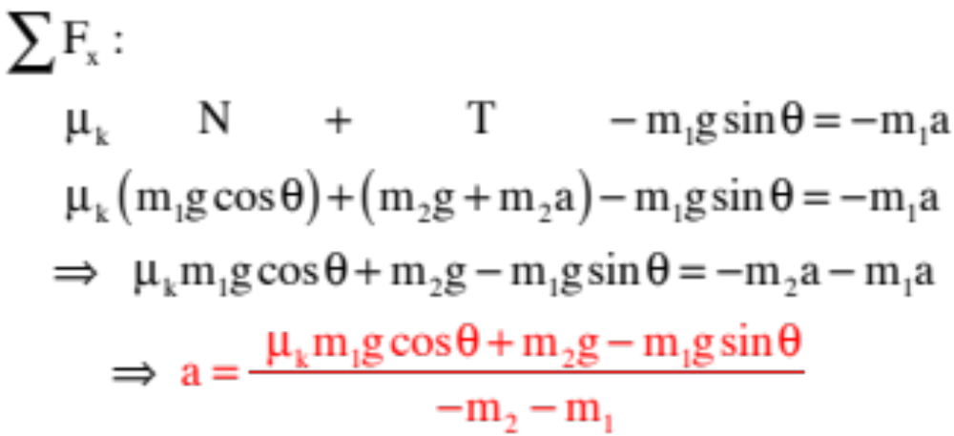
From looking at the f.b.d., and noting that the acceleration of is in the negative direction, as defined by our coordinate axis, we can write (with substitutions):
60.)

Slide 14
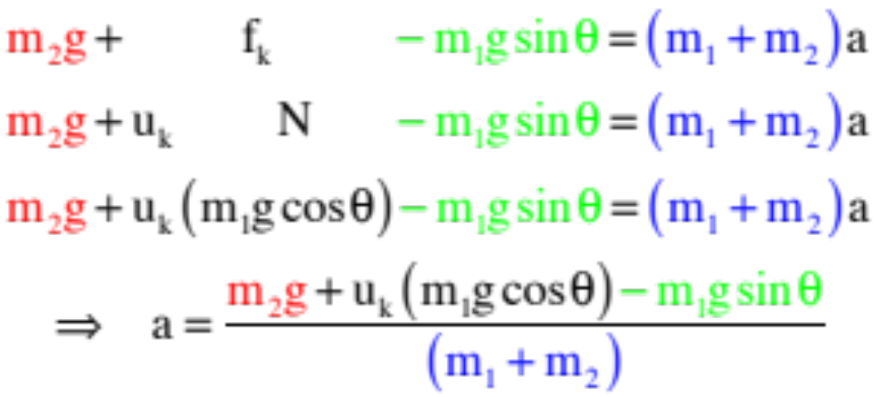
Quick and Dirty!
Showing more steps than are needed (but doing so to be complete), and remembering we are adding up all the forces that actively motivate the system to accelerate in one direction and subtracting those that actively motivate the system to accelerate in the other (then putting that equal to the total mass times acceleration), we get:
61.)

Slide 15





As a slight twist: Same problem, but now you are told that the static frictional force between and the incline is just large enough to keep from breaking loose. What can you deduce about the system and what additional information would you need (or would you have to assume) before you could derive an expression for that coefficient of static friction? Is this a big deal?
To determine the direction of the static frictional force on the f.b.d., you need to know the direction the body would move if it DID break loose. If was tiny and the incline’s angle large, would be tugging to accelerate DOWN the incline and the static frictional force would fight that, being oriented UP the incline. If was large the angle not too big, would be tugged UP the incline and the static frictional force would be DOWN the incline. Knowing which way the body will be tugged defines the direction of the static frictional force (i.e., opposite the tug). Also, with a = 0, the tension T is just the weight of .
Does it matter? You bet. If you do the f.b.d. both ways and use N.S.L. with the wrong direction for , you get different numerically values for . This makes sense as in the one case, friction will be working with gravity, and in the other, not.
62.)

Slide 16
A penguin (which took me a seriously long time to draw) sits on a slightly frictional block. When a large force F is applied to the block, the penguin breaks traction and slides. Draw a f.b.d. for the forces acting on the penguin.
F
63.)

Slide 17


A penguin (which took me a seriously long time to draw) sits on a slightly frictional block. When a large force F is applied to the block, the penguin breaks traction and slides. Draw a f.b.d. for the forces acting on the penguin.
F
Some will notice that the block moves right, so they will automatic-ally put the frictional force to the left (this will be reinforced by the fact that the penguin will sooner or later slide off the back side of the block). Problem is, relative to the ground—an inertial frame of reference—the penguin is being dragged (accelerated) to the right (see sketches below), which means you need a force to the right. The only force available to do that is friction. Gotta be careful!
wrong
F
F
64.)

Slide 18

Kinetic friction
Summary:
  Kinetic friction always points in the direction opposite relative motion of the body, and parallel to the surfaces;
  Assuming you don’t actually change the surfaces (e.g. melt something, significantly smooth out), the kinetic frictional force will remain constant
  Kinetic friction:
    Does depend on the normal force between the surfaces and the surface interface itself (texture)
    Does not depend on surface area or (most generally, at the scales we’re talking about) the velocity of the object
$$F_{fk}=μ_{k}F_{N}$$
Why F_{N} and not weight (F_{g})?
v
v
F

Slide 19

Static friction
Summary:
  Static friction is a force that opposes the start of motion – what keeps something from sliding in the first place.
    Static friction always opposes the direction an object would accelerate if cut loose (this can be tricky to figure out!)
  Static friction is weird: unlike kinetic friction, there isn’t just one value.
    If nothing is trying to make the object move, static friction is 0.
    As force is applied to the object, static friction will increase to keep the object stationary until some threshold point, at which point the object moves and friction becomes kinetic friction!
    Thus, there are an infinite number of possible static friction forces between 0 and the maximum value.
  Maximum possible static friction force depends on normal force (weight) and the surface proportionality constant 𝝁_{s} such that:
$$F_{fs}≤μ_{s}F_{N}$$

Slide 20
Static → kinetic friction
Static friction transitions to kinetic friction once an object moves
Both types of friction depend on F_{N} (same for both), but they have unique coefficients (𝝁_{s} vs 𝝁_{k}). (Which is greater, 𝝁_{s} or 𝝁_{k} and why?)
  𝝁_{s} : harder to get something moving than keep it moving (N.F.L.!)

Slide 21
Example 1 (kinetic friction):
A block slowing down as it moves on a table to the right:
1.) For both kinetic and static friction (as in a centripetal situation), if friction is the only force acting along the line of acceleration, the frictional force MUST be in the direction of acceleration.
For this case, a force must be directed to the left if the block is to slow down. The only force available is friction, so friction must be to the left.
3.) For kinetic friction, the direction of the frictional force is ALWAYS opposite the direction of relative motion of the body relative to the surfaces it is sliding over.
For this case, the block moves to the right, relative to the surface upon which it rides (the tabletop), so the frictional force must be to the left.

Slide 22

Example 2 (static friction):
A flat bed truck accelerates from rest to the right with the box holding tight due to static friction. The direction of the static frictional force MUST be:
1.) For both kinetic and static friction, if friction is the only force acting along the line of acceleration, the frictional force MUST be in the direction of acceleration.
The block is accelerating to the right with the truck (static friction implies there is no movement between the two surfaces), so the static frictional force MUST be to the right.
2.) The static frictional force will ALWAYS be OPPOSITE the direction the body would accelerate if it broke traction.
If the block broke loose, it would slide off the rear of the truck, so the static frictional force MUST be opposite that direction, or to the right.

Slide 23
Example 3 (kinetic friction):
A flat bed truck accelerates from rest to the right. The box breaks loose and slides:
1.) If kinetic friction is the only force acting along the line of acceleration, the frictional force MUST be in the direction of acceleration. The question here is, “What direction will the box accelerate.”
This is actually a bit tricky. As the block slides, it will appear to be sliding to the left toward the rear of the truck (put a little differently, if you attached an axis to the accelerating truck so the axis was accelerating, relative to that axis the box will move to the left). From the perspective of a FIXED AXIS (i.e., one attached to the ground), the box will move to the RIGHT. If kinetic friction is the only force acting along the line of acceleration, it’s direction must be in the direction of the acceleration, to the right.
Notice the block has slid toward the back of the truck but has experienced a net displacement to the right of the dotted line. This means force to right!
4.)

Slide 24
Example 3 (kinetic friction):
A flat bed truck accelerates from rest to the right. The box breaks loose and slides:
2.) The static frictional force will ALWAYS be OPPOSITE the direction the body would accelerate if it broke traction.
The box DID break traction and, in doing so, slid to the left RELATIVE TO THE TRUCK’S BED. That means the original static frictional force was to the right, and so was the subsequent kinetic frictional force.
3.) For kinetic friction, the direction of the frictional force is ALWAYS opposite the direction of relative motion between the two surfaces experiencing the friction.
Relative to the truck’s bed, the block is moving left. That means the frictional force must be to the right.

Slide 25

Example 4 (beginning to walk to the right):
To begin with, if this was kinetic friction the foot would be sliding over the floor. It isn’t, so this MUST BE static friction.
1.) For both kinetic and static friction, if friction is the only force acting along the line of acceleration, the frictional force MUST be in the direction of acceleration.
As the acceleration is to the right, apparently the static frictional force MUST BE to the right.
2.) The static frictional force will ALWAYS be OPPOSITE the direction the body would accelerate if it broke traction.
If the foot broke traction, it would slide toward the left. Evidently, the static frictional force MUST BE to the right.
Additional observation: If the foot pushed off on soft dirt, dirt would fly out to the left. That would mean the foot was applying a force to the ground to the left. By Newton’s Third Law (for every action, there’s an equal and opposite “re”action), if the foot applies a force to the ground to the left, the ground must apply a force to the foot to the right. That force is the static frictional force that motivates the foot (and body) to acceleration to the right.

Slide 26

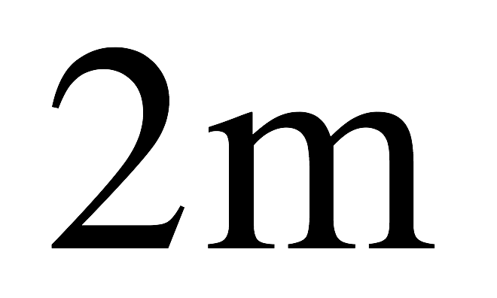
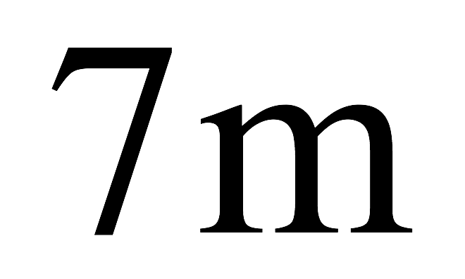


So back to that crazy HW question…
frictional on both surfaces; (7m mass moving to left initially with 2m mass just barely holding on (not sliding relative to the lower block, so think about what that means!)

