Slide 1
Center Seeking Forces:

Slide 2
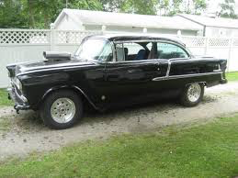
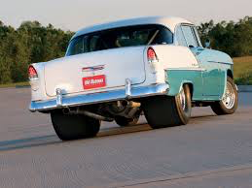
When I was a kid, the cool car to have, aside from a Corvette, was a 55 Chevy. They were light, they were fast, they had bench seats, and I couldn’t afford one.
So I tried to get
2.)

Slide 3


a 1938 Hearse . . .
But that didn’t work out, so I ended up with:
3.)

Slide 4
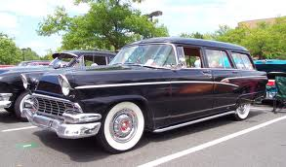
‘56 FORD STATION WAGON
Features:
--312 cu. inch engine with three on the tree;
--room for a mattress in the back (I slept in it more than once at the beach);
--bench seats without seat belts (dangerous, very dangerous);
Why are we talking about all of this?
--BENCH SEATS were required for the MOB maneuver . . .
4.)

Slide 5
The MOB Maneuver
The Problem (and remember, this was the 60’s, so we’ll modify some):
You are on a second date.
You (assumed in its original iteration to be a heterosexual male, but hey, it could be any old sex) kind of like her/him/they.
She/he/they kind of likes you.
You don’t want to seem overly aggressive.
She/he/they doesn’t want to seem too easy.
So there she/he/they sits, way over there, next to the passenger-side door.
You’d like her/him/they to be sitting next to you.
Enter the MOB maneuver.
5.)

Slide 6

(the MOB maneuver)
You approach an intersection moving at a constant speed . . .
force-free
path
and there you have it
As you begin your turn, your
date follows a force-free path
until voila
you
your date
6.)

Slide 7
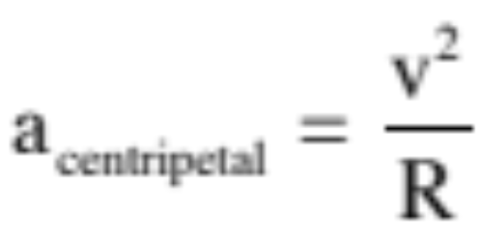
To make the move, a center seeking (centripetal) acceleration is required:
7.)

Slide 8
Which means a center seeking (centripetal) FORCE is required.
“center-seeking” forces
8.)

Slide 9
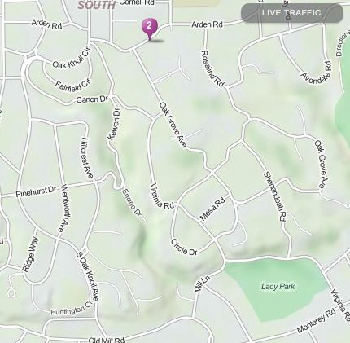
On the way to Lacy park…
And the Reverse MOB Maneuver

Slide 10
LACY PARK

Slide 11
What about moving in circles?
An object moving at a constant speed in a circle is said to be undergoing uniform circular motion.
  No change in speed means no force is acting along the line of motion
  Change in direction means there must be a force acting perpendicular to the line of motion. This force causes an acceleration that is also perpendicular to the line of motion. This is called the centripetal direction and it points towards the center of the arc of motion.
“Centripetal” means “center-seeking.”
  Forces that act in a line between an object and the center of the circle in which it is moving are centripetal forces.
The velocity at any moment in the circle is tangent to the circle. Vector math tells us that the acceleration must be pointed inward.

Slide 12






Magnitude of Centripetal Acceleration?
Consider a ball moving with a constant velocity magnitude v around a circular path. What kind of acceleration must be present?
For the body to execute this motion, there must be an acceleration pushing it out of straight-line motion. An acceleration that does this is called a centripetal acceleration. The direction of a centripetal acceleration is always along the radial-axis (i.e., center seeking).
Kindly note: What changes with a centripetal acceleration is not the velocity magnitude, it is the velocity direction!
26.)

Slide 13






So how can we relate a centripetal acceleration to the radius of the arc R and magnitude of velocity of motion v?
Look at how the body’s velocity vector changes after the body displaces an angular distance of (that change is shown below as a vector subtraction).
added to
will equal
Notice that the direction of that velocity change is, more or less, toward the center of the arc upon which the body rides. In fact, as the angle goes to zero, that direction would become dead-on center seeking.
Notice also that the triangle itself is isosceles.
27.)

Slide 14


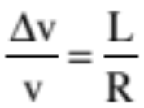


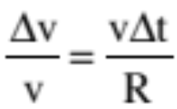
Now consider the dotted triangle (look at sketch). It is also isosceles, and it is similar (in a mathematical sense) to the velocity triangle (same ).
Being similar, we can equate side ratios.
But “L” is just the distance traveled in time , which means , so we can write.
28.)

Slide 15
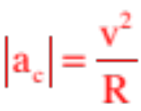
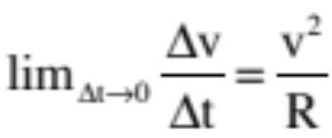
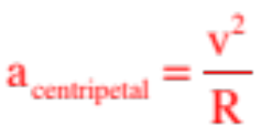
Rearranging and letting time go to zero in the limit, we can write:
Except the change of velocity in the limit as time goes to zero is the definition of an instantaneous acceleration, and because we’ve already deduced that this acceleration is center seeking in nature, we must be looking at a centripetal acceleration.
In short, any object moving along a curved path will need a component of acceleration that is centripetal (center seeking) in nature, and the magnitude of that acceleration component will always be related to the radius of the arc and the magnitude of the velocity vector by:
29.)

Slide 16
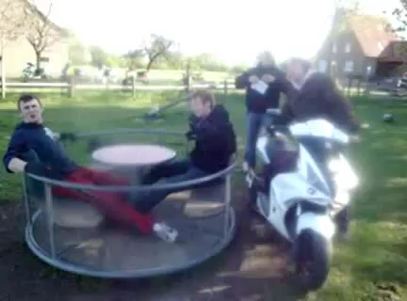
30.)

Slide 17
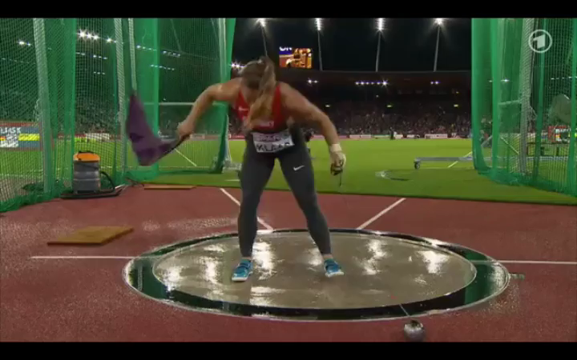
31.)

Slide 18
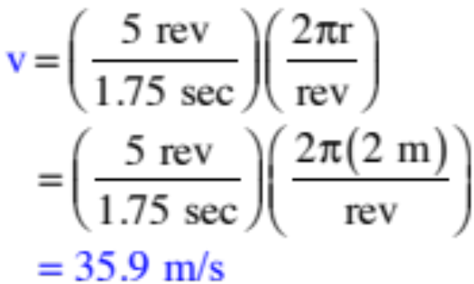
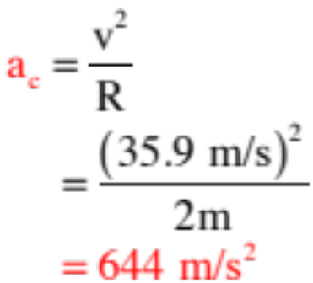
Example: The woman in the previous video was swinging a 4 kg ball at the end of a 1.2 meter long chain at a rate of 5 revolutions in 1.75 seconds (I measured it!). Assuming her arms were .8 meters long, how large a centripetal acceleration would she have to exert on the ball to launch it as she did? In what direction did she exert that force. What happened to the ball when she ceased to exert that acceleration in that direction?
We need the magnitude of the velocity:
So the centripetal acceleration will be:
And the direction will be toward the center of the ball’s arc until release, at which time the ball will travel tangent to that arc out away from the woman.
32.)

Slide 19
Centripetal forces
Put differently, a “centripetal force” is just a term we use for forces that are center-seeking. It is not a new type of force!
  What force(s) is/are acting as the centripetal force in the following situations?
    Moon orbiting the Earth?
    Whirling keys on a lanyard in a circle around your head?
    A car going around a flat curve?
    A sled going over the top of a small bump/hill?
Gravity
The inward component of tension
Static friction between the tires and the road
(Gravity – normal force)

Slide 20
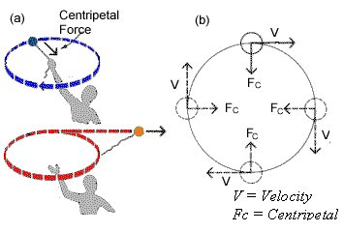
What happens if centripetal force goes away?

Slide 21
A couple of things to note…
A couple of things to note (the idea of which you should understand but the math of which you won’t be tested on):
apparent force
From DRIVER’S PERSPECTIVE: the passenger seems to be accelerating away from him.

Slide 22
A couple of things to note…
As far as the driver is concerned, the only way the passenger could be accelerating away from him is if there was a force on them. That is, from his perspective, they does NOT appear to be force free.
So where does the force come from?
NOWHERE!
The only reason they appear to be accelerating is because he is looking at things from his own frame of reference which happens to be an ACCELERATED FRAME OF REFERENCE!!!

Slide 23
A couple of things to note…
Nevertheless, he may still want to attempt to use N.S.L. to predict their motion (i.e., “When will they hit the edge of the car, etc.?”)
To do this, he has to assume a “fictitious force” is acting on them.
In this case, the name of the fictitious force is CENTRIFUGAL FORCE!
In short, CENTRIFUGAL FORCES do not exist. They are a mathematical contrivance designed to allow you to use NSL-type analysis in situations in which the observation frame is non-inertial . . . Which is to say ACCELERATED . . .

Slide 24
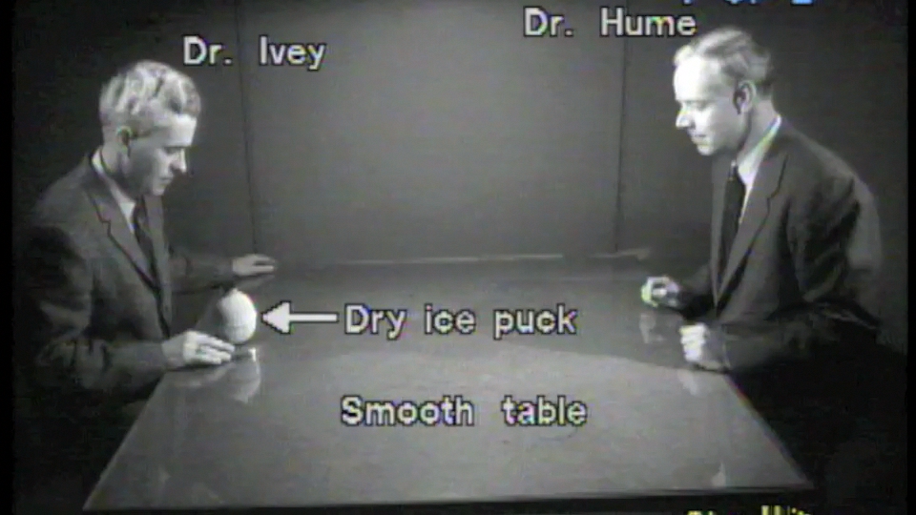
Non-inertial frame:
https://youtu.be/zqYHaulHzLI
start at 16:45, go to 18:40
11.)

