Slide 1
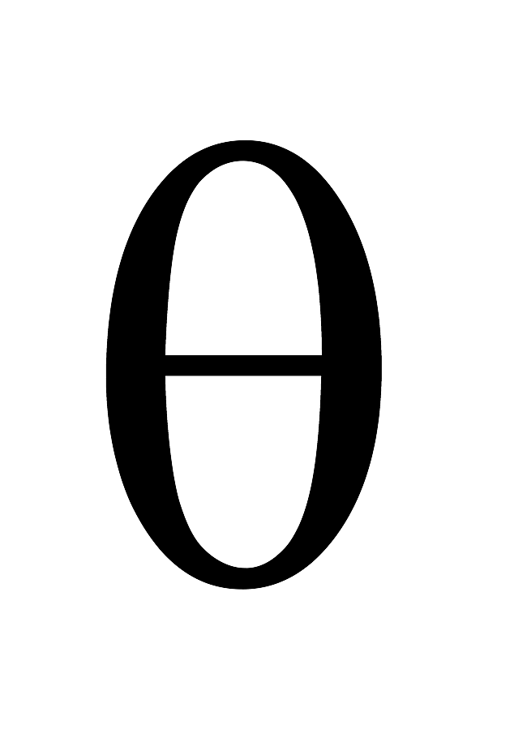
Banked curve – no friction
At what velocity must a car have to take a banked curve of radius R and angle theta if the bank’s surface is FRICTIONLESS?
R
As viewed from head-on
v

Slide 2

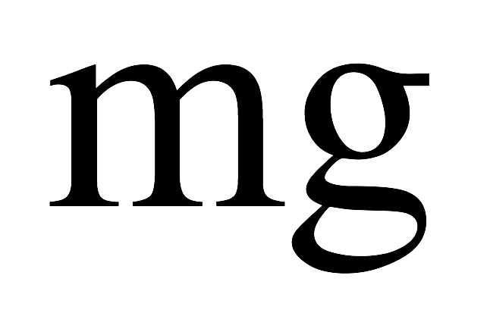
Banked curve – no friction
As always, start with a free body diagram (in this case, viewed from head-on):
R
It’s CRITICAL that you get the right direction for the centripetal axis (see below). In this case, that axis is in the horizontal (think about where the center of the arc is located). With that, the axes look like:
v
Center of the arc is this way!!!

Slide 3
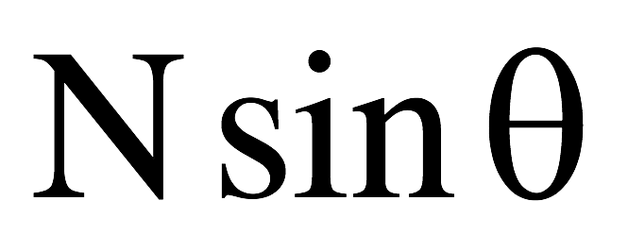
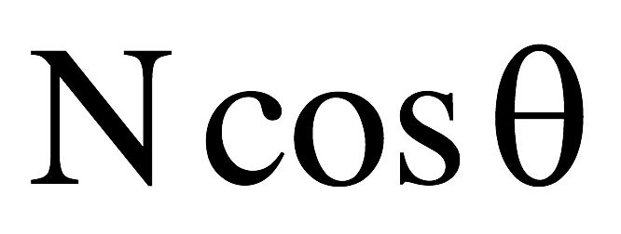

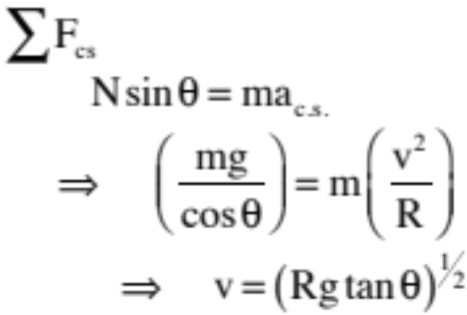
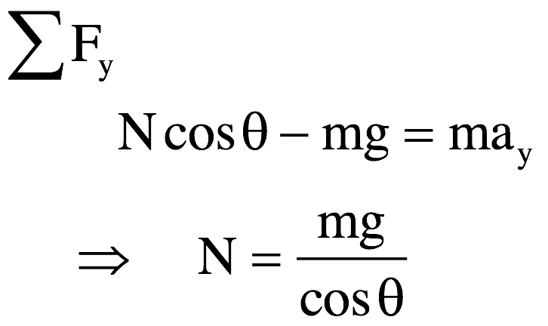

Banked curve – no friction
With the axes, we get:
R
v
N.S.L. yields:
and

Slide 4
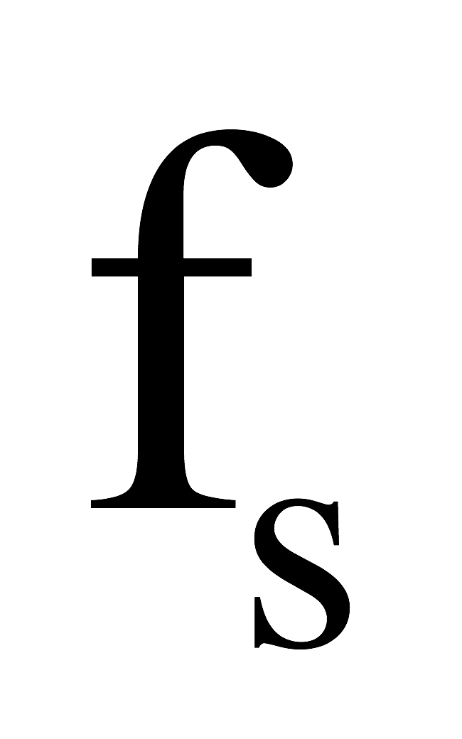
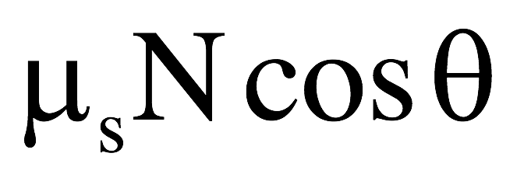
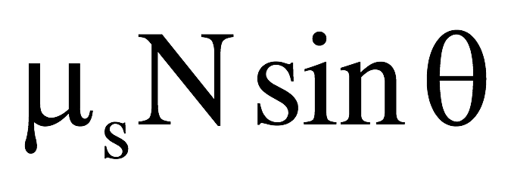
Banked curve – WITH friction
What would happen if there was friction? It would depend upon whether the car was traveling slowly or fast.
If the car was moving extremely fast, the car would slide up and over the top if it broke loose suggesting that the static frictional force would be DOWN the embankment. Its free body diagram would look like:
The center seeking direction would still be to the right in the horizontal, so the static frictional force would have to be broken into its components (as shown) before using N.S.L.

Slide 5
Banked curve – WITH friction
If the car was moving extremely slow, the car would tend to slide down the embankment if it broke loose suggesting that the static frictional force would be UP the embankment in that case. Its free body diagram would look like:
And the components would look like:

Slide 6
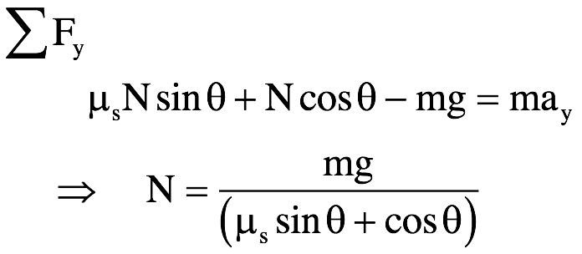
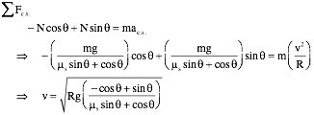
Banked curve – WITH friction
In the case of going too slow, the math would look like:
Crazy, huh? (you do NOT need to know how to do all this math – it’s to show you how it WOULD be done). You DO need to know how to draw the FBDs.

Slide 7
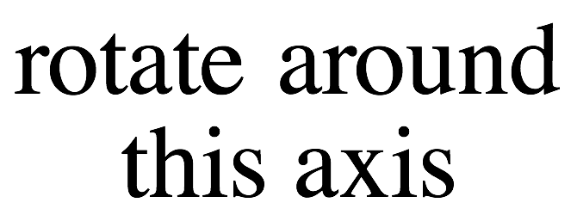

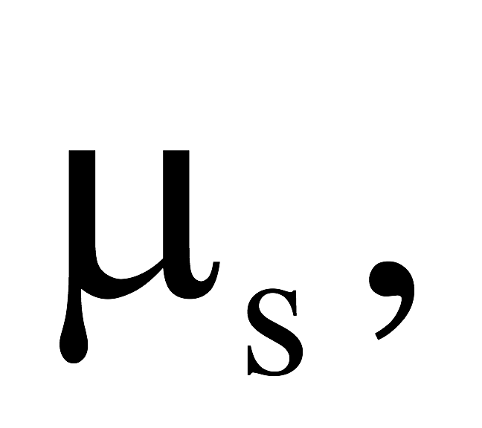
Carnival ride – take 1
A rider stands against the wall of a huge cylinder of radius “R” that is constrained to rotate about its central axis. Once up to speed, the rider finds himself pinned against the wall as the floor drops out from under him.
If the coefficient of static friction between the rider and the wall is what is the minimum speed the cylinder can rotate and keep the man from falling through to the ground?

Slide 8
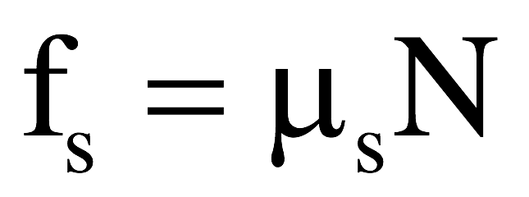
Carnival ride – take 1
As always, we must start with a f.b.d. on the man as he stands in the “snapshot” we are looking at.
Note 1: Remember, the normal force acts away from the support that provides it, and,
Note 2: The static frictional force is UPWARD as the body would move DOWNWARD if it broke loose. Remember, it’s the static frictional force that KEEPS the body from breaking loose!

Slide 9
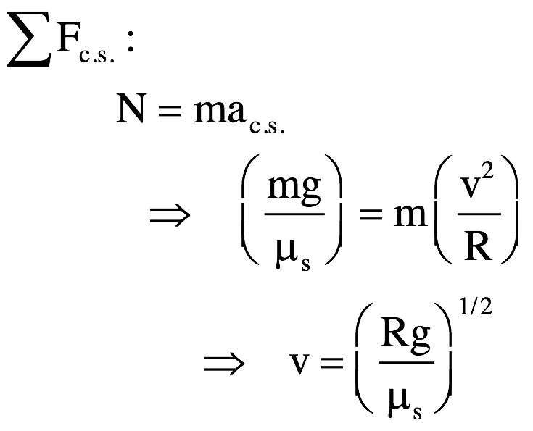
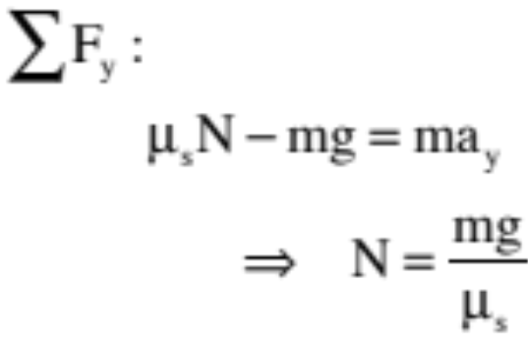

Carnival ride – take 1
The center seeking direction is toward the center of the arc, so our axis becomes:
With the f.b.d., we can write:
and

Slide 10
Carnival ride…take 2!
A rider stands against the wall of a huge cylinder of radius “R” that is constrained to rotate about its central axis. Once up to speed, the cylinder tilts upward to and angle while the rider finds himself pinned against the wall as the floor drops out from under him.
If the coefficient of static friction between the rider and the wall is what is the minimum speed the cylinder can rotate and keep the man from falling through to the ground?

Slide 11
Carnival ride – take 2
Clearly, we want to observe the man when he is most vulnerable to falling. That is shown to the right. The f.b.d. that goes with that position is:
Note 1: As always, the normal force acts away from the support that provides it, and
Note 2: The static frictional force is parallel to the surface providing it.

Slide 12
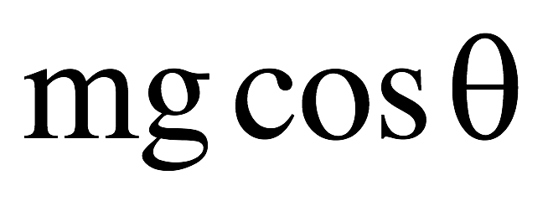
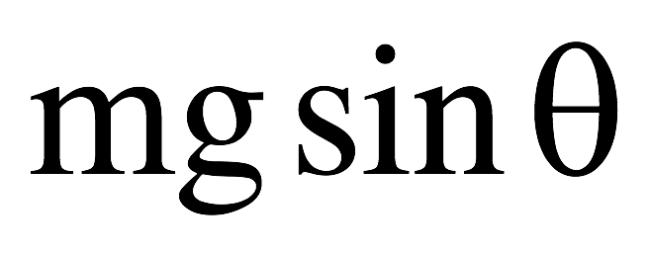
Carnival ride – take 2
The center seeking direction is toward the center of the arc, so our axis becomes:
We need to break “mg” into its component parts along our axis, or:

Slide 13
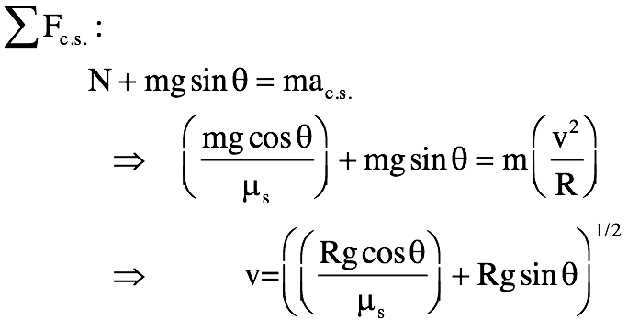
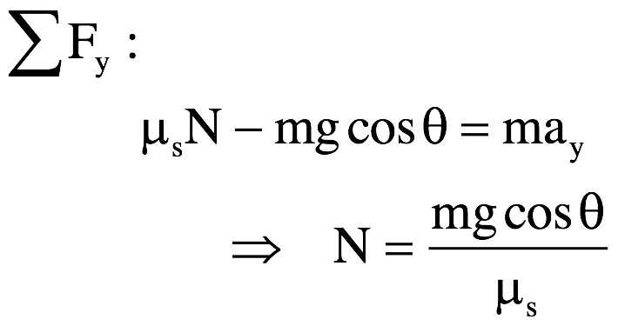
Carnival ride – take 2
The center seeking direction is toward the center of the arc, so our axis becomes:
and

Slide 14







Mini-lab: An airplane circles with some unknown velocity v (see demo at front of room). Derive an expression for v, then check to see if that value matches up with the actual velocity of the plane. Determine also the motion’s period T.
From what perspective will you view the system?
Look at it from head-on.
Hint for f.b.d.: Think of viewing the system as though the body was at an extreme—that is, with the velocity coming straight at you and the mass and string in the plane of the page.)
f.b.d. (looking at the body from head-on)
body coming straight out at you
39.)

Slide 15




So how will you orient your axes?
body coming straight out at you
Breaking off-axis forces into components:
40.)

