Slide 1
General announcements

Slide 2
The Island Series:
You have been kidnapped by a crazed physics nerd and left on an island with twenty-four hours to solve the following problem. Solve the problem and you get to leave. Don’t solve the problem and you don’t.
The problem: You are told that a mass will be accelerated, and the question will be, “Will the velocity change be relatively big or relatively small.” You respond with a, “What the hell, how should I know,” at which time your captor says, “Oh, yeah, OK, well, I’ll let you ask two questions before giving your answer, but not “is the velocity change big or small” . . . and know that I (the captor) had a bad experience with kinematics when young and any allusion to that approach will outrage me.”
What two questions should you ask?
1.)

Slide 3
Solution to Island Problem
What does govern how much velocity change a body experiences under the influence of a force? The two parameters that will matter are:
The magnitude of the force (the bigger the force, the larger the velocity change will likely be); and
The distance over which the force acts (the farther the force acts, the more the body will pick up speed);
Except there is a problem with this as stated. We will take a look at what it is shortly.
2.)

Slide 4
CHAPTER 7:
Work and Energy
To date, you have seen two approaches to problem-solving in this class:
1.) Kinematics says: that if a body’s acceleration is constant, look to see what information you are given, look to see what you are trying to determine, then find a kinematic equation that has everything you know along with what you are trying to determine. I call it idiot physics because you can be an idiot and do just fine with it. All it really is is pattern recognition.
2.) Newton’s Laws say: if a body experiences a net force along some line, that force will be proportional to the acceleration of the body along that line with the proportionality constant being the body’s mass. It is a considerably more powerful approach than kinematics as considerably less information is required to make it work.
We are now ready to look at the world from a completely different perspective, one in which a system’s energy content is the key. It will begin with a definition, that of work, from which all else will follow. First, though, some non-AP related exotica
3.)

Slide 5
What is Energy?
(this is not an AP-related topic)
You are out in space and you give a 1.00000 kg object a push with a constant force. What changes?
The acceleration won’t change as the force is constant, but the velocity will; time will; momentum will; position will.
There is one other things that will change in this case, though not by any amount that you will notice. The body’s mass will change (remember, mass is a relative measure of a body’s inertia).
In fact, a velocity/mass breakdown for your 1.0000 kg mass object is found on the next slide;
4.)

Slide 6
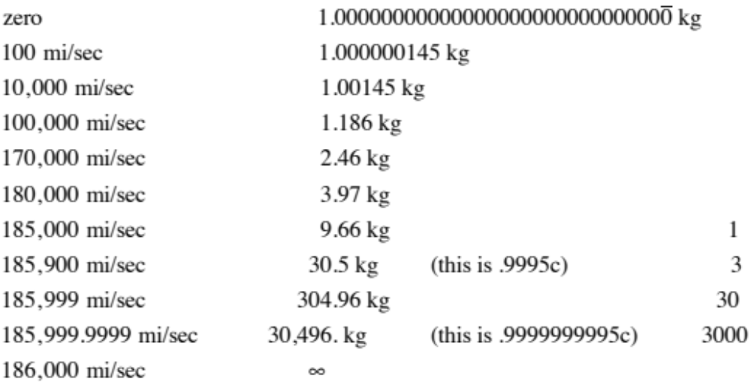
velocity
mass
Apparently, putting energy into a system as low velocities shows itself by changing the body’s energy of motion (it’s kinetic energy) whereas putting energy into a system at velocities close to the speed of light changes the body’s mass.
5.)

Slide 7

You are are familiar with the key to this rather bizarre behavior. What was the first relativistic equation you have ever learned from Einstein?
It says claims is that mass and energy are different forms of the same thing.
Don’t believe me? Take 1.000 grams of hydrogen and fuse it. You will end up with .993 grams of helium. Where did the missing .007 grams go? Turned into pure energy, enough energy to send three-hundred and fifty, 4000 pound Cadillacs (the old school kind) 100 miles into the atmosphere. The sun fuses 657,000,000 TONS of hydrogen into approximately 653,000,000 tons of helium every second. That’s how it generates enough energy to heat our planet 93,000,000 miles away.
When Feynman (Nobel laureate from Caltech) was asked by me at a CAIS meeting what energy was, he said, simply, “I have no idea.” And in saying that, he spoke for the physicists of the world! We know how to use energy, how to store it, how to generate it, how to transfer it great distances, but we have absolutely no idea what it is.
Fortunately, you don’t need to know what it is to use the idea as a problem-solving tool, which is exactly what we are about to do in a non-relativistic setting.
6.)

Slide 8



Work
So what does govern the velocity change a body experiences under the influence of a force at low velocities? The two parameters that will matter are:
The magnitude of the force (the bigger the force, the larger the velocity change will likely be); and
The distance over which the force acts (the farther the force acts, the more the body will pick up speed);
There is a problem with this as stated, though. Consider the following force and displacement . . . will F be changing that body’s velocity as it moves across the table?
NO!!! This force will generate NO VELOCITY CHANGE . . . yet there’s a force and displacement involved . . . so what’s the deal?
7.)

Slide 9









To understand the problem, we need to look at a little more general situation. Consider a constant force oriented at an angle with the displacement vector. In that case, we have:
Clearly, the perpendicular component of the force will do nothing to change the body’s velocity (assuming it doesn’t yank the block off the tabletop), whereas the parallel component WILL effect a velocity change.
In fact, the product of and the magnitude of will yield a number that, if large, would suggest a relatively large velocity change, and if small, a would suggest a relatively small velocity change.
8.)

Slide 10




This product, the product of the, magnitude of the component-of-the-force-along-the-line-of-the-displacement and the magnitude-of-the-displacement is important enough to be given a special
name. It is called WORK. Formally, it is defined as:
Note that the units are newton-meters, or joules (the units of energy):
Looking at the geometry in the sketch, this is also written as:
where is the angle between the line of the force and the line of the displacement and d is the magnitude of the displacement.
It is also not uncommon to see this quantity written as:
Or the magnitude of one vector times the magnitude of the second vector times the cosine of the angle between the line of the two vectors:
9.)

Slide 11

Because this kind of operation is used so often in physics (that is, multiplying the magnitude of one vector times the component of the second vector along the line of the first), the operation is given a special name and designation. It is called
a DOT PRODUCT, and it’s use allows us to write out the work relationship as:
This is not as spooky as it looks. It is just a mathematical operation. The point is that the dot product between a force and displacement tells you something about how that force is motivating the body to change its motion.
11.)

Slide 12
Dot products
Orientation means nothing - it’s the relationship between the vectors that matters!

Slide 13
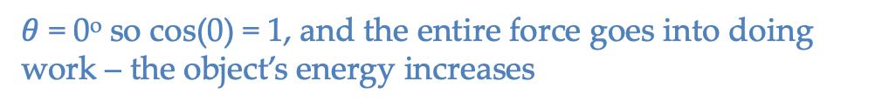
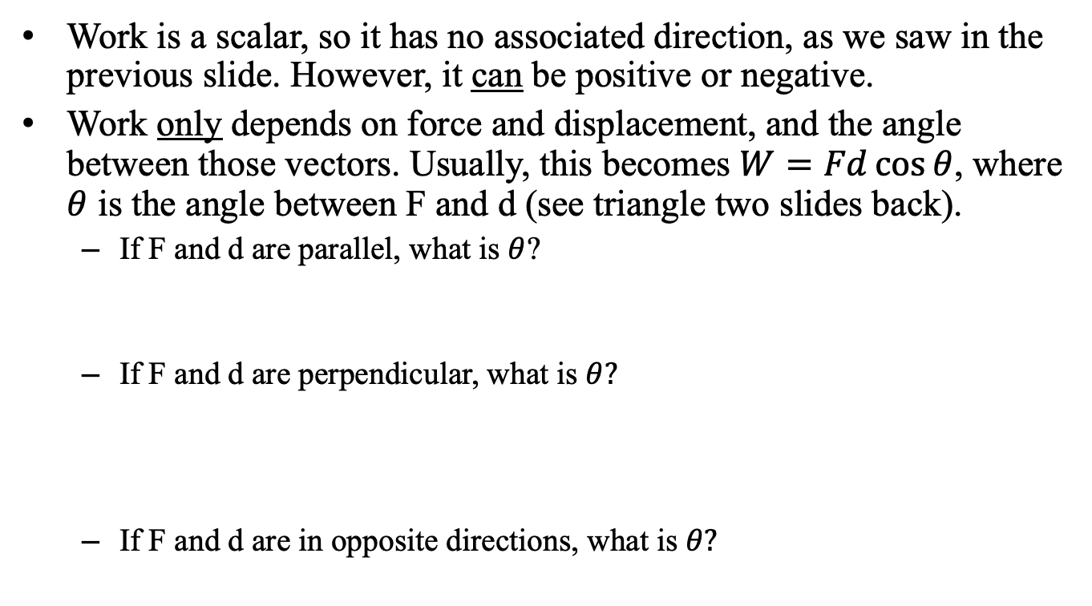
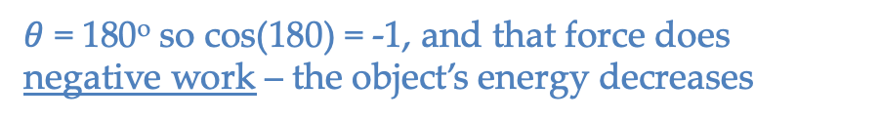
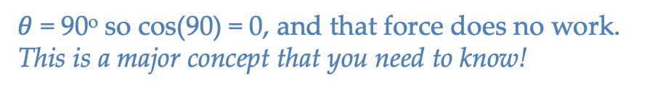
Work as a scalar
Work is a scalar, so it has no associated direction, as we saw in the previous slide. However, it can be positive or negative.
Work only depends on force and displacement, and the angle between those vectors. Usually, this becomes $W=Fd\cos{θ}$, where $θ$ is the angle between F and d (see triangle two slides back).
  If F and d are parallel, what is $θ$?
  If F and d are perpendicular, what is $θ?$
  If F and d are in opposite directions, what is $θ?$
$θ$ = 0º so cos(0) = 1, and the entire force goes into doing work – the object’s energy increases
$θ$ = 90º so cos(90) = 0, and that force does no work. This is a major concept that you need to know!
$θ$ = 180º so cos(180) = -1, and that force does negative work – the object’s energy decreases

Slide 14
Work concept check
In which case is work being done? Is that work + or -?
  Carrying a bucket horizontally at constant velocity
  Holding a heavy bag motionless while waiting for the bus
  Lifting a box from the ground to a table
  Pushing against a wall for an hour
No work – gravity and applied force are perpendicular to displacement (and velocity is unchanged)
No work – bag is not displaced
Positive work is done by person as they lift upwards and the box displaces upwards
No work – wall does not move. You might get really tired, but you do no work on the wall.

Slide 15



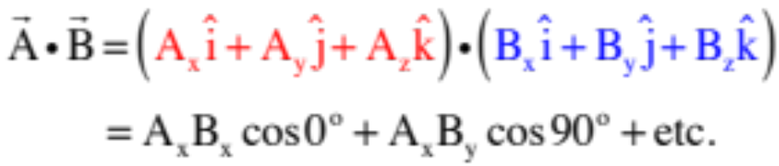



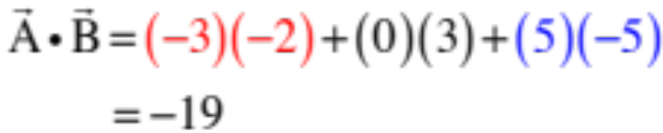
How about a dot product if the vectors are in unit vector notation? In that case:
which is to say, the sum of the products of like component.
Justification:
Let
and
Notice the like-terms stay and the off-terms go away, so extrapolating:
Example: if
and
16.)

