Slide 1
General announcements

Slide 2
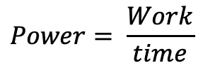
One last definition
A 1965 VW Beetle and a 2017 Porsche (roughly the same mass) both start from rest, and accelerate to 45 mph.
  Which one gets to 45 mph first? Why?
  Which one requires more work to get to that speed? Why?
Both require roughly the same amount of work, but one does it much faster – this means it’s more “powerful.”
Power is how quickly work is done. In equation form:
The units for power are Watts (J/s). Sometimes we use horsepower (hp) where 1 hp = 746 W.
$$Power= \frac{Work}{time}$$

Slide 3
Conservation of Energy lab
This is a group data-collection lab – we will collect data as a class, and you will analyze it individually. Your partners are “the whole class.”
The background:
  Pendulum motion normally dampens out very slowly because its major sources of energy loss--resistance due to air friction and frictional heating at the support--don't remove energy very quickly. It is, therefore, an ideal system from which to take a close look at the consequences of energy conservation.

Slide 4
Atwood problem – with energy
The original problem was set up as follows: Two masses are attached via a string that is positioned over a massless, frictionless pulley. The masses start from rest. I’m altering the problem by NOT having one mass start at floor level. That means the diagram ends up looking like the one shown below. It also means you will have more “fun” defining the zero levels for the PE functions. In any case, with that:
  A) how fast are they moving when they pass one another?
  B) how fast is m₁ moving when m₂ hits the floor?
  C) How much higher does m₁ rise after m₂ hits the floor?
m₂
h
m₁

Slide 5

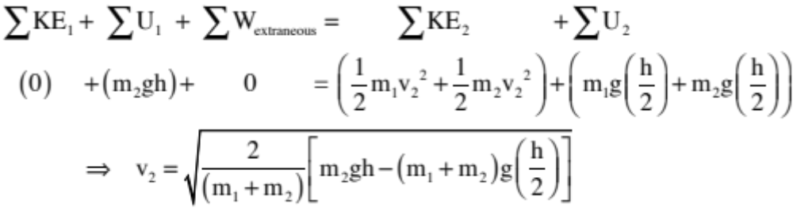

Atwood problem
a.) How fast are they moving when they pass one another?
m₂
y₁ = h
h
y₂ = h/2
m₁
2
2

Slide 6
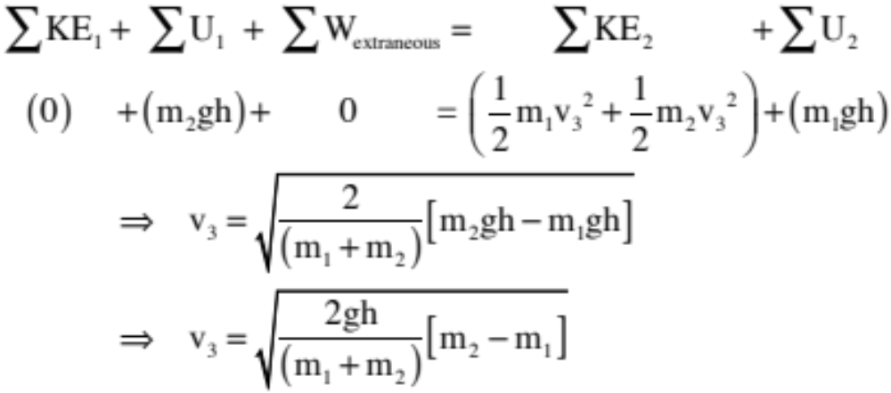
Atwood problem revisited
b.) How fast is m₁ moving when m₂ reaches the table?
m₂
h
m₁
1

Slide 7
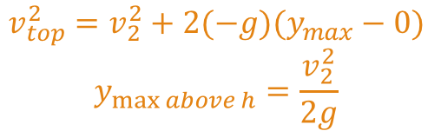
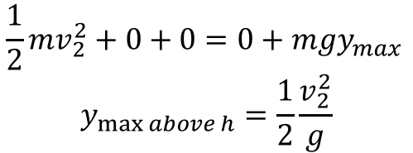
Atwood problem
c.) How far will m₁ move above the initial h of m₂ (i.e., after m₂ hits the table)?
Just looking at m₁ from the initial h mark on, and setting that to y = 0 for this portion, we can write:
$$\frac{1}{2}mv_{2}^{2}+0+0=0+mgy_{max }$$
$$y_{\max{above h}}=\frac{1}{2}\frac{v_{2}^{2}}{g}$$
0
You could also use kinematics…and get the same answer!
$$v_{top}^{2}=v_{2}^{2}+2(−g)(y_{max}−0)$$
$$y_{\max{above h}}=\frac{v_{2}^{2}}{2g}$$
5.)

Slide 8








Atwood problem revisited – a twist
There are two things to notice at the outset.
First, there are TWO bodies moving with the same velocity magnitude and displacing the same net distance (though one is moving downward and the other upward).
Second, you can identify the “zero potential energy level” separately for EACH BODY independent of the other (we will do a problem below where that is important). Having said that, I usually make the LOWEST POINT OF TRAVEL the y=0 level for each body. This means that the 3 kg mass will have its y = 0 point at it’s start-point and the 5 kg mass at its end-point (see sketch)

Slide 9









Insane Energy Problem aka “Another Problem from Hell”
k = 200 N/m
v_{f} = 0 m/s
Jello (loses 40 J)
An object of m = 3 kg starts with initial velocity = 4 m/s down a 30 degree frictionless incline. It then enters a frictionless loop of radius = 2 meters where its velocity through the top is measured at 12 m/s. It then enters a jello vat which removes 40 joules of energy between entry and exit, then passes over a 12-meter-long frictional surface where F_{fk}=2.5 N and hits a spring, losing an unknown amount of energy while pushing spring of k = 200 N/m a distance of 1.2 meters before coming to rest (whew).
(a) What is h? (b) How much energy is lost due to collision with the spring?

Slide 10
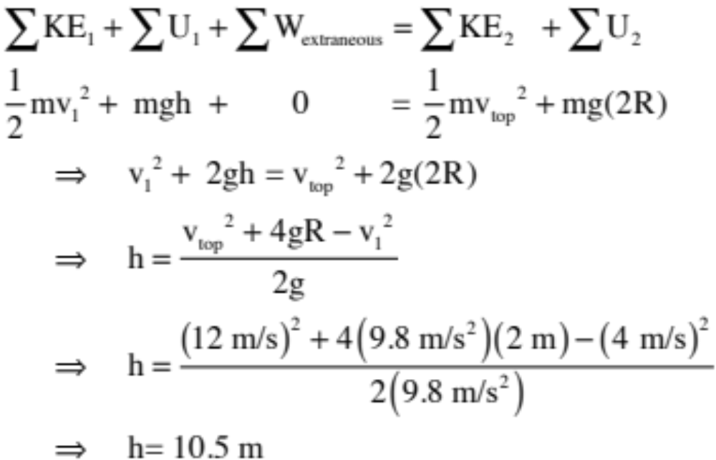
Insane Energy Problem
What is h?
You know what’s happening at the top of the arc, so the reasonable thing to do would be to use conservation of energy between the initial point and the top of the arc (note that you will don’t have to use N2L and centripetal forces for this).

Slide 11
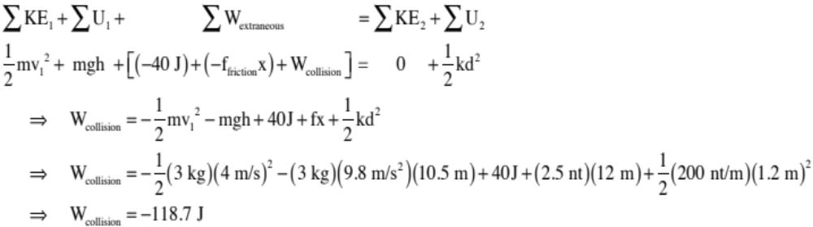
Insane Energy Problem
How much energy is lost due to collision with the spring?
Conservation of energy from start to finish:

