Slide 1
General announcements

Slide 2








Atwood problem revisited – a twist
There are two things to notice at the outset.
First, there are TWO bodies moving with the same velocity magnitude and displacing the same net distance (though one is moving downward and the other upward).
Second, you can identify the “zero potential energy level” separately for EACH BODY independent of the other (we will do a problem below where that is important). Having said that, I usually make the LOWEST POINT OF TRAVEL the y=0 level for each body. This means that the 3 kg mass will have its y = 0 point at it’s start-point and the 5 kg mass at its end-point (see sketch)

Slide 3









“Another Problem from Hell” Revisited
k = 200 N/m
v_{f} = 0 m/s
Jello (loses 40 J)
An object of m = 3 kg starts with initial velocity = 4 m/s down a 30 degree frictionless incline. It then enters a frictionless loop of radius = 2 meters where its velocity through the top is measured at 12 m/s. It then enters a jello vat which removes 40 joules of energy between entry and exit, then passes over a 12-meter-long frictional surface where F_{fk}=2.5 N and hits a spring, losing an unknown amount of energy while pushing spring of k = 200 N/m a distance of 1.2 meters before coming to rest (whew).
(a) What is h? (b) How much energy is lost while compressing the spring?

Slide 4






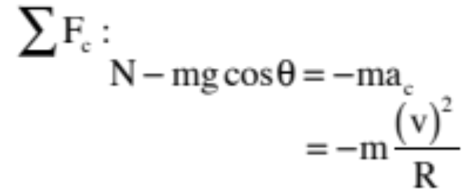



Still more fun with Problem #6: A small mass m sits stationary atop a frictionless ice dome of radius R. A tiny, tiny, tiny gust of wind just slightly nudges the mass off-center, and it begins to slide down the dome. At what angle will it leave the dome?
There are, as usual, two points of interest
here. WHENEVER YOU RUN into a problem like this where it isn’t at all obvious how to proceed, just start writing down relationships you know are true. In this case, the two that should jump out at you are energy and the fact that the body is moving centripetally at the lift-off point. Utilizing the latter first:
f.b.d. at in general:
23.)

Slide 5
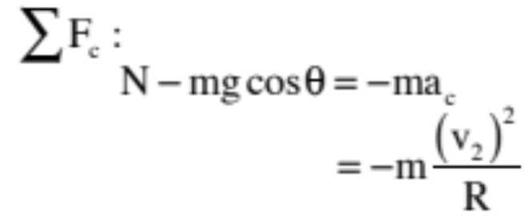

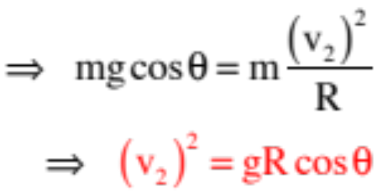
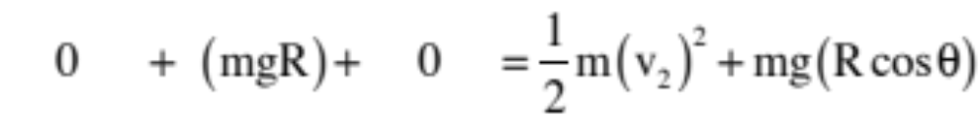
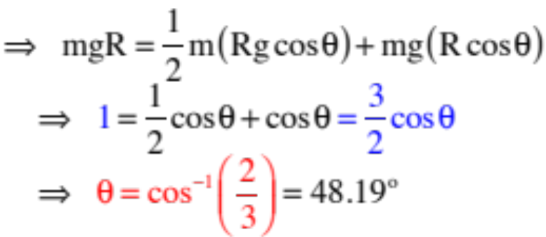
At lift-off, the normal force goes to zero, which means:
What about energy?
24.)

Slide 6
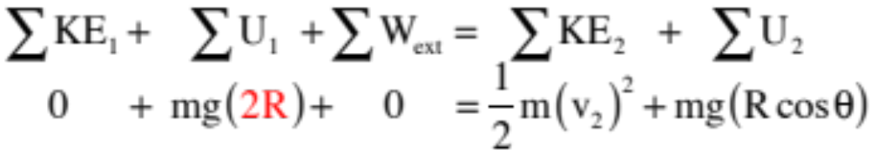
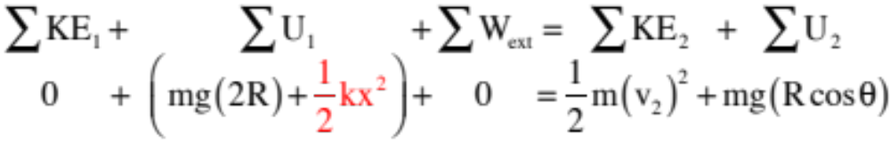
And how might we make this more exciting?
We could extend the ramp upward as shown.
That would change the initial gravitational potential energy to mg(2R) yielding:
We could additionally add a spring at the top (not shown), which would also change the initial potential energy yielding
25.)

Slide 7

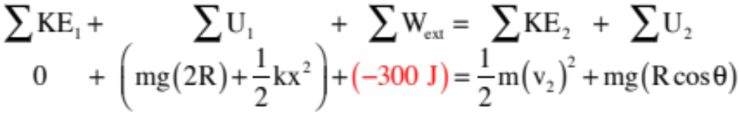
And, of course, we could add to all of that jello that would take out, say 300 joules of energy
yielding:
None of these changes would alter the centripetal force part of the problem, but they would alter the energy part. The energy APPROACH wouldn’t change, though. Look to see what’s happening at the beginning of the interval. Look to see what’s happening at the end. Look to see what happened during the interval. It’s simple!
26.)

Slide 8



What to expect for the test
Multiple choice questions, as usual
Skills:
  What is a dot product? How do we “dot” two vectors? What does theta represent in that equation? How do you determine the angle between the line of two vectors?
  Be able to determine work using the various definitions of work ( ,
  Know the potential energy functions for objects close to the surface of the earth (U_{g}) and for springs (U_{spr}), as well as equations for those and KE
  Know what conservative vs. nonconservative forces are and what that means in terms of work/energy
  Know what power is (in terms of energy) and its units (not much on this)
Long-answer problems:
  Be able to solve problems involving ramps, loops, springs, Atwood machines, rollercoasters, toy spring guns, etc. using Cons. of Energy
  Be able to use N2L if necessary (e.g. loops and humps…)
  Be able to solve them if we throw something silly in like Jello…

