Slide 1
General announcements

Slide 2






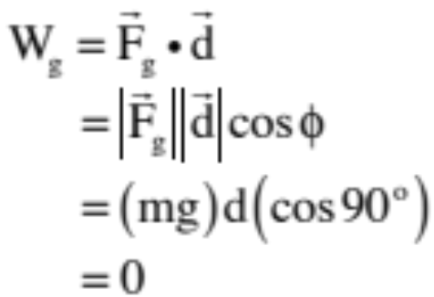


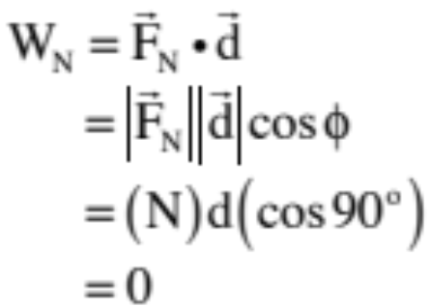

Consider: a 100-N force F applied at above the horizontal drags a 20-kg box 3.0 meters across a rough surface whose coefficient of kinetic friction is .
Derive an expression for the work done by the various forces acting on the box.
gavity:
normal:
12.)

Slide 3
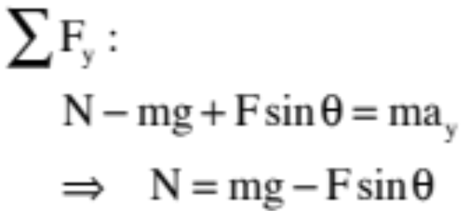

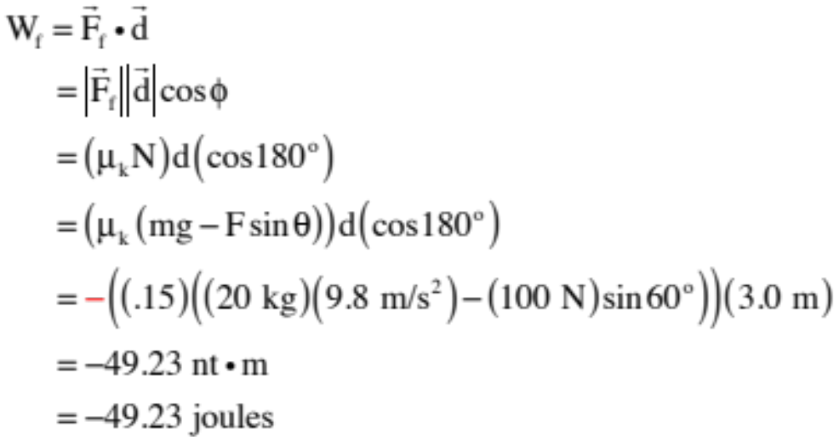

friction:
To deal with friction, we need the normal force. Using N.S.L. in the vertical:
So
13.)

Slide 4
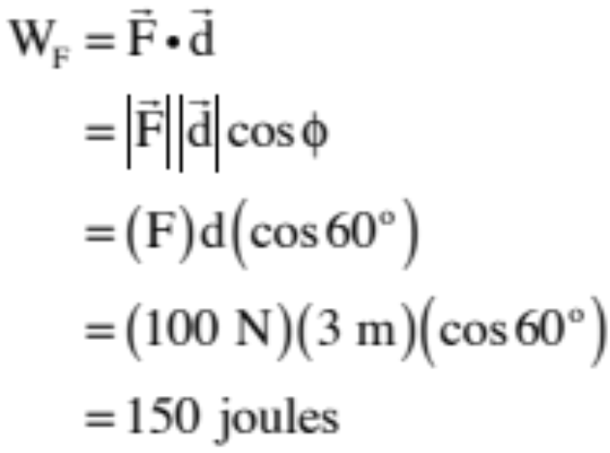
Notice the units of work are newton-meters, which are joules, an energy quantity. So what must the significance of a negative work calculation like friction’s be?
Negative work acts to pull energy out of the system (which means that positive work must act to put energy into a system).
F’s work:
14.)

Slide 5

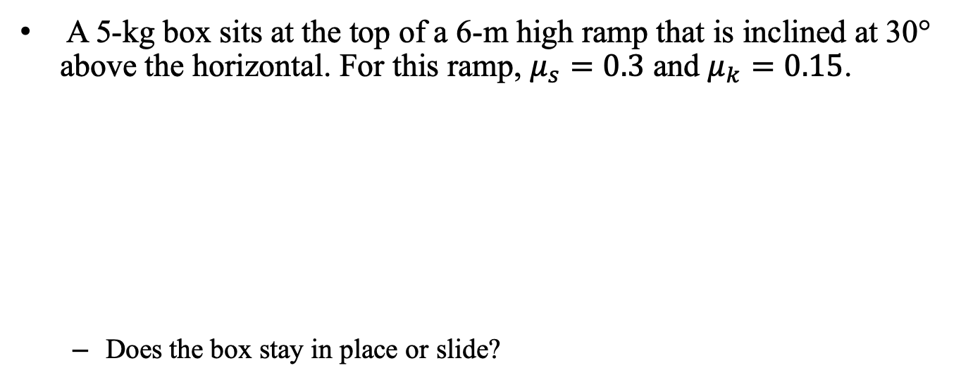
Box on an incline…
A 5-kg box sits at the top of a 6-m high ramp that is inclined at 30° above the horizontal. For this ramp, $μ_{s}=0.3$ and $μ_{k}=0.15$.
  Does the box stay in place or slide?
6 m
30°
Gravity is pulling down with force:
Maximum static frictional force is:
Clearly gravity wins out and the body slides!

Slide 6




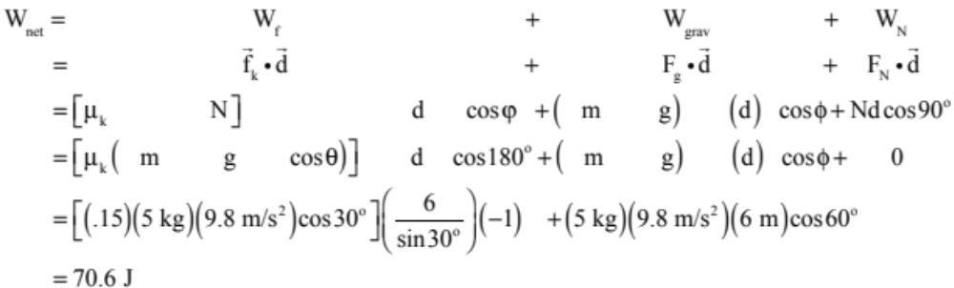
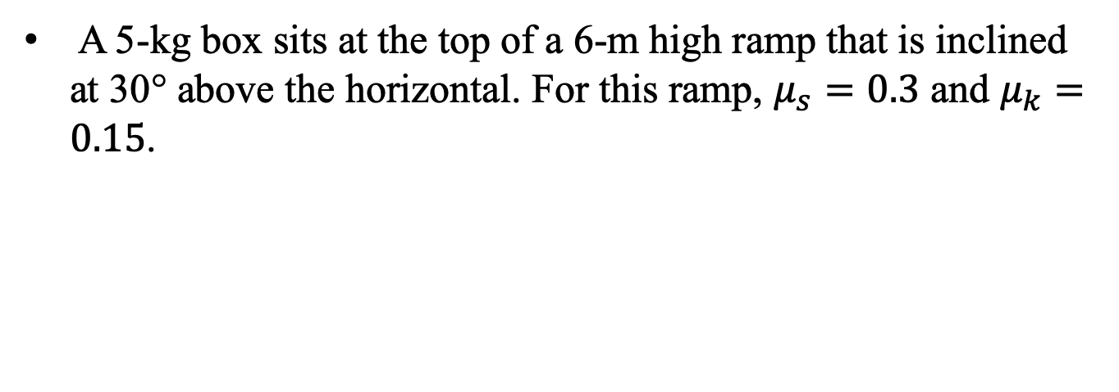
A 5-kg box sits at the top of a 6-m high ramp that is inclined at 30° above the horizontal. For this ramp, $μ_{s}=0.3$ and $μ_{k}=0.15$.
6 m
30°
  Assuming it slides, how much work is done by each force acting on the box by the time it reaches the bottom of the ramp? Also, what is the net work done during the motion?

Slide 7
A 5-kg box sits at the top of a 6-m high ramp that is inclined at 30° above the horizontal. For this ramp, $μ_{s}=0.3$ and $μ_{k}=0.15$.
6 m
30°
  How fast is the block traveling when it gets to the bottom of the incline?
  AND HERE IS WHERE WE NEED A LITTLE HELP . . .

