Slide 1
General announcements

Slide 2




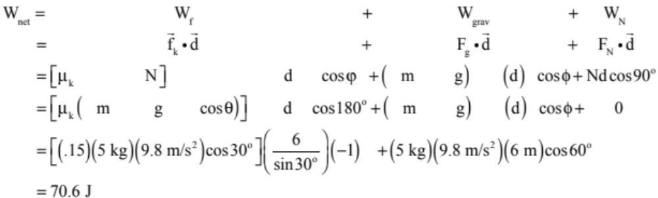
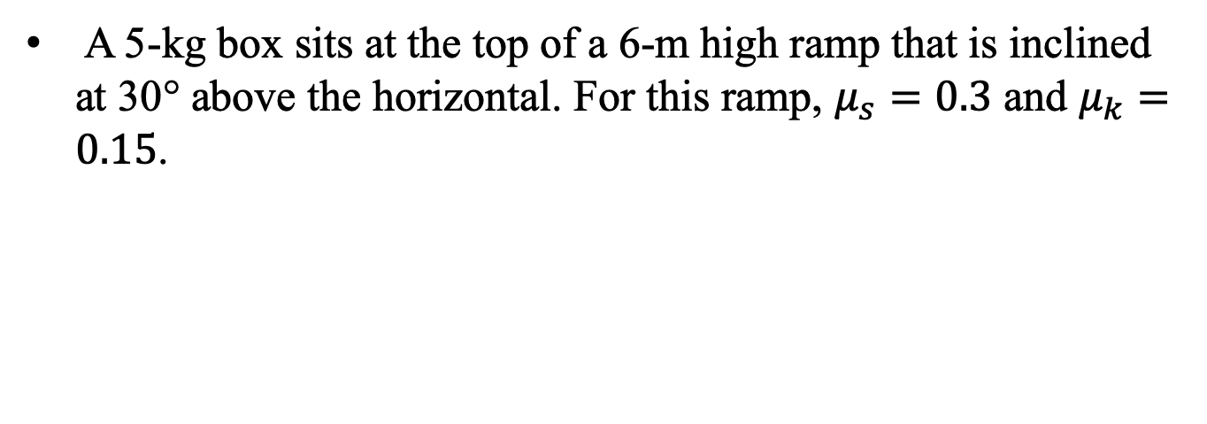
A 5-kg box sits at the top of a 6-m high ramp that is inclined at 30° above the horizontal. For this ramp, $μ_{s}=0.3$ and $μ_{k}=0.15$.
6 m
30°
  Assuming it slides, how much work is done by each force acting on the box by the time it reaches the bottom of the ramp? Also, what is the net work done during the motion?

Slide 3
A 5-kg box sits at the top of a 6-m high ramp that is inclined at 30° above the horizontal. For this ramp, $μ_{s}=0.3$ and $μ_{k}=0.15$.
6 m
30°
  How fast is the block traveling when it gets to the bottom of the incline?
  AND HERE IS WHERE WE NEED A LITTLE HELP . . .

Slide 4
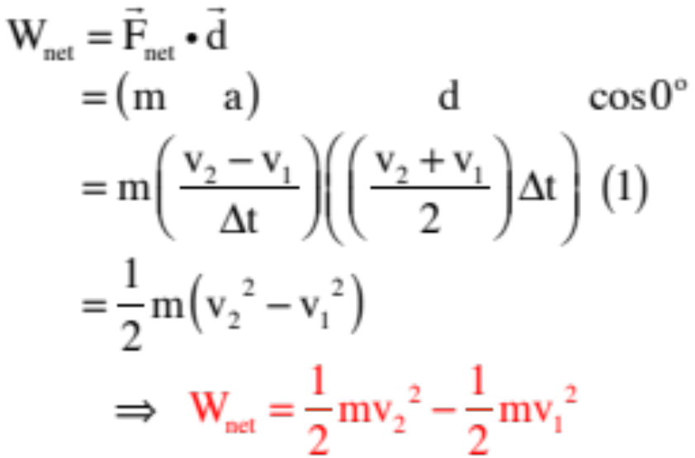
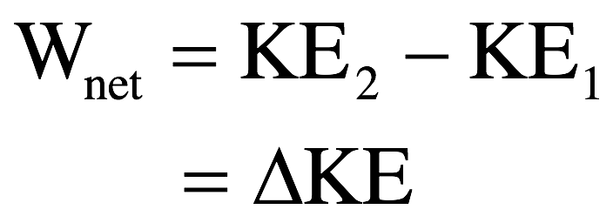
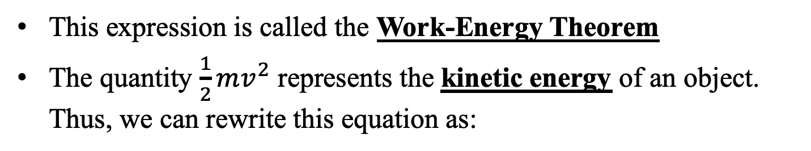
Work and energy
This expression is called the Work-Energy Theorem
The quantity $\frac{1}{2}mv^{2}$ represents the kinetic energy of an object. Thus, we can rewrite this equation as:
The work-energy theorem in this form tells us that when net work is done on an object, the object’s kinetic energy will change.

Slide 5
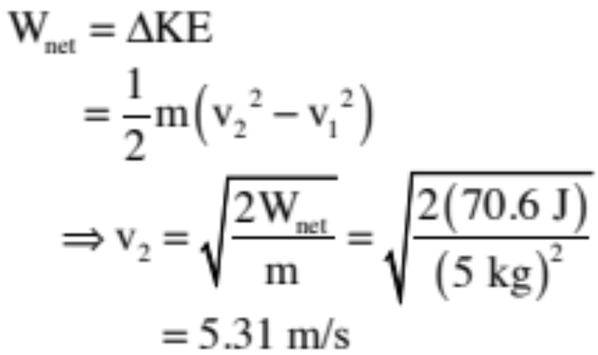

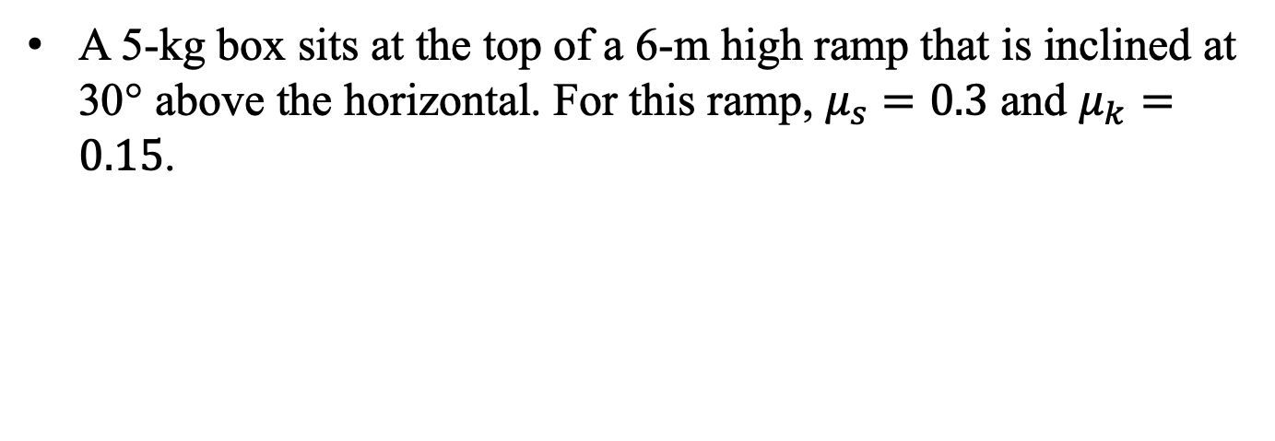
A 5-kg box sits at the top of a 6-m high ramp that is inclined at 30° above the horizontal. For this ramp, $μ_{s}=0.3$ and $μ_{k}=0.15$.
6 m
30°
  How fast is the block traveling when it gets to the bottom of the incline?
So now we can answer our question with the help of the Work/Energy Theorem!

Slide 6
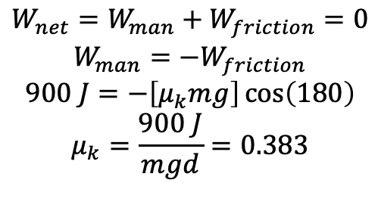
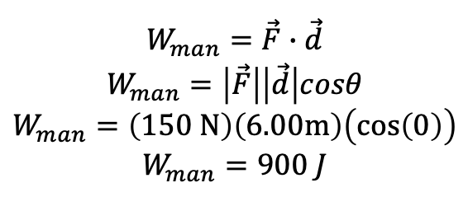
Problem 5.6 – with friction
A man applied a horizontal force of 150 N to push a 40.0 kg crate 6.00 m on a rough surface. If v is constant,
  (a) What is the work done by the 150 N force?
  (b) What is the coefficient of kinetic friction?
F = 150 N
d = 6 m
$$W_{man}=\vec{F}∙\vec{d}$$
$$W_{man}=\left|\vec{F}\right|\left|\vec{d}\right|cosθ$$
$$W_{man}=\left(150 N\right)\left(6.00m\right)\left(cos\left(0\right)\right)$$
$$W_{man}=900 J$$
$$W_{net}=W_{man}+W_{friction}=0$$
$$W_{man}=−W_{friction}$$
$$900 J=−\left[μ_{k}mg\right]\cos\left(180\right)$$
$$μ_{k}=\frac{900 J}{mgd}=0.383$$
Because v is constant, we know W_{net} = 0 (no change in KE). We also know a_{y} is 0, so F_{N} = mg. So:

Slide 7



So Consider . . .
A plane moving with velocity v at an angle with the horizontal is “h” meters above the ground. A coke bottle is released out its window. How fast is the bottle moving just before it hits the ground?
The Work/Energy Theorem might work, except the work gravity does is going to change from point to point. So what to do?

