Slide 1
General announcements

Slide 2


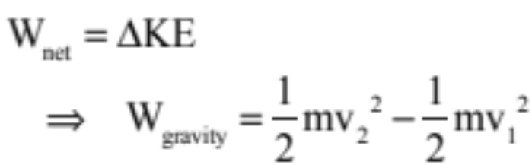

The Gods Must be Crazy. . .
A plane moving with velocity v at an angle with the horizontal is “h” meters above the ground. A coke bottle is released out its window. How fast is the bottle moving just before it hits the ground?
The Work/Energy Theorem might work, except the work gravity does is going to change from point to point. So what to do?

Slide 3








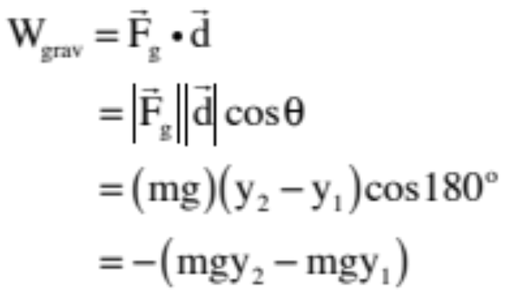

Bit of Slight of Hand
A ball moves from position 1 at to position 2 at as shown on the sketch. How much work does gravity do in the process?
We can derive the work quantity using the standard approach and noting that the direction of the gravitational force is opposite the direction of the displacement of the ball as it moves upward. Doing so yields:
28.)

Slide 4





We next need to derive the amount of work gravity does on the ball as it traveled from position 1 to position 2 along the convoluted path shown to the right. Note that I’ve broken the sections into mini-sections for easy analysis.
--in section 1 and 4, gravity does no work done as the force is perpendicular to the displacement through those sections;
--in section 3, gravity’s work is negative (force down, motion up) whereas in section 5, its work is the same magnitude but positive, so these two add to zero.
--in section 2, gravity does negative work in the amount calculated in the previous section . . .
Conclusion: All that matters when doing a work calculation with gravity is where you start and where you end with the path making no difference at all.
29.)

Slide 5




Force fields that act this way, whose work calculations are PATH INDEPENDENT, are called CONSERVATIVE FORCES.
Note that a conservative force does NO NET WORK around a closed path (another example beyond the visual shown to the right is the work gravity would do as the ball went from position 1 out and back to position 1).
This means a non-conservative force does work that is path dependent. The classic example of this is friction.
Pick any point and begin summing the work quantities back around to that point. If the force is conservative, the sum will be zero (same amount of positive as negative work done, net)
30.)

Slide 6


If all that matters is where you start and where you end when doing a work calculation for a conservative forces like gravity, wouldn’t it be cool if we could define a function U that would assign a number to and a number to that would be such that when you took the difference between the two, you got the amount of work done by the field as you proceeded between the two points?
(And the answer to that question is, “Yes, definitely very cool.”)
Well, that’s exactly what we stumbled onto when we did the work calculation using the conventional approach on on gravity. Because looking at our solution, we got:
with looking very much like such a function (almost—there’s a negative sign out in front of the difference, but that’s OK, the general idea still holds)
31.)

Slide 7


Functions that do this kind of thing, that allow you to determine how much work a conservative force field does on a body moving from one point to another in the field simply by evaluating the function at the endpoints of the displacement, are called POTENTIAL ENERGY FUNCTIONS.
The symbol used for potential energy functions is a U, and the potential energy function for gravity when near the earth’s surface is:
Furthermore, the relationship between potential energy functions and work calculations is:
32.)

Slide 8

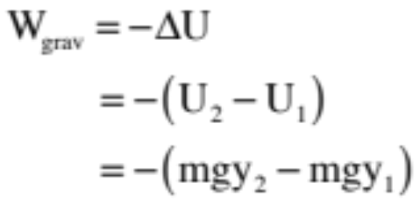

So using our potential energy function for gravity (near the surface of the earth) on our ball problem, we could write:
In short, if you know a force field’s potential energy function, in almost all instances it’s a LOT easier to do a work calculation for the force using its potential energy function than trying to get the result using .
33.)

Slide 9
What’s important to understand is that potential energy is a mathematical contrivance created to do ONE THING and ONE THING ONLY—to determine how much work a conservative force does on a body moving from one point to another in the field.
The ONLY THING you will ever use a potential energy function for will be to do WORK CALCULATIONS, and the only way you will ever use that function will be by taking the difference of the evaluation of the function at the motion’s endpoints, then sticking a negative sign in front of that value.
34.)

Slide 10



Let’s see how well you’ve understood this. A block is about to fall from the position shown to the level of the table top. Little Billy says the block starts out with potential energy . Little Missie says, “Oh, no, it has potential energy equal to . Who is right?
Answer: Both are making statements that could be correct. How so?
As there is no preferred F = 0 position for gravity near the surface of the earth, there is no preferred position to make the gravitational
potential energy equal to zero. You can see that in its definition. Mgy is dependent upon where you put y = 0, which is dependent upon where how you define your coordinate axis.
35.)

Slide 11

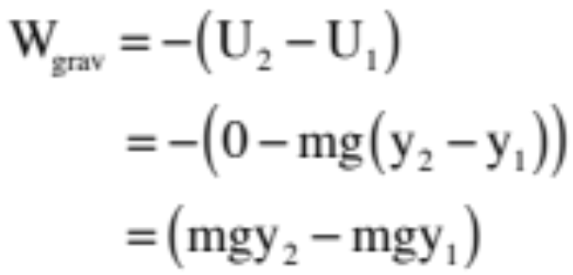
But Little Suzie is an iconoclast. She decides to make her y = 0 position the top of the table (i.e., at position 1). So in her rendition, her sketch looks like the one shown to the right and her “work done” calculation for the body as it moves from position 2
to position 1 looks like:
This is the same value Little Billie got in his calculation (shouldn’t be surprising as the motion hasn’t changed even if the coordinate axis has).
37.)

Slide 12

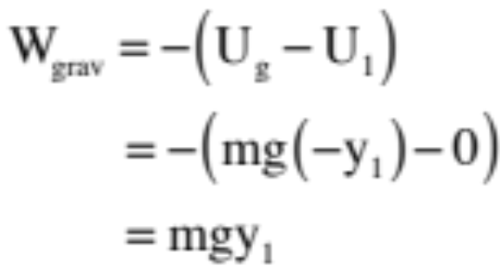
Conclusions:
1.) Although it is commonly done, making statements like, “The body at position 2 has potential energy in the sense that it can potentially pick up kinetic energy” is a little bit dangerous. Why? Because if we take the zero level to be the tabletop, the gravitational potential energy at that point, BY DEFINITION, is ZERO. With that, it makes no sense to claim that there is NO potential for a body to pick up kinetic energy if it were to drop from that level to the ground. In fact, that work calculation would look like:
38.)

Slide 13

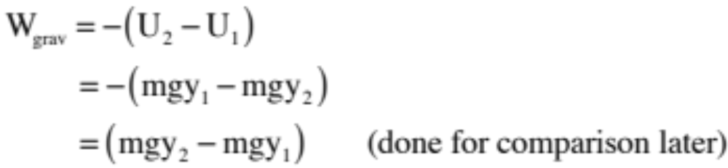
As the axis is currently set up with y = 0 at the floor, the potential energy at position 2 is, indeed,
as Little Billie stated. But potential energy functions are only meaningful in pairs because minus their difference between two points is what is related to work calculations.
Using Little Billie’s defined value as it was meant to be used, then, the work done on the body as it went from position 2 to position 1 becomes:
Little Billie seems vindicated.
36.)

Slide 14
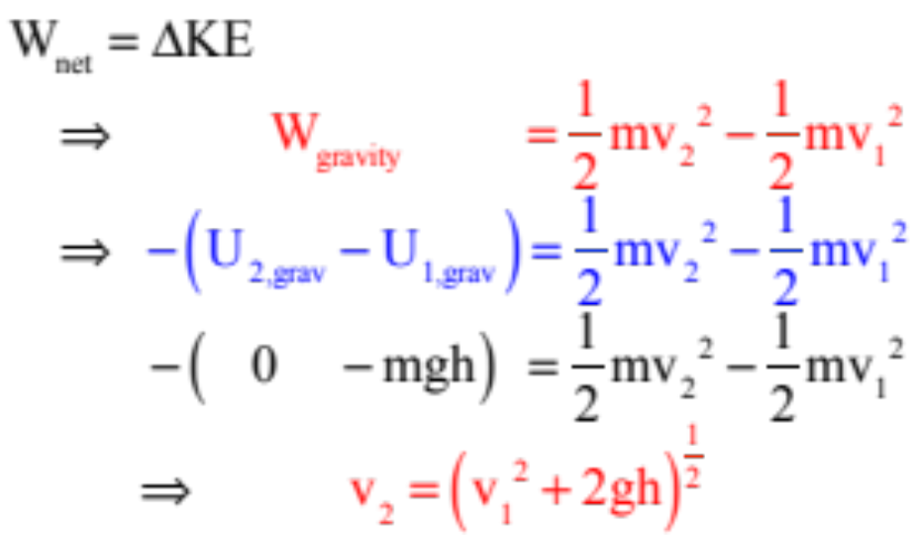
Back to “The Gods Craziness . . . “
A plane moving with velocity v at an angle with the horizontal is “h” meters above the ground. A coke bottle is released out its window. How fast is the bottle moving just before it hits the ground?
We can now use the Work/Energy Theorem because even though gravity’s work changes from point to point, it’s potential energy function allows us to circumvent that . . . (yippee . . . ). And with that, we get:

Slide 15
Pile driver
A 2100-kg pile driver drops 5.00 m before striking a vertical I-beam stuck in the ground. Upon collision, it drives the I-beam 18.0 cm farther into the ground. Assuming 3000 joules of energy was lost during the collision, use energy considerations to determine the average force the driver exerts on the beam.
2100 kg
5.00 m
18 cm
I-beam

Slide 16


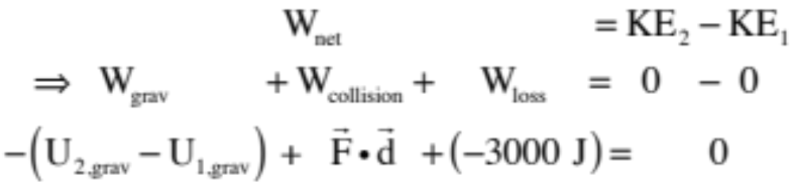
A 2100 kg pile driver drops from a height of 5 meters before striking a vertical I-beam. It drives the beam 18 cm into the ground. ASSUMING 3000 joules of energy was lost during the collision, use energy considerations to determine the average force the driver exerts on the beam. (You may also assume that the change of the beam’s gravitational potential energy is negligible).
y=0
The temptation is to assume that energy considerations have to be exercised over the entire system—both the driver and the beam. If that had been the case, we would have had to take into account the fact that a gravitational potential energy change occurred for both the driver AND the beam (the beam did change vertical position during the contact). As we don’t know the mass of the beam, we can’t do that. An alternative is
ground
to use energy considerations on just the driver. In that case, along with potential and kinetic energy considerations, there is also work done by the force the beam exerts on the driver as the driver is brought to rest (in fact, that is the very force we are trying to determine) and the energy loss due to the actual collision. The driver starts from rest and ends at rest, so putting it all together, the Work/Energy yields:
2.)

Slide 17
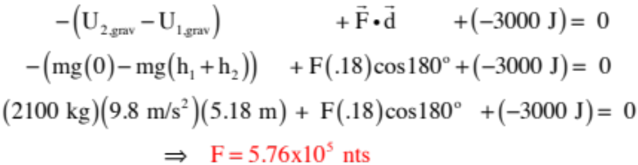
Putting in the numbers in we get:
y=0
ground
3.)

Slide 18

Gravitational PE, aka U
From these examples (and many others like them) we can see that the work done by gravity as an object moves between heights is independent of the path taken.
  That is, work done by gravity only cares about the starting and ending points and the height differential between them.
  This makes gravity a conservative force
    Path independent
    Energy is turned into another form within the system
This leads us to the idea of gravitational potential energy, U
  Near the Earth’s surface, the gravitational potential energy of any object of mass m at a height y above a reference point can be found by:
$$U=mgy$$

Slide 19
Gravitational PE
You get to decide where y = 0 is!
  Depending on the problem, it might be the ground, a table, the lowest point the object reaches, the highest point, whatever.
  It doesn’t matter where y = 0 is as long as you indicate where it is, and you keep it consistent. It’s the change of position that’s important.
Gravitational PE is also measured in Joules, just like kinetic energy and work.
Gravitational PE can turn into kinetic energy and vice versa without being “lost” – as long as there are no outside forces doing work. This is part of being a conservative force.

Slide 20
How We Got Here!
We started by noticing that a force component acted along the line of a body’s motion will affect the magnitude of the body’s velocity. We multiplied the force component and displacement to generate the scalar quantity called work.
Using Newton’s Second, we derived a relationship between the net work done on a body and the change of the body’s kinetic energy. This was called the work/energy theorem.
We then noticed that there are forces whose work done does not depend upon the path taken as a body travels between two points—whose work is strictly end-point dependent (friction was clearly not one of these forces). In such cases, we developed the idea of a function that, when evaluated at the endpoints, would allow us to determine how much work the field did as a body moved between the points . . . which is to say, we developed the idea of potential energy functions.
So now it’s time to take the last step, starting with the work/energy theorem.
2.)

