Slide 1
General announcements

Slide 2
How We Got Here!
We started by noticing that a force component acted along the line of a body’s motion will affect the magnitude of the body’s velocity. We multiplied the force component and displacement to generate the scalar quantity called work.
Using Newton’s Second, we derived a relationship between the net work done on a body and the change of the body’s kinetic energy. This was called the work/energy theorem.
We then noticed that there are forces whose work done does not depend upon the path taken as a body travels between two points—whose work is end-point independent (friction was clearly not one of these forces). In such cases, we developed the idea of a function that, when evaluated at the endpoints, would allow us to determine how much work the field did as a body moved between the points . . . which is to say, we developed the idea of potential energy functions.
So now it’s time to take the last step, starting with the work/energy theorem.
2.)

Slide 3
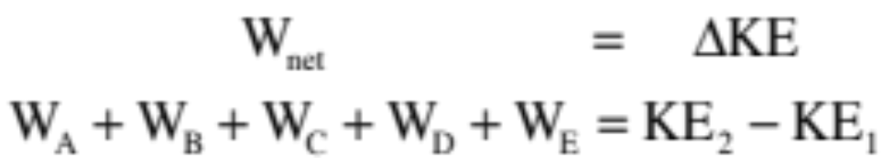

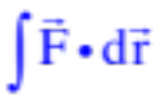
Consider a body moving through a group of force fields on its way from Point 1 to Point 2. What does the work/energy theorem tell us about the body’s motion?
The net work done will equal the sum of all the bits of work done by the various pieces of force acting on the system. Denoting each force with a letter, this can be written as:
Assume:
--the forces that produce work A and work B are conservative with KNOWN potential energy functions.
--the force that produces work C is conservative but with an UNKNOWN potential energy function.
--the forces that produce work D and work E are non-conservative, don’t HAVE potential energy functions and need to be determined using either or .
3.)

Slide 4
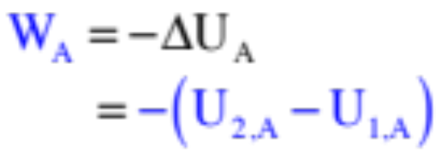
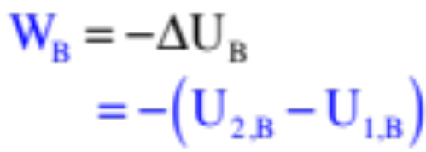
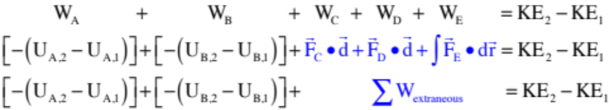
For work A and work B, we have potential energy functions. So . . .
and
For work C, D and E, we can’t use potential energy functions, either because we don’t know them or because they are non-conservative forces and don’t have them.
With this, the work/energy theorem becomes:
4.)

Slide 5
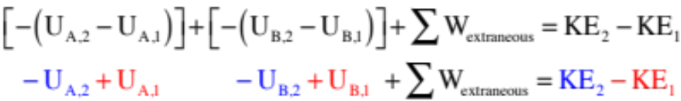


Rewriting this so the signs are easy to see, we get . . .
What we are left with are a bunch of potential energy terms (U terms) and at least one kinetic energy term evaluated at time , and a similar group of terms evaluated at time . If we put all of the terms associated with the state of the system at the beginning of the time interval, at point in time 1, on the left side of the equal sign, and put all of the terms associated with the state of the system at the end of the time interval, at point in time 2, on the right side of the equal sign (leaving the extraneous work terms alone), we get:
5.)

Slide 6

Rewriting this in it’s most succinct form, allowing for the possibility that you could have more than one object with kinetic energy in a system at a given instant (think Atwood Machine), we get:
If we call the sum of all the kinetic energies and all of the potential energies at a point in time the mechanical energy E at that time, we can make this relationship even more abbreviated as:
This is the absolute simplest form of this relationship.
6.)

Slide 7

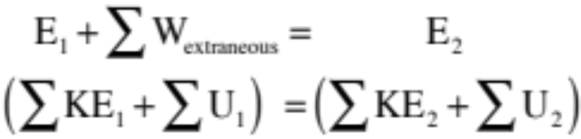
In summary, this relationship states that if there is no work being done by extraneous forces in a system (remember, a force that does extraneous work is one whose work calculation can’t be done using a potential energy function), then the total mechanical energy at time 1 will equal the total mechanical energy at time 2. In other words, the total mechanical energy does not change, is conserved and
Note 1: At time 1, the distribution of potential and kinetic energies may be different than at time 2. The claim is that the SUM of those two types of energy will always be equal.
Note 2: How to conceptually understand this? If there is extraneous work being done, that will simply increase or decrease the initial mechanical energy in the system giving us the final mechanical energy in the system.
7.)

Slide 8
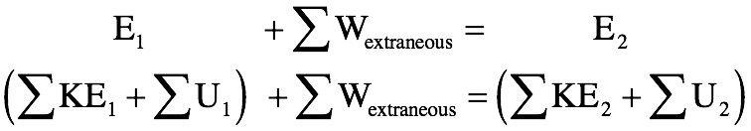
Conservation of Energy!
What this relationship says is that if there is no work being done by extraneous forces in a system (remember, an force that does extraneous work is one whose work calculation can’t be done using a potential energy function), then the total mechanical energy at time 1 will equal the total mechanical energy at time 2. In other words, the total mechanical energy does not change and is “conserved.”
Note 1: At time 1, the distribution of potential and kinetic energies may be different than at time 2. The claim is that the sum of those two types of energy will always equal the same number.
Note 2: If there is extraneous work being done, that will simply increase or decrease the initial mechanical energy in the system to give us the “final” mechanical energy in the system.

Slide 9





Block on Table
A block has been forced to move to the left on a tabletop. It is attached to a string that runs over a frictionless, massless pulley. The other end of the string is attached to a hanging mass . If the coefficient of friction between the block and the tabletop is , and if the initial velocity is 2 m/s
with the block being twice as massive as the hanging mass, how far will the block travel (d) before coming to rest?
This is straight conservation of energy, so we start with bailiwicks:

Slide 10



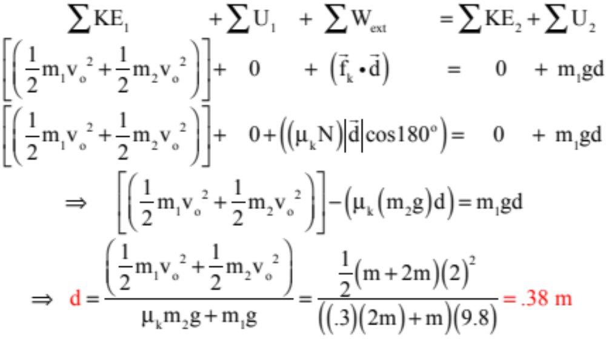
The frictional force is , where in this case the normal is clearly equal to the weight of the block, or . Also, the angle between the frictional force and the displacement will be .
So we start:

Slide 11

Block on Tilted Table
How would this problem change if was on an incline of angle , friction was removed and both bodies started from rest?
In that case, you’d have to assume a direction of acceleration (you don’t know if the angle is enough to make accelerate up or down the incline), and once assumed you’d have to set a zero-point for your potential energy function for the block.
We’ll assume the block accelerates down the incline. So what’s its velocity once it has traveled a distance d units down the incline?
Again, this is straight conservation of energy, so we start with bailiwicks:

Slide 12





Getting the potential-energy zero-levels for the two bodies is a little tricky. I always set the zero-level to be the lowest the body gets during the motion.
For the hanging mass, it’s easy. It starts at its lowest points, so that’s where I’d put its zero-point.
For the block, a little trig is required to determine how far it physically drops in the vertical. The sketch shows this calculation and the “lowest point” zero point.

Slide 13
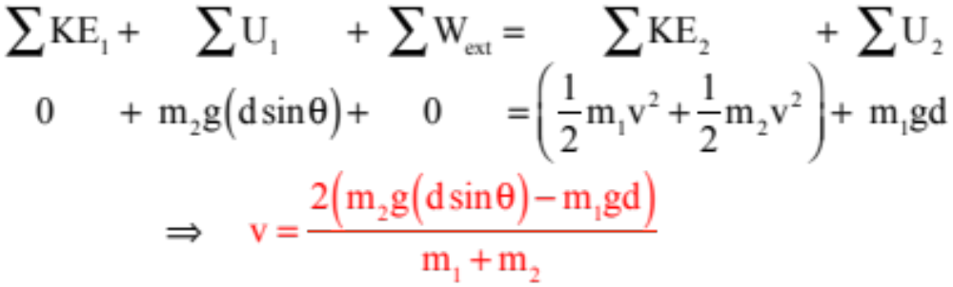
In any case, with the zero’s set, we can start with the standard for
and just fill in the bailiwicks:

Slide 14

Pendulum
A pendulum bob of mass m = 3 kg is attached to a rope of length L = 0.8 meters that is, itself, attached to the ceiling. Assuming the bob starts from rest at angle 𝝷. The bob swings down through the bottom of the arc and out again. What is the tension in the rope as the bob swings through the bottom of the arc?
L

Slide 15
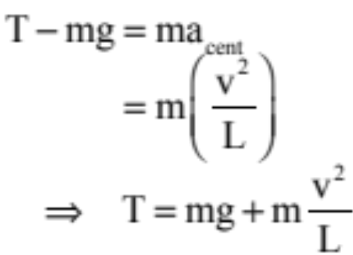






This is a bit tricky. As the bob is passing through the bottom of the arc, gravity and tension will both be in the vertical, and they will have to accommodate centripetal acceleration. The f.b.d. looks like
L
and N.S.L. becomes:
This is where energy comes in. And to do that, we need to know how far the bob “drops” to get to the bottom . . . Looking at the geometry to the right, we get:
To get this, we need “v.”

Slide 16
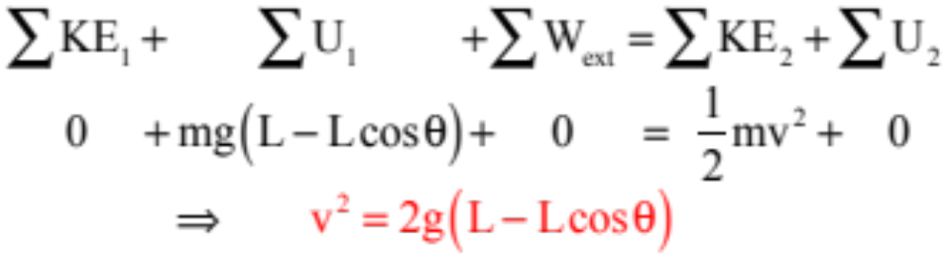
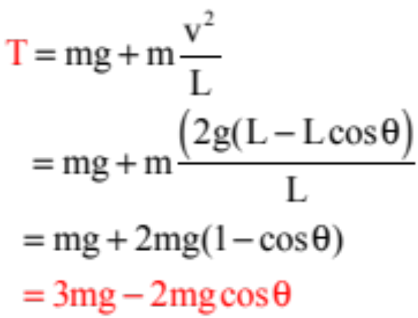
So to get the velocity, energy suggests:
L
And the tension becomes:

Slide 17
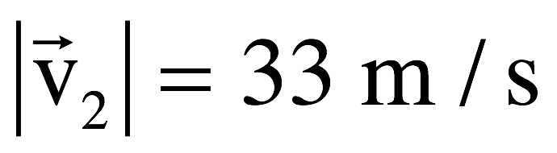
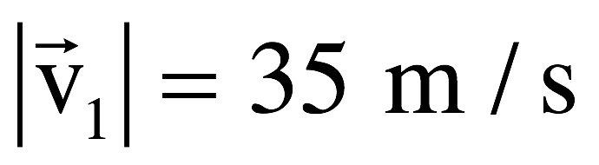
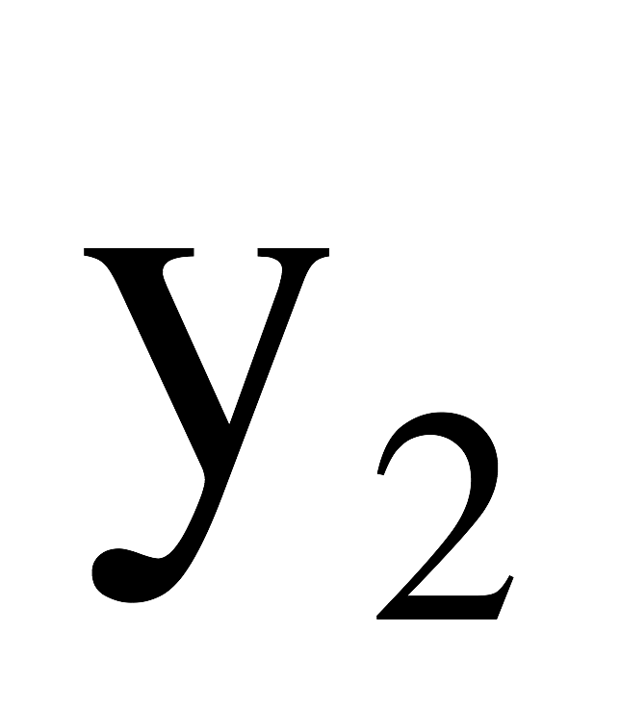
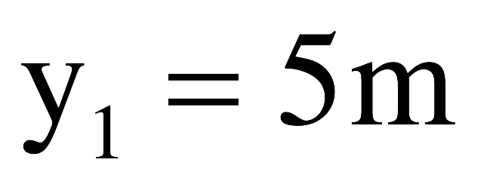
Problem 5.25
A daredevil on a motorcycle leaves a ramp with speed 35.0 m/s. If the speed is 33.0 m/s at the peak of motion, what is the maximum height the motorcycle reaches (relative to the end of the ramp)? Ignore friction and air resistance in this problem.
See solution on class Website

