Slide 1
General announcements

Slide 2




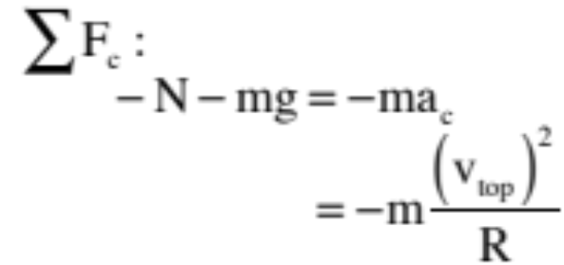


More fun—Problem #5: A friction-less ramp terminates in a loop of radius R. A block of mass m is released from rest and allowed to slide down the ramp and into the loop. How high up from the ground must the block be placed if it is to just barely make it through the top of the loop and out again?
There are two points of interest here, the start point defined by h and the top of the arc where the velocity is just big enough to allow the block to skim through and out again. The motion at the top is clearly centripetal, so let’s start there. In general:
f.b.d.
20.)

Slide 3

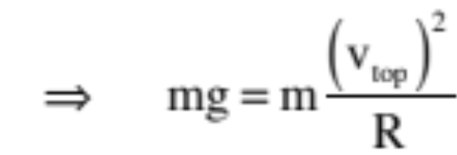
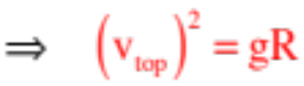
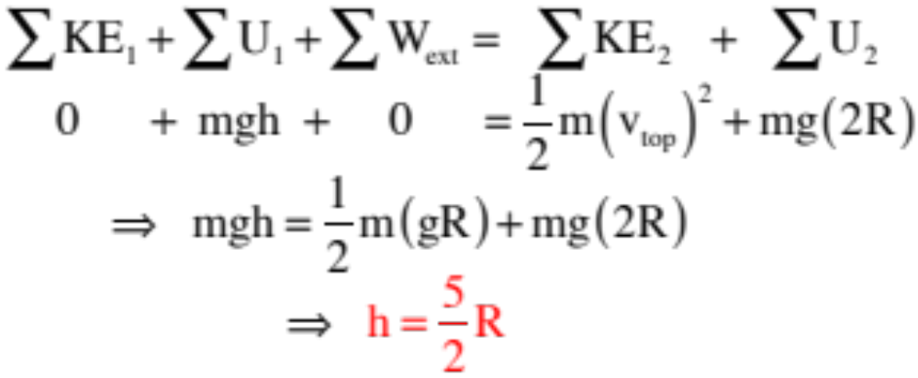
The trickiness here is in noting that at if the block is to just barely skim through the top, the normal force will go to zero, so that:
What does energy have to say about the situation?
21.)

Slide 4


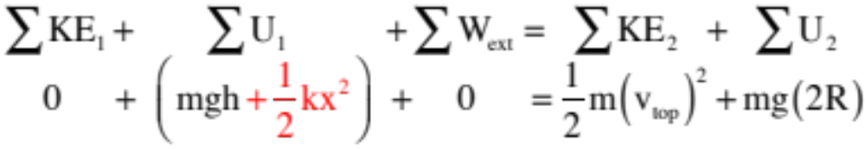

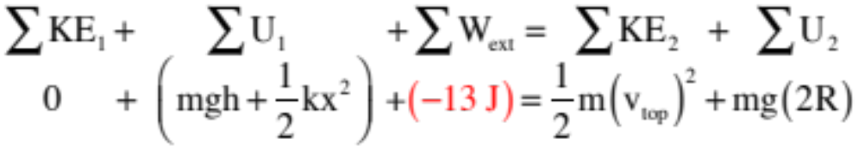
So how might we have made this problem more exciting? Well . . .
--we could have put a spring at the top (spring constant k) and pushed the block x units into it before release.
No big deal. All that would have changed would have been the term yielding:
--we could have additionally added jello, maintaining that the block lost 13 joules of energy as it passed through the jello at the bottom of the ramp before moving on. That would have affect the extraneous work part of the equation:
AS I SAID, FUN . . .
22.)

Slide 5
Things to Think About!
Is mechanical energy conserved in a pure sense?
  Nope? Why?
    Friction? Probably a big culprit. Is it the only one? NO.
    Sound! Sound is a form of energy, too.
    Rotation! Some of that energy goes into the rolling of the ball – all our equations so far are assuming objects that are sliding along. However, there IS energy related to the rotation (or rolling) of an object, which has to come from that initial U as well.
  How do we account for this?
    This is where the ∑W_{ext} term of our equations comes in handy. Ignoring the rotational energy for now (because we don’t have the tools for it just yet), we can say that the extraneous work is being done by friction, or W = F_{f}dcos(180) = -F_{f}d = -𝝁F_{N}d
    We can’t easily calculate this – why?
    Instead, we can use trial and error to find the actual height that will allow the object to get around the loop, then use CoE to find the work done by friction (and therefore the average friction force acting on the object along the track).

Slide 6







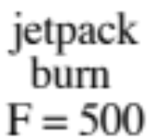







Finally, the problem from hell #1: A mass m = 2 kg with a jet pack on its back slides down a radius curved incline, through a frictional pit of length L = 2 m with , up, over, through and out a loop-the-loop of radius
, through a jello pit that takes 80 joules out of the system whereupon the jetpack fires and produces 500 newtons of force over an x = .5 meter distance before colliding with a spring whose spring constant is k = 120 N/m. If 110 joules of energy are lost due to that collision, by how much does the spring compress during the collision?
27.)

Slide 7


Note: There is one saving grace to this problem. In the normal approach to energy considerations, all you do is write down the energy content of the system at the beginning of the interval (KE plus U), write down the energy content at the end of the interval, then look and write down any work done between the beginning and end that hasn’t been taken into account with a potential energy function.
If it hadn’t been stated otherwise (which it was), this problem could have been different in that one possible answer to “how much is the spring compressed” could have been ZERO. Huh? If the body didn’t have enough energy to get passed the loop, it never would have gotten to the spring. You don’t have to worry here as you were told it got thru, but if you hadn’t been you’d have to check to see if it made it.
So let’s look at energy:

Slide 8






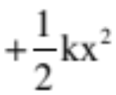


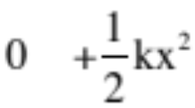

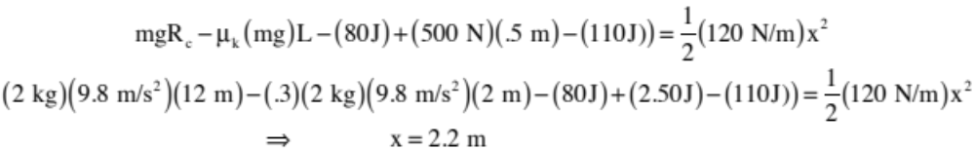
What’s the first thing you will write?
29.)

Slide 9
Mention Roller Coaster . . .

