Slide 1
General announcements

Slide 2
The Island Series:
You have been kidnapped by a crazed physics nerd and left on an island with twenty-four hours to solve the following problem. Solve the problem and you get to leave. Don’t solve the problem and you don’t.
The problem: You are told you will be given 5 seconds to stop two different object using a constant force of your choice (it doesn’t have to be the same force for each object, and you don’t know anything about their speed). Before you see either object, though, you must say which will take the greatest force to stop.
You dissent saying you don’t have enough information to make the call, so you are given two questions (not “which force is bigger” or “which body experiences the largest acceleration”). From the responses to those two questions, you are to determine which body will require the larger force.
What are your questions?
1.)

Slide 3
What You Know To Date
A moving object has KE;
Doing work on an object can change its KE;
Adding energy increases KE and v while removing energy decreases KE
and v.
Work is done when a force component along the line of motion is applied
over a distance.
To stop a body, negative work must be done.
The problem: We are NOT dealing with a force exerted over a distance
(i.e., an energy-related quantity), we are dealing with a force exerted over a
period of time . . . so how do we deal with that?

Slide 4
Solution to Island Problem
What governs stopping force requirements over time? The two parameters that will matter are:
The mass of each body (the bigger the mass, the larger the force required to stop the body in a given amount of time); and
The body’s velocity (the faster the body is moving, the greater the force required to bring the body to a stop in a given amount of time);
2.)

Slide 5
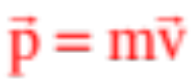
CHAPTER 9:
Momentum
When physicists run into a qualitative question like the one posed in the Island Series question, they will often take the parameters that are key to understanding the solution to the problem and multiply them together to get an overall governing relationship (that is, after all, where the idea of work came from). The idea is that if that quantity is large, the phenomenon being examined will be pronounced, and if small, not so much.
In this case, the product of the mass and velocity produces a vector
called MOMENTUM.
Kindly notice that this relationship is really three equations in one— it denotes momentum in the x-direction, in the y-direction and in the z-direction.
3.)

Slide 6

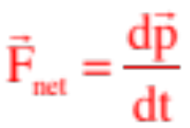
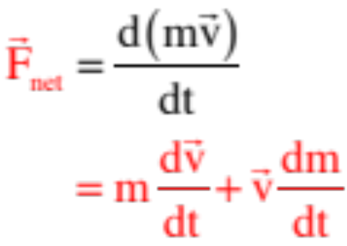

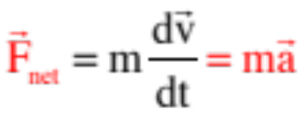
Interestingly, Newton didn’t originally write his second law as , he wrote it as:
Taking that derivative yields:
The first part relates force to the acceleration of the object. It just equals . The second part is related to how force is required to deal with situations in which the mass of a moving object changes. An example of such situations might be a rocket whose mass is changing as it burns fuel upon lift-off, or possibly a dump truck that is being loaded with gravel as it moves. As problems like that are not generally addressed in classes like this, we end up with Newton’s Second Law looking like:
4.)

Slide 7
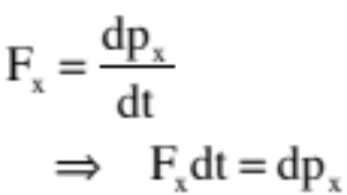

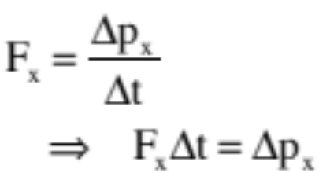


What is useful is that if we focus on just one direction, say, the x-direction, we can use the idea of momentum in conjunction with Newton’s Second Law to write a relationship that links force and changing momentum to a single body’s motion. That is:
Over a differentially small time interval dt:
Over a macroscopically large time interval :
--The quantity is called the IMPULSE on the body.
--The quantity is called the impulse relationship.
5.)

Slide 8

Consider: A puck moving over a frictionless floor is viewed from above. It hits a wall and bounces off, as shown below. What is the puck’s change of momentum?
before
after
6.)

Slide 9





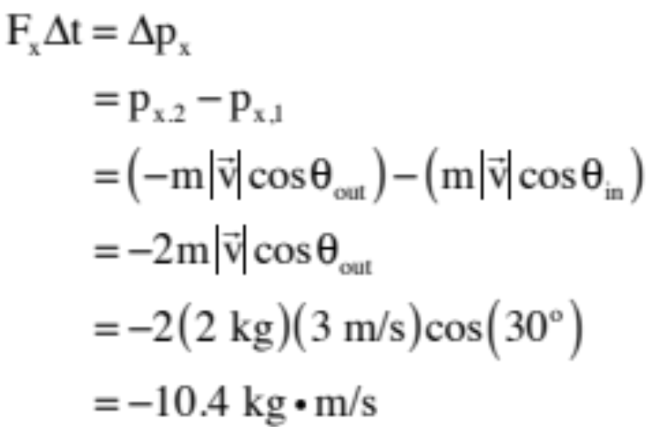
Consider: You are looking down on a 2 kg puck sliding over a frictionless surface moving at 3 m/s as shown. It bounces off a wall as shown. What is the net impulse on the puck?
The key is to realize that you have to treat the momentum change as a vector (look at the momentum in the y-direction—it isn’t changing, so you’d better not end up with math that suggests that it should . . . )
In the x-direction:
6.)

Slide 10
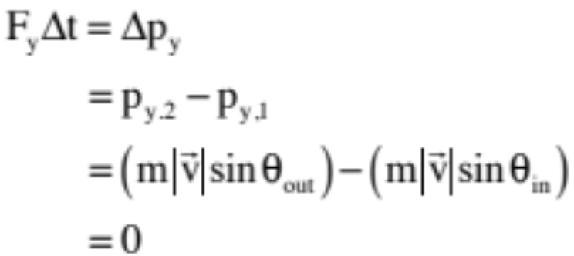
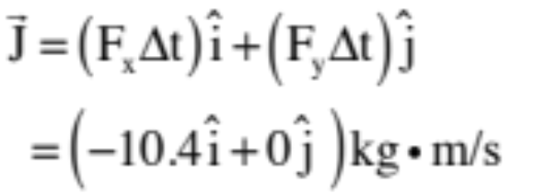
In the y-direction:
So the net impulse (which is normally characterized as a J, though the book uses I for reasons that are unclear):
This makes perfect sense as you would expect the impulse that would change the puck’s motion to be away from the wall in the minus x-direction.
7.)

Slide 11
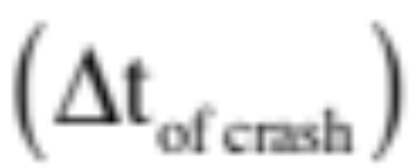
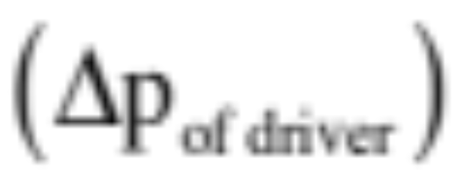


This also tells you something about our world:
Want to keep a driver safe during a car crash, pad the dashboard or, better yet, put air bags into the car. Why? Because when the driver goes from 60 miles per hour to zero miles per hour due to a crash, the impulse (the change of momentum) will be what it will be, but the time of impact can be controlled (you want it to be as long as possible so the FORCE of impact is as small as possible. That is:
8.)

Slide 12
More on why impulse and momentum matter
You are standing on a second-story balcony. Below you is a pool full of water, surrounded by concrete. If you had to jump, where would you want to land and why?
  Pool (duh). It’s “softer” – meaning, it brings you to rest more gently than the concrete, which stops you pretty much immediately.
  This is all part of the impulse/delta-p relationship!
    Either way, you’ll have the same momentum on impact (same mass, fall same height so same velocity)
    That momentum has to “go away” due to the impulse from the ground. The impulse to bring you to a stop is the same no matter which surface you hit.
    This means F_{concrete}t_{concrete} = F_{pool}t_{pool}. In other words: short time to stop, bigger force. Longer time to stop, smaller force.
    How do we use this principle in everyday life?

Slide 13
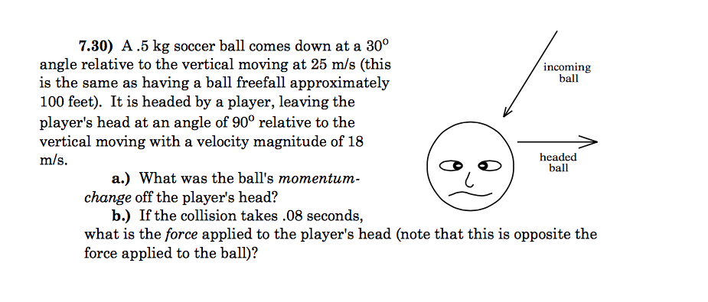
Here’s another one!
30º

Slide 14
Problem 6.3
A tennis player claims they can serve a 0.145 kg tennis ball with as much momentum as a 3.0 g bullet moving at 1500 m/s.
  a) How fast must the tennis ball be moving for this to be true?
  b) Does the tennis ball or the bullet have more kinetic energy?

