Slide 1
General announcements

Slide 2

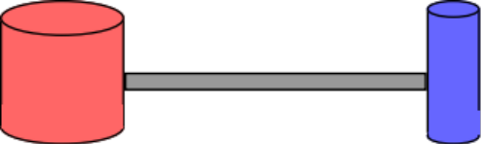
Center of Mass
The center of mass of a system of masses (or a single mass) is located at the weighted average position of the system’s mass.
Example: a basketball:
Example: a horse shoe:
Example: multiple masses:
46.)

Slide 3







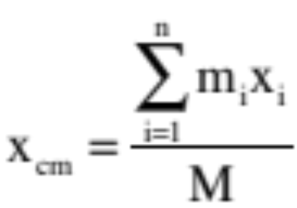
A center of mass coordinate must be relative to a coordinate axis. In the x-direction, the numerical value, being a weighted coordinate, is defined such that:
Being careful to take signs into consideration and defining the total mass of the system as M, the center of mass coordinate becomes:
47.)

Slide 4



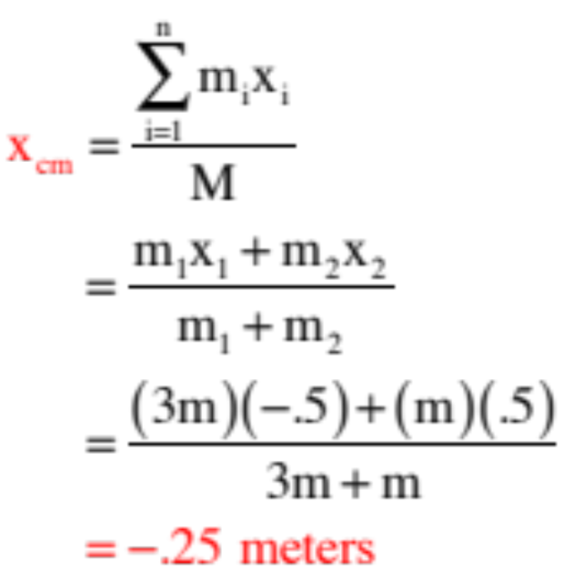




Example 7: Consider two masses “m” and “3m” located a distance 1.0 meters apart. Relative to the coordinate axes used:
a.) What is the x-coordinate of the system’s center of mass?
48.)

Slide 5
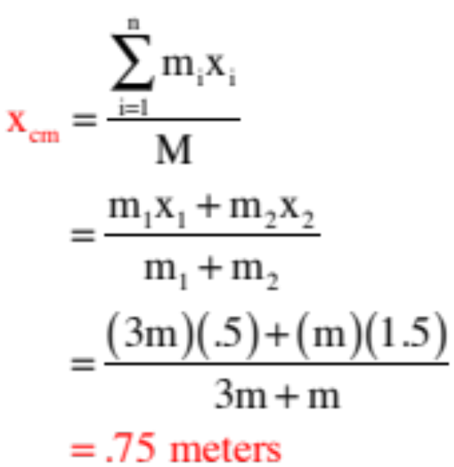


Cont’d: Consider two masses “m” and “3m” located a distance 1.0 meters apart. Relative to the coordinate axes used:
b.) What is the x-coordinate of the system’s center of mass?
Bottom line: A system’s center of mass is identified as a coordinate relative to a coordinate system.
49.)

Slide 6
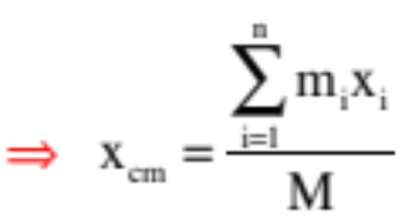

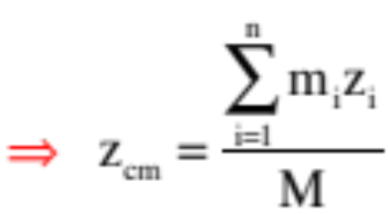

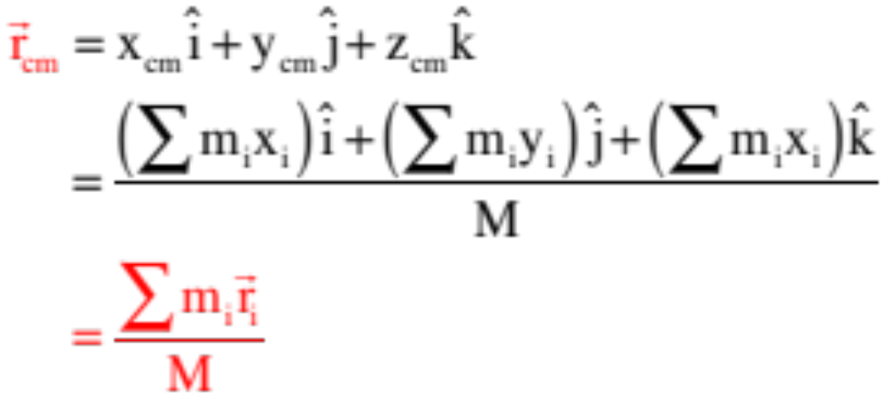
Center of mass in three dimensional situations:
50.)

Slide 7
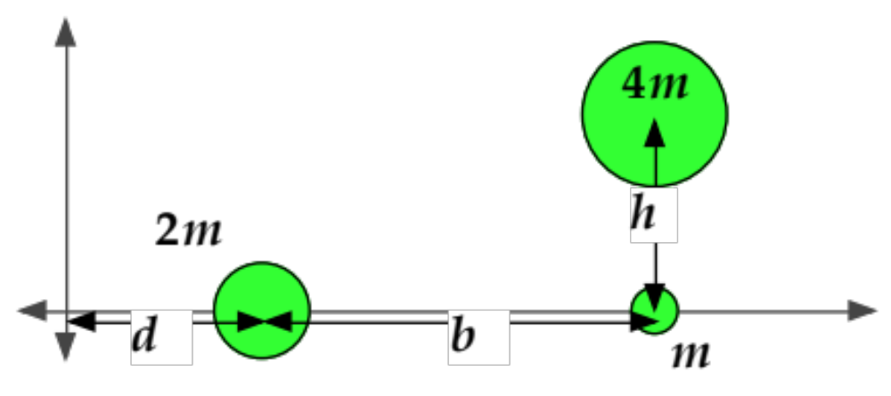

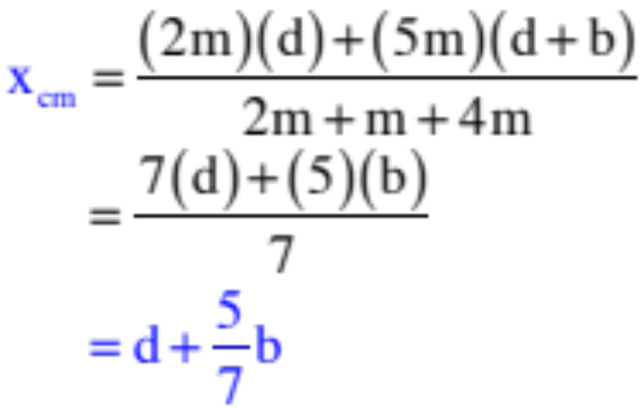
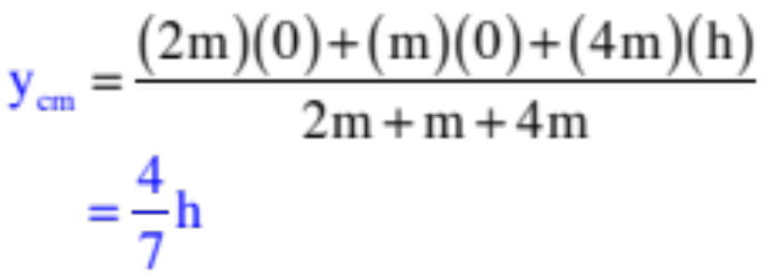
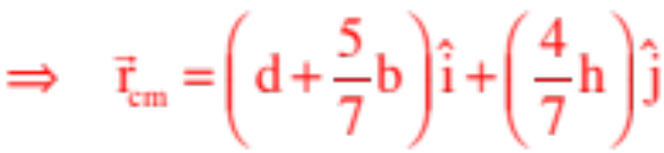
Example 8: Determine the coordinate of the center of mass for the system shown.
51.)

Slide 8
So before we get into the hard stuff, let’s review what we are really being asked to do with center of mass calculations.
To determine a center of mass coordinate along a particular axis:
--Move from the origin outward along the axis until you find some mass.
--Multiply the mass by its coordinate.
--Continue doing this, adding the products as you go.
--Once you’ve covered all the mass in the system, normalize the sum by dividing by the total mass.
That will give you the center of mass coordinate along that axis.
52.)

Slide 9
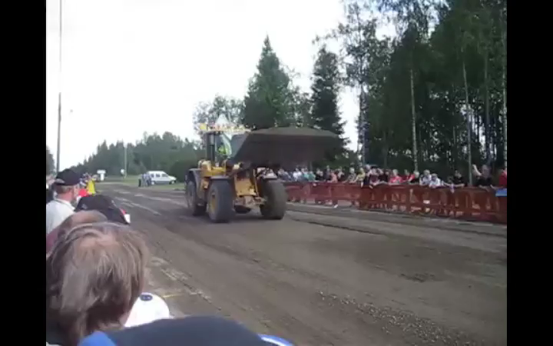
As long as an object’s center of mass is located over a point of support, it will be stable.
53.)

Slide 10
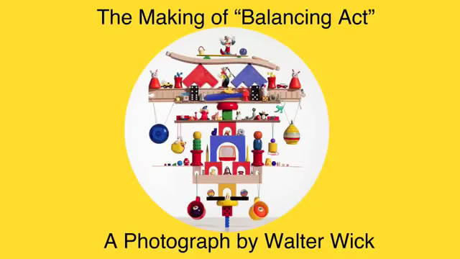
And again:
54.)

Slide 11
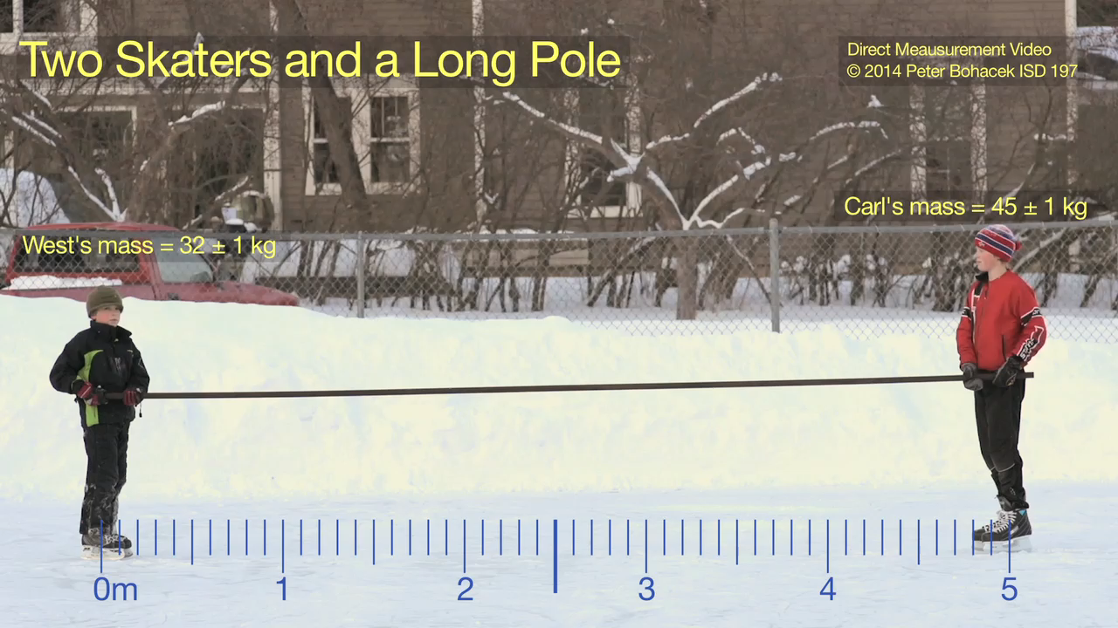
Video example!
Calculate the center of mass of the system BEFORE watching the video. Then watch the video and see where the boys end up…

Slide 12
Example
There is a meter stick at the front of the class with masses taped at two different points on the meter stick. Determine the center of mass for the object.
  Remember to define your x = 0 point clearly!

