Slide 1
General announcements

Slide 2





The Modified Conservation of Momentum Theory
Consider two masses moving in opposite directions that collide as shown below. If one mass has a jet pack on its back that provides a constant force F (again, as shown), what do the impulse equations suggest for both masses?
before collision
after collision:
2.)

Slide 3








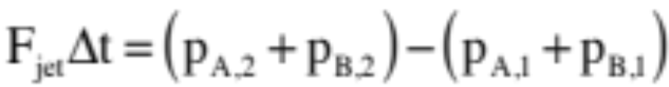
before collision
During the collision, the green fellow will feel an impulse to the right due to the jet and an impulse to the left due to the collision. Assuming the time of collision is , the impulse relationship for the green mass through the collision becomes:
after collision
The blue fellow will NOT feel an impulse due to a jet as there is no jet attached to it, but it will feel an impulse to the right due to the collision. It will be equal in magnitude and opposite in direction to the impulse the green fellow felt due to the collision. The blue block’s impulse relationship through the collision will be:
Adding the two relationships, the collision impulses (whose forces are N.T.L. action/action pairs referred to as internal forces) will add to zero, so:
3.)

Slide 4
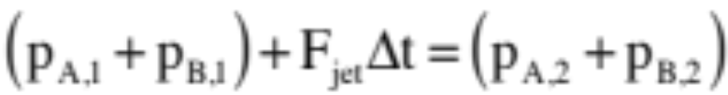

before collision
Rearranging the terms so that the “before” terms are on the left side of the equation and the “after” terms on the right, we end up with
after collision
If we include the fact that all of this is happening in the x-direction, this can be re-written as:
This is called the modified conservation of momentum relationship. It essentially maintains that in a particular direction, if all of the forces acting on a system over a time interval are internal to the system (i.e., Newton’s Third Law action/action pairs) with no impulses being generated by external forces (i.e., non-action/action pairs, like the jet pack), then the sum of the momenta (signs included) at the beginning of the interval will equal the sum of the momenta at the end of the interval. That is, the individual momenta can change, but the sum must remain the same . . . unless there are external forces producing external impulses present to change the momentum content of the system.
4.)

Slide 5
As a point of semantics: An isolated system is a system in which there are no external forces (hence no external impulses) acting. With the modified conservation of momentum equation including the possibility of external impulses (or not), making the distinction between isolated and non-isolated systems is not so important, but you may run into the language so you need to know about it.
Technically, collision always produce deformation and sound and heat, so energy is never really conserved through a collision. There are close calls, though. When this happens, because potential energy changes are almost non-existent thru collisions, what is “conserved” is kinetic energy.
To delineate types of collision, three kinds are given special names:
1.) An inelastic collision is defined as a “normal” collision—momentum conserved thru the collision unless there is an especially large external impulse present—with energy NOT conserved.
2.) A perfectly inelastic collision is defined as an inelastic collision in which the bodies stick together after the collision (i.e., final velocities are the same).
5.)

Slide 6

3.) An elastic collision is defined as a collision in which both momentum and mechanical energy are assumed to be conserved.
Easy example: two electrons veering from one another due to electrical repulsion as they pass one another. This interaction, this “collision,” is to a very good approximation conservative in energy.
Not so obvious examples: ideal, massless springs:
Example 1: A block jammed against an ideal spring is struck by another block moving in with velocity v. Energy is NOT conserved in the collision due to deformation between the blocks.
Example 2: A block collides with an ideal, massless spring, pushing it in to the left. Energy IS conserved in this case. Why? Because due to
the masslessness of the spring, no resistance, hence deformation, occurs so no energy is lost. (This is not terribly appealing because it ignores energy loss to sound and heat, but that’s the assumption made.)
6.)

Slide 7
Momentum and systems practice
A boy is standing at one end of a floating raft that is stationary relative to the shore. He walks to the opposite end of the raft, away from shore. What happens to the raft? Explain using momentum.
If two objects collide and one is initially at rest, is it possible for both to be at rest after the collision? Is it possible for only one to be at rest after the collision? Explain.
Your friend throws you a tennis ball at a certain velocity and you catch it. Then you have a choice: your friend can throw you a heavy medicine ball at the same velocity, same momentum, or same KE as the tennis ball. Which option would you choose to make the easiest catch, and why?
Raft moves the opposite direction. There was no momentum to begin with for either boy or raft – as boy moves one way (positive p), raft moves the other (same amount of negative p). Depending on mass of raft, it will move faster or slower than the boy’s walking pace.
No – there was momentum before the collision, so there must be the same net momentum after; if objects are stopped, momentum is 0 which violates the law. Yes, one can be at rest, if all the momentum from the first object transfers to the initially stationary one (let’s try it!).
Same momentum. With same v, momentum would be much greater for the medicine ball, which would be harder to stop (more impulse). With same KE, medicine ball’s velocity is smaller but its overall momentum is still greater so it will also take more impulse to stop.
7.)

Slide 8
More questions…
If you throw a ball in the air, is momentum conserved? During what part(s) of the motion? In what system(s)?
Why are bullets so small compared to the gun they’re shooting from? Put another way, why are cannons so heavy?
In the system of just the ball alone, momentum is never conserved in this motion: the hand, gravity, and air resistance all provide external impulses at various times. Once the ball leaves the hand (ignoring air resistance), momentum IS conserved in the ball-Earth system: gravity becomes an internal force (because the ball is also causing the Earth to increase its upward momentum, even though we can’t sense it.
BIG M, tiny v. Tiny m, BIG v. The more momentum the projectile has forward when you shoot, the more recoil the gun/cannon will have backwards (to keep momentum conserved). Making the gun/cannon much much much heavier means its recoil velocity will be much less, allowing the smaller projectile to move forward at a greater relative velocity.
In movie form…
8.)

Slide 9
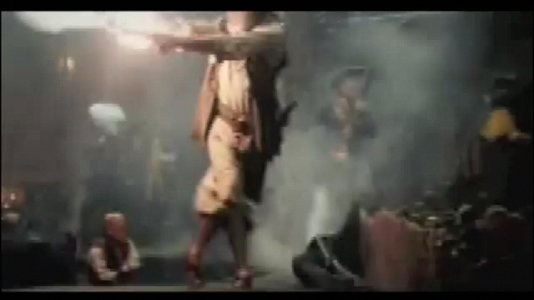
Recoil in action…
9.)

Slide 10


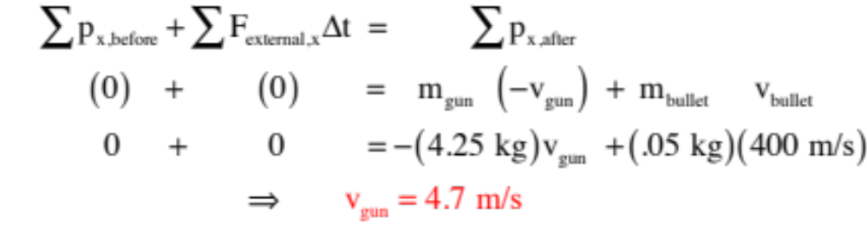


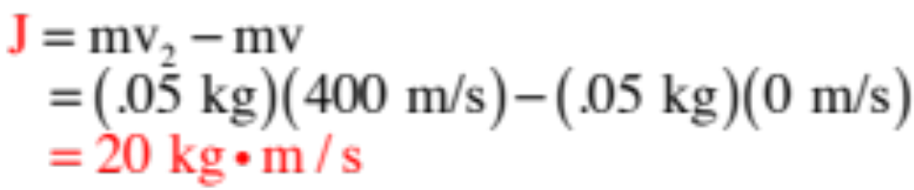
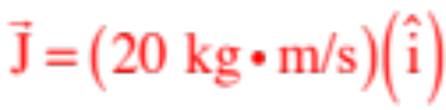
before
Example 2: Consider shooting a 4.25-kg gun with an 80 cm long barrel that fires a 50-gram bullet with velocity 400 m/s.
after
What is the magnitude of the gun’s recoil velocity?
What is the impulse on the bullet?
You can get this either by calculating or . We’ll use .
So formally, as a vector, this would be:
10.)

Slide 11
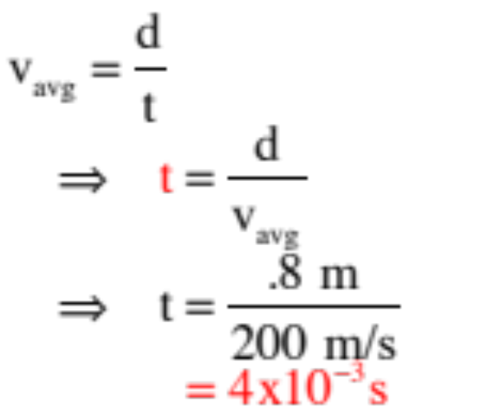
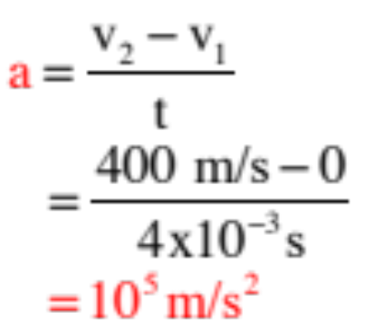
before
Con’t: Consider shooting a 4.25-kg gun with an 80 cm long barrel that fires a 50-gram bullet with velocity 400 m/s.
after
What is the bullet’s time of flight?
This is a kinematics problem—irritating, but something you need to not forget how to do . . .
What is the bullet’s acceleration?
Again, kinematics.
11.)

Slide 12
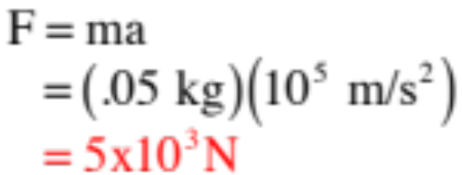
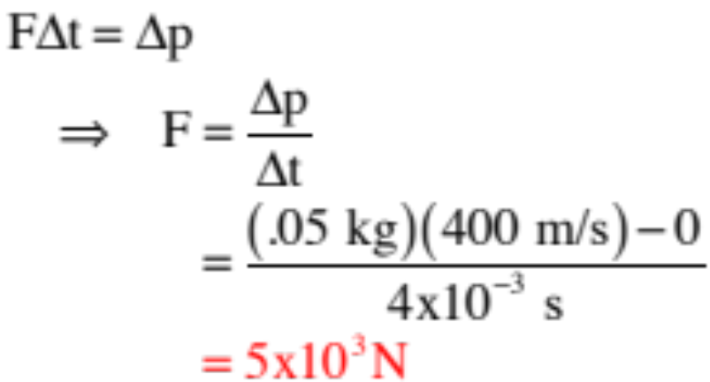
before
Con’t: Consider shooting a 4.25-kg gun with an 80 cm long barrel that fires a 50-gram bullet with velocity 400 m/s.
after
Determine the force on the bullet two different ways.
Using Newton’s Second Law:
Using the Impulse relationship:
12.)

Slide 13
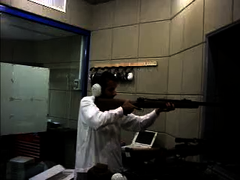
13.)

