Slide 1
General announcements

Slide 2
Reminders about momentum and energy
When is momentum conserved?
  In any collision in an isolated system (no external impulses)
  Remember to define your system carefully!
  Remember to treat the x and y directions separately!
When is mechanical energy conserved?
  In elastic collisions (KE specifically is conserved, can only use this if you are told it’s elastic)
  In any situation where either (a) there is no extraneous work (i.e. energy remains mechanical and none goes to other forms like heat, sound, etc.), or (b) you have enough information to account for work done

Slide 3
Collisions vs. “explosions”
We just did a spring example (toy gun and ball; compressed spring extends to fire the ball away). We could use conservation of energy there because the spring’s potential energy transferred completely to kinetic energy (it was an ideal spring), and there was no extraneous work (no sound, heat, etc.) and no extraneous impulses (so momentum was also conserved).
What if a ball hits a spring and comes to rest (a true collision)? Is energy conserved in that situation? Is momentum?
  Technically not: some energy will be lost to non-mechanical forms (sound, heat, etc.) during the instant of collision. We can use conservation of energy after the collision until the spring comes to rest for sure, but through the collision itself we should be told that it is an elastic collision or that the “energy loss is negligible”
  Momentum IS conserved throughout the collision because there are no external impulses. Once the spring starts to compress, however, momentum is no longer conserved (spring acts like an external impulse).
What about a true explosion? (e.g. cannon and cannonball)
  Energy conserved? NO: the system begins with no mechanical energy, and ends with kinetic energy – we can’t use conservation of energy during the explosion, because non-conservative work was done by converting chemical PE
  Momentum IS conserved through the explosion because there are no external impulses.

Slide 4





The bullet, the block, and the spring
An 8 gram bullet fired at a 30 degree angle into a 250 gram block initially at rest on a frictional table, where the coefficient of kinetic friction is 0.2. Attached to the block is an ideal spring whose spring constant is k=40 N/m. After the embedding, the block moves a distance d = 0.4 m before coming to rest.
  Where is momentum conserved?
  Where is energy conserved?
  Where is energy not conserved?
  What kind of collision is this?
  What must v_{i} be?
bullet moving at angle but block at rest
x
just after embedding, masses moving but
spring still essentially not compressed
x
masses come to rest after depressing spring maximum distance “d”

Slide 5
The bullet, the block, and the spring
  Where is momentum conserved?
  Where is energy conserved? Not conserved?
  What kind of collision is this?
bullet moving at angle but block at rest
Momentum is conserved in the x direction during the collision. It is not conserved in the y direction because the table provides a huge external impulse via the normal force.
x
just after embedding, masses moving but
spring still essentially not compressed
Energy is not conserved through the collision; however, once the bullet embeds and the block starts to compress the spring, energy is conserved until the block stops (because we know enough about friction to do this).
x
masses come to rest after depressing spring maximum distance “d”
This is a perfectly inelastic collision.

Slide 6
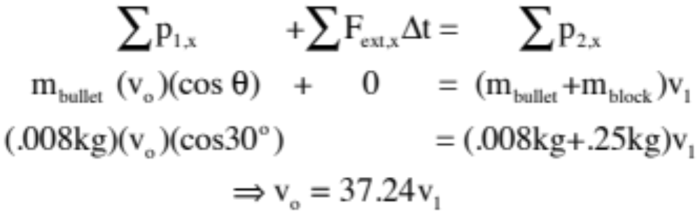
Finding v_{i}…
There is friction in the “x” direction, so there will be an external impulse in that direction as the block moves to the right. Still, if all you are looking at is the time interval through the collision, things will happen so fast that friction will not have the time to affect the overall “x”-directed momentum of the system to any great degree. In other words, for that tiny time interval you can use the modified conservation of momentum relationship and assume the external impulse factor is essentially zero for the interval. As for the “y” direction, the normal force produces an enormous impulse that makes conservation of momentum unusable even through the collision.
bullet moving at angle but block at rest
x
just after embedding, masses moving but
spring still essentially not compressed
THROUGH THE COLLISION in the “x” direction:
x
masses come to rest after depressing spring maximum distance “d”
Figure out v₁ and you’ve got it.

Slide 7
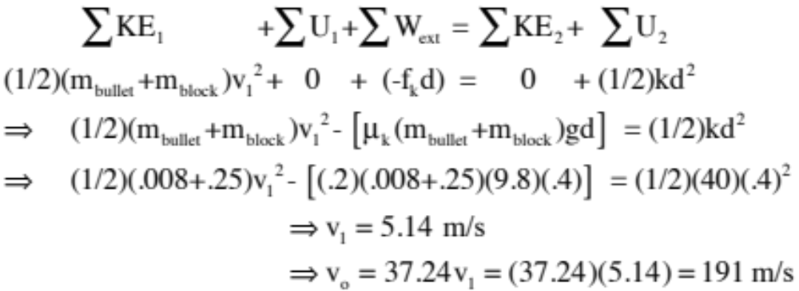
Finding v_{i}…
To get the after-collision velocity v₁, we need to deal with energy consideration as they exist after the collision (that is, just after the bullet embeds until both the bullet and block come to rest under the influence of the spring). Noting that JUST after the collision the spring will have deflected only a tiny, tiny bit (ignorable, in other words), we can write:
bullet moving at angle but block at rest
x
just after embedding, masses moving but
spring still essentially not compressed
x
masses come to rest after depressing spring maximum distance “d”

Slide 8


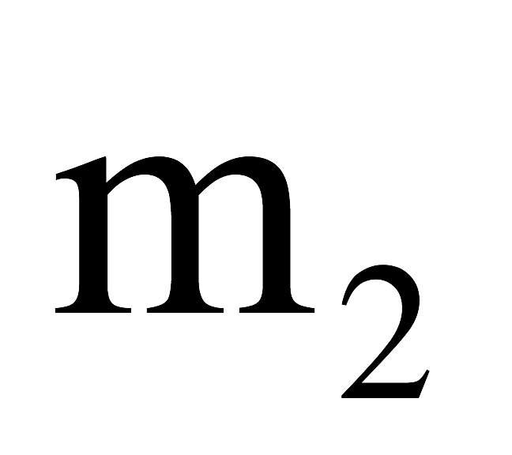
Block sliding down wedge (Problem 6.65)
A small, 0.5 kg block starts from rest and slides down a frictionless, curved incline of mass 3 kg. When the block leaves the incline, it is moving with velocity 4 m/s. (the incline is free to move on frictionless ground)
  What’s the velocity of the wedge when the block reaches the ground?
  What’s the height of the wedge?
See solution on MyPoly

Slide 9

Two more for you:
A bullet of mass m and speed v passes completely through a pendulum bob of mass M as shown in the figure below. The bullet emerges with a speed of v/2. The pendulum bob is suspended by a stiff rod of length L and negligible mass. What is the minimum value of v such that the bob will barely swing through a complete vertical circle? (Problem 6.56)
Given the info below:
  (a) determine the recoil speed of the cannon
  (b) determine the maximum extension of the spring
  (c) determine the maximum force exerted on the carriage by the spring
125 m/s
200 kg
55º
k = 2x10⁴ N/m
4800 kg
Minimal friction…

Slide 10






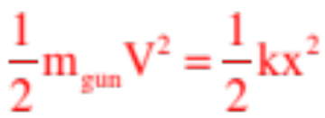
There is the cannon problem in which you want to determine how much the spring expands after the cannon is fired.
Here, momentum in the y-direction is NOT conserved during the firing (nothing moving in the y-direction to start with, then the shell is moving with velocity component in the y-direction).
There are no external forces (hence impulses) in the x-direction during firing, so momentum of the gun/shell system is conserved in the x-direction (it is assumed that the spring does not compress much during the firing, so it does not provide an external impulse in the x-direction during firing).
After firing, the recoil velocity V provides KE to the cannon which turns into spring potential energy as energy associated with cannon (EXCLUDING the cannon ball) is conserved after the firing.
44.)

Slide 11




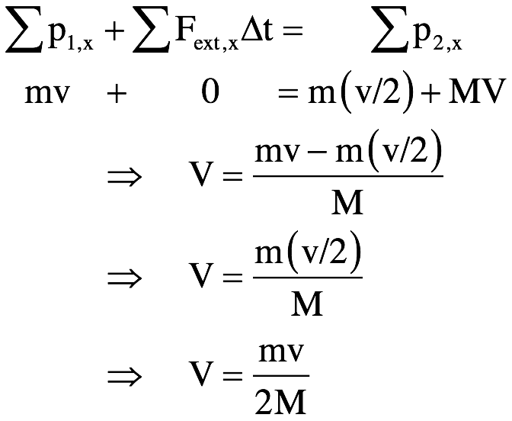

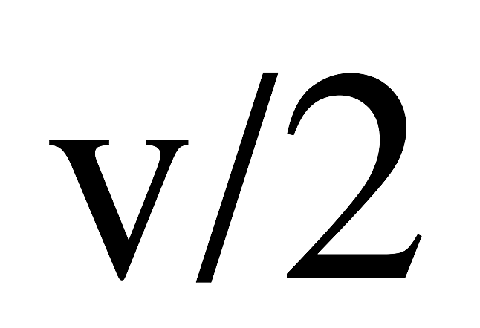
Bullet into pendulum block
The first thing to notice is that the rod is rigid. In other words, all the ball has to do is get to the top of the arc and it will fall through from there. This is different than a block moving freely through the top of a loop where there needs to be velocity to keep the block on the track. Having said that, we need to use conservation of momentum through the collision and conservation of energy for the bob after the collision.
Conservation of momentum through the collision:

Slide 12
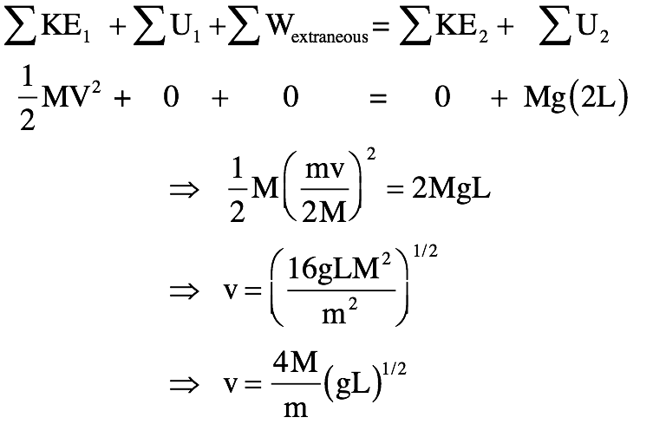
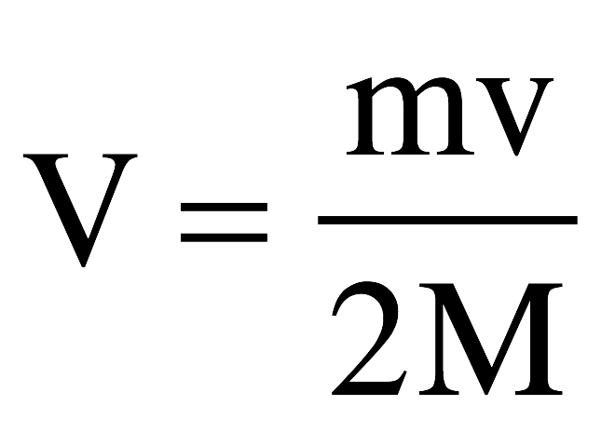
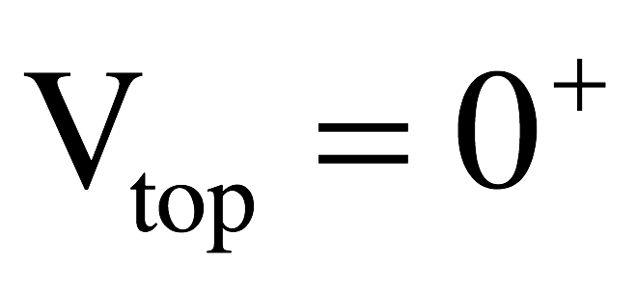
Bullet into pendulum block
Conservation of energy on “M” after the collision:
Follow up question: How would this have differed if the rod had been a string?

Slide 13
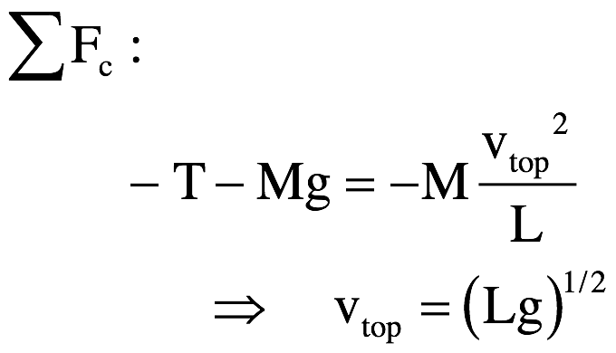


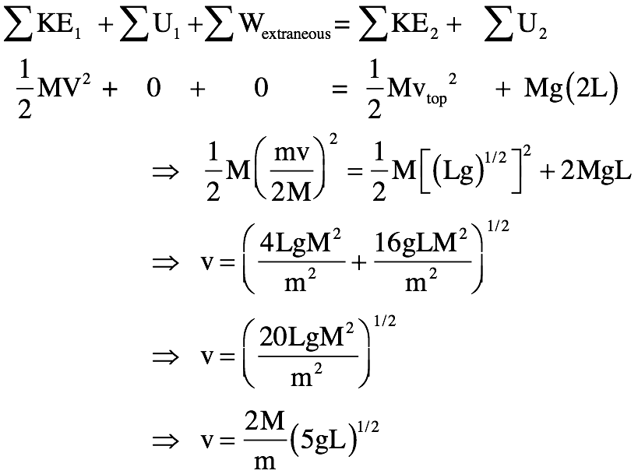

Bullet into pendulum block – with a string
The momentum part would have been the same, but the velocity at the top of the arc would have to satisfy a centripetal force requirement. In that case, a f.b.d. for the forces on the bob at the top would be as shown below with the tension going to zero at the correct velocity. That is:
Conservation of energy would become:

Slide 14
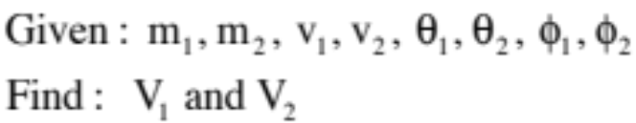










2-D collision (not a test problem)
For the situation shown below, write down but do not solve the equation(s) you would need to solve for the unknown values.

Slide 15
















2-D collision
As always with two dimensions, break down the momenta into x- and y-components:

Slide 16
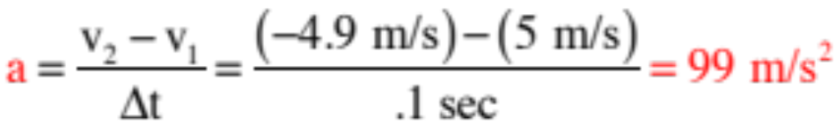

This is supposed to be FUN.
Don’t take notes,
but do listen and think!
A ball moving at 5 m/s strikes a surface and bounces back at 4.9 m/s in the opposite direction, all in 0.1 seconds. What is the ball’s acceleration?
Let’s say the ball’s mass is 5 grams. What was the average force required to effect that acceleration?
What we’ve just done is to examine a situation by looking at the forces acting on a system. In other words, we’ve utilized the Newton’s Second Law approach to come to conclusions about our ball. (Note that a half newton is about a tenth of a pound.)
It is possible to look at situations from OTHER perspectives using OTHER approaches.
72.)

Slide 17
A ball moving at 5 m/s strikes a surface and bounces back at 4.9 m/s in the opposite direction, all in 0.1 seconds. What is the ball’s acceleration?
Option 1: Determine the impulse in the ball. Justify your results.
What does the impulse tell you about the motion?
A relative measure of what it takes to stop the body in the given amount of time.
Option 2: Determine the net work done in changing the motion of the ball.
Is the net work done in changing the ball’s kinetic energy large or small?
Really small.
73.)

Slide 18

From the perspective of impulse, energy and ball acceleration, it appears that it doesn’t take a lot to make our ball change course.
In other words, the ball can’t hurt us much.
So let’s play FACE BALL!!!!!
74.)

