Slide 1
General announcements
  This unit’s assessment will be a bit different – we’ll be having 10 minute quizzes every other class (or so), each worth ~20 points. These quizzes will be based on what we do in class, so it’s important that you (a) stay engaged and use class time wisely; (b) take close notes and review a little each night; and (c) ask questions early and often.
  The first quiz will be ??? and will cover what we do today and most of tomorrow (rotational definitions and rotational kinematics, mayyyyybe a little bit about torque).
  We will take a test at the end of the unit, but it will be scored a little differently. More on that later. No official homework (to turn in) this unit, because you‘ll need to be doing a little reviewing in between quizzes anyways.

Slide 2
The Island Series:
You have been kidnapped by a crazed physics nerd and left on an island with twenty-four hours to solve the following problem. Solve the problem and you get to leave. Don’t solve the problem and you don’t.
The problem: A large disk is set spinning with constant speed. The translational velocity of four points on the disk are identified along with each point’s position relative to the axis of rotation. It is pointed out that at a minimum, two bits of information are required to characterize the motion of each point. Your captor is a minimalist, so the question is, “How can the motion of all the points be characterized with only one bit of information?” Put a little differently, if someone with another disk somewhere else on the island wanted to duplicate your disk’s motion, what single bit of information might you tell that that would allow them to accomplish the task?
2.)

Slide 3

Solution to Island Problem
If you want to characterize the velocity of the particles of a spinning disk, alluding to their translational velocities is REALLY inefficient. Bits of mass that have a common radius from the center of the rotation will all have the same velocity MAGNITUDE, but each bit’s velocity vector will have a different direction.
same velocity magnitude
And following a radial line out from the center will produce bits that all have the same DIRECTION, but each bit will have a different velocity magnitude (as you get out farther, the velocities will go up).
same velocity direction
What IS common to all of the bits is their angular velocity. Each bit will sweep out the same number of radians per second as the disk rotates. That’s why using rotational parameters for rotating systems is so useful. It is suffused with economy.
3.)

Slide 4
Consequence…
Up until now, almost everything we’ve done has assumed bodies can be approximated as point masses, and nothing is actually rotating, not even the balls we’ve rolled down inclines as demonstrations (remember the loop-the-loop?).
It’s time to look at the world of rotation.
What you are going to find is that for every principle, every law, every parameter, indeed every equation that exists within the world of translational motion, there exists a rotational counterpart.
What more, you are about to run into some very unexpected phenomenon, all of which needs to be predictable if our theories about rotation are correct. For instance:

Slide 5
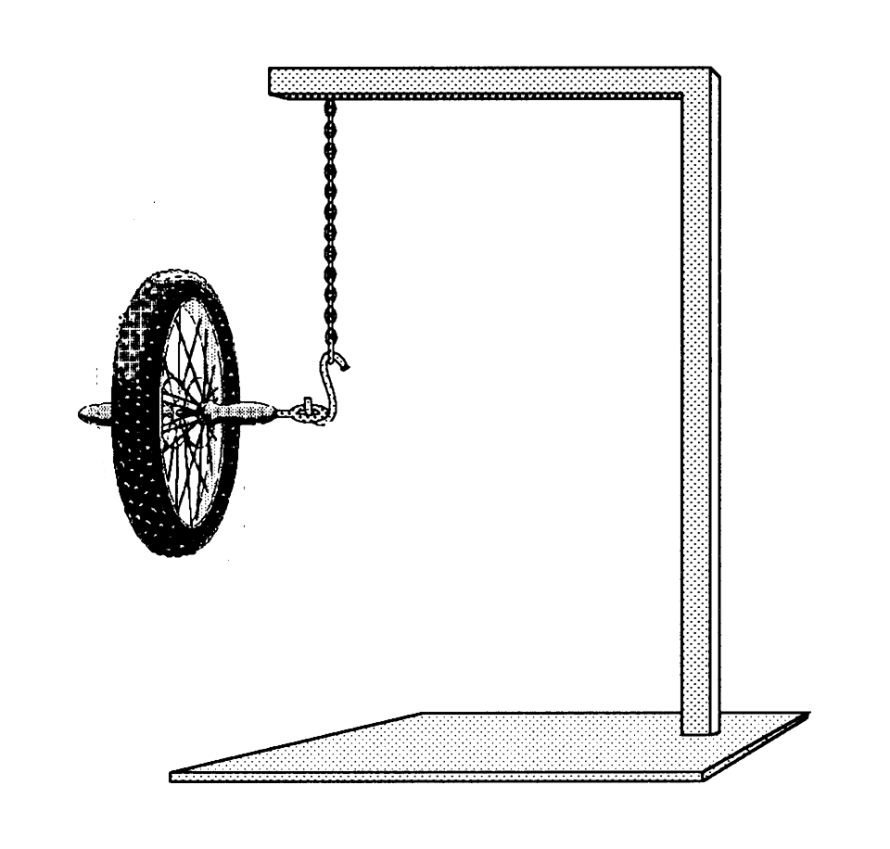
Consider a Wheel Suspended as Shown
A wheel suspended from the ceiling is held motionless in the position shown.
What will happen when it is released?
One would expect it to just flop over . . . which it will do if you try it . . .
But get it spinning . . .
What will happen when it is released?
https://www.exploratorium.edu/snacks/bicycle-wheel-gyro
In that case, you find what is called precession . . .
By the end of this unit, you will have the tools required to, if not explain what’s going on, at the very least PREDICT that it should happen!

Slide 6
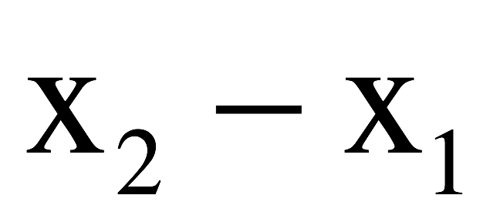
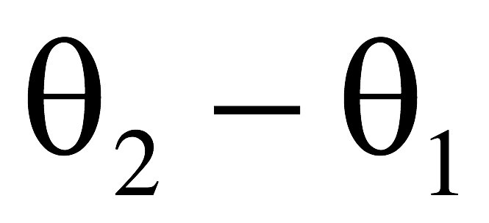
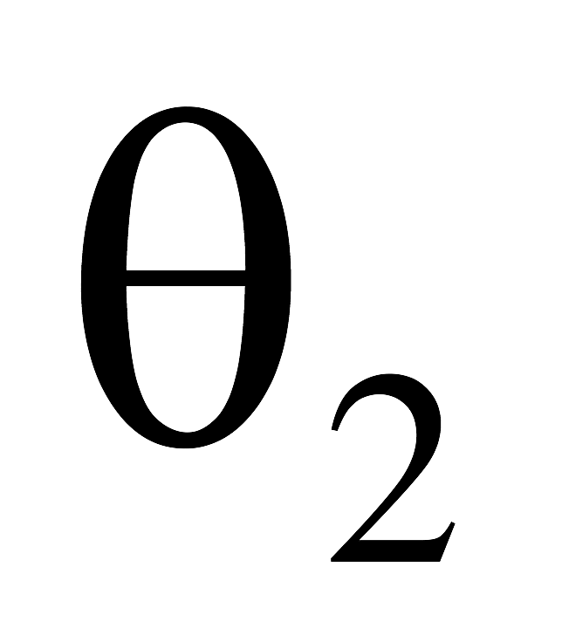
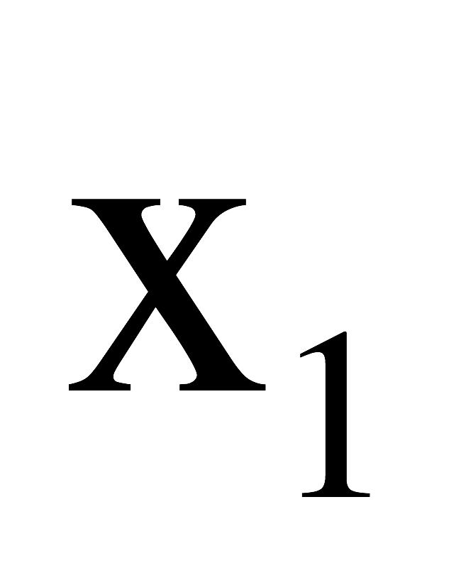
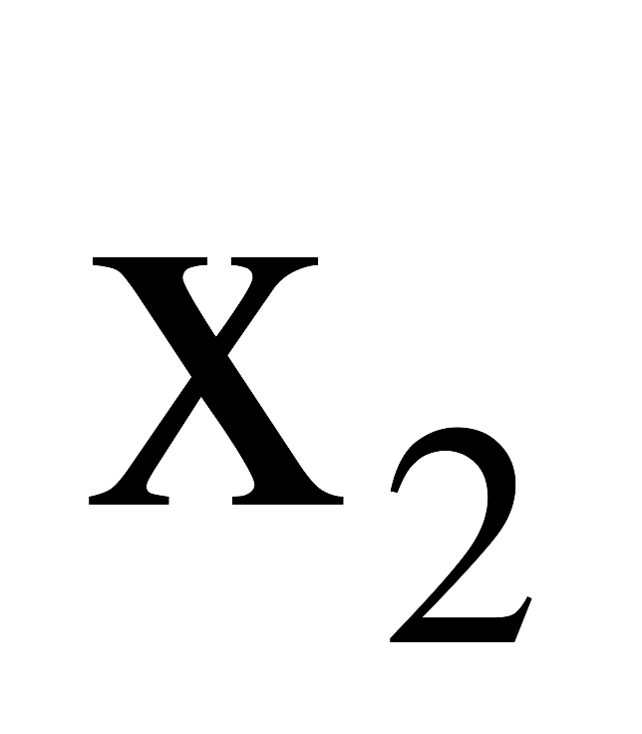
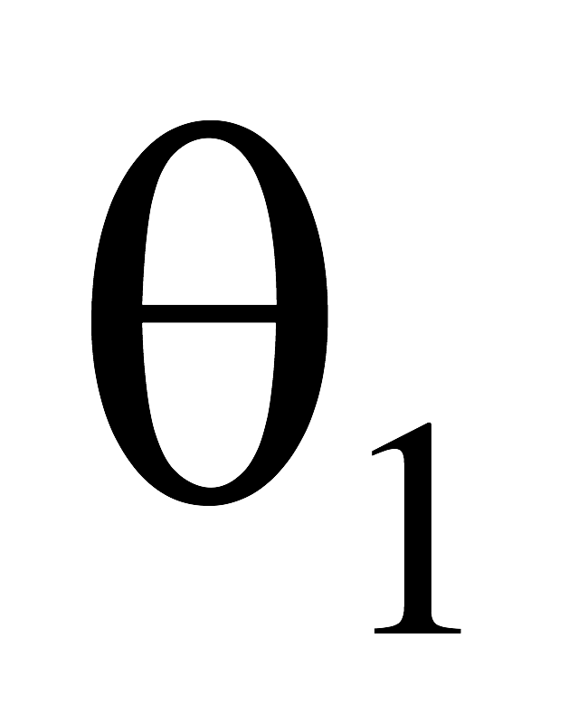

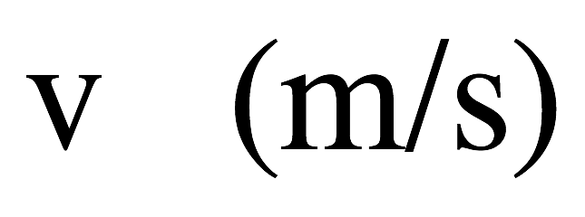
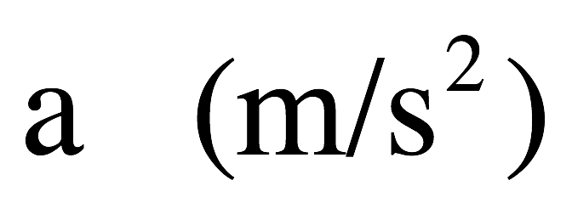
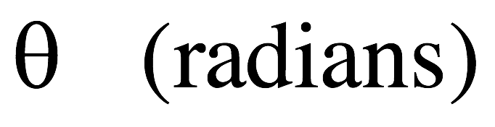

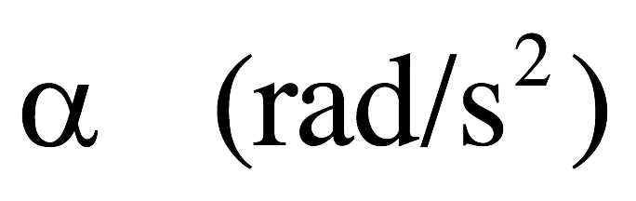
Some terminology
body translates
in time “t”
body rotates
in time “t”
rate of change
of position
rate of change
of velocity
position
translational
rotational

Slide 7
Position
𝛥θ = angular displacement (the angle through which a point on the body rotates). Measured in radians
  Reminder that 360° = 2𝛑 radians
  1 radian is the angle subtended for an arclength of 1 radius
s = arc length (linear distance a rotating point moves)
r = radius (measured from axis of rotation)
  Axis of rotation: the line around which the object is rotating—this is perpendicular to the plane of rotation
How to connect rotational displacement and translational displacement?
= s

Slide 8




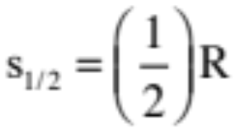



Rotational versus Translational Parameters
Definition of a radian?
If you lay out a one radius arc-length, the angle subtended is defined as one radian (see sketch).
So what arc-length is associated with a 2 radian angle?
And what arc-length is associated with a 1/2 radian angle?
And what is the arc length associated with a radian angle?
where R’s units are meters per radian and units are in radians.
13.)

Slide 9
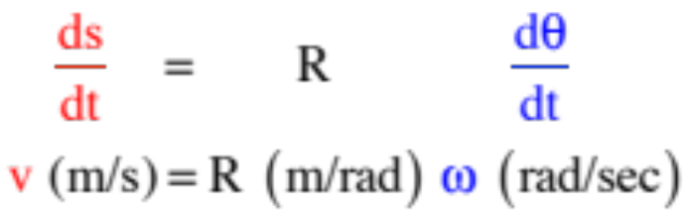





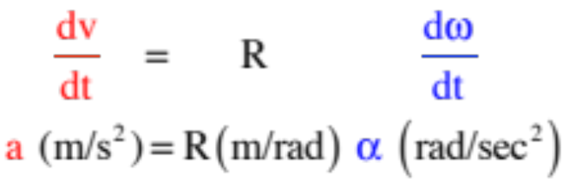

Taking the derivative of both sides yields:
or
more commonly written as:
where v is the velocity of a point moving with angular velocity upon an arc R units from the fixed center.
Taking the derivative of both sides again yields:
Fixed point
more commonly written as:
These are NOT kinematic relationships! They work whether the acceleration is a constant or not.
14.)

Slide 10
Position: 𝛥x vs. 𝛥θ
Imagine a bike wheel. As the wheel turns through some angular displacement 𝛥θ , it will also travel across the ground in a translational fashion:
The arc length s of the rotation is the same as the linear distance the wheel’s center of mass travels in the same amount of time.
The larger the wheel radius, the greater the arc length for any given angular displacement. Thus:
s = r θ (and s is also = to linear distance x traveled along the ground)
  This is not a kinematic relationship! This is a rotational definition and is true for any rotation.

Slide 11
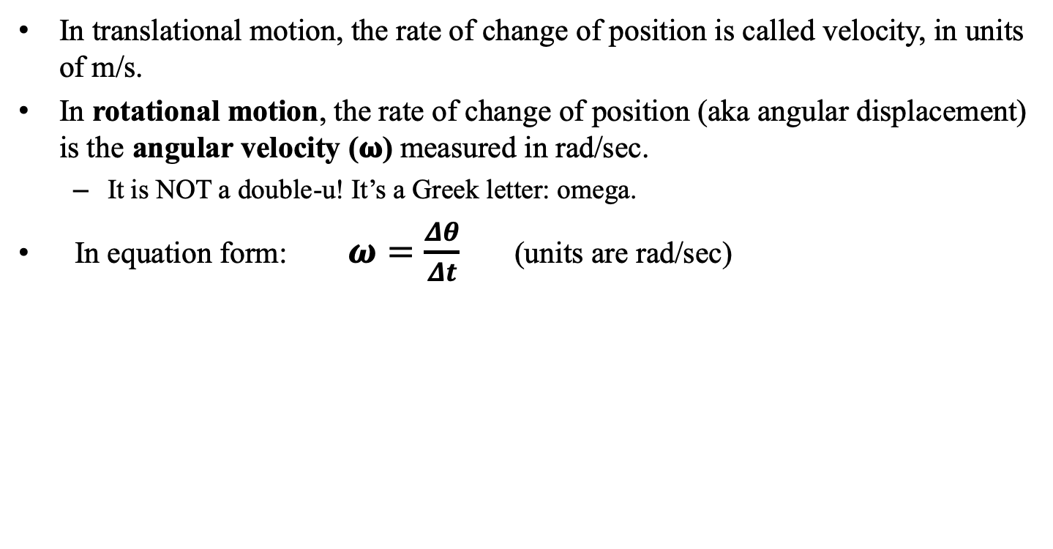
Velocity
In translational motion, the rate of change of position is called velocity, in units of m/s.
In rotational motion, the rate of change of position (aka angular displacement) is the angular velocity (𝛚) measured in rad/sec.
  It is NOT a double-u! It’s a Greek letter: omega.
In equation form: $ω=\frac{Δθ}{Δt}$ (units are rad/sec)
Remember that any point along a line on the disk rotates through the same angular displacement in the same time. Thus, the angular velocity of any point must be the same!
--> What does this mean about the translational speed of each point?

Slide 12

Velocity: v vs. 𝛚
We know the angular velocity (𝛚) of any point on the disk must be equal.
The translational velocity of each point, however, depends on its position relative to the axis of rotation (its radial distance).
This translational velocity is also known as the tangential velocity, because this vector is perpendicular to the rotation of the circle!
  The closer to the center, the slower each point has to move per unit time to achieve the same 𝛚.
  Farther out, points have to move faster to get through the same angular displacement in the same time.
  All this means is:
$$v_{t}=rω$$

Slide 13

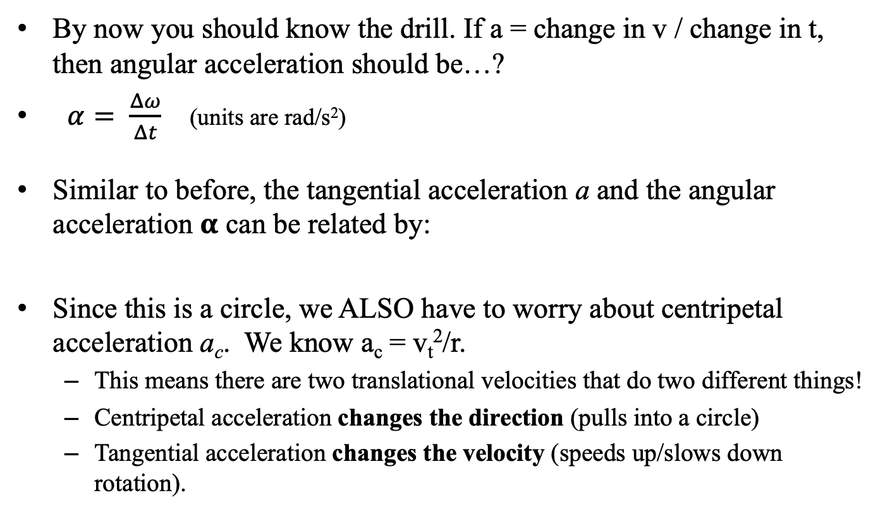
Acceleration
By now you should know the drill. If a = change in v / change in t, then angular acceleration should be…?
$α= \frac{Δω}{Δt}$ (units are rad/s²)
Similar to before, the tangential acceleration a and the angular acceleration 𝛂 can be related by:
Since this is a circle, we ALSO have to worry about centripetal acceleration a_{c}. We know a_{c} = v_{t}²/r.
  This means there are two translational velocities that do two different things!
  Centripetal acceleration changes the direction (pulls into a circle)
  Tangential acceleration changes the velocity (speeds up/slows down rotation).
$$a_{t}=rα$$

Slide 14
Some conceptual practice
Mr. White and Mr. Fletcher are riding on a merry-go-round. Mr. White rides on the outer rim of the circular platform, and Mr. Fletcher rides halfway between the rim and the center of the platform. When the MGR is rotating at a constant angular speed, compare Mr. White’s and Mr. Fletcher’s angular and tangential speeds.
Why is the launch area for the European Space Agency in South America and not in Europe?
Their angular speeds are the same, as both of them travel the same portion of the circle in the same time. Mr. White’s tangential velocity is twice Mr. Fletcher’s, however, because he is twice as far radially from the center (v = r𝛚).
The tangential velocity of the Earth is greater at the equator than it is closer to the poles – Europe’s radial distance from the axis of rotation is much smaller than the equator’s. This way, the satellite being launched (eastward, in the direction of rotation) already has some initial tangential speed (about 1700 m/s) which makes it easier to get into orbit (which requires a speed of about 8000 m/s).

Slide 15
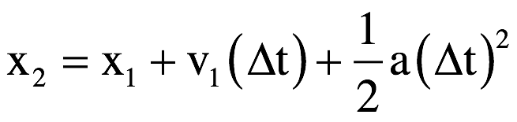
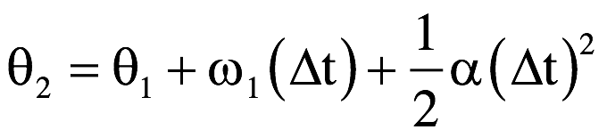
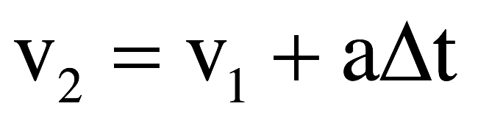
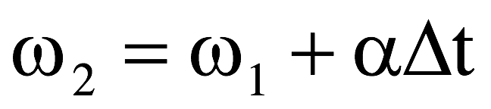
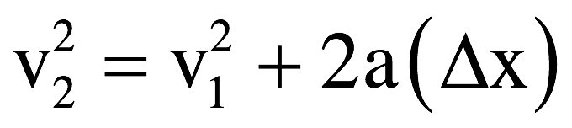
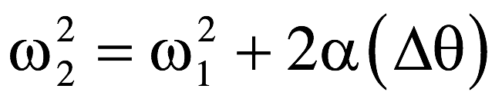
Rotational kinematics
In translational motion, we knew that if acceleration was constant, we could use our three kinematic equations to calculate displacement and velocity over certain time intervals.
In rotational motion, we use the same equations to calculate angular displacement and angular velocity, as long as the angular acceleration is constant! Same rules, same equations, but with rotational parameters.
Translational motion
Rotational motion

Slide 16
Rotational kinematics problem (7.5)
A dentist’s drill starts from rest and reaches 2.51 x 10⁴ revolutions per minute in 3.2 seconds with constant angular acceleration. Determine the drill’s:
  (a) angular acceleration
  (b) angular displacement during that interval
We know that 𝞈₁ = 0 rad/sec and t = 3.2 seconds. We need to convert 𝞈₂ into rad/sec:
$$2.51x{10}^{4}\frac{rev}{min}\left(\frac{2π rad}{1 rev}\right)\left(\frac{1 min}{60 sec}\right)=2628 rad/sec$$
Now find 𝛂 using the angular velocity equation:
$$ω_{2}=ω_{2}+αt ⟹ α=\frac{ω_{2}−ω_{1}}{t}=\frac{2628 rad/\sec{− 0 rad/sec}}{3.2 sec}=821\frac{rad}{s^{2}}$$
Now find 𝛉 using either equation with angular displacement:
$$∆θ=ω_{1}t+\frac{1}{2}αt^{2}=0+\frac{1}{2}\left(821\frac{rad}{s^{2}}\right){\left(3.2 s\right)}^{2}=4203 radians$$

Slide 17



Rotational Vectors
The relationship is really code. It is telling you three things:
a.) the magnitude of the velocity (in this case, it’s 3 m/s);
b.) the line of the velocity (the tells you the vector is along the x-axis, versus being along the y-axis or z-axis or some combination thereof); and
c.) the + or – tells you the actual direction along the line (in this case, it’s in the NEGATIVE x-direction, versus the POSITIVE x-direction);
You know how to decode the above expression. The following is also a code.
The question is, “What three things does this coding tell you?”
8.)

Slide 18

The relationship tells you:
a.) the magnitude of the angular velocity (in this case, it’s 3 rad/s);
b.) the DIRECTION OF THE AXIS about which the angular velocity proceeds (this will be perpendicular to the plane of the motion, so an “ “ tells you the motion is in the y-z plane); and
c.) the + or – tells you the whether the rotation is clockwise or counterclockwise, as viewed from the positive side of the axis (in this case, it’s NEGATIVE, so the rotation will be clockwise—more about this later).
Clarification concerning parts c above. Both physics and standard mathematics use what is called a right-handed coordinate system. That means that if you place your right hand along the +x direction and curl your fingers in the +y direction, your thumb will point in the +z direction. The reason this is significant is that in doing so, you will be curling your fingers counterclockwise. So if you want to characterize a body moving counterclockwise in the x-y plane, giving the direction as +k makes sense as that is the direction your thumb would point if you made the fingers of your right hand curl along the direction of motion.
In short, though, if you know how to do the decoding, the notation is as simple as .
9.)

Slide 19
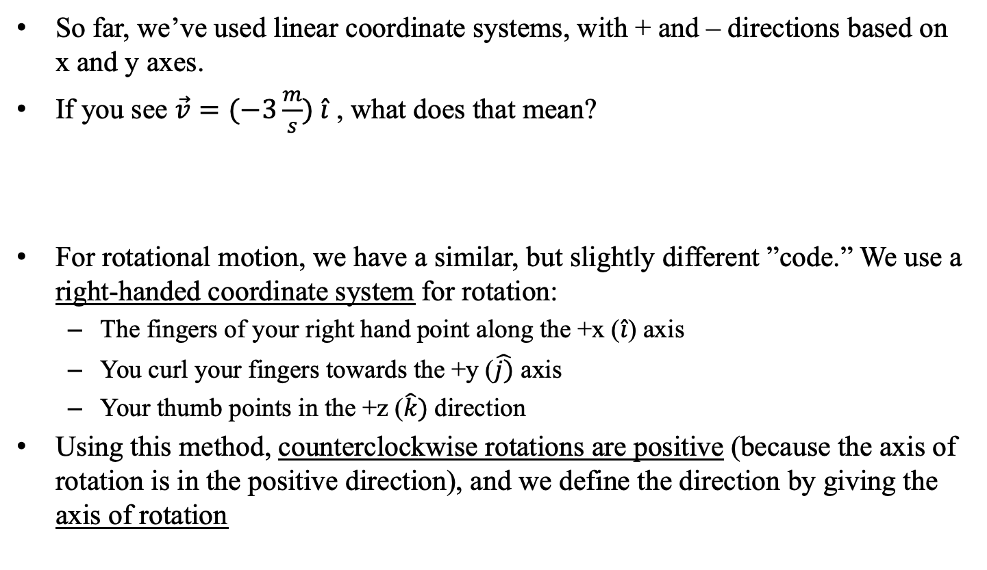
Sign conventions with rotation
So far, we’ve used linear coordinate systems, with + and – directions based on x and y axes.
If you see $\vec{v}=(−3\frac{m}{s}) \hat{i}$ , what does that mean?
For rotational motion, we have a similar, but slightly different ”code.” We use a right-handed coordinate system for rotation:
  The fingers of your right hand point along the +x ($\hat{i}$) axis
  You curl your fingers towards the +y ($\hat{j)}$ axis
  Your thumb points in the +z ($\hat{k})$direction
Using this method, counterclockwise rotations are positive (because the axis of rotation is in the positive direction), and we define the direction by giving the axis of rotation
It’s a code! This code tells you three things: (1) the magnitude of the velocity is 3 m/s, (2) the velocity is along the $\hat{i}$ (x) axis, and (3) it’s in the negative direction along that axis.

Slide 20
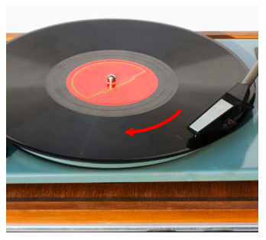
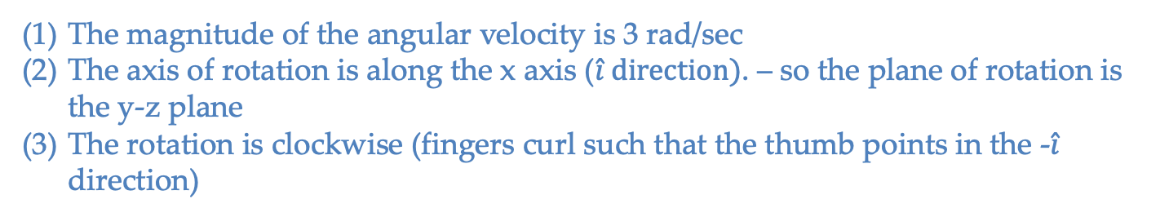
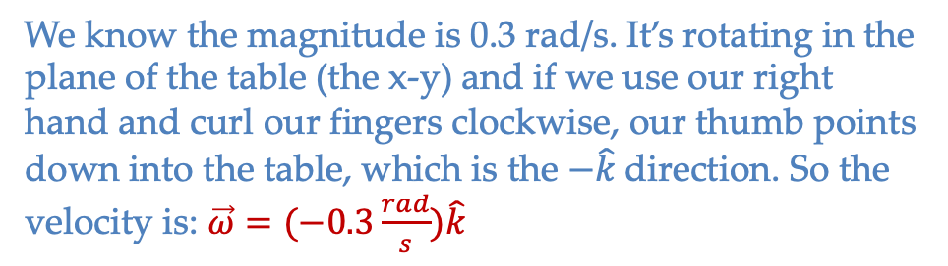
Sign conventions with rotation
Knowing this, what does this code tell you: $\vec{ω}=(−3 rad/sec){\hat{i}}$
The magnitude of the angular velocity is 3 rad/sec
The axis of rotation is along the x axis ($\hat{i} direction)$. – so the plane of rotation is the y-z plane
The rotation is clockwise (fingers curl such that the thumb points in the -$\hat{i}$ direction)
A turntable (record player) is rotating as shown to the right (thanks, Mr. White!). The magnitude of its angular speed is 0.3 rad/sec. What is its angular velocity in vector form?
We know the magnitude is 0.3 rad/s. It’s rotating in the plane of the table (the x-y) and if we use our right hand and curl our fingers clockwise, our thumb points down into the table, which is the $−\hat{k}$direction. So the velocity is: $\vec{ω}=(−0.3\frac{rad}{s})\hat{k}$

Slide 21
Sign conventions with calculations
Just like in linear kinematics, the signs of your displacement, velocity, and acceleration vectors in rotational kinematics matter. Determine the signs of your initial parameters properly, and things will work out.
  If you want practice with these calculations before the quiz, there are a few problems on the next few slides you’re welcome to try, with numerical answers (not worked out solutions) following.

Slide 22
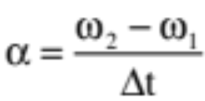

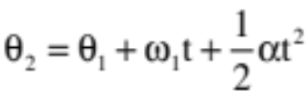
Rotational kinematics practice - 1
A turntable rotates at -0.28 rad/sec. In 4 seconds, it reaches +0.20 rad/sec.
  (a) What is the turntable’s angular acceleration?
  (b) How long will it take to reach +0.10 rad/sec?
  (c) What angular speed will it have after 0.3 seconds?
  (d) Through how many radians will it travel in 8 seconds? How many rotations is that?

Slide 23
Rotational kinematics practice - 2
A disk is rotating at -25 rad/sec and angularly accelerates at -9.8 rad/sec/sec.
  (a) How far will the disk rotate in 2 seconds?
  (b) How fast (angularly) will the disk be moving after it rotates for 2 seconds?
  (c) How far will the disk rotate between t = 1 and t = 3 seconds?
  (d) After 2 seconds, the acceleration changes to 3 rad/sec/sec. How long will it take for the disk to come to rest?
  (e) Without actually using the time, determine through how many radians the disk will turn during the time calculated in part (d).
  (f) How many rotations is that?

Slide 24
Rotational kinematics practice - 3
An auto whose wheel radius is 0.3 m moves at 15 m/sec. The car applies its brakes uniformly, slowing to 4 m/s over a 50-m distance.
  (a) What is the wheel’s final angular velocity?
  (b) What is the wheel’s initial angular velocity?
  (c) What is the angular displacement of the wheels as the car slows over this distance?
  (d) What is the wheel’s angular acceleration during the slow-down?
  (e) Using the information from (d), determine the car’s translational acceleration.
  (f) Without using the final angular velocity, determine how long was required for the slow down.
  (g) Knowing the final angular velocity, determine how long was required for the slow down (yes, this should end up the same as f).
  (h) Determine the angular displacement and the linear displacement of the wheels during the first 0.5 seconds of the slow down.

Slide 25
Rotational kinematics practice - answers
Question 1:
  (a) +0.12 rad/sec/sec (b) 3.2 sec. (c) -0.24 rad/sec (d) 1.6 rad = 0.25 revolutions
Question 2:
  (a) -69.6 rad (b) -44.6 rad/sec (c) -89.2 rad (d) 14.9 sec (e) -332 rad (f) 52.8 revolutions
Question 3:
  (a) 13.33 rad/s (b) 50 rad/s (c) 166.6 rad (d) -6.97 rad/s/s (e) -2.09 m/s (f) 5.26 sec (g) 5.26 sec (h) 7.23 m

Slide 26
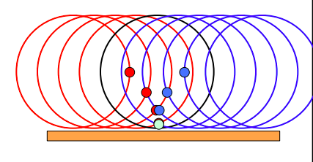
Point of contact on a rolling object
Let’s consider a point on the edge of a rolling object, like a wheel:
When the point on the edge of the wheel hits the ground, what is its instantaneous velocity?
The point is turning around in the y-direction, which means its y velocity is 0. It’s not sliding relative to the ground, either, so its x velocity is 0. At this instant, its overall velocity is 0 m/s!
We call this “rolling without slipping” – a major assumption in many problems. The “without slipping” part means we don’t have to worry about kinetic friction along the surface contact (which would really complicate the math). This also means that static friction must be preventing the sliding – this is how objects roll in the first place!

Slide 27


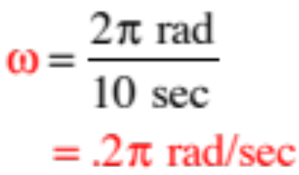
As an additional bit of craziness, if you know the angular velocity about one point on a rotating object, that will be the the angular velocity about ALL points on the object. How so?
Consider a rotating platform with a chair at its center that is rigged to ALWAYS face toward the wall:
You sit in the seat. It takes 10 seconds for the platform to rotate through one complete rotation.
a.) What does the motion look like from your perspective, assuming a constant angular velocity?
(It will move around you.)
b.) Relative to the axis you are sitting on, what will be the platform’s angular velocity?
18.)

Slide 28


The chair is now placed at the edge of the platform. It is still rigged to always face toward the wall. Just as was the previous case, it takes 10 seconds for the disk to move through one rotation. From your perspective, what does the motion look like, and what is the angular velocity of the disk about your position?
Following the motion as seen by you in the chair at the edge:
You start facing away from the disk, seeing none of it (looking at the wall).
As the disk rotates, you continue to face the wall and the disk begins to come into view on your right. In other words, the disk appears to be rotating around the axis upon which you sit.
19.)

Slide 29


Progression of motion from watcher’s perspective (remember, the watch is ALWAYS facing the wall!).
Time 1
Time 3
And what is the angular velocity of the disk about your vantage point?
Time 2
Time 4
You will sweep out radians in 10 seconds, so you’ll get:
The same as about the central axis!!!!!
20.)

Slide 30
The point: The amount of time it takes the for the platform to rotate around you is the same in both the “center seat” situation and the “edge seat” situation. Additionally, the angular displacement in both cases during one revolution’s worth of time is 2π radians.
Sooooo (in other words), if the object appears to be rotating around you, the angular velocity you observed will be the same no matter where on the platform you are standing.
Translation: If you know the angular velocity of an object about any point on the object, you know the angular velocity about any other point on the object.
21.)

Slide 31


Angular velocity on a disk
(Ms. Dunham’s version)
Let’s look at what a rotation looks like from different points of view (e.g. axes of rotation) based on what we just saw.
Imagine a person sitting on a disk, on a chair that is fixed so that it always faces the same direction. The disk rotates through 1 rotation in 10 seconds. What does the person see?
Wall the chair faces
The person sees the platform rotate around them at $ω=\frac{2π rad}{10 sec}$.
platform as seen
from above

Slide 32
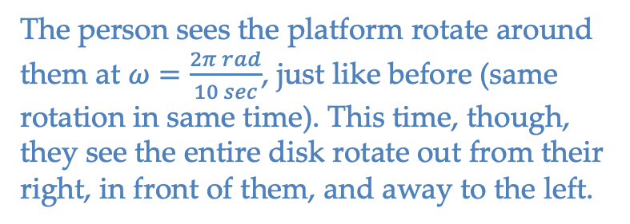
Angular velocity on a disk
Now the chair is placed so that it’s on the edge of the platform, but still faces the same direction at all times. The disk again rotates through one rotation in 10 seconds. Now what does the person experience?
The person sees the platform rotate around them at $ω=\frac{2π rad}{10 sec}$, just like before (same rotation in same time). This time, though, they see the entire disk rotate out from their right, in front of them, and away to the left.
Wall the chair faces
The point is that you could pick ANY point on the disk and observe the rotation from the perspective of that point, and the angular velocity of the disk about that point would be the same as the angular velocity of the disk about any other point on the disk.
platform as seen
from above
EVERY POINT WILL SEE THE SAME ANGULAR VELOCITY ABOUT ITSELF AS EVERY OTHER POINT!

Slide 33
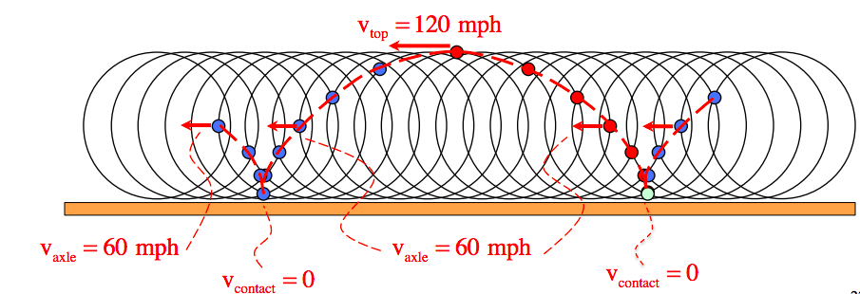
Point of contact on a rolling object
Back to the point on the edge of a wheel – let’s follow it around the wheel as it rotates. We know the point’s velocity is 0 m/s at the point of contact, but what happens as it moves to the “top” of the wheel on, say, a car on the freeway going 60 mph?
When the point reaches the height of the axle, it will be moving at the speed of the car (v=R𝞈). When it reaches the top of the wheel, it will be going twice the speed of the car (v = 2R𝞈). This cycle repeats – crazy!

Slide 34








But why is this important, really?
Consider a ball rolling across a table. It’s center of mass has some velocity and all of the body’s mass is rotation about the center of mass with some angular velocity . So how do we relate those two parameters (and how do we justify that relationship)?
We only have one relationship between the angular velocity of a mass moving in a circular path and its instantaneous velocity in that motion, and that is , but that requires rotation around a fixed point.
But if the contact point of the rolling ball is instantaneously fixed (zero velocity), and if the angular velocity about the center of mass is the same as the angular velocity about that fixed point (instantaneously), then it follows that
This is important!!!
zero velocity point
21.)

Slide 35
Quiz 1
We have now covered what will be on Quiz 1 tomorrow.
Be able to:
  State the rotational counterparts of translational motion (e.g. position, velocity, acceleration) in both systems and how they're related (e.g. v = r𝛚)
  State the rotational kinematic equations and use them to solve problems like the ones from class/in the ppt
  Interpret unit-vector notation for angular velocity and how we determine direction
  Explain any examples we've talked about in class (e.g. rolling about point of contact)
Anything after this slide is not on quiz 1

