Slide 1
General announcements

Slide 2
The Beginning
We’ve said there is a rotational counterpart to every translational parameter you’ve used to date. You need to learn what those counterparts are. You need to know what the symbols are and what those symbols are called. That is what the beginning of the PowerPoint is about . . .

Slide 3
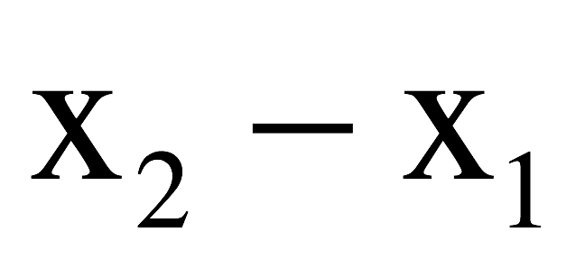
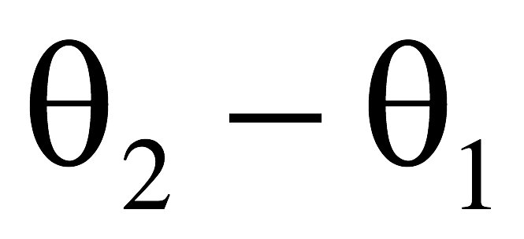
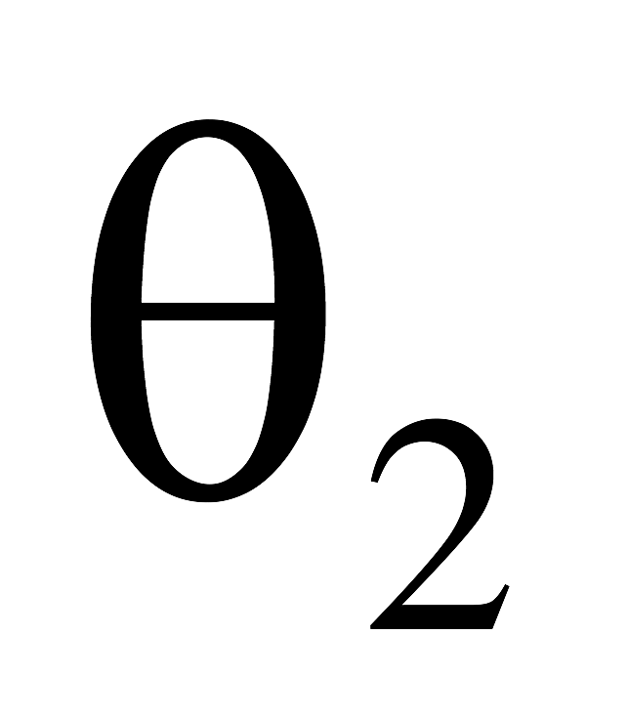

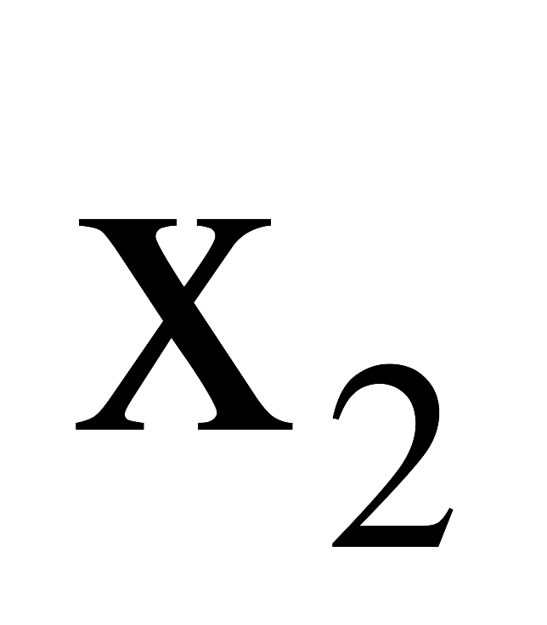
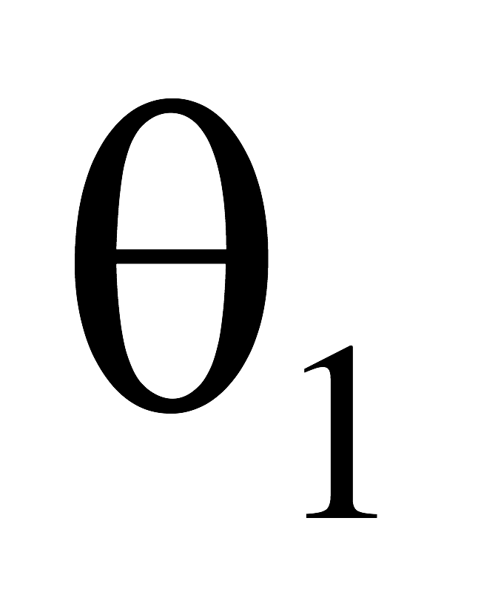

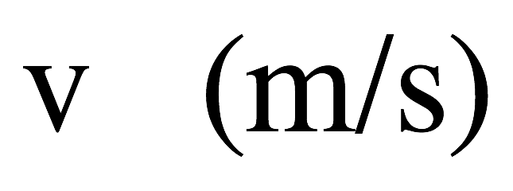
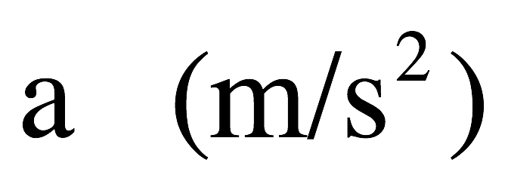



Some terminology
body translates
in time “t”
body rotates
in time “t”
rate of change
of position
rate of change
of velocity
position
translational
rotational
(called angular
(called angular
(called angular
position)
velocity)
acceleration)
(symbol theta)
(symbol omega)
(symbol alpha)
2
(unit radians)
(unit radians/sec)
(unit radians/sec )

Slide 4



Position
Angular displacement : the angle through which a point on the body rotates.
Units: radians.
Reminders:
--
s
--
One radian is the angle subtended for an
arclength of one radius
--
Arc length “s” is the linear distance a rotating
point moves
--
Radius “r” is the distance of a point from the
axis of rotation, where the axis of rotation is the line around which
the object rotates—it is perpendicular to the plane of rotation.
So how to connect rotational displacement and translational displacement, and what might be the consequence of that relationship?

Slide 5




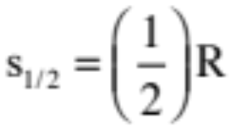



Rotational versus Translational Parameters
Definition of a radian?
If you lay out a one radius arc-length, the angle subtended is defined as one radian (see sketch).
So what arc-length is associated with a 2 radian angle?
And what arc-length is associated with a 1/2 radian angle?
And what is the arc length associated with a radian angle?
where R’s units are meters per radian and units are in radians.
13.)

Slide 6
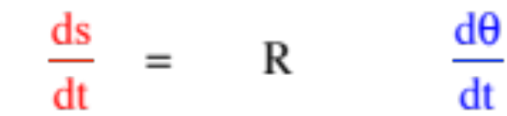






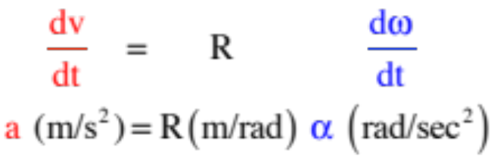

Taking the derivative of both sides yields:
which means
more commonly written as:
where v is the velocity of a point moving with angular velocity upon an arc R units from the fixed center.
Taking the derivative of both sides again yields:
Fixed point
more commonly written as:
These are NOT kinematic relationships! They work whether the acceleration is a constant or not.
14.)

Slide 7
Position: 𝛥x vs. 𝛥θ
A little different view of all you’ve just learned
Consider a bike wheel. As the wheel turns through some angular displacement 𝛥θ , it will also travel across the ground in a translational fashion:
The arclength s of the rotation is the same as the linear distance the wheel’s center of mass travels in the same amount of time.
The larger the wheel radius, the greater the arc length for any given angular displacement. Thus:
s = r θ (where s is also to linear distance x traveled along the ground)
  Note that this is not a kinematic relationship! This is a rotational definition and is true for any rotation.

Slide 8
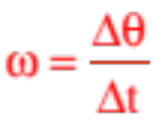
Velocity
In translational motion, the rate of change of position is called velocity, in units of m/s.
In rotational motion, the rate of change of position (aka angular displacement) is called the angular velocity (𝛚) measured in rad/sec.
  Note that this is NOT a double-u! It’s a Greek letter: omega.
In equation form: (units are rad/sec)
Remember that any point along a line on the disk rotates through the same angular displacement in the same time. Thus, the angular velocity of any point must be the same!
So what does this tell us about the translational speed of each point?

Slide 9

Velocity: v vs. 𝛚
We know the angular velocity (𝛚) of any point on the disk must be equal.
The translational velocity of each point, however, depends on its position relative to the axis of rotation (its radial distance).
Note that this translational velocity is also known as the tangential velocity because this vector is tangent to the arc the body is traveling along!
  The closer to the center, the slower each point has to move per unit time to achieve the same 𝛚.
  Farther out, points have to move faster to get through the same angular displacement in the same time.
  In other words:
$$v_{t}=rω$$

Slide 10
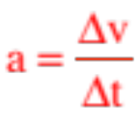

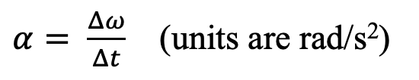
Acceleration
By now you should know the drill. If , then angular acceleration should be…?
$α= \frac{Δω}{Δt}$ (units are rad/s²)
Similar to before, the tangential acceleration a and the angular acceleration 𝛂 can be related by:
$$a_{t}=rα$$
Since this is circular motion, we ALSO have to worry about centripetal acceleration a_{c}. As a_{c} = v_{t}²/r.
  Apparently translational velocity does two different things!
  It contributes to centripetal acceleration which changes the body’s direction (pulls it out of straight-line motion); and
  It contributes to tangential acceleration which changes the velocity’s magnitude (speeds a body up or slows it down).

Slide 11
Some conceptual practice
Mr. White and Mr. Fletcher are riding on a merry-go-round. Mr. White rides on the outer rim of the circular platform, and Mr. Fletcher rides halfway between the rim and the center of the platform. When the MGR is rotating at a constant angular speed, compare Mr. White’s and Mr. Fletcher’s angular and tangential speeds.
Why is the launch area for the European Space Agency in South America and not in Europe?
Their angular speeds are the same, as both of them travel the same portion of the circle in the same time. Mr. White’s tangential velocity is twice Mr. Fletcher’s, however, because he is twice as far radially from the center (v = r𝛚).
The tangential velocity of the Earth is greater at the equator than it is closer to the poles – Europe’s radial distance from the axis of rotation is much smaller than the equator’s. This way, the satellite being launched (eastward, in the direction of rotation) already has some initial tangential speed (about 1700 m/s) which makes it easier to get into orbit (which requires a speed of about 8000 m/s).

Slide 12



Rotational Vector Notation
The relationship is really code. It is telling you three things:
a.) the magnitude of the velocity (in this case, it’s 3 m/s);
b.) the line of the velocity (the tells you the vector is along the x-axis, versus being along the y-axis or z-axis or some combination thereof); and
c.) the + or – tells you the actual direction along the line (in this case, it’s in the NEGATIVE x-direction, versus the POSITIVE x-direction);
You know how to decode the above expression. For you, it’s no big deal.
Similarly, there is a way to decode the expression below.
The question is, “What three things does this coding tell you?”
8.)

Slide 13

The relationship tells you:
a.) the magnitude of the angular velocity (in this case, it’s 3 rad/s);
b.) the DIRECTION OF THE AXIS about which the angular velocity proceeds (this will be perpendicular to the plane of the motion, so an “ “ tells you the motion is in the y-z plane); and
c.) the + or – tells you the whether the rotation is clockwise or counterclockwise, as viewed from the positive side of the axis (in this case, it’s NEGATIVE, so the rotation will be clockwise—more about this later).
Clarification concerning parts c above. Both physics and standard mathematics use what is called a right-handed coordinate system. That means that if you place your right hand along the +x direction and curl your fingers in the +y direction, your thumb will point in the +z direction. The reason this is significant is that in doing so, you will be curling your fingers counterclockwise. So if you want to characterize a body moving counterclockwise in the x-y plane, giving the direction as +k makes sense as that is the direction your thumb would point if you made the fingers of your right hand curl along the direction of motion.
In short, though, if you know how to do the decoding, the notation is as simple as .
9.)

Slide 14
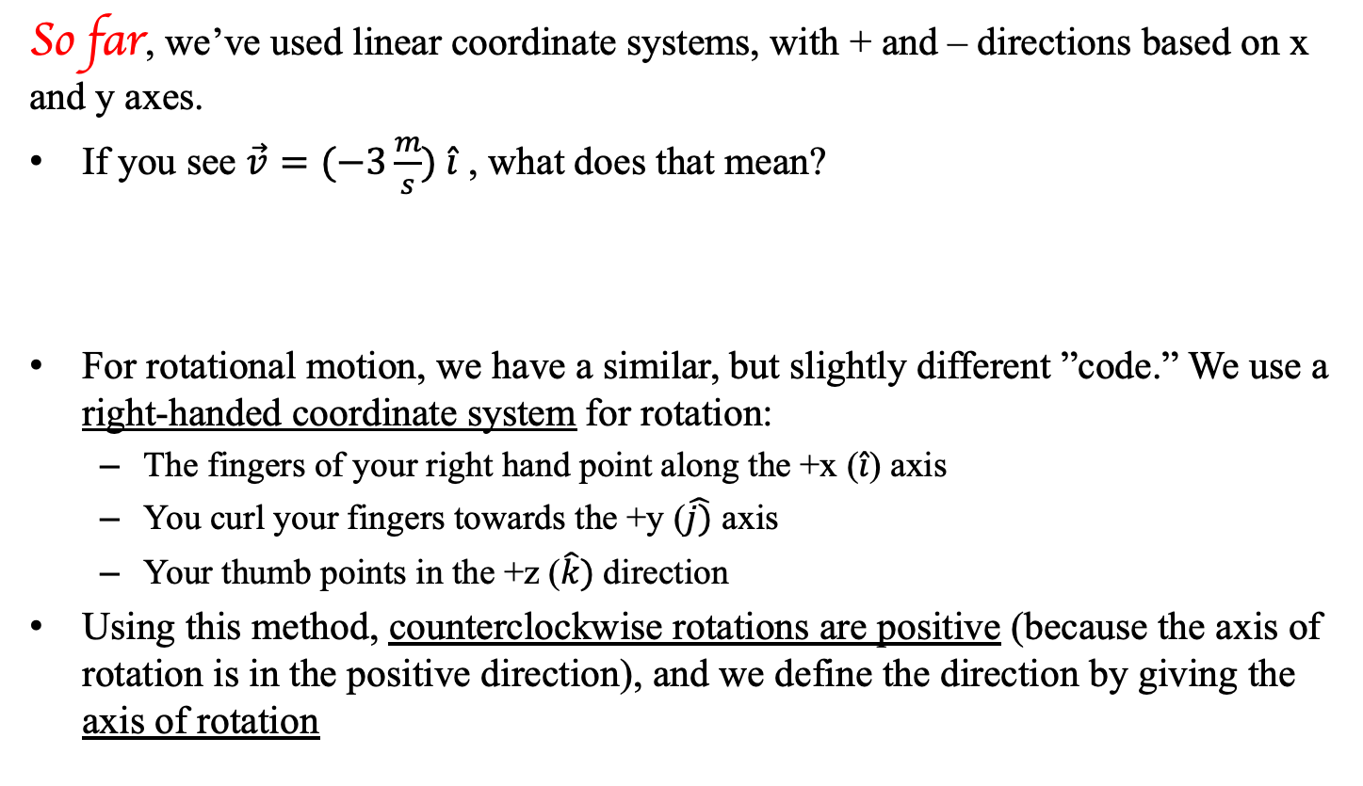
Sign conventions with rotation
Same Material, Different Approach
So far, we’ve used linear coordinate systems, with + and – directions based on x and y axes.
If you see $\vec{v}=(−3\frac{m}{s}) \hat{i}$ , what does that mean?
For rotational motion, we have a similar, but slightly different ”code.” We use a right-handed coordinate system for rotation:
  The fingers of your right hand point along the +x ($\hat{i}$) axis
  You curl your fingers towards the +y ($\hat{j)}$ axis
  Your thumb points in the +z ($\hat{k})$direction
Using this method, counterclockwise rotations are positive (because the axis of rotation is in the positive direction), and we define the direction by giving the axis of rotation
It’s a code! This code tells you three things: (1) the magnitude of the velocity is 3 m/s, (2) the velocity is along the $\hat{i}$ (x) axis, and (3) it’s in the negative direction along that axis.

Slide 15
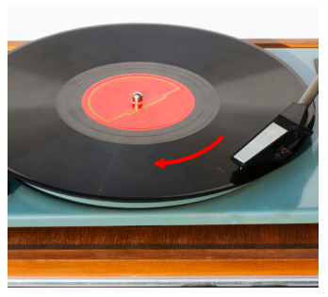
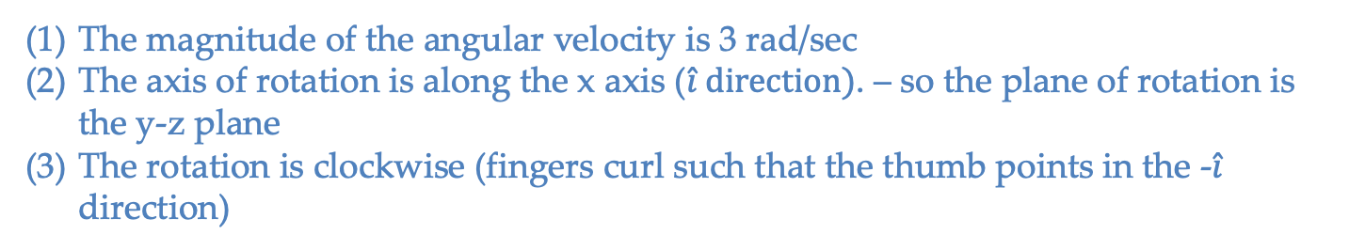
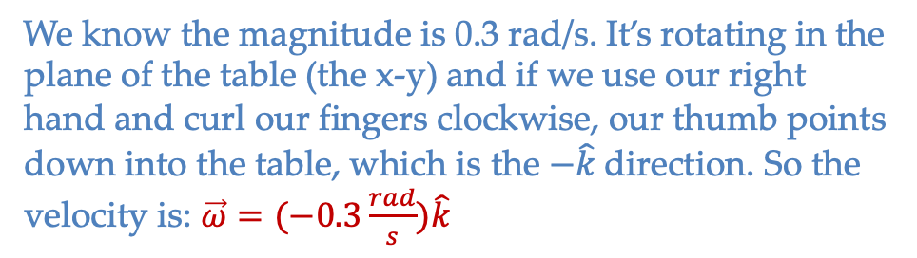
Sign conventions with rotation
Knowing this, what does this code tell you: $\vec{ω}=(−3 rad/sec){\hat{i}}$
The magnitude of the angular velocity is 3 rad/sec
The axis of rotation is along the x axis ($\hat{i} direction)$. – so the plane of rotation is the y-z plane
The rotation is clockwise (fingers curl such that the thumb points in the -$\hat{i}$ direction)
A turntable (record player) is rotating as shown to the right (thanks, Mr. White!). The magnitude of its angular speed is 0.3 rad/sec. What is its angular velocity in vector form?
We know the magnitude is 0.3 rad/s. It’s rotating in the plane of the table (the x-y) and if we use our right hand and curl our fingers clockwise, our thumb points down into the table, which is the $−\hat{k}$direction. So the velocity is: $\vec{ω}=(−0.3\frac{rad}{s})\hat{k}$

Slide 16
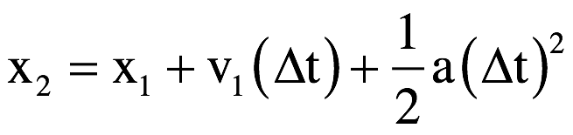
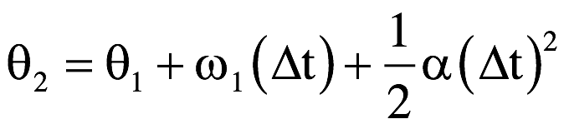
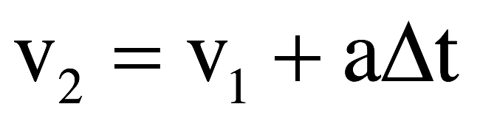
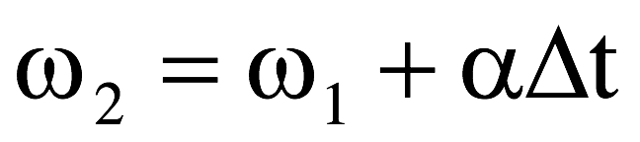
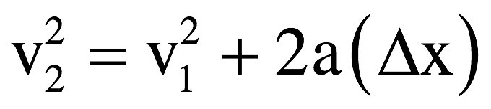
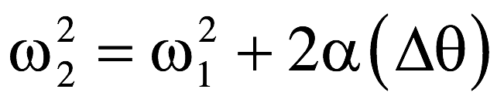
Rotational kinematics
In translational motion, we knew that if acceleration was constant over an interval, we could use our three kinematic equations to calculate initial and/or final coordinates, initial and/or final velocities and/or acceleration over that time interval.
In rotational motion, we use the SAME EQUATIONS to calculate angular parameters over a time interval, as long as the angular acceleration is constant! Same rules, same equations, but with rotational parameters.
Translational motion
Rotational motion

Slide 17
Sign conventions with calculations
Just like in linear kinematics, the signs of your displacement, velocity, and acceleration vectors in rotational kinematics matter. Determine the signs of your initial parameters properly, and things will work out.
  If you want practice with rotational kinematic calculations before the quiz, there are a few problems on the next few slides you’re welcome to try, with numerical answers (not worked out solutions) following.

Slide 18
Rotational kinematics problem (7.5)
A dentist’s drill starts from rest and reaches 2.51 x 10⁴ revolutions per minute in 3.2 seconds with constant angular acceleration. Determine the drill’s:
  (a) angular acceleration
  (b) angular displacement during that interval
We know that 𝞈₁ = 0 rad/sec and t = 3.2 seconds. We need to convert 𝞈₂ into rad/sec:
$$2.51x{10}^{4}\frac{rev}{min}\left(\frac{2π rad}{1 rev}\right)\left(\frac{1 min}{60 sec}\right)=2628 rad/sec$$
Now find 𝛂 using the angular velocity equation:
$$ω_{2}=ω_{2}+αt ⟹ α=\frac{ω_{2}−ω_{1}}{t}=\frac{2628 rad/\sec{− 0 rad/sec}}{3.2 sec}=821\frac{rad}{s^{2}}$$
Now find 𝛉 using either equation with angular displacement:
$$∆θ=ω_{1}t+\frac{1}{2}αt^{2}=0+\frac{1}{2}\left(821\frac{rad}{s^{2}}\right){\left(3.2 s\right)}^{2}=4203 radians$$

Slide 19
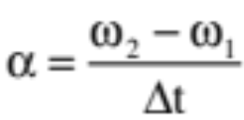

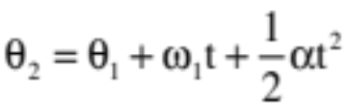
Rotational kinematics practice - 1
A turntable rotates at -0.28 rad/sec. In 4 seconds, it reaches +0.20 rad/sec.
  (a) What is the turntable’s angular acceleration?
  (b) How long will it take to reach +0.10 rad/sec?
  (c) What angular speed will it have after 0.3 seconds?
  (d) Through how many radians will it travel in 8 seconds? How many rotations is that?

Slide 20
Rotational kinematics practice - 2
A disk is rotating at -25 rad/sec and angularly accelerates at -9.8 rad/sec/sec.
  (a) How far will the disk rotate in 2 seconds?
  (b) How fast (angularly) will the disk be moving after it rotates for 2 seconds?
  (c) How far will the disk rotate between t = 1 and t = 3 seconds?
  (d) After 2 seconds, the acceleration changes to 3 rad/sec/sec. How long will it take for the disk to come to rest?
  (e) Without actually using the time, determine through how many radians the disk will turn during the time calculated in part (d).
  (f) How many rotations is that?

Slide 21
Rotational kinematics practice - 3
An auto whose wheel radius is 0.3 m moves at 15 m/sec. The car applies its brakes uniformly, slowing to 4 m/s over a 50-m distance.
  (a) What is the wheel’s final angular velocity?
  (b) What is the wheel’s initial angular velocity?
  (c) What is the angular displacement of the wheels as the car slows over this distance?
  (d) What is the wheel’s angular acceleration during the slow-down?
  (e) Using the information from (d), determine the car’s translational acceleration.
  (f) Without using the final angular velocity, determine how long was required for the slow down.
  (g) Knowing the final angular velocity, determine how long was required for the slow down (yes, this should end up the same as f).
  (h) Determine the angular displacement and the linear displacement of the wheels during the first 0.5 seconds of the slow down.

Slide 22
Rotational kinematics practice - answers
Question 1:
  (a) +0.12 rad/sec/sec (b) 3.2 sec. (c) -0.24 rad/sec (d) 1.6 rad = 0.25 revolutions
Question 2:
  (a) -69.6 rad (b) -44.6 rad/sec (c) -89.2 rad (d) 14.9 sec (e) -332 rad (f) 52.8 revolutions
Question 3:
  (a) 13.33 rad/s (b) 50 rad/s (c) 166.6 rad (d) -6.97 rad/s/s (e) -2.09 m/s (f) 5.26 sec (g) 5.26 sec (h) 7.23 m

Slide 23
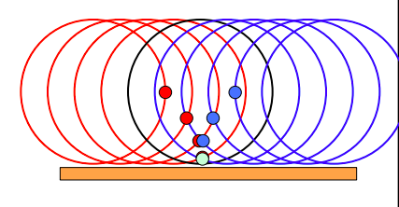
Point of contact on a rolling object
Consider a point on the edge of a rolling object, like a wheel:
When the point on the edge of the wheel hits the ground, what’s its instantaneous velocity?
The point turns around in the y-direction, which means its y velocity is 0. It’s not sliding relative to the ground, either, so its x velocity is 0. At this instant, its overall velocity is 0 m/s!
We call this “rolling without slipping” – a major assumption in many problems. The “without slipping” part means we don’t have to worry about kinetic friction along the surface contact (which would really complicate the math). This also means that static friction must be preventing the sliding – this is how objects roll in the first place!

Slide 24


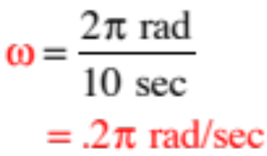
As an additional bit of craziness, if you know the angular velocity about one point on a rotating object, that will be the the angular velocity about ALL points on the object. How so?
Consider a rotating platform with a chair at its center that is rigged to ALWAYS face toward the wall:
You sit in the seat. It takes 10 seconds for the platform to rotate through one complete rotation underneath you.
a.) What does the motion look like from your perspective, assuming a constant angular velocity?
(It will move around you.)
b.) Relative to the axis you are sitting on, what will be the platform’s angular velocity?
18.)

Slide 25






The chair is now placed at the edge of the platform. It is still rigged to always face toward the wall. Just as was the previous case, it takes 10 seconds for the disk to move through one rotation.
You always start facing away from the disk, seeing none of it (looking at the wall).
Following the motion as seen from the perspective of the room:
What you notice is that YOU are moving away from the wall at the start.
BUT from your perspective IN THE CHAIR:
As the disk rotates, you continue to face the wall but the disk begins to come into view on your right. In other words, the disk appears to be rotating around the axis upon which you sit.
19.)

Slide 26
The chair is now placed at the edge of the platform. It is still rigged to always face toward the wall. Just as was the previous case, it takes 10 seconds for the disk to move through one rotation. From your perspective, what does the motion look like, and what is the angular velocity of the disk about your position?
Following the motion as seen by you in the chair at the edge:
You start facing away from the disk, seeing none of it (looking at the wall).
As the disk rotates, you continue to face the wall and the disk begins to come into view on your right. In other words, the disk appears to be rotating around the axis upon which you sit.
19.)

Slide 27


Progression of motion from watcher’s perspective (remember, the watch is ALWAYS facing the wall!).
Time 1
Time 3
And what is the angular velocity of the disk about your vantage point?
Time 2
Time 4
You will sweep out radians in 10 seconds, so you’ll get:
The same as about the central axis!!!!!
20.)

Slide 28
The point: The amount of time it takes the for the platform to rotate around you is the same in both the “center seat” situation and the “edge seat” situation. Additionally, the angular displacement in both cases during one revolution’s worth of time is 2π radians.
Sooooo (in other words), if the object appears to be rotating around you, the angular velocity you observed will be the same no matter where on the platform you are standing.
Translation: If you know the angular velocity of an object about any point on the object, you know the angular velocity about any other point on the object.
21.)

Slide 29


Angular velocity on a disk
(Ms. Dunham’s version)
Let’s look at what a rotation looks like from different points of view (e.g. from the central axis of rotation) based on what we just saw.
Imagine a person sitting on a disk, on a chair that is fixed so that it always faces the same direction. The disk rotates through 1 rotation in 10 seconds. What does the person see?
Wall the chair faces
The person sees the platform rotate around them at $ω=\frac{2π rad}{10 sec}$.
platform as seen
from above

Slide 30
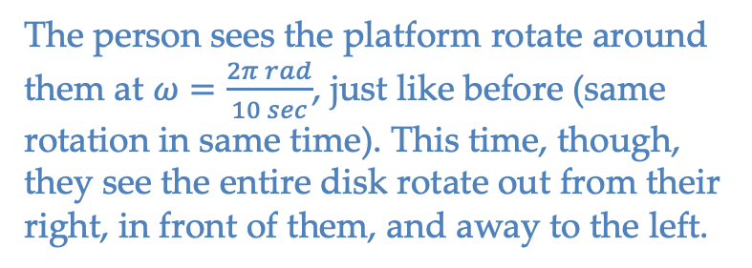
Angular velocity on a disk
Now the chair is placed so that it’s on the edge of the platform, but still faces the same direction at all times. The disk again rotates through one rotation in 10 seconds. Now what does the person experience?
The person sees the platform rotate around them at $ω=\frac{2π rad}{10 sec}$, just like before (same rotation in same time). This time, though, they see the entire disk rotate out from their right, in front of them, and away to the left.
Wall the chair faces
The point is that you could pick ANY point on the disk and observe the rotation from the perspective of that point, and the angular velocity of the disk about that point would be the same as the angular velocity of the disk about any other point on the disk.
platform as seen
from above
EVERY POINT WILL SEE THE SAME ANGULAR VELOCITY ABOUT ITSELF AS EVERY OTHER POINT!

Slide 31
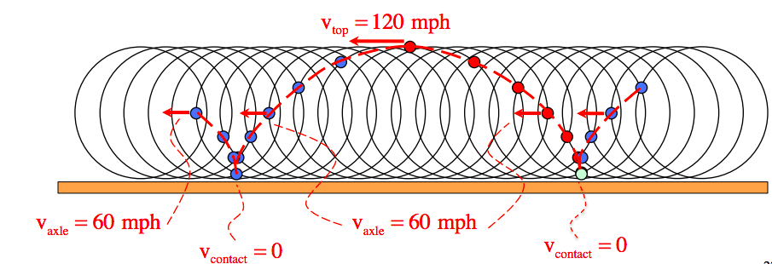
Point of contact on a rolling object
Back to the point on the edge of a wheel – let’s follow it around the wheel as it rotates. We know the point’s velocity is 0 m/s at the point of contact, but what happens as it moves to the “top” of the wheel on, say, a car on the freeway going 60 mph?
When the point reaches the height of the axle, it will be moving at the speed of the car (v=R𝞈). When it reaches the top of the wheel, it will be going twice the speed of the car (v = 2R𝞈). This cycle repeats – crazy!

Slide 32










But why is this important, really?
Consider a ball rolling across a table. It’s center of mass has some velocity and all of the body’s mass is rotation about the center of mass with some angular velocity . So how do we relate those two parameters (and how do we justify that relationship)?
We only have one relationship between the angular velocity of a mass moving in a circular path and its instantaneous velocity in that motion, and that is , but that requires rotation around a fixed point.
But if the contact point of the rolling ball is instantaneously fixed (zero velocity), and if the angular velocity about the center of mass is the same as the angular velocity about that fixed point (instantaneously), then it follows that
This is important!!!
zero velocity point
21.)

Slide 33
Quiz 1
We have now covered what will be on Quiz 1 tomorrow.
Be able to:
  State the rotational counterparts of translational motion (e.g. position, velocity, acceleration) in both systems and how they're related (e.g. v = r𝛚)
  State the rotational kinematic equations and use them to solve problems like the ones from class/in the ppt
  Interpret unit-vector notation for angular velocity and how we determine direction
  Explain any examples we've talked about in class (e.g. rolling about point of contact)
Anything after this slide is not on quiz 1

