Slide 1
General announcements
1.)

Slide 2






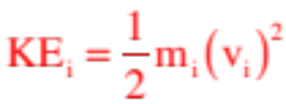
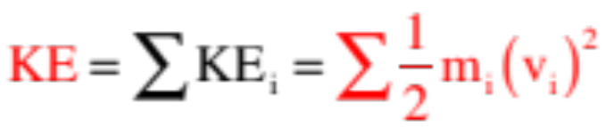

More Minutia: Rotational Inertia
and the Moment of Inertia
There is a rotational counterpart for every translational concept and para-meter out there. So what can we say about the energy content of a rotating disk?
Moved a distance units from the center of a disk rotating with angular velocity and you will find the mass moving with translational velocity . It’s kinetic energy calculates as:
To get the total kinetic energy for the entire mass, this process has to be done for all the masses with the results summed, or.
2.)

Slide 3


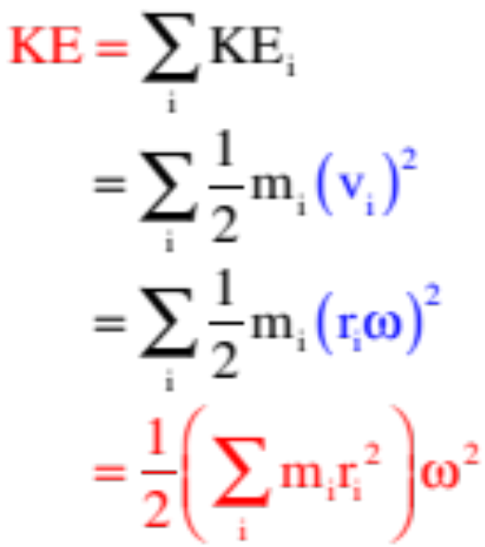


Noting that , we can rewrite that summation yielding:
Comparing this to leaves us with ½ and a velocity term squared, and a mass related term in parentheses.
This mass-related term is . It is called moment of inertia. It is always defined relative to an axis and it is the rotational counterpart to mass . . . which is to say, it is a relative measure of a body’s resistance to changing its rotational motion, or its rotational inertia.
3.)

Slide 4
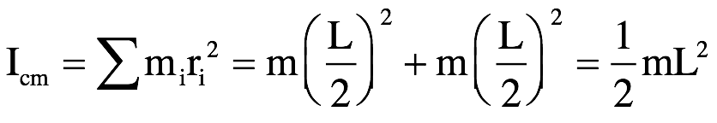
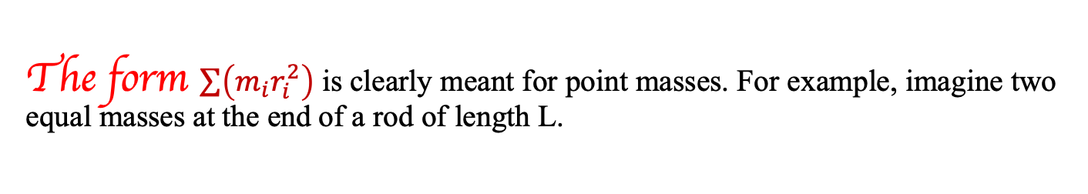
Moment of inertia
The form $\sum{\left(m_{i}r_{i}^{2}\right)}$ is clearly meant for point masses. For example, imagine two equal masses at the end of a rod of length L.
1. Determine the moment of inertia about the central axis for the set-up shown below. Assume the rod is massless and the masses equal in magnitude.
central axis
m
m
L
4.)

Slide 5

Moment of inertia
2. Determine the moment of inertia about an axis through one of the masses as shown. Assume the rod is massless and the masses equal in magnitude.
axis of
interest
m
m
L
5.)

Slide 6
Moment of inertia
3.) Determine the moment of inertia about an axis a length L units to the left of the left mass. Again, assume the rod is massless.
axis of
interest
m
m
L
L
Parting shot: The moment of inertia gets bigger and bigger as you get farther and farther away from the body’s center of mass.
6.)

Slide 7



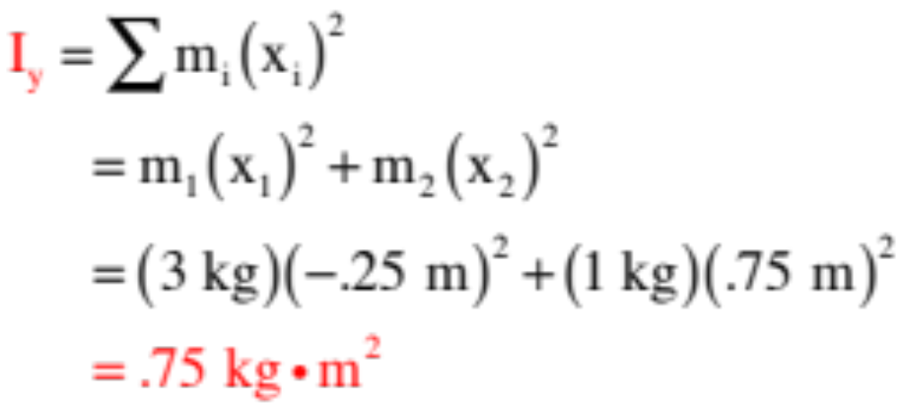



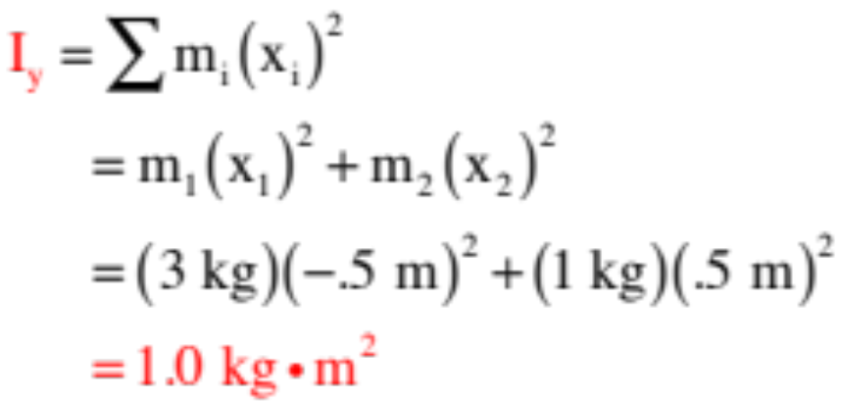


Example 2: Consider two masses m and 3m located a distance 1.0 meter apart. Relative to the coordinate axes shown:
a.) Determine the moment of inertia about the y-axis through the x-axis center of mass:
b.) Determine the moment of inertia about the y-axis as shown:
7.)

Slide 8




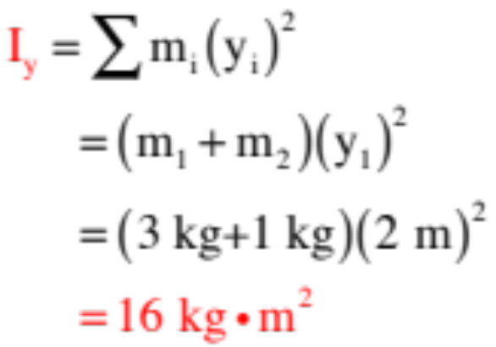



Notice the moment of inertia about the center of mass is smaller than about the other axes denoted. This is always true. is always a minimum.
c.) Determine the moment of inertia about the x-axis:
So what is this approach asking you to do? It is asking that you begin at the axis of interest, proceed outward until you run into some mass, multiply the mass by the distance-out-quantity-squared, and sum
all those quantities up. For this problem, that will look like:
Note: The closer a body is to an axis of rotation, the smaller its moment of inertia is about that axis.
8.)

Slide 9
Reminders about moment of inertia
The moment of inertia is the rotational counterpart to mass.
  Mass is a measure of inertia: more mass means more resistance to acceleration.
  For a rotation, the distribution of mass about the axis of rotation is what matters in terms of resisting angular acceleration
    An object has a given amount of mass--that doesn’t change, but its moment of inertia may be different about different rotational axes (e.g. about one end vs. through center of mass)
When mass is farther from the axis of rotation, the moment of inertia increases.
  Solid disk vs a hoop with the same mass: which has greater I?
The hoop: the mass is concentrated farther out from the axis of rotation (through the center of the disk/hoop). (For your information, I_{hoop} = MR² whereas I_{disk} = ½ MR²)
This means the disk will angularly accelerate more quickly for the same applied torque.
9.)

Slide 10

Things To Know About I
Every object has a moment of inertia expression that allows you to determine its rotational inertia about a particular axis. A greater moment of inertia means it’s harder to change the object’s rotation motion (just like more mass means it’s harder to accelerate an object).
These expressions can be derived using calculus. This is not something you will be tested on.
  You should know that the general form for moment of inertia for a point mass is mr² (where r is the distance between the axis of rotation and the location of the point mass)
  If there are multiple point masses, you just sum their individual I’s.
  For more complicated shapes, you’ll be given the I for that shape (or given everything else and asked to find it—see table on next slide).
If you know the moment of inertia about an axis thru the center of mass and need one about a parallel axis, use the Parallel Axis Theorem (three slides down):
$$I_{parallel}=I_{cm}+Md^{2}$$
10.)

Slide 11
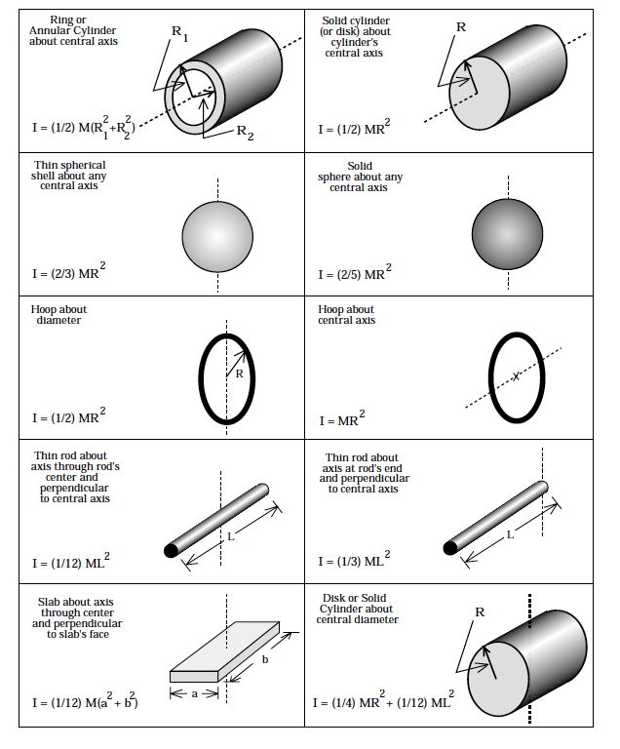


The table from Fletch’s book is shown to the right.
There is a similar table in the Open Stax textbook for the class. Notice that the moment of inertia of a hoop (which is just a very short, thin cylinder) about its central axis is quote as:
just as we surmised. You will not be required to derive any of these quantities, but you will be expected to know what to do with them in a problem when they are provided.
22b.)

Slide 12
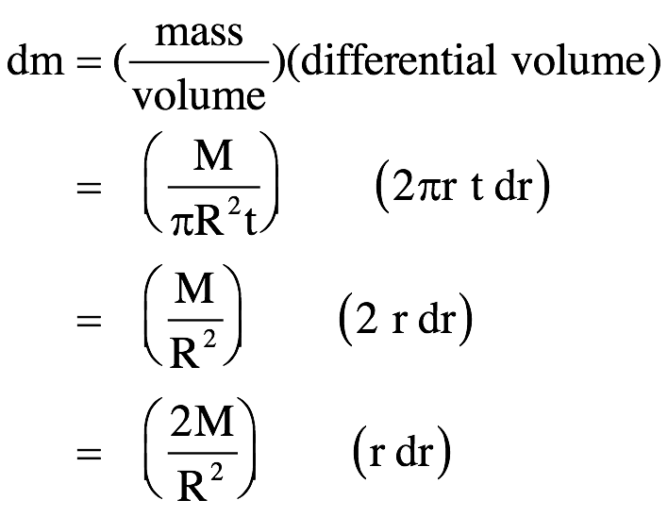
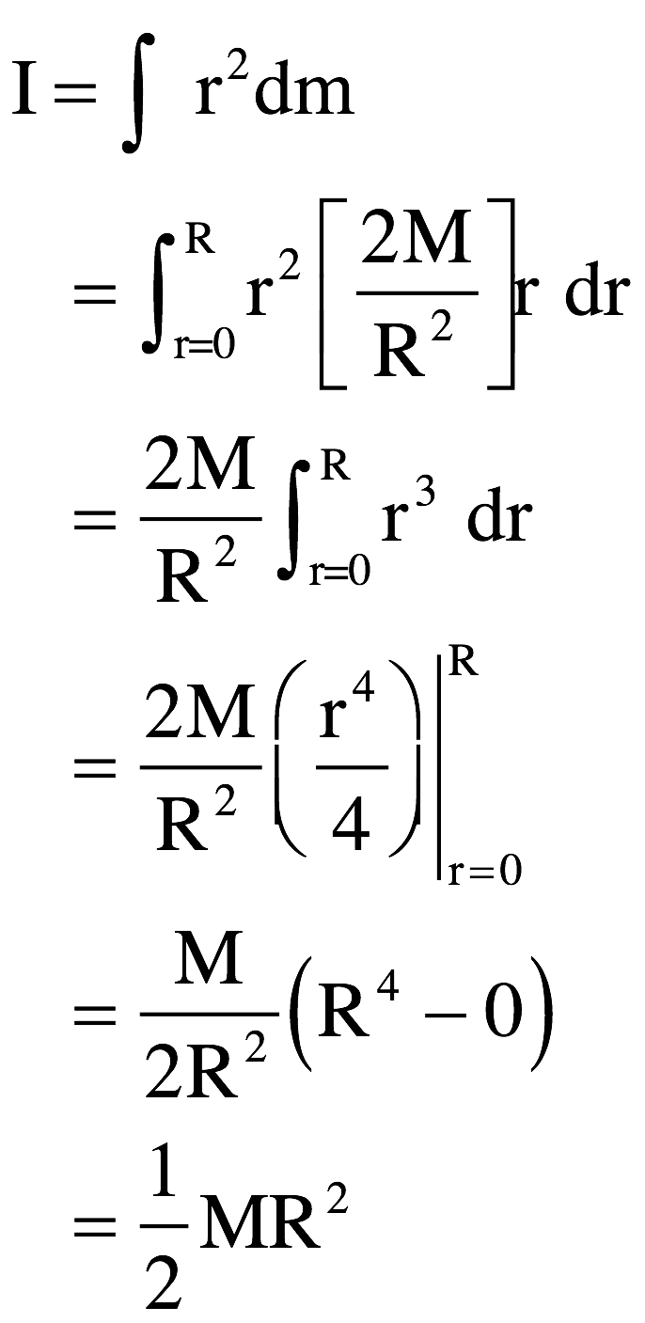
Where does I come from for a disk?
dr
r
So the moment of inertia is:
Example of derivation of moment of inertia for a continuous mass--NOT something you will be tested on!
Disk of mass “m”, radius “R” and thickness “t.”
12.)

Slide 13

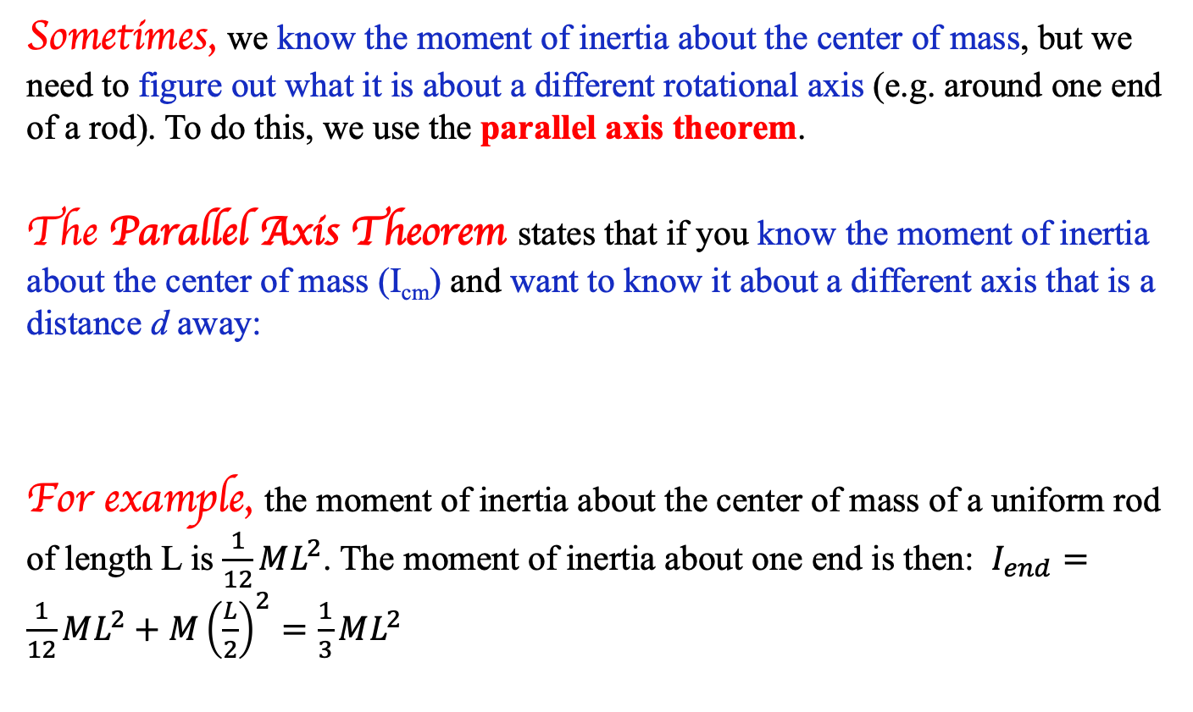
Parallel axis theorem
Sometimes, we know the moment of inertia about the center of mass, but we need to figure out what it is about a different rotational axis (e.g. around one end of a rod). To do this, we use the parallel axis theorem.
The Parallel Axis Theorem states that if you know the moment of inertia about the center of mass (I_{cm}) and want to know it about a different axis that is a distance d away:
For example, the moment of inertia about the center of mass of a uniform rod of length L is $\frac{1}{12}ML^{2}$. The moment of inertia about one end is then: $I_{end}=\frac{1}{12}ML^{2}+M{\left(\frac{L}{2}\right)}^{2}=\frac{1}{3}ML^{2}$
$$I_{parallel}=I_{cm}+Md^{2}$$
13.)

Slide 14
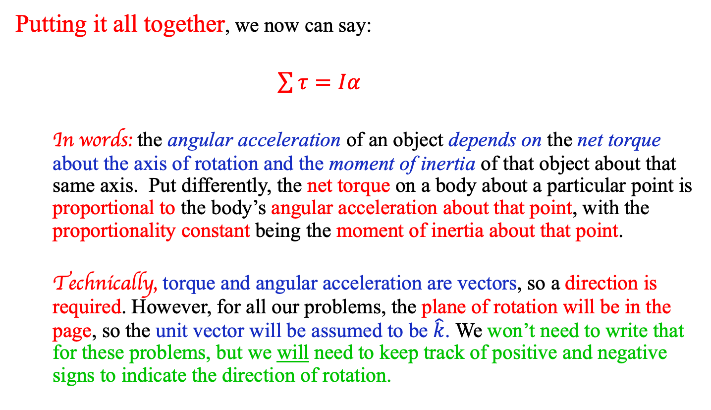
Rotational N2L -- Full Form
Putting it all together, we now can say:
$\sum{τ}=Iα$
  In words: the angular acceleration of an object depends on the net torque about the axis of rotation and the moment of inertia of that object about that same axis. Put differently, the net torque on a body about a particular point is proportional to the body’s angular acceleration about that point, with the proportionality constant being the moment of inertia about that point.
  Technically, torque and angular acceleration are vectors, so a direction is required. However, for all our problems, the plane of rotation will be in the page, so the unit vector will be assumed to be $\hat{k}$. We won’t need to write that for these problems, but we will need to keep track of positive and negative signs to indicate the direction of rotation.
14.)

Slide 15
N2L/I example (8.32)
For the system shown here, what torque around point O is required to produce an angular acceleration of 1.50 rad/sec/sec about:
  A) the x axis
  B) the y axis
  C) the z axis (out of the page)
y
3 kg
2 kg
6 m
O
x
2 kg
4 kg
4 m
15.)

Slide 16
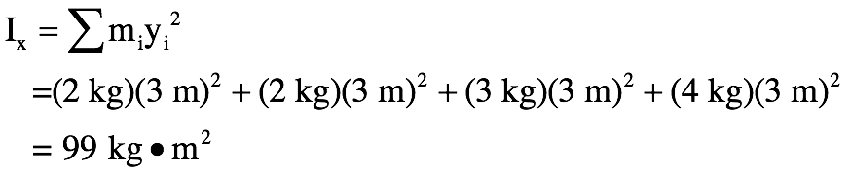

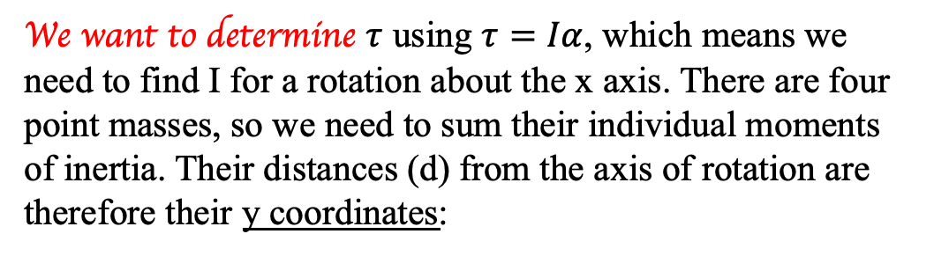
8.32 continued
We want to determine $τ$ using $τ=Iα$, which means we need to find I for a rotation about the x axis. There are four point masses, so we need to sum their individual moments of inertia. Their distances (d) from the axis of rotation are therefore their y coordinates:
y
3 kg
2 kg
6 m
O
x
2 kg
4 kg
4 m
Now, using N2L:
$$τ=I_{x}α=\left(99 kg∙m^{2}\right)\left(1.50\frac{rad}{s^{2}}\right)=149 Nm$$
16.)

Slide 17
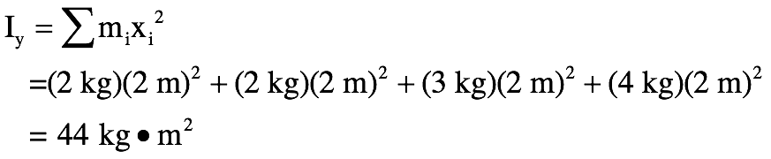
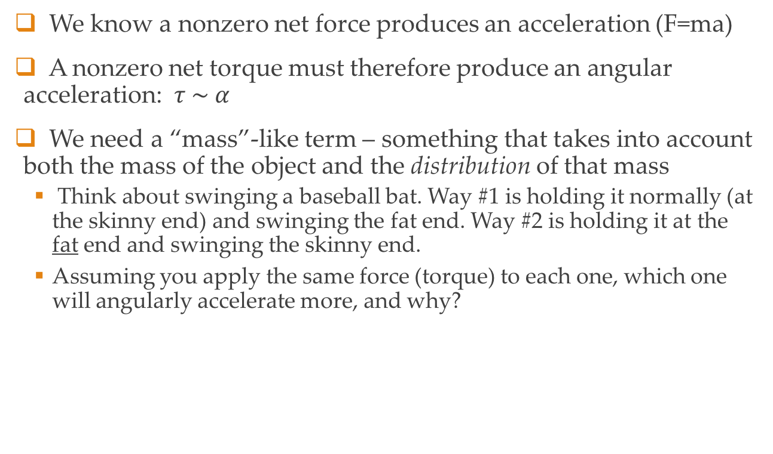
8.32 continued
For a rotation about the y axis, we do the same thing, but now we use each point’s x coordinate as their distances from the axis of rotation:
y
3 kg
2 kg
6 m
O
x
2 kg
4 kg
4 m
Now, using N2L:
$$τ=I_{y}α=\left(44 kg∙m^{2}\right)\left(1.50\frac{rad}{s^{2}}\right)=66 Nm$$
17.)

Slide 18



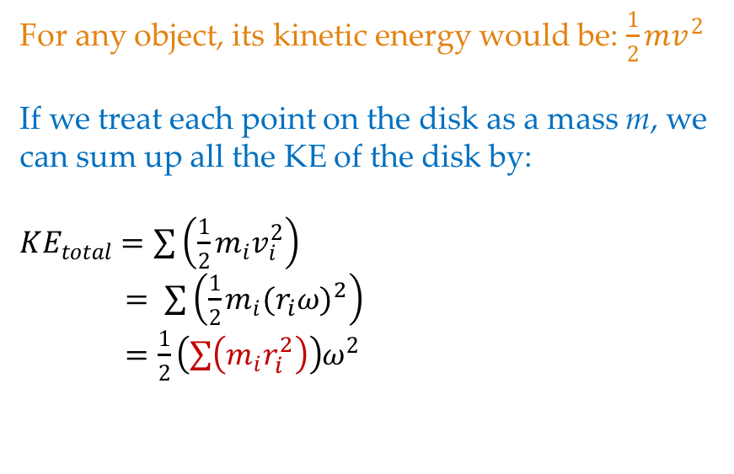
8.32 continued
For a rotation about the z axis, we do the same thing, but finding each mass’s distance from the z axis (out of the page) requires finding the distance to O. Back to our trusty friend Pythagoras…
y
3 kg
2 kg
O
x
3 m
2 kg
4 kg
So for the z axis:
2 m
And finally…
$$τ=I_{z}α=\left(143 kg∙m^{2}\right)\left(1.50\frac{rad}{s^{2}}\right)=215 Nm$$
18.)

Slide 19
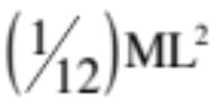



Our lab problem - with a twist! (literally..)
You’ve done a problem in which the tension keeps the rigid body stationary (your lab!). What is the angular acceleration of the beam if the rope is cut, and what is the translational acceleration of a point at the end of the beam?? You may assume the moment of inertia about the beam’s center of mass is (we are leaving off the hanging mass to simplify this)
19.)
1.)

Slide 20





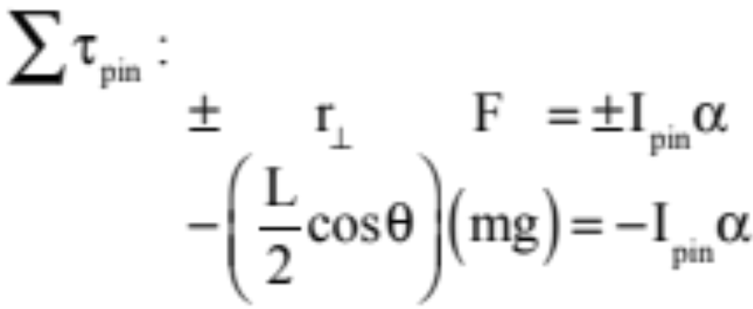
FBD and concepts
Last time, all the torques were balanced as the tension force held the beam steady. Now, when the rope is cut, the beam will start to fall down and rotate clockwise.
H and V are once again through the axis of rotation, so they do not produce a torque. We have two forces that do, so let’s sum the torques about the pin (this will eliminate our need to deal with H and V). Using the moment-arm approach:
20.)

Slide 21

To find the angular acceleration, we need the moment of inertia about the pin. Unfortunately, what we have is I about the beam’s center of mass. To get what we need, we will use what is called the Parallel Axis Theorem:
The Parallel Axis Theorem states that if you want the moment of inertia about an axis PARALLEL to an axis through the center of mass that you know the moment of inertia for, you can get the new moment of inertia by taking the center of mass moment of inertia and adding a fudge factor equal to the object’s mass times the distance D between the two parallel axes squared, or:
Axis thru
c.of m.
secondary
axis
mass M
Remember that “d” in this equation is the distance between the axis through the center of mass and the axis through the point you are interested in. In the case of our ladder problem, the distance between the ladder’s center of mass and the pin is “L/2,” so in this case, that is “d.”
distance d
between
axes
21.)

Slide 22
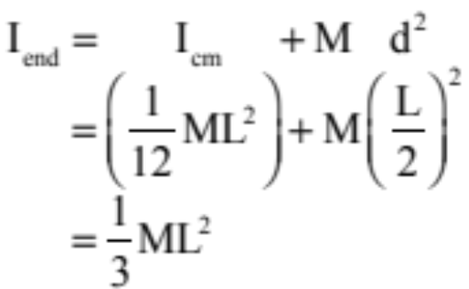
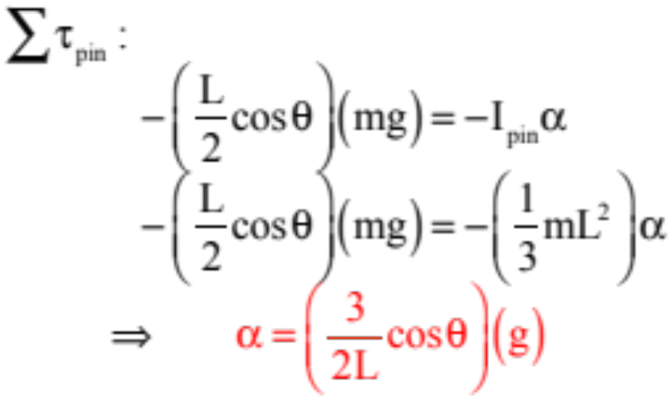
For our ladder problem, remembering that its moment of inertia about its center of mass is given, we can write:
and our Newton’s Law expression becomes:
22.)

Slide 23

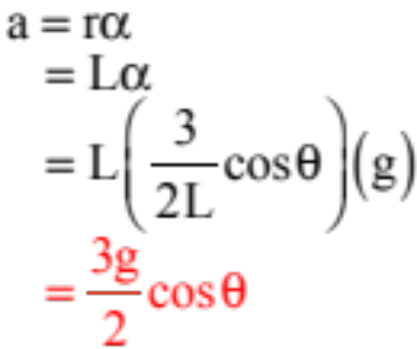

As for the translational acceleration of a point on the beam, we an use:
We want the translational acceleration of a point all the way down the beam at its end. Remembering that the acceleration relationship stated above measures “r” from a “fixed point,” (which in this case would be the pin), r = L for our situation and we can write:
In summary: Use N.S.L., rotational style (sum of the torques, etc.); calculate the right moment of inertia using the parallel axis theorem if needed; use if required.
23.)

Slide 24
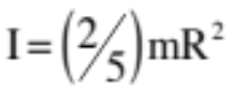

Ball rolling down an incline
Determine the acceleration of the ball as it rolls down the incline. Assume you know the incline’s angle, the ball’s mass and radius, and assume its moment of inertia about its central axis is
How does a ball roll? Something must be required to allow it to rotate about the point of contact – that means keeping the point of contact motionless as the ball rotates around it. What could do that?
24.)

Slide 25
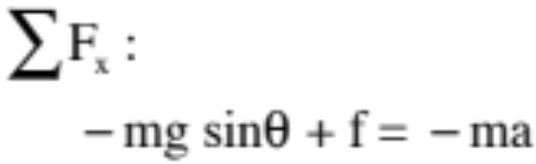
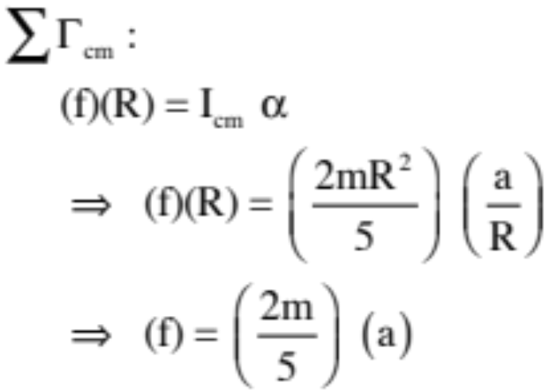

Ball rolling down an incline
For the acceleration of the center of mass, the translational version of N.S.L:
y
x
mg
F_{fs}
N
For the angular acceleration about the center of mass, the rotational version of N.S.L:
$$Στ_{CM}:$$
25.)

Slide 26
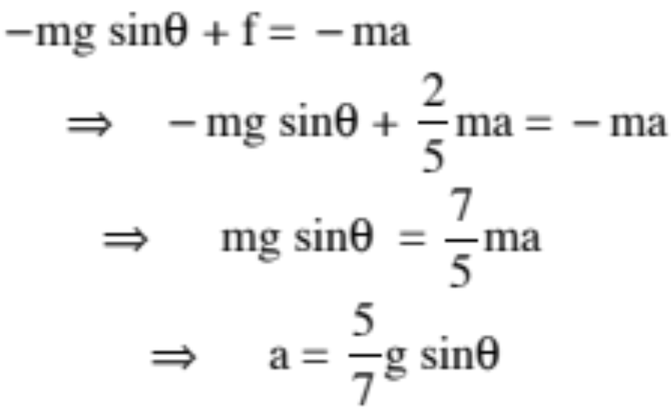
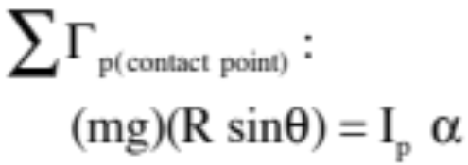
Combining, we get:
But wait! There’s another way! What if we found the angular acceleration about the contact point?
If we were to sum the torques about the contact point (which is, instantaneously, a fixed point), we would get (see next page for justification):
26.)

Slide 27






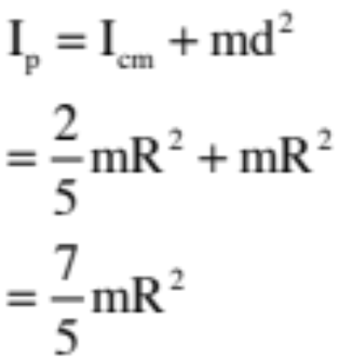



Alternate Balling rolling Problem
From previous page:
To finish this off, we need to know the moment of inertia about the contact point “p” and the relationship between the acceleration of the center of mass and the angular acceleration of the ball about the contact point.
Using the Parallel Axis Theorem, we can write:
Note: is the shortest distance between the “line of force” and point about which torque is being taken . . .
27.)
6.)

Slide 28
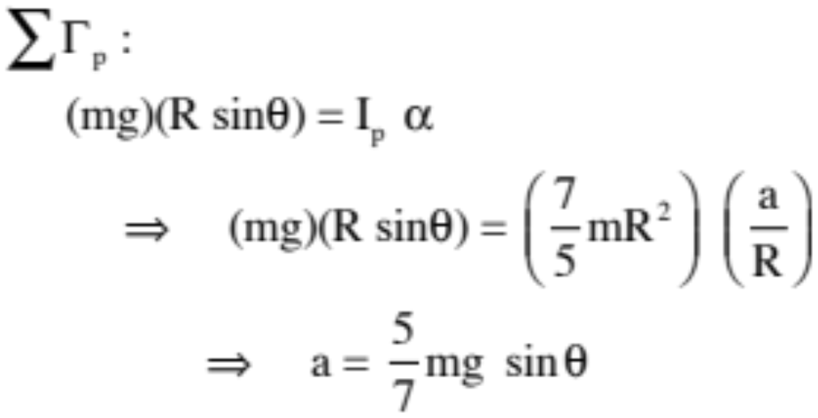
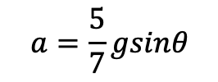

With the moment of inertia from the parallel axis theorem and the known relationship between the angular acceleration and the acceleration of the center of mass, we can write:
$$Στ_{p}:$$
$$a=\frac{5}{7}gsinθ$$
We get the exact same answer, which makes sense as no matter what the axis of rotation, the angular acceleration of the object about itself should be the same.
The moral of the story is that in almost all of these problems, you can attack from the perspective of the center of mass or from a fixed point, pure rotation perspective.
28.)

Slide 29

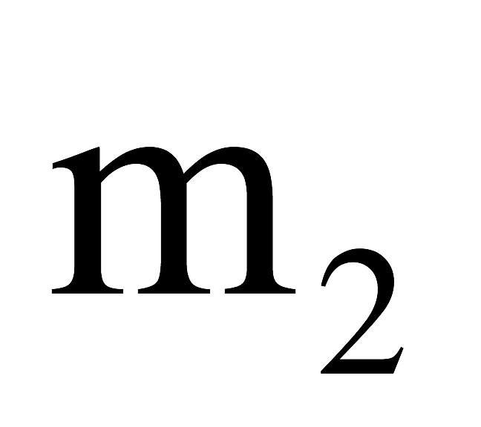
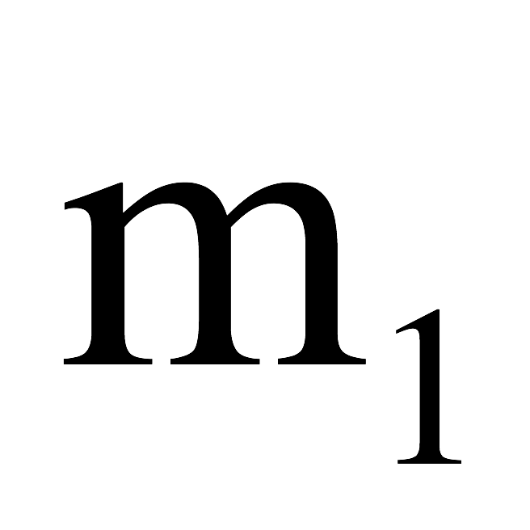
Atwood machine problem
A mass m₁ is attached to a rope that is threaded over a massive pulley and attached to a second mass m₂. If the pulley’s mass is “M,” its radius “R” and its moment of inertia about its center of mass is 0.5MR², determine both the angular acceleration of the pulley and the acceleration of each of the masses.
To start: think about what assumptions we made in the past in order to do this problem. Why did we do that? Can we still make those assumptions now?
29.)

Slide 30

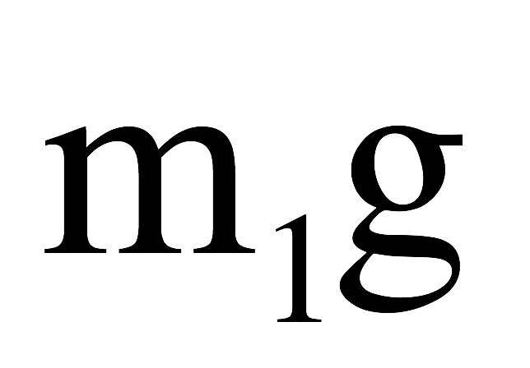
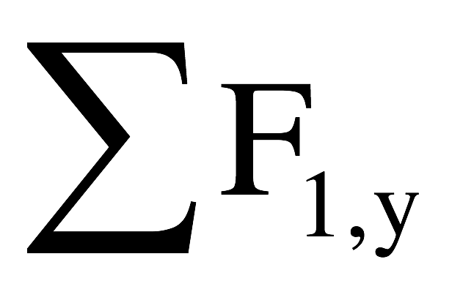
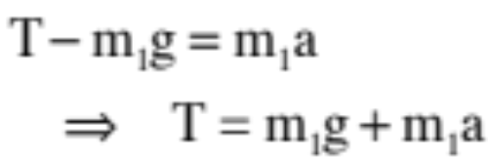
To get a feel for the intricacies of this problem, let’s do it first on the assumption the the pulley is NOT massive. In that case, Newton’s Second Law applied to each mass and we can write:
f.b.d. on m₁ :
So:
30.)

Slide 31
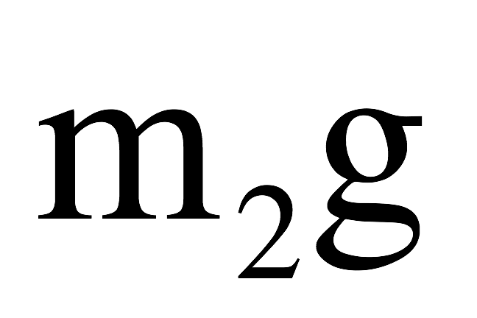
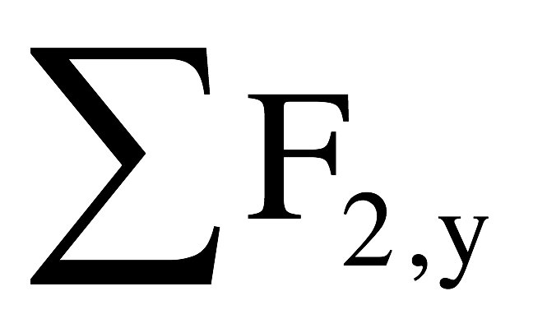
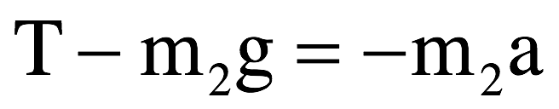
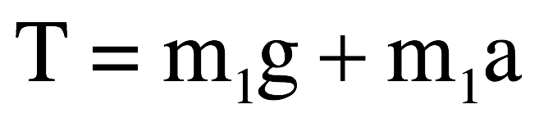
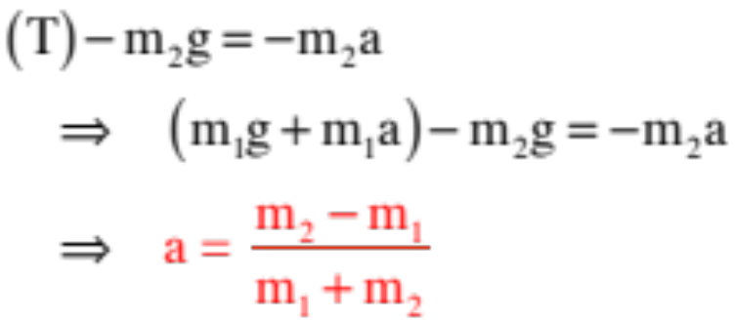
f.b.d. on m₂:
So:
From the previous page,
so we can write:
Notice that we are able to assume the tension on both sides of the pulley is the same. This is the consequence of the fact that the pulley is assumed to be massless.
If that hadn’t been the case, a net torque would have been required to make the pulley rotate. That could only come if the tension forces on either side of the pulley were imbalanced.
g
31.)

Slide 32

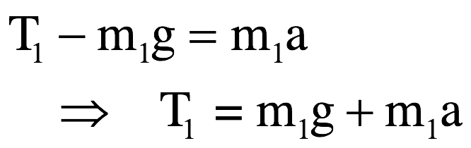
Now let’s look at the situation assuming the pulley is massive. In that case, the only difference is that the tensions are different on either side of the pulley (this has to be so so the torque sum about the pulley’s center of mass is not zero). Writing, we get:
f.b.d. on m₁ :
So:
32.)

Slide 33

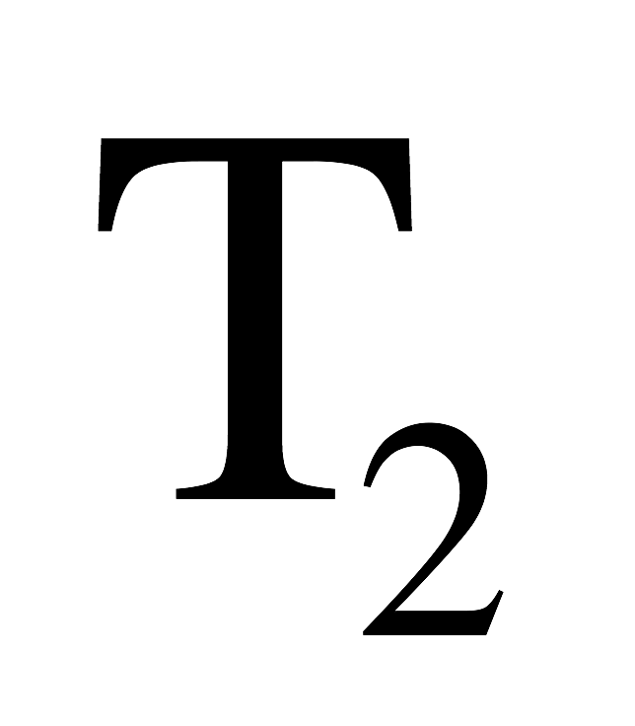
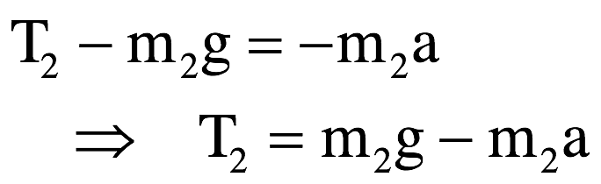
f.b.d. on :
So:
At this point, we have three unknowns, the two tensions and the acceleration “a.” We need another equation. ENTER SUMMING THE TORQUES ABOUT THE PULLEY’S CENTER OF MASS.
33.)

Slide 34
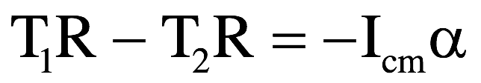


f.b.d. on pulley (ignoring forces at the pin):
So:
Has to be negative because it’s rotating clockwise!
$$Στ_{CM}:$$
At this point, we have FOUR unknowns, the two tensions, the acceleration “a” and the angular acceleration 𝛂. Once again, we need another equation. That relationship connects the angular acceleration about the pulley’s center of mass to the translational acceleration of a point on the pulley’s edge (this will be the same as the translational acceleration of the string and, hence, the masses). In other words, we need:
34.)

Slide 35
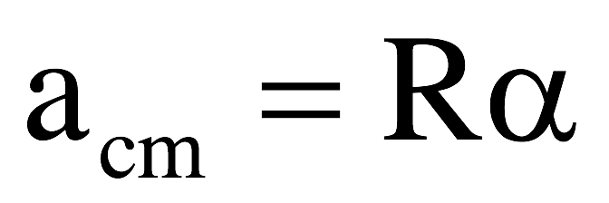
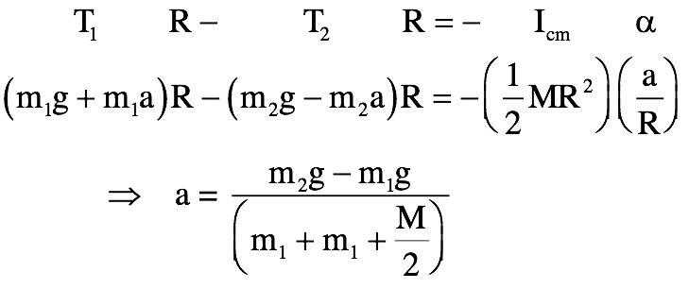
We now have four equations:
Equ. A
Equ. B
Equ. C
Equ. D
Substituting Equ. A, B and D into C, we get:
₂
Note that with the exception of the presence of the “M” term, this is exactly the same relationship you got with the massless pulley analysis.
35.)

Slide 36

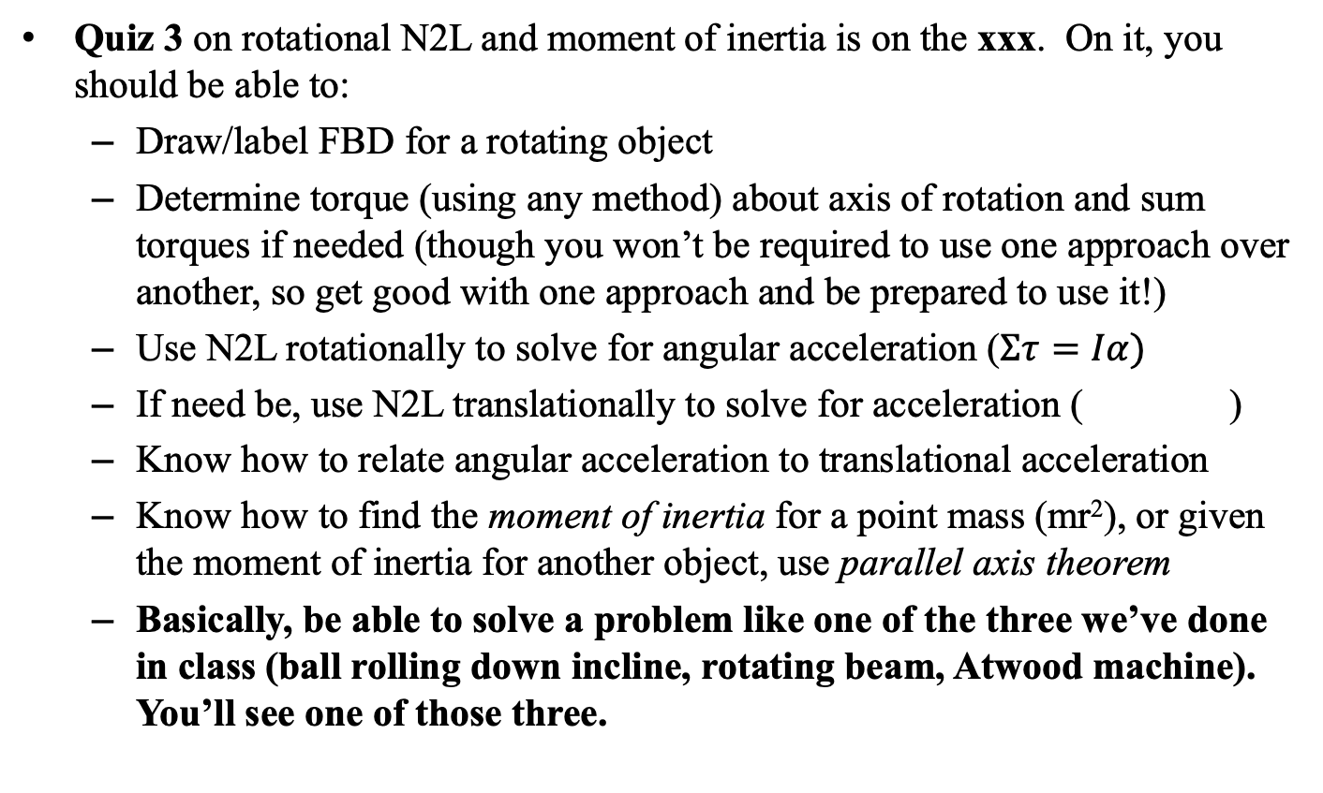
General Information
Quiz 3 on rotational N2L and moment of inertia is on the xxx. On it, you should be able to:
  Draw/label FBD for a rotating object
  Determine torque (using any method) about axis of rotation and sum torques if needed (though you won’t be required to use one approach over another, so get good with one approach and be prepared to use it!)
  Use N2L rotationally to solve for angular acceleration ($Στ=Iα)$
  If need be, use N2L translationally to solve for acceleration ( )
  Know how to relate angular acceleration to translational acceleration
  Know how to find the moment of inertia for a point mass (mr²), or given the moment of inertia for another object, use parallel axis theorem
  Basically, be able to solve a problem like one of the three we’ve done in class (ball rolling down incline, rotating beam, Atwood machine). You’ll see one of those three.
36.)

