Slide 1
General announcements
This section is on ENERGY
1.)

Slide 2


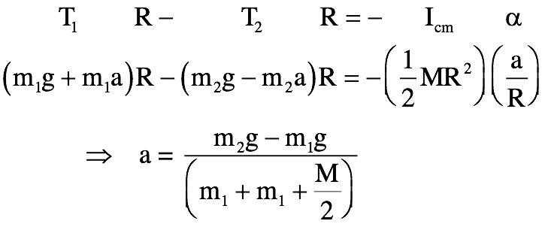
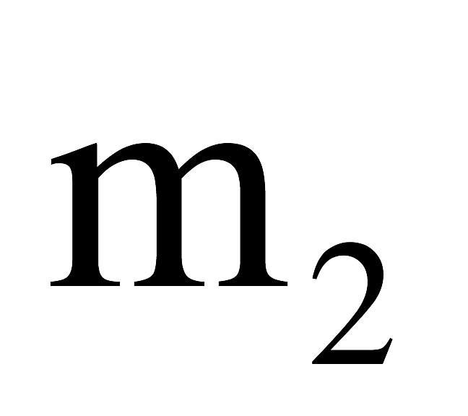
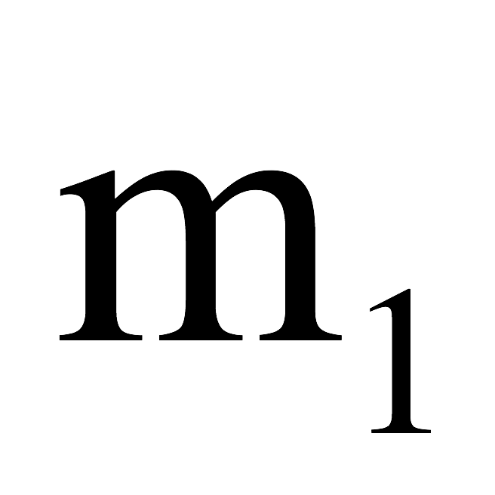
Revisiting the Atwood machine problem
Recall: A mass m₁ is attached to a rope that is threaded over a massive pulley and attached to a second mass m₂. If the pulley’s mass is “M,” its radius “R” and its moment of inertia about its center of mass is 0.5MR², determine both the angular acceleration of the pulley and the acceleration of each of the masses.
In a nutshell:
₂
We found that when the pulley’s mass is taken into account, the acceleration of the system is smaller than it was when we ignored it because some of the force had to go into motivating the extra mass wrapped up on the pulley. This extra drag caused the acceleration to be a little less.
2.)

Slide 3
What does this tell us?
When we take into account the rotation of the pulley in this situation, the acceleration of the hanging mass is less than when we assumed the pulley was massless. This makes sense, because more mass has been put into motion (the pulley + the hanging masses) by the same motivating force(s).
We can also look at this from an energy perspective.
  At the start, the system has gravitational PE due to the hanging masses’ positions above the ground
  As the pulley begins to rotate and the masses fall, some of the PE transfers into the translational KE of the masses. However, some of that PE also has to transfer into the rotational motion of the pulley.
  There is rotational KE as well as translational KE that has to be taken into account!
    This is why the acceleration of the hanging masses is less than before – the pulley itself is now interacting with the string and hanging masses, impeding their motion
3.)

Slide 4

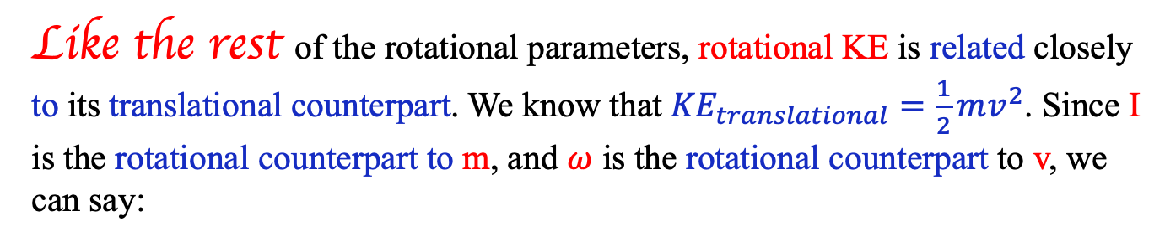
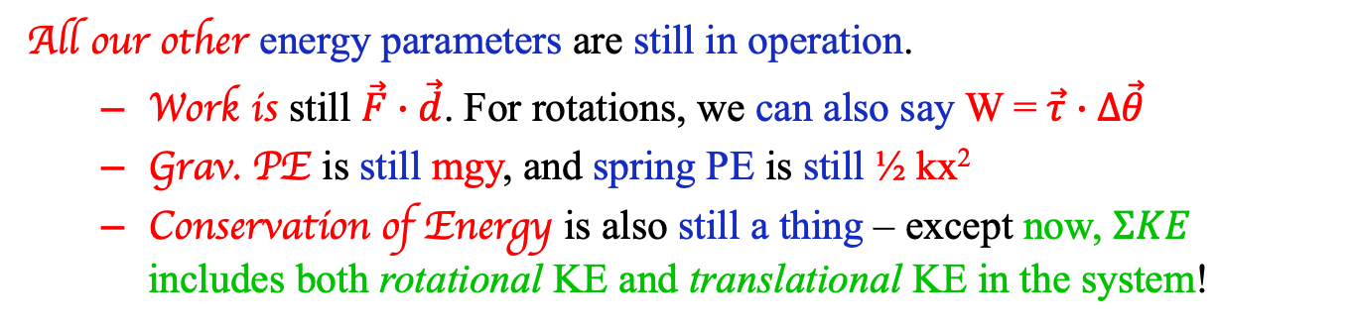
Rotational KE
Like the rest of the rotational parameters, rotational KE is related closely to its translational counterpart. We know that ${KE}_{translational}=\frac{1}{2}mv^{2}$. Since I is the rotational counterpart to m, and $ω$ is the rotational counterpart to v, we can say:
$${KE}_{rotational}=\frac{1}{2}Iω^{2}$$
All our other energy parameters are still in operation.
  Work is still $\vec{F}∙\vec{d}$. For rotations, we can also say W = $\vec{τ}∙Δ\vec{θ}$
  Grav. PE is still mgy, and spring PE is still ½ kx²
  Conservation of Energy is also still a thing – except now, $ΣKE$ includes both rotational KE and translational KE in the system!
4.)

Slide 5

Conservation of Energy
Now, taking both translational and rotational motion into account, conservation of energy looks like:
$$ΣK_{i}+ΣU_{i}+W_{ext}=ΣK_{f}+ΣU_{f}$$
$${ΣK}_{rotational, final}+{ΣK}_{translational, final}$$
$${ΣK}_{rotational, initial}+{ΣK}_{translational, initial}$$
Note that objects that are both rotating and translating have both types of KE!
Examples: ball rolling down a ramp, wheel rolling across ground, etc.
5.)

Slide 6






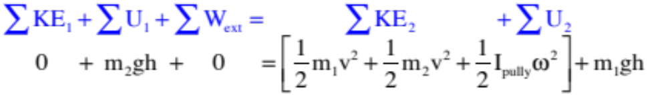

So how fast are the hanging masses moving after they have traversed a distance h?
This is a conservation of energy problem. Defining the zero-potential energy levels, then writing out the governing equation for the system without solving yields:
So two morals here are:
1.) The tension on either side of a massive pulley is different; and
2.) You can assign each mass its own zero potential energy level for gravity (near the surface of the earth), independent of any other mass in the system.
3.) Although it may not be obvious at first glance, the extraneous work done by the two tensions added to the work done by the torque produced by those tensions on the pulley will add to zero (that’s why is zero).
6.)

Slide 7
Quick moment of inertia question
Consider the following shapes: a hoop (I = MR²), a solid sphere (I = 2/5 MR²), a solid cylinder (I = ½ MR²), and a thin shelled sphere (I = 2/3 MR²). All four have the same mass and same radius, and are released from rest at the top of a ramp.
Rank the bodies from highest to lowest acceleration down the ramp. Explain.
Rank the spheres from highest to lowest rotational KE down the ramp. Explain.
Greater moment of inertia means less angular acceleration, therefore less translational acceleration (because a = r𝛂). So, highest acceleration is least I and: solid sphere > solid cylinder > thin shell sphere > hoop
All start with the same PE, so their total E is equal. As they roll, some E goes to rotational KE, some to translational KE. Energy devoted to translational motion turns into accelerating the body, so the slowest object has the most ROTATIONAL KE: hoop > thin shell sphere > cylinder > sphere
7.)

Slide 8
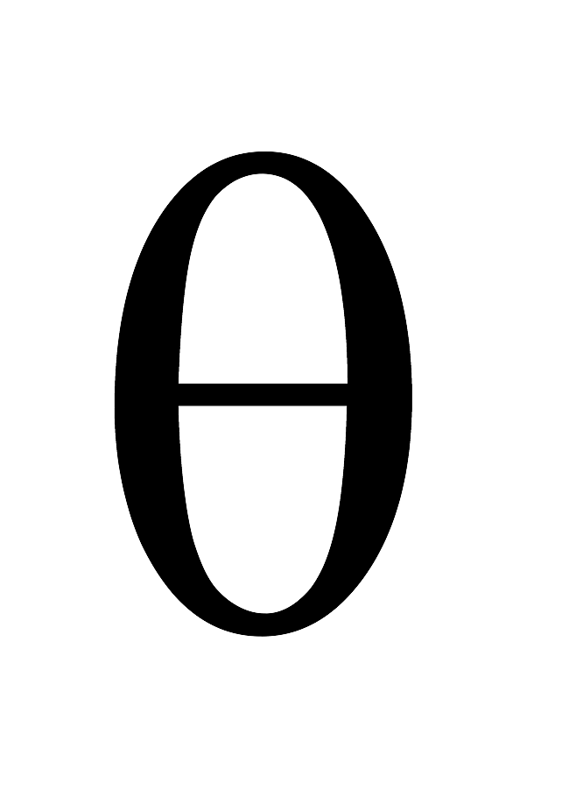
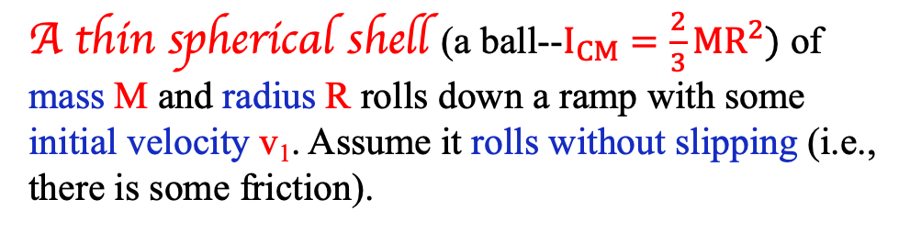
Ball rolling down ramp – now with energy!
A thin spherical shell (a ball--$I_{CM}=\frac{2}{3}MR^{2})$ of mass M and radius R rolls down a ramp with some initial velocity v₁. Assume it rolls without slipping (i.e., there is some friction).
a.) How fast is it moving once it’s dropped a vertical distance h? (or this could ask, “after the ball had traveled a distance d?”
b.) How does that velocity compare to a block on a similar but frictionless incline when the block drops the same distance and has the same initial v_{i}?
8.)

Slide 9
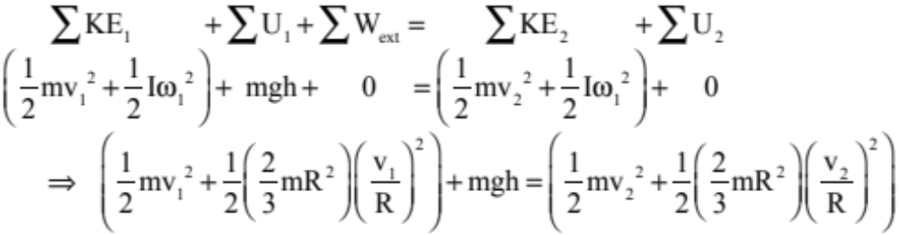
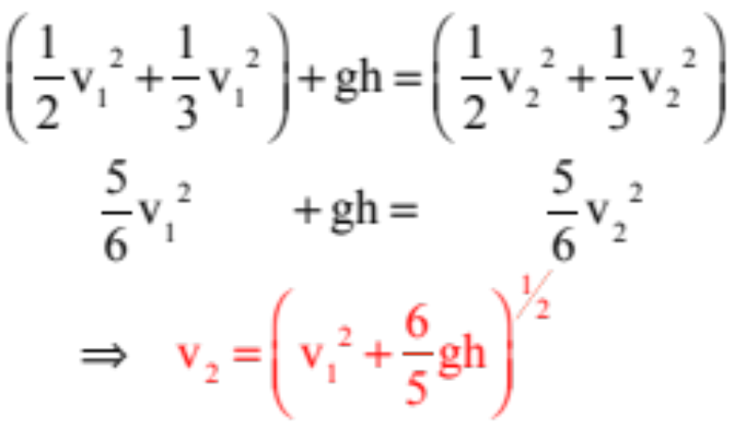
Let’s start with the Conservation of Energy equation, with all its terms:
h
h=0
Canceling the M and R terms leaves us with:
9.)

Slide 10
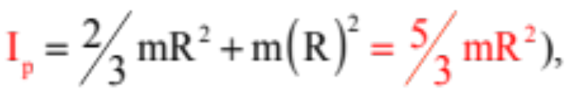
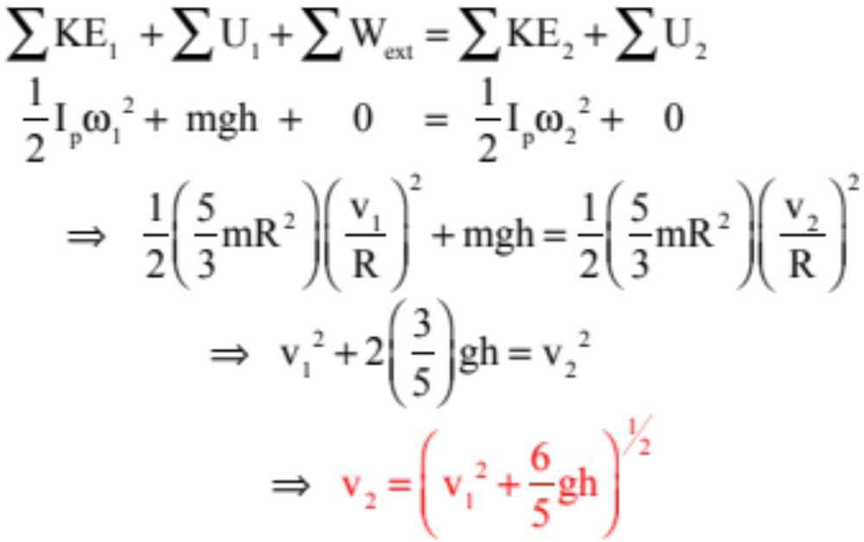
Note that we could have taken the “fixed point, instantaneous pure rotation” perspective with this problem and, with the Parallel Axis Theorem ( written the kinetic energy relationship thinking of the ball as though it was executing a pure rotation (instantaneously) about its contact point. That equation would have looked like:
h
h=0
Even though it’s the same, the reasonable way to approach this is from the center of mass perspective!
10.)

Slide 11
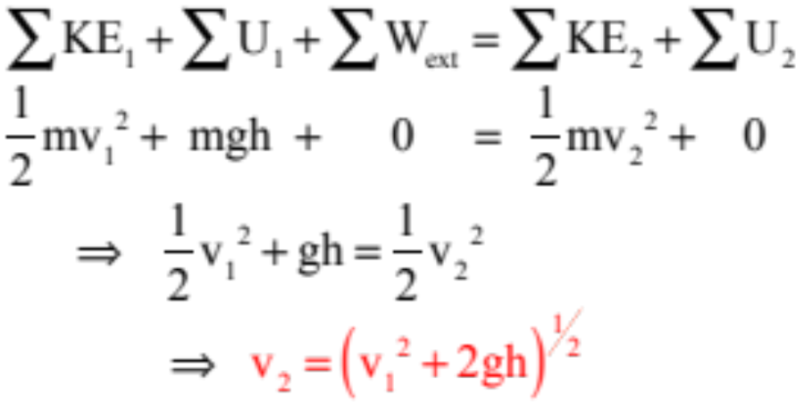
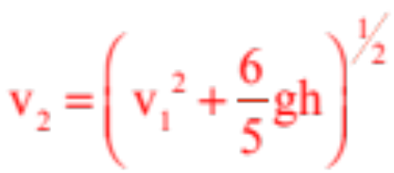
Block sliding down ramp
How does this compare to a non-rolling object:
From previous slide, v₁ with rotation:
Notice that when an object is rotating as well as translating, its total (kinetic) energy is split between the two modes of motion. How much rotational KE there is compared to translational KE will depend on the moment of inertia of the object.
11.)

Slide 12





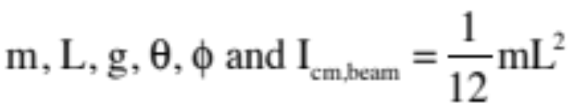


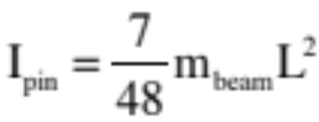

Example 11: So let’s go back to the swinging beam of length L pinned at an angle a quarter of the way up the beam (i.e., at L/4). The cable is cut and the beam swings down. What is the velocity of it’s center of mass as it passes through its lowest point. We know:
pin
and we used the Parallel Axis Theorem to calculate earlier the moment of inertia about the pin as:
In this case, the object is rotating about the pin, so it makes sense to evaluate its motion relative to the fixed axis at the pin. Tracking the center of mass drop for potential energy positions (see sketch), we can write:
12.)

Slide 13
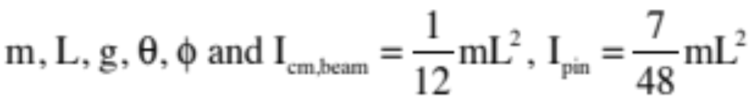
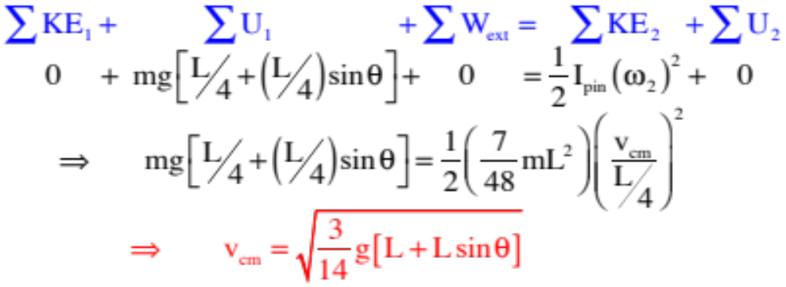
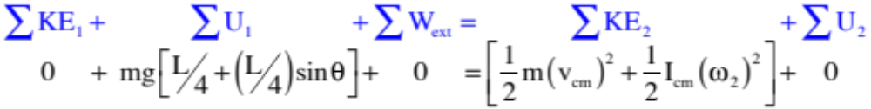
We could have looked at this from the perspective of the center of mass. That would look like:
Try the math. It will yields the same result.
13.)

Slide 14

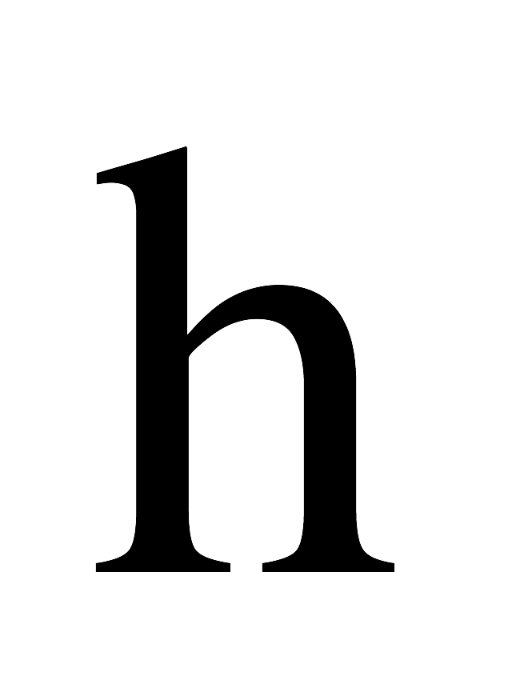
Problem 8.52: dropping bucket
A 3 kg pail is attached to a rope wound around a 5.0 kg spool of radius 0.6 meter. The pail is released and falls 4.0 vertical meters.
a.) Write the equations you’d need to determine the acceleration of the bucket. (in terms of m_{pail}, m_{spool}, R, h, g)
b.) Using energy considerations (NOT the acceleration from Part a), find the velocity of the pail after it has fallen a distance “h,” which you can make equal to 4.0 vertical meters once you have done the problem algebraically.
14.)

Slide 15
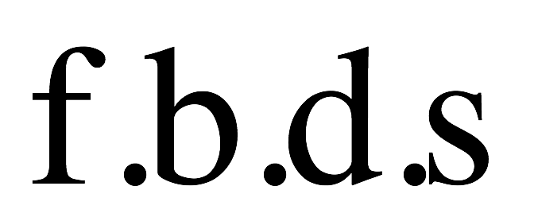

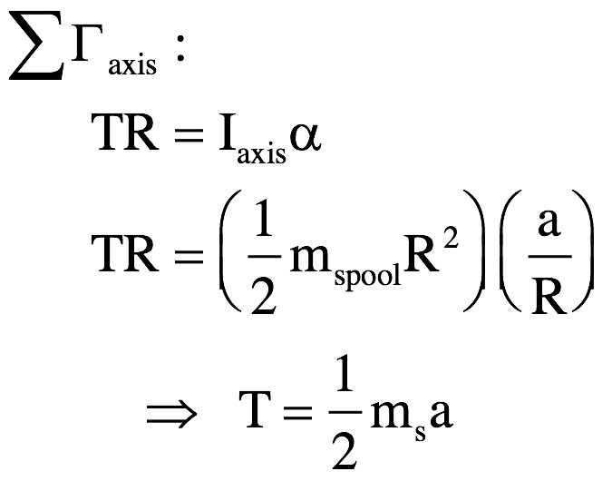

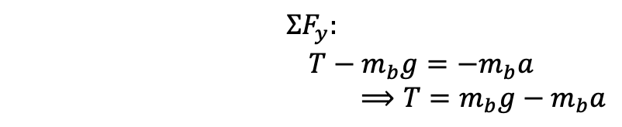
Bucket problem
To find the acceleration (using variables), draw some fbd’s, sum the forces in the y-direction and sum the torques about the axis of rotation:
$$ΣF_{y}:$$
$$T−m_{b}g=−m_{b}a$$
$⟹T=m_{b}g−m_{b}a$
$$Στ_{axis}:$$
m_{s}g
m_{b}g
Now, combine them:
$$m_{b}g−m_{b}a=\frac{1}{2}m_{s}a$$
$$a=\frac{m_{b}g}{m_{b}+\frac{1}{2}m_{s}}$$
$$=\frac{(3kg)(9.8\frac{m}{s^{2}})}{3kg+\frac{1}{2}(5kg)}=5.35 m/s^{2}$$
15.)

Slide 16
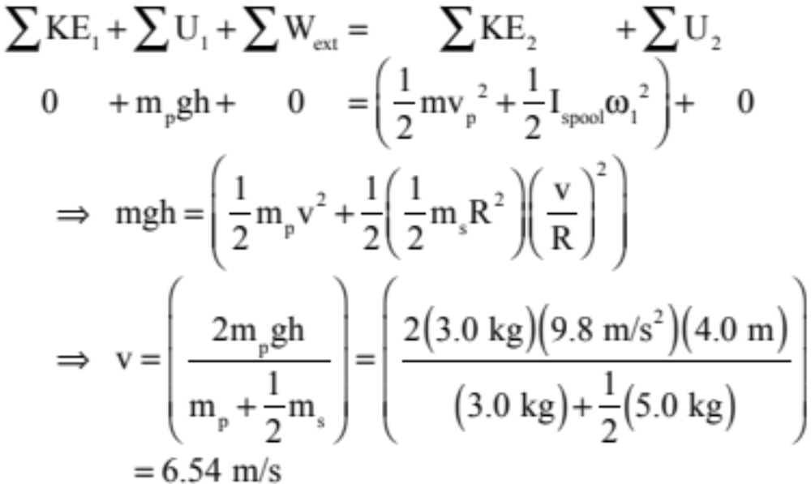
Bucket problem (con’t.)
Now, use conservation of energy to determine the velocity of the pail after it has fallen h = 4 meters:
Note that using the acceleration from Part a and a combination of kinematic equations (which we could use as the angular acceleration is constant), we get v = 6.54 m/s also – same answer both ways!
16.)

Slide 17
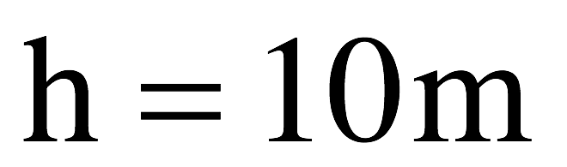
Swinging beam…now with energy!
A giant swing consists of a M = 365 kg, L = 10 meter long arm with two “massless” seats at its end. Consider the swing as a uniform bar, with I_{cm} = 1/12 ML².
Problem 8.53
a.) Relative to the chair’s lowest point, where’s the center-of-mass of the arm?
b.) What’s the potential energy when at some angle above the lowest point?
c.) What’s the potential energy at the bottom of the arc?
d.) What’s the speed of the chairs at the bottom of the arc?
17.)

Slide 18


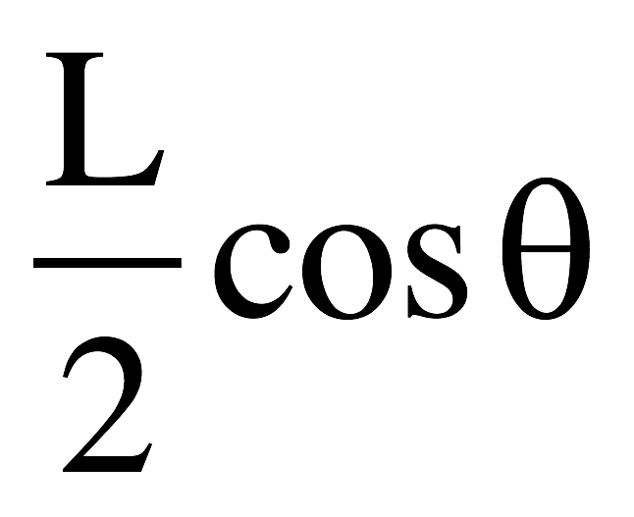

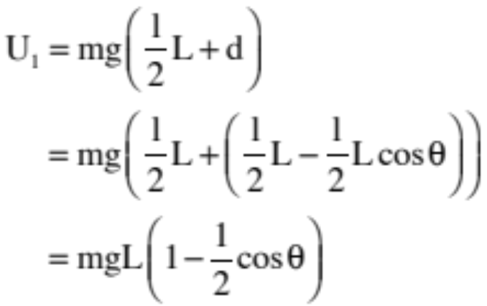
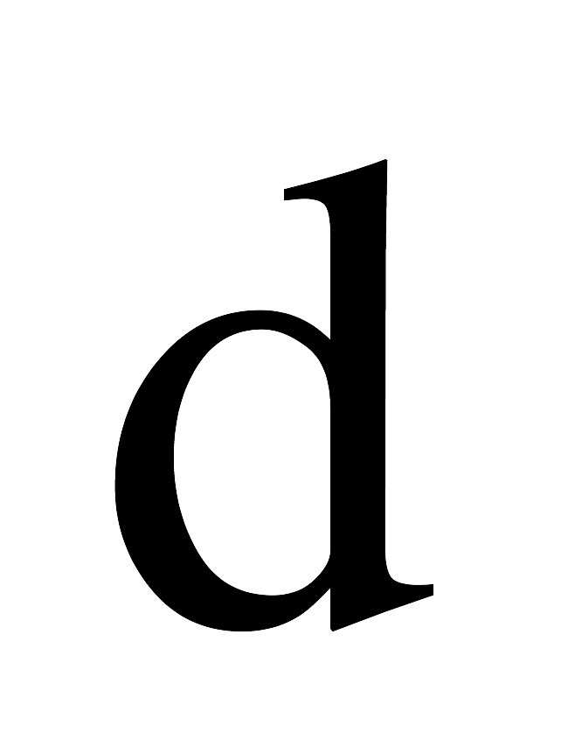
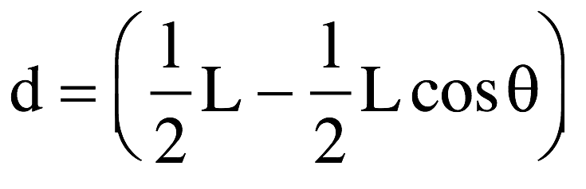
a.) Relative to the chair’s lowest point, where’s the center-of-mass of the arm?
The center of mass will be halfway down as the chairs are massless.
y_{cm} = L/2
b.) What’s the potential energy when at some angle above the lowest point?
We measure U from the center of mass – its displacement gives us the h we need here
c.) What’s the potential energy at the bottom of the arc?
U_{bottom} = mgh(L/2)
18.)

Slide 19
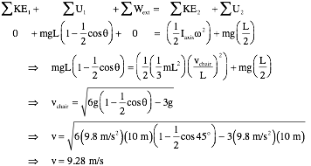
Remember to consider what moment of inertia you have vs. what you need:
I_{pin} = I_{cm} + md² = 1/12 ML² + M(L/2)²
d.) What’s the speed of the chairs at the bottom of the arc?
Now we get to put it together and use energy considerations:
19.)

