Slide 1
General announcements
1.)

Slide 2
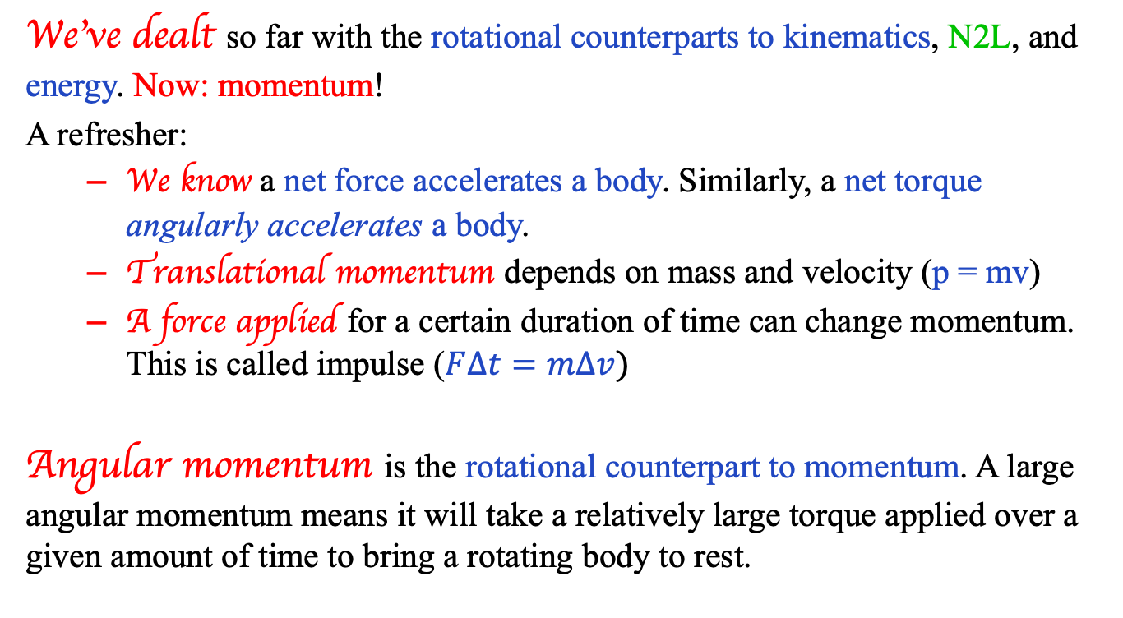
What’s left?
We’ve dealt so far with the rotational counterparts to kinematics, N2L, and energy. Now: momentum!
A refresher:
  We know a net force accelerates a body. Similarly, a net torque angularly accelerates a body.
  Translational momentum depends on mass and velocity (p = mv)
  A force applied for a certain duration of time can change momentum. This is called impulse ($F∆t=m∆v)$
Angular momentum is the rotational counterpart to momentum. A large angular momentum means it will take a relatively large torque applied over a given amount of time to bring a rotating body to rest.
2.)

Slide 3
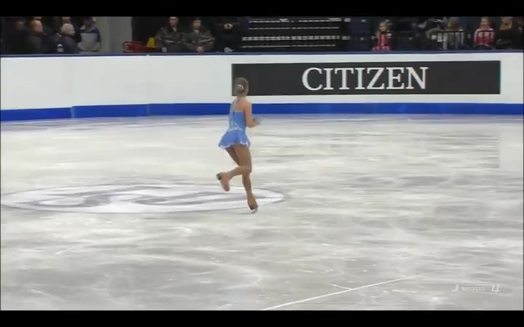
Change your orientation, you change your motion . . . (courtesy of Yulia Lipnitskaya
1.)
3.)

Slide 4
The Island Series:
You have been kidnapped by a crazed physics nerd and left on an island with twenty-four hours to solve the following problem. Solve the problem and you get to leave. Don’t solve the problem and you don’t.
The problem: You are on a street walking a bicycle toward a curb. You want to lift the bike by its seat up and over the curb without having the front tire flopping around as you do it. Your task is to divine a maneuver that will insure the wheel stays straight.
4.)

Slide 5

Solution to Island Problem
Just before you get to the curb, accelerate the bike so the front wheel is rotating as fast as possible. The front wheel’s large angular momentum vector, directed along the wheel’s axle, will keep the wheel orientated as set. That is, as long as there are no external torques acting, the wheel will keep its orientation just as a gyroscope keeps its.
angular momentum
5.)

Slide 6
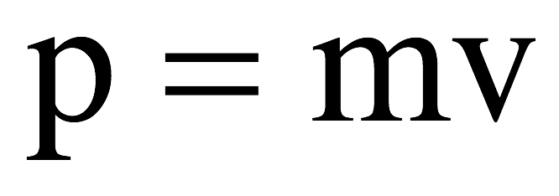
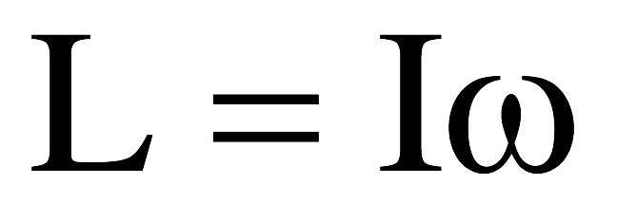
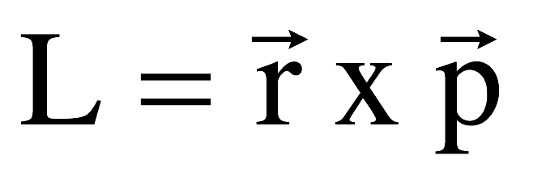
Angular momentum
Translational motion: Rotational motion:
momentum
angular momentum
For momentum, if all the forces acting on a group of particles are zero or are internal to the system, momentum is said to be conserved.
Likewise, if all the torques acting on a group of particles (or just one) are zero or are internal to the system, then angular momentum is said to be conserved.
6.)

Slide 7







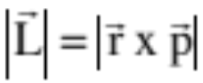

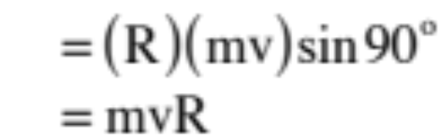

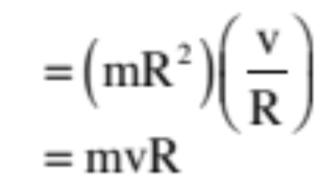

There is a lot here. To make life easier, we are going to go after these ideas in pieces.
Example 1: A point mass m moves with velocity v in a circular path of radius R. Determine its angular momentum using:
a.) Translational parameters:
Note the direction of the cross product!
b.) Rotational parameters:
Note: the direction of the angular momentum is perpendicular to the plane of the motion ( direction), as would be expected of a counterclockwise rotation.
7.)

Slide 8
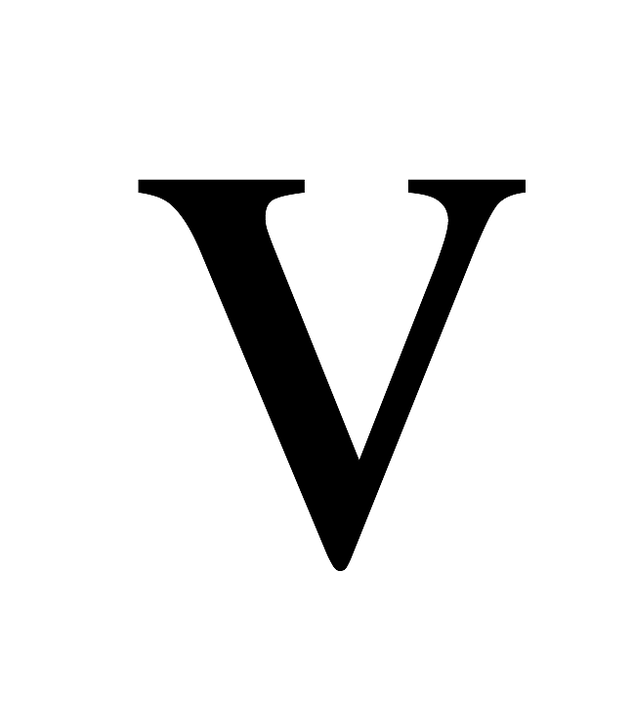
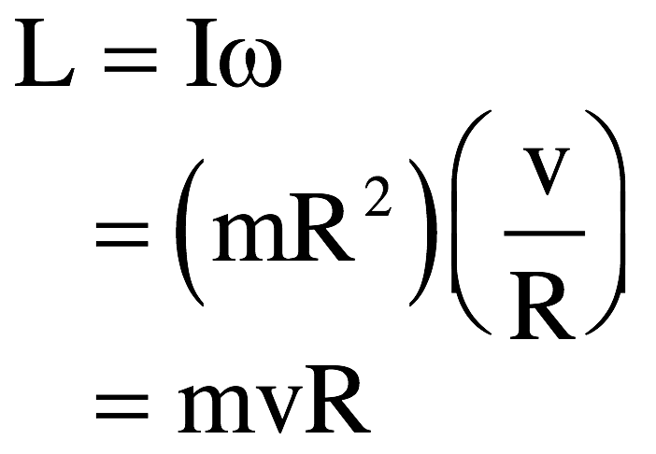


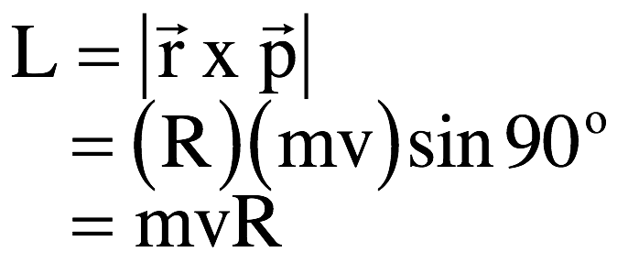
Angular momentum example (Ms Dunham’s version)
Example: A point mass m circles a fixed point at a distance R units out. If its velocity is v, use both angular momentum relationships to determine the body’s angular momentum.
or
Shazam! It doesn’t matter which approach you use, you get the same value for the body’s angular momentum.
8.)

Slide 9
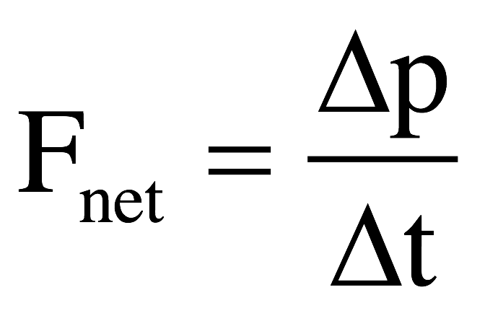
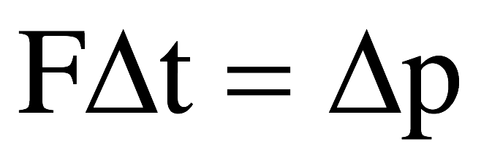
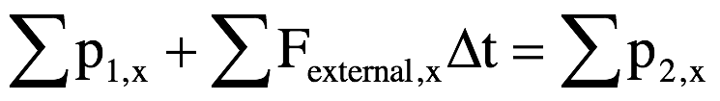
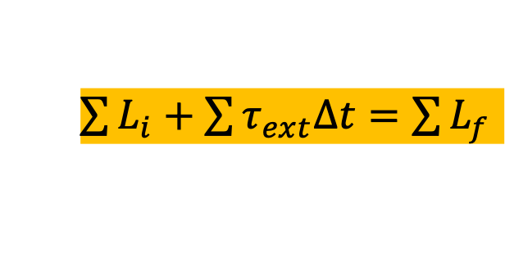

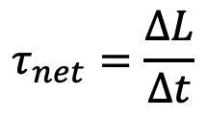
Changing angular momentum
A few units ago, we started with Newton’s 2nd Law and did some rearranging to come up with the relationship
From that, we got the Conservation of Momentum relationship:
So, for rotational motion:
$$τ_{net}=\frac{∆L}{∆t}$$
$$τ∆t=∆L$$
$\sum{L_{i}+\sum{τ_{ext}∆t}=\sum{L_{f}}}$

Slide 10

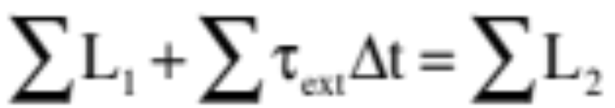
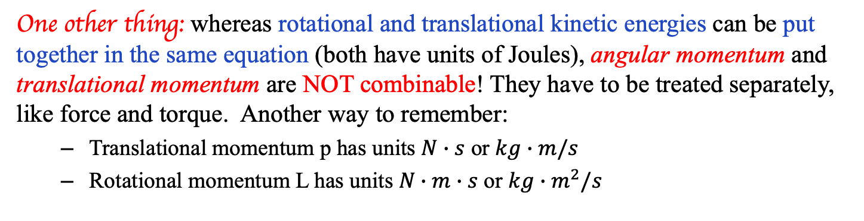
Important note about L
What is different between the two conservation relationships is that for momentum, it is common to have an external forces acting over a time interval, whereas for angular momentum, it rarely happens that an external torque acts. In other words, with no external torques acting on a system, the conservation of angular momentum relationship usually ends up looking like:
One other thing: whereas rotational and translational kinetic energies can be put together in the same equation (both have units of Joules), angular momentum and translational momentum are NOT combinable! They have to be treated separately, like force and torque. Another way to remember:
  Translational momentum p has units $N∙s$ or $kg∙m/s$
  Rotational momentum L has units $N∙m∙s$ or $kg∙m^{2}/s$
10.)

Slide 11






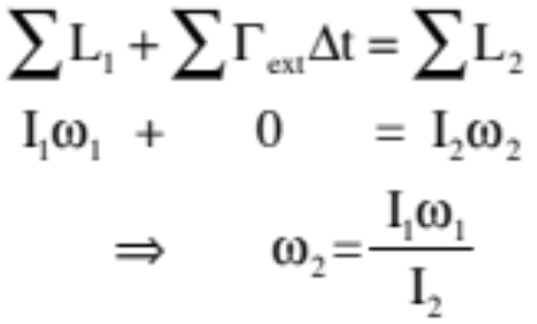

Example 4: An ice skater with arms out has an angular speed of and a moment of inertia . She pulls her arms in.
before
after
a.) What happens to her moment of inertia as she pulls her arms in?
(it decreases)
b.) What is her new angular momentum?
(no external torques, so it doesn’t change)
c.) What was her new angular speed?
There are no external torques acting on the woman, so conservation of angular momentum yields:
. . . And as , her angular velocity increases.
11.)

Slide 12
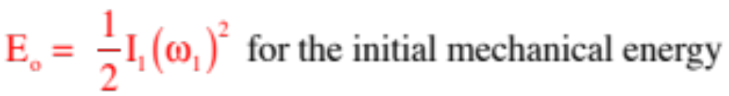
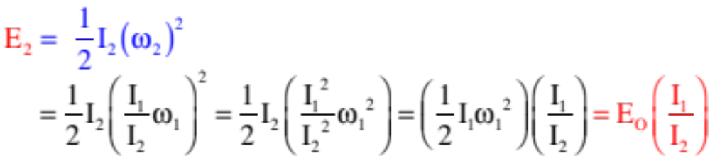
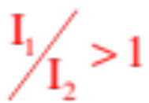

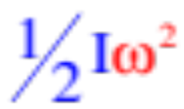
Example 4 (cont’) : An ice skater with arms out has an angular speed of and a moment of inertia . She pulls her arms in.
before
after
d.) Is mechanical energy conserved during this action? Justify and comment.
Just by using your head, chemical energy in your muscles must be burned to force your arms inward, so you might expect that the mechanical energy in the system would not be conserved. Looking at the math, though:
But , so and mechanical energy is NOT conserved. This should not be a surprise. When the moment of inertia diminishes and angular velocity gets proportionally LARGER due to conservation of angular momentum, KE must go UP as it is governed by velocity (remember, ).
12.)

Slide 13
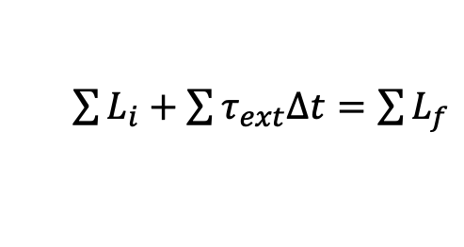
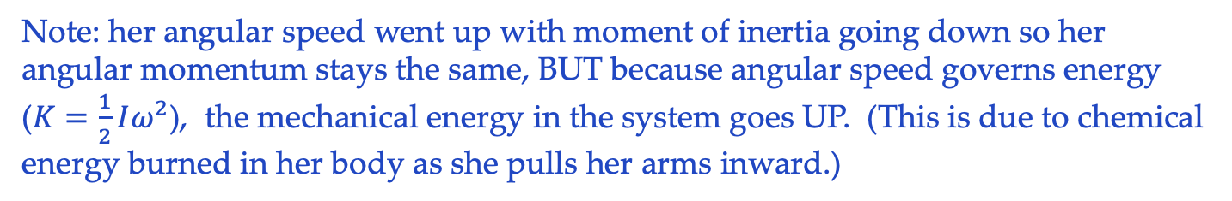
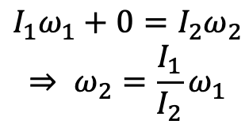
Figure skater example (Ms. Dunham)
Example: An ice skater with arms out have an angular speed of 𝛚₁ and a moment of inertia I₁. She pulls her arms in so her moment of inertia diminishes to I₂. What happens to her angular speed?
There are no external torques acting on the woman, so although her angular momentum and speed will change, her angular momentum will not. Mathematically, this comes out to:
$\sum{L_{i}+\sum{τ_{ext}∆t}=\sum{L_{f}}}$
$$I_{1}ω_{1}+0=I_{2}ω_{2}$$
$$⇒ ω_{2}=\frac{I_{1}}{I_{2}}ω_{1}$$
http://ffden-2.phys.uaf.edu/webproj/211_fall_2014/Ariel_Ellison/Ariel_Ellison/Angular.html
Note: her angular speed went up with moment of inertia going down so her angular momentum stays the same, BUT because angular speed governs energy ($K=\frac{1}{2}Iω^{2}$), the mechanical energy in the system goes UP. (This is due to chemical energy burned in her body as she pulls her arms inward.)
13.)

Slide 14
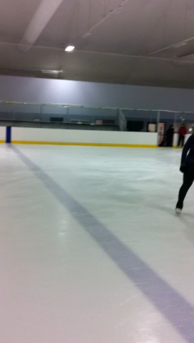
Poly student . . .
And for planetary motion, look at:
URL http://galileoandeinstein.phys.virginia.edu/more_stuff/Applets/Kepler/kepler.html
14.)

Slide 15



Example 5: Another standard problem is the merry-go-round problem. A merry-go-round, assumed to be a disk, has mass M and radius R. It also has two kids who push the m.g.r.’s outer edge by running along side of it to get it up to an angular speed of . The kids, each of which have a mass of , then jump on and start to walk toward the center of the m.g.r. When they get to within units from the center, they stop. What is their speed at that point?
kid
walk
walk
kid
As they walk inward, each kid applies a force, hence torque, to the m.g.r., that changes the m.g.r.’s angular velocity. As a Newton’s Third Law action/action pair, the m.g.r. applies a force, hence torque, to the kids changing their angular velocity. As these are all internal impulses, conservation of angular momentum is applicable.
Interestingly, there are TWO ways we can go here with the kids:
15.)

Slide 16
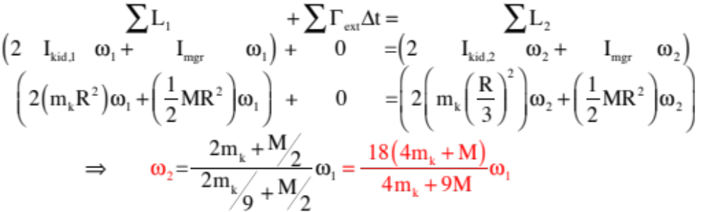
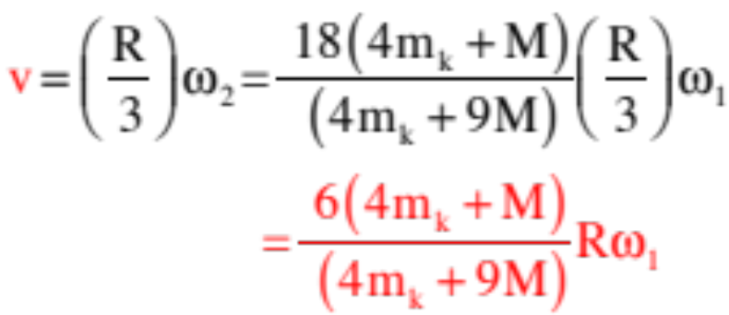
treating the two kids as masses executing rotational motion:
the kid’s velocities:
16.)

Slide 17
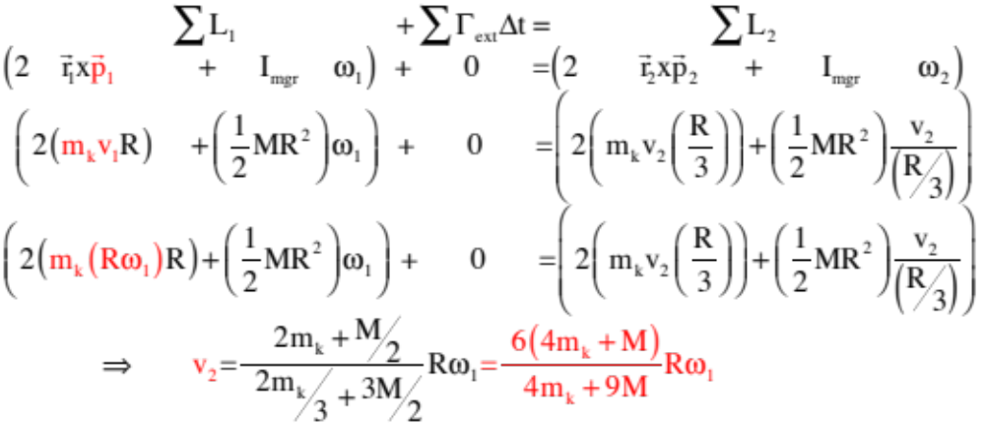
treating the kids as point masses moving with velocity “v”:
Same solution either way. What’s important is the set-up, not all the nasty math.
17.)

Slide 18
MGR example – with a twist!
A child of mass m runs with velocity v_{i} tangent to a stationary merry-go-round and jumps onto it. The merry-go-round’s mass is M, radius R and moment of inertia ½ MR² .
a.) Are there any torques acting on the system? If so, where do they happen? Are they internal or external?
b.) Is momentum conserved in the system?
c.) Is energy conserved in the system?
d.) Is angular momentum conserved in the system?
e.) What is the final angular velocity of the merry go round?
before jump
after jump
MGR initially at rest
18.)

Slide 19
MGR with a twist (con’t.)!
a.) Are there any torques acting on the system? If so, where do they happen? Are they internal or external?
There is a torque provided by the kid on the MGR when she jumps on. However, the MGR exerts an equal torque back on the kid, so these are internal torques.
b.) Is momentum conserved in the system?
No – there is an external forces providing an impulse during the collision due to the axle’s interaction with the ground
c.) Is energy conserved in the system?
No – the kid is crashing into the mgr . . . it’s a perfectly inelastic collision
d.) Is angular momentum conserved in the system?
The torques are internal, so theory says yes, but there doesn’t seems to be any rotation and associated angular momentum before the collision, so this is confusing. How might we reconcile these two seemingly disparate observation?
19.)

Slide 20







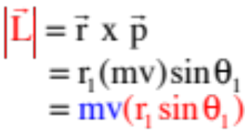
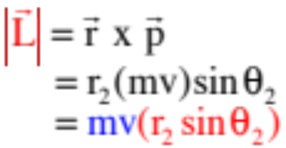


This is important: Objects moving in a straight line with constant speed HAVE angular momentum, and the angular momentum is CONSTANT!
This seemingly insane bit of amusement is actually grounded in intuitively sound reasoning. To see how, consider the simplest motion possible, a mass moving with constant velocity parallel to the x-axis. How does the angular momentum calculate out at several points in that case?
A little bit later . . .
Same angular momentum! But how can a body moving STRAIGHT have angular momentum?
20.)

Slide 21
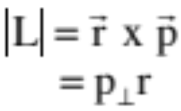








Consider a body moving in circular motion. Its angular momentum will equal:
where is the body’s momentum. This momentum will be perpendicular to the position vector and tangent to the path. Nobody would argue that this body’s motion didn’t have angular momentum, as its motion is circular!
Now consider a particle moving parallel to the x-axis with momentum mv, as shown in the sketch.
It will have a momentum component that is radial and outward from the origin, and a tangential component ( ) that is perpendicular to the .
In other words, one of its components will be exactly like the momentum involved in the object that was executing a pure rotation, that had angular momentum. Conclusion, this body, moving in a straight line, will also have angular momentum (assuming its velocity vector’s line doesn’t go thru the reference point).
21.)

Slide 22

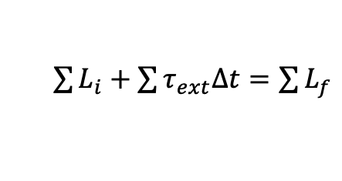
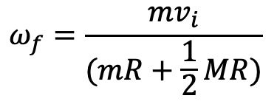
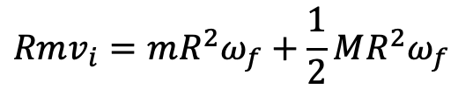
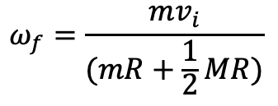
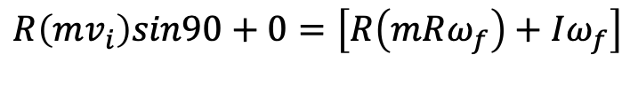
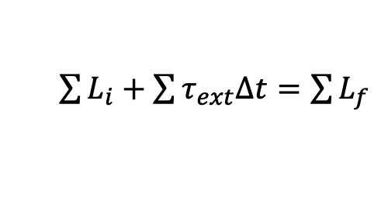
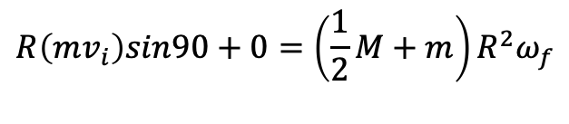
Back to the MGR…
e.) what is the final angular velocity?
before jump
after jump
The kid’s initial momentum was mv_{i}. After she jumps on, became mv_{new} = m(R𝛚). This means we can write:
MGR initially at rest
$\sum{L_{i}+\sum{τ_{ext}∆t}=\sum{L_{f}}}$
$$R\left(mv_{i}\right)sin90+0=\left[R\left(mRω_{f}\right)+Iω_{f}\right]$$
$$Rmv_{i}=mR^{2}ω_{f}+\frac{1}{2}MR^{2}ω_{f}$$
Alternately, you could say after the collision, we have one disk with total I = I_{MGR} + I_{kid as pt mass} = ½ MR² + mR² so:
$$ω_{f}=\frac{mv_{i}}{(mR+\frac{1}{2}MR)}$$
$\sum{L_{i}+\sum{τ_{ext}∆t}=\sum{L_{f}}}$
$$R\left(mv_{i}\right)sin90+0=\left(\frac{1}{2}M+m\right)R^{2}ω_{f}$$
$$ω_{f}=\frac{mv_{i}}{(mR+\frac{1}{2}MR)}$$
22.)

Slide 23
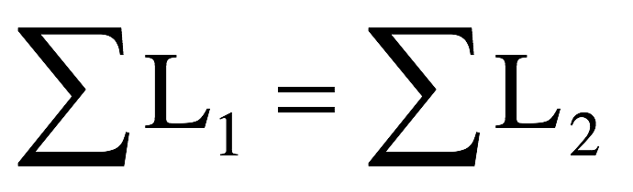
Angular momentum reminders
Angular momentum is the rotational version of momentum:
If there are no external torques in a system (only internal torques), angular momentum is conserved!
  In almost every situation, this will be true, so:
Can you conserve angular momentum but not energy? Give an example to support your answer.
Yes: figure skater (brings arms in, I decreases so angular velocity increases; rotational energy increases due to burning chemical energy in her arms)
Yes: merry go round (people walked from outside to inside; net I decreased so 𝛚 increased; energy of system increased due to same reason as above)
→ remember for this one, we had to consider the total I of the system
before and after – the kids were point masses!
23.)

Slide 24
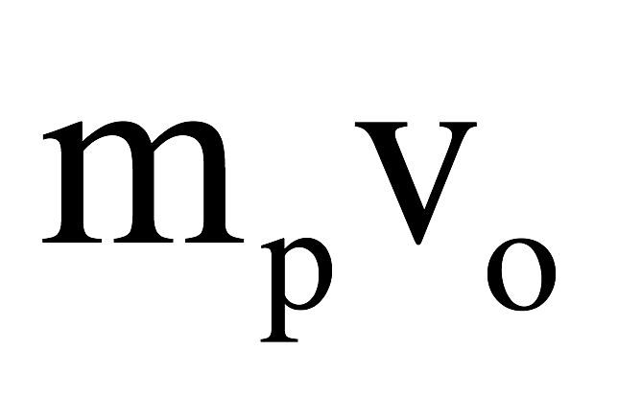

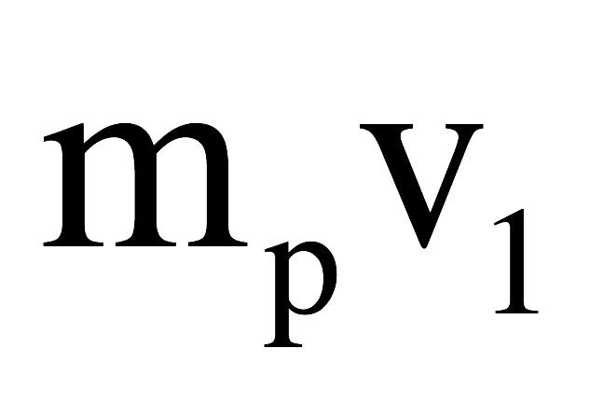
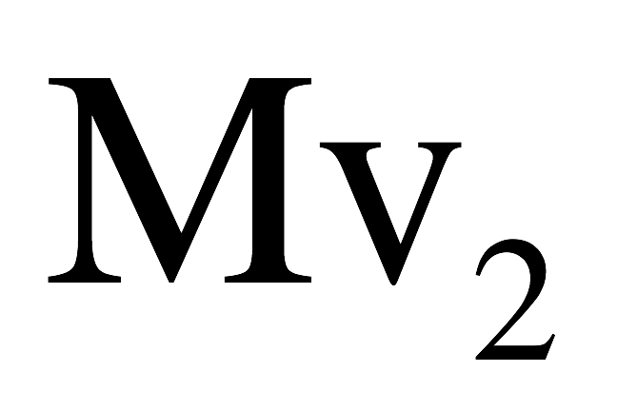
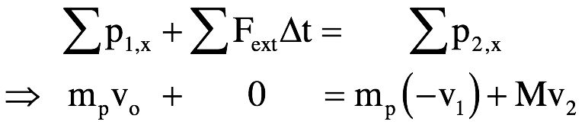
Another example: ball and beam
So with this in mind, consider a stationary meter stick of mass M (I_{cm} = (1/12) ML²) sitting on a frictionless table. A puck of mass m_{p} moving with velocity v₀ hits the stick at its center of mass. What is conserved during the collision?
Energy: As is the case with all collisions, energy is not conserved here unless you are told the collision is elastic, which it isn’t in this case.
Energy:
Momentum: There are no external forces, so momentum is conserved. The math:
Momentum:
Angular momentum: There are no external torques, so angular momentum, which is initially ZERO, is conserved. Since the ball hits the center of mass, the beam merely translates instead of rotating (no internal torque, either!)
Angular momentum:
24.)

Slide 25

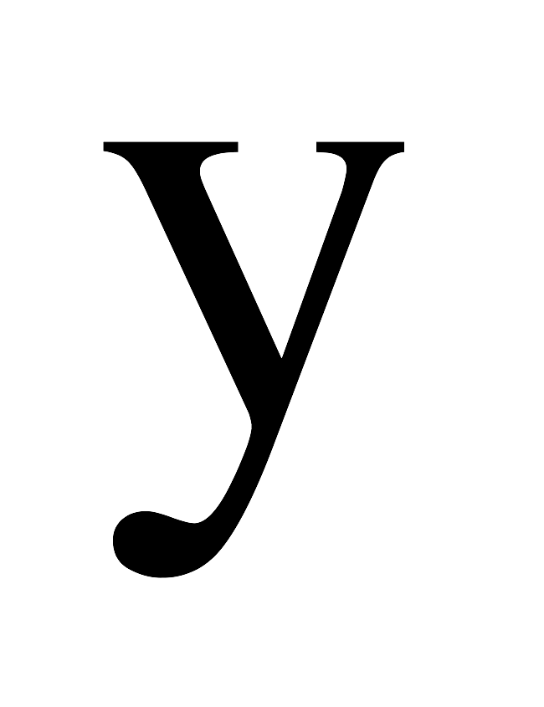
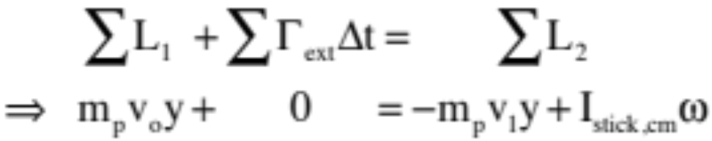
Ball and beam v.2
Now, the same collision but with the puck hitting a distance y units from the stick’s center of mass. What is conserved now?
Energy:
Energy: Still no!
Momentum: Still yes, with:
Momentum:
Angular momentum:
Angular momentum: Still yes, except there is
angular momentum about the stick’s center of mass due to the puck’s straight-line motion. That angular momentum equation becomes:
25.)

Slide 26
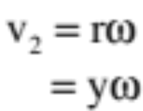
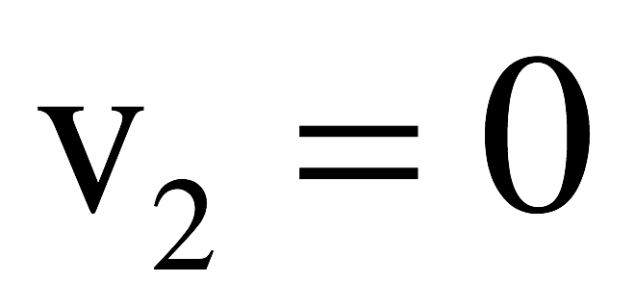
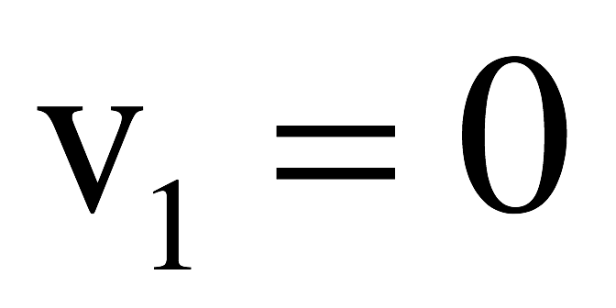

One important (and strange) point:
What’s unfortunate, at least from the perspective of problem solving, is that the velocity of the center of mass of the free stick is NOT related to the angular velocity about the stick’s center of mass by
That’s why you usually see this problem in the following alternate form: The stick is pinned at its center of mass, and when the puck hits, it stops dead. In that case:
Momentum is no longer conserved (an external force acts at the pin) but angular momentum is conserved with the final angular momentum being that of the stick only (the puck is not moving). With that, the stick’s final angular velocity can be calculated using the conservation of angular momentum equation, or:
26.)

Slide 27
General information
Last rotational motion quiz is xxx on angular momentum
You will definitely see some version of the merry-go-round problem. Be able to:
    apply concepts of conservation of angular momentum for a MGR with things moving on its surface (e.g. kids moving from outside in or inside out, or jumping on);
    Turn a translational momentum vector into a rotational momentum vector (r x p);
    Understand what would cause a change in angular momentum (impulse due to torque);
    Understand whether momentum, angular momentum and/or energy are conserved;
  There is also a good chance you will see some version of the meterstick/puck problem (today’s) – be able to tell whether energy, momentum, and angular momentum are conserved for either situation (pinned or not).
After the quiz, we’ll tie up some loose ends with angular momentum (fun examples - and The Wheel, pulsars, etc.) and start talking about the unit test + goalless problem for next week’s Block Day
  Goalless problem guidelines are posted, but we’ll talk more Friday and I’ll have a couple of practice ones for you
27.)

Slide 28





Example 10: A mass m sits at the top of a curved, frictionless incline of radius R. It slides down the incline and executes a perfectly inelastic collision with the end of a pinned rod of mass 5m and length d. The two rotate up to some angle before coming to rest. If R = .4d, derive an expression for . You know:
This is the rotational analogue to the problem shown to the right: A mass m sitting at the top of a curved incline of radius R slides down the incline,
executes a perfectly inelastic collision with a 5m mass, and proceeds up a ramp. How high up the ramp does it go?
So how would you do this problem?
(Energy up to the collision, momentum through the collision, energy after the collision!)
28.)

Slide 29

How are the problems different as far as solving goes? That is, why can’t we just use conservation of momentum when the two masses collide in the pinned beam problem?
To use conservation of momentum, we
need a system in which there are no external impulses. The pin provides an external impulse (it keeps the rod from accelerating en-mass to the left through the collision), so conservation of momentum won’t work for this collision. There are no external torques acting about the pin, though, so conservation of angular momentum IS applicable.
29.)

Slide 30



To begin, the velocity of the mass m just before the collision can be determine using conservation of energy:
Because there are no external torques acting about the pin, conservation of angular momentum is the key to the collision. Taking a time interval through the collision, and summing the angular momenta about the pin, we can write:
We need those angular momentum quantities.
30.)

Slide 31








To determine the angular momentum of the mass about the pin, we can go two ways. We can either treat the mass as a translating point mass and using , or we can use rotational parameters. I’ll show both (assuming the velocity of the mass at the bottom of the incline is ):
translating point mass:
rotational parameters:
OR
Same either way.
After the collision, the mass’s angular momentum in terms of angular velocity:
31.)

Slide 32




We need the moment of inertia of the rod about the pin. We’ll use the parallel axis theorem for that:
Putting everything together through the collision yields:
As
32.)

Slide 33




Knowing the after-collision velocities, we can use conservation of energy to determine how high the rod’s center of mass rises, and how high up the mass rises, before coming to a stop. Without doing the math to its conclusion, assuming the time interval is from just after the collision to the stop point and noting that the mass rises a distance (you should understand why by now) while the rod’s center of mass rises that equation looks like:
33.)

Slide 34

Example 6: In 1967 as a graduate student, Jocelyn Bell (aca Dame Jocelyn Bell Burnett) observed, in the face of scant support from her advisor, Antony Hewish, the first pulsar. In 1974, in a classic “keep ‘em barefoot and pregnant” move, the all male, presumably all white Nobel committee gave Hewish the Nobel
Prize in Physics for the discovery while ignoring Bell altogether. With that monumental injustice in mind, consider the lowly pulsars:
When a star with a core between 1.4 and 1.8 solar masses dies, it explodes spectac-ularly in what is called a supernova. (Example: In 1054, a supernova occurred that was observed by the Chinese and was visible during the day for two weeks.) When a supernova happens, the outer part of the star blows outward creating what is called a supernova remnant (the supernova in 1054 created the Crab Nebulae) and the core is blown inward. The implosion is so violent that it forces electrons into the nuclei of their atoms (removing all the space in the atoms in the process) where they combine with the protons there to produce neutrons that stop the implosion by literally jamming up against one another. With all that space removed, the resulting structure is incredibly dense (think a thousand Nimitz class aircraft carriers compressed into the size of a marble) and small (think 10 to 15 kilometers across).
34.)

Slide 35



(con’t) The significance of all of this is that nature provides us with a WICKED example of conservation of angular momentum.
How so? There are no external torques acting during the supernova, so angular momentum is conserved. The enormously massive structure spread out over hundreds of thousands of kilometers starts out with a HUGE RADIUS and angular momentum even though its angular speed is low (the sun takes 25 days to rotate once about its axis). In other words, its angular momentum looks like:
35.)

Slide 36


After the supernova, the moment of inertial drops precipitously because the radius goes from several hundred thousand kilometers to, maybe, 15 kilometers during the explosion, BUT THE ANGULAR MOMENTUM STAYS THE SAME which means the angular velocity skyrockets. In other words, the final angular momentum relationship will look like:
In short, pulsars (neutron stars) are super dense structures that rotate anywhere from a few cycles per second all the way up the several hundred cycles per second, all as a consequence of conservation of angular momentum.
36.)

Slide 37




But what’s really cool is that they put out what is called synchronous radiation—radiation that is very directional and that is in the radio frequency range. So if the sweep of radiation of one of these fast rotating objects just happens to cross the
earth’s path, a blast of radio wave will hit the earth every time the star completes one rotation. In other words, we can hear them using a radio telescope. This is what you will experience on the next slide. Pretty amazing!
And as a small side-point, I’ve REALLY simplified what’s going on with these things. According to Sterl Phinney, Professor of Astrophysics at Caltech (and a Poly parent), the progenitor of the Crab Nebula lost 99% of its angular momentum during and since its supernova. More about this on the next slide (if I get the time to generate it).
37.)

Slide 38

Remembering that these are super dense (density of 1000 Nimitz-class aircraft carriers compressed to the size of a marble) stars that are, maybe, 15 km across, and that each rotation produces one beat, here is what a pulsar sounds like as observed by a radio telescope.
AMAZING!!!
38.)

