Slide 1
General announcements

Slide 2
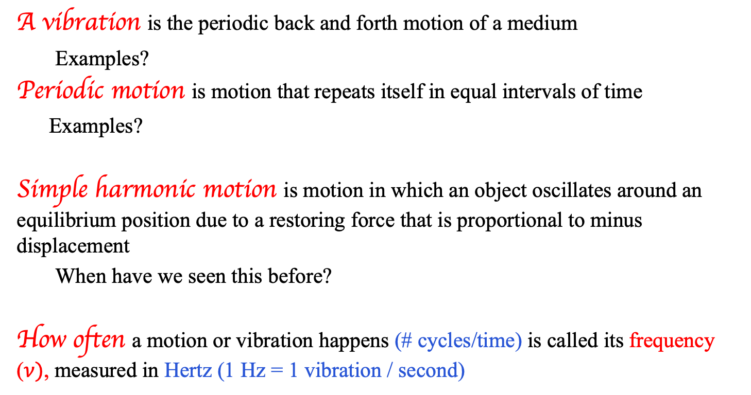
Vibrations and terminology
A vibration is the periodic back and forth motion of a medium
  Examples?
Periodic motion is motion that repeats itself in equal intervals of time
Examples?
Simple harmonic motion is motion in which an object oscillates around an equilibrium position due to a restoring force that is proportional to minus displacement
  When have we seen this before?
How often a motion or vibration happens (# cycles/time) is called its frequency ($ν)$, measured in Hertz (1 Hz = 1 vibration / second)
Guitar string, pendulum, metronome, spring/mass system
All of the above, plus: orbits, rotations at constant angular velocity (e.g. spinning CD or record), delivery of a paper each morning, etc.
Spring-mass systems, a pendulum

Slide 3







Simple Harmonic Motion
A vibrating body executes SIMPLE HARMONIC MOTION if the restoring force driving the body back toward its equilibrium position is proportional to the displacement x of the body from its equilibrium position.
The classic example is a mass attached to an ideal spring. Pull the spring away from equilibrium and release it, what happens?
The spring exerts a force back towards equilibrium, accelerating it towards the center.
When it reaches equilibrium, though, the mass is moving (has inertia and KE!) and continues past…now the force pulls back towards equilibrium, accelerating it again but this time slowing it down.
How can we describe or represent this type of periodic motion?

Slide 4
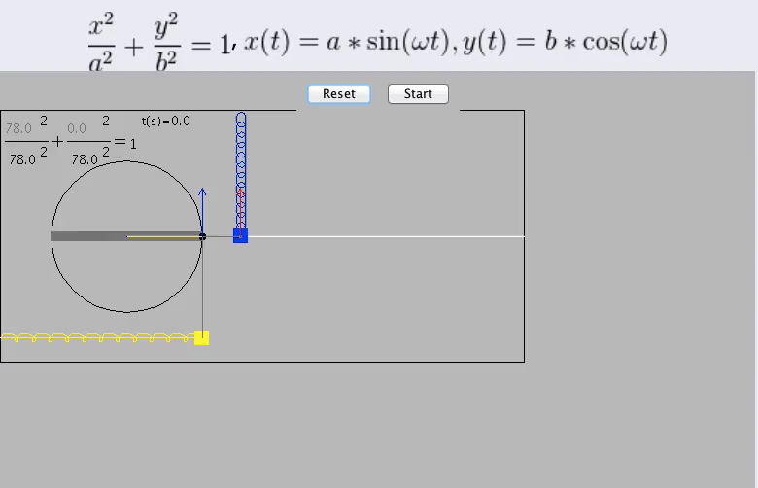
Vibratory motion visualized
courtesy of Richard White

Slide 5





What did we see from that?
1.) The PROJECTION of a point on a circle moving with constant angular velocity follows the same path as a mass attached to an ideal hanging spring as the spring oscillates up and down. And:
2.) If you track the oscillation in time, it traces out a sinusoidal path.
Both of these observations fall out from the math if we start with Newton’s Second Law applied to a mass m attached to an ideal spring oscillating over a frictionless, horizontal surface.
That analysis follows:

Slide 6

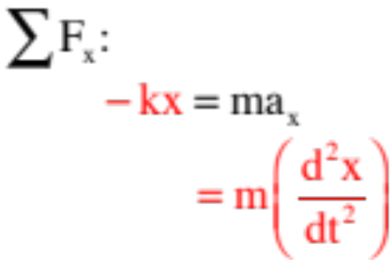
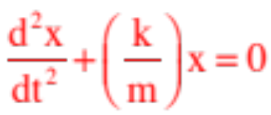
Keeping the sign of the acceleration embedded (it will be either positive or negative, depending upon the point in time, so we’ll leave it implicit), and noting that the spring force in the x-direction on a mass attached to the
spring will be (Hooke’s Law), Newton Second Law suggests:
Pulling the –kx to the right side and dividing by m yields the relationship:
This is the characteristic equation of SIMPLE HARMONIC MOTION.

Slide 7


This relationship:
essentially asks us to find a function x such that when you take its second derivative and add it to a constant times itself, the sum will always add to zero.
The function that does this is either a cosine or a sine (I usually use a sine, but your book for no particularly good reason uses a cosine, so we’ll use that).
There are restrictions on the cosine function we need. In fact, we want the most general form possible. Specifically:
1.) We need the cosine’s angle to be time dependent, so instead of using an angle we will use a constant times t, where the constants units have to be radians/second. As we have already run into a variable with those units ( ), we will use that symbol. (Interesting note: If the angular velocity of the rotating point on the circle shown in the first slide had been , the time-constant for the vibratory motion’s cosine function would have been that same number .)

Slide 8

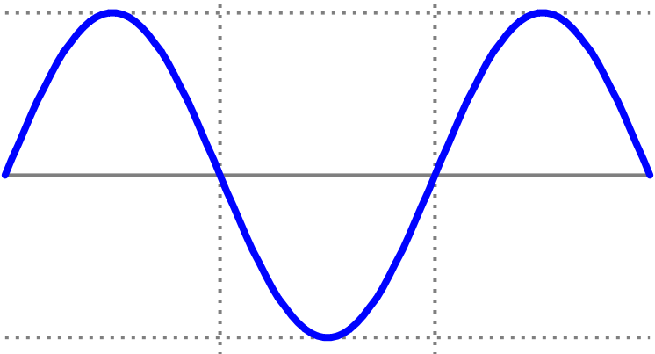



2.) We need the ability to start the clock when we want. A simple cosine function sets the position to be at a positive maximum at t = 0 (see sketch).
at t=0, x=max pos. displ.
new axis
3.) We need to be able to shift the axis by some phase shift amount , essentially starting the clock (i.e., setting t = 0) when the body is at any chosen x-coordinate.
at t=0, x-coord. shifted
4.) Lastly, we need to be able to accommodate motion whose maximum displacement is other than one.
The function that does all of this for us is:

Slide 9
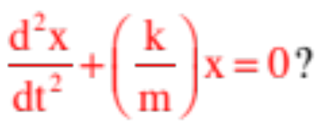
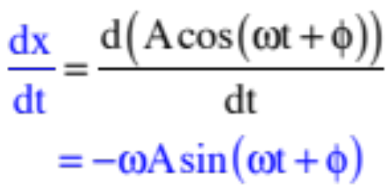

So back to the problem at hand. Does
satisfy
The only way to tell is to try it out:
This, by the way, is the velocity function. And as a sine function can never be larger than one, this means the magnitude of the maximum velocity for this oscillatory motion will be:
This will happen when the force is completely spent, or at equilibrium.

Slide 10
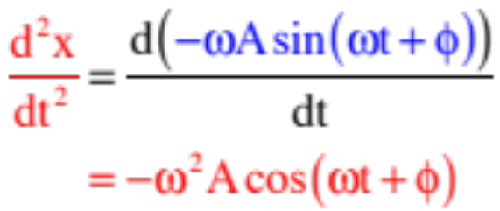

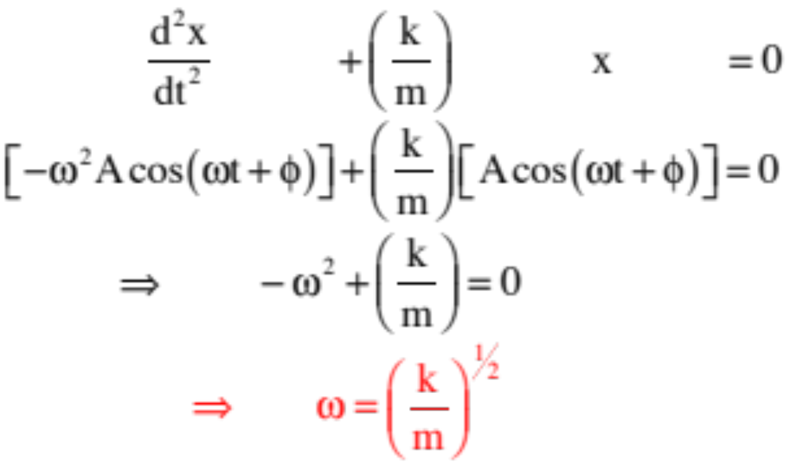
Continuing:
Another side point: This means the magnitude of the maximum acceleration, which happens at the extremes where the spring force is maximum, will be:
Putting everything together:

Slide 11
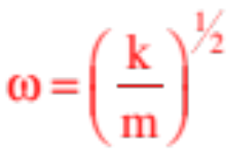
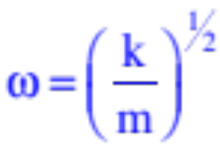

In other words, the differential equation
is satisfied by the position function
as long as the angular frequency satisfies:
Big Note: Notice that in concluding that , we are saying that the square root of the constant that sits in front of the position term in the Newton’s Second Law equation is equal to the oscillations angular frequency! Put a little differently, if you can get any N.S.L. evaluation into the form:
you will know the oscillation is simple harmonic in nature AND you will know that the angular frequency of the system will be .

Slide 12



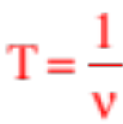
Minor point: So what is the angular frequency really doing for us? It is simply another way to identify how quickly the system is oscillating back and forth. But instead of telling us the frequency in cycles per second, it is telling us how many radians being swept through per cycle. Noting that there are radians per cycle, the relationship between frequency and angular frequency is:
And as the frequency in cycles per second is the inverse of the number of seconds required to traverse one cycle (or the period T in seconds per cycle), we can also write:
In short, if we can derive an expression for for a system, we also know and T.

Slide 13
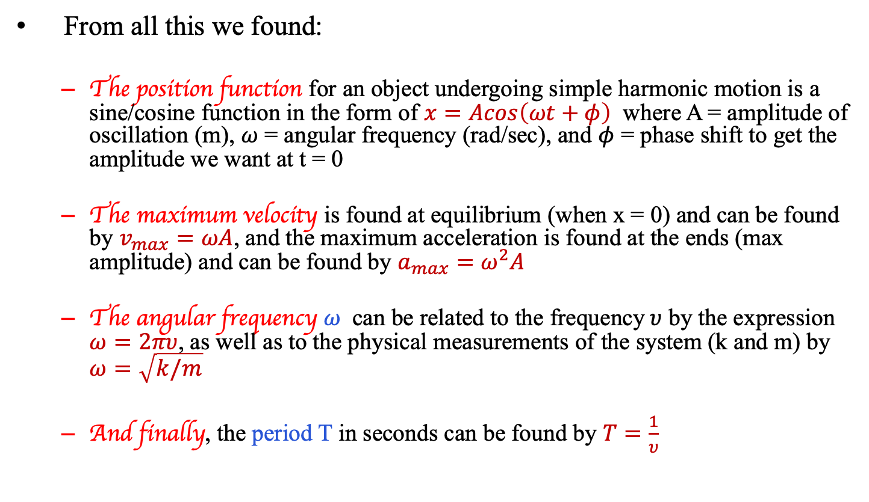
Summing up the important equations:
From all this we found:
  The position function for an object undergoing simple harmonic motion is a sine/cosine function in the form of $x=Acos\left(ωt+φ\right)$ where A = amplitude of oscillation (m), $ω$ = angular frequency (rad/sec), and $φ$ = phase shift to get the amplitude we want at t = 0
  The maximum velocity is found at equilibrium (when x = 0) and can be found by $v_{max}=ωA$, and the maximum acceleration is found at the ends (max amplitude) and can be found by $a_{max}=ω^{2}A$
  The angular frequency $ω$ can be related to the frequency$υ$ by the expression $ω=2πυ$, as well as to the physical measurements of the system (k and m) by $ω=\sqrt{k/m}$
  And finally, the period T in seconds can be found by $T=\frac{1}{υ}$

