Slide 1
General announcements
1.)

Slide 2
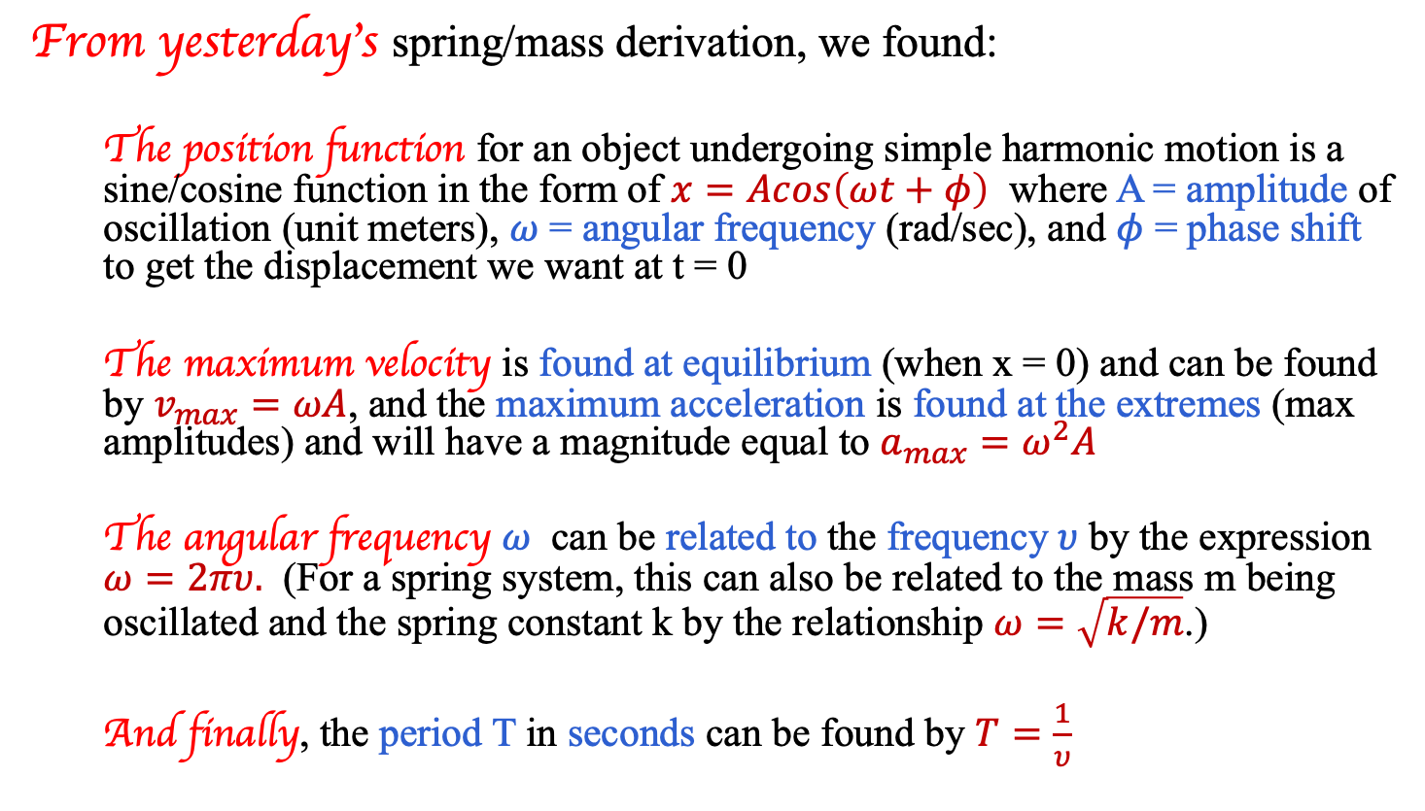
Summing up the important equations:
From yesterday’s spring/mass derivation, we found:
  The position function for an object undergoing simple harmonic motion is a sine/cosine function in the form of $x=Acos\left(ωt+φ\right)$ where A = amplitude of oscillation (unit meters), $ω$ = angular frequency (rad/sec), and $φ$ = phase shift to get the displacement we want at t = 0
  The maximum velocity is found at equilibrium (when x = 0) and can be found by $v_{max}=ωA$, and the maximum acceleration is found at the extremes (max amplitudes) and will have a magnitude equal to $a_{max}=ω^{2}A$
  The angular frequency $ω$ can be related to the frequency$υ$ by the expression $ω=2πυ.$ (For a spring system, this can also be related to the mass m being oscillated and the spring constant k by the relationship $ω=\sqrt{k/m}$.)
  And finally, the period T in seconds can be found by $T=\frac{1}{υ}$
2.)

Slide 3
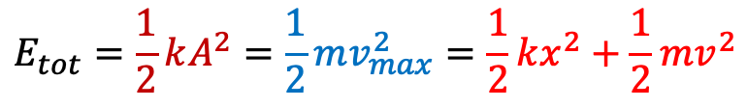
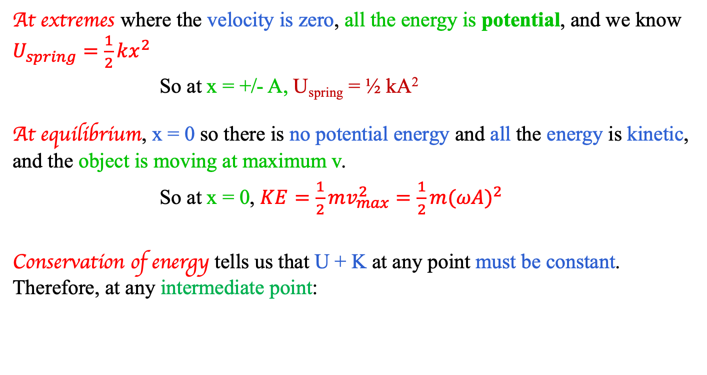
Energy in a Simple Harmonic Oscillation
At extremes where the velocity is zero, all the energy is potential, and we know $U_{spring}=\frac{1}{2}kx^{2}$
  So at x = +/- A, U_{spring} = ½ kA²
At equilibrium, x = 0 so there is no potential energy and all the energy is kinetic, and the object is moving at maximum v.
  So at x = 0, $KE=\frac{1}{2}mv_{max}^{2}=\frac{1}{2}m{(ωA)}^{2}$
Conservation of energy tells us that U + K at any point must be constant. Therefore, at any intermediate point:
$$E_{tot}=\frac{1}{2}kA^{2}=\frac{1}{2}mv_{max}^{2}=\frac{1}{2}kx^{2}+\frac{1}{2}mv^{2}$$
3.)

Slide 4
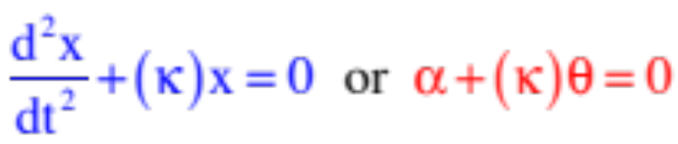


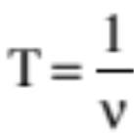

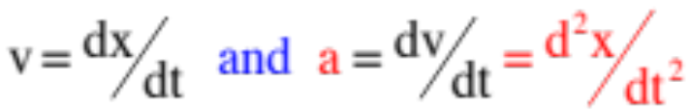


Summary of Relationships
Relationships always true:
characteristic equation for simple harmonic motion
angular frequency from characteristic equation
angular frequency and frequency related
period inversely related to frequency
position function for s.h.m.
velocity and acceleration functions
maximum velocity (happens at equilibrium)
maximum acceleration (happens at extremes)
4..)

Slide 5
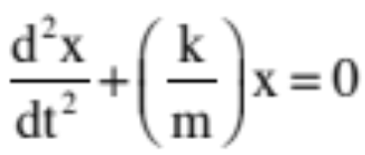
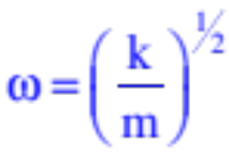
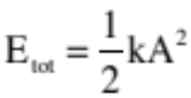
Summary of Relationships
For a spring:
characteristic equation for simple harmonic motion
angular frequency from characteristic equation
total mechanical energy in system
The period of oscillation for a spring is constant no matter what the spring’s amplitude. How so? A larger displacement will require more distance traveled to execute a single cycle, but because force is a function of displacement, it will also generate a larger maximum force, so the period will stay the same no matter what!
12.)

Slide 6


























Looking for patterns…
5.)

Slide 7
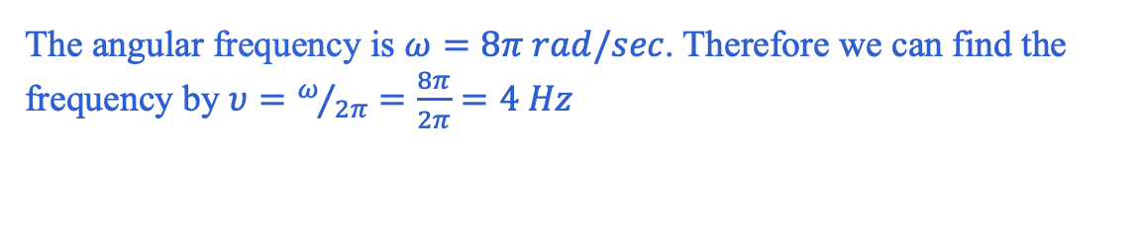
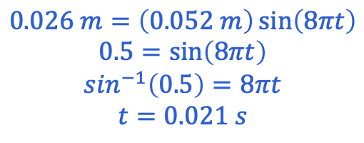
A Problem…(13.28)
Consider a position function $x\left(t\right)=\left(0.052 m\right)sin⁡(8πt)$
a.) What is the frequency?
The angular frequency is $ω=8π rad/sec$. Therefore we can find the frequency by $υ=ω/{2π}=\frac{8π}{2π}=4 Hz$
b.) What is the period?
Period is the inverse of frequency, so $T=\frac{1}{υ}=\frac{1}{4 Hz}=0.25 s$
c.) What is the amplitude?
The amplitude is 0.052 m (the A term in the equation)
d.) When will it reach x = 0.026 meters?
$$0.026 m=\left(0.052 m\right)\sin\left(8πt\right)$$
$$0.5=\sin\left(8πt\right)$$
$$\sin^{−1}\left(0.5\right)=8πt$$
$$t=0.021 s$$
6.)

Slide 8



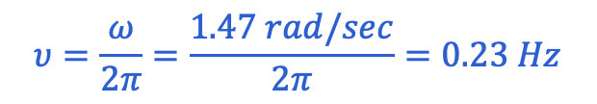
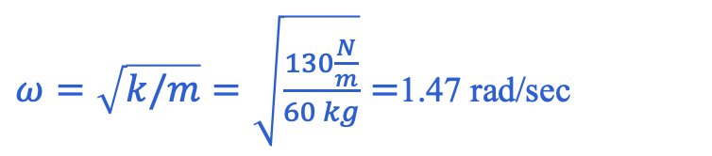


A spring/mass problem (13.1)
When a 60 kg mass is attached to a spring with a spring constant of 130 N/m, it is elongated a distance 0.13 meters from its equilibrium position.
a.) What is the force on the mass in this position?
$$F_{spring}=−kx=−\left(130\frac{N}{m}\right)\left(0.13\right)=−16.9 N$$
b.) What is the acceleration of the mass at this point?
$$a=\frac{F_{spring}}{m}=\frac{−16.9 N}{60 kg}=−0.28 m/s^{2}$$
c.) The mass is released. What is the amplitude of the periodic motion?
Amplitude is the maximum distance from equilibrium; since it was initially displaced 0.13 m, that will be the amplitude of its vibration.
d.) What is the frequency of the motion?
$ω=\sqrt{k/m}=\sqrt{\frac{130\frac{N}{m}}{60 kg}}=$1.47 rad/sec
$$υ=\frac{ω}{2π}=\frac{1.47 rad/sec}{2π}=0.23 Hz$$
7.)

Slide 9
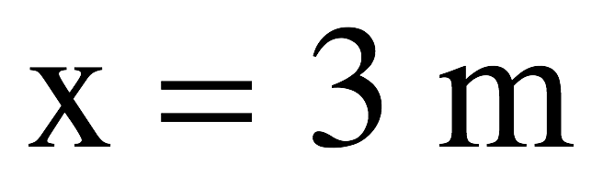
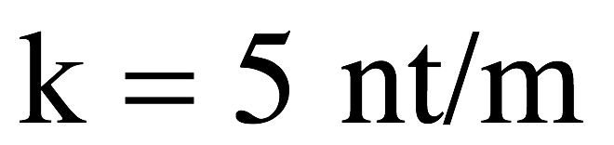
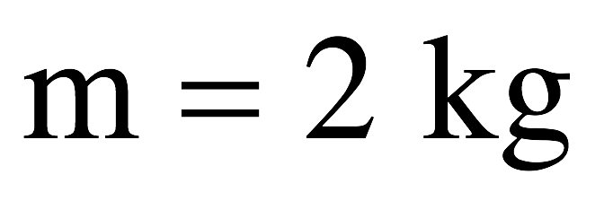
A slightly more complex one…(13.31)
When a 2 kg mass is attached to a spring with a spring constant of 5 N/m is elongated a distance 3 meters from its equilibrium position and is released at t=0:
a.) What is the force 3.5 seconds after release?
b.) Through how many cycles does the body oscillate in 3.5 seconds?
Hint: you need to find the function that will describe this motion…
See solution on class Website– or notes from class
8.)

Slide 10
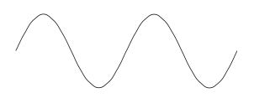
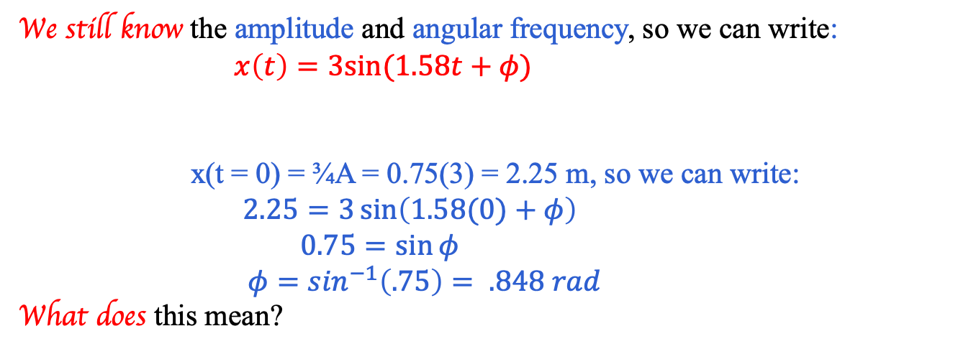

More with the phase shift…
Same problem as previous slide except this time you are told that at t = 0, the mass is at ¾ A moving away from equilibrium. What is the equation of motion?
We still know the amplitude and angular frequency, so we can write: $x\left(t\right)=3sin⁡(1.58t+φ)$
x(t = 0) = ¾A = 0.75(3) = 2.25 m, so we can write: $2.25=3\sin\left(1.58(0)+φ\right)$
$0.75=\sin{φ}$
$φ=\sin^{−1}\left(.75\right)= .848 rad$
What does this mean?
Plugging the information we know into our equation (i.e., what’s happening at t = 0):
We want to shift our t = 0 axis 0.848 rad to the right, so that the initial x value at t = 0 will be (3/4)A meters.
A
¾ A
$$ωt$$
-A
9.)

Slide 11

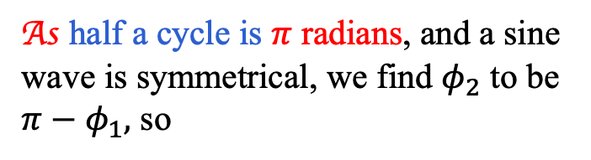

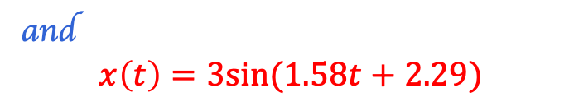

Another one…
What if at t = 0 the mass is at ¾ A moving towards equilibrium?
The math will end up being the same, as you’re still setting x = ¾ A on the left-hand side. However, you can’t just blithely put +0.848 rad for your phase shift! How so?
Looking at a graph, there are two locations per cycle where the mass is at ¾ A – one moving away from and one moving towards equilibrium. We want the second one – so the sketch comes in really handy here:
From the sketch, we see we want the bigger phase shift ($φ_{2}$).
A
¾ A
As half a cycle is $π$ radians, and a sine wave is symmetrical, we find $φ_{2}$ to be $π−φ_{1},$ so
$$ωt$$
-A
$${\begin{aligned} \\ φ\end{aligned}}_{2}=π−0.848=2.29.$$
and
$$x\left(t\right)=3sin⁡(1.58t+2.29)$$
10.)

Slide 12
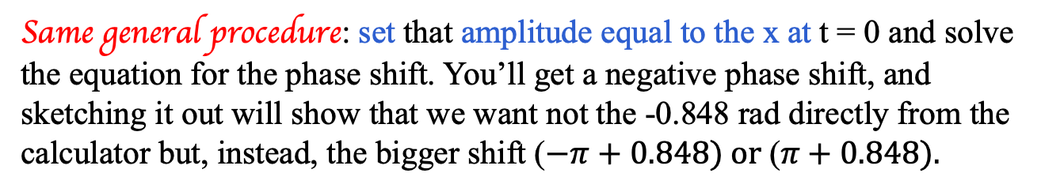

And lastly…
What if it’s at –¾A and moving away from equilibrium at t = 0?
Same general procedure: set that amplitude equal to the x at t = 0 and solve the equation for the phase shift. You’ll get a negative phase shift, and sketching it out will show that we want not the -0.848 rad directly from the calculator but, instead, the bigger shift ($−π+0.848) or \text{(}π+0.848).$
or
$$ωt$$
$$ωt$$
-¾ A
-¾ A
Moral of the story: sketch the wave and think about what your calculator is giving you, then decide what to do about the phase shift.
11.)

Slide 13
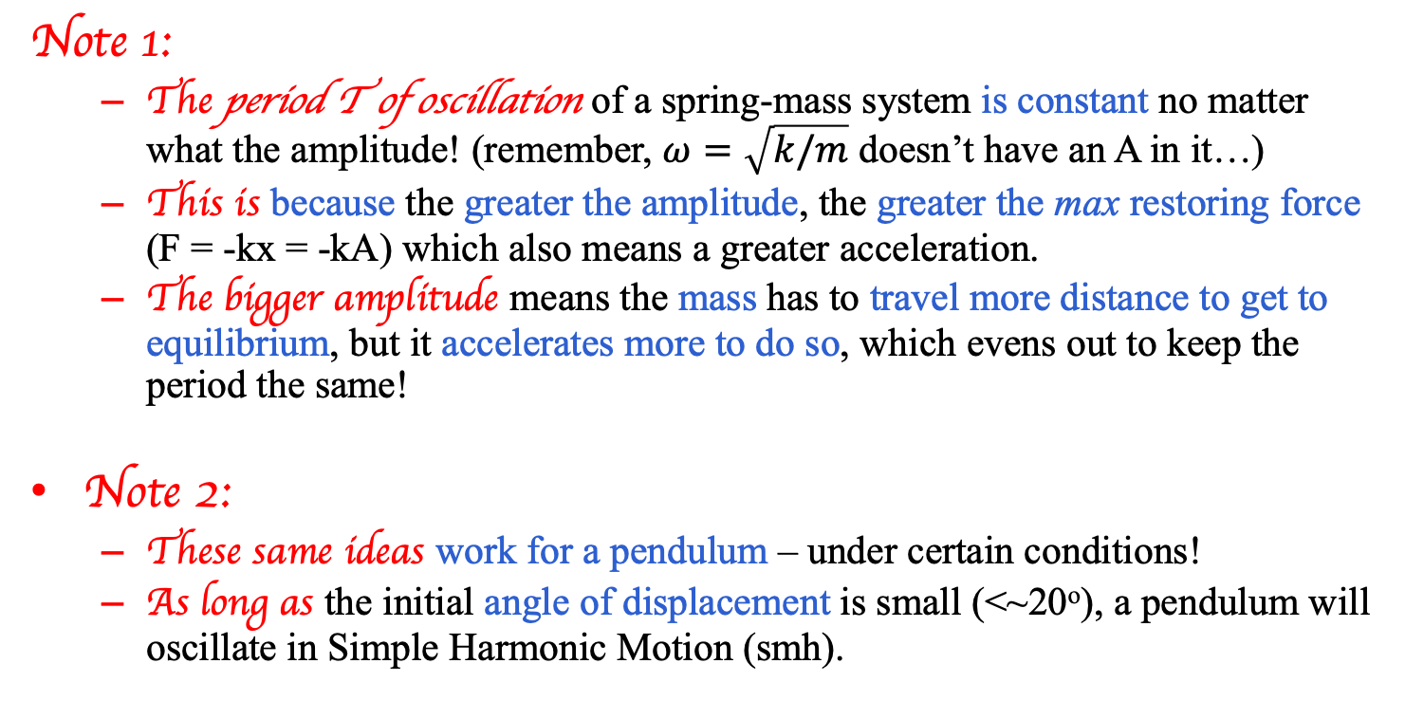
Some interesting points…
Note 1:
  The period T of oscillation of a spring-mass system is constant no matter what the amplitude! (remember, $ω=\sqrt{k/m}$ doesn’t have an A in it…)
  This is because the greater the amplitude, the greater the max restoring force (F = -kx = -kA) which also means a greater acceleration.
  The bigger amplitude means the mass has to travel more distance to get to equilibrium, but it accelerates more to do so, which evens out to keep the period the same!
Note 2:
  These same ideas work for a pendulum – under certain conditions!
  As long as the initial angle of displacement is small (<~20º), a pendulum will oscillate in Simple Harmonic Motion (smh).
12.)

Slide 14







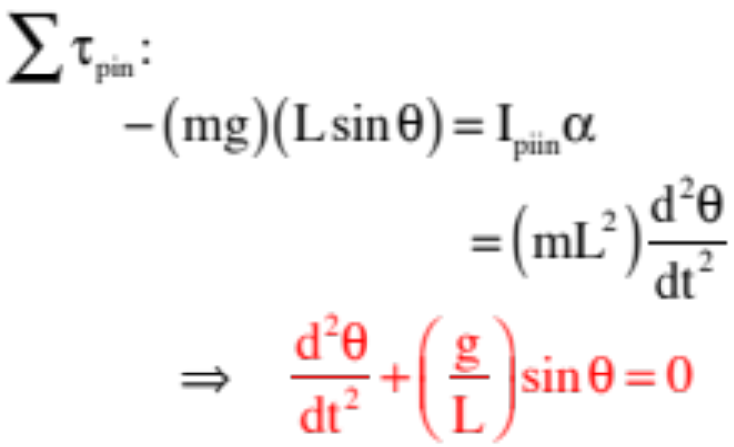
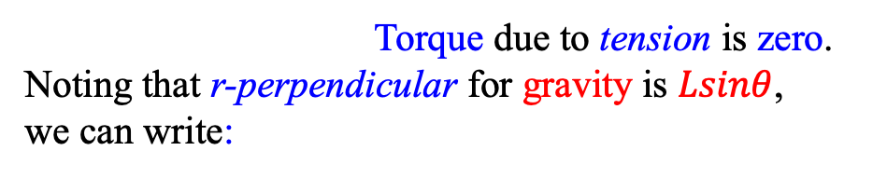
Pendulum
Does a simple pendulum fit our model?
Consider the simple pendulum shown to the right. What is its period of motion?
Strategy: If we can show that this system’s N.S.L. expression conforms to simple harmonic motion, we have it.
As the motion is rotational, we need to sum torques about the pivot point.
Torque due to tension is zero. Noting that r-perpendicular for gravity is $Lsinθ$, we can write:
13.)

Slide 15
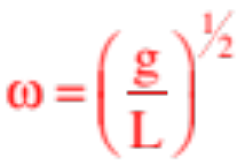
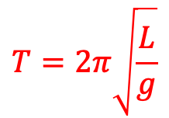
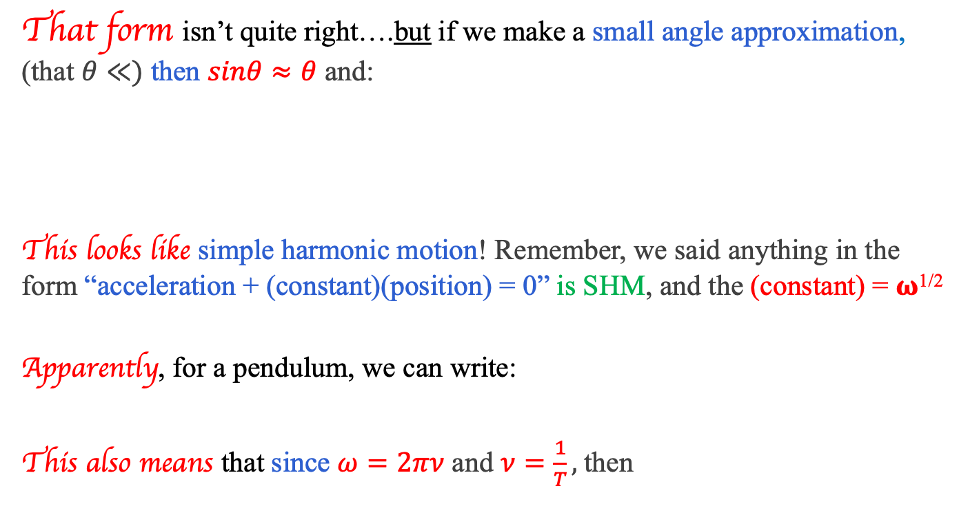
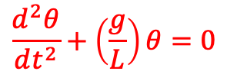
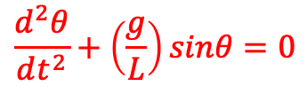
Pendulum
That form isn’t quite right….but if we make a small angle approximation, (that $θ≪)$ then $sinθ≈θ$ and:
This looks like simple harmonic motion! Remember, we said anything in the form “acceleration + (constant)(position) = 0” is SHM, and the (constant) = 𝛚^{1/2}
Apparently, for a pendulum, we can write:
This also means that since $ω=2πν$ and $ν=\frac{1}{T},$then
$$\frac{d^{2}θ}{dt^{2}}+\left(\frac{g}{L}\right)sinθ=0$$
$$\frac{d^{2}θ}{dt^{2}}+\left(\frac{g}{L}\right)θ=0$$
$$T=2π\sqrt{\frac{L}{g}}$$
NOTE that these relationships are true for any pendulum with a small angle amplitude!
14.)

Slide 16
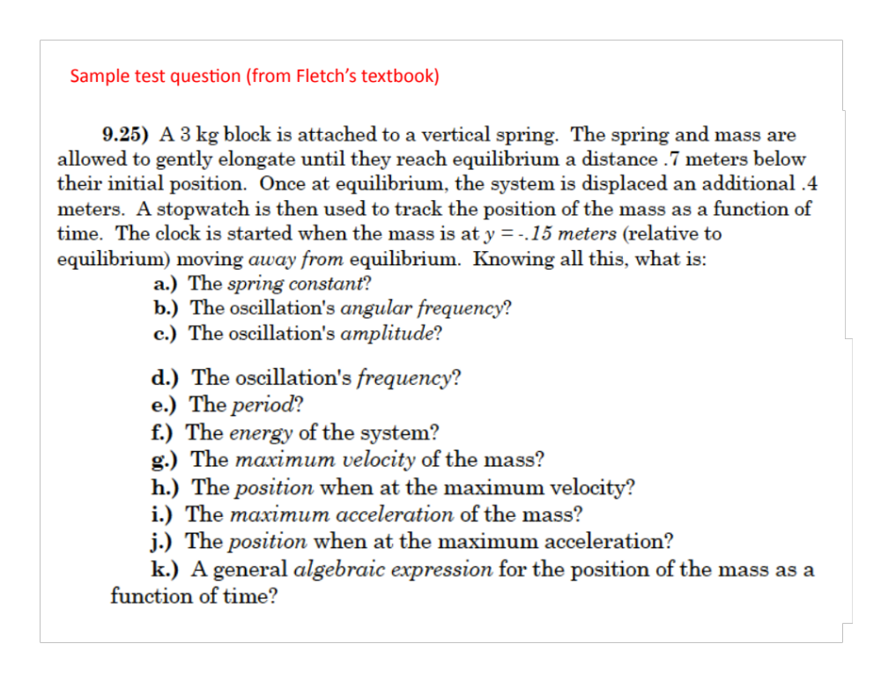
15.)

Slide 17
Answers to previous slide
(a) 42 N/m
(b) 3.74 rad/sec
(c) 0.4 m
(d) .595 Hz
(e) 1.68 sec
(f) 3.36 J
(g) 1.50 m/s
(h) x = 0.
(i) a = +/- 5.6 m/s²
(j) x = +/- A
(k) y(t) = 0.4sin(3.74t-2.76) or y(t) = 0.4cos(3.74t+1.96)
16.)

