Slide 1
General announcements

Slide 2
Simple harmonic motion - summed up
What does it mean to undergo simple harmonic oscillation?
What quantities do we have to describe an oscillation?
A vibration back and forth about an equilibrium point, with a defined amplitude and frequency of oscillation and a restoring force that is proportional to minus the displacement of the body from equilibrium.
Examples: spring/mass system, pendulum with small initial angle
Angular frequency (rad/s) and frequency (Hz), related by $ω=2πν$
Position vs. time functions, like $x=Asin\left(ωt+φ\right)$ and its derivatives
From those derivatives, knowledge that $v_{max}=ωA$ and $a_{max}=ω^{2}A$
For a spring mass system, $ω=\sqrt{k/m}$ and for a pendulum, $ω=\sqrt{g/L}$
Period of oscillation is the inverse of frequency, or $T=1/ν$

Slide 3
Resonance
A vibratory system will have natural frequencies at which it will oscillate if set into motion.
Example: we’ve already seen that a hanging spring with a mass attached to one end has only one frequency it will oscillate at no matter what the displacement of the mass. Although hat one frequency is the single natural frequency of oscillation for that system, there do exist systems that have more than one natural frequency.
A system can be forced to vibrate by an outside force (hitting a tuning fork with a mallet, for instance).
An outside force can be periodic having having a frequency of application associated with it.
If the frequency of an applied force happens to match one of the natural frequencies of a system, energy is poured into the system by the force in a coherent way and the amplitude of motion gets bigger and bigger.
This phenomenon is called RESONANCE!

Slide 4
Examples of resonance?
Pushing a child on a swing – when should you push?
Instruments – cello string vibrates, causes wood to vibrate at same frequency and sound amplifies
Sea shells sounding like the ocean – it amplifies the ambient noise in the room
Demo: tuning forks
Demo: Chladni plate
Breaking glass with sound –
http://techtv.mit.edu/videos/2964-breaking-glass-with-sound

Slide 5
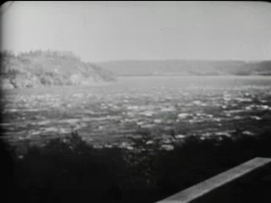
Tacoma Narrows Bridge collapse

Slide 6

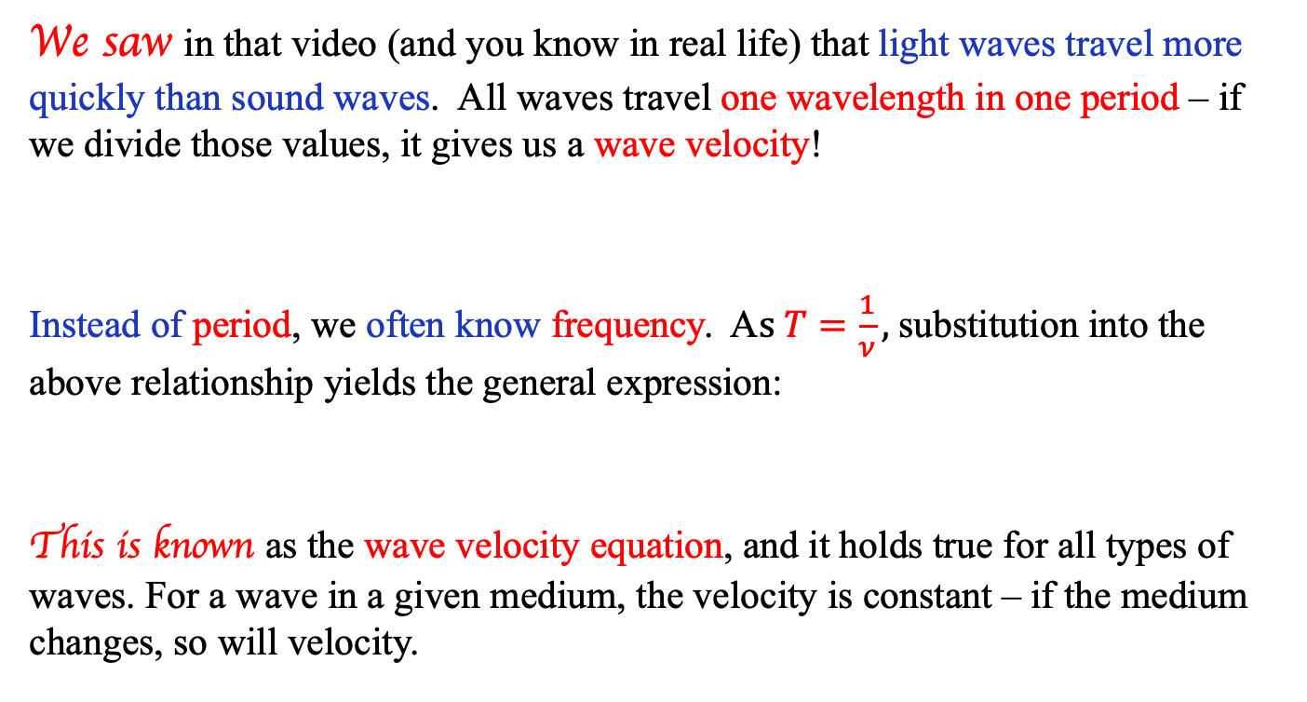

Wave velocity
We saw in that video (and you know in real life) that light waves travel more quickly than sound waves. All waves travel one wavelength in one period – if we divide those values, it gives us a wave velocity!
Instead of period, we often know frequency. A$s T=\frac{1}{ν},$substitution into the above relationship yields the general expression:
This is known as the wave velocity equation, and it holds true for all types of waves. For a wave in a given medium, the velocity is constant – if the medium changes, so will velocity.
$$\frac{λ}{T}=velocity in m/s$$
$$v=λν$$

Slide 7



Waves
Mechanical waves are the propagation of a DISTURBANCE through a medium.
Note that light is not a mechanical wave as it has no medium through which it propagates—we’ll talk about electromagnetic waves later . . .
Note also that what makes waves useful is that they all carry energy . . .
A transverse waves is a mechanical wave that is produced by a force that is applied perpendicular to the direction of the wave’s propagation through its medium.
A longitudinal waves is a mechanical wave that is produced by a force that is applied parallel to the direction of the wave’s propagation through its medium.
transverse
longitudinal
rarifaction
compression
The up and down motion of the string is perpendicular to the direction of wave propagation
The back and forth motion of the string is parallel to the direction of wave propagation

Slide 8
Transverse waves
Transverse waves are classified by their
  Amplitude: maximum displacement from equilibrium to a crest (or trough)
  Wavelength: distance between two identical points on the wave (crest/crest, trough/trough, midpt/midpt)
Classic examples are:
  Shaking a rope or slinky side to side
  Dropping a stone in a pond and watching the ripples go outward
  S-waves in an earthquake
We’ll use the rope analogy most when representing waves because it’s easier to visualize, but they’re not the only type!

Slide 9
Longitudinal Waves
Longitudinal waves are classified by their
  Compressions and rarefactions: areas of minimum and maximum density as the medium vibrates. Amplitude can be found if you can measure how much a point moves from equilibrium to maximum compression or extension.
  Wavelength: distance between successive compressions or rarefactions
Classic examples are:
  Scrunching up an extended slinky and letting it go
  Sound waves
  P-waves in an earthquake
All longitudinal waves require a medium! Why? What problem does this bring up in modern cinema?
Sorry, Star Wars…

Slide 10
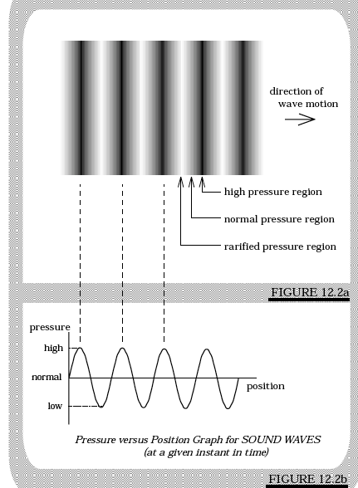
Visualizing longitudinal waves
Longitudinal waves do not have a sinusoidal look to them. In the case of sound, where the disturbance is a variation in air pressure that moves through, say, a room, the look is that of a region of dense air bracketed by regions of less or more dense air on either side. If you take a snapshot of such a situation, though, and map the density from point to point, you will find the graph produced will be sinusoidal.
The example to the right is of a sound wave’s pressure-variations plot, as lifted from Fletch’s text.

