Slide 1
General announcements

Slide 2
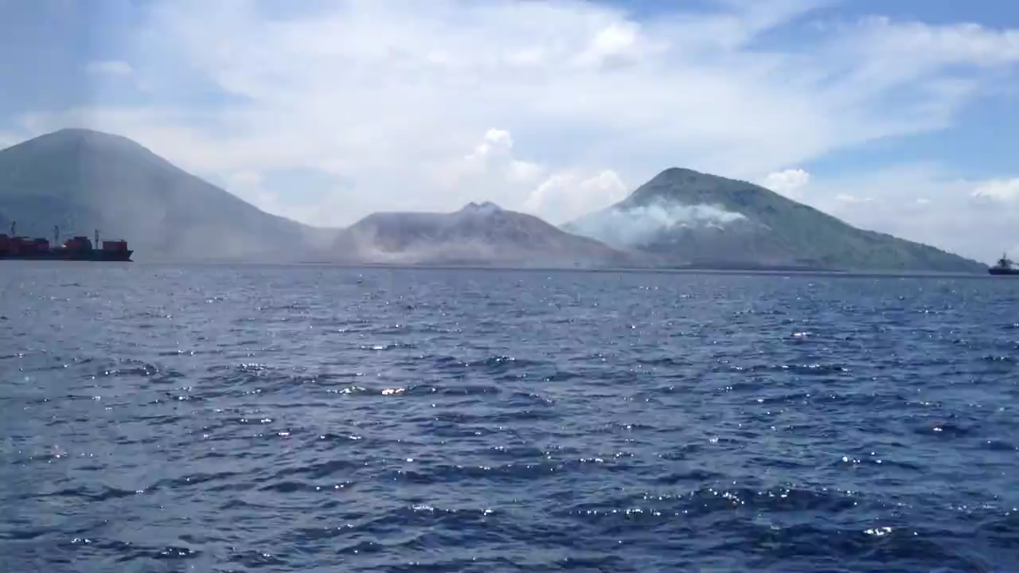
A cool example of a Wave – Mt Tavurvur Volcano
Video credit: Phil McNamara

Slide 3

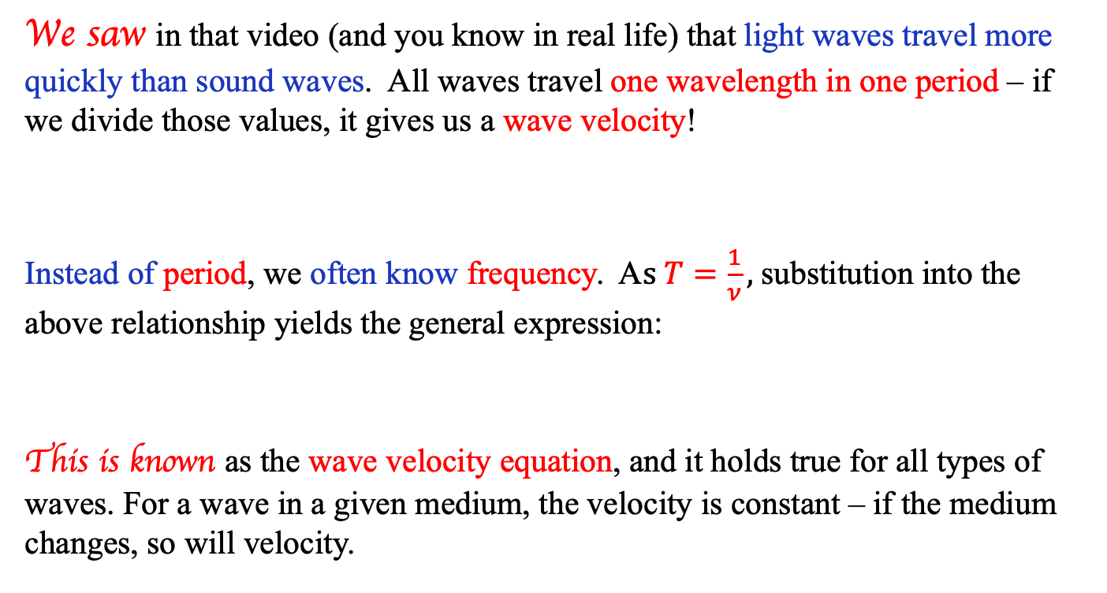
Wave velocity
We saw in that video (and you know in real life) that light waves travel more quickly than sound waves. All waves travel one wavelength in one period – if we divide those values, it gives us a wave velocity!
Instead of period, we often know frequency. A$s T=\frac{1}{ν},$substitution into the above relationship yields the general expression:
This is known as the wave velocity equation, and it holds true for all types of waves. For a wave in a given medium, the velocity is constant – if the medium changes, so will velocity.
$$\frac{λ}{T}=velocity in m/s$$
$$v=λν$$
3.)

Slide 4
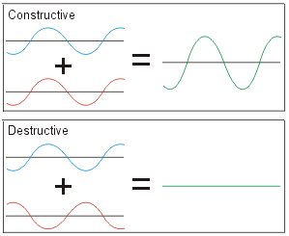
What happens when waves interact?
When two waves meet, for an instant their energies combine to form a new wave
  The combination is only for the instant during which both occupy the same point—afterward, each individual wave continues on its way
Constructive interference creates a greater amplitude than either wave alone
Destructive interference results in a smaller amplitude than either wave alone
4.)

Slide 5
How about when waves hit a boundary?
Questions to ponder as we play with waves on a rope…
  If I shake a rope that is attached to a fixed point (e.g. a wall), what happens when the wave pulse hits that fixed point?
  What happens if I keep jiggling the rope randomly and allowing the pulses to bounce back?
  What happens if I jiggle the rope at just the right frequency? How about at faster frequencies?
5.)

Slide 6
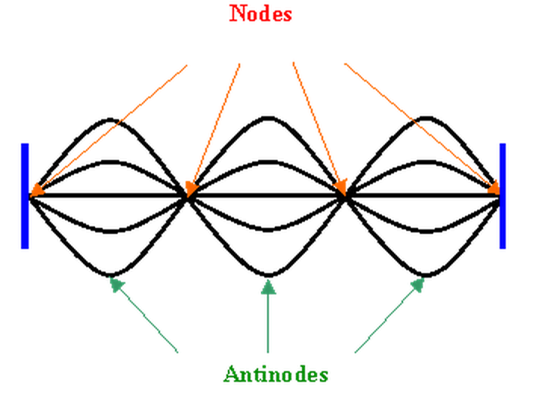
Standing waves
Under the right conditions, the bouncing waves will superimpose in an orderly fashion, almost seeming to “stand still” on the rope. This is called a standing wave.
The “right conditions” are, essentially, those of resonance (though having reson- ance does not guarantee a standing wave--a kid on a swing experiences resonance when the parent pushes but a standing wave doesn’t come with that situation).
  If the frequency of the force causing the system to vibrate matches one of the natural frequencies of the system, the resulting superposition will produce a standing wave.
A standing wave’s anatomy is described by “nodes” (areas of no motion) and “antinodes” (areas of maximum motion).
http://web.utk.edu/~cnattras/Physics221Spring2013/modules/m10/images/stand.gif
6.)

Slide 7

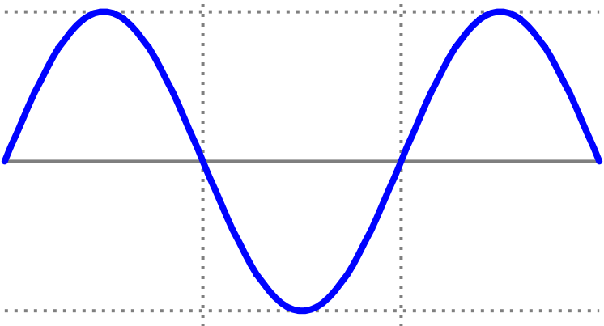


How do standing waves work?
What observations do we have to help determine what kind of a standing wave will be produced for a system? Let’s recap what we know so far:
1.) A wave is traditionally characterized by its frequency $ν$, its wavelength $λ$ and its wave velocity v.
v (meters/second)
2.) The relationship between these three parameters is:
7.)

Slide 8
3.) That means that if we know the wave velocity, and if we can determine the “appropriate wavelength” for a given situation, we can determine the frequency of the wave and, hence, the frequency our force must vibrate at to generate a standing wave.
4.) So how to get the “appropriate wavelength” for a given system?
Let’s look at our rope situation. What constraint must be satisfied by our “appropriate wavelength”?
It better have a node (a “fixed” point) at each end, as each end is tied to a rigid structure and can’t move. What kind of wave will do that? Three are shown below.
NOTICE: In all three cases, the end-point constraints are met (that is, they ALL have nodes at both ends of their respective wavelengths).
8.)

Slide 9
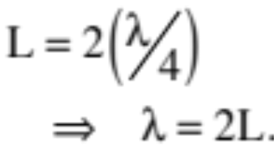
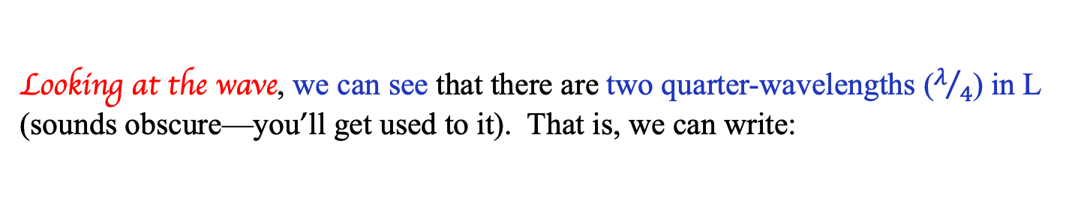
5.) This is all fine and dandy, but how does it help with our problem? It helps because we know that the span between the ends is a fixed distance “L.” All we have to do it link “L” to the wavelengths viewed, and we have the wavelengths in terms of a know quantity. Specifically:
a.) For the first situation: We know “L,” so the question is, “How many wavelengths are in “L?”
L
Looking at the wave, we can see that there are two quarter-wavelengths ($λ/4$) in L (sounds obscure—you’ll get used to it). That is, we can write:
9.)

Slide 10
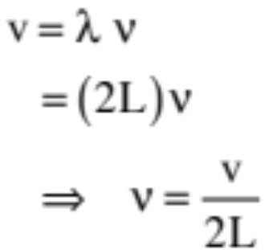
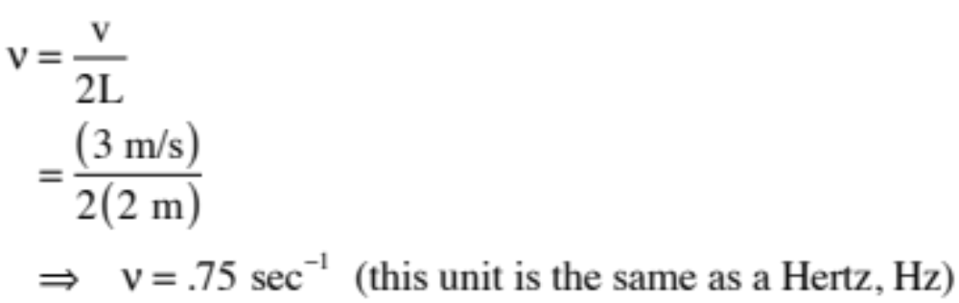
6.) Assuming we know the wave velocity (this would normally be given), we can write:
7.) So let’s say the wave velocity is 3 m/s and the length of the rope is 2 meters. That means:
10.)

Slide 11
8.) Apparently, if we jiggle the rope at .75 Hz, we will get a standing wave on the rope that, over time, looks like:
9.) We could do a similar bit of analysis for the other two waveforms.
10.) ONE OTHER THING: If there had been any internal constraints—if, for instance, we had pinched the rope at L/2 making that point a node, then our waveform wouldn’t have worked (look at it—there is an anti-node—an extreme—at L/2) and we would have had to have done a bit more thinking (you’ll see examples of this in class).
11.)

Slide 12
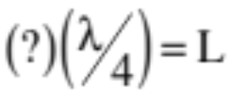
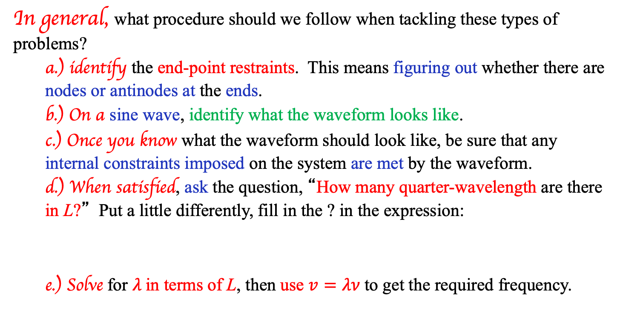
Standing wave behavior
In general, what procedure should we follow when tackling these types of problems?
  a.) identify the end-point restraints. This means figuring out whether there are nodes or antinodes at the ends.
  b.) On a sine wave, identify what the waveform looks like.
  c.) Once you know what the waveform should look like, be sure that any internal constraints imposed on the system are met by the waveform.
  d.) When satisfied, ask the question, “How many quarter-wavelength are there in L?” Put a little differently, fill in the ? in the expression:
  e.) Solve for $λ$in terms of L, then use $v=λν$to get the required frequency.
12.)

Slide 13
Pipe closed at one end
Another example of a standing wave is the waveform that is generated when air is piped through a tube.
1.) Consider a pipe of length L closed at one end. What frequency of sound will stand in the pipe?
→ In a problem like this, the first thing you have to do is identity what standing waves will fit in the pipe. To do that, you have to begin by identifying the end-point constraints.
→ For a pipe closed at one end, the end-point constraints dictate an anti-node at the open end and a node at the closed end.
13.)

Slide 14
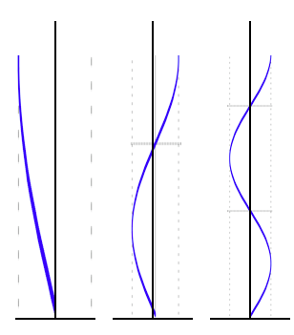





Pipe closed at one end
→ The waveforms that fit the bill are shown below, then reproduced in the vertical:
14.)

Slide 15
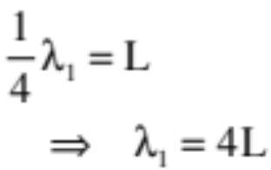
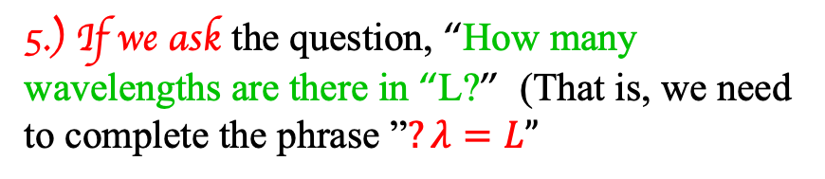
Pipe closed at one end
4.) Each section of wave has a numerical length equal to the length of the tube, or “L.”
5.) If we ask the question, “How many wavelengths are there in “L?” (That is, we need to complete the phrase ”$?λ=L”$
By examination, there is ONE quarter-wavelength in “L,” so we can write:
Minor Note: In real life, the effective length of the tube has to be altered due to perturbation effects at the ends. In the case of a singly open tube, the effective length of the tube isn’t “L” but rather “L+.4d,” where “d” is the tube’s diameter. If open at each end, it’s “L+.8d.”
15.)

Slide 16
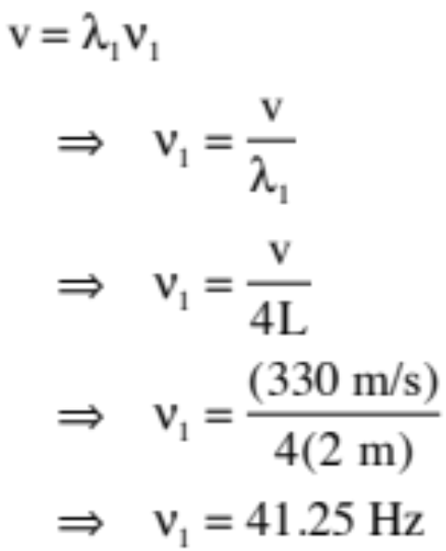
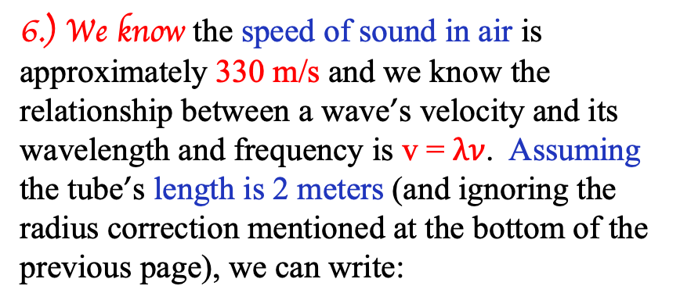
6.) We know the speed of sound in air is approximately 330 m/s and we know the relationship between a wave’s velocity and its wavelength and frequency is v = $λν$. Assuming the tube’s length is 2 meters (and ignoring the radius correction mentioned at the bottom of the previous page), we can write:
7.) Put a 41.25 Hz tuning fork at the mouth of our tube and it will howl quite loudly.
16.)

Slide 17
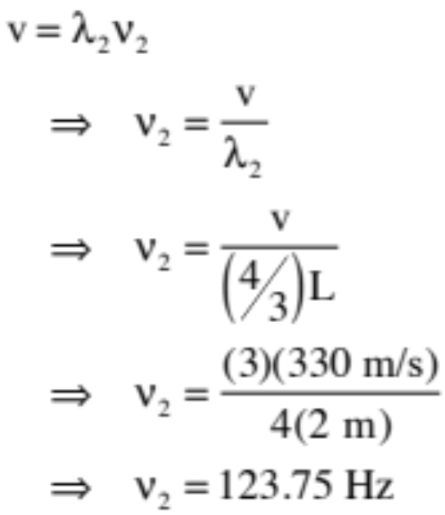
8.) Doing the same calculation for the second situation where there is three-quarter of a wave in “L,” we can write:
9.) Put a 123.75 Hz tuning fork at the mouth of our tube and it will howl quite loudly.
17.)

Slide 18
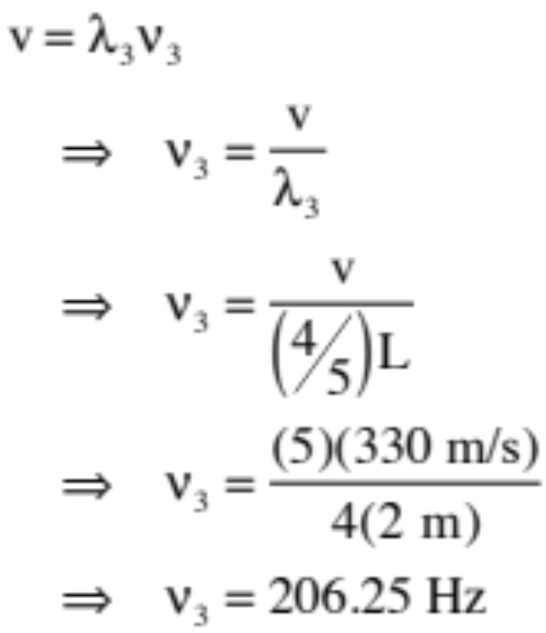
10.) Doing the same calculation for the third situation where there is five-quarters of a wave in “L,” we can write:
11.) Put a 206.25 Hz tuning fork at the mouth of our tube and it will howl quite loudly.
18.)

Slide 19
Pipe open at both ends
Consider a pipe of length “L” open at both ends. What frequency of sound will stand in the pipe?
→ In a problem like this, the first thing you have to do is identity what standing waves will fit in the pipe. To do that, you have to begin by identifying the end-point constraints.
→ For a pipe open at both ends, the end-point constraints dictate anti-nodes at the both ends.
19.)

Slide 20
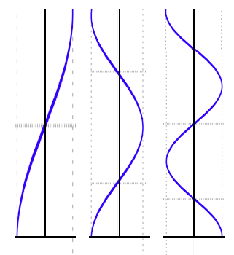
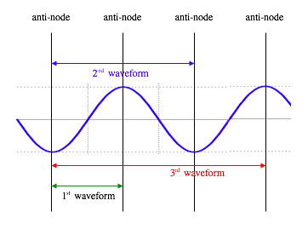
On the sine wave presented below, you can see the waveforms that satisfy the end-point constraints. Once determined, they can be put on the sketch to the right.
20.)

Slide 21
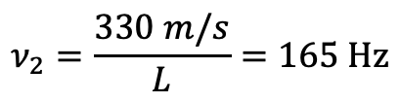
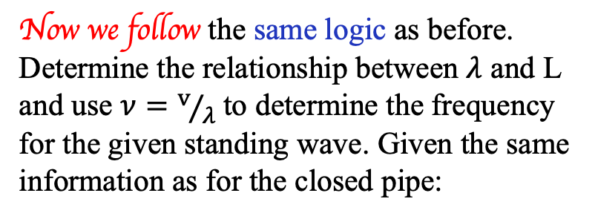
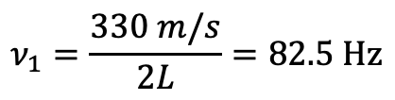
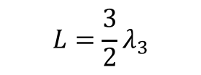
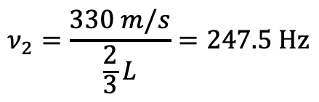
Now we follow the same logic as before. Determine the relationship between $λ$ and L and use $ν=v/λ$ to determine the frequency for the given standing wave. Given the same information as for the closed pipe:
$$ν_{1}=\frac{330 m/s}{2L}=82.5 Hz$$
$$ν_{2}=\frac{330 m/s}{L}=165 Hz$$
$$ν_{2}=\frac{330 m/s}{\frac{2}{3}L}=247.5 Hz$$
$$L=\frac{1}{2}λ_{1}$$
$$L=λ_{2}$$
$$L=\frac{3}{2}λ_{3}$$
21.)

Slide 22
Pipes and strings
You may have noticed that as more fractions of a wave were added inside the pipe, the frequency associated with that wave increased in a regular fashion
  The same thing happens on a string, too! It follows a similar pattern to an open pipe.
The lowest frequency that will produce a standing wave in a pipe or on a string is called the fundamental frequency or first harmonic. This is the base “note” it will play
  Plucking or bowing an open string will make its first harmonic sound loudly (e.g. plucking the A string on a cello creates a 220 Hz sound)
  Blowing across the top of a pipe will play a characteristic sound too
The related frequencies above the fundamental are harmonics, which are related to the base frequency by the factors we found before
To change a note, you change the length of the string (by putting a finger down) or the length of the pipe (by opening/closing valves or holes), which changes the fundamental frequency
22.)

Slide 23
What’s really going on…
Sticking with a string instrument for now, when you pluck an open string, the fundamental frequency vibrates the loudest – but it’s not the only frequency resonating on that string!
  All the harmonics are also producing standing waves at the same time, and superimposing together to create one complex sound wave!
  This mix of frequencies gives the instrument its “timbre,” or characteristic sound (how we tell a cello from a ukulele, for example)
23.)

Slide 24
Practice problem #1
A piccolo is .32 meters long and open at both ends.
a.) What is the lowest frequency the piccolo can play if the speed of sound in air is 340 m/s?
b.) If the highest note the piccolo can sound is 4000 Hz, what must be the distance between adjacent antinodes?
24.)

Slide 25
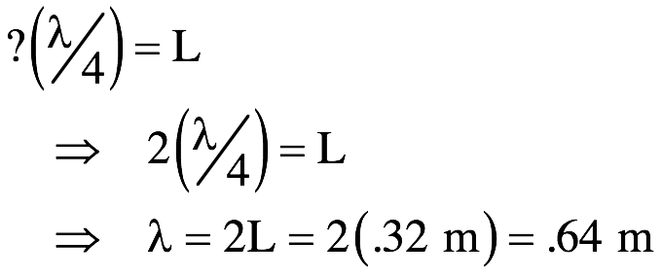
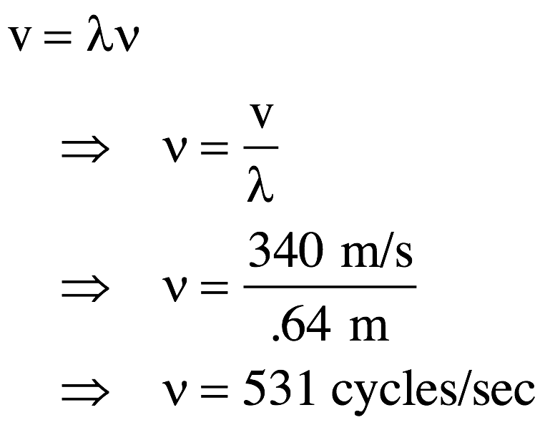
Solution – problem #1
a.) What is the lowest frequency the piccolo can play if the speed of sound in air is 340 m/s?
With both ends acting like antinodes, the wave form associated with the lowest frequency will look like the form shown to the right. In that case, there are two quarter-wavelengths in L. That is:
Knowing the wave velocity, we can write:
25.)

Slide 26
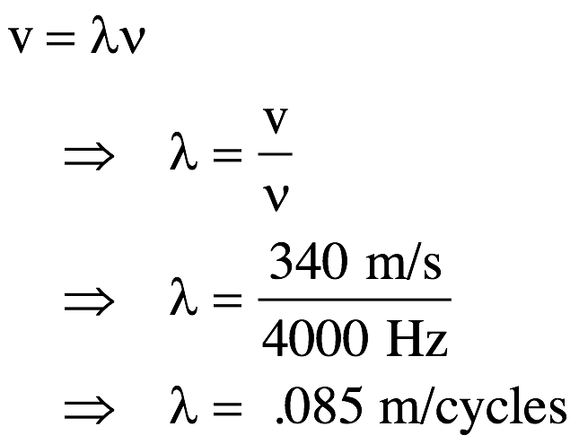
b.) If the highest note the piccolo can sound is 4000 Hz, what must be the distance between adjacent antinodes?
The distance between antinodes is equal to half the wavelength of the wave in question. At 4000 Hz, we can write:
Half this yields an antinode to antinode distance of .0425 meters, or 4.25 cm.
26.)

Slide 27
Problem #2
A tunnel is 20,000 meters long.
a.) At what frequency can the air in the tunnel resonate?
b.) Would it be a good idea to honk a horn in tunnel like this?
27.)

Slide 28
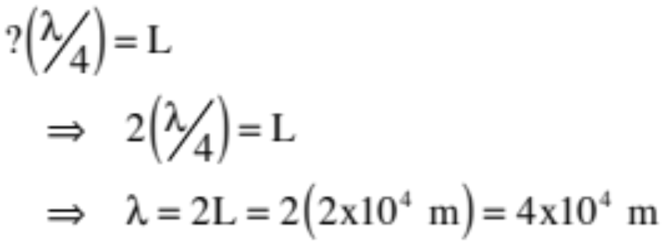
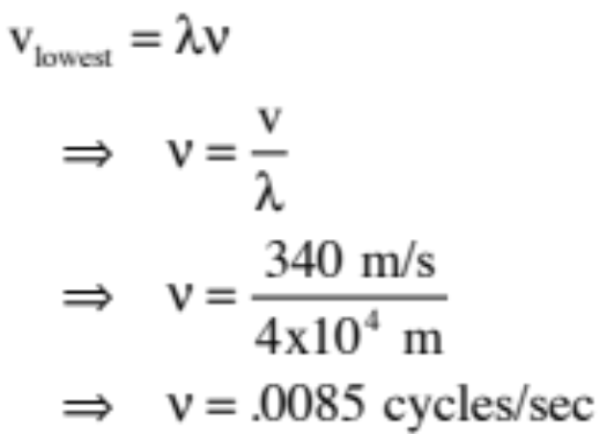
Solution – problem #2
a.) At what frequency can the air in the tunnel resonate?
The longest wavelength that can stand (highest frequency) looks like the form shown to the right. The frequency associated with that is:
So:
28.)

Slide 29

Solution – problem #2
The harmonics will be multiples of this “lowest frequency,” or:
where “n” is any number from 1 to infinity.
b.) Would it be a good idea to honk a horn in tunnel like this?
Our ears are sensitive to frequencies between 20 Hz and 20,000 Hz (assuming we haven’t messed them up by now). Trillions of trillions of multiples of .0085 happen within those bounds. In other words, just about any horn blast has the potential of resonating in a tunnel.
29.)

Slide 30
Problem #3
A copper bar of length L = 3 m is pinned in two places, ¼ L in from each end. The metal bar is struck and allowed to vibrate, and the primary frequency it produces is measured as 1230 Hz.
a.) Sketch the waveform corresponding to the lowest frequency that can stand on the bar (as we’ve done before).
b.) What’s the speed of sound in the copper bar?
30.)

Slide 31
Solution – problem #3
a.) Sketch the waveform (as we’ve done before).
Usually you start with is a wave train:
In this case, you need antinodes at each end and two interior nodes at L/4 from each end.
The first two antinodes won’t do as there is only one interior node between them (see sketch).
Going to the third antinodes does include two nodes interior, and they happen to be in the right place . . . so there is our waveform.
31.)

Slide 32
Fitting the waveform onto the bar (which you don’t have to do, but I’m doing for educational purposes), you can see how it fits . . .
b.) What’s the speed of sound in the copper bar?
$$v=λν=\left(L\right)ν=\left(3 m\right)\left(1230 Hz\right)=3690 m/s$$
For another, slightly longer example, see Fletch’s video (zPoly30) linked on the calendar.
32.)

