Slide 1

CHAPTER 3:
VECTORS AND SCALARS
Scalars (magnitude only)
(not 78 degrees down or up, just 78 degrees—just a relative measure of the average amount of kinetic energy per molecule of air)
Vectors (magnitude and direction . . . direction matters!)
There are two ways to deal with vectors, graphically and in conjunction with a coordinate axis. We’ll start with the graphical approach first.
1.)

Slide 2









STRAIGHT GRAPHICAL VECTOR ADDITION/SUBTRACTION
A+B+C+D
A+B-C+D
2.)

Slide 3

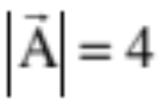
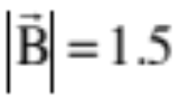






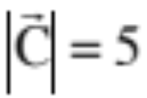


GRAPHICAL MANIPULATION FROM POLAR INFORMATION
individual vectors:
(VECTOR ADDITION using a centimeter stick and protractor to measure both the vectors and the resultant)
(Reproduce vectors to scale using cm. stick and protractor)
(using cm. stick and protractor)
3.)

Slide 4







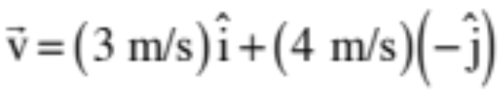
VECTORS
Vectors (defined in polar notation)
(a force whose magnitude is 8 newtons oriented at an angle of 125 degrees relative to the +x-axis)
Vectors (defined in unit vector notation)
A vector with magnitude ONE defined to be in the x-direction is called a UNIT VECTOR in the x-direction. It’s symbol is (pronounced “i-hat”). The unit vector in the y-direction is .
A vector framed in Cartesian coordinates in unit vector notation might look like:
(this is really the addition of a mini-vector of magnitude 3 m/s in the x-direction and a min-vector of magnitude 4 in the minus y-direction)
4.)

Slide 5

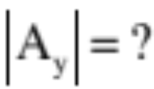
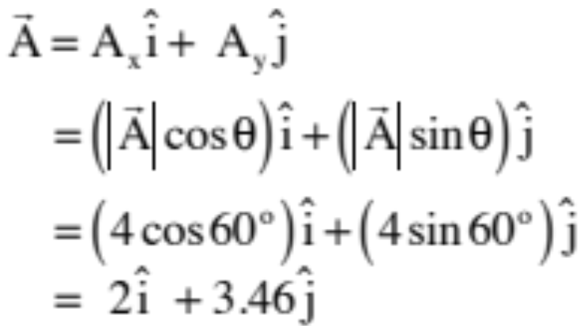

CONVERSIONS
POLAR TO UNIT VECTOR NOTATION
Example 1:
In looking at the sketch, you can use trig to write:
5.)

Slide 6

Vector conversions
How do we go from polar to unit vector notation?
  Example 2:
This is a little bit trickier because you are no longer looking at a first-quadrant triangle. There are two ways to do this. The easiest is to create a triangle that IS a right triangle (see sketch), determine its sides, then add whatever signs and unit vectors are needed to characterize the vector. Remember, what you are doing with unit vector notation is creating mini-vectors, one in the x-direction, one in the y-direction, and adding them.
6.)

Slide 7
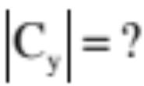


Example 2:
7.)

Slide 8
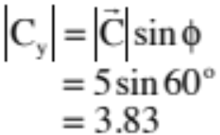
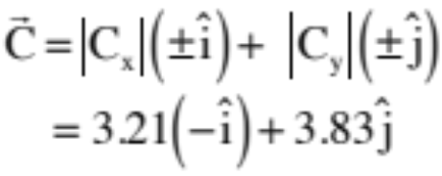
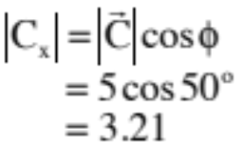
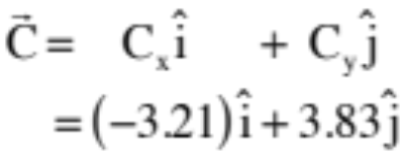
Vector conversions
In looking at the sketch, you can either use the magnitudes, which are always positive, and manually put in the signs for the unit vectors, yielding:
OR write it in terms of components, which carry along the signs with them, yielding:
You get the same result either way.
8.)

Slide 9

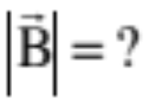
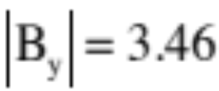
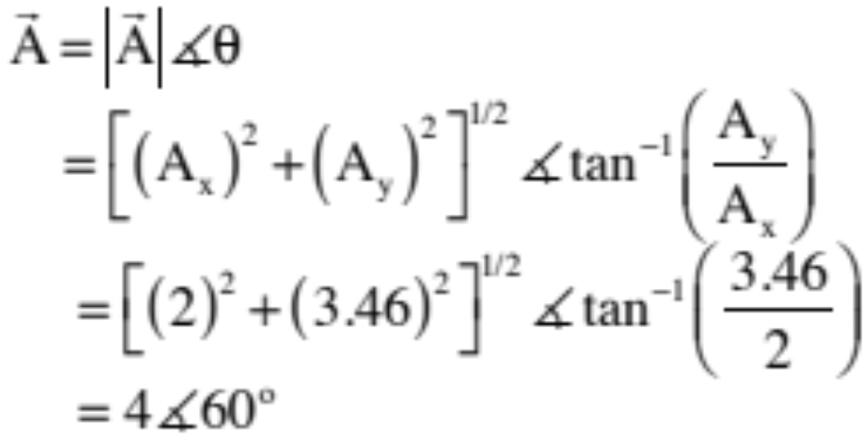



UNIT VECTOR to POLAR NOTATION
Example 1:
In looking at the sketch and noting that you can get the magnitude using the Pythagorean relationship and the angle using the tangent function, we can write:
Note that is ALWAYS positive.
9.)

Slide 10

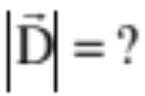
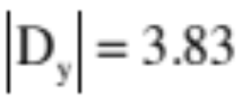


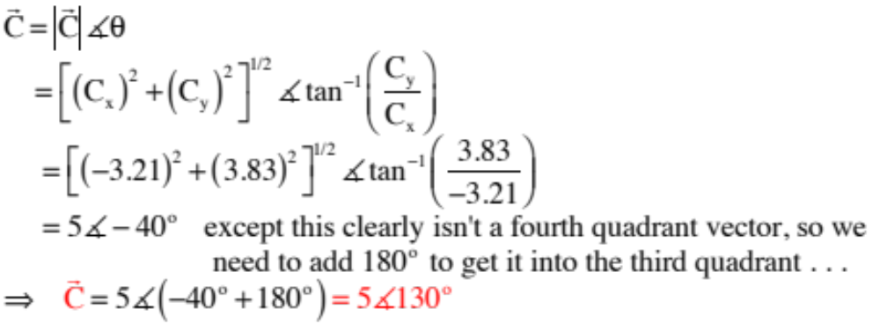
Example 2:
Again, in looking at the sketch and noting that you can get the magnitude using the Pythagorean relationship and the angle using the tangent function, we can write:
10.)

