Slide 1







CHAPTER 4:
Some Definitions and 2-d Kinematics
Position
(a position “x” or “y” denotes a coordinate, relative to a coordinate axis)
Position Vector
(a position vector, often denoted as , is a vector that denotes a point in space relative to some defined point, often the origin of a coordinate axis)
or
(position vectors can be written either in polar or unit vector notation)
(note that the SIGN of the position vectors tells you which side of the origin the point is on)
1.)

Slide 2



Note:
A radial unit vector has a magnitude of 1 and is directed radially outward from the origin. An example of its usefulness is shown on the next slide.
$$\hat{r}$$
$$\hat{r}$$
$$\hat{r}$$
Note that ” r “ is sometimes used to denote a general vector ( ,whether in unit vector or polar notation). This can be confusing because a radial unit vector also uses an “r,” except it includes a hat over it ( ).
$$\hat{r}$$
2.)

Slide 3
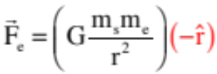



Example of Radial and Tangential Vectors
Example of radial vector ( ):
The earth’s feels an attractive force due to the presence of the sun that is along a line between the sun and the earth. A radial vector in the negative direction does nicely for this.
Example of vector in tangential direction ( ):
The earth motion in its orbit (assumed circular) can be assumed to have the same magnitude but an every changing direction. It is always moving in the “tangential” direction, though, so characterizing it in the “theta” direction works well here.
3.)

Slide 4


Position Vector (con’t)
So what’s the deal with that last vector? To get it, consider the others:
--In Cartesian coordinates, the unit vector notation of is:
which sees you taking the x-component of times its unit vector, etc.
--In Cartesian coordinates, the polar notation of is:
where the magnitude and angle of are uppermost.
4.)

Slide 5



Velocity (a vector that measures the time-rate-of change-of position, the number of m/s, at which an object covers ground)
Average Velocity (the single velocity at which an object must travel to displace a given distance in a given amount of time)
Instantaneous Velocity (an object’s velocity at a particular point in time)
Velocity Vector (with examples):
or
Note that the SIGN of the velocity vectors tells you the direction in which the object is traveling (this is most obvious in one dimension where a velocity is a velocity in the negative x-direction).
5.)

Slide 6


Acceleration (a vector that measures the time-rate-of change-of velocity, the number of m/s/s, at which an object covers ground)
Average Acceleration (the single acceleration at which an object must accelerate to change its velocity a given amount in a given amount of time)
Instantaneous Acceleration (an object’s acceleration at a particular point in time)
Acceleration Vector (with examples):
or
Note: the SIGN of the acceleration vectors tells you NOTHING about the speeding up or slowing down of an object without your knowing the direction of the velocity vector. Likes signs mean a velocity increase; unlikes mean velocity decrease.
6.)

Slide 7
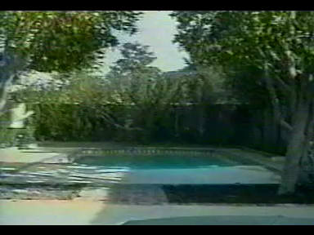
2-d Kinematics
Two-dimensional kinematics is classically modeled as a projectile problem. Example:
7.)

Slide 8
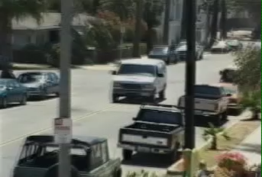
2-d Kinematics
Another example:
8.)

Slide 9

2-d Kinematics
A third example:
9.)

Slide 10
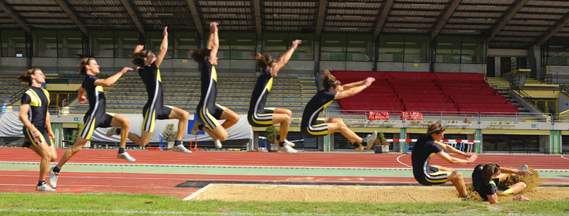
2-d Kinematics
And, lastly, something a little less disturbing . . . (courtesy of Mr. White)
Notice, she goes the same distance in the x-direction per unit time . . . Why?
10.)

Slide 11






Some Slightly Exotic Calculus
Let’s say you’ve thrown a ball off a cliff that is h meters high. Ignoring air friction, the ball’s velocity in the x-direction is observed to be (this will not change as there are no frictional effects to make the change). The red dashed line in the time lapse photo to the right shows the motion.
The relationship between the y-coordinate and the x-coordinate just happens to be:
where h is the height of the cliff and k is a constant related to gravity. (In fact, this is the equation for a downward pointing parabola.)
In terms of time, the x-coordinate of the body is:
where, again, is the constant velocity of the body in the x-direction.
11..)

Slide 12
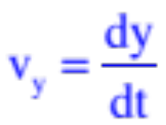
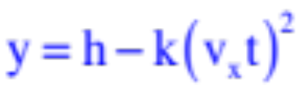
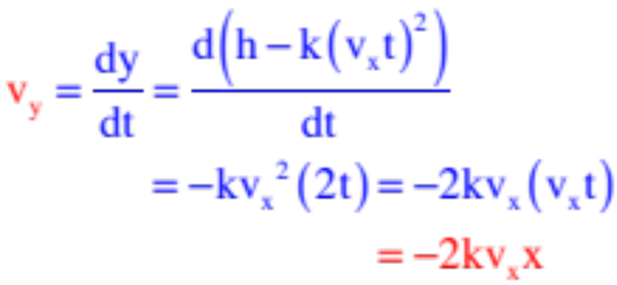
So here’s the question: With
and
what is the ball’s velocity in the y-direction in terms of x?
Knowing that the velocity in the y-direction is the time derivative of the y-coordinate function, or
the chintzy way to do this would be to substitute the time-related x-coordinate function into the x-related y-coordinate function, take the time derivative, then substitute x information back into that result.
That is: If and , then by substitution ,
we can write:
12..)

Slide 13
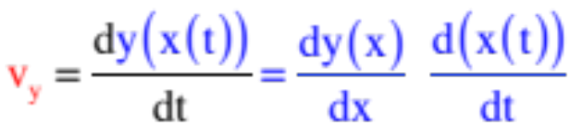
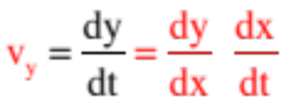
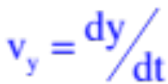
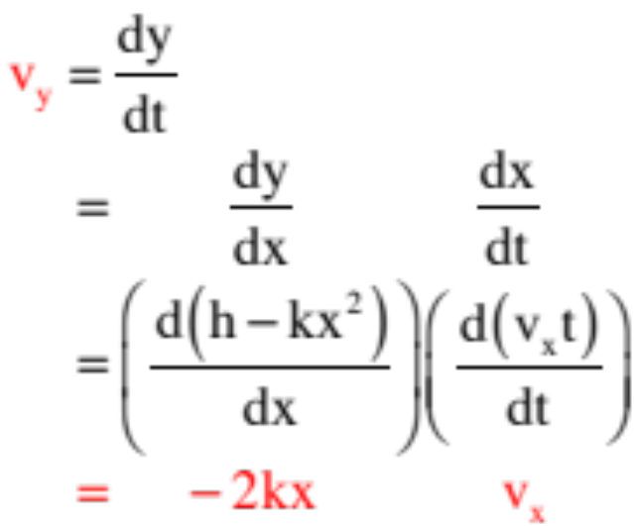
The more elegant way to do this is to utilize what is called the chain rule. It states (loosely) that if you want the derivative of a function that you know in terms of another function, you can get that result by executing the operation:
or just
(Notice how the “dx’s” might be seen to cancel, if they could, leaving us with
. . . cool, eh?)
Executing that operation, remembering that,
and
and we get:
. . . much more satisfying.
13.)

Slide 14




2-d Kinematics
Consider viewing a cannonball with muzzle velocity of 100 m/s fired from a cannon angles at as it leaves a cannon 1.5 meters off the ground on its way downrange.
What would the cannonball’s motion look like if you viewed it FROM DOWNRANGE, and you had no depth perception? More to the point:
a.) How fast would it appear to be going as it left the muzzle? And;
b.) How high would it appear to go?
14.)

Slide 15

What would the cannonball’s motion look like if you viewed it FROM DOWNRANGE and you had no depth perception? More to the point:
you viewing from downrange
What you’d initially see would be a ball moving straight upward (remember, no depth perception) with velocity equal to the y-component of the muzzle velocity.
15)

Slide 16

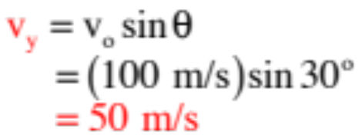
What would the cannonball’s motion look like if you viewed it FROM DOWNRANGE, and you had no depth perception? More to the point:
you viewing from downrange
What you’d initially see would be a ball moving straight upward (remember, no depth perception) with velocity equal to the y-component of the muzzle velocity. So answering:
a.) How fast would it appear to be going as it left the muzzle? We get (looking at the sketch above);
16.)

Slide 17

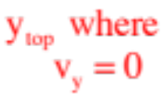
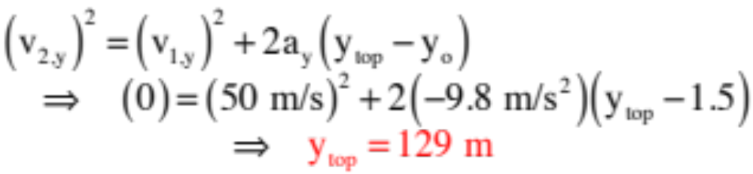

. . . AND you’d see the ball rise to the same height a ball moving straight up with velocity equal to would rise. So to answer:
you viewing from downrange
b.) How high would it appear to go?
One-dimensional kinematics in the y-direction to the rescue!
17.)

Slide 18
Notice that NONE of what we have done has had ANYTHING TO DO with the x-direction . . . we haven’t used the acceleration in the x-direction, which happens to be zero once the cannonball has left the muzzle, and we haven’t used the initial velocity component in the x-direction . . . nothing . . . We have only used y-axis information.
18.)

Slide 19

Re-consider viewing a cannonball with muzzle velocity of 100 m/s fired from a cannon angles at as it leaves a cannon 1.5 meters off the ground on its way downrange.
So what would the cannonball’s motion look like if you viewed it FROM ABOVE, and you had no depth perception? More to the point:
a.) How fast would it appear to be going as it left the muzzle? . . . How about as it moved along its way? And:
b.) How far would it travel before touchdown?
19.)

Slide 20

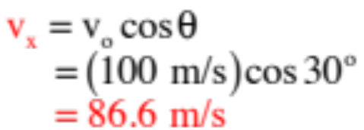
What would the cannonball’s motion look like if you viewed it FROM ABOVE and you had no depth perception? More to the point:
As viewed from above
What you’d initially see would be a ball moving straight along the ground (remember, no depth perception) with velocity equal to the x-component of the muzzle velocity. And because the acceleration in the x-direction is ZERO, you would observe that velocity to hold until the cannonball terminated its motion by hitting the ground. So answering:
a.) How fast would it appear to be going as it left the muzzle? . . . How about as it moved along its way? We have:
20.)

Slide 21





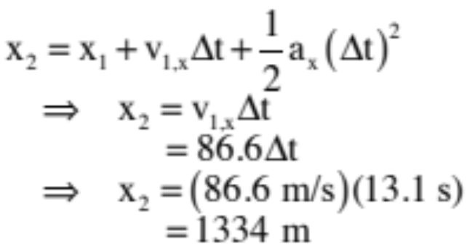
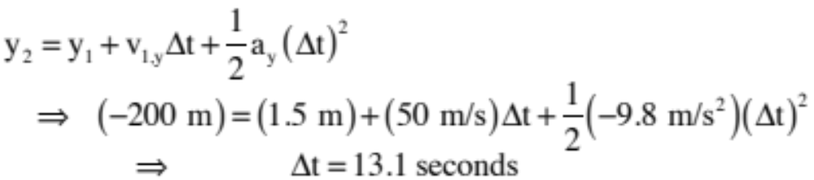
b.) How far would it travel before touchdown?
Putting everything we know onto the sketch, what kinematic relationship can we write for the x-motion? The only one that makes sense is the one that has more than the acceleration term in it, as the acceleration in the x-direction is ZERO. That is:
To get the time of flight, consider the y-direction:
Distance traveled (x-direction):
21.)

Slide 22
The moral of the story:
Projectile problems,
and all two-dimensional kinematic problems,
are really just two, independent, one-dimensional problems
HAPPENING AT THE SAME TIME.
22.)

Slide 23



Another example: Consider: A particle passes through the origin at t = 0 with velocity components and . The particle accelerated in the x-direction at a constant rate of .
a.) derive an expression for the velocity as a function of time.
b.) express the velocity (as a function of time) in unit vector notation.
c.) determine the velocity at t = 5.0 seconds.
d.) derive an expression for the x and y position as a function of time.
e.) express the position vector (as a function of time) in u.v.n.
23.)

Slide 24
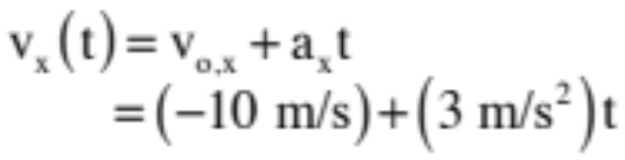
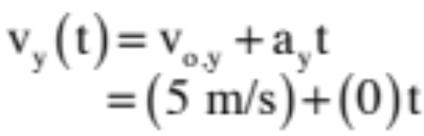

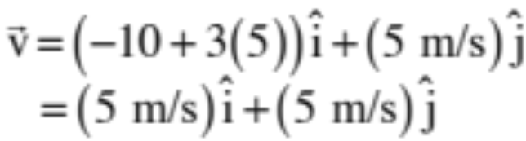
Another example: Consider: A particle passes through the origin at t = 0 with velocity components and . The particle accelerated in the x-direction at a constant rate of .
a.) derive an expression for the velocity as a function of time.
Using kinematics, which you can do as the acceleration in both directions is CONSTANT:
in the x-direction:
in the y-direction:
b.) express the velocity (as a function of time) in unit vector notation.
c.) determine the velocity at t = 5.0 seconds.
24.)

Slide 25
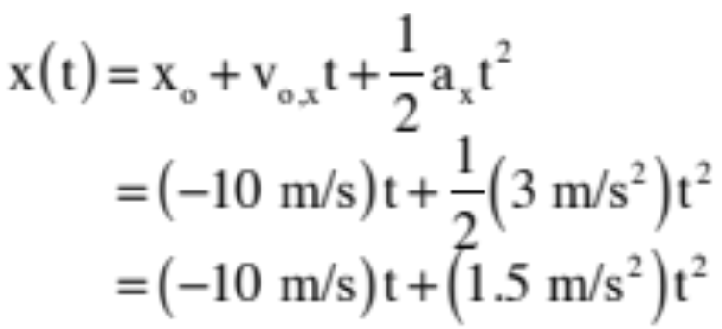
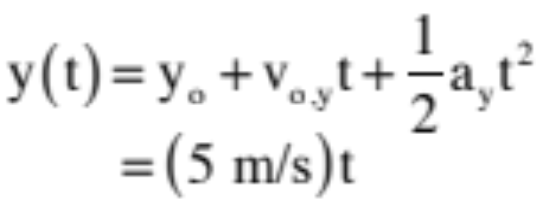
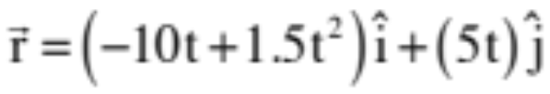
Another example: Consider: A particle passes through the origin at t = 0 with velocity components and . The particle accelerated in the x-direction at a constant rate of .
d.) derive an expression for the x and y position as a function of time.
Again, using kinematics:
in the x-direction:
in the y-direction:
e.) express the position vector (as a function of time) in u.v.n.
25.)

Slide 26

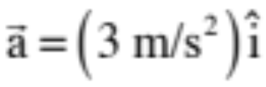
Still another example: Consider: A particle passes through the origin at t = 0 with velocity . The particle’s acceleration is
Surprise! This is the same problem you just did with the initial parameters presented in a unit vector notation instead of a components notation. I just wanted you to see at least two ways you might have information given to you.
26.)

Slide 27
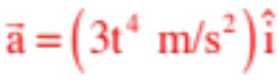
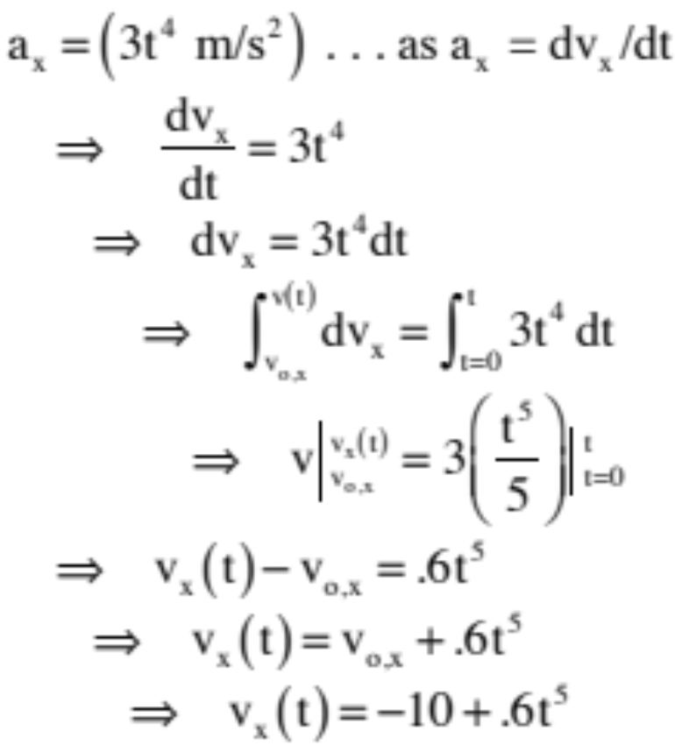
Still another, another example: Consider: A particle passes through the origin at t = 0 with velocity . The particle’s acceleration is NOT constant but, rather, equal to .
a.) derive an expression for the velocity as a function of time.
The acceleration in the y-direction is still a constant zero, so the velocity in the y-direction will be 5 m/s throughout time. In the x-direction:
27.)

Slide 28
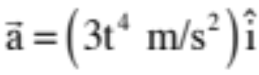
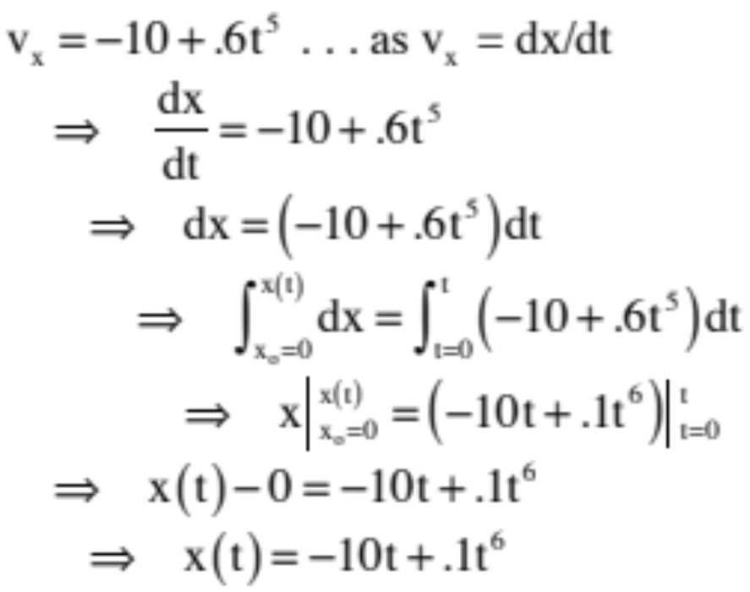
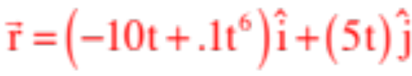
Still another, another example: Consider: A particle passes through the origin at t = 0 with velocity . The particle’s acceleration is NOT constant but, rather, equal to .
b.) derive an expression for the x and y position as a function of time.
As before with a constant acceleration in the y-direction, the y-coordinate will be (5 m/s)t. In the x-direction:
So:
28.)

Slide 29

Nice Acting, Keanu. . . Speed
1.) There is a gap in the freeway. Convert the gap’s width to meters.
2.) How fast is the bus traveling when it hits the gap? What is its velocity in m/s?
3.) Keanu hopes that there is some “incline” that will assist them. Assume that the opposite side of the gap is 1 meter lower than the take-off point. Also, the stunt drivers that launch this bus clearly have the assistance of a “take-off ramp” from which the bus launches at an angle. Assume that the ramp’s angled at above the horizontal. Prove whether or not the bus makes it to the opposite side. (Consider the bus as a point mass.)
29.)

Slide 30
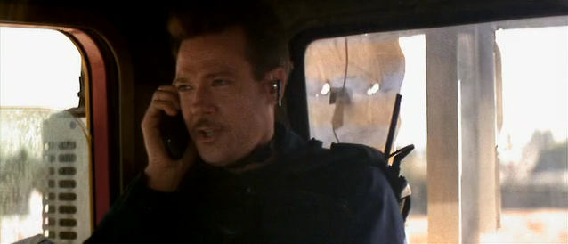
30.)

Slide 31






Center Seeking Acceleration
Consider a ball moving with a constant velocity magnitude v around a circular path. What kind of acceleration must be present?
For the body to execute this motion, there must be an acceleration pushing it out of straight-line motion. An acceleration that does this is called a centripetal acceleration. The direction of a centripetal acceleration is always along the radial-axis (i.e., center seeking).
Kindly note: What changes with a centripetal acceleration is not the velocity magnitude, it is the velocity direction!
31)

Slide 32






So how can we relate a centripetal acceleration to the radius of the arc R and magnitude of velocity of motion v?
Look at how the body’s velocity vector changes after the body displaces an angular distance of (that change is shown below as a vector subtraction).
Notice that the direction of that velocity change is, more or less, toward the center of the arc upon which the body rides. In fact, as the angle goes to zero, that direction would become dead-on center seeking.
Notice also that the triangle itself is isosceles.
32.)

Slide 33


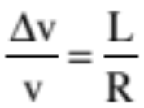


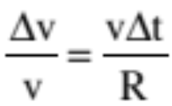
Now consider the dotted triangle (look at sketch). It is also isosceles, and it is similar (in a mathematical sense) to the velocity triangle (same ).
Being similar, we can equate side ratios.
But “L” is just the distance traveled in time , which means , so we can write.
33.)

Slide 34
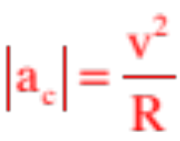
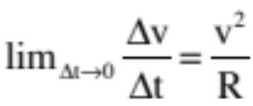
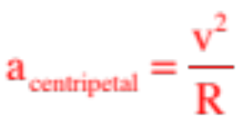
Rearranging and letting time go to zero in the limit, we can write:
Except the change of velocity in the limit as time goes to zero is the definition of an instantaneous acceleration, and because we’ve already deduced that this acceleration is center seeking in nature, we must be looking at a centripetal acceleration.
In short, any object moving along a curved path will need a component of acceleration that is centripetal (center seeking) in nature, and the magnitude of that acceleration component will always be related to the radius of the arc and the magnitude of the velocity vector by:
34.)

Slide 35
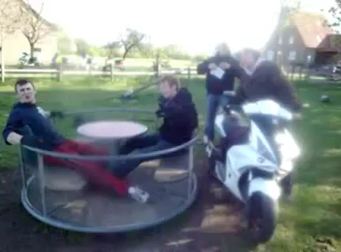
35.)

Slide 36
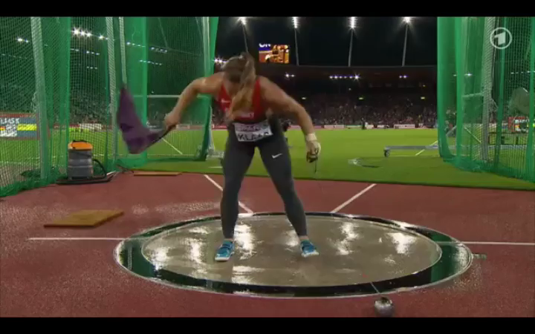
36.)

Slide 37
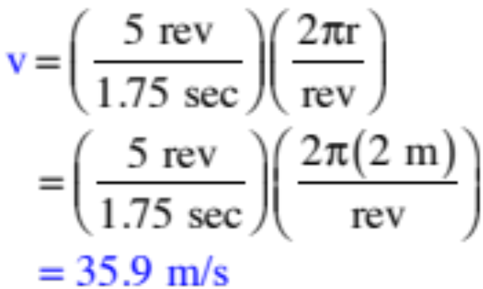
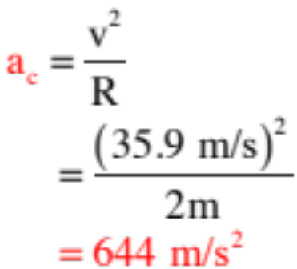
Example: The woman in the previous video was swinging a 4 kg ball at the end of a 1.2 meter long chain at a rate of 5 revolutions in 1.75 seconds (I measured it!). Assuming her arms were .8 meters long, how large a centripetal acceleration would she have to exert on the ball to launch it as she did? In what direction did she exert that force. What happened to the ball when she ceased to exert that acceleration in that direction?
We need the magnitude of the velocity:
So the centripetal acceleration will be:
And the direction will be toward the center of the ball’s arc until release, at which time the ball will travel tangent to that arc out away from the woman.
37.)

Slide 38





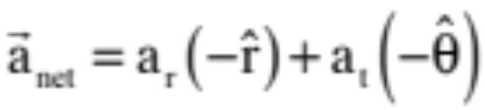
Consider the accelerating cart rolling over the curved path shown. At Point A, the cart is picking up speed due to an accelera-tion that is tangential to the path , and it will be changing its velocity direction due to a radial (centripetal) acceleration that is oriented toward the center of the arc upon which the cart is traveling. Both accelerations are denoted in the sketch.
Use a unit vector notation in a polar-spherical coordinate system to denote the net acceleration:
38.)

Slide 39




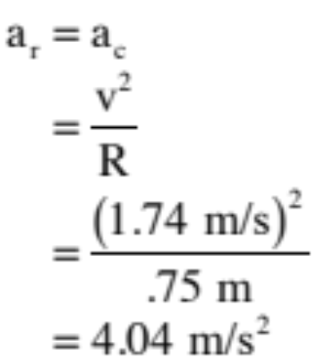

Another Example: Consider a pendulum bob is attached to a string of radius R = .75 m and allowed to swing as shown to the right. At the angle , the bob is found to be moving with velocity magnitude 1.74 m/s. With the only force in the tangential direction being from gravity (and equaling ), determine the net acceleration acting and denote it using u.v.n. in terms of polar-spherical coordinates.
Radially (centripetally):
. . . And why am I not claiming that the acceleration in the radial direction is ?
(Answer: Because gravity isn’t the only force acting radially—you also have tension to contend with . . . )
39.)

Slide 40
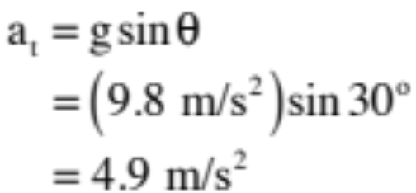
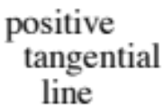



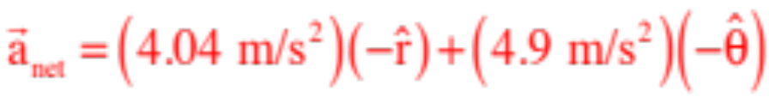
Tangentially along the arc:
So assuming a counterclockwise rotation is associated with a positive tangential direction, the net acceleration is:
40.)

Slide 41




RELATIVE MOTION PROBLEMS
CONSIDER: a frame of reference that is moving with known velocity , relative to a fixed frame of reference.
Example: say the fixed frame is this page and the moving frame is as shown:
If an object moves relative to the moving frame with known velocity
What is the objects velocity relative to the fixed frame, or ?
It is the frame velocity plus the object’s velocity relative to the frame. This can be written as:
This is all about the object’s motion. Where it gets tricky is when the frame is, itself, attached to a secondary object. To wit:
41.)

Slide 42




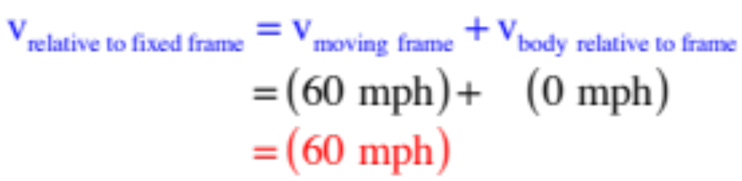
Simple Example: You are moving in a car at 60 mph. Your car is the moving frame. A second car is moving with the same speed right next to you, so relative to you, that car isn’t moving. Concerning that second car, the math says:
You are the moving frame. You—that frame—have velocity, relative to the road (the fixed frame) of:
The other car, relative to you (the moving frame), isn’t moving, so its velocity, relative to you, is zero, or:
So the velocity of the other car, relative to the roadway (the fixed frame), will be:
As expected.
42.)

Slide 43


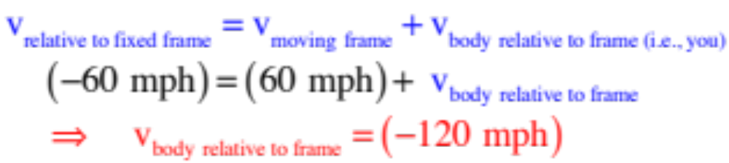
A little different look: You are moving in a car at 60 mph. You are the moving frame.
A car moves with the same speed, relative to the street (the fixed frame), but comes in the opposite direction.
You are the moving frame. You—that frame—have velocity, relative to the road (the fixed frame) of:
The other car, relative to the road, has velocity -60 mph. That means
That means the other car’s velocity, relative to you (as it passes you), will be:
Again, as expected.
43.)

Slide 44






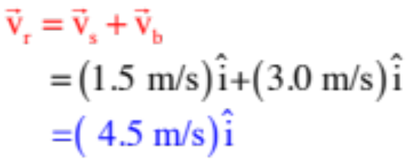
RELATIVE MOTION PROBLEMS
CONSIDER a stream moving to the right with velocity . Let’s say you have a boat that can move in standing water with velocity magnitude equal to . How fast will the boat be traveling
relative to the shoreline if the boat
travels downstream?
downstream
This is a relative velocity in the sense that it isn’t the boat’s inherent velocity, it’s its velocity relative to the shoreline, so we will tag it . In this case, just adding the two velocities together yields:
which makes sense!
44.)

Slide 45
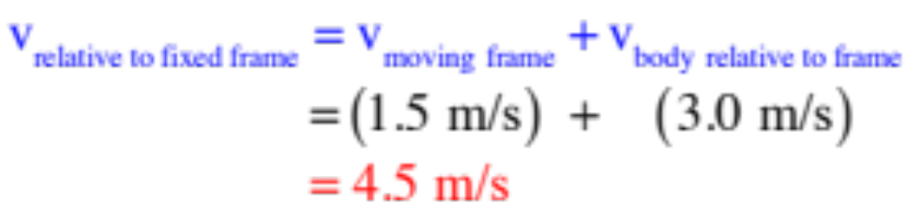
How does this mesh with what we have already said?
In this case, the shoreline is the fixed frame, the stream is the moving frame with velocity relative to the fixed frame and the boat can move with velocity relative to the fixed shoreline if given the chance. The question is, “What is the boat’s velocity in the stream’s frame?” The math suggests:
downstream
This is just as we concluded before.
Clearly, the trick is to identify what part is what part in the problem.
45.)

Slide 46
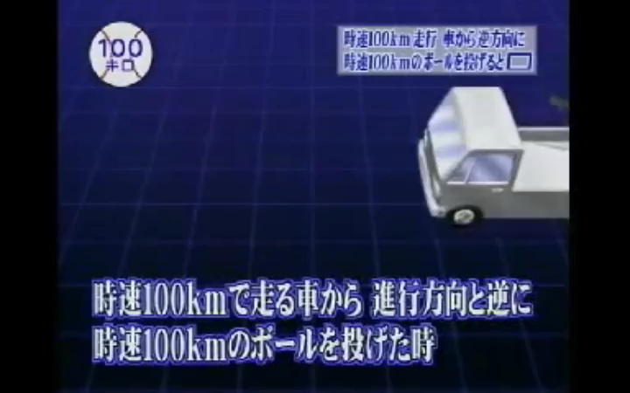
46.)

Slide 47
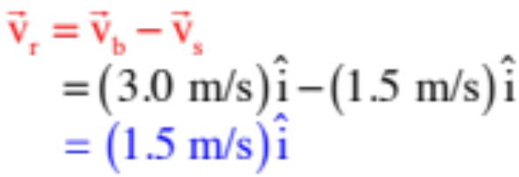


What about traveling upstream?
The vectors oppose one another, so subtract the two yields:
downstream
What happens if the boat points itself directly ACROSS the stream?
This is also an add the vectors problem, except now the vectors aren’t aligned. Laying each vector out ignoring the other vectors, then adding yields:
downstream
47.)

Slide 48
On the next slide, a video shows two airplanes trying to land in a crosswind.
To start with, just focus on the first plane. Assume it is moving 150 mph and the crosswind is blowing directly across (i.e., perpendicular to) the runway. Take whatever information you need from the video to determine the speed of the crosswind’s velocity.
48.)

Slide 49

49.)

Slide 50





plane coming this way
I’m going to approximate the first plane’s angle with the runway at . We need a coordinate axis, so I’m going to assume we are looking from above, down on the runway, which is oriented as shown.
actual path of the plane
We know the planes “no wind” speed is 150 mph, and we know the plane has to be turned into the wind to keep it moving straight down the runway. Drawing the vectors as we know them yields the sketch to the right, and from it, the relationship between the plane’s windless velocity and the wind’s velocity must be:
50.)

Slide 51
Back to the video:
Now, FOR FUN (don’t take a lot of time on this—it’s more complicated), consider the second plane. As shown, it would be moving 150 mph but it has run into both a crosswind and a headwind. As such, it is seemingly floating as it comes in for its landing moving only, maybe, 100 mph along the line of the runway. With that approximation, take whatever additional information is required to determine the wind velocity (as a vector), relative to the line of the runway, for that situation.
51.)

Slide 52
52.)

Slide 53







This is for fun. Don’t take lots of time on it!
plane coming this way
Let’s approximate the second plane’s average angle with the runway at . Using the same set-up as before, our vector assembly will oriented as shown to the right, where is the velocity of the plane relative to the runway. All the information we know about the situation is included in the sketch (I’d prefer to make reference line along the runway, but it works better on the sketch as shown).
actual path of the plane
We need to do this in components.
53.)

Slide 54







Along the “y” (runway) direction, the difference between the plane’s “free speed” component and the wind speed component will give us the plane’s relative speed. Showing the components on the sketch and making down positive, that leaves us with:
Along the “x” direction perpendicular to the runway, the vector components have to add to zero (the plane isn’t moving perpendicular to the runway), so:
54.)

Slide 55





plane coming this way
Really minor mathematical trick: The way to solve two equations like this
divide one into the other and notice that sine/cosine is equal to tangent, or:
actual path of the plane
Again, lots of minutia here. This is not bad thinking fodder, but it’s a lot more complicated than an AP question is likely to be!
55.)

Slide 56



Ball in the Cup Lab
Your task is to determine where you would have to put a cup so a ball rolling off a table would land in the cup.
For homework:
a.) briefly explain how you will determine the velocity of the ball as it leaves the ramp.
b.) Draw a sketch of the system.
c.) Derive an expression for cup’s x-coordinate if it is to land in the cup. This should be in terms of g, h and the velocity v of the ball as it leaves the ramp (note that the ball leaves in the horizontal).
(Note: Don’t let the ball roll off the tabletop as you are trying to determine its constant velocity after leaving the incline. You don’t get to see how it will fly before your run!!!)
In class:
a.) take the data needed to determine the coordinate, place the cup, then we will all make our run at the same time (hee hee).
56.)

Slide 57

Marshmallow Gun Problem
A teacher who likes to reward his best students with treats has built a marshmallow-shooting gun that he uses to dole out treats. To make things interesting, he has set things up so that a hanging student (off a wall) begins to free fall when the trigger is pulled. Ignoring friction, how should he aim the gun?
Notice that the velocity magnitude doesn’t matter. If its fast, the marshmallow gets there before the guy falls far. If it’s
slow, it gets there later and the guy falls farther. Either way works.
57.)

