Slide 1






Some Slightly Exotic Calculus
Let’s say you’ve thrown a ball off a cliff that is h meters high. Ignoring air friction, the ball’s velocity in the x-direction is observed to be (this will not change as there are no frictional effects to make the change). The red dashed line in the time lapse photo to the right shows the motion.
The relationship between the y-coordinate and the x-coordinate just happens to be:
where h is the height of the cliff and k is a constant related to gravity. (In fact, this is the equation for a downward pointing parabola.)
In terms of time, the x-coordinate of the body is:
where, again, is the constant velocity of the body in the x-direction.
Insert a.)

Slide 2
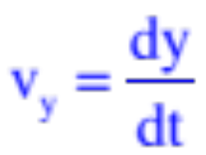
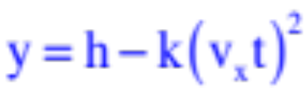
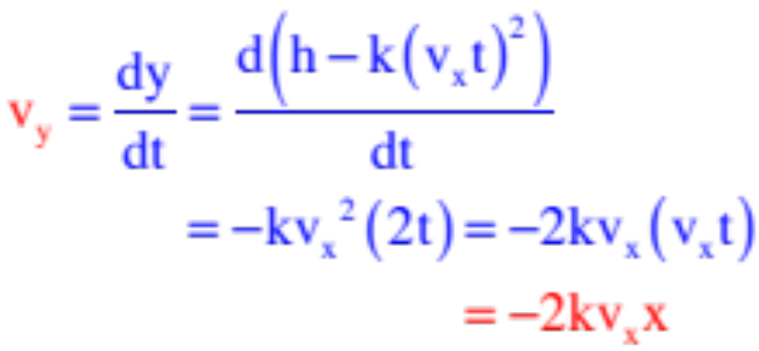
So here’s the question: With
and
what is the ball’s velocity in the y-direction in terms of x?
Knowing that the velocity in the y-direction is the time derivative of the y-coordinate function, or
the chintzy way to do this would be to substitute the time-related x-coordinate function into the x-related y-coordinate function, take the time derivative, then substitute x information back into that result.
That is: If and , then by substitution ,
we can write:
Insert b.)

Slide 3
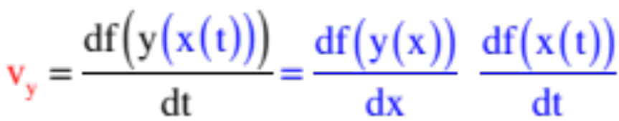
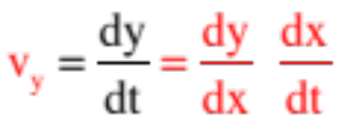
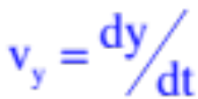
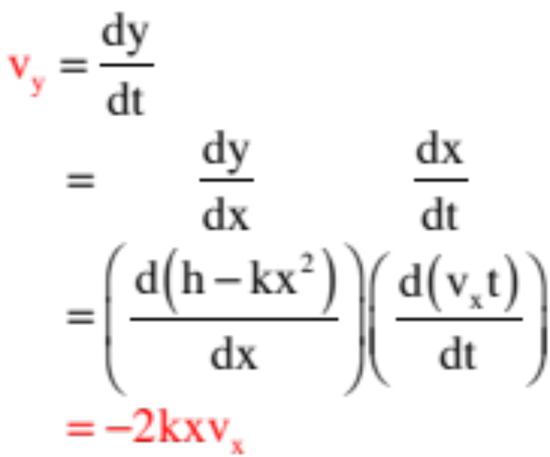
The more elegant way to do this is to utilize what is called the chain rule. It states (loosely) that if you want the derivative of a function that you know in terms of another function, you can get that result by executing the operation:
or just
(Notice how the “dx’s” might be seen to cancel, if they could, leaving us with
. . . cool, eh?)
Executing that operation, remembering that,
and
and we get:
. . . much more satisfying.
insert c)

