Slide 1
CHAPTER 6:
Center Seeking Forces
1.)

Slide 2
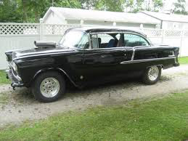
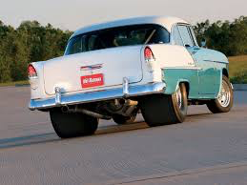
When I was a kid, the cool car to have, aside from a Corvette, was a 55 Chevy. They were light, they were fast, they had bench seats, and I couldn’t afford one.
So I tried to get
2.)

Slide 3


a 1938 Hearse . . .
Didn’t work out, so I ended up with:
3.)

Slide 4
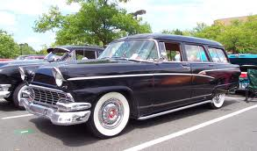
‘56 FORD STATION WAGON
Features:
--312 cu. inch engine with three on the tree;
--room for a mattress in the back (I slept in it more than once at the beach);
--bench seats without seat belts (dangerous, very dangerous);
Why are we talking about all of this?
--BENCH SEATS were required for the MOB maneuver . . .
4.)

Slide 5
The MOB Maneuver
The Problem:
You are on a second date.
You kind of like your date.
Your date kind of likes you.
You don’t want to seem overly aggressive.
Your date doesn’t want to seem too easy.
So there your date sits, way over there, next to the passenger-side door.
You’d like your date sitting next to you.
Enter the MOB maneuver.
5.)

Slide 6

(the MOB maneuver)
You approach an intersection moving at a constant speed . . .
force-free path
and there you have it
As you begin your turn
she follows a force-free path
until voila
you
your date
6.)

Slide 7
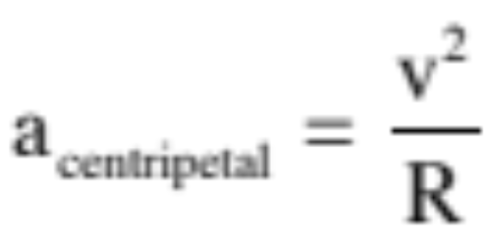
To make the move, a center seeking (centripetal) acceleration is required:
7.)

Slide 8
Which means a center seeking (centripetal) FORCE is required.
“center-seeking” forces
8.)

Slide 9
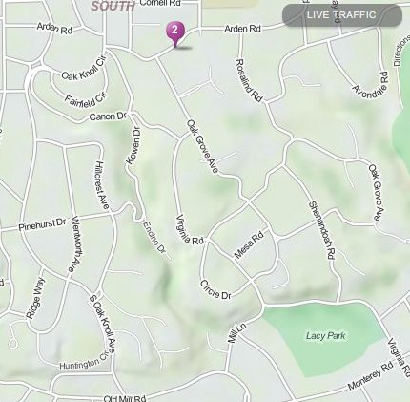
The force must ALWAYS be toward the center of the arc being subscribed, so one could execute an INADVERTENT REVERSE M.O.B. MANEUVER if one wasn’t careful . . .
9.)

Slide 10
LACY PARK
Ack! Don’t want to punish you enough to
die in the process
Me hurtling across the seat to grab her before she flew out of the door
Virginia Ave.
me
Irritated girlfriend
10.)

Slide 11
Additional side note: (an idea you should understand but the math of which you won’t be tested on):
1.) From DRIVER’S PERSPECTIVE: the date seems to be accelerating toward him/her/they.
apparent force
2.) As far as driver is concerned, the only way date can be accelerating toward him/her/they is if there is a force on the date. That is, from the driver’s perspective, date does NOT appear to be force free.
3.) So where does the force come from?
4.) NOWHERE!
5.) The only reason date appears to be accelerating is because driver is looking at things from driver’s own frame of reference, which happens to be an ACCELERATED FRAME OF REFERENCE!!!
6.) Nevertheless, driver may still want to attempt to use N.S.L. to predict date’s motion (i.e., “When is date going to arrive at my side, etc.?”)
11.)

Slide 12
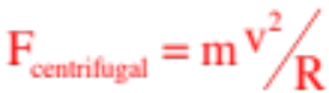
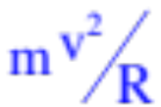
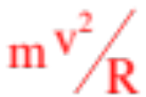
7.) To do this, he has to assume that a fictitious force acts on her.
8.) With a magnitude of , this fictitious force is called a CENTRIFUGAL FORCE!
apparent force
9.) In short, a CENTRIFUGAL FORCE does not exist. It is a mathematical contrivance designed to allow you to use NSL-type analysis in situations in which the observation frame is non-inertial . . . which is to say ACCELERATED . . . along a curved path.
10.) There are other kinds of fictitious forces, the coriolis force being one of the most quoted, but they all do the same thing. They all allow the user access to Newton’s Second Law when a system is being analyzed from the perspective of a non-inertial frames of reference.
12.)

Slide 13




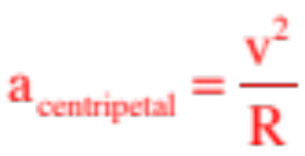


Center Seeking Accelerations
In the previous chapter, we found that when an object follows a curved path, it must experience an acceleration that is center seeking (i.e., centripetal), and that the magnitude of that acceleration was derived as
Centripetal acceleration is produced by centripetal force, so is centripetal force NEW kind of force?
NO! God didn’t say, “There are gravitational forces, tension forces, normal forces, friction forces and, oh, yeah, centripetal forces . . . “ The word CENTRIPETAL is a blurb. It identifies one or more of the four standard forces (or their components) in a system that happens to be doing a very specific thing—pushing a body out of straight-line motion. That’s all!
13.)

Slide 14
Forces Acting Centripetally
When any naturally occurring force in a system, or component of a naturally occurring force in a system, or combination of forces and/or components of naturally occurring forces in a system, push a body out of straight line motion, THEY ARE ACTING CENTRIPETALLY. So-called centripetal forces are not new forces. They are old forces doing a new thing. Examples:
Gravity from the earth acting on the moon as the moon orbits the earth.
Tension acting on a hammer as a hammer-thrower winds up for a heave.
Normal (or component of normal) acting on a car rounding a banked curve on a freeway.
Friction acting on a car rounding a corner on a flat road.
Old forces doing a new thing.
14.)

Slide 15


Consider a 1000 kg car traveling over the crest of a rolling hill of radius 50 meters moving with a constant speed of 60 km/hr.
a.) What is the net centripetal force acting on the car at the top of the hill?
b.) Draw a f.b.d. on the car at the top.
c.) How large a normal force will the road provide to the car in this situation?
d.) What is the maximum velocity the car could pass over the top of the hill without without lifting off?
15.)

Slide 16
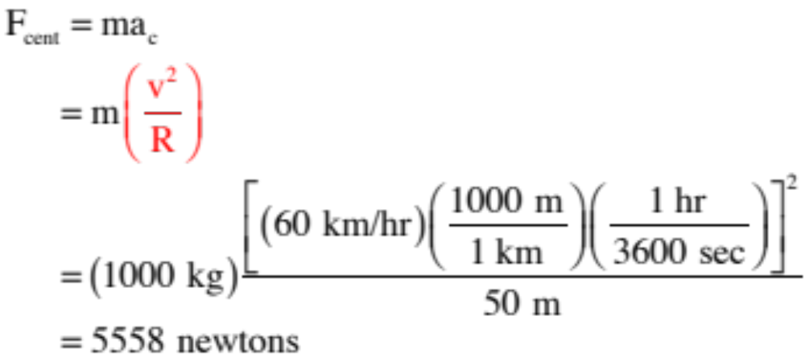
Consider a 1000 kg car traveling over the crest of a rolling hill of radius 50 meters moving with a constant speed of 60 km/hr.
a.) What is the net centripetal force acting on the car at the top of the hill?
Note that questions like this are designed to be tricky. They are asking for a force, so you are thinking about forces, but all you have to do is figure out ma and you have the net force via N.S.L. Also, notice you have to do a little bit of converting. Don’t be surprised if you are asked to do this. It’s standard fare. (And for future reference, v turned out to be 16.67 m/s)
16.)

Slide 17





b.) Draw a f.b.d. on the car at the top.
There are a bunch of questions to be answered when doing a f.b.d. on a centripetal force problem, not the least of which is what perspective you are going to take and what forces you will include. That is:
a.) Rolling friction along the line of motion will be countered by the force provided to the wheels by the car’s engine. Because the velocity is constant, these will add to zero and don’t have to be included (though I did).
b.) You need a perspective that will allow you to see all relevant forces. In most vehicle-related centripetal force problems, looking at the vehicle front-on is the way to go, though in this case it is from the side. With that:
HUGE OBSERVATION: Notice there is no shown on the f.b.d. That’s because there is NO SUCH THING as a centripetal force proper. The forces that are acting centripetally in this case are the combination of normal and gravity!!!
17.)

Slide 18
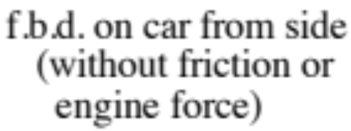


c.) How large a normal force will the road provide to the car in this situation?
This is a N.S.L. problem:
By the numbers:
Step 0: Lordy, lordy, “I couldn’t possibly figure this out.”
Step 1: Pick one body in the system and draw a f.b.d. for it (blurbing well!).
18.)

Slide 19

Step 2: Identify the line of the body’s acceleration and put a coordinate axis along that line.
This is really important in centripetal force problems. How do you do this?
You HAVE to identify the CENTER OF THE ARC upon which the body is traveling. Once determined, put an axis FROM THE BODY through that center—that’s the center seeking direction. If you mess this up, NOTHING YOU WILL DO FROM THERE ON WILL BE RIGHT!!!!!!!!!
In this case, the center of the arc when the car is at the top of the hill is toward the bottom of the page, so we will put one axis along that line.
19.)

Slide 20

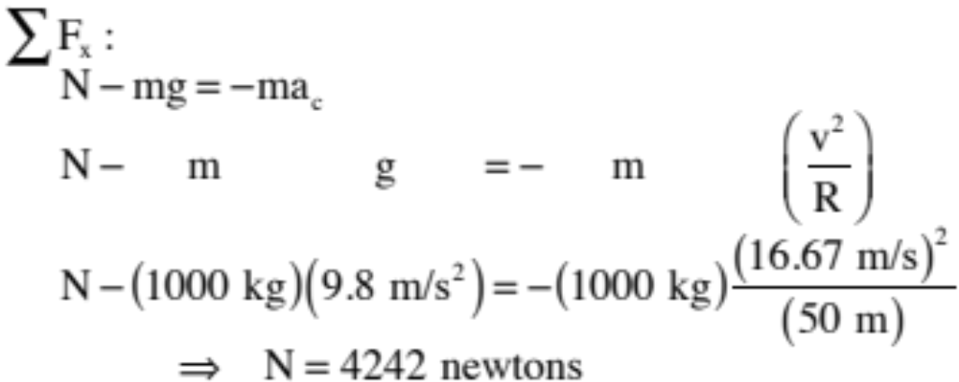
Step 3: If there are any off-axis forces, break them into components along your two coordinate axes.
(There aren’t any.)
Step 4: Sum the forces running along one of the axes and put that sum equal to the body’s mass “m” times its acceleration (centripetal) along that line (include blurbs—remember, v = 16.67 m/s).
Huge observation: Because the centripetal acceleration is toward the center of the arc upon which the body rides, and because the center of the arc in this case is toward the bottom of the page in the negative direction, as defined by our coordinate axis, we NEED to make the acceleration negative in the N.S.L. equation. Minutia, but mess it up and you are screwed!
20.)

Slide 21
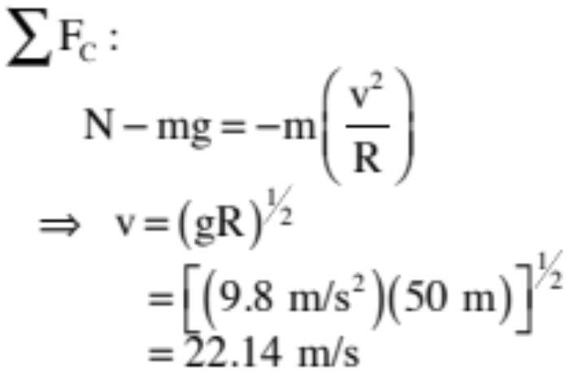

d.) What is the maximum velocity the car could pass over the top of the hill without without lifting off?
Another bit of trickiness raises its head here. What happens to the normal force if the car just skims through the top of the arc? It goes to zero. So you would do this problem
exactly as you did it in the previous section, except at the end you would let N go to zero and you’d solve for v. That is:
Observation: Notice how important it is to get that negative sign in front of the acceleration term? If it wasn’t there, you’d be trying to take the square root of a negative number, which is never a good thing.
21.)

Slide 22
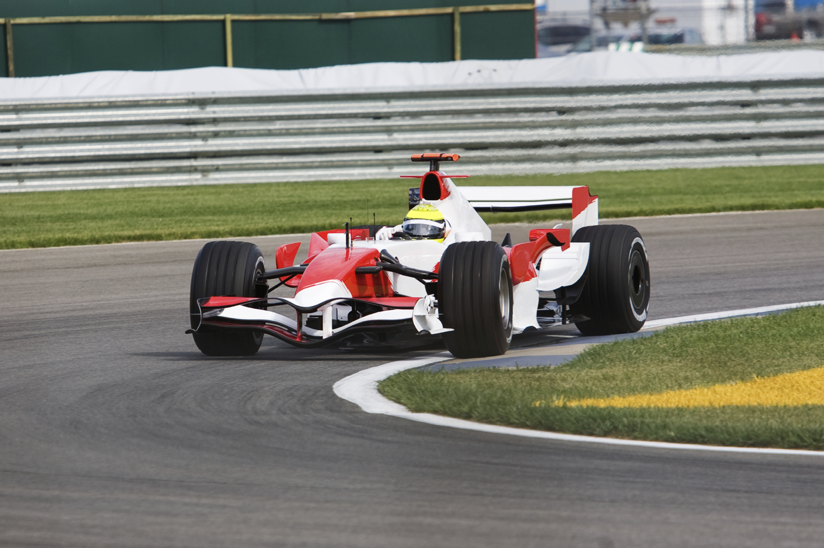

From above, the car takes the curve as shown below. If it is 1000 kg, the curve is 50 meter radius and the car is moving at a rate of 14 m/s:
a.) Where is the centripetal force in this problem coming from?
b.) How much centripetal force is being provided in this scenario?
c.) Draw a f.b.d. for the forces acting on the car as it appears on the sketch? Include coordinate axes.
d.) Assuming the coefficient of static friction is .4, derive an expression for the maximum velocity the car can take the curve.
Looking down on track and car
22.)

Slide 23
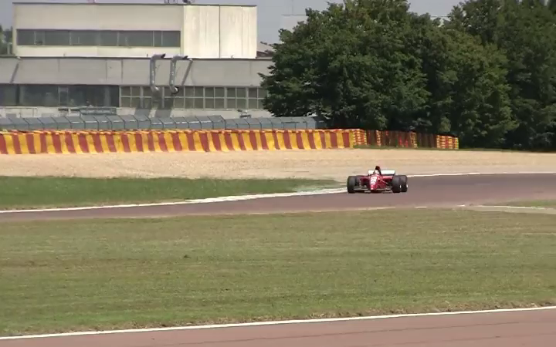
Consider a Formula 1 race car taking a turn.
31.)

Slide 24
From above, the car takes the curve as shown below. If it is 1000 kg, the curve is 50 meter radius and the car is moving at a rate of 14 m/s as shown:
a.) Where is the centripetal force in this problem coming from?
Static friction between the pavement and the road . . . and we need to talk some about this!
24.)

Slide 25

Friction and Wheels
Looking down through a car, what happens when you crank the wheel to make a hard right turn?
25.)

Slide 26
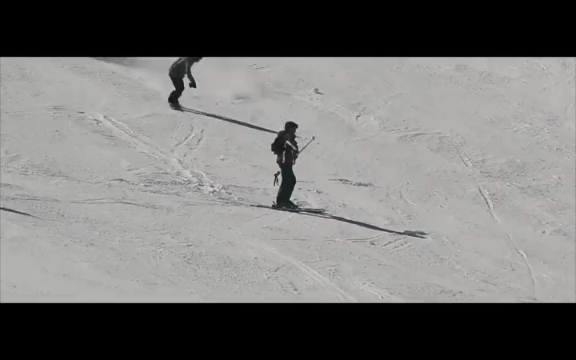
A turning car wheel does to a street what a turning skier does to snow . . .
1.)

Slide 27
In other words, the tires apply a static frictional force to the road outward (this is like the skis pushing outward on the snow, spraying it outward on unsuspecting shooshers)
27.)

Slide 28

In other words, the tires apply a static frictional force to the road outward (this is like the skis pushing outward on the snow, spraying it outward on unsuspecting revelers) as the road pushes INWARD on the tires.
The direction of the force on the tires by the road is perpendicular to the tires (as shown).
28.)

Slide 29




Examining the forces in the exaggerated presentation on one tire:
If the angle is big (i.e., with the wheels turned a lot), the radius of the arc is small and the static frictional force has two components:
--one component is along the line-of-motion. It tends to slow the motion of the car.
--one component is perpendicular to the line-of-motion. It pushes the car out of straight-line motion.
29.)

Slide 30


If the angle is small (i.e., with the wheels turned just a bit), the radius of the arc is huge and the static frictional force is almost entirely directed in the center seeking (centripetal) direction.
In that case, we assume that ALL of the static frictional force is centripetal.
That is the standard assumption made in these problems.
30.)

Slide 31
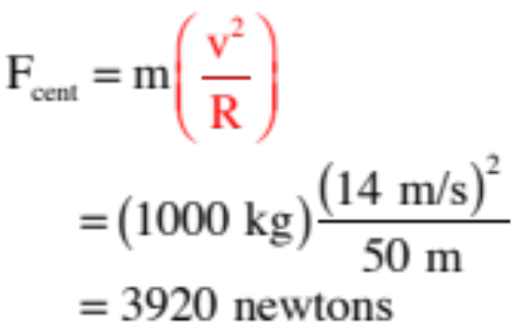
From above, the car takes the curve as shown below. If it is 1000 kg, the curve is 50 meter radius and the car is moving at a rate of 14 m/s:
a.) Where is the centripetal force in this problem coming from?
Friction between the pavement and the road . . . And we need to talk some about this!
b.) How much centripetal force is being provided in this scenario?
As before, this is just “ma!”
31.)

Slide 32



c.) Draw a f.b.d. for the forces acting on the car as it appears on the sketch? Include coordinate axes.
Remembering the type of friction involved and it’s assumed direction in problems like this;
Remembering that we view the body from the front of the car in doing f.d.b.s for problems like this;
And realizing that the force of rolling friction retarding the motion, along with the small component of static friction fighting the forward motion, is exactly countered by the force of the engine urging the car forward, so the net force along the line of motion is ZERO . . . hence no need to include any of those forces . . . we have:
32.)

Slide 33
How did you find the center seeking (centripetal) direction?
You identified the position of the center of the arc upon which the body was moving, then you ran an axis from the body THROUGH THAT POINT. THAT IS HOW YOU DETERMINE THE CENTER SEEKING DIRECTION!!!
33.)

Slide 34


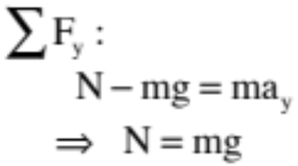
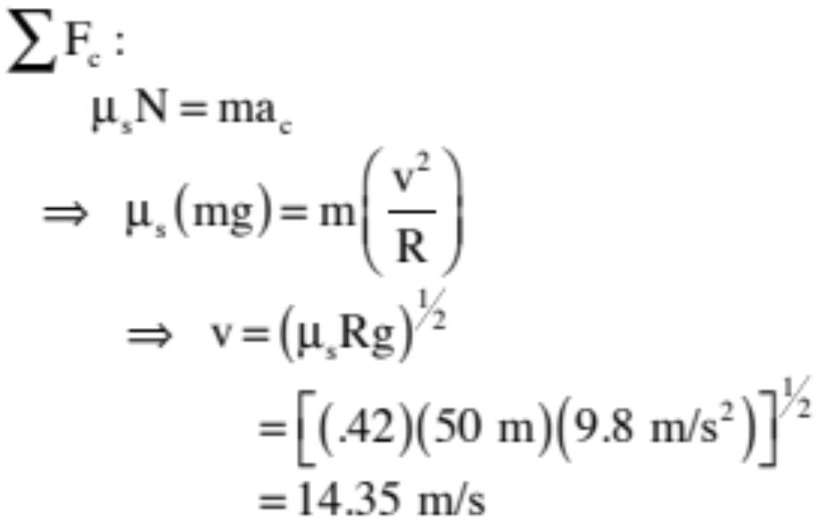

d.) Assuming the coefficient of static friction is .42, derive an expression for the maximum velocity the car can take the curve.
If we are talking MAXIMUM velocity, we are talking MAXIMUM STATIC FRICTION, which means we can use .
f.b.d.
34.)

Slide 35





Looking down on track and car
Now for the fun! Consider a 1000 kg car moving through a curve of 50 meter that is BANKED at an angle . What is the maximum velocity the car can have and not lose it if the curve is frictionless.
f.b.d.
WHAT’S THE CENTRIPETAL DIRECTION?
As viewed from head-on coming around the curve
35.)

Slide 36



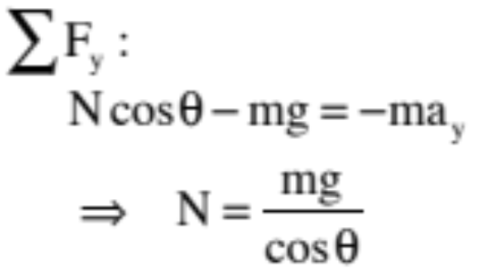
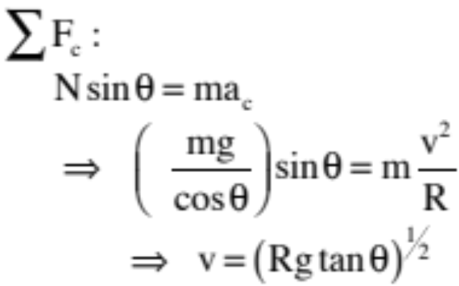
f.b.d.
Looking down on track and car
As viewed from head-on coming around the curve
36.)

Slide 37




Looking down on track and car
Now for more fun! Same problem, almost: Consider a 1000 kg car moving through a curve of 50 meter that is BANKED at an angle . What is the maximum velocity the car can have and not lose it if the curve is FRICTIONAL.
You actually don’t have enough information to do this. The trickiness is with the direction of the static frictional force. Consider:
--if the car is moving slowly and the incline angle is relatively large, the car will want to break loose DOWN the incline and static friction will have to be TOWARD THE TOP to keep it in place.
large angle—slow car wants to break loose DOWN incline
Note that you’ll be summing forces in the horizontal, as that’s the center-seeking direction.
37.)

Slide 38
Looking down on track and car
--but if the car is moving fast and the incline angle is relatively small, the car will want to break loose UP the incline and static friction will have to be TOWARD THE BOTTOM to keep it in place.
And again, you’ll be summing forces in the horizontal as that’s the center-seeking direction.
large angle—slow car wants to break loose DOWN incline
38.)

Slide 39




Mini-lab: An airplane circles with some unknown velocity v (see demo at front of room). Derive an expression for v, then check to see if that value matches up with the actual velocity of the plane. Determine also the motion’s period T.
From what perspective will you view the system?
Look at it from head-on.
Hint for f.b.d.: Think of viewing the system as though the body was at an extreme—that is, with the velocity coming straight at you and the mass and string in the plane of the page.)
f.b.d. (looking at the body from head-on)
body coming straight out at you
39.)

Slide 40



So how will you orient your axes?
body coming straight out at you
Breaking off-axis forces into components:
40.)

Slide 41
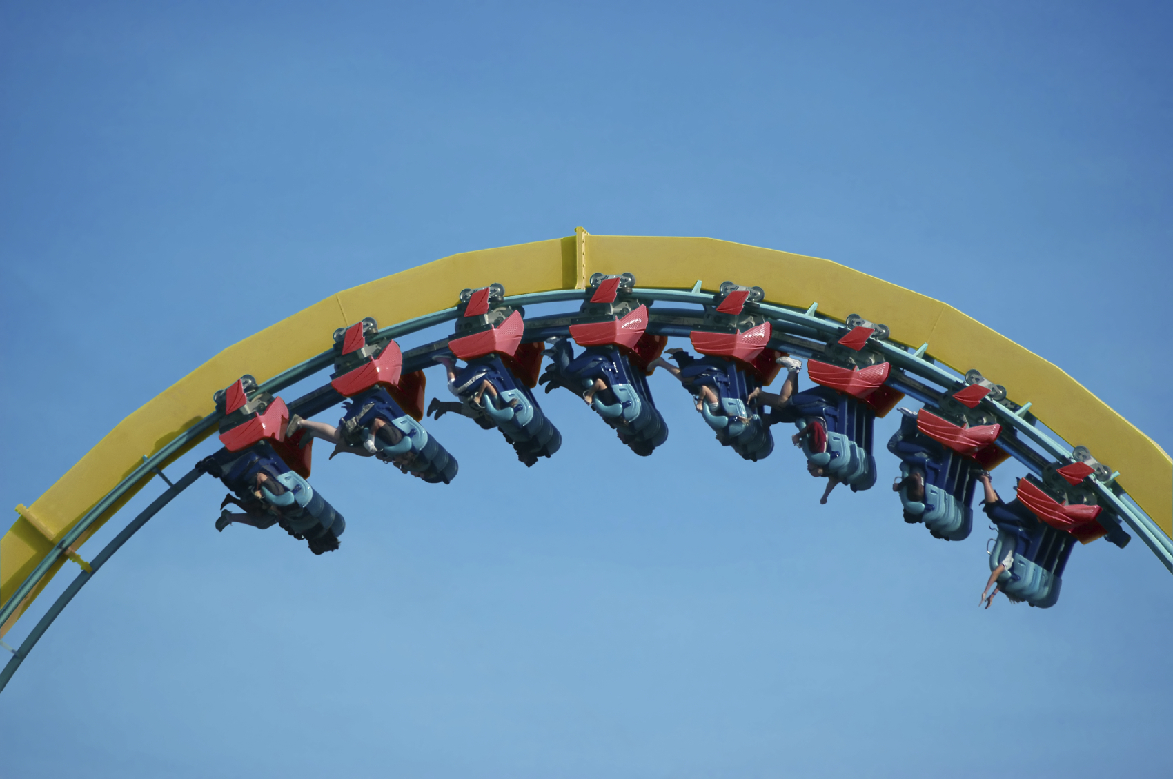
Vertical Circles
Objects traveling in vertical circles are treated exactly the same as objects traveling in horizontal circles: the sum of the centripetal forces adds up to allow the object to accelerate centripetally, and thus, travel in a circle. (∑F_{c}=ma_{c})
Notes:
Are these people accelerating? In which direction? What forces are providing the centripetal force that keeps them moving in a circle?

Slide 42











Consider a ball attached to a string of length L moving along a vertical path.
Draw a f.b.d. for the forces acting on the ball at the top.
Draw a f.b.d. for the forces acting on the ball at the bottom.
Draw a f.b.d. for the forces acting on the ball at Point B.
42.)

Slide 43
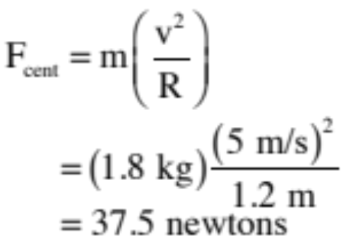
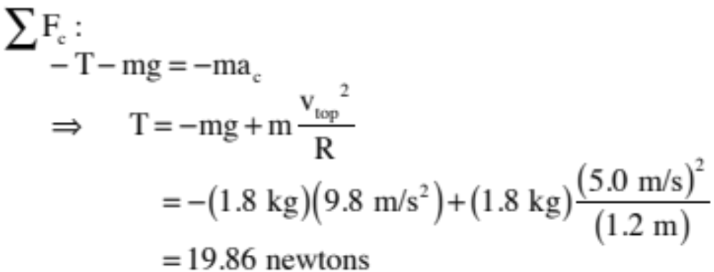
Assume the ball’s mass is m = 1.8 kg and the rope’s length is L = 1.2 meters. If the velocity at the top of the arc is 5.0 m/s:
a.) What is the net centripetal force required for the ball to execute the motion?
This is just “ma.”
b.) From scratch, derive an expression, then determine the tension at the top?
f.b.d. at top
43.)

Slide 44
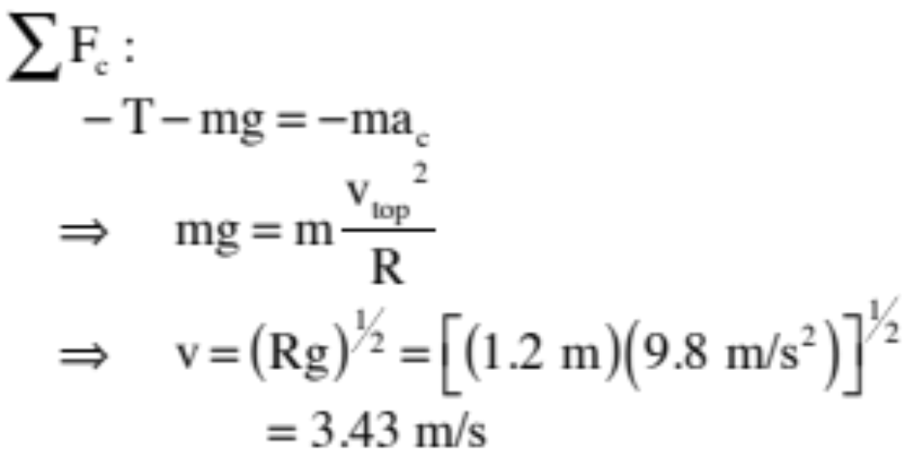
c.) What is the the minimum speed the ball could pass through the top without falling out of the arc (in fact, it would fall out before reaching the top)? Do from scratch.
Once you’ve done a general f.b.d., the key is to notice that if the ball is to just barely skim through the top of the arc, the tension must go to zero (it will not be needed as gravity will do everything that is required to centripetally accelerate the ball). With that in mind:
general f.b.d. for top
44.)

Slide 45
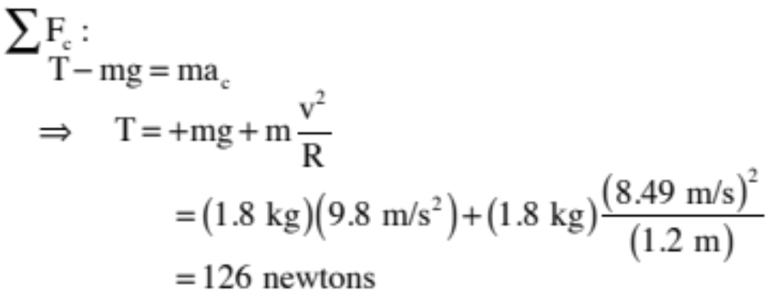
d.) At the bottom of the arc, the ball was observed to be moving 8.49 m/s. What would the tension be there (from scratch)?
f.b.d. at bottom
45.)

Slide 46
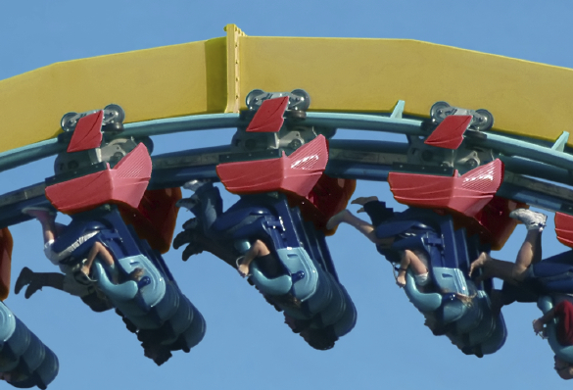
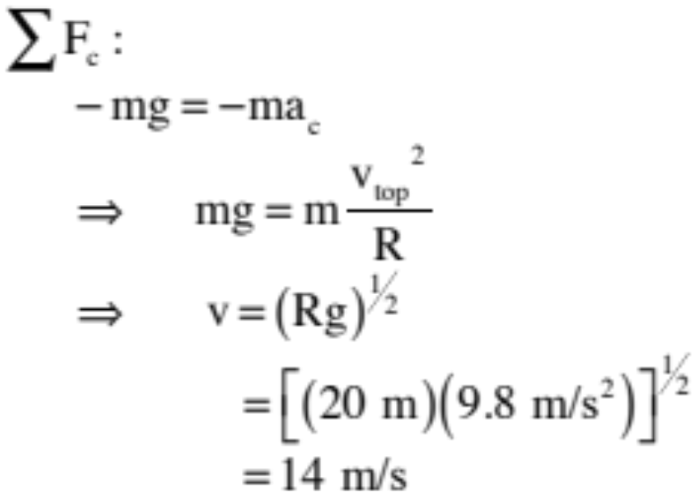
Consider a 100 kg rollercoaster car traveling inverted through the top of a vertically oriented circular loop of radius 20 meters.
a.) At what speed should the car travel through the top of the loop if the track is not to supply any force on the car?
f.b.d.
46.)

Slide 47

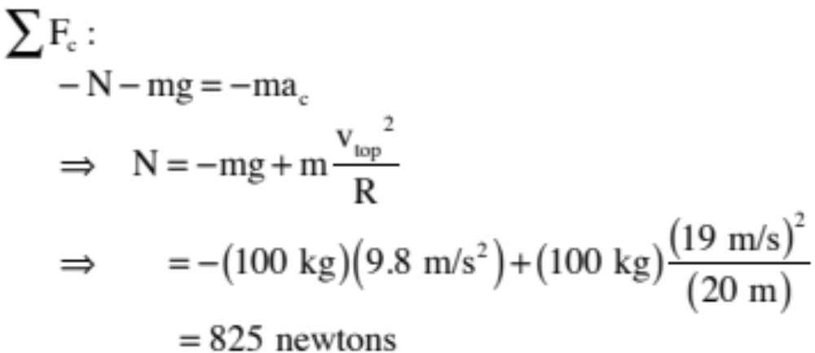
b.) Describe the force supplied by the track if the car travels 5 m/s faster than the free fall speed calculated in Part a.
The track will have to provide a normal force to appropriately push the car out of its straight line motion. Soooo . . .
f.b.d.
47.)

Slide 48
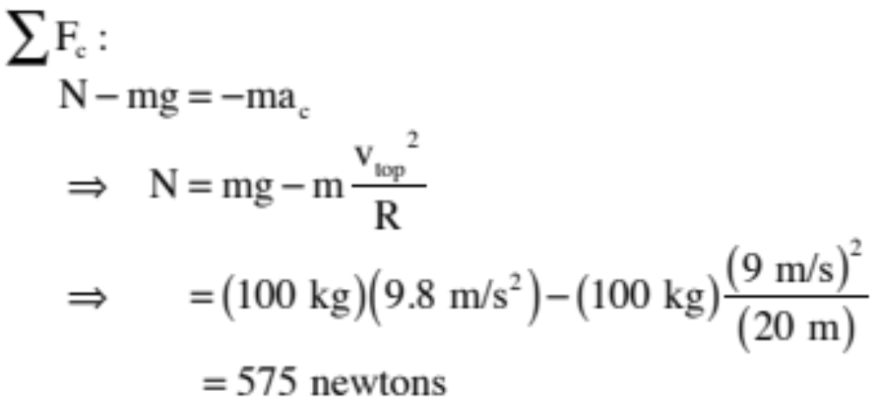
c.) Describe the force supplied by the track if the car travels 5 m/s slower than the free fall speed calculated in Part a.
The track will again have to provide a normal force in the centripetal direction, this time to keep the car from falling. Soooo . . .
f.b.d.
48.)

Slide 49




Non-uniform Circular Motion:
Consider a mass m attached to a string of length L that is suspended from the ceiling. At some point, it makes an angle with the vertical moving upward with velocity .
a.) Derive an expression for the tension in the string.
f.b.d.
What’s tricky is the axes . . .
49.)

Slide 50


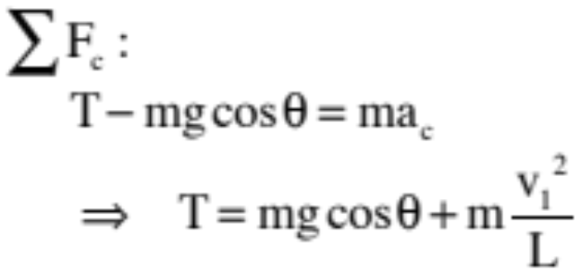

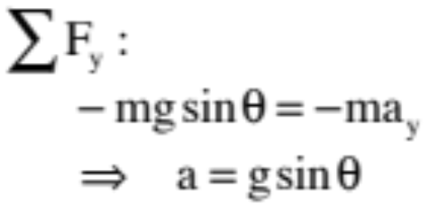
Breaking forces into components:
f.b.d.
b.) Derive an expression for the magnitude of the translational acceleration of the mass.
50.)

Slide 51
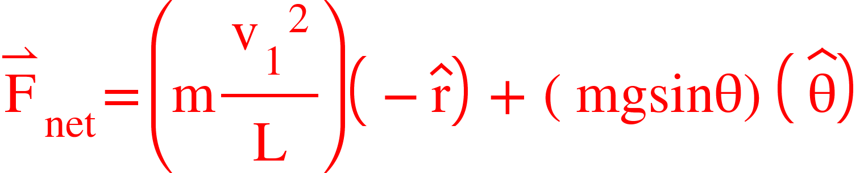
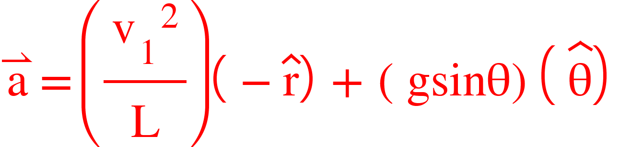
c.) Write out the net force using a unit vector notation.
f.b.d.
d.) Write out the acceleration of the mass at the point of interest using a unit vector notation.
51.)

Slide 52





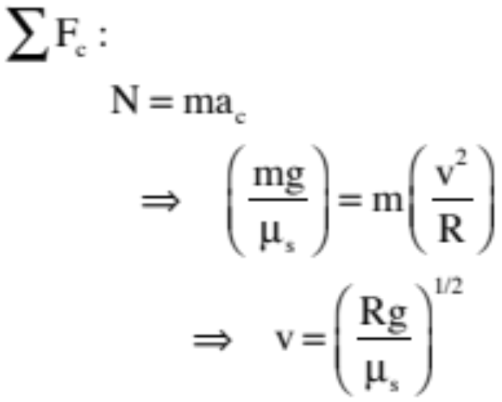

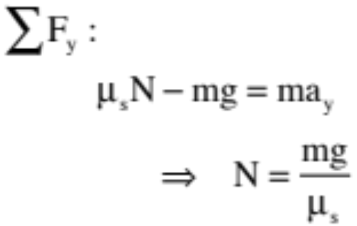

Carnival Ride:
A classic carnival ride consists of a huge, rotating cylinder in which people stand with their back against the wall. As the cylinder rotates faster and faster, friction between the people and the wall “stick” the riders to the wall, and at some point the floor drops out leaving the riders suspended, whirling round and round.
f.b.d.
For fun, derive the velocity a rider of mass m would need to just barely stick to the wall if the ride’s radius was R and the coefficient of static friction between the rider and wall was .
52.)

Slide 53
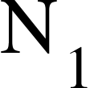
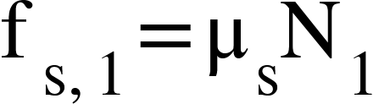
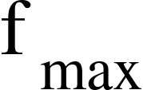
A subtlety: Think about what is actually happening. The cylinder begins to rotate. At some velocity “v” there will be a normal force providing the centripetal force required to make the rider execute the expected rotational motion. The maximum static frictional force provided by the wall at that point will be which is LESS THAN “mg” (see Figure 1). In this case, friction won’t be able to hold and the person will slip.
If the velocity is increased some, the same outcome may well occur (see Figure 2). At some point, though, the maximum static friction will EQUAL “mg” (see Figure 3), and now friction will hold the individual in place.
But what happens if the velocity continues to rise? Then the maximum static friction force possible continues to increase, but the amount of static friction required to keep the individual in place will still only be “mg.” In other words, the force you will be looking for won’t be that MAXIMUM POSSIBLE static frictional force for that speed, it will be a lesser static frictional force (see last graph).
I’m talking about this is because you will occasionally run into situations in which static friction is involved, but the amount of static friction required to make the system work will NOT be . Example: What is the static frictional force required to keep the block from moving on the incline to the right? It isn’t the MAXIMUM possible static frictional force. It is a lesser amount! Just sayin . . .
mg
Fig 1
mg
low v
Fig 2
higher v
mg
Fig 3
still higher v
mg
Static force needed to stick
Fig 4
still higher v
53.)

Slide 54
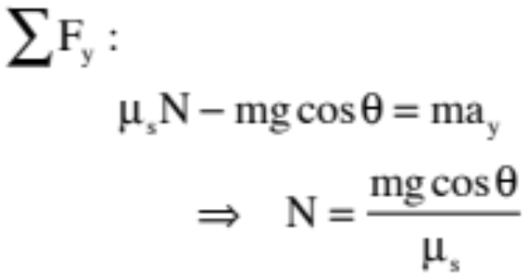

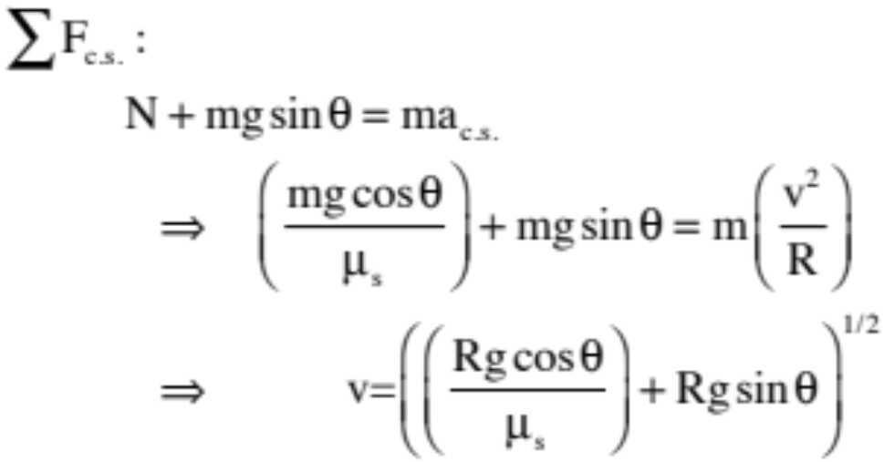

A second, funner scenario (just made that word up), has all of the above features along with the added twist of the ride angling upward out of the horizontal (see sketch). For the rider-position shown, determine the minimum velocity the rider would have to have to keep from falling out of the ride.
f.b.d.
54.)

Slide 55





A Second Problem Based in Friction:
A bit of nastiness, compliments of the AP folks.
horizontal cylinder on tabletop as viewed FROM ABOVE
A block of mass m on a table moving with initial velocity is jammed up against a frictional, circular wall (coefficient of kinetic friction ) of radius R. The tabletop upon which it moves is frictionless. Derive an expression for the mass’s velocity as a function of time.
The first task is to identify the forces, and identify the perspective for the f.b.d.
frictionalwall
viewed FROM SIDE
frictionless floor
55.)

Slide 56






3-d f.b.d.
FROM ABOVE
Gravity and the floor’s normal are useless as the floor isn’t frictional, so we need a perspective that shows the wall’s normal and friction. That view COMES FROM ABOVE. From our “above view,” then:
56.)

Slide 57
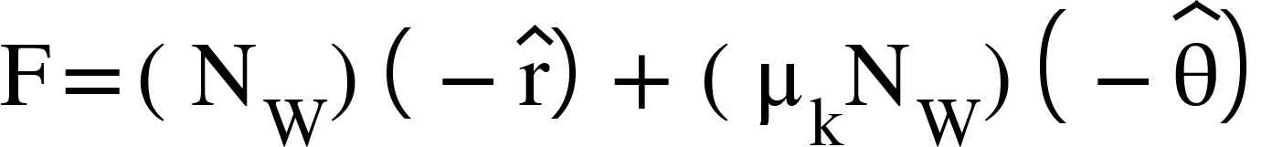
f.b.d.
FROM ABOVE
Notice that we have a radial force vector (that would be the normal) and what is going to be a force in the tangential direction (that would be friction). We can write the net force, in other words, as:
->
We are going to see what Newton’s Second Law will do for us in the case of each of those components.
57.)

Slide 58

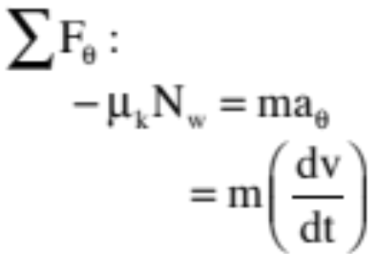
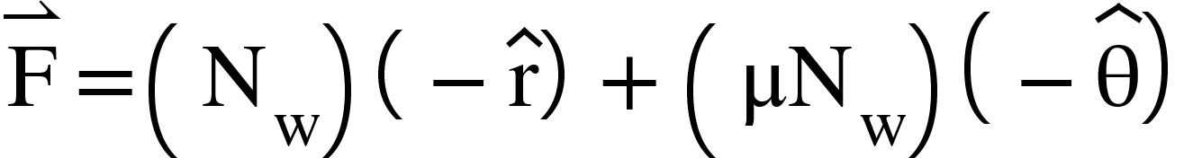
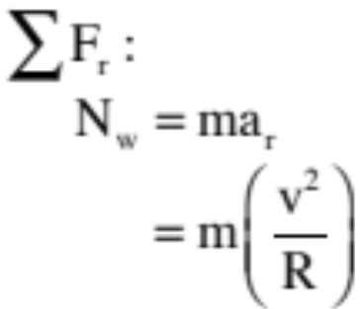
In the direction, the body is slowing down. This tells us that the acceleration is opposite the direction of the velocity (taken as the positive direction) AND is of the form dv/dt. With that information, we can write N.S.L. as:
Note the trickiness. The force is opposite the direction of “v,” so it’s in the negative direction,
whereas we’ve left the negative sign embedded in the “dv/dt” term. Why? Because when you do derivations with differentials, you need to be as general in your presentation as possible.
In any case, if we knew the wall’s normal, we could proceed . . . but we do, as the wall is providing a centripetal force in the system. As such, we can write:
58.)

Slide 59
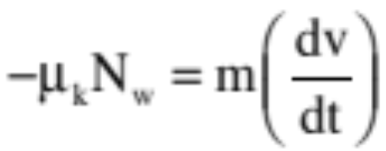
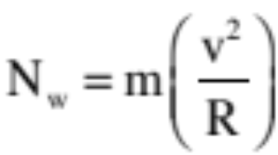
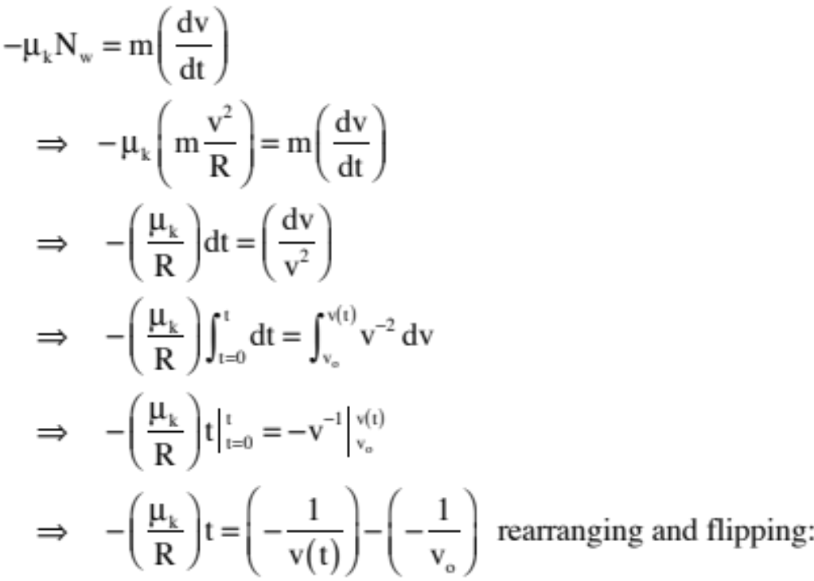
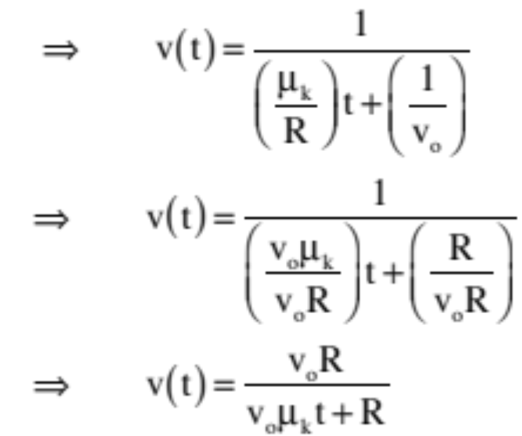
Putting together:
and
We can write:
putting v’s on same side of equal sign:
59.)

Slide 60
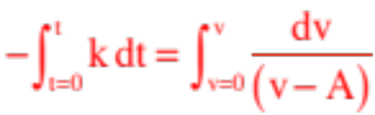










And some helpful hints concerning math manipulation:
Let’s say you find yourself with a definite integral that looks something like:
where both “k” and “A” are positive constant.
The solution is:
But if “A” is known to be larger than “v” at all points in time, we can write:
And using the exponential trick, we end up with:
So
60.)

Slide 61
Why the hints on the previous page?:
A classic Newton’s Laws problem has to do with forces that are velocity dependent. Can you, for instance, derive an algebraic expression for the time-dependent velocity of a freefalling body (mass m) if air is producing a frictional force that depended at any instant upon how fast the body is falling through the air. That is, for a body that, along with gravity, is experiencing a drag force whose magnitude is proportional to its velocity (that is, a force whose magnitude is equal to, say, kv, where k was a constant and v is the magnitude of the velocity)?
Think about this problem. Take twenty-minutes to see how far you can get with it, and to see what hangs you up in the approach. This has the potential of being educational. Don’t mess it up by turning to the next slide immediately! (And please note, all the tricks shown on the previous page will be of help to you in this problem!)
61.)

Slide 62
So here we go. Start the way all Newton’s Laws problems start, with a freebody diagram.
Mine is shown to the right. It assumes the body is falling downward with “up” being the positive direction. With that, we get:
kv
Note that I have identified the line of acceleration (step 2 in our protocol) and presented it on the f.b.d. as a dotted line. Also, as there are no off-axis forces, we are ready to sum. That looks like:
mg
𝚺
F :
y
kv – mg = - m(dv/dt)
Note that because the acceleration is downward in what has been defined as the negative direction, we have to unembed the negative sign inherent in the acceleration ”dv/dt” term so the “v” part can be a magnitude. That is what that negative sign on the right side of the equation is doing.
62.)

Slide 63
Minor note: As our body is falling, the drag force (being a function of velocity) will increase until it completely nulls out the force of gravity. At that point, the acceleration will be zero. The velocity at which this happens is called the terminal velocity. We can determine the terminal velocity with our Newton’s Second Law equation. Specifically:
0
kv_{t} – mg = - m(dv/dt)
⇒
kv_{t} – mg = 0
⇒
v_{t} = mg/k
This is important because if we tidy up the original N.S.L. relationship by dividing everything by k (thereby allowing the velocity term to stand alone), we get:
kv – mg = - m(dv/dt)
⇒
v – (mg/k) = - (m/k)(dv/dt)
⇒
v – v_{t} = - (m/k)(dv/dt)
This move will make our integration easier (you’ll see).
63.)

Slide 64
There are velocity terms on both side of this equation. We need to group all the velocity-related terms on one side with everything else on the other. We also have to pull the dubious move (though it does give us something a more kosher mathematical approach would produce) of pulling the dt into the numerator on the left-side of the equation, while leaving the dv on the right. Coupling this with pulling the velocity terms onto the right side and we get:
(v – v_{t}) = - (m/k)(dv/dt)
⇒
- (k/m) dt =
dv
(v – v_{t})
Integrating this between t = 0 and an artibrary t, and v = 0 and the arbitrary t’s velocity v yields:
t
v
∫
∫
dv
- (k/m) dt =
(v – v_{t})
t = 0
v = 0
v
- (k/m) t =
ln v – v_{t}
⇒
v = 0
This should look familiar (back to slide 60).
64.)

Slide 65
Continuing with the math:
v
- (k/m) t =
ln v – v_{t}
v = 0
ln v – v_{t}
0
- (k/m) t =
- ln v – v_{t}
⇒
- (k/m) t =
ln v – v_{t}
- ln – v_{t}
⇒
This is where the trickiness comes in. We don’t want to deal with absolute values, but we know that is the same as (that’s how absolute values work), and that . We can do this second move because v_{t} (being the terminal velocity) will always be larger than any other v meaning that if v is subtracted from v_{t} as shown in the second equation, the difference will be positive eliminating the need for the absolute value sign. Tricky, eh?
- ln – v_{t}
- ln v_{t}
ln v – v_{t}
= ln (v_{t} – v)
Manipulating the ln functions appropriately, we can write (finally):
v_{t} - v
- (k/m) t =
ln ( )
v_{t}
65.)

Slide 66
The next bit of trickiness is in getting rid of the ln function. We know that if we use each side of the equation as the exponent of e, the ln goes away. Doing that, then following along to the conclusion, yields:
v_{t} - v
- (k/m) t
ln ( )
e
=
e
v_{t}
- (k/m) t
v_{t} - v
⇒
e
=
( )
v_{t}
- (k/m) t
v_{t} - v
⇒
v_{t} e
=
- (k/m) t
⇒
v_{t} e
- v_{t} =
- v
-(k/m) t
- 1) = - v
⇒
v_{t} (e
-(k/m) t
⇒
v(t) =
v_{t} (1 - e )
66.)

Slide 67
A warning: The temptation might be to look at this problem and think the only way you could ever negotiate it a month from now would be to memorize all the steps. DON’T DO THAT! All you need to do is to follow the protocol.
Start with a f.b.d. That isn’t hard. You just need to get the direction of forces
right.
What do you do next? Write out N.S.L. with the acceleration written as
“dv/dt.” There is a little trickiness in making the sign of the acceleration
right, but that should be second nature to you by now.
What do you do with the N.S.L. equation? Split the “dv/dt” into two variables
dv and dt (a mathematically dubious move, but one that works), getting all
the velocity terms on one side of the equation and everything else on the other.
What to do next? Integrate (don’t forget to show the limits in each integral).
What next? Evaluating the integral, then deal with absolute values if there are any.
What next? Deal with the ln function if there is one.
What next? Finish off the algebra.
In other words, EACH STEP follows logically from the previous step. You don’t have to MEMORIZE anything.
67.)

Slide 68
For fun, try doing this same problem again, but this time have the velocity dependent drag force be proportional to v² instead of v (and are we having fun yet? I think so!). You don’t have to solve the integral, just generate the integral (limits and all).
Huge minor point: This is one of those problems in which you are asked to set up everything all the way to the integral, but not to solve the integral. Why? Because solving the integral is not easy. Its solution looks something like
(
m
(
1
)
v
+v
t =
)
ln
t
k
v
v
v
t
2
2
t
or, alternately, the hyperbolic function:
(
1
)
(
v
)
-1
t =
v
v
tanh
v
2
2
t
t
Nasty, eh?
68.)

