Slide 1
The Island Series:
You have been kidnapped by a crazed physics nerd and left on an island with twenty-four hours to solve the following problem. Solve the problem and you get to leave. Don’t solve the problem and you don’t.
The problem: You are told that a small mass (a cart) will be accelerated by a single force, and the question will ask, “Will the velocity change be relatively big or relatively small.” You respond with a, “What the hell, how should I know,” at which time your captor says, “Oh, yeah, OK, well, I’ll let you ask two questions before giving your answer, but not “is the velocity change big or small” . . . and know that I (the captor) had a bad experience with kinematics when young and any allusion to that approach will outrage me.”
What two questions should you ask?
1.)

Slide 2
Solution to Island Problem
What does govern how much velocity change a body experiences under the influence of a force? The two parameters that will matter are:
The magnitude of the force (the bigger the force, the larger the velocity change will likely be); and
The distance over which the force acts (the farther the force acts, the more the body will pick up speed);
Except there is a problem with this as stated. We will take a look at what it is shortly.
2.)

Slide 3
CHAPTER 7:
Work and Energy
To date, you have seen two approaches to problem-solving in this class:
1.) Kinematics says: that if a body’s acceleration is constant, look to see what information you are given, look to see what you are trying to determine, then find a kinematic equation that has everything you know along with what you are trying to determine. I call it idiot physics because you can be an idiot and do just fine with it. All it really is is pattern recognition.
2.) Newton’s Laws say: if a body experiences a net force along some line, that force will be proportional to the acceleration of the body along that line with the proportionality constant being the body’s mass. It is a considerably more powerful approach than kinematics as considerably less information is required to make it work.
We are now ready to look at the world from a completely different perspective, one in which a system’s energy content is the key. It will begin with a definition, that of work, from which all else will follow. First, though, some non-AP related exotica
3.)

Slide 4
What is Energy?
(this is not an AP-related topic)
You are out in space and you give a 1.00000 kg object a push with a constant force. What changes?
The acceleration won’t change as the force is constant, but the velocity will; time will; momentum will; position will.
There is one other things that will change in this case, though not by any amount that you will notice. The body’s mass will change (remember, mass is a relative measure of a body’s inertia).
In fact, a velocity/mass breakdown for your 1.0000 kg mass object is found on the next slide;
4.)

Slide 5
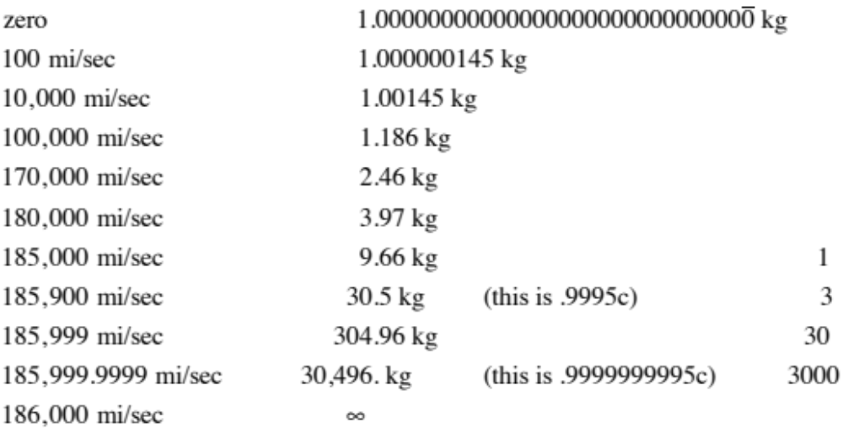
velocity
mass
Apparently, putting energy into a system as low velocities shows itself by changing the body’s energy of motion (it’s kinetic energy) whereas putting energy into a system at velocities close to the speed of light changes the body’s mass.
5.)

Slide 6

You are are familiar with the key to this rather bizarre behavior. What was the first relativistic equation you have ever learned from Einstein?
Its claim is that mass and energy are different forms of the same thing.
Don’t believe me? Take 1.000 grams of hydrogen and fuse it. You will end up with .993 grams of helium. Where did the missing .007 grams go? Turned into pure energy, enough energy to send three-hundred and fifty, 4000 pound Cadillacs (the old school kind) 100 miles into the atmosphere. The sun fuses 657,000,000 TONS of hydrogen into approximately 653,000,000 tons of helium every second. That’s how it generates enough energy to heat our planet 93,000,000 miles away.
When Feynman (Nobel laureate from Caltech) was asked by me at a CAIS meeting what energy was, he said, simply, “I have no idea.” And in saying that, he spoke for the physicists of the world! We know when a body has energy, how to use energy, how to store it, how to generate it, how to transfer it great distances, but we have absolutely no idea what it actually is.
Fortunately, you don’t need to know what it is to use the idea as a problem-solving tool, which is exactly what we are about to do in a non-relativistic setting.
6.)

Slide 7



Work
So what does govern the velocity change a body experiences under the influence of a force at low velocities? The two parameters that will matter are:
The magnitude of the force (the bigger the force, the larger the velocity change will likely be); and
The distance over which the force acts (the farther the force acts, the more the body will pick up speed);
There is a problem with this as stated, though. Consider the following force and displacement . . . will F be changing that body’s velocity as it moves across the table?
NO!!! This force will generate NO VELOCITY CHANGE . . . yet there’s a force and displacement involved . . . so what’s the deal?
7.)

Slide 8









To understand the problem, we need to look at a little more general situation. Consider a constant force oriented at an angle with the displacement vector. In that case, we have:
Clearly, the perpendicular component of the force will do nothing to change the body’s velocity (assuming it doesn’t yank the block off the tabletop), whereas the parallel component WILL effect a velocity change.
In fact, the product of and the magnitude of will yield a number that, if large, would suggest a relatively large velocity change, and if small, a would suggest a relatively small velocity change.
8.)

Slide 9




This product, the product of the, magnitude of the component-of-the-force-along-the-line-of-the-displacement and the magnitude-of-the-displacement is important enough to be given a special
name. It is called WORK. Formally, it is defined as:
Note that the units are newton-meters, or joules (the units of energy):
Looking at the geometry in the sketch, this is also written as:
where is the angle between the line of the force and the line of the displacement and d is the magnitude of the displacement.
It is also not uncommon to see this quantity written as:
Or the magnitude of one vector times the magnitude of the second vector times the cosine of the angle between the line of the two vectors:
9.)

Slide 10


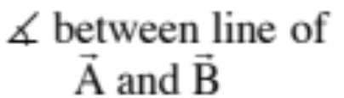


Minor note: It’s important to be able to determine the angle between the line of each vector. Notice that you need a vertex to define an angle . . .
Examples:
vertex
vertex
vertex
10.)

Slide 11

Because this kind of operation is used so often in physics (that is, multiplying the magnitude of one vector times the component of the second vector along the line of the first), the operation is given a special name and designation. It is called
a DOT PRODUCT, and it’s use allows us to write out the work relationship as:
This is not as spooky as it looks. It is just a mathematical operation. The point is that the dot product between a force and displacement vector tells you something about how that force is motivating the body to change its motion.
11.)

Slide 12



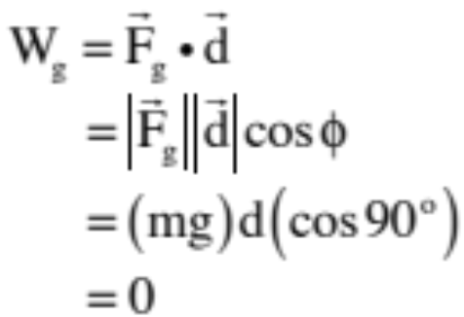


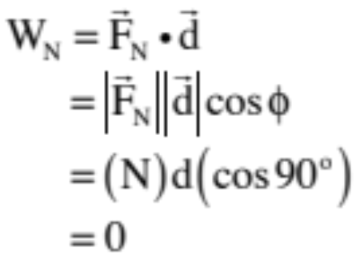

Consider: a 100-N force F applied at above the horizontal drags a 20-kg box 3.0 meters across a rough surface whose coefficient of kinetic friction is .
Derive an expression for the work done by the various forces acting on the box.
gavity:
normal:
12.)

Slide 13
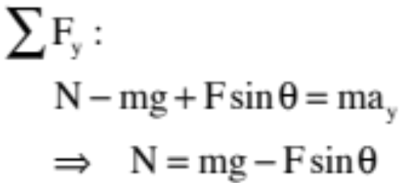

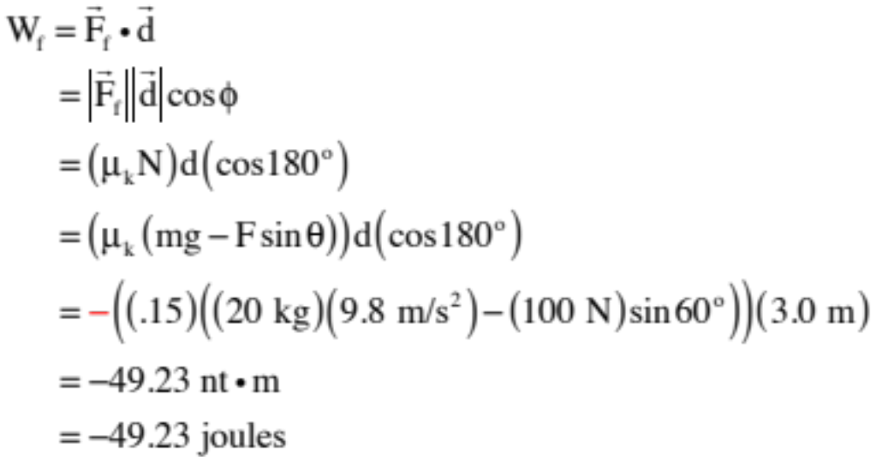

friction:
To deal with friction, we need the normal force. Using N.S.L. in the vertical:
So
13.)

Slide 14
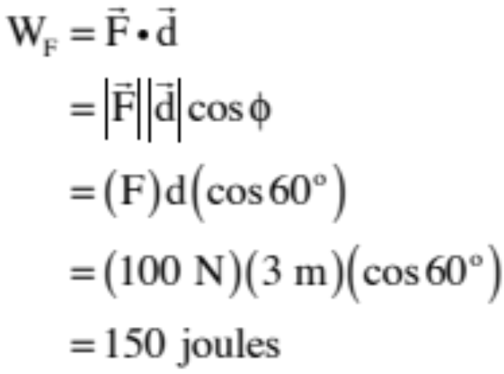
Notice the units of work are newton-meters, which are joules, an energy quantity. So what must the significance of a negative work calculation like friction’s be?
Negative work acts to pull energy out of the system (which means that positive work must act to put energy into a system).
F’s work:
14.)

Slide 15
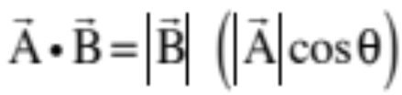
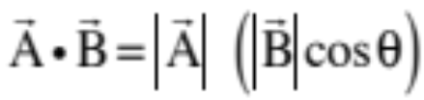



Summary of dot product characteristics:
A dot product is equal to the magnitude of one vector times the component of the second vector along the line of the first vector.
Or, simply, the magnitudes of one vector times the magnitude of the other vector times the cosine of the angle between the vectors.
But everything we’ve done to date has been in terms of unit vectors.
15.)

Slide 16



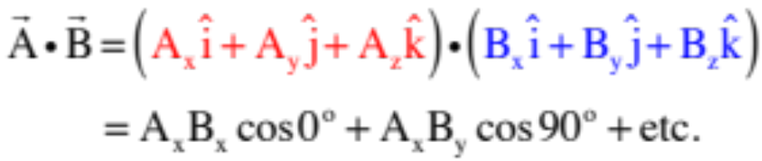



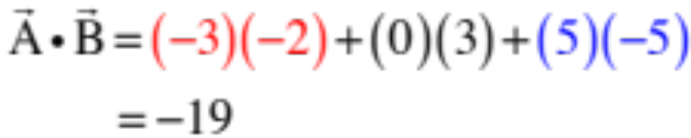
How about a dot product if the vectors are in unit vector notation? In that case:
which is to say, the sum of the products of like component.
Justification:
Let
and
Notice the like-terms stay and the off-terms go away, so extrapolating:
Example: if
and
16.)

Slide 17





Work and Variable Forces
Consider a force that changes both its direction and magnitude as a body moves along the x-axis. Specifically, assume that How much work does the force do as the body travels from x = 1 to x = 4 meters?
To begin with, because the force changes continuously as the body moves from point to point, we need to determine the “differential work” (that is, the tiny bit of the work) equal to , that is generated when the body moves through “differentially small displacement dr . . . or dx if the displacement is along the x-axis (notice that if the displacement was large, we’d use , but because it’s edging toward infinitesimally small, we’d use “dx” instead). And once we had that expression, we could differential to determine the total work done over the entire path, or
Please note that a general differential displacement is denoted as:
17.)

Slide 18






There are two ways to do a dot product.
The first is from a polar perspective. It looks like:
where is the angle between and .
To use this approach, you need to determine expressions for the magnitude of the force, the magnitude of the differential displacement, and the cosine of the angle between those two.
The second is from the unit vector perspective. It looks like:
To use this approach, multiply the components and integrate (note that this is actually three integrals ).
18.)

Slide 19












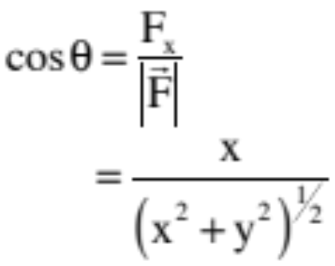
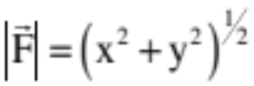

Kindly notice that the force at x=1,y=1 and x=4,y=1 looks like:
So both the angle and the magnitude of the force are changing as the body moves along its path. With the angle between the force and the displacement along the x-direction at any point defined as , we can write:
with
and
19.)

Slide 20
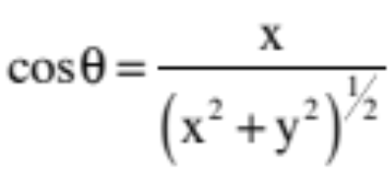
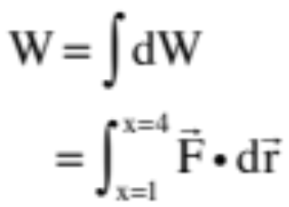
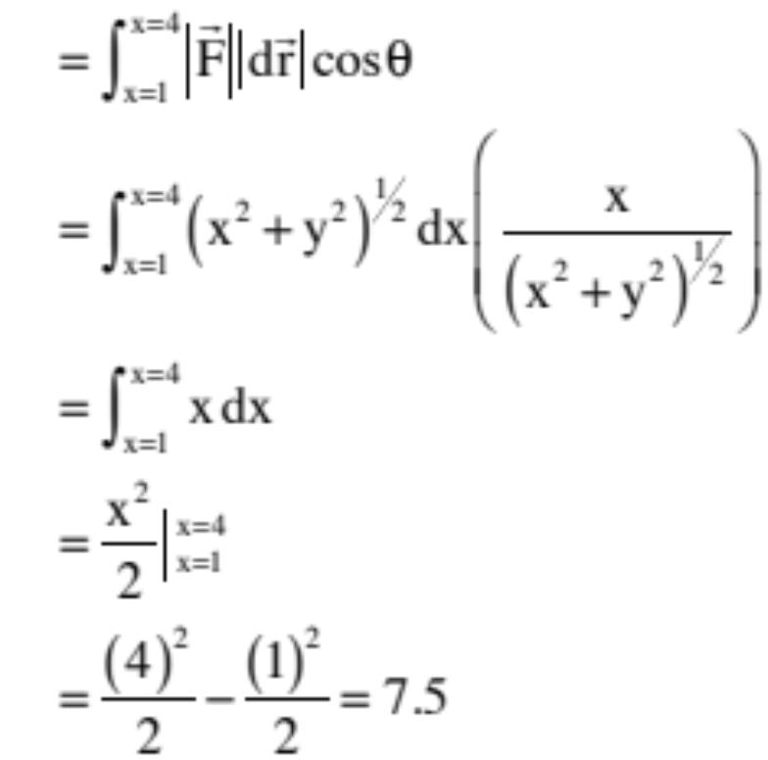
So using polar notation, we can write:
20.)

Slide 21

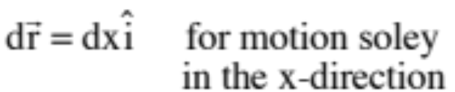
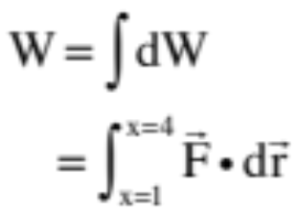
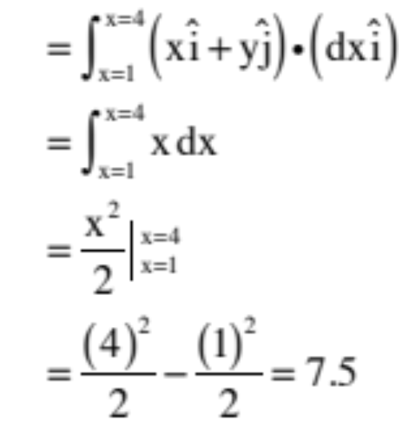
And using unit vector notation, we can write:
Great jumping huzzahs . . . same work value using either notation! Aint physics grand!
21.)

Slide 22
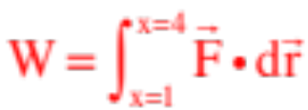






Force vs Displacement Graphs
As a small aside, how are force versus displacement graphs related to work quantities?
Noting that the last problem used to come to solutions, and give that integrals yields areas under curves, it pretty much makes sense that the amount of work a force does as a body moves in, say, the x-direction is equal to the area under the force versus x-displacement graph.
So how much work does the force graphed to the right do as the body moves from x = 1 meter to x = 6 meters?
Solution: the area under the graph above the axis is positive and below is
negative, so at .25 joules per square the solution is 6.5 joules.
22.)

Slide 23
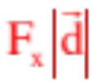
A Useful Observation
In the Island Series question, what you hopefully realized was this. First, mass was not a player in the scenario. You were given a mass; the question was whether it would experience a big or small velocity change . . .
If you’d been thinking, you may have deduced that the bigger the net force along the line of motion, the bigger the velocity change, and the bigger the distance over which the net force acts, the bigger the velocity change. From those two observation should come have formed your two questions.
Put in a little different light, what you were really asking about was the amount of WORK being done on the mass: the greater the work, the greater the velocity change!
In short, there must be a quantitative relationship between velocity-change and net work. What is what we are about to derive.
23.)

Slide 24

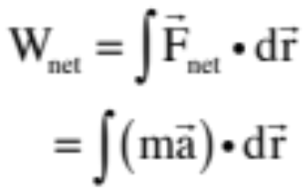
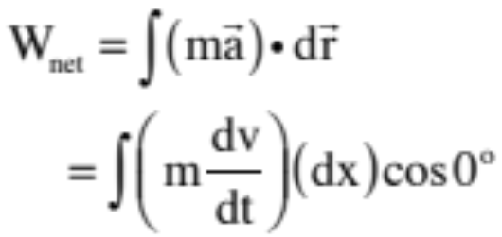
Derivation of the WORK/ENERGY THEOREM
It’s time to link up work with velocity change. In its most general, differential form, net work is defined as:
But with Newton’s Second Law, we can write:
Assuming, for simplicity, that the body is moving in the x-direction and that the the force is also in that direction, and noting the acceleration is the time derivative of velocity, we can expand the dot product to read:
24.)

Slide 25
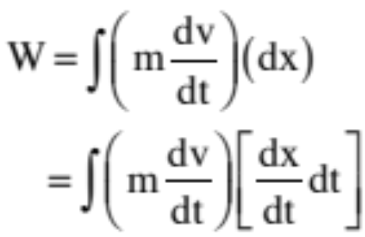
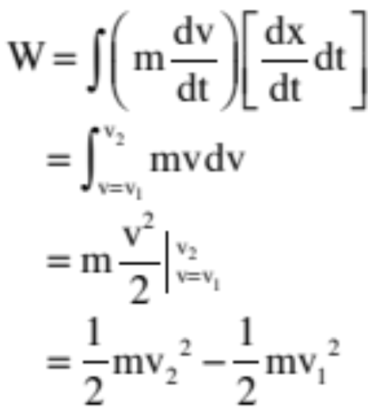
Noticing that the displacement dx equals the velocity dx/dt time the time interval dt over which the displacement occurs, we can write:
Executing the ever present canceling of variables (a ghastly moan coming out of the math department as we do), noting that dx/dt is “v” and integrating over a beginning and ending velocity, we can write:
25.)

Slide 26
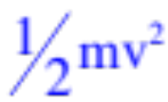


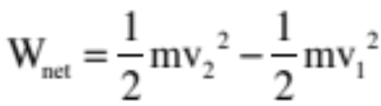
This quantity is deemed important enough to be given a special name. It is called KINETIC ENERGY, and the relationship between it and the net work done on a body by all the forces acting on the body as it moves is called the WORK/ENERGY THEOREM.
THE WORK/ENERGY THEOREM’S many forms:
256)

Slide 27





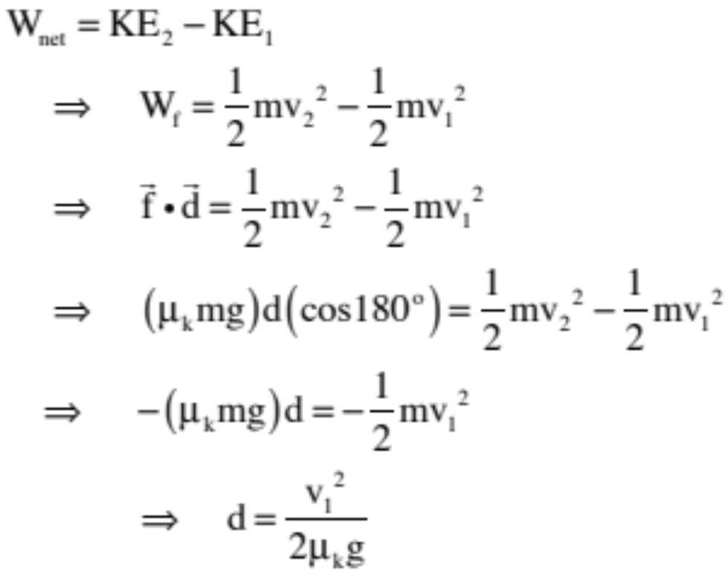


Classic Work/Energy Problem
How far will a block of mass m moving with velocity travel over a frictional surface whose coefficient of kinetic friction is before coming to rest?
Using the Work/Energy Theorem: Noting that the frictional force will be , where N is just mg and where that force is directed opposite the direction of motion (this means the work friction does will be negative) and the final velocity is zero, we can write:
Note: when the net work done is NEGATIVE, energy is pulled out of the system and the body slows down.
27.)

Slide 28



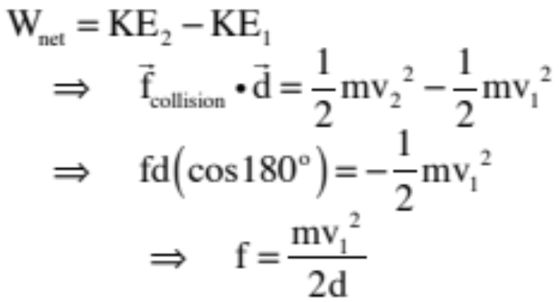
Another Problem: An 8 gram bullet moving with velocity embeds itself into a block of wood burying itself 4.5 centimeters before coming to rest.
a.) Using the idea of energy, how much force, on average, was required to do this?
b.) Was the work done on the bullet positive or negative?
(negative)
c.) Where did the energy of motion go as the bullet came to a stop?
(burrowing hole, sound and heat)
28.)

Slide 29

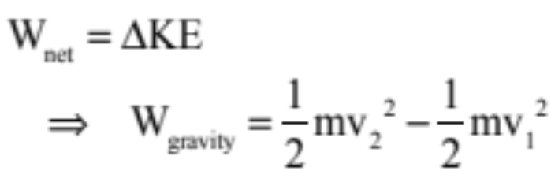

The Gods Must be Crazy. . .
A plane moving with velocity v at an angle with the horizontal is “h” meters above the ground. A coke bottle is released out its window. How fast is the bottle moving just before it hits the ground?
The Work/Energy Theorem might work, except the work gravity does is going to change from point to point. So what to do?
29.)

Slide 30








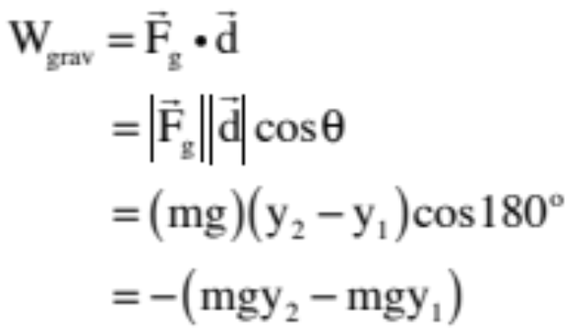
Bit of Slight of Hand
A ball moves from position 1 at to position 2 at as shown on the sketch. How much work does gravity do in the process?
We can derive the work quantity using the standard approach and noting that the direction of the gravitational force is opposite the direction of the displacement of the ball as it moves upward. Doing so yields:
30.)

Slide 31





We next need to derive the amount of work gravity does on the ball as it traveled from position 1 to position 2 along the convoluted path shown to the right. Note that I’ve broken the sections into mini-sections for easy analysis.
--in section 1 and 4, gravity does no work done as the force is perpendicular to the displacement through those sections;
--in section 3, gravity’s work is negative (force down, motion up) whereas in section 5, its work is the same magnitude but positive, so these two add to zero.
--in section 2, gravity does negative work in the amount calculated in the previous section . . .
Conclusion: All that matters when doing a work calculation with gravity is where you start and where you end with the path making no difference at all.
31.)

Slide 32




Force fields that act this way, whose work calculations are PATH INDEPENDENT, are called CONSERVATIVE FORCES.
Note that a conservative force does NO NET WORK around a closed path (another example beyond the visual shown to the right is the work gravity would do as the ball went from position 1 out and back to position 1).
This means non-conservative forces do work that is not path dependent. The classic example of this is friction.
Pick any point and begin summing the work quantities back around to that point. If the force is conservative, the sum will be zero (same amount of positive as negative work done, net)
32.)

Slide 33


If all that matters is where you start and where you end when doing a work calculation for a conservative forces like gravity, wouldn’t it be cool if we could define a function U that would assign a number to and a number to that would be such that when you took the difference between the two, you got the amount of work done by the field as you proceeded between the two points?
(And the answer to that question is, “Yes, definitely very cool.”)
Well, that’s exactly what we stumbled onto when we did the work calculation using the conventional approach on on gravity. Because looking at our solution, we got:
with looking very much like such a function (almost—there’s a negative sign out in front of the difference, but that’s OK, the general idea still holds)
33.)

Slide 34


Functions that do this kind of thing, that allow you to determine how much work a conservative force field does on a body moving from one point to another in the field simply by evaluating the function at the endpoints of the displacement, are called POTENTIAL ENERGY FUNCTIONS.
The symbol used for potential energy functions is a U, and the potential energy function for gravity when near the earth’s surface is:
Furthermore, the relationship between potential energy functions and work calculations is:
34.)

Slide 35

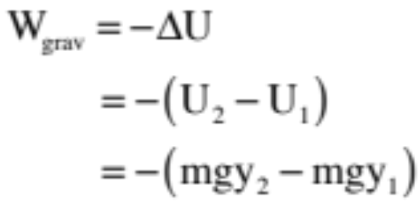

So using our potential energy function for gravity (near the surface of the earth) on our ball problem, we could write:
In short, if you know a force field’s potential energy function, in almost all instances it’s a LOT easier to do a work calculation for the force using its potential energy function than trying to get the result using .
35.)

Slide 36
What’s important to understand is that potential energy is a mathematical contrivance created to do ONE THING and ONE THING ONLY—to determine how much work a conservative force does on a body moving from one point to another in the field.
The ONLY THING you will ever use a potential energy function for will be to do WORK CALCULATIONS, and the only way you will ever use that function will be by taking the difference of the evaluation of the function at the motion’s endpoints, then sticking a negative sign in front of that value.
36.)

Slide 37



So let’s see how well you’ve understood this. A block is about to fall from the position shown to the level of the table top. Little Billy says the block starts out with potential energy . Little Missie says, “Oh, no, it has potential energy equal to . Who is right?
Answer: Both are making statements that could be correct. How so?
As there is no preferred F = 0 position for gravity near the surface of the earth, there is no preferred position to make the gravitational
potential energy equal to zero. You can see that in its definition. Mgy is dependent upon where you put y = 0, which is dependent upon where how you define your coordinate axis.
37.)

Slide 38

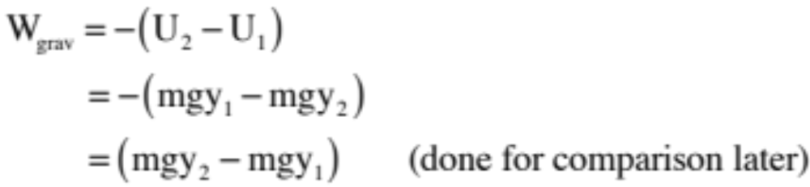
As the axis is currently set up with y = 0 at the floor, the potential energy at position 2 is, indeed,
as Little Billie stated. But potential energy functions are only meaningful in pairs because minus their difference between two points is what is related to work calculations.
Using Little Billie’s defined value as it was meant to be used, then, the work done on the body as it went from position 2 to position 1 becomes:
Little Billie seems vindicated.
38.)

Slide 39

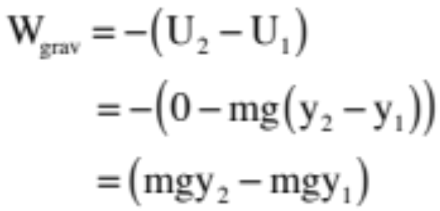
But Little Suzie is an iconoclast. She decides to make her y = 0 position the top of the table (i.e., at position 1). So in her rendition, her sketch looks like the one shown to the right and her “work done” calculation for the body as it moves from position 2
to position 1 looks like:
This is the same value Little Billie got in his calculation (shouldn’t be surprising as the motion hasn’t changed even if the coordinate axis has).
39.)

Slide 40

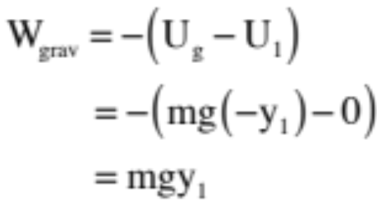
Conclusions:
1.) Although it is commonly done, making statements like, “The body at position 2 has potential energy in the sense that it can potentially pick up kinetic energy” is a little bit dangerous. Why? Because if we take the zero level to be the tabletop, the gravitational potential energy at that point, BY DEFINITION, is ZERO. With that, it makes no sense to claim that there is NO potential for a body to pick up kinetic energy if it were to drop from that level to the ground. In fact, that work calculation would look like:
40.)

Slide 41

It’s time to talk energy concepts:
1.) From a purely theoretical perspective, idea of potential energy is a mathematical contrivance. It is used to aid in work calculations and that’s it.
2.) At least in situations in which there is no preferred F = 0 point (like gravity near the surface of the earth), the coordinate axis can be set ANYWHERE CONVENIENT, which means trying to place physical significance on the quantity can get you in trouble (hence, the last example).
3.) That doesn’t mean you don’t know anything about a system when given potential energy information.
a.) What do you know if I tell you the potential energy difference between two points in a force field is 6 joules?
You know the field will do -6 joules of work on any body moving between the points. How so? Because you know that
b.) What do you know if I tell you the potential energy at a point in a force field is -6 joules?
Nothing unless you know the field has a dedicated U = 0 point. If then, the negative sign may tell you the body is “bound” to the system (see energy diagrams), and even then there are bounded systems that don’t act like that.
41.)

Slide 42



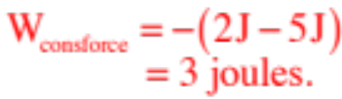
3.) That doesn’t mean you don’t know anything about a system when given potential energy information (con’t).
c.) We know that if left to their own devices, systems in nature migrate from higher potential energy states to lower potential energy states.
--Electrons in atomic orbitals respond to electrical forces by spontaneously cascading from higher energy state “outer orbitals” to lower energy state “inner orbitals” naturally;
--Water runs down hill.
d.) We know from the math that when a body moves with a force field, it moves from higher potential energy to lower potential energy with the field doing positive work (hence the need for the negative sign in the work/potential energy relationship).
--An interesting observation is that when positive work is done and energy is put into the system (in most cases showing itself with an increase of energy of motion, or kinetic energy), the potential energy of the body goes DOWN. From the perspective of energy transfer, it is as though the potential energy converts itself into kinetic energy.
42.)

Slide 43
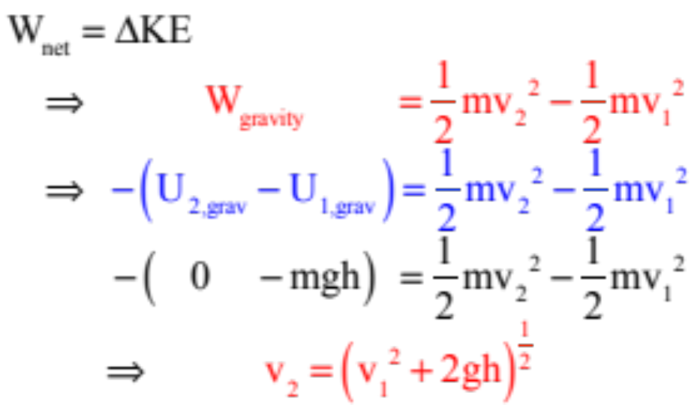
Back to “The Gods Craziness . . . “
A plane moving with velocity v at an angle with the horizontal is “h” meters above the ground. A coke bottle is released out its window. How fast is the bottle moving just before it hits the ground?
We can now use the Work/Energy Theorem because even though gravity’s work changes from point to point, it’s potential energy function allows us to circumvent that . . . (yippee . . . ). And with that, we get:
43.)

Slide 44
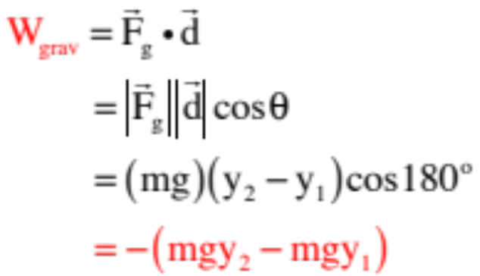


Deriving a Potential Energy Function from a Force Field Function
Think back to how we got the potential energy function for gravity. We determine the amount of work done by gravity as a body moved through a gravitational field using :
then compared that final result to
To conclude that:
44.)

Slide 45
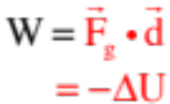




In other words, we executed the following operation:
rearranging to get:
And this was all fine and swell as long as the angle between and wasn’t changing, and as long as was constant. But what if there was variability somewhere in the system? Then what? Then we’d have to go differential and use the form:
Except there’s one more twist.
We want a function “U(x)” or “U(r)” that identifies in general what a body’s potential energy is at any point “x” or “r”, relative to the position we’ve chosen as the body’s zero potential energy point.
So how do we find that point?
45.)

Slide 46

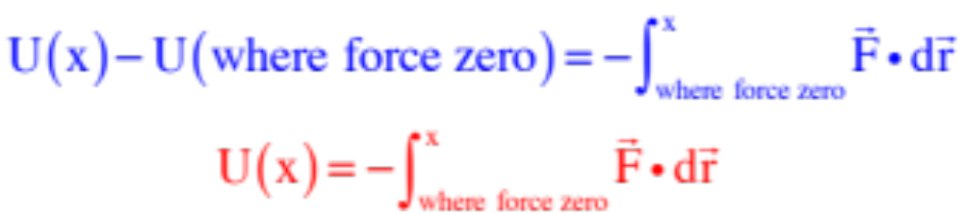
The convention is to define the potential energy function to be zero where the force field associated with the potential energy field is zero.
We couldn’t do this with gravity near the surface of the earth because there is no place where the gravitational force is inherently zero, so you get to pick your zero point in that case. But that isn’t the case with most force fields. A
A spring’s force field, for instance, is zero at the spring’s equilibrium position. And for gravitational fields far out away from the field-producing entity, the force is zero at infinity.
The point is, with this in mind and remember the potential energy where the force is zero must be defined as zero, the expression used to generate a general potential energy function ( ) takes the form:
46.)

Slide 47





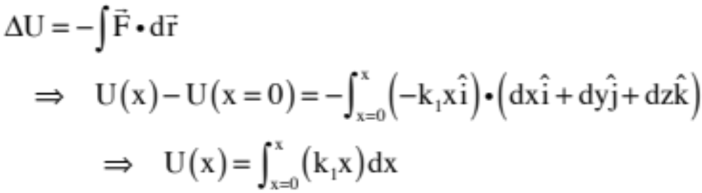

Example 1: An ideal spring oriented along the x-axis carries a force function:
where is the spring’s spring constant—this tells you how much force per unit distance is
required to elongate or compress the spring . . . a big spring constant means a stiff spring—and x is the displacement of the spring from its equilibrium position. In the case of a spring, equilibrium is where the spring force is ZERO.
Because we have a preferred position where the spring force F = 0 (i.e., at x = 0), that is where we will define our potential energy function to be ZERO. Determining the work the force does as we go from that point to an arbitrary point looks like:
47.)

Slide 48
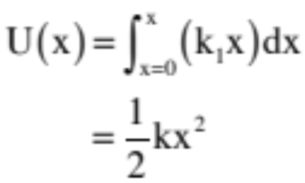
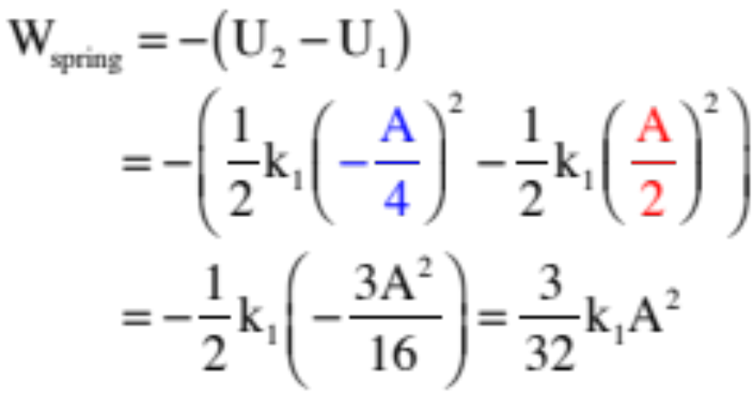
Doing: the integral yields a potential energy function for an ideal spring of:
You would use this as you would any other potential energy function:
Example: Determine how much work the spring does to the mass as the spring moves the mass from A/2 to –A/4, where A is the maximum displacement.
48.)

Slide 49
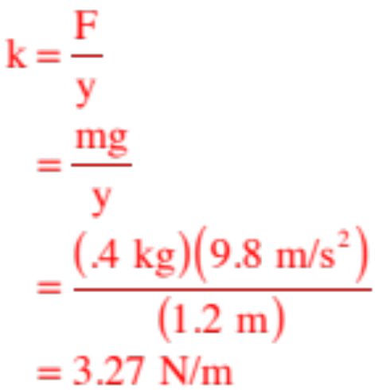
Determination of Spring Constant
Side note: How do you determine a spring constant? (This is something you will need to be able to do in the future.)
The spring constant tells you how much force is required to elongate or depress a spring a given amount, so apply a force, measure the amount of elongation produced by the force and divide the one into the other. That is:
1.) Attach a spring balance (a force balance) to the spring, pull until the spring is a predetermined length, record the force required, then divide that force by the distance of elongation to get k. Or:
2.) Hang a mass m from the spring in the vertical. Divide the distance the spring elongates into the mass’s weight (mg). That will also give you the amount of force per unit distance required to elongate the spring.
Example: What’s the spring constant if a .4 kg hanging mass elongates a spring 1.2 meters?
49.)

Slide 50




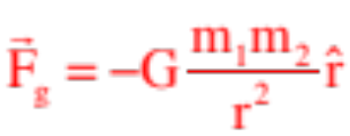

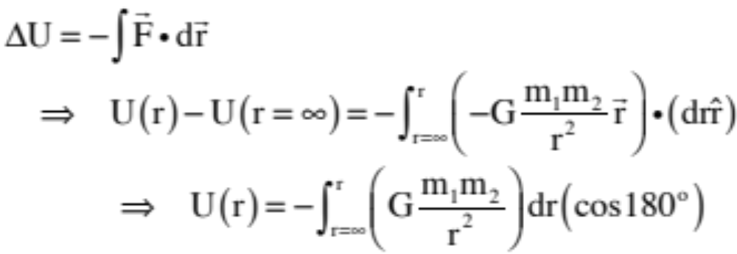

A second example: (Note that this is given as a radial vector.) Away from the earth’s surface, the gravitational force that exerts on is given by :
where G is a constant. Determine the force’s potential energy function.
The first thing to do is to decide if there is a preferred F = 0 point, as that should be where you would put your potential energy equal to zero point.
In this case, this is out at infinity. Additionally noting that in radial unit vector notation, , we can write:
50.)

Slide 51
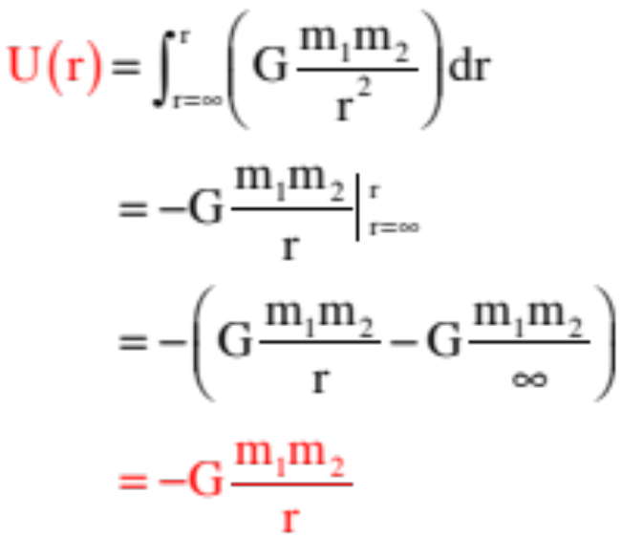
As before, doing the integral yields a potential energy function for gravity far from the earth’s surface of:
Interesting note: This potential energy function is NEGATIVE. No worries. AS LONG AS YOU USE IT the way potential energy functions are supposed to be used (i.e., to calculate work quantities), it will work just fine . . . no pun intended.
51.)

Slide 52

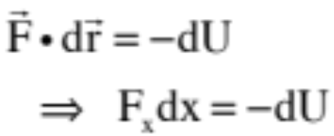
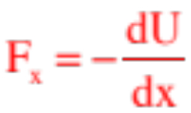
Deriving a Force Function from a Potential Energy Function
According to the math, if a body moves a differentially small distance over a path in a force field, it will have a differentially small amount of work dW done to it equal to:
If both the force and motion happen to be in the x-direction, this would mean that
It would also mean that:
This is the relationship uses to determine a potential energy’s force function.
52.)

Slide 53

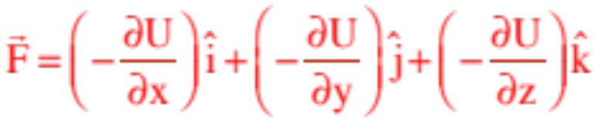



Except life is never that simple. Forces aren’t just in the x-direction. So how do we notationally deal with multiple-directional forces?
We want a force expression that, in its most general form, looks like:
According to our potential energy relationship with force, this will become:
where the symbol is called the partial derivative with respect to “x,” and is used when taking a derivative of a multi-dimensional function (U) with respect to ONE VARIABLE ONLY—in this case, with respect to a change in the x-direction.
And this is where it gets freaky, and non-AP (though you will certainly see it if you ever take a physics course in college). There is a differential vector operator called the del operator whose symbol looks like and that is equal to:
53.)

Slide 54



The beauty of this operator, being a vector, is that you can use it to operate on other vectors. So, for instance, you can cross a del operator into a vector (the cross product being an operation you will learn more about when we talk about torque and rotational motion)
producing what is called the curl, a vector unto itself that tells you something about the way vector F circulates around a point of interest.
Our needs are simpler. All we require is what is called the gradient. That is the del operator acting on a scalar function (like our potential energy function U). It produces a vector whose magnitude is the maximum SPATIAL rate of change of the scalar and whose direction is the direction of that maximum change. In any case, using:
we can write:
54.)

Slide 55


Example 3: An ideal spring oriented along the x-axis has a potential energy function of:
where is the spring’s spring constant—this tells you how much force per unit distance is
required to elongate or compress the spring . . . a big spring constant means a stiff spring—and x is the displacement of the spring from its equilibrium position. In the case of a spring, equilibrium is where the spring force is ZERO.
What is the force function that goes along with this potential energy function?
Doing this the reasonable (and acceptable) way:
55.)

Slide 56


Doing this the formal way utilizing the del operator idea:
This is clearly cumbersome in comparison the first way, which is the kind of AP problem you will undoubtedly get, but it is the way you’d do the problem for more complex potential energy function.
56.)

Slide 57


Example 4: The gravitational potential energy function for a mass far from its surface is:
where G is a constant. Derive an expression the force that goes with that potential energy function.
Observation: From our previous example and all the theory that has proceeded this problem, it should be reminded that the relationship between a force and its potential energy function is that the force magnitude is related to the maximum rate at which the energy content of the system changes spatially at a given point (that’s what is if the force is only in the x-direction), with a direction that is related to the direction of MAXIMUM change (that might not be obvious, but that’s what a gradient does).
If the potential energy function is radial in nature, force will tell you something about the way energy changes radially as you move out away from the force producing object.
57.)

Slide 58

With this in mind, it shouldn’t be too much of a stretch to see that:
as expected.
NOTE: In polar-spherical notation, the del operator is a horror. We don’t need to go there for the calculation of the work gravity does on objects far away (translation: be happy with what you see above—it’s more than enough for our needs).
58.)

Slide 59






Summary
a.) Work calculations:
b.) Work/Energy Theorem:
c.) Potential Energy functions:
d.) Use of Potential Energy functions:
e.) Deriving U function from Force F function:
f.) Deriving Force F function from U function:
59.)

Slide 60


Energy Diagrams I
a.) What does the slope of this curve represent?
As , it represents a conservative-force function
b) What is happening at the bottom of the curve?
This is a point of stable equili-brium. Place a body there and the force will be zero, which means the body won’t be motivated to move.
c) What happens if the mass is given an initial displacement x?
A displacement in the positive x direction results in a conservative “restoring force” in the –x direction. If the mass is released, it will oscillate back and forth, with U+K = constant. Visualize this oscillating system as a “marble in a bowl.”
60.)

Slide 61

Energy Diagrams II
How is this potential energy diagram different?
There is a point of unstable equilibrium at x = 0 . . . Put a body there and the body won’t feel a force (so it will sit stationary), but displace it slightly and it will accelerate picking up kinetic energy rapidly . . .
61.)

Slide 62




AP Problem
1995 M2. A particle of mass m moves in a conservative force field described by the potential energy function
U(r) = a(r/b + b/r), where a and b are positive constants and r is the distance from the origin. The graph of U(r) has the following shape.
a.) In terms of the constants a and b, determine the following.
  i.) The position r_{o} at which the potential energy is a minimum?
  To get a minimum, take the derivative of the function and put equal to zero
  ii.) The minimum potential energy U_{o}?
62.)

Slide 63






AP Problem (con’t)
b. Sketch the net force on the particle as a function of r on the graph below, considering a force directed away from the origin to be positive, and a force directed toward the origin to be negative.
63.)

Slide 64







AP Problem (con’t)
The particle is released from rest at r = r_{o}/2.
c. In terms of U_{o} and m, determine the speed of the particle when it is at r = r_{o} .
64.)

Slide 65


AP Problem (con’t)
The particle is released from rest at r = r_{o}/2.
will oscillate
between
d. Write the equation or equations that could be used to determine where, if ever, the particle will again come to rest. It is not necessary to solve for this position.
Assuming no energy is lost in the motion, the body will come back to rest when it returns to it’s start
point or at it’s other extreme. In other words, wherever .
e. Briefly and qualitatively describe the motion of the particle over a long period of time.
The particle will oscillate with no energy loss.
65.)

