Slide 1
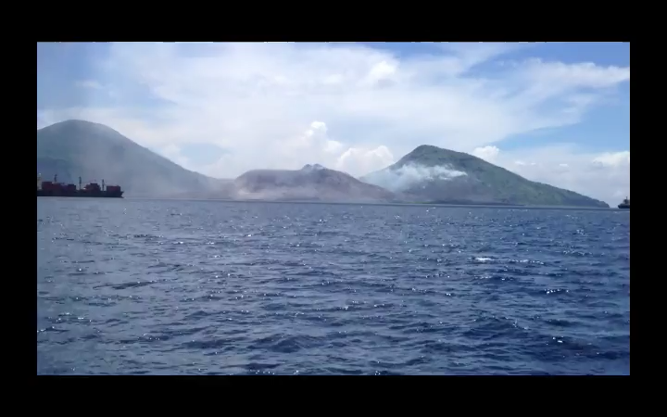
CHAPTER 8:
Conservation of Energy
1.)

Slide 2
How We Got Here!
We started by noticing that a force component acted along the line of a body’s motion will affect the magnitude of the body’s velocity. We multiplied the force component and displacement to generate the scalar quantity called work.
Using Newton’s Second, we derived a relationship between the net work done on a body and the change of the body’s kinetic energy. This was called the work/energy theorem.
We then noticed that there are forces whose work done does not depend upon the path taken as a body travels between two points—whose work is end-point independent (friction was clearly not one of these forces). In such cases, we developed the idea of a function that, when evaluated at the endpoints, would allow us to determine how much work the field did as a body moved between the points . . . which is to say, we developed the idea of potential energy functions.
So now it’s time to take the last step, starting with the work/energy theorem.
2.)

Slide 3
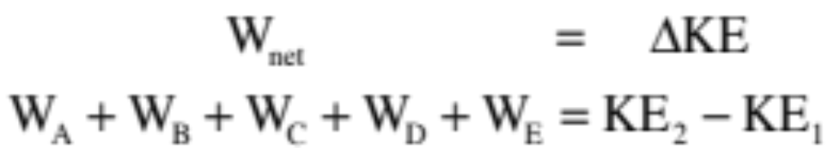

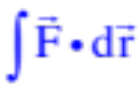
Consider a body moving through a group of force fields on its way from Point 1 to Point 2. What does the work/energy theorem tell us about the body’s motion?
The net work done will equal the sum of all the bits of work done by the various pieces of force acting on the system. Denoting each force with a letter, this can be written as:
Assume:
--the forces that produce work A and work B are conservative with KNOWN potential energy functions.
--the force that produces work C is conservative but with an UNKNOWN potential energy function.
--the forces that produce work D and work E are non-conservative, don’t HAVE potential energy functions and need to be determined using either or .
3.)

Slide 4
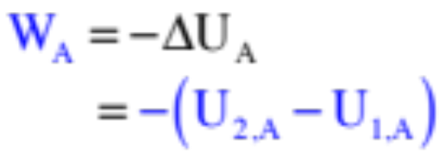
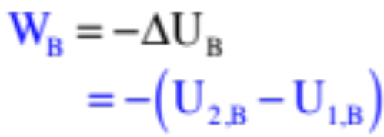
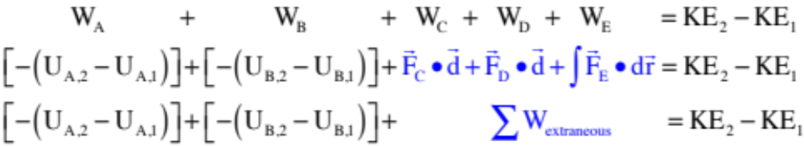
For work A and work B, we have potential energy functions. So . . .
and
For work C, D and E, we can’t use potential energy functions, either because we don’t know them or because they are non-conservative forces and don’t have them.
With this, the work/energy theorem becomes:
4.)

Slide 5
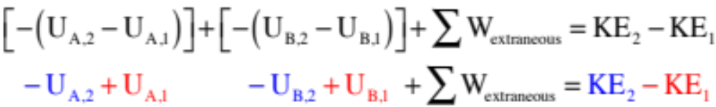


Rewriting this so the signs are easy to see, we get . . .
What we are left with are a bunch of potential energy terms (U terms) and at least one kinetic energy term evaluated at time , and a similar group of terms evaluated at time . If we put all of the terms associated with the state of the system at the beginning of the time interval, at point in time 1, on the left side of the equal sign, and put all of the terms associated with the state of the system at the end of the time interval, at point in time 2, on the right side of the equal sign (leaving the extraneous work terms alone), we get:
5.)

Slide 6

Rewriting this in it’s most succinct form, allowing for the possibility that you could have more than one object with kinetic energy in a system at a given instant (think Atwood Machine), we get:
If we call the sum of all the kinetic energies and all of the potential energies at a point in time the mechanical energy E at that time, we can make this relationship even more abbreviated as:
This is the absolute simplest form of this relationship.
6.)

Slide 7

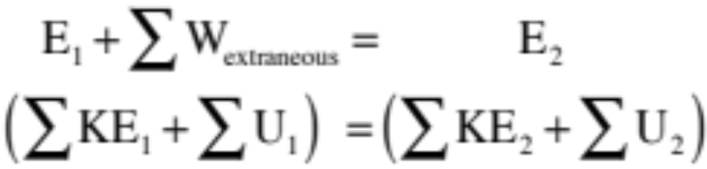
In summary, this relationship states that if there is no work being done by extraneous forces in a system (remember, a force that does extraneous work is one whose work calculation can’t be done using a potential energy function), then the total mechanical energy at time 1 will equal the total mechanical energy at time 2. In other words, the total mechanical energy does not change, is conserved and
Note 1: At time 1, the distribution of potential and kinetic energies may be different than at time 2. The claim is that the SUM of those two types of energy will always be equal.
Note 2: How to conceptually understand this? If there is extraneous work being done, that will simply increase or decrease the initial mechanical energy in the system giving us the final mechanical energy in the system.
7.)

Slide 8





Using Conservation of Energy
Several gentle starter Problems #1 (you will look back at these with fondness): A ball of mass m is thrown from a height h with an initial velocity upward of . If it loses 10 joules of energy to friction on the way, how fast is it moving when it reaches the ground? What is its velocity at an arbitrary height y if it has lost 6 joules of energy to friction by that point?
Because there is no preferred F = 0 point for gravity near the surface of the earth, hence no preferred U = 0 point, it is always your choice as to where you will place the zero potential energy level when doing problems like this. In the case of the ball, the most reasonable choice is to take the ground as the y = 0 level.
8.)

Slide 9

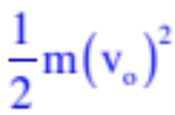


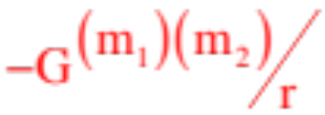
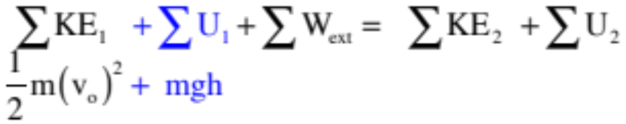
With all that in mind, this is a typical conservation of energy problem. Starting with the standard form, we can simply filling in the bailiwicks . . .
--at the beginning of the interval, is anything moving? If so, write for it. If not, write 0. There is movement in this case, so we write:
--at the beginning of the interval, is there any potential energy in the system? If so, write or or
or whatever the function is, evaluated where the body is at the beginning of the interval. If not, write 0. There is gravity close to the earth’s surface, so we write:
9.)

Slide 10

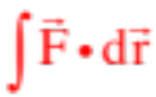
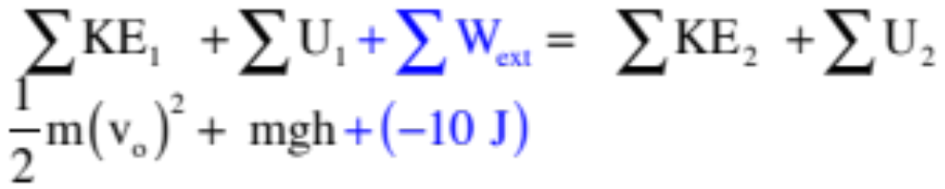

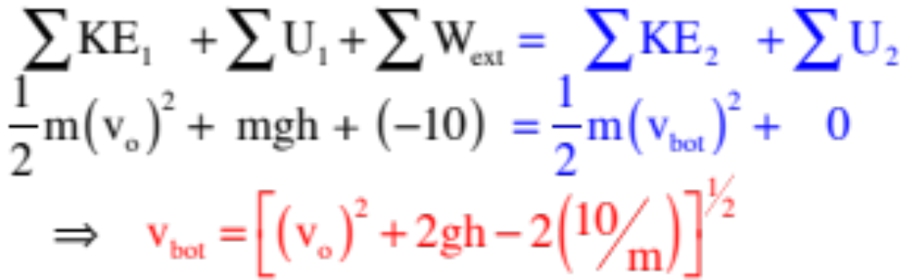
--if there is any work being done during the interval by forces not being taken care of by potential energy functions, write out those extraneous work quantities using or or, if an amount is given, that amount. If not, write 0. In this case, you know you lose 10 joules, so we write:
--at the end of the interval, is anything moving? If so, write for it. If not, write 0 . . . etc., then solve.
10.)

Slide 11
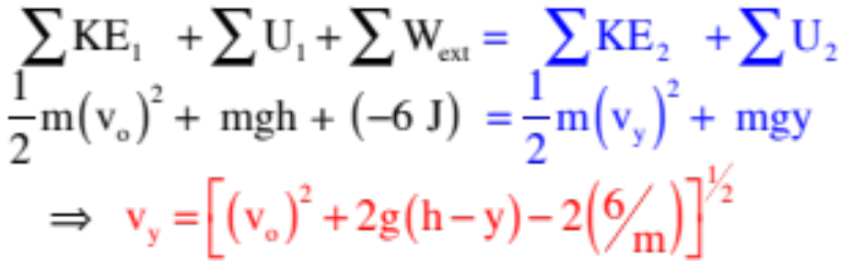
--How about the velocity at arbitrary position y, assuming 6 joules of energy was lost in the motion:
11.)

Slide 12


Sorta gentle starter #2: A spring gun with barrel length d = .20 meters (a Butline Special) and unknown spring constant k compresses its spring the full 0.2 meters when “cocked.” When fired, the 35 grams projectile will travel h=10.0 meters above the barrel’s end. Assume the spring is depressed very little when the projectile is placed gently on it . . .
Notice: Part of what makes problems like this difficult is that the spring is not in the horizontal but, rather, in the vertical where gravity lives. The additional twist is that there are two kinds of problems possible with this kind of set-up, problems in which the mass is attached to the spring (so the mass oscillates around its natural equilibrium position) and problems in which the mass is free to leave the spring after being accelerated by the spring (like this problem). For this case, we can look at the amount of work the spring does on the projectile as the projectile is shoved into the gun the full distance “d.” That is what we will have to do for the first part of this scenario.
12.)

Slide 13
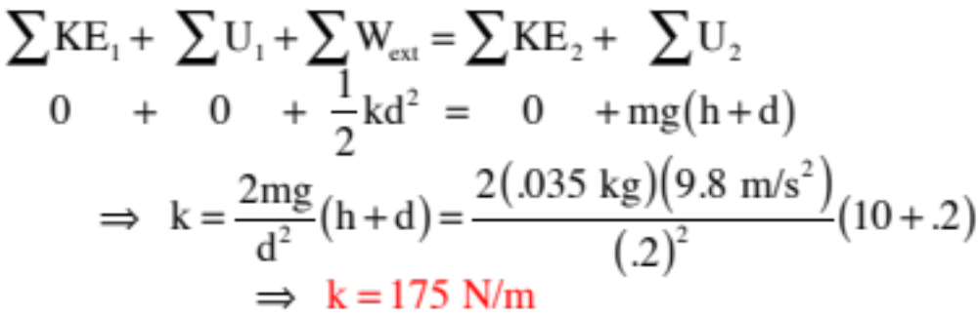
Barrel length d = .20 meters; unknown k; barrel and spring length .2 meters when “cocked;” projectile mass 35 grams, maximum height h=10.0 meters above the barrel’s end.
a.) Neglecting friction, determine the spring constant.
Two things: 1.) We need to decide where we want to place the y = 0 level for gravitational potential energy (we need a coordinate axis for “mgy” to make any sense). We will place it where the projectile resides when the gun is cocked. And 2.) Because it isn’t obvious how to deal with the spring/projectile equilibrium position, we are going to treat the work done by the spring as extraneous work and figure out how much work the spring does as the projectile is shoved down the barrel the distance ”d.” With that, the conservation of energy becomes:
13.)

Slide 14
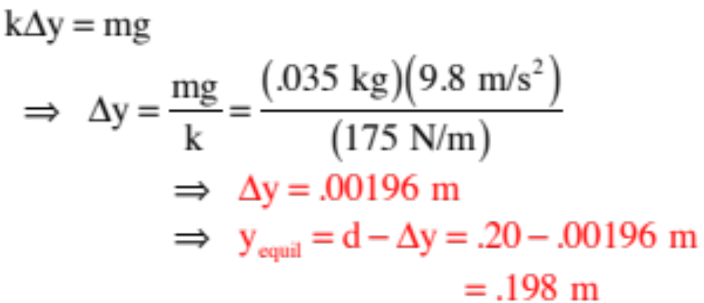


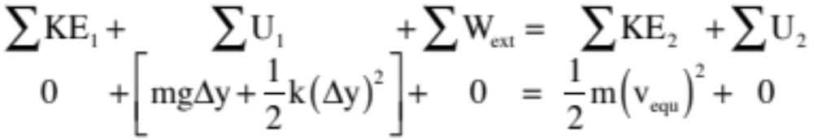
b.) Knowing k, what is the spring’s equilibrium position when the projectile rests on it?
At equilibrium, the spring force will exactly counteract gravity, so:
Notice you could try to use the conservation of energy to get this, but if you put the projectile at “d” and just let it go, it would be moving when it passed through the equilibrium position. With gravitational y = 0 at the spring’s equilibrium, we would write:
There is a way to get that velocity quantity, but we haven’t covered it yet so this isn’t a good avenue.
14.)

Slide 15
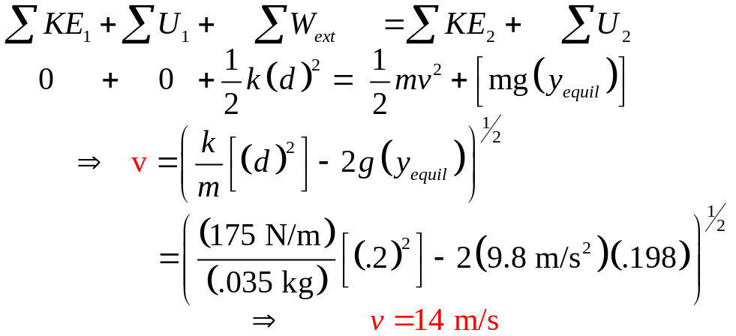
c.) Determine the projectile velocity as it moves through the spring’s equilibrium position . . .
Using the conservation of energy, again assuming the spring is compressed from its full-length position (that is, that is its equilibrium position for this part):
d.) Add-on #1: How, generally, would Part a change if there had been friction?
There just would have been a “work extraneous” term in the conservation of energy expression.
e.) Add-on #2: How would the c.of e. expression in Part a change if you wanted to know the projectile’s velocity 5 meters above the barrel’s end?
At the end of the time interval, the “h” term in “mgh” would be “d+5” instead of “d+10”, and there would be a kinetic energy term at the end of the time interval.
145)

Slide 16







A little less gentle starter #3: Consider the block/pulley/spring set-up shown with the spring initially uncompressed and the surface frictional with coefficients of frictions and . When the system is released, the hanging mass is allowed to slowly descend a distance h before coming to rest.
Once the hanging mass comes to rest, what forces act to keep the system in equilibrium?
The spring is certainly acting, but there is also a static frictional force acting. If there was no friction in the system, the spring would allow the mass to drop even farther down than h. The static frictional force is not be the maximum static frictional force. It will, instead, numerically equal the kinetic frictional force. That was the force that was acting as the body was moving, and as the body came to rest.
16.)

Slide 17
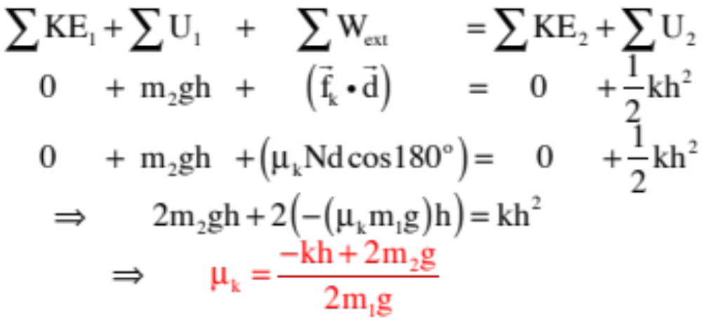

Determine the coefficient of kinetic friction.
Using conservation of energy:
17.)

Slide 18







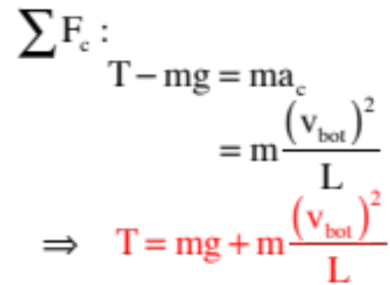

For a little more sophistication Problem #4 : A pendulum of length L = .7 meters has a mass m = .2 kg at its end. It is observed to have a velocity when at with the vertical. What is the tension in the line when it passes through the bottom of the arc?
On the surface, this looks like a centripetal force problem. When at the bottom, N.S.L. yields:
f.b.d. at bottom:
18.)

Slide 19



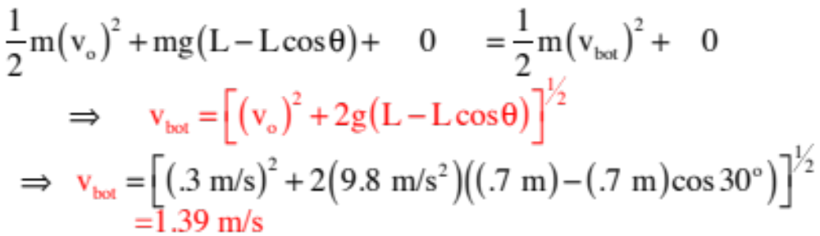

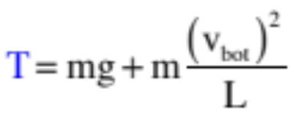
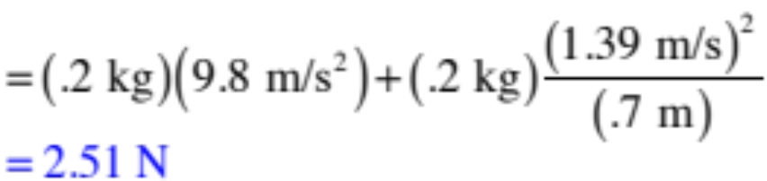
We need an expression for the velocity at the bottom of the arc. Enter the conservation of energy. Taking the bottom of the arc to be the zero potential energy for gravity, noticing that the bob is initially units above the zero level (how so?—see sketch), and we can write:
which means:
19.)

Slide 20

Loop-the-loop trike:
20.)

Slide 21


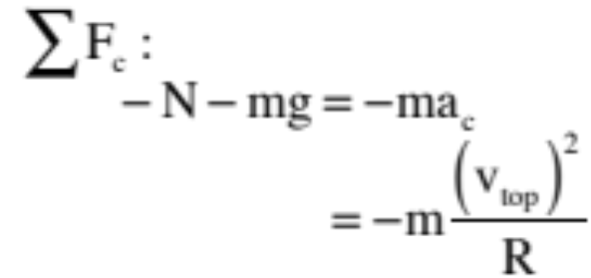

More fun—Problem #5: A friction-less ramp terminates in a loop of radius R. A block of mass m is released from rest and allowed to slide down the ramp and into the loop. How high up from the ground must the block be placed if it is to just barely make it through the top of the loop and out again?
There are two points of interest here, the start point defined by h and the top of the arc where the velocity is just big enough to allow the block to skim through and out again. The motion at the top is clearly centripetal, so let’s start there. In general:
f.b.d.
21.)

Slide 22

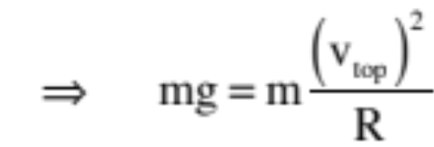
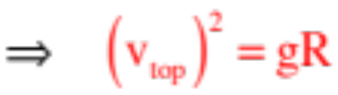
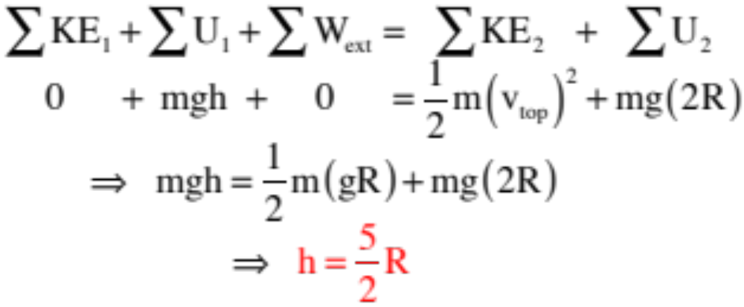
The trickiness here is in noting that at if the block is to just barely skim through the top, the normal force will go to zero, so that:
What does energy have to say about the situation?
22.)

Slide 23


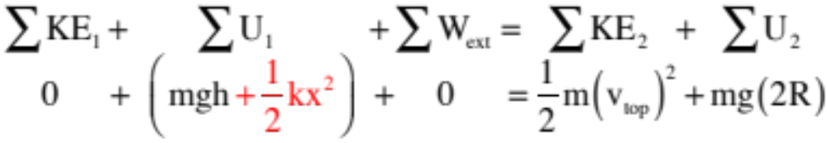

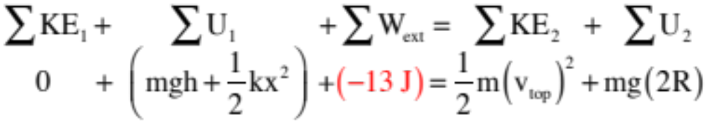
So how might we have made this problem more exciting? Well . . .
--we could have put a spring at the top (spring constant k) and pushed the block x units into it before release.
No big deal. All that would have changed would have been the term yielding:
--we could have additionally added jello, maintaining that the block lost 13 joules of energy as it passed through the jello at the bottom of the ramp before moving on. That would have affect the extraneous work part of the equation:
AS I SAID, FUN . . .
23.)

Slide 24


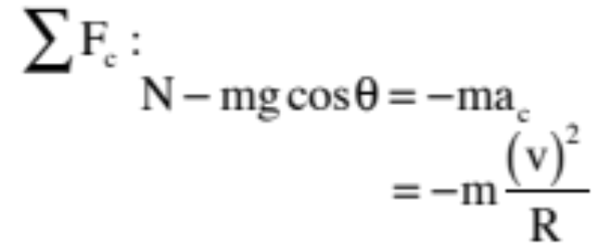


Still more fun with Problem #6: A small mass m sits stationary atop a frictionless ice dome of radius R. A tiny, tiny, tiny gust of wind just slightly nudges the mass off-center, and it begins to slide down the dome. At what angle will it leave the dome?
There are, as usual, two points of interest
here. WHENEVER YOU RUN into a problem like this where it isn’t at all obvious how to proceed, just start writing down relationships you know are true. In this case, the two that should jump out at you are energy and the fact that the body is moving centripetally at the lift-off point. Utilizing the latter first:
f.b.d. at in general:
24.)

Slide 25
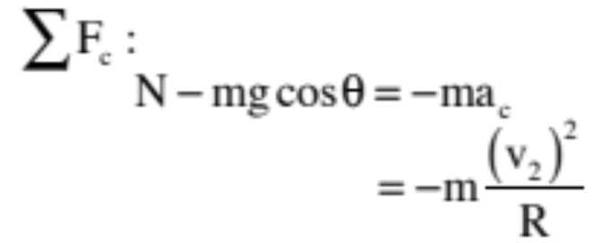
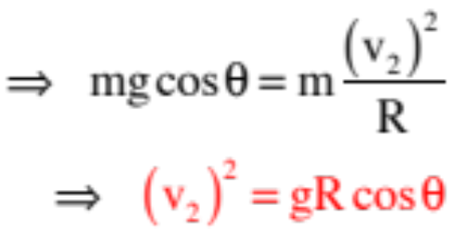
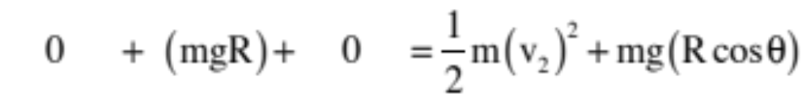
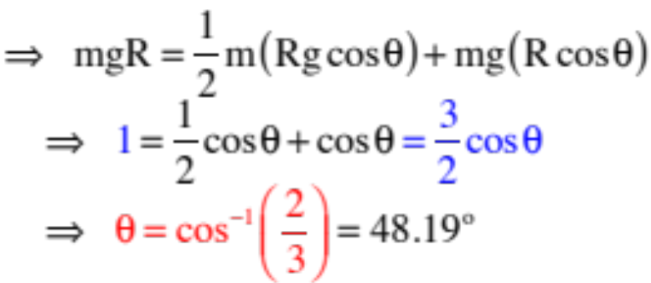
At lift-off, the normal force goes to zero, which means:
What about energy?
25.)

Slide 26
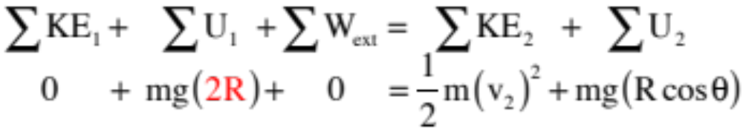
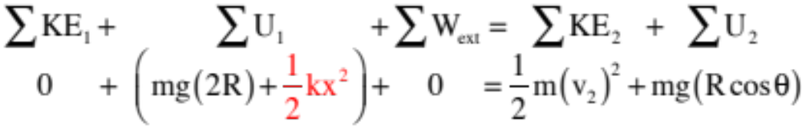
And how might we make this more exciting?
We could extend the ramp upward as shown.
That would change the initial gravitational potential energy to mg(2R) yielding:
We could additionally add a spring at the top (not shown), which would also change the initial potential energy yielding
26.)

Slide 27
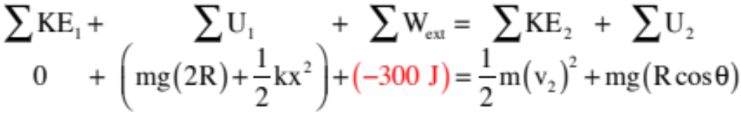
And, of course, we could add to all of that jello that would take out, say 300 joules of energy
yielding:
None of these changes would alter the centripetal force part of the problem, but they would alter the energy part. The energy APPROACH wouldn’t change, though. Look to see what’s happening at the beginning of the interval. Look to see what’s happening at the end. Look to see what happened during the interval. It’s simple!
27.)

Slide 28








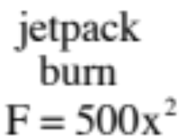







Finally, the problem from hell #1: A mass m = 2 kg with a jet pack on its back slides down a radius curved incline, through a frictional pit of length L = 2 m with , up, over, through and out a loop-the-loop of radius
, through a jello pit that takes 80 joules out of the system whereupon the jetpack fires and produces newtons of force over an x = .5 meter distance before colliding with a spring whose spring constant is k = 120 N/m. If 110 joules of energy are lost due to that collision, by how much does the spring compress during the collision?
28.)

Slide 29

Note: There is one saving grace to this problem. In the normal approach to energy considerations, all you do is write down the energy content of the system at the beginning of the interval (KE plus U), write down the energy content at the end of the interval, then look and write down any work done between the beginning and end that hasn’t been taken into account with a potential energy function.
If it hadn’t been stated otherwise (which it was), this problem could have been different in that one possible answer to “how much is the spring compressed” could have been ZERO. Huh? If the body didn’t have enough energy to get passed the loop, it never would have gotten to the spring. You don’t have to worry here as you were told it got thru, but if you hadn’t been you’d have to check to see if it made it.
So let’s look at energy:

Slide 30



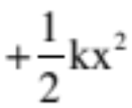



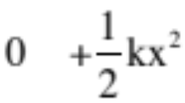
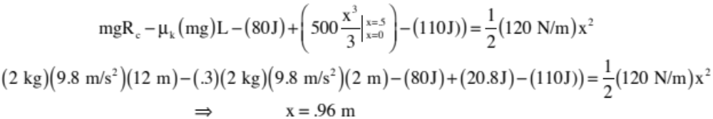
What’s the first thing you will write?
30.)

Slide 31



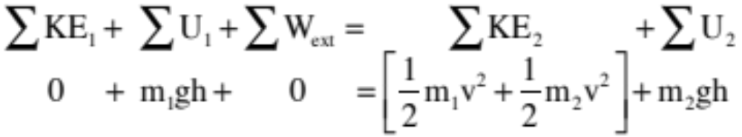
Minor Point: Because the gravitational potential energy function near the surface of the earth is a function of a coordinate axis OF YOUR CHOOSING, it is perfectly permissible to give each body in a system its own axis. A good example of this is the Atwood Machine:
An Atwood Machine consists of two masses attached to a string that is hung over a pulley. How does energy lay out as the masses move a distance h, assuming they start from rest.
If the left one drops, the right one rises. Assigning each zero-potential-energy-level (i.e., “y = 0”) for each mass at its lowest point in its motion, we have:
31.)

Slide 32
Summary
Using energy consideration to problem-solve is essentially a book keeping technique. You focus on the BEGINNING of an interval, looking to see (and writing down) how much mechanical energy (KE + U) there is at that point in time. You focus on the END of the interval, looking to see (and writing down) how much mechanical energy there is that point in time. You examine what has happened over the course of the interval, looking to see if there has been any work done on the system that has not been taken into account with potential energy functions.
. . . And when you are done, you have a relationship that has kept track of energy movement within the system in terms of parameters you might be interested in.
32.)

Slide 33
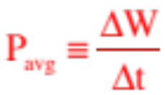
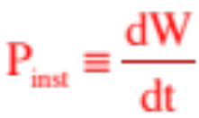

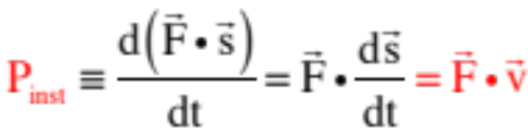
Power
Although it’s useful to know how much work a force field will do on an object traveling through it, it is often considerably more useful to know how much work per unit time the field is capable of doing (or actually does). Called power, this rate at which work is done per unit time is mathematically defined as:
or if you are talking incremental changes at an instant, .
For a moving body with constant velocity v, the instantaneous power provided by a force on the body over a displacement will be:
The units of power in the MKS system are joules per second, or the watt.
33.)

Slide 34
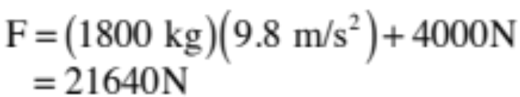
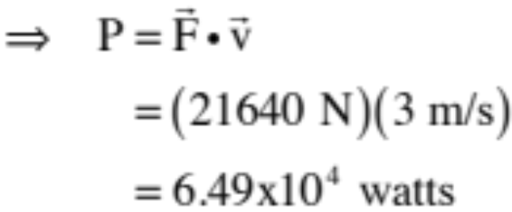
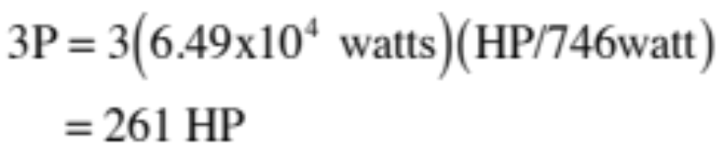
Example: An elevator with mass 1000 kg carries a load of 800 kg. A frictional force of 4000 N retards the elevator’s upward motion.
a.) Determine the minimum power required to lift the elevator at 3.0 m/s.
The motor has to provide force to overcome the weight of the elevator and occupants (1800 kg times 9.8) plus overcoming the 4000 N of friction. That is:
b.) If the motor needs a 3:1 safety factor, what should the horsepower factor be on the motor (746 watt/HP)?
34.)

Slide 35
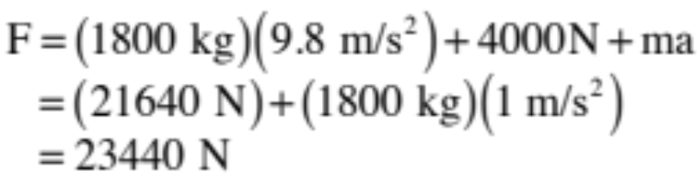

An elevator with mass 1000 kg carries a load of 800 kg. A frictional force of 4000 N retards the elevator’s upward motion.
c.) If the motor is designed to accelerate the elevator at a rate of 1 m/s/s, what power (as a function of v) must the motor deliver to the system?
Now, along with the force required to overcome the weight of the elevator and occupants (1800 kg times 9.8) plus overcoming the 4000 N of friction, the force must also provide acceleration (ma). That is:
35.)

