Slide 1






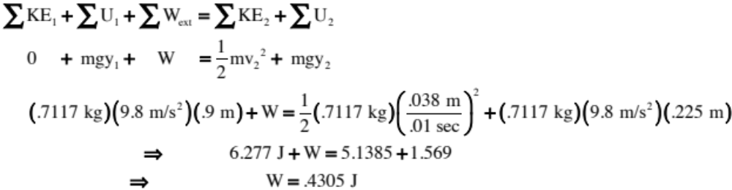
Energy Lab Anomaly
According to our data, is energy LOST during the run?
The positive work done over the interval means the bob appears to have GAINED energy through the run, which violates conservation of mechanical energy. So what’s the deal?

Slide 2
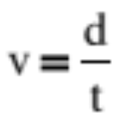
Looking from above:
We assume the distance the bob travels while the beam is blocked is the bob’s diameter. The actual distance the bob travels while the timer is engaged is less (that distance is identified between the dotted lines). Because this is less than the diameter, the time registered by the timer will be less than the time it would have taken if we had actually tracked the diameter. With a smaller time than expected (for a given bob diameter), the denominator of the velocity relationship is smaller than it should be and the velocity is measured as being larger.
beam
To start timer
bob
v
Expected distance bob
travels while
timer is
engaged
v
Ideal timer stop
position
Actual distance
bob travels
while timer
engaged
v
Timer stop
position

