Slide 1
The Island Series:
You have been kidnapped by a crazed physics nerd and left on an island with twenty-four hours to solve the following problem. Solve the problem and you get to leave. Don’t solve the problem and you don’t.
The problem: You are told you will be given 5 seconds to stop two different object using a constant force of your choice (it doesn’t have to be the same force for each object). Before you see either object, though, you must say which will take the greatest force to stop. You dissent saying you don’t have enough information to make the call, so you are given two questions (not “which force is bigger” or “which body experiences the largest acceleration”). From the responses to those two questions, you are to determine which body will require the larger force. What are the questions?
1.)

Slide 2
Solution to Island Problem
What governs stopping force requirements? The two parameters that will matter are:
The mass of each body (the bigger the mass, the larger the force required to stop the body in a given amount of time); and
The body’s velocity (the faster the body is moving, the greater the force required to bring the body to a stop in a given amount of time);
2.)

Slide 3
CHAPTER 9:
Momentum
When physicists run into a qualitative question like the one posed in the Island Series question, they will often take the parameters that are key to understanding the solution to the problem and multiply them together to get an overall governing relationship (that is, after all, where the idea of work came from). The idea is that if that quantity is large, the phenomenon being examined will be pronounced, and if small, not so much.
In this case, the product of the mass and velocity produces a vector
called MOMENTUM.
Kindly notice that this relationship is really three equations in one— it denotes momentum in the x-direction, in the y-direction and in the z-direction.
Also, this means the idea of momentum is contrived mathematical relationship designed to answer a very specific question (back to the Island Series query).
3.)

Slide 4
Interestingly, Newton didn’t originally write his second law as , he wrote it as:
Taking that derivative yields:
The first part relates force to the acceleration of the object. It just equals . The second part is related to how force is required to deal with situations in which the mass of a moving object changes. An example of such situations might be a rocket whose mass is changing as it burns fuel upon lift-off, or possibly a dump truck that is being loaded with gravel as it moves. As problems like that are not generally addressed in classes like this, we end up with Newton’s Second Law looking like:
4.)

Slide 5

What is useful is that if we focus on just one direction, say, the x-direction, we can use the idea of momentum in conjunction with Newton’s Second Law to write a relationship that links force and changing momentum to a single body’s motion. That is:
Over a differentially small time interval dt:
Over a macroscopically large time interval :
--The quantity is called the IMPULSE on the body.
--The quantity is called the impulse relationship.
5.)

Slide 6

Consider: A puck moving over a frictionless floor is viewed from above. It hits a wall and bounces off, as shown below. What is the puck’s change of momentum?
before
after
6.)

Slide 7





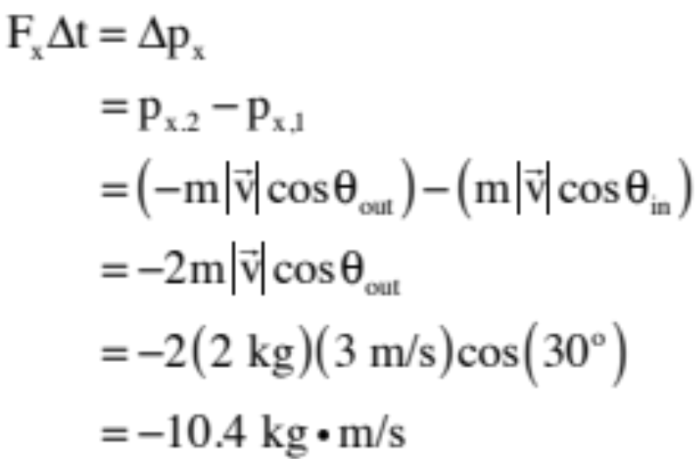
Consider: You are looking down on a 2 kg puck sliding over a frictionless surface moving at 3 m/s as shown. It bounces off a wall as shown. What is the net impulse on the puck?
The key is to realize that you have to treat the momentum change as a vector (look at the momentum in the y-direction—it isn’t changing, so you’d better not end up with math that suggests that it should . . . )
In the x-direction:
7.)

Slide 8
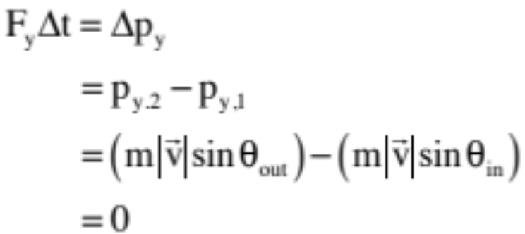
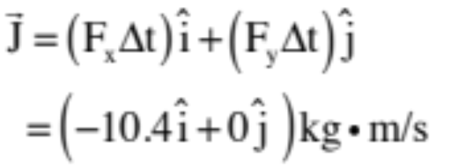
In the y-direction:
So the net impulse (which is normally characterized as a J, though the book uses I for reasons that are unclear):
This makes perfect sense as you would expect the impulse that would change the puck’s motion to be away from the wall in the minus x-direction.
8.)

Slide 9
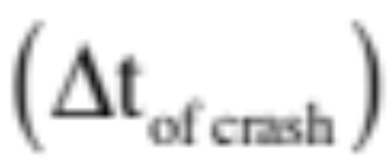
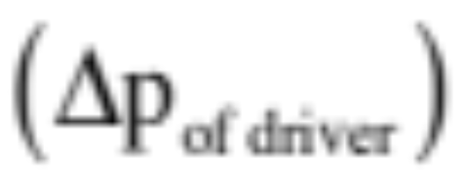


This also tells you something about our world:
Want to keep a driver safe during a car crash, pad the dashboard or, better yet, put air bags into the car. Why? Because when the driver goes from 60 miles per hour to zero miles per hour due to a crash, the impulse (the change of momentum) will be what it will be, but the time of impact can be controlled (you want it to be as long as possible so the FORCE of impact is as small as possible. That is:
9.)

Slide 10





The Modified Conservation of Momentum Theory
Consider two masses moving in opposite directions that collide as shown below. If one mass has a jet pack on its back that provides a constant force F (again, as shown), what do the impulse equations suggest for both masses?
before collision
after collision:
10.)

Slide 11







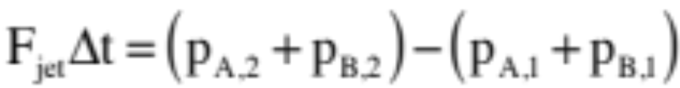
before collision
During the collision, the green fellow will feel an impulse to the right due to the jet and an impulse to the left due to the collision. Assuming the time of collision is , the impulse relationship for the green mass through the collision becomes:
after collision
The blue fellow will NOT feel an impulse due to a jet as there is no jet attached to it, but it will feel an impulse to the right due to the collision. It will be equal in magnitude and opposite in direction to the impulse the green fellow felt due to the collision. The blue block’s impulse relationship through the collision will be:
Adding the two relationships, the collision impulses (whose forces are N.T.L. action/action pairs referred to as internal forces) will add to zero, so:
11.)

Slide 12
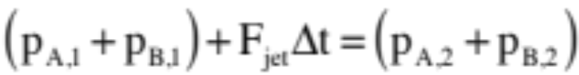

before collision
Rearranging the terms so that the “before” terms are on the left side of the equation and the “after” terms on the right, we end up with
after collision
If we include the fact that all of this is happening in the x-direction, this can be re-written as:
This is called the modified conservation of momentum relationship. It essentially maintains that in a particular direction, if all of the forces acting on a system over a time interval are internal to the system (i.e., Newton’s Third Law action/action pairs) with no impulses being generated by external forces (i.e., non-action/action pairs, like the jet pack), then the sum of the momenta (signs included) at the beginning of the interval will equal the sum of the momenta at the end of the interval. That is, the individual momenta can change, but the sum must remain the same . . . unless there are external forces producing external impulses present to change the momentum content of the system.
12.)

Slide 13
Momentum Musings
Is it possible to have no momentum but some KE in a system? Explain.
Is it possible to have momentum conserved but some KE in a system? Explain.
Is it possible to have momentum conserved but not mechanical energy?
Is it possible to have mechanical energy conserved but momentum not? Explain.
Is it possible to have momentum in one direction but none in another? Explain.
What changes momentum in a particular direction? Explain.
What changes mechanical energy in a particular direction? Explain.
You are standing stationary in a rowboat that sits stationary next to a dock. You attempt to step out of the boat onto the dock. What does the boat do? Why?
As a football player, would you prefer to be hit by a 100 kg lineman (220 lbs) moving at 5 m/s or a 50 kg back (110 lbs) moving at 10 m/s? Explain?
13.)

Slide 14
As a point of semantics: An isolated system is a system in which there are no external forces (hence no external impulses) acting. With the modified conservation of momentum equation including the possibility of external impulses (or not), making the distinction between isolated and non-isolated systems is not so important, but you may run into the language so you need to know about it.
Technically, collision always produce deformation and sound and heat, so energy is never really conserved through a collision. There are close calls, though. When this happens, because potential energy changes are almost non-existent thru collisions, what is “conserved” is kinetic energy.
To delineate types of collision, three kinds are given special names:
An inelastic collision is defined as a “normal” collision—momentum conserved thru the collision unless there is an especially large external impulse present—with energy NOT conserved.
A perfectly inelastic collision is defined as an inelastic collision in which the bodies stick together after the collision (i.e., final velocities are the same).
14.)

Slide 15




An elastic collision is defined as a collision in which both momentum and mechanical energy are assumed to be conserved.
Easy example: two electrons veering from one another due to electrical repulsion as they pass one another. This interaction, this “collision,” is to a very good approximation conservative in energy.
Not so obvious examples: ideal, massless springs:
Example 1: A block jammed against an ideal spring is struck by another block moving in with velocity v. Energy is NOT conserved in the collision due to deformation between the blocks.
Example 2: A block collides with an ideal, massless spring, pushing it in to the left. Energy IS conserved in this case. Why? Because due to
the masslessness of the spring, no deformation of material occurs so no energy is lost. (This is not terribly appealing because it ignores energy loss to sound and heat, but that’s the assumption made.)
15.)

Slide 16


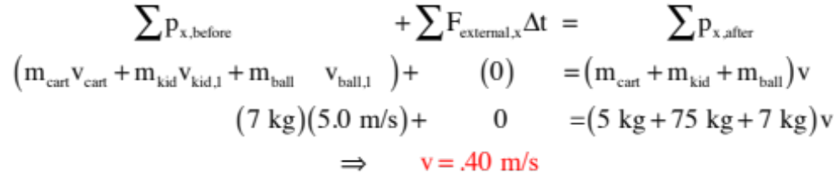
Example 1: Consider a 75-kg kid sitting on a stationary, 5.0-kg cart with frictionless wheels. He catches a 7.0-kg bowling ball moving in the horizontal at 5.0 m/s.
What kind of collision is this?
(perfectly inelastic)
How fast does the kid move after the collision?
Just as in conservation of energy problems, start out with the generic conservation of momentum expression and filling in the bailiwicks appropri-ately, noting that the kid and cart start out at rest, the velocities are all the same after the collision and all the forces acting in the system are internal (i.e., action/action N.T.L. pairs). With no external impulses, we can write:
16.)

Slide 17
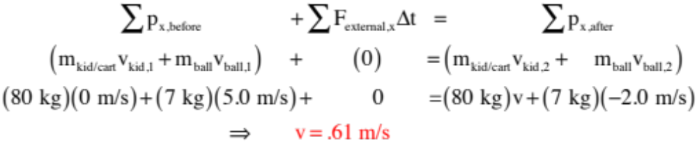
Continuing: A 75-kg kid sitting on a station-ary 5.0-kg cart with frictionless wheels. He tries to catch a 7.0-kg bowling ball moving in the horizontal at 5.0 m/s but fumbles it. It bounces off him leaving in the x-direction with velocity 2 m/s.
In that case, what will the kid’s velocity be after the collision?
Always be aware of signs when dealing with momenta. Momentum is a VECTOR. With that in mind, we can write:
17.)

Slide 18














Force vs Time Graphs
As a small aside, how are force versus time graphs related to impulse quantities?
Noting that the total impulse J on a body will be the sum of all the differential impulses Fdt acting on the body over a time interval dt, it’s kind of obvious that the area under the force versus x-time graph yields the impulse on the body over the time interval.
So how much impulse does the force graphed to the right do as the body moves from t = 1 second to t = 6 seconds?
Solution: the area under the graph above the axis is positive and below is
negative, so the solution is 22 newton-seconds.
18.)

Slide 19
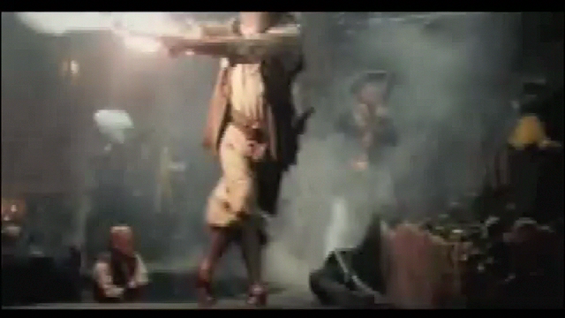
Why is the mass of a rifle always more than the mass of the bullet it fires?
From Pirates of the Caribbean . . .
19.)

Slide 20


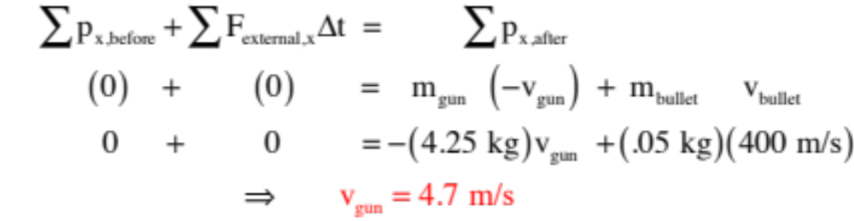


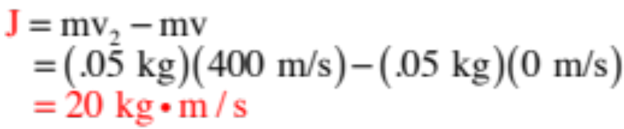
before
Example 2: Consider shooting a 4.25-kg gun with an 80 cm long barrel that fires a 50-gram bullet with velocity 400 m/s.
after
What is the magnitude of the gun’s recoil velocity?
What is the impulse on the bullet?
You can get this either by calculating or . We’ll use .
So formally, as a vector, this would be:
20.)

Slide 21
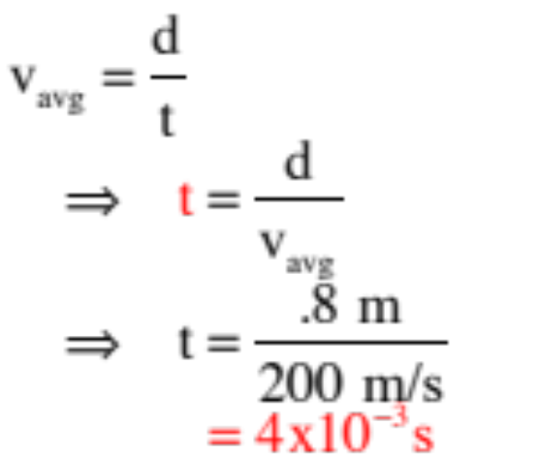
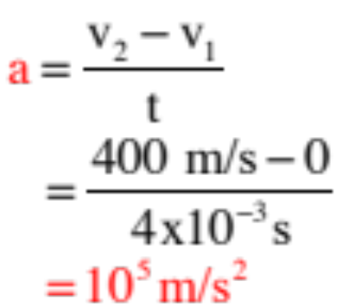
before
Con’t: Consider shooting a 4.25-kg gun with an 80 cm long barrel that fires a 50-gram bullet with velocity 400 m/s.
after
What is the bullet’s time of flight?
This is a kinematics problem—irritating, but something you need to not forget how to do . . .
What is the bullet’s acceleration?
Again, kinematics.
21.)

Slide 22
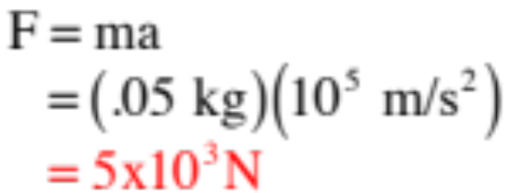
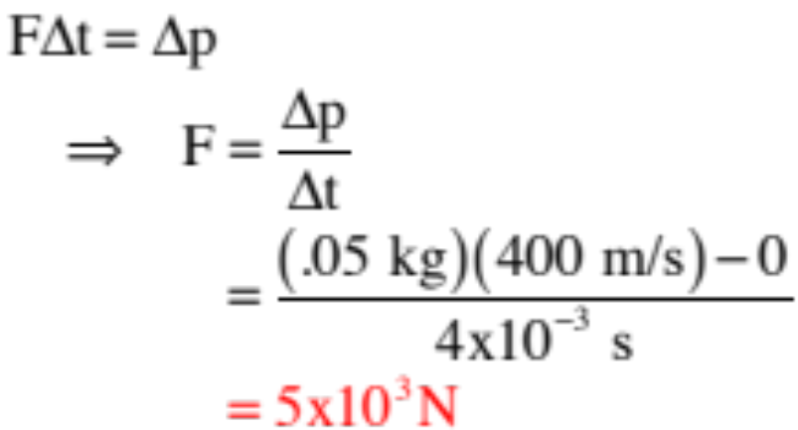
before
Con’t: Consider shooting a 4.25-kg gun with an 80 cm long barrel that fires a 50-gram bullet with velocity 400 m/s.
after
Determine the force on the bullet two different ways.
Using Newton’s Second Law:
Using the Impulse relationship:
22.)

Slide 23
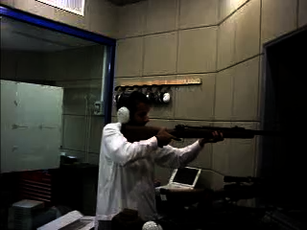
23..)

Slide 24
Example 3: An ideal spring (spring constant k) is attached to a mass M. The mass is initially sitting at equilibrium. A bullet of mass m moving with velocity v buries itself into the block.
During this happening:
When was mechanical energy conserved?
Energy was conserved after the collision. That is, once the energy loss due to the embedding of the bullet was done, energy was conserved.
When was momentum conserved?
As all the forces in the x-direction are internal thru the collision, momentum is conserved thru the collision. As soon as the spring, which produces an external force, begins to exert its influence, then momentum begins to change (the system begins to slow) and momentum is no longer conserved.
24.)

Slide 25
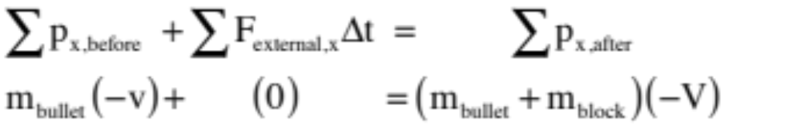

Con’t: An ideal spring (spring constant k) is attached to a mass M. The mass is initially sitting at equilibrium. A bullet of mass m moving with velocity v buries itself into the block.
Derive an expression for the spring’s maximum depression.
From conservation of momentum through the collision (i.e., from just before the bullet hit the block to just after—notice the spring will not have compressed hardly at all during this interval, so no external impulse there . . . also, assuming the “just after embedding” velocity is “V”):
Note: From a momentum through the collision perspective, would it have mattered if the surface had been frictional?
Answer: Nope! The time interval of collision would be so small that the frictional impulse would be negligible and ignorable.
25.)

Slide 26
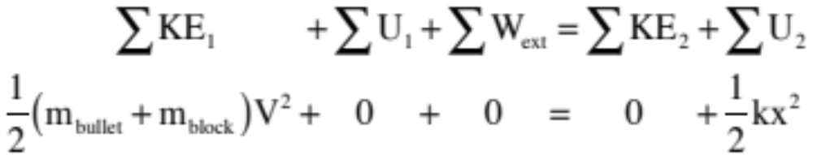
For conservation of mechanical energy AFTER the collision (that is, using a time interval that does not include any before collision parameters like “v”), noting that the “final” velocity of the system will be zero (everything will have come to rest with the maximum deformation of the spring), we can write:
26.)

Slide 27
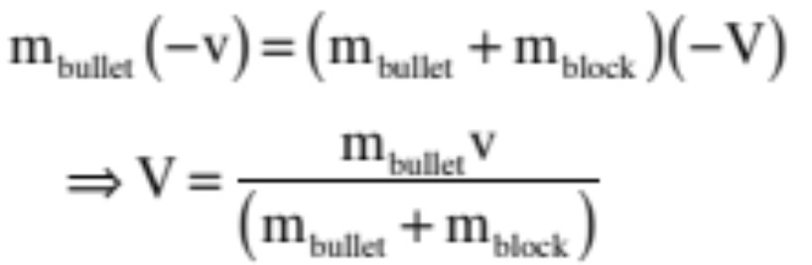
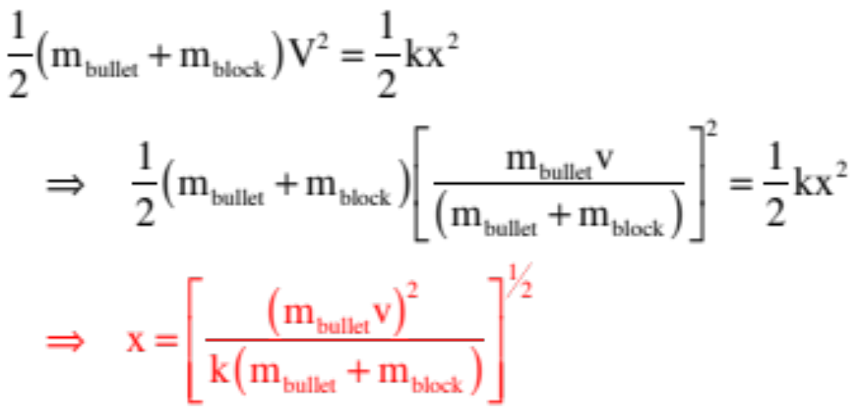
Using these two equations to solve the problem, we can write:
from the momentum relationship:
substituting V into the energy relationship:
27.)

Slide 28
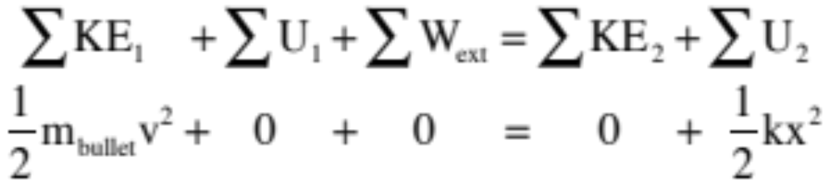
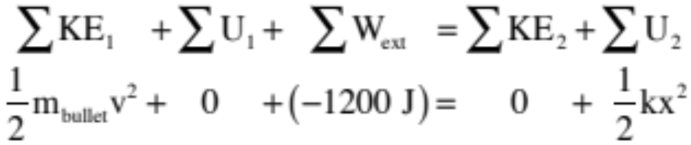
Note: There is often a temptation for students to use conservation of energy from the before collision time until the maximum deflection time. That would look like:
The monumental problem with this is energy is lost (probably a LOT of energy lost) during the collision, so the kinetic energy before the collision isn’t going to equal the spring potential energy at full depression. If you had been told there was, say, 1200 joules of energy lost to heat and deformation and sound during the collision, then you could ignore momentum considerations completely and simply written:
That wasn’t the case, though, so you had to split the problem up into two intervals with energy governing one and momentum linking the two.
28.)

Slide 29






Interesting twist: Consider now a bullet that strikes a block against a spring, but the bullet comes in at an angle.
bullet moving at angle but block at rest
Where, if anywhere, is energy conserved in this happening, and where is it NOT? Justify!
After the collision, there is no extraneous work being done as the spring is ideal, so energy is conserved after the embedding. Energy is not conserved through the collision as energy is required for the bullet to burrow into the wood, which means there is an energy loss during the impact.
x
just after embedding, masses moving but
spring still essentially not compressed
Where, if anywhere, is momentum conserved in this happening, and where is it NOT? Justify!
x
There is momentum in the y-direction before the impact, but none after, so momentum is not be conserved in that direction through the collision. And
masses come to rest after depressing spring maximum distance “d”
after the collision, the spring applies an external force and impulse in the x-direction, so no momentum conserved then. The only forces acting in the x-direction through the collision are internal, so momentum will be conserved in the x-direction through the collision.
29.)

Slide 30


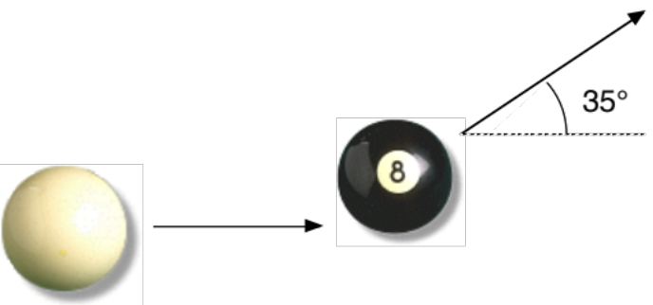



Glancing Collisions
When a billiard ball strikes a second, stationary billiard ball, and the collision is assumed to be elastic, the two balls will leave each other at . Although this rather bizarre observation is being made without proof (a problem follows that shows it works), it is something the AP folks have utilized on AP questions in the past.
Example 4: A player needs to sink the eight-ball into the corner pocket on a pool table. The cue ball approaches at 1.00 m/s:
a.) If the 8-ball leaves at , at what angle does the striking ball leave?
30.)

Slide 31

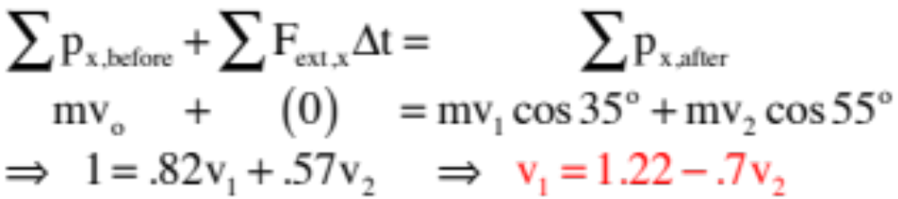


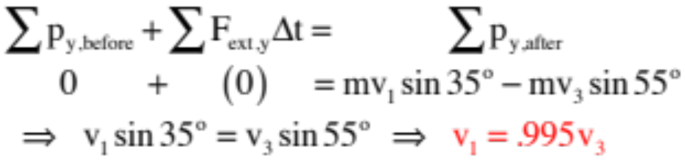

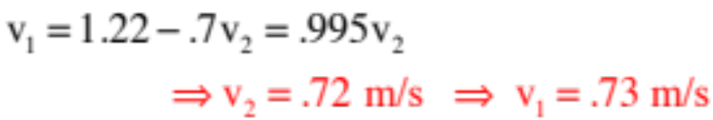
b.) What are the final velocities of each ball, assuming the masses are the same and the collision is elastic?
In the x-direction (with ):
In the y-direction:
Combining the two :
31.)

Slide 32


















Example 4: This is an old lab problem. You know the incoming velocities and angles of two billiard balls that collide elastically. You know the outgoing angle and velocity (denoted as “u” to differentiate from the incoming velocities) of one of the balls. Derive an expression and determine the outgoing velocity and angle for the other ball. In the sketch, vectors in black are known.
We first thing we need to do is break the momentum vectors into their component parts. Doing so yields:
32.)

Slide 33



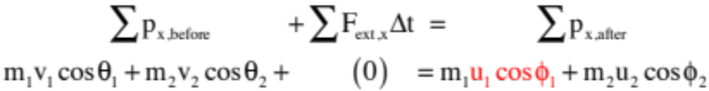
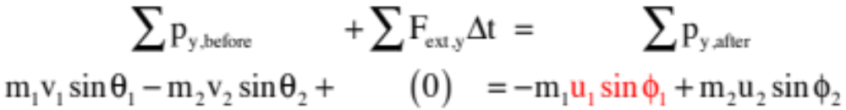
In the x-direction:
In the y-direction:
33.)

Slide 34


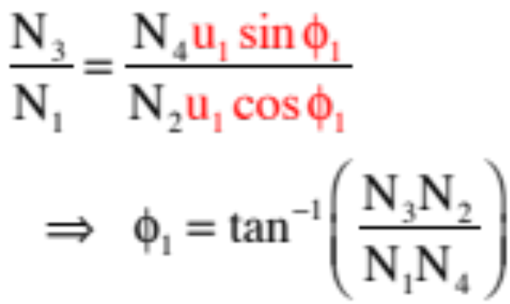
This simplifies to:
and
Dividing the one into the other yields:
Knowing the angle, you can go back and determine the unknown velocity.
34.)

Slide 35
One of the biggest challenges students face is deciding when conservation of momentum is applicable in a problem, and in many cases more critically, when conservation of energy is applicable. If you make assumptions that are not true on that count, everything you do from there on will be wrong. To that end, consider:
35.)

Slide 36


Is it possible to have a situation in which momentum is conserved and energy is technically not . . . but we let it slide. If so, give an example, formally justifying each conservation assertion.
Consider two blocks moving in opposite directions over a frictionless surface with an ideal spring in the system. When there is collision and bounce back in opposite directions:
Momentum is conserved THROUGH THE COLLISION as the spring, whether ideal or not, provides only an internal force and, hence, no external impulse during the collision. Even if friction had been involved, the time of collision over the interval would have been so small that friction’s impulse would hardly changed the momentum content of the system over the interval, and could have been approximated as zero conserving momentum through the interval (i.e., through the collision).
There is a tiny bit of work through the collision that isn’t being taken care of by a potential energy function (in the energy section, we call work like this extraneous work), because there is sound and a tiny bit of heating and, in all probability, a tiny bit of molecular deformation as the spring gets smooshed, but this is SO SMALL that for all intents and purposes is it ignored. So in cases like this, mechanical energy is assumed to be conserved.
Bottom line: If it’s just a spring that being collided with, mechanical energy is conserved.
36.)

Slide 37
But is it possible to have a situation in which momentum is conserved but energy is not, and we don’t let it slide. If so, give an example, formally justifying each conservation assertion.
Consider a two-blocks with spring running into a third block moving over a frictionless surface, as shown. When collision and bounce back in opposite directions happens:
Momentum is conserved THROUGH THE COLLISION as the collision forces are all internal force and, hence, no external impulse exists in the x-direction during the collision. Again, even if friction had been involved, the time of collision over the interval would have been so small that friction’s impulse would hardly changed the momentum content of the system over the interval, and could have been approximated as zero conserving momentum through the interval (i.e., through the collision).
But now you have serious energy loss through the collision as the blocks collide (probably due to big-time molecular deformation, sound, heat, etc.). As this loss isn’t taken into account by potential energy functions (in the energy section, we would call work like this extraneous work), the mechanical energy is NOT conserved through the collision (though it may be conserved subsequently after the collision happens). The trickiness here is that people are sometimes thrown by the fact that the spring is ideal.
37.)

Slide 38
Is it possible to have a situation in which mechanical energy is conserved but momentum is not? If so, give an example and justifying.
Ignoring air friction, consider throwing a ball straight up into the air.
Momentum is not conserved as gravity produces an external impulse that changes the momentum content of the system in the y-direction as time proceeds.
Mechanical energy IS conserved as kinetic energy is turned into gravitational potential energy but there are no extraneous bits of work being done by forces like friction.
Is it possible to have a situation in which momentum is conserved in one direction but not in another? If so, give an example and justifying.
Ignoring air friction, consider throwing a ball in two dimensions.
Momentum is not conserved in the y-direction as gravity produces an external impulse that changes the momentum content of the system in the y-direction.
Momentum is conserved in the x-direction as there are no external forces, hence impulse, in that direction to change the body’s x-momentum.
38.)

Slide 39





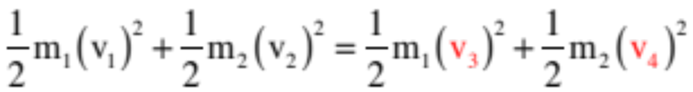
before
Example 5: A bit of mathematical nastiness: Consider two blocks with spring attached and known incoming velocities. They collide and bounce. Derive an expression for the recoil velocities.
after
from the momentum relationship (highlighting the unknowns in red and unembedding - signs):
We’ve already said that situations like this are elastic (mechanical energy conserved). Noting that the spring only redirects motion (at the beginning and end of the interval, it is not engaged), the energy relationship reads:
So far, so good.
39.)

Slide 40
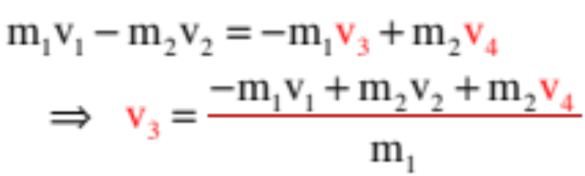
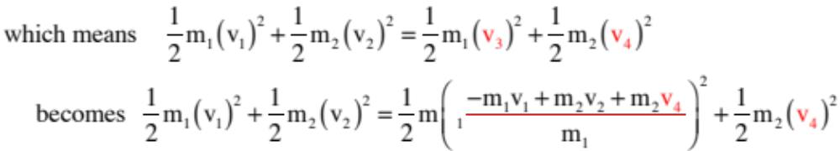

And here we find the nastiness. Standard techniques to solve this would solve for one velocity in the momentum equation and substitute it into the energy equation yielding:
Now solve for .
YIKES!!!
A new technique: Group your masses; factor your energy quadratics; divide the momentum equation into the energy equation and cancel out one factor; get new relationship between variables and plug that back into original momentum expression.
40.)

Slide 41


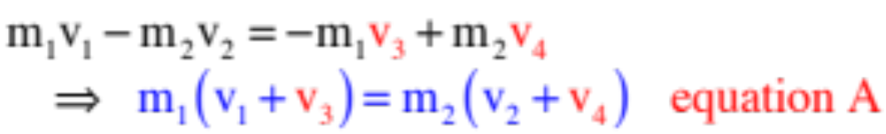
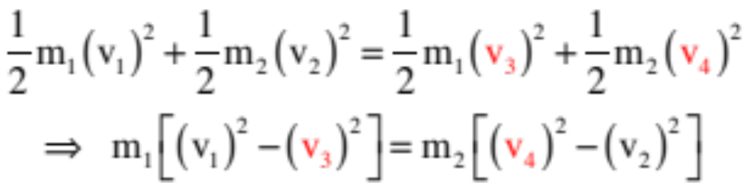
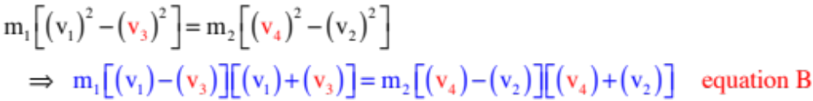
There is a clever, simpler way, though.
Start by gathering all the terms associated with the mass and all the terms associated with the mass and put them into two piles.
and
Factoring the energy relationship yields:
41.)

Slide 42
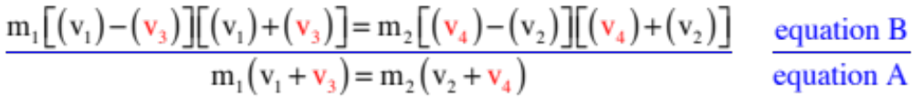
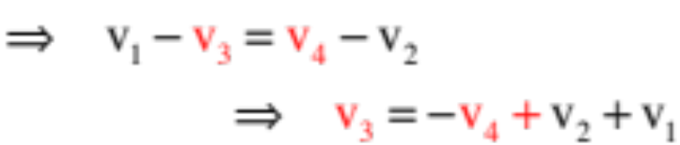


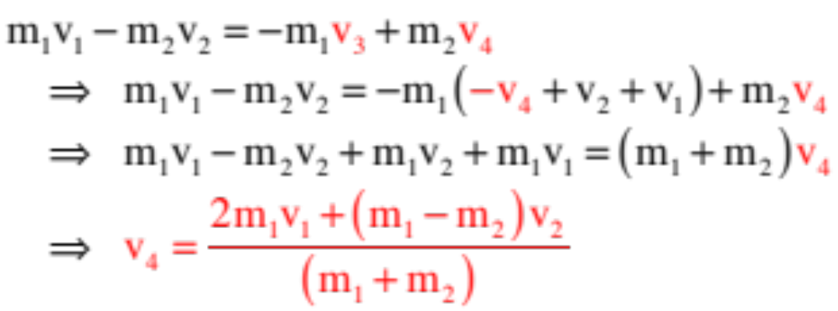

Take equation A and divide it into equation B (left side to left side, right side to right side) yields a simplified, new relationship.
Note that in its most general form, with signs embedded, this relationship becomes:
With that, we can go back to the original momentum relationship, substitute in for the velocity , and solve:
And knowing , you can go back and determine .
42.)

Slide 43






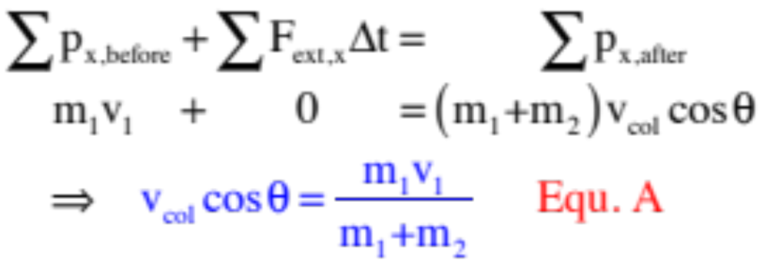
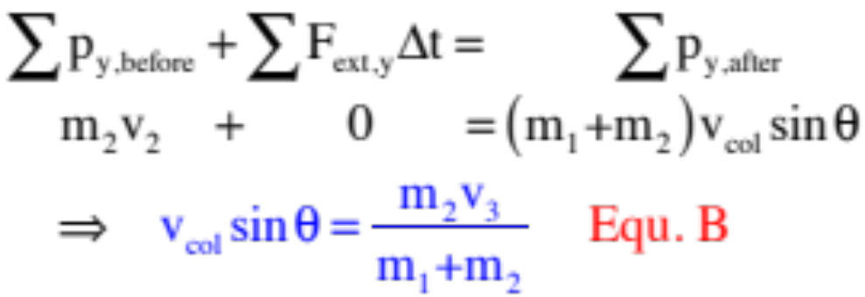
Example 6: A 1500 kg car moving eastward with velocity 12 m/s experiences a perfectly inelastic collision with a 1000 kg car moving 10 m/s north-ward. What is the final velocity of the 2500 kg car?
With all the forces internal in the x-direction, conservation of momentum in the x-direction yields:
In the y-direction:
43.)

Slide 44
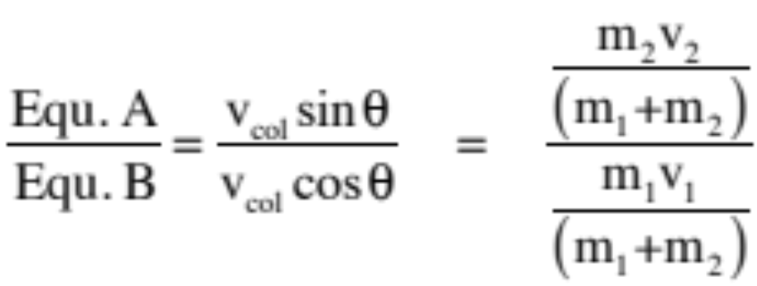
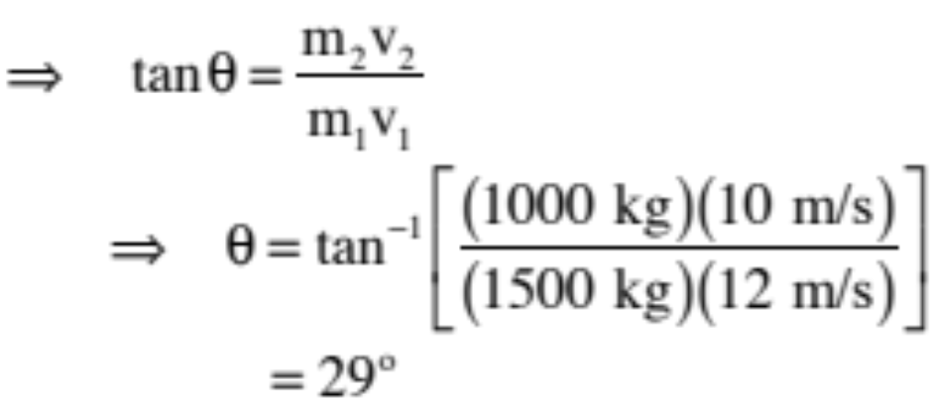
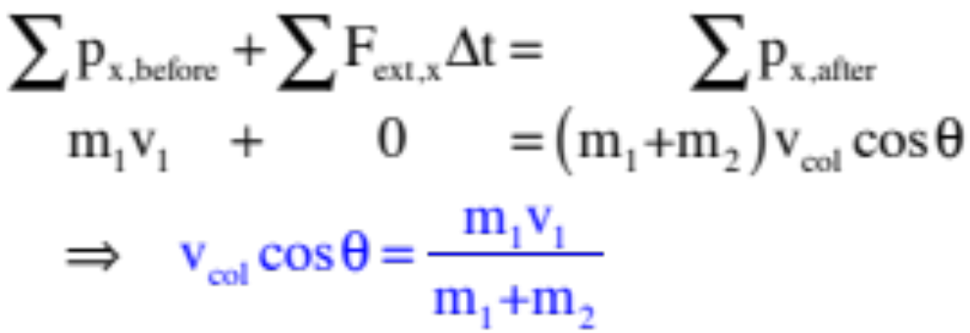
The trick to solving is to divide the one equation into the other and canceling stuff, so:
44.)

Slide 45
For My People
Although this may or may not be important in an AP sense, in a PHYSICS sense it is important to understand that almost every problem you did in the energy section can be made into a momentum problem by simply including a collision.
For instance:
45.)

Slide 46




Take the extended ice dome problem and make it into a Jack and Jill event with Jill shoved up against a spring (not shown) to start with and Jill crashing into Jack at the crest of the hill. Now you need to work in sections, keeping in mind where energy and where momentum are conserved (and where they aren’t!).
Jill starts
here against spring
Jill and
Jack collide
two leave
The next page animates this segregating:
46.)

Slide 47


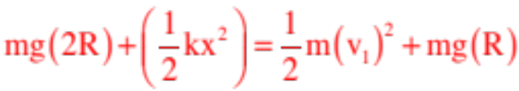

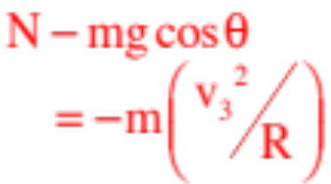






after collision energy conserved
Jill’s velocity just before collision
Jill and Jack’s velocity just after collision
before collision, energy conserved
still need Newton’s Second and centripetal acceleration
during collision, momentum conserved
47.)

Slide 48




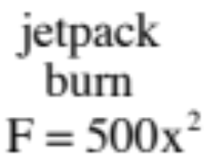








There is the problem from hell with the first mass running into a second mass in a perfectly inelastic collision.
In that case, you’d have to use energy up until the collision, then momentum to connect the before collision and after collision velocities, then go from there with energy considerations.
48.)

Slide 49







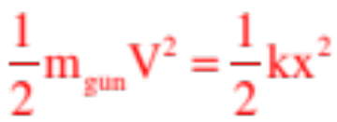
There is the cannon problem in which you want to determine how much the spring expands after the cannon is fired.
Here, momentum in the y-direction is NOT conserved during the firing (nothing moving in the y-direction to start with, then the shell is moving with velocity component in the y-direction).
There are no external forces (hence impulses) in the x-direction during firing, so momentum of the gun/shell system is conserved in the x-direction (it is assumed that the spring does not compress much during the firing, so it does not provide an external impulse in the x-direction during firing).
After firing, the recoil velocity V provides KE to the cannon which turns into spring potential energy as energy associated with cannon (EXCLUDING the cannon ball) is conserved after the firing.
49.)

Slide 50




And there is the block on block with spring problem on frictionless surface in which you want to determine the maximum compression of the spring, assuming you know all the parameters listed on the sketch.
Want to see the solution to this little gem. I did a video on it. You can find it at:
https://youtu.be/_vffPexYS4I
. . . though I may have maintained that energy wasn’t conserved through the collision, which we are now assuming is the case . . .
50.)

Slide 51

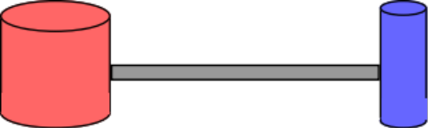
Center of Mass
The center of mass of a system of masses (or a single mass) is located at the weighted average position of the system’s mass.
Example: a basketball:
Example: a horse shoe:
Example: multiple masses:
There have been some very clever uses this concept have been put to . . . Enter the Fosbury flop:
https://www.youtube.com/watch?v=RaGUW1d0w8g
51.)

Slide 52







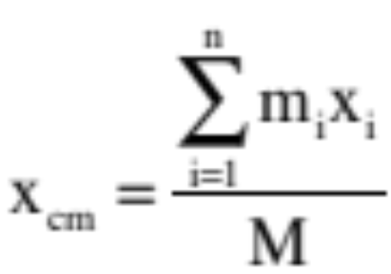
A center of mass coordinate must be relative to a coordinate axis. In the x-direction, the numerical value, being a weighted coordinate, is defined such that:
Being careful to take signs into consideration and defining the total mass of the system as M, the center of mass coordinate becomes:
52.)

Slide 53








Example 7: Consider two masses “m” and “3m” located a distance 1.0 meters apart. Relative to the coordinate axes used:
a.) What is the x-coordinate of the system’s center of mass?
53.)

Slide 54



Cont’d: Consider two masses “m” and “3m” located a distance 1.0 meters apart. Relative to the coordinate axes used:
b.) What is the x-coordinate of the system’s center of mass?
Bottom line: A system’s center of mass is identified as a coordinate relative to a coordinate system.
54.)

Slide 55





Center of mass in three dimensional situations:
55.)

Slide 56





Example 8: Determine the coordinate of the center of mass for the system shown.
56.)

Slide 57
So before we get into the hard stuff, let’s review what we are really being asked to do with center of mass calculations.
To determine a center of mass coordinate along a particular axis:
--Move from the origin outward along the axis until you find some mass.
--Multiply the mass by its coordinate.
--Continue doing this, adding the products as you go.
--Once you’ve covered all the mass in the system, normalize the sum by dividing by the total mass.
That will give you the center of mass coordinate along that axis.
57.)

Slide 58

As long as an object’s center of mass is located over a point of support, it will be stable.
58.)

Slide 59

And again:
59.)

Slide 60
Example 9: With the guidelines for doing these kinds of problems in mind, determine the coordinate of the center of mass of a homogeneous rod of length L, assuming the origin is at the rod’s end.
60.)

Slide 61




Example 9: With the guidelines for doing these kinds of problems in mind, determine the coordinate of the center of mass of a homogeneous rod of length L, assuming the origin is at the rod’s end.
Although this is a continuous mass, the principle is the same. Move out along the x-axis until you find some mass, multiply by the mass’s coordinate, then sum that quantity for all the masses found before dividing by the total mass.
The problem? The system is not made up of discrete pieces of mass. That means that after moving an arbitrary distance “x” units down the axis, you need to create a differentially thin section of the rod of width “dx” to defines a differentially small piece of mass “dm,” do the required multiplication, then sum all such pieces using integration. Doing this yields:
61.)

Slide 62



This is where it gets exciting. To do this integral, we need to relate the position x of the bit of mass to the amount of mass dm that is there. To do that, we invoke a very clever mathematical contrivance called a density function.
Although there are three types of mass density functions, we will start with the simplest (we’ll talk about the other two shortly). Called a linear density function, it’s units are mass/unit length and its a symbol is . What it essentially says is:
If you have a massive, extended object that has obvious one-dimensional variability (like a rod), give me a length of the rod and I can multiply that length by and tell you the amount of mass that was associated with that length. (Just think about the units—(mass/length)(length) = mass).
In some instances you may be given the density function (eg. ), but in most AP problems it is assumed to be associated with a homogeneous structure. In other words, it is equal to the total mass divided by the total length, or:
62.)

Slide 63


The linear density function can also be written in differential terms. That is, as the ratio of the differential mass per differential length. It is from this that our dm substitution can be generated. That is:
With this, we can write:
63.)

Slide 64

As added non-AP fun, how would this differ if the rod was weighted funny, like ?
No problem: The only thing that’s tricky is that now you have to do an integral to determine the total mass of the rod . . .
64.)

Slide 65



Example 10: Now determine the y-coordinate of the center of mass of a homo-geneous half-circle plate about its central axis.
Half of this problem is easy. By inspection, we can see that the x-coordinate of the center of mass is zero. The y-coordinate, not so obvious.
It is time to now consider the other two types of density function:
The area mass density function is a bit of an oddball. It essentially says, “Give me an area on the face of an extended object, and I’ll multiply that area by the area density function to tell you how much mass is behind that area.” Its symbol is a sigma and its units are mass/unit area. For a homogeneous structure, it can also be defined two ways:
and
65.)

Slide 66



The other way to go is with a volume mass density function, . It essentially says, “Give me a volume in an extended object and I’ll multiply that volume by the volume density function to tell you how much mass is within that volume.” Its symbol is a rho
and its units are mass/unit volume. For a homogeneous structure, it can be defined two ways:
and
The strategy to find the y-coordinate of the hemisphere’s center of mass is simple. Move up the y-axis some arbitrary distant y, determine how much mass is at that coordinate (it will be in a differentially thin strip of height dy), do our multiplication and integrate.
66.)

Slide 67






Executing that and using an area density function, we start:
We know that the area mass density function is such that:
and
So we need to determine the differential area of a swath whose width is 2x (look at the sketch) and whose height dy. That is:
67.)

Slide 68

With all that, we can write:
68.)

Slide 69









Example 11: To see a problem using volume mass density function, consider determine the x-coordinate of the center of mass of the triangle whose length is a and whose height is b.
As we are working with the x-coordinate, we move down the x-axis an arbitrary distance x, determine how much mass is within the volume
comprising a differentially thin slice of thickness dx, then integrate.
If the thickness of the triangle is t and total area A, the volume density function can be written as:
Also,
69.)

Slide 70


All we need to proceed is a relationship between x and y, which we have as the line defining the y-coordinate is a straight line. That is, using:
we get:
With that:
70.)

Slide 71


71.)

Slide 72


TRICKINESS
YOU HAVE SEEN the approach for deriving center-of-mass quantities for both discrete masses and for more complex situations, and that is all information you need, but there may come a time (like, say, on an AP test) when you are asked to simply determine (not derive) the center of mass coordinates for some oddball mass configuration, and when that happens, a bit of trickery might do you well. Specifically:
Consider the geometry shown to the right.
What is the y-coordinate of this object’s center-of-mass?
72.)

Slide 73


The trick is to particulate the mass into bite-sized pieces, identify geometries whose center of mass is easy to eyeball, then assume all the mass in each of these regions is centered at their particular center of mass.
For this case (and looking just at the y-components):
The geometry has 22 squares in its mass, so each square is worth (1/22)m. Also, there are 2 rectangular geometries easily identified.
The left rectangle’s y-center of mass is at .5 meters,
and the right geometry’s coordinate is +1.
Assuming all the mass is at their center of mass, we can write:
73.)

Slide 74


Theoretical Nitty Gritty for a System In Motion
Unpacking our definition of center of mass reveals something interesting.
Observation 1: The sum of the weighted positions of all of the masses in a system yields a vector that is equivalent to congealing all of the masses at the center of mass and weighting that position.
74.)

Slide 75


We can see how this weighted center of mass vector acts over time by taking its time derivative. Doing so yields:
Observation 2: If all the mass M in the system was coagulated at the system’s center of mass and made to move at the center of mass’s velocity , its momentum would equal the sum of the momenta of all of the individual masses in a system as they actually exist.
75.)

Slide 76

Taking still one more derivative yields:
Observation 3: Sum up all of the forces on all of the masses in the system in a particular direction, and the center of mass will act as though all of the mass in the system was coagulated at the c. of m. with that force applied to it. That is, the c. of m. will accelerate as though it had all of the mass at it with that force acting upon it.
76.)

Slide 77
Bottom line (though not something you will be able to use on the AP test):
There are two ways to analyze system of particles problems.
1.) You can track the individual particles, which is what we have been doing to date (think about the two-car collision problem—we tracked what each car’s momentum was throughout the collision), or;
2.) You can transform into the center of mass frame of reference (one in which you are traveling along with the center of mass), do the problem in that frame, then transform back into the lab frame. This is not something the AP folks will ask you to do, but it is a common approach in physics (that is, transforming into a frame of reference in which the problem can be done easily, then transforming back).
This second approach is most elegantly observed in the two-dimensional, collision-lab problem presented earlier.
77.)

Slide 78




Extra non-AP problem, for your amusement: Reconsider the old lab problem we did earlier. What does the system look like from the lab versus center of mass frame?
lab frame
c. of m. frame
Two masses approach obliquely, collide and rebound obliquely.
Two masses approach on-line, collide and rebound on-line.
78.)

Slide 79
lab frame
c. of m. frame
Approaching this conventionally, you’d have to write out the momentum relationship in the x-direction, the y-direction, and possibly the energy relationship should the collision be elastic. Then you’d have to solve the mess of equations simultaneously.
Looking at things from the center of mass frame, not only does the problem become one-dimensional, the total momentum is ZERO. This is a wildly easier problem to solve . . . and once you’ve done so in this frame, you can transform back into the lab frame and you are done.
79.)

Slide 80


This is supposed to be FUN.
Don’t take notes,
but do listen and think!
A ball moving at 5 m/s strikes a surface and bounces back at 4.9 m/s in the opposite direction, all in 0.1 seconds. What is the ball’s acceleration?
Let’s say the ball’s mass is 5 grams. What was the average force required to effect that acceleration?
What we’ve just done is to examine a situation by looking at the forces acting on a system. In other words, we’ve utilized the Newton’s Second Law approach to come to conclusions about our ball. (Note that a half newton is about a tenth of a pound.)
It is possible to look at situations from OTHER perspectives using OTHER approaches.
80.)

Slide 81
A ball moving at 5 m/s strikes a surface and bounces back at 4.9 m/s in the opposite direction, all in 0.1 seconds. What can you tell about the ball?
Option 1: Determine the impulse in the ball. Justify your results.
What does the impulse tell you about the motion?
A relative measure of what it takes to stop the body in the given amount of time.
Option 2: Determine the net work done in changing the motion of the ball.
Is the net work done in changing the ball’s kinetic energy large or small?
Really small.
81.)

Slide 82

From the perspective of impulse, energy and ball acceleration, it appears that it doesn’t take a lot to make our ball change course.
In other words, the ball can’t hurt us much.
So let’s play FACE BALL!!!!!
82.)

Slide 83






And completely off the wall . . .
outcoming
incoming
A really massive wall sits stationary in the lab. A ball is observed to hit the wall square-on with velocity , and bouncing back with that same velocity , (i.e., energy is conserved).
before collision
after collision
The situation changes. Now the wall is moving toward the incoming ball with velocity . The ball comes in as before, but because the wall is so massive the wall just keeps going with velocity after the collision. The ball hits the wall and rebounds. How fast is the ball moving after the collision?
The temptation is think that the wall will give the ball an extra worth of velocity boost, and that the answer is . In fact, that isn’t what happens. The answer is actually (this question used to be given to Caltech frosh when they were being sorted into Recitation Sections for the Physics 1 class).
How could this be?
83.)

Slide 84



The trickiness resides in the fact that you only know what the ball will do if you examine the system from the wall’s perspective (i.e., from a frame of reference stationary, relative to the wall). Only in the wall’s frame is mechanical energy conserved and velocity-in equals velocity-out.
before collision
after collision
So in the second scenario, what does the ball’s motion appear to be from the wall’s perspective?
In wall’s frame,
before collision
after collision
The ball appears to be closing on the wall with velocity .
That means, according to our velocity-in equals velocity-out assumption, that relative to the wall, it will leave with velocity .
wall sitting still
after collision
But relative to the lab frame, which is the frame we are really interested in, the wall itself is moving with velocity . So the net velocity of the ball, relative to the lab frame, should be:
in wall’s frame,
wall’s velocity relative to lab
84.)

Slide 85




This all sounds fine and good in a fantasy land sort of way, but does it hold to real life? A little experiment suggests it will.
Take two balls, one fairly massive (a golf ball) and one fairly massless (a ping-pong ball). Place the ping-pong ball on top of the golf ball and drop from an arbitrary height h. Notice what happens.
before drop
The following should happen: The two should fall, picking up kinetic energy in the process. The math to figure out their “final” velocity is:
after collision
So let’s assume that when the golf ball hits the ground, it generates a rebound velocity of (i.e., no energy loss), and let’s assume that that there has been a bit of separation between the two during the fall, so with the golf ball now moving upward with rebound velocity , the ping pong ball is still moving downward with velocity .
85.)

Slide 86



In other words, we now have the wall and ball situation (sort of). A massive golf ball is moving in one direction (upward) and a smaller ping pong ball is moving in the other direction (downward) with the same velocity (yes, it’s not a direct parallel as the golf ball isn’t super massive and energy is never conserved in collisions like this, but work with me here).
This means, according to our previous analysis, that the ping pong ball should bounce off the golf ball with THREE TIMES its incoming velocity.
What’s more, with three times the velocity, the ping pong ball now has NINE TIMES the kinetic energy that it had to start with, and should therefore fly nine times higher after its rebound.
Justification:
just before collision
after collision
This we will try in class.
86.)

